Slide 1
Our lesson today is :
- Unit 5
- Grammar
- P : 42

Slide 2
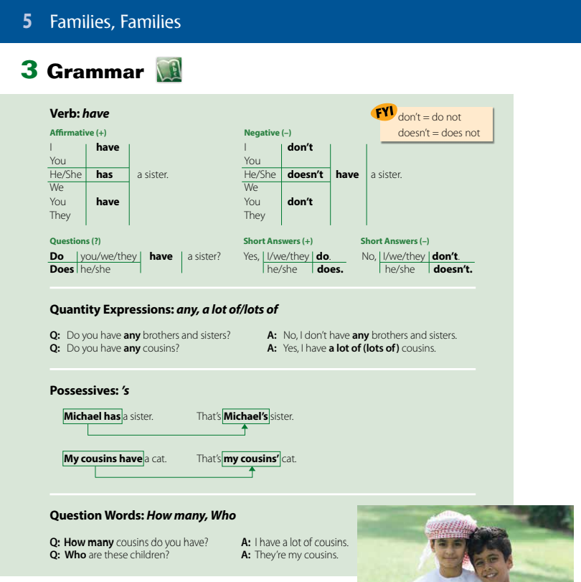
Page
42

Slide 3
Verb have
Have
Has
I have a book
You have a book
They have a book
We have a book
He has a book
She has a book

Slide 4

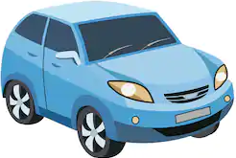
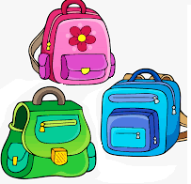

Choose ( have , has ) :
I ( have – has ) a ball.
He ( have – has ) a car.
We ( have – has ) three bags.
She ( have – has ) a pen.

Slide 5
Complete with ( have , has )
have
1- I _ _ _ _ _ seven books.
has
2- He _ _ _ _ _ _ a green jacket.
.

Slide 6
Verb have
في حالة النفي Negative
Have
Has
I have a book
You have a book
They have a book
We have a book
I don’t have a book
You don’t have a book
They don’t have a book
We don’t have a book
He has a book
She has a book
He doesn’t have a book
She doesn’t have a book

Slide 7
Make it negative
1- I have a blue shirt.
I don’t have a blue shirt.
2- She has a notebook.
She doesn’t have a notebook.

Slide 8
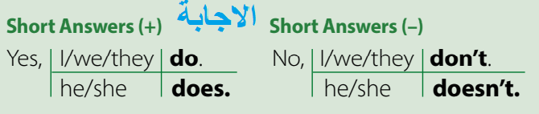
السؤالQuestions
Do
Do
Do
Do
I have a book
You have a book
They have a book
We have a book
?
?
?
?
Does
Does
?
He has a book
She has a book
have
have
?

Slide 9
Make it a question
1- you have a blue shirt.
Do you have a blue shirt ?
2- She has a notebook.
Does she have a notebook ?

Slide 10
Quantity Expressions: any, a lot of
any
أي من
تستخدم في النفي والسؤال
a lot of
الكثير من
تستخدم في الجمل المثبتة
Do you have any brothers?
Yes, I have a lot of brothers.
No, I don’t have any brothers.

Slide 11
Possessive s (اس) الملكية
1- اذا كان الاسم مفرد نضيف له ‘s لملكية الشيء اللذي يليه
Omar’s book.
كتاب عمر
قلم سارة
Sarah’s pen.
2- اذا كان الاسم جمع نضيف له فقط الفاصلة’ لملكية الشيء الذي يليه
Students’ books.
كتب الطلاب
My cousins’ car.
سيارة أبناء عمي

Slide 12
Question Words: How many, Who
كـــــم
How many brothers do you have ?
I have one brother
من
Who are they?
They are my cousins

Slide 13
Thank you

