Slide 1
Done by: Entisar Al-Obaidallah
Mega Goal 2.1
Unit 3
Far And Away
Conversation+ Listening

Slide 2
Lesson Objectives
Name stuff to take along when traveling
Use the "real talk " phrases in new sentences
Make and decline special requests
Listen for specific information
stressed the compound nouns correctly.
Match the words with their meanings

Slide 3
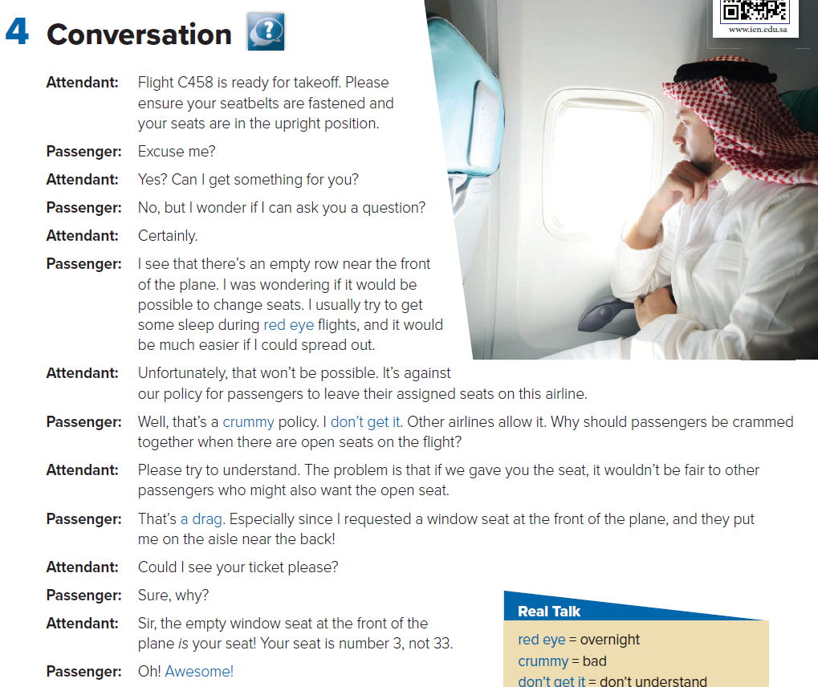
Open UR book p.(38)
Read along as u listen

Slide 4
What is your opinion of the man’s request?.
Was it OK to ask for the seat change?
What do you think of the airline policy?

Slide 5
1
2
3
The passenger was in the wrong seat to begin with. He moves to his assigned seat, which is the one that he wanted

Slide 6
Why do you think that overnight flights are called red-eye flights?
because overnight travelers are usually very tired and have red eyes
Are the expressions crummy and a drag formal or informal expressions?
They are informal.
Why does the passenger say Awesome?
What doesn’t the passenger get?
He’s happy that he will get the seat he wanted.
He doesn’t know why he can’t sit in the open sea.

Slide 7
these Expressions used for Making and Declining Special Requests
using phrases like these makes the
request sound more polite.

Slide 8
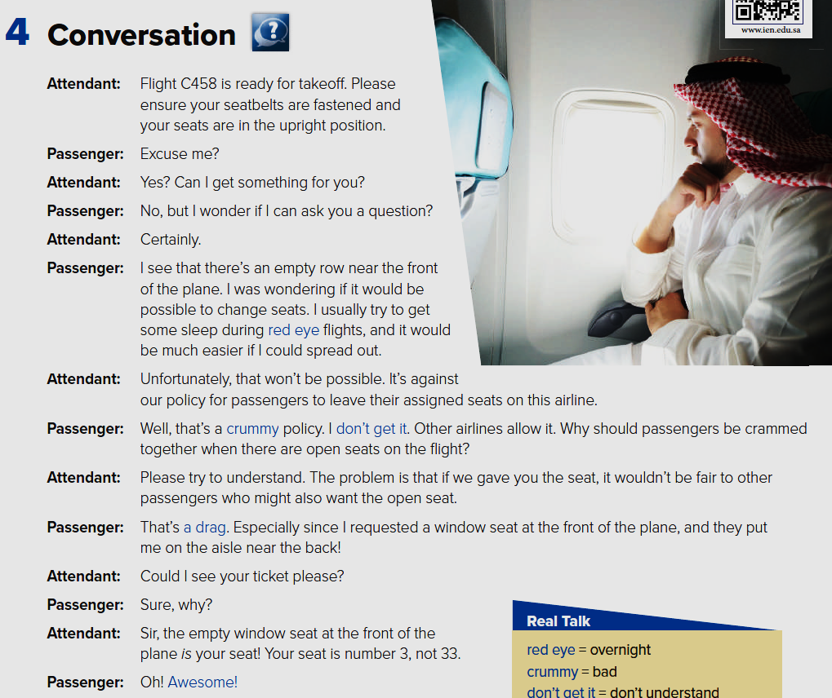
Find examples of those phrases in the conversation

Slide 9
Create requests

Slide 12
i
f
e
c
a
b
h
g
d

Slide 13
Homework
workbook p.(242) exercise (G)

Slide 14
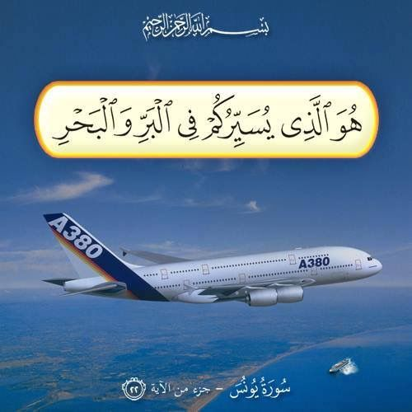
From The Holy Qura’an

Slide 15
Thanks!

