Slide 1
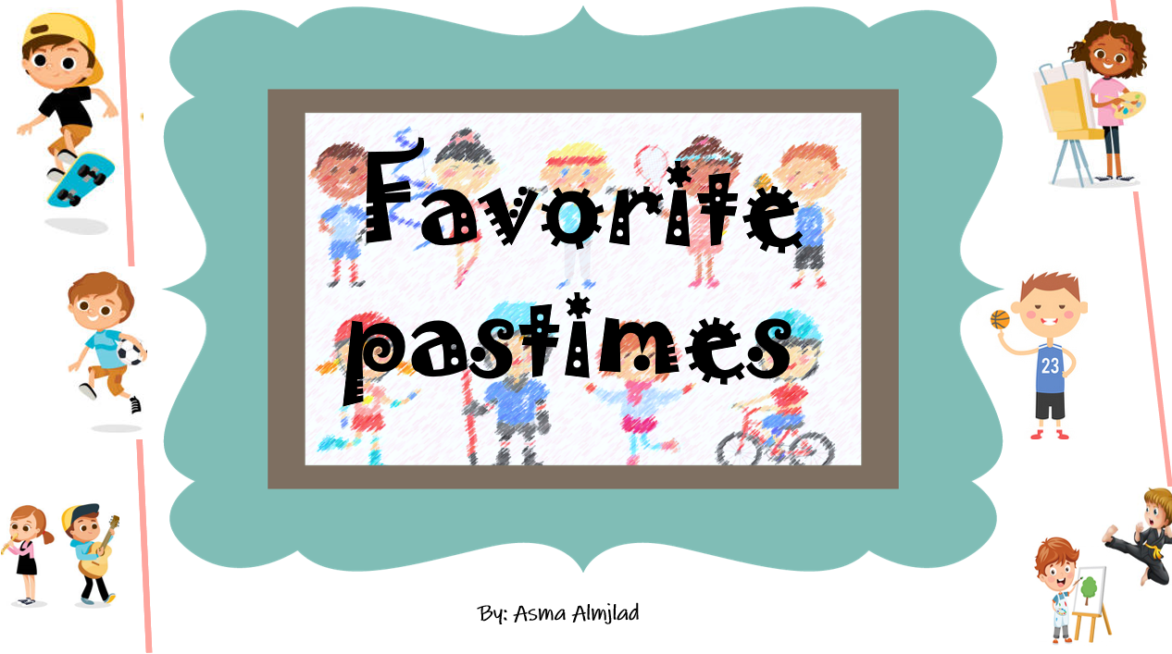
Listen and discuss

Slide 2
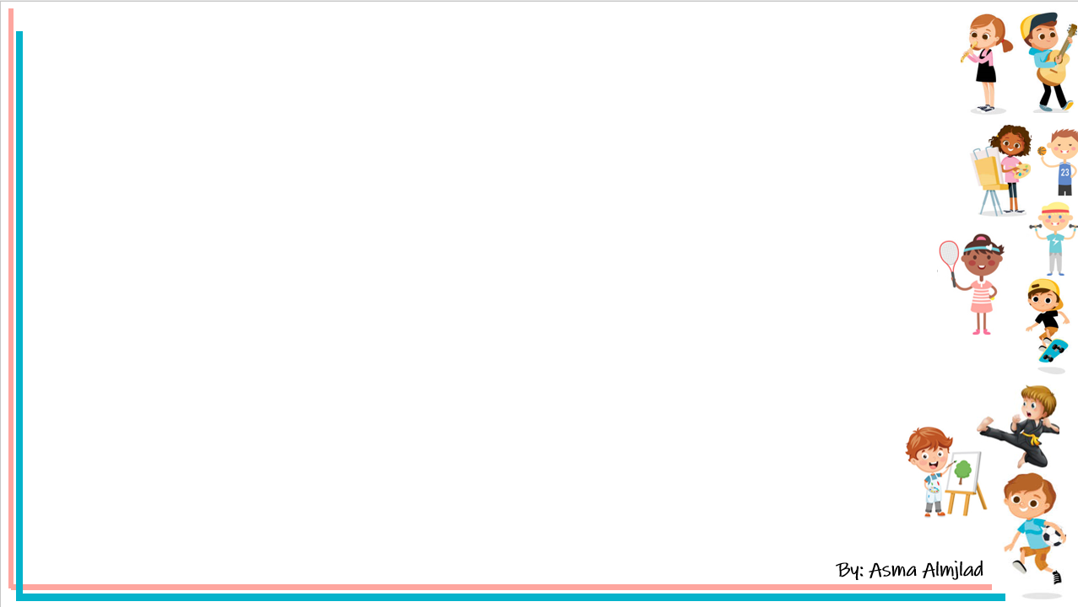

Objectives
Name the hobbies they see
Make questions about teens pastime
Answer question in the book

Slide 3
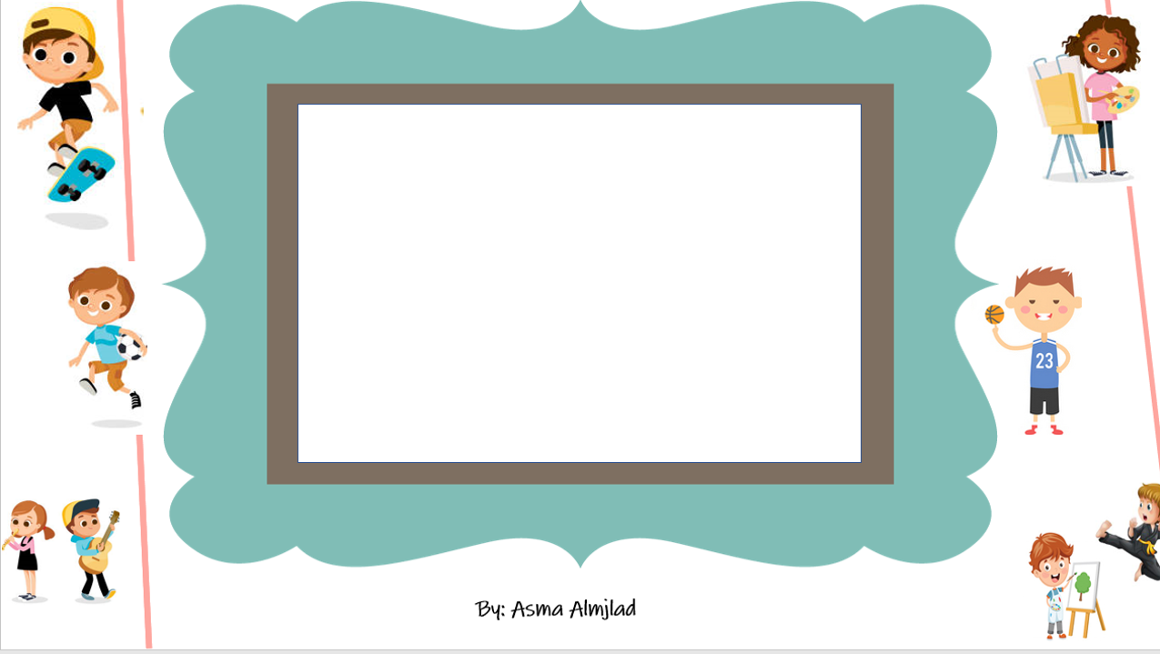


Slide 4
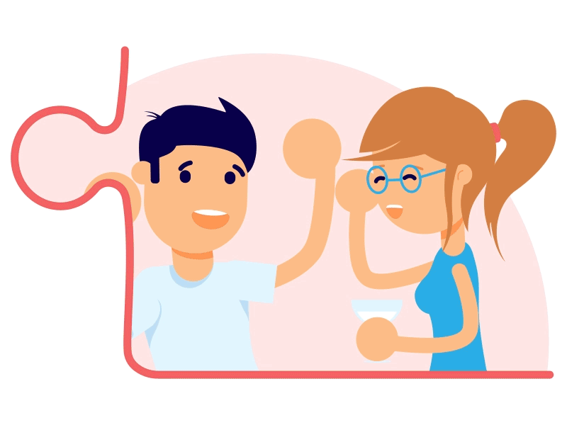
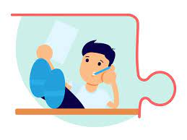
What do you do in your free-time ?
What is your favorite hobby ?
List some common free-time activities

Slide 5
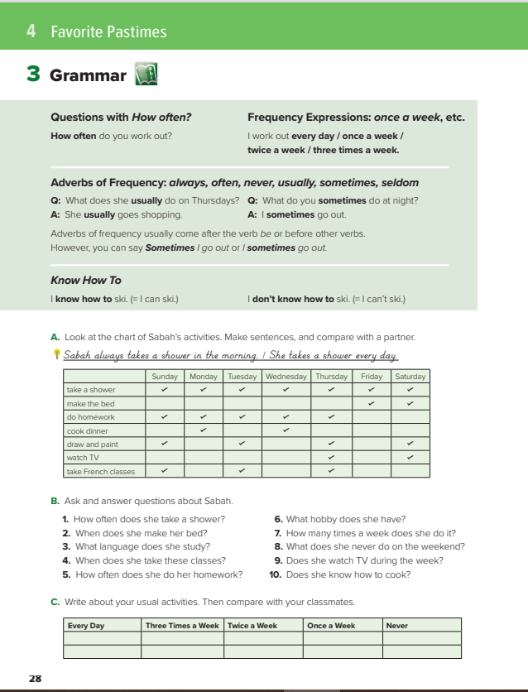
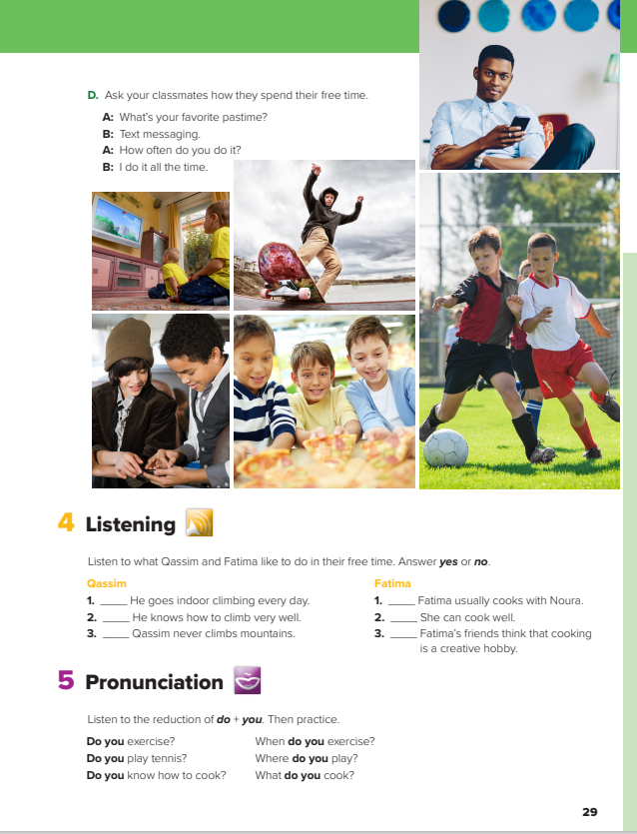
@ page 28+29

Slide 6
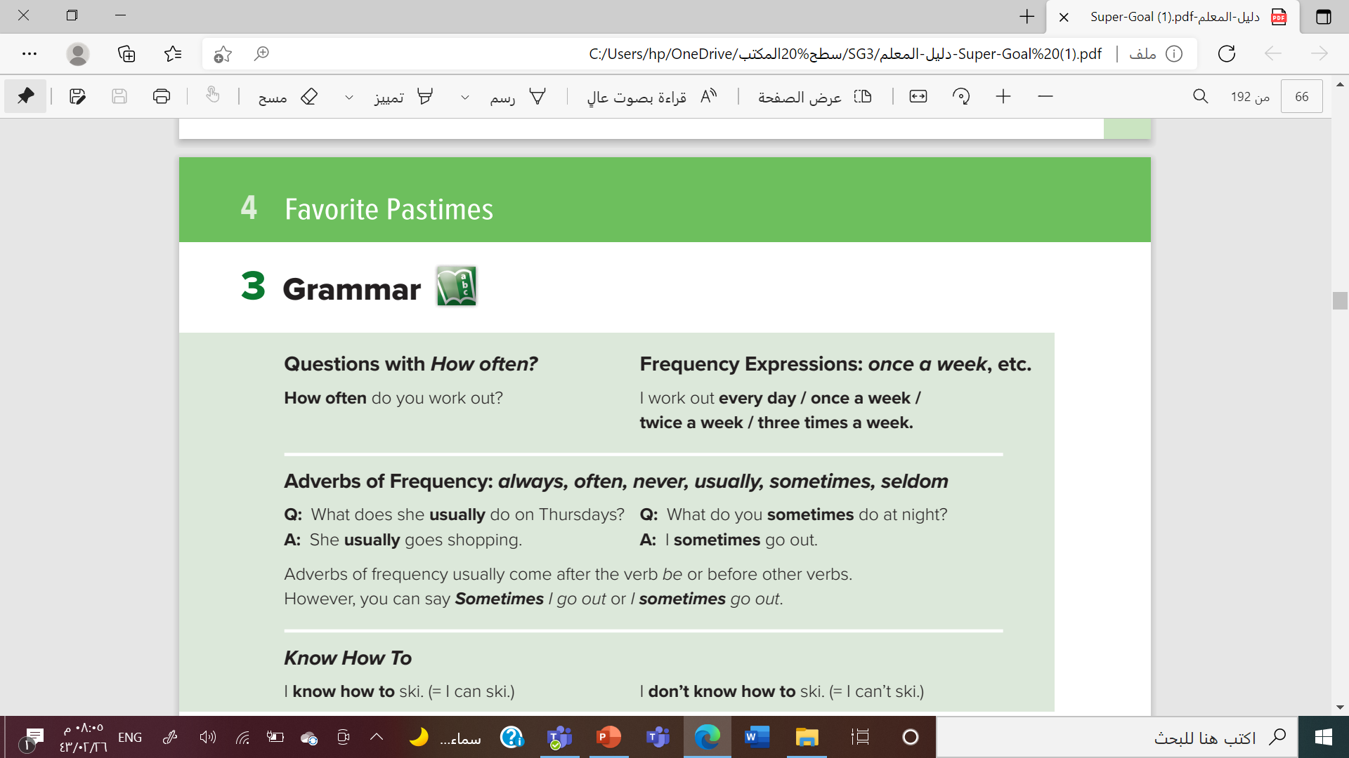

Slide 7
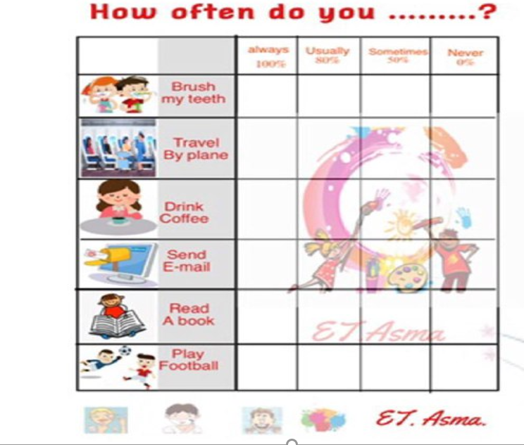



Slide 8
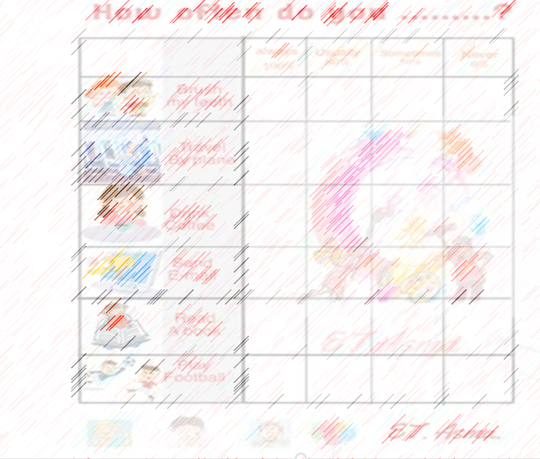
How often do you brush your teeth ?
How often do you drink coffee?
How often do you read a book ?
How often does ……….. Travel by plane?
How often does ……….. Send e-mail?

Slide 9
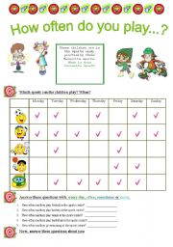
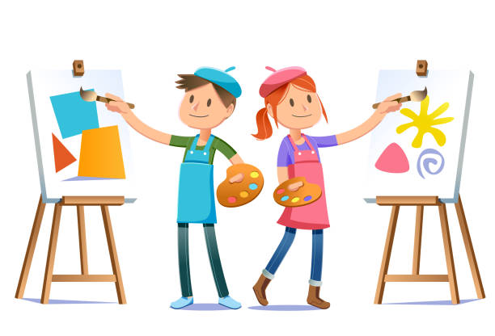

How often do they paint ?
They paint five times a week
How often does Ali study ?
Ali studies everyday

Slide 10


How often
Do
Does
S
V inf
….?
Write a question

Slide 11
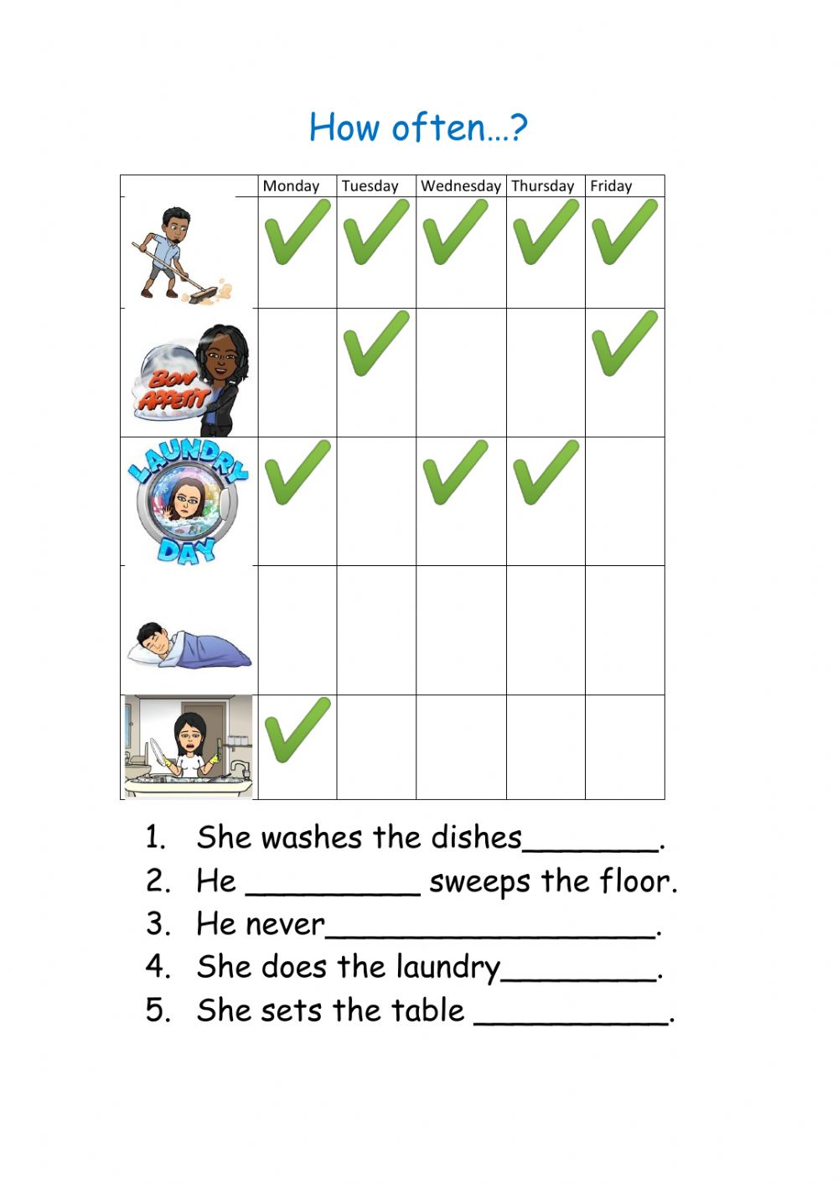

Slide 12



Slide 13
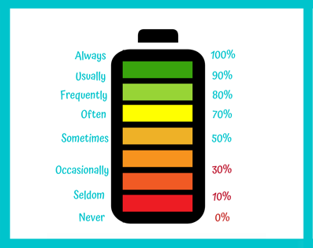

Slide 14


Slide 15
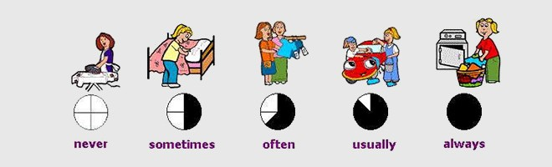


Slide 16

I always pray five times a day
I sometimes work out
I never do the laundry

Slide 17



Slide 19





I know how to ride a horse
I don’t know how to speak French

Slide 20
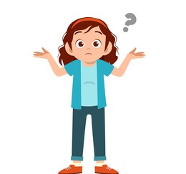

I don’t know how to ……….
I know how to ………..

Slide 21
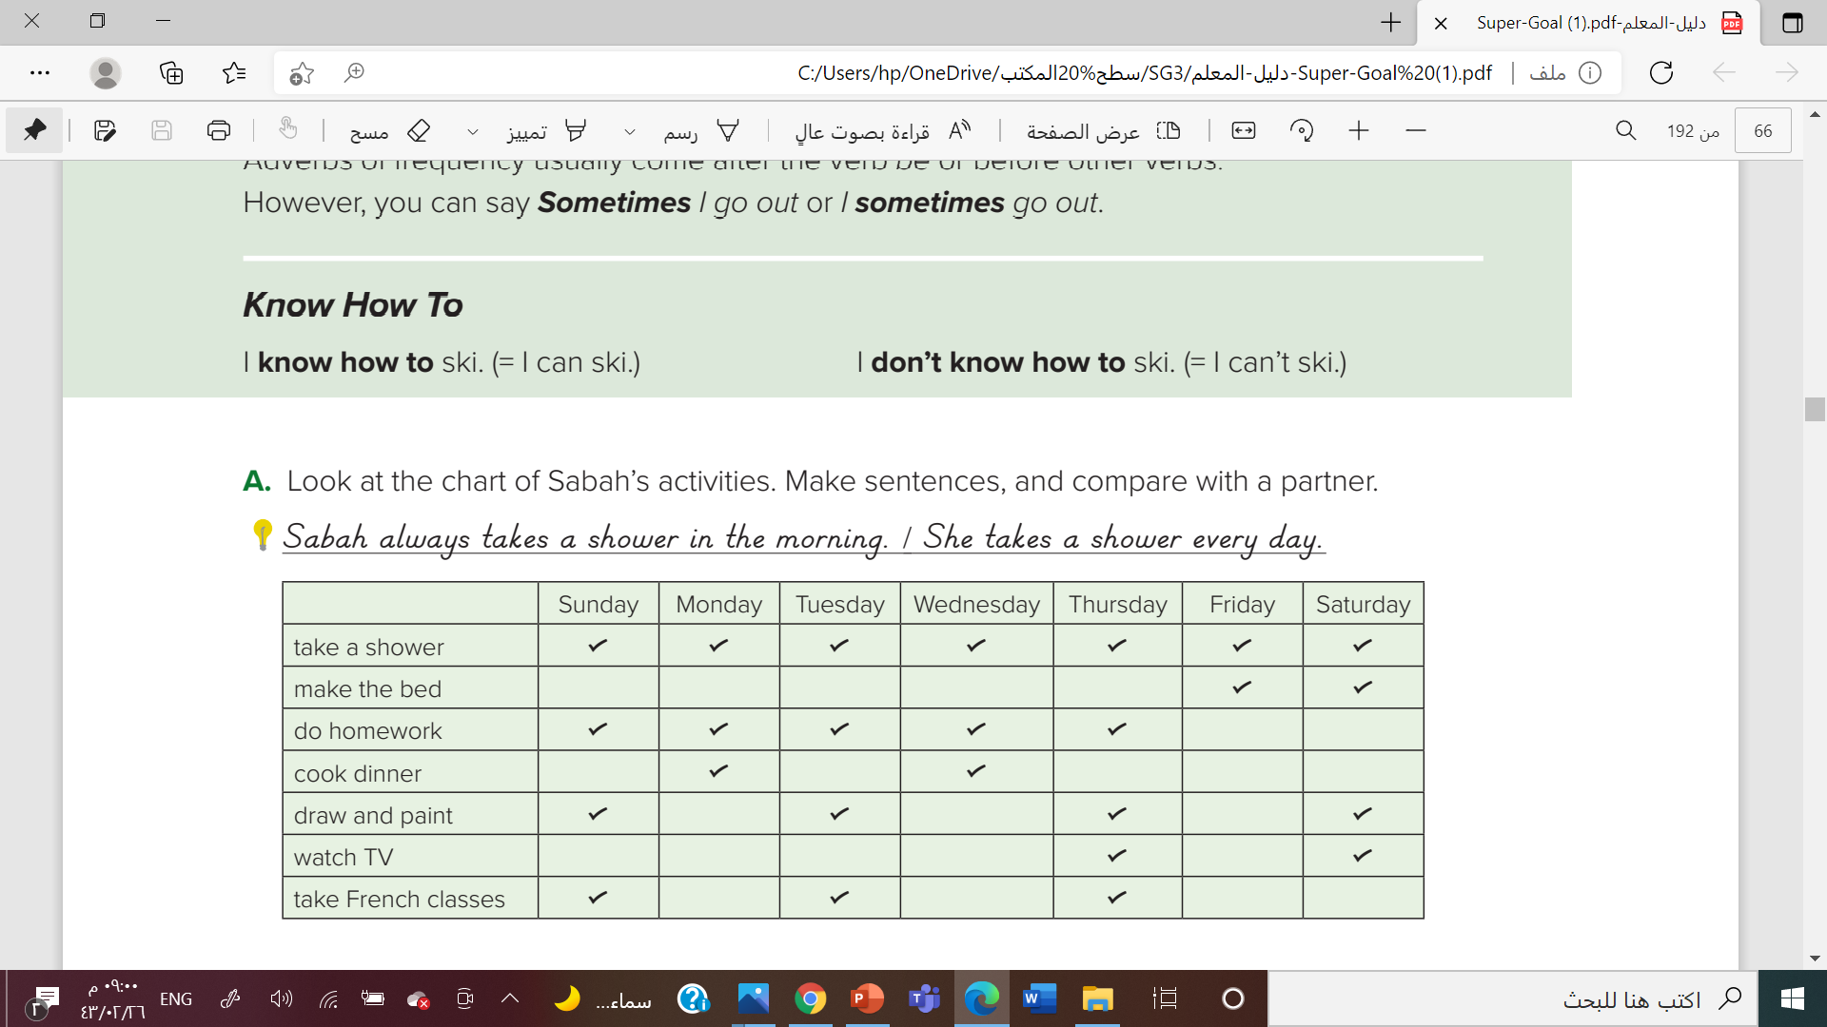

She takes a shower every day
She makes her bed on the weekend/twice a week.
She does homework five times a week.

Slide 22
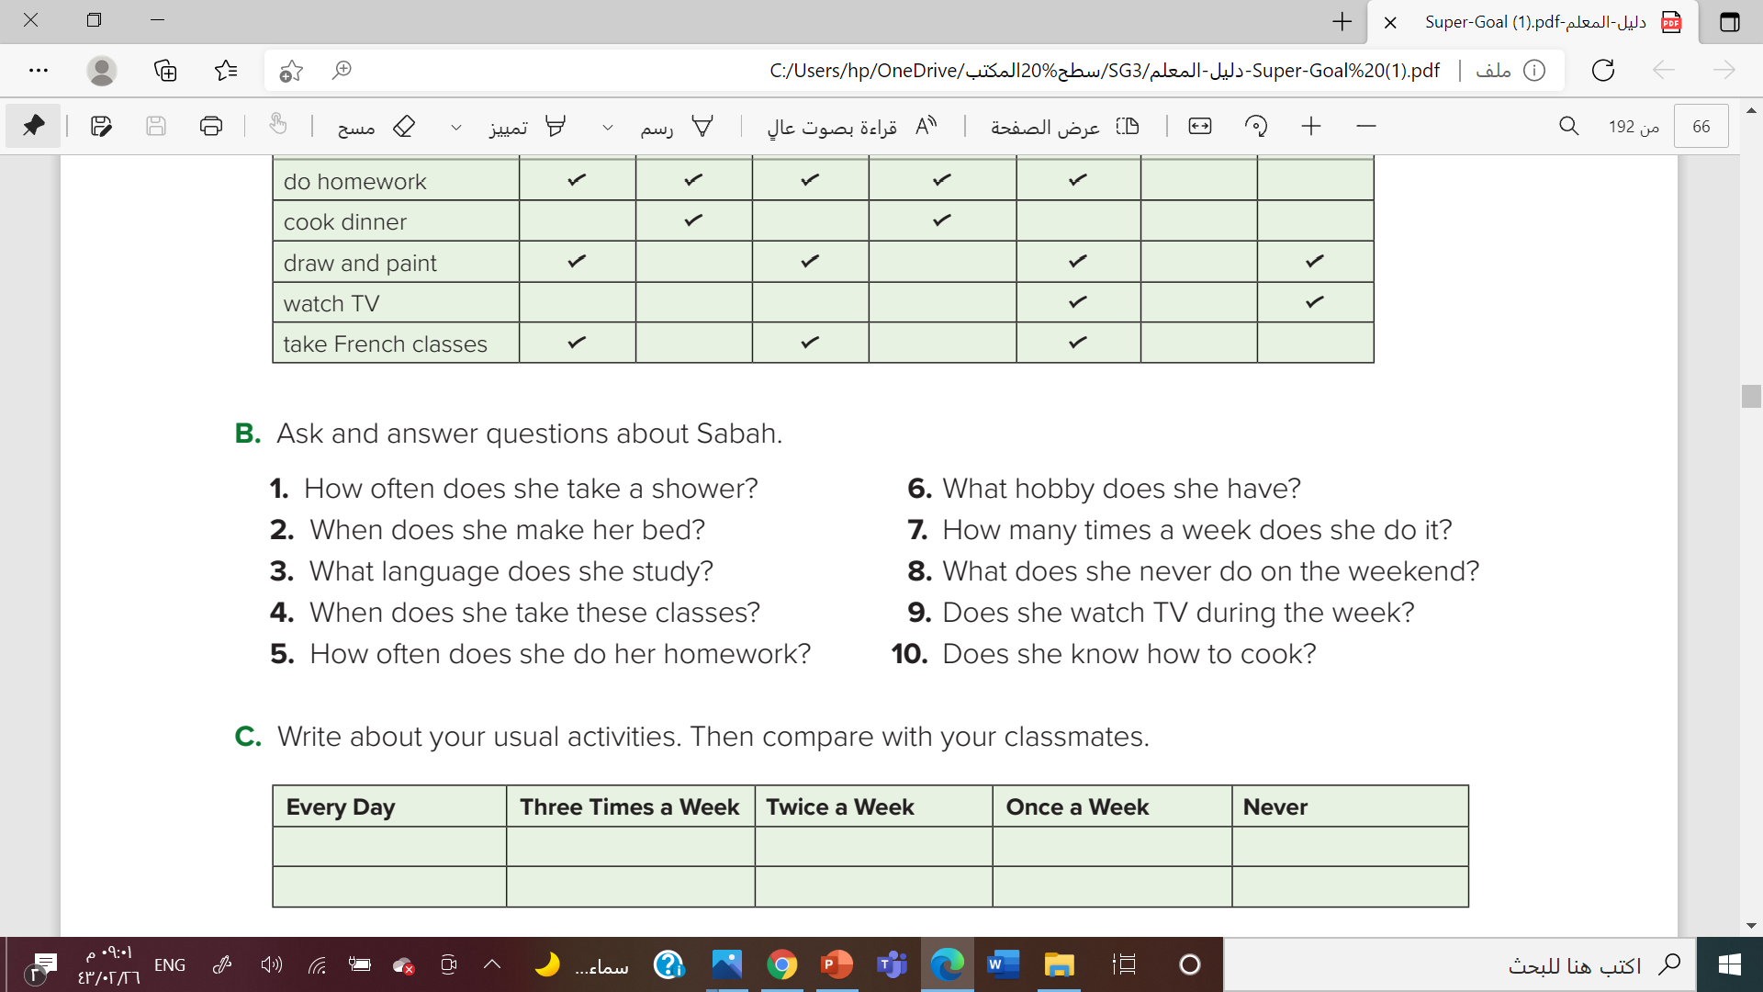
She takes a shower every day.
she makes her bed on weekends
She studies French.
She takes classes on Sunday(s), Tuesday(s), and Thursday(s).

Slide 23



Slide 24
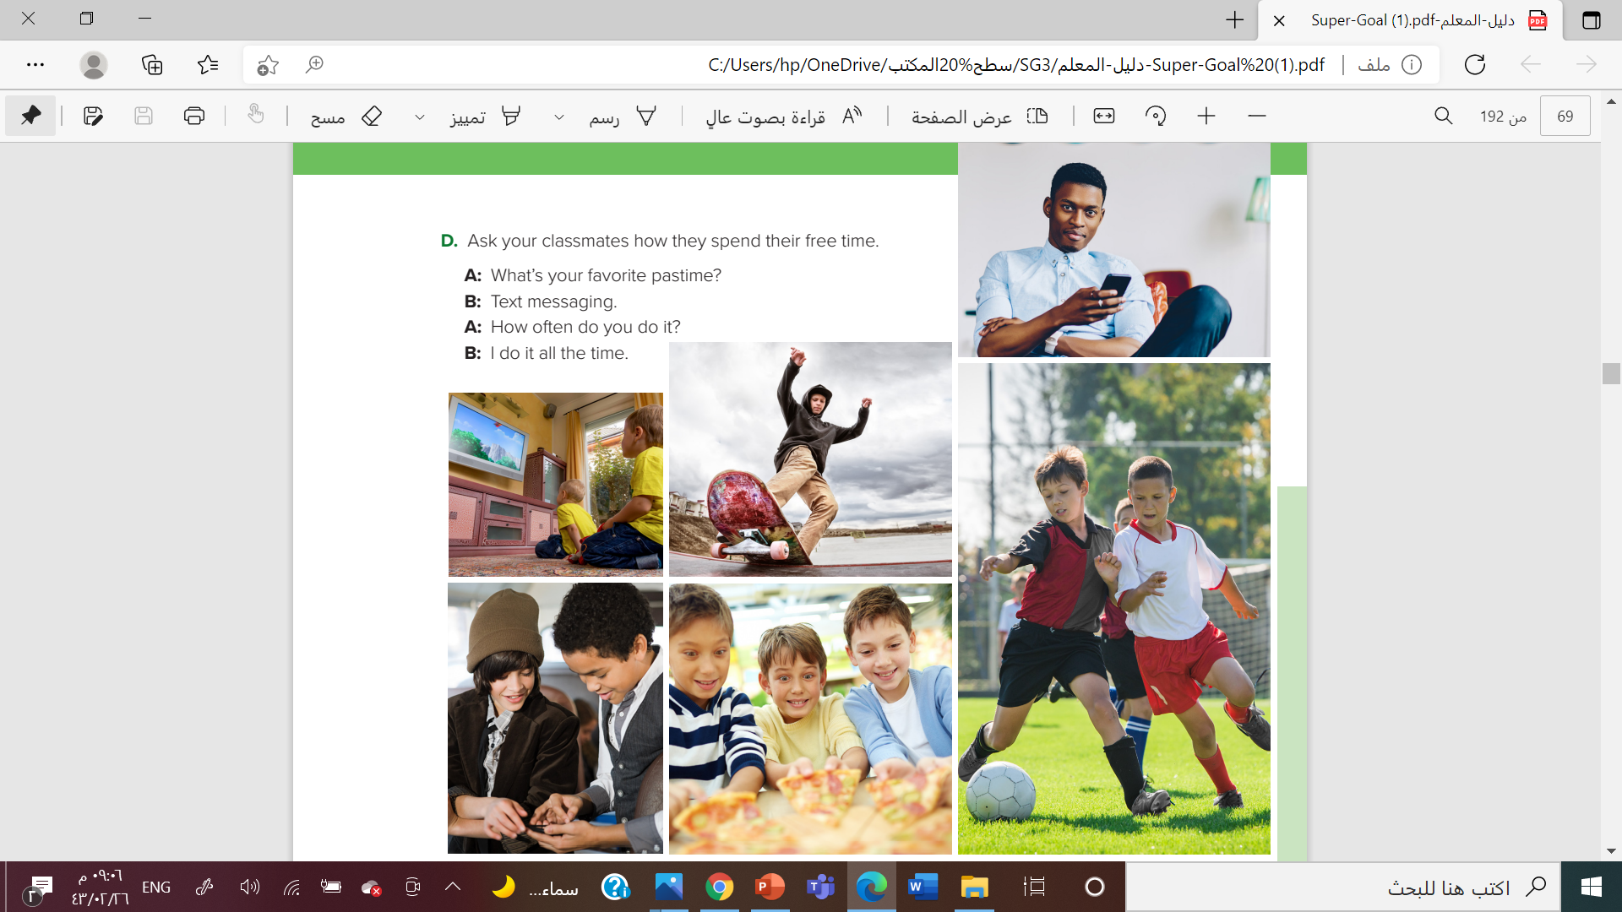

Slide 25

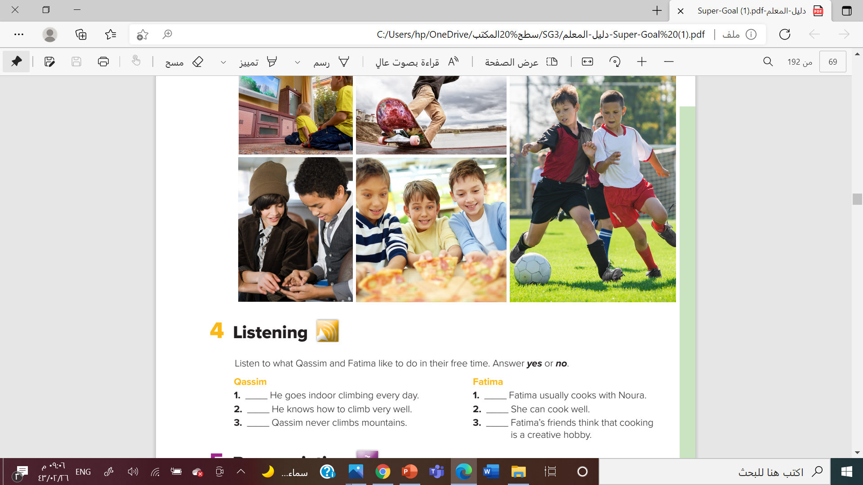
No
yes
yes
yes
No
No

Slide 26
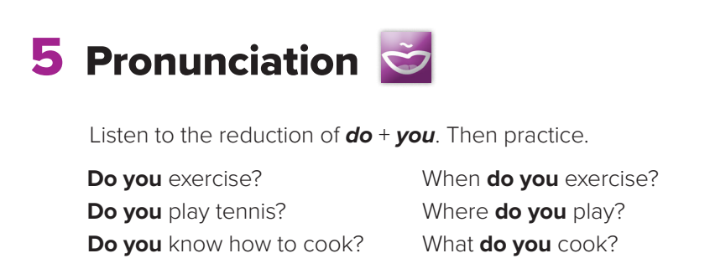

Slide 27

Work
Book

Slide 28
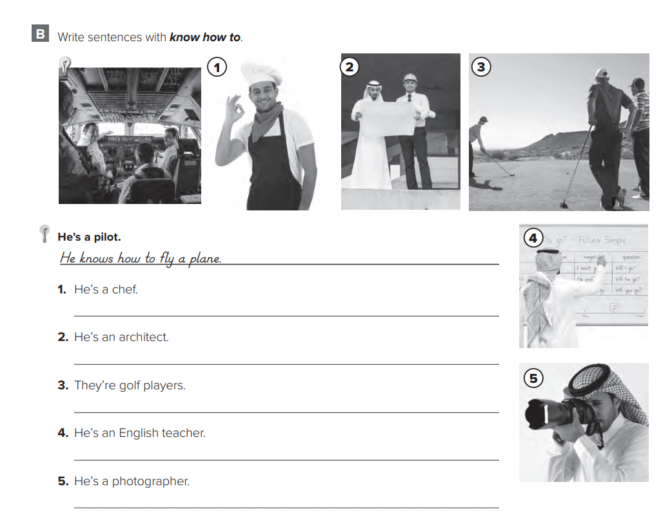
He knows how to cook.
He knows how to design houses.
They know how to play golf
He knows how to speak English.
He knows how to take photos.

Slide 29
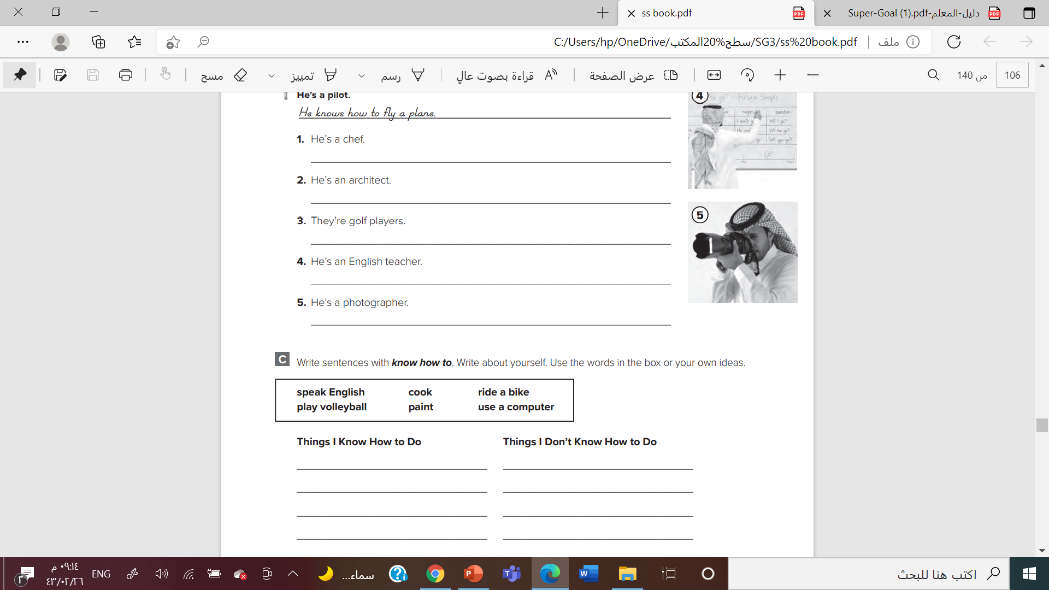
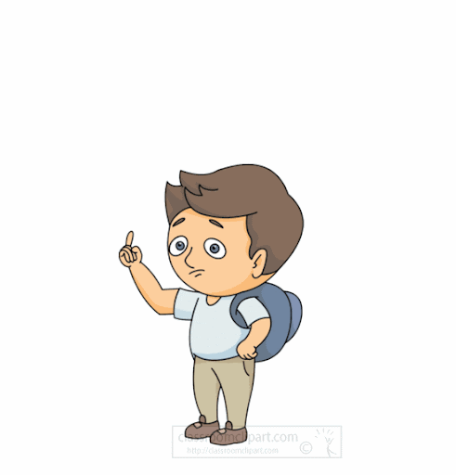

Slide 30
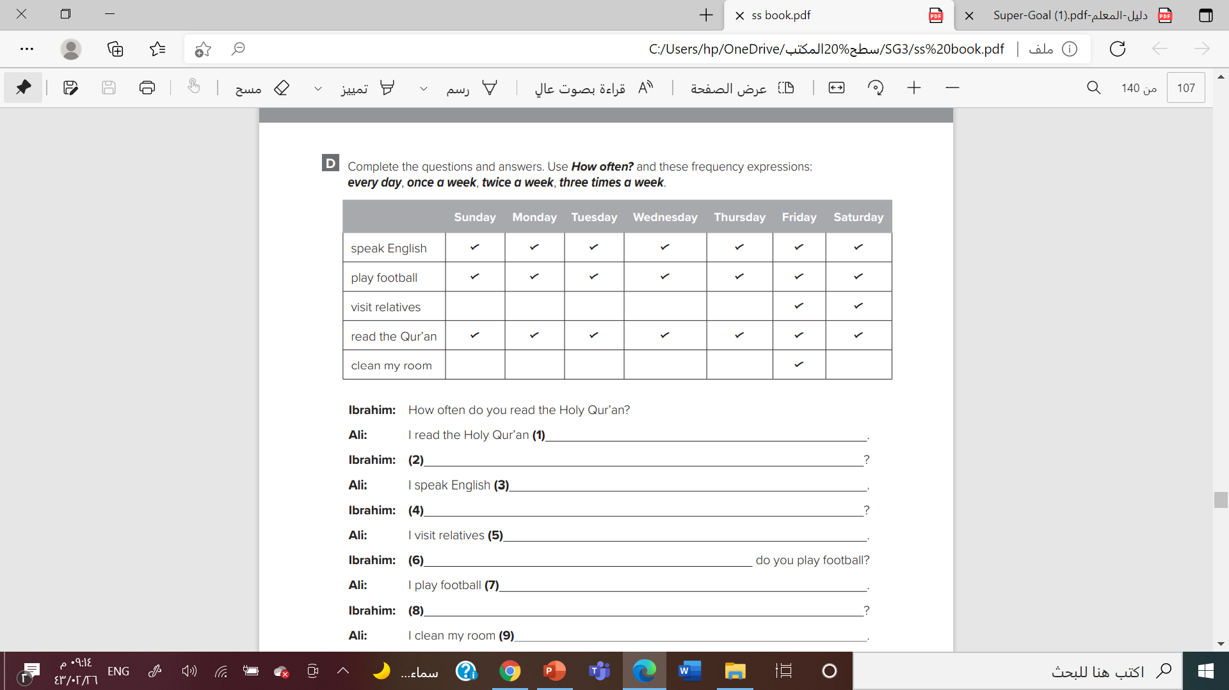

Every day
How often do you speak English
everyday
How often do you visit (your) relatives
Twice a week

Slide 31

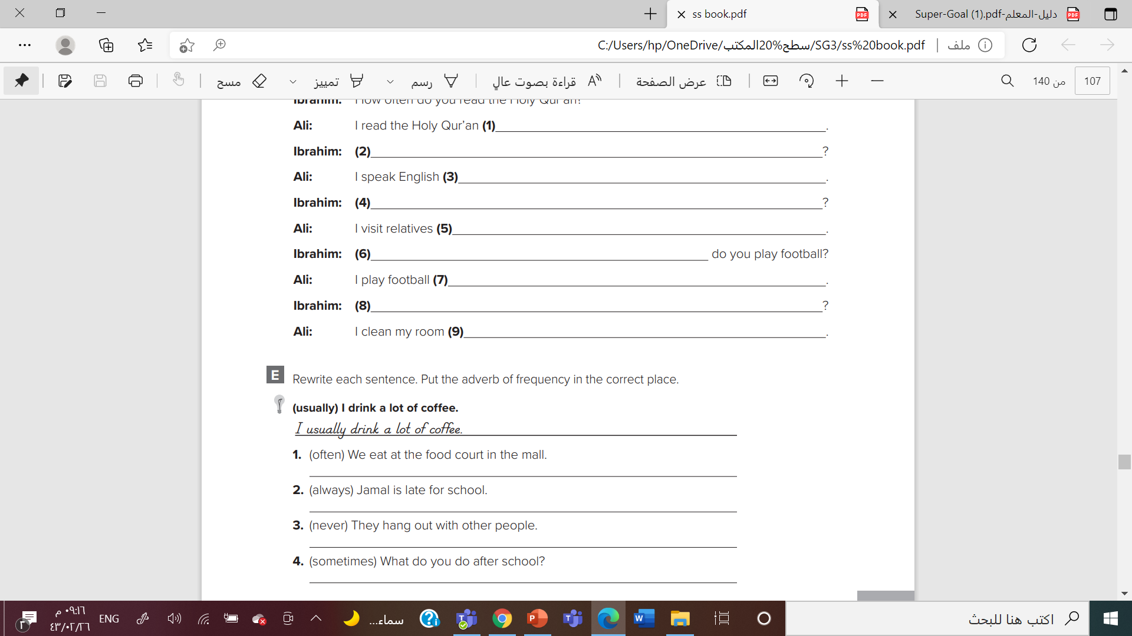
We often eat at the food court in the mall.
Jamal is always late for school.
They never hang out with other people.
What do you sometimes do after school?

Slide 32




Slide 33


