Slide 1

U 4 writing p 32
Tr. Nora Khalid

Slide 2

Write about Ss hobby or pastime using “gerunds” as a subject and an object.

Slide 3


Ask me!
Walking
Running shoes & track suit
Every morning
Along the road
With my friend
I love walking because it’s relaxing and good for body

Slide 4
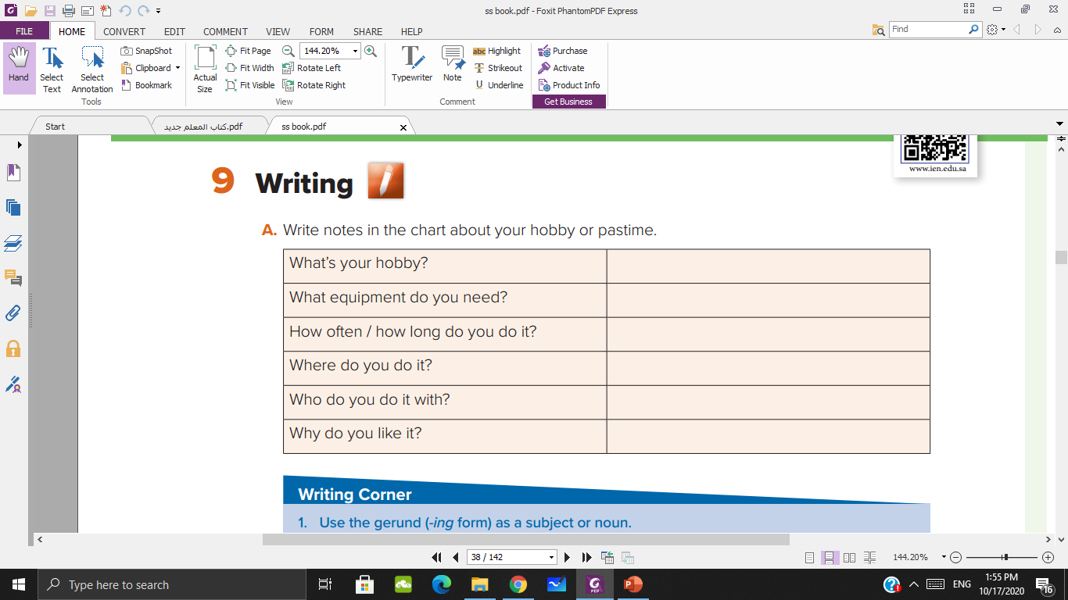
Write

Slide 5
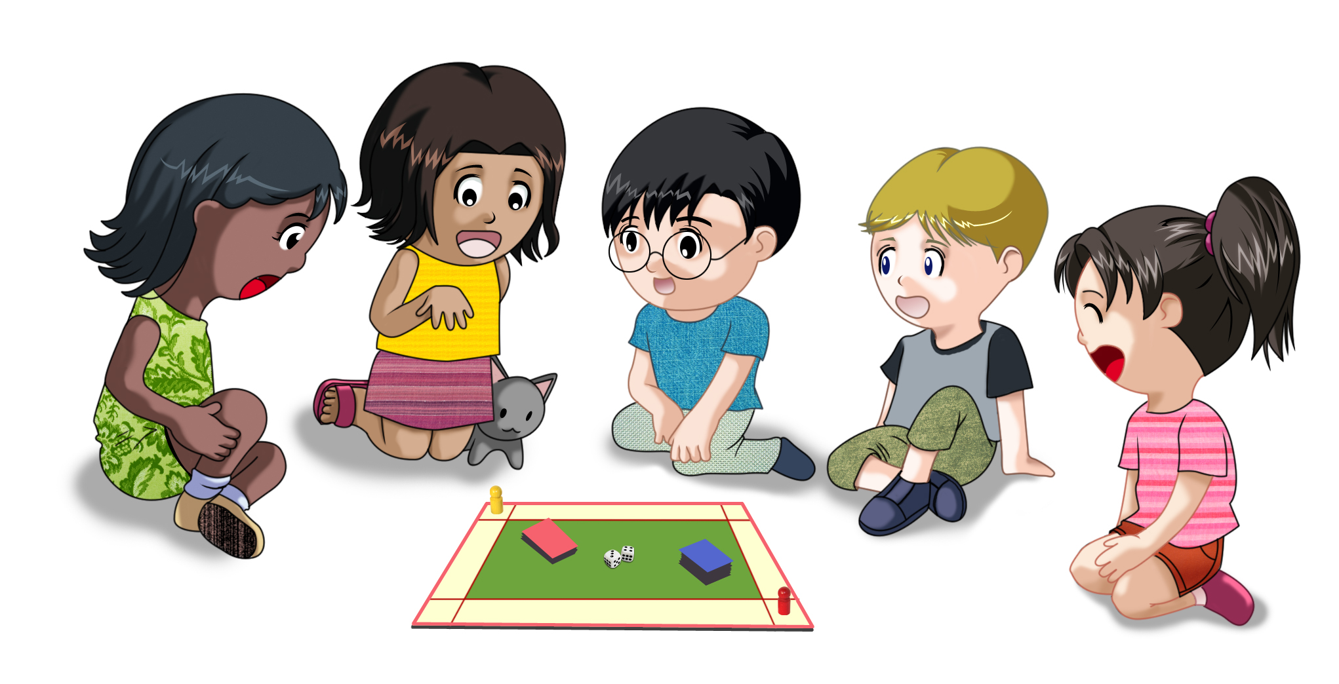
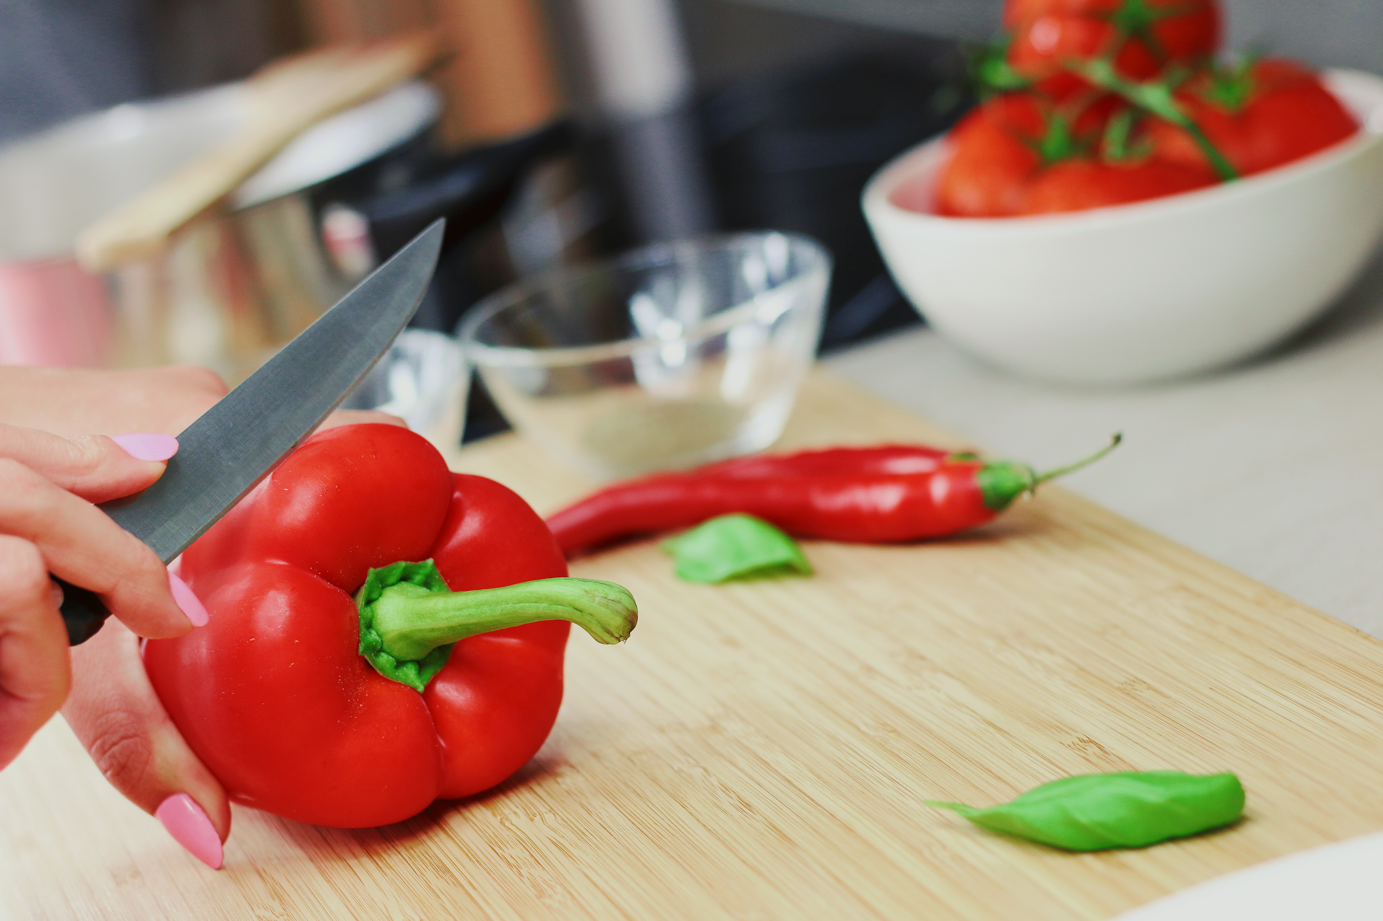
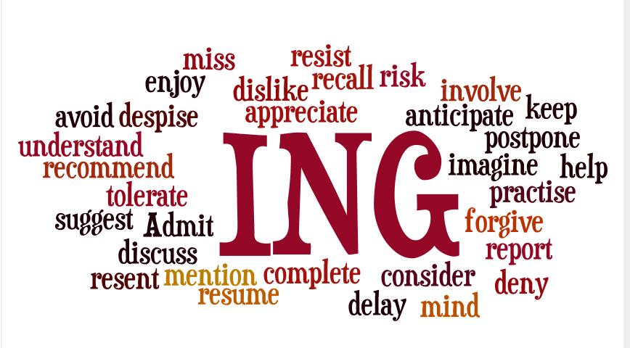

playing
Cooking
dancing

Slide 6


Are you watching TV?
Do you prefer watching TV?

Slide 7
She is painting a picture.
Painting is a relaxing hobby.
What other activities or sports use the -ing form?

Slide 8
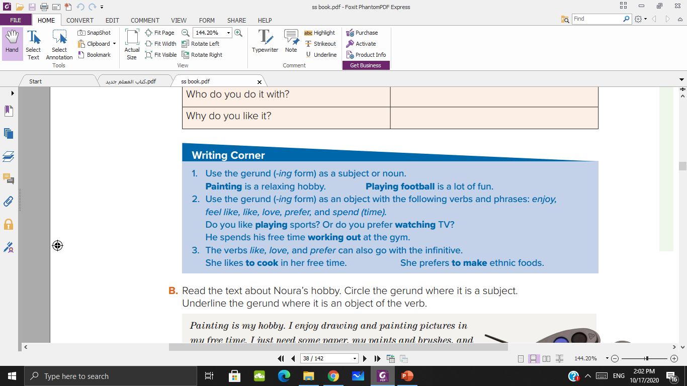

Slide 9

I enjoy cooking in
my free time.
say a sentence about your hobby

Slide 10
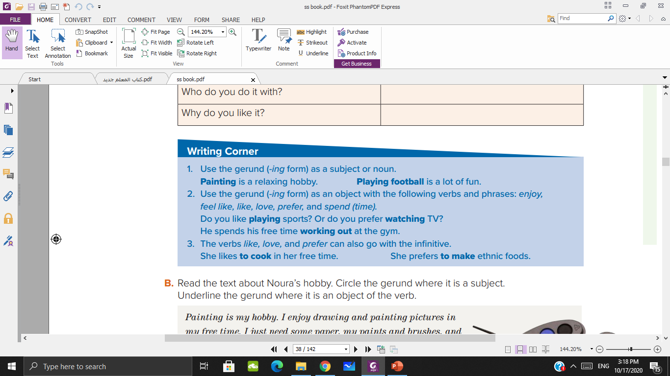

Slide 11
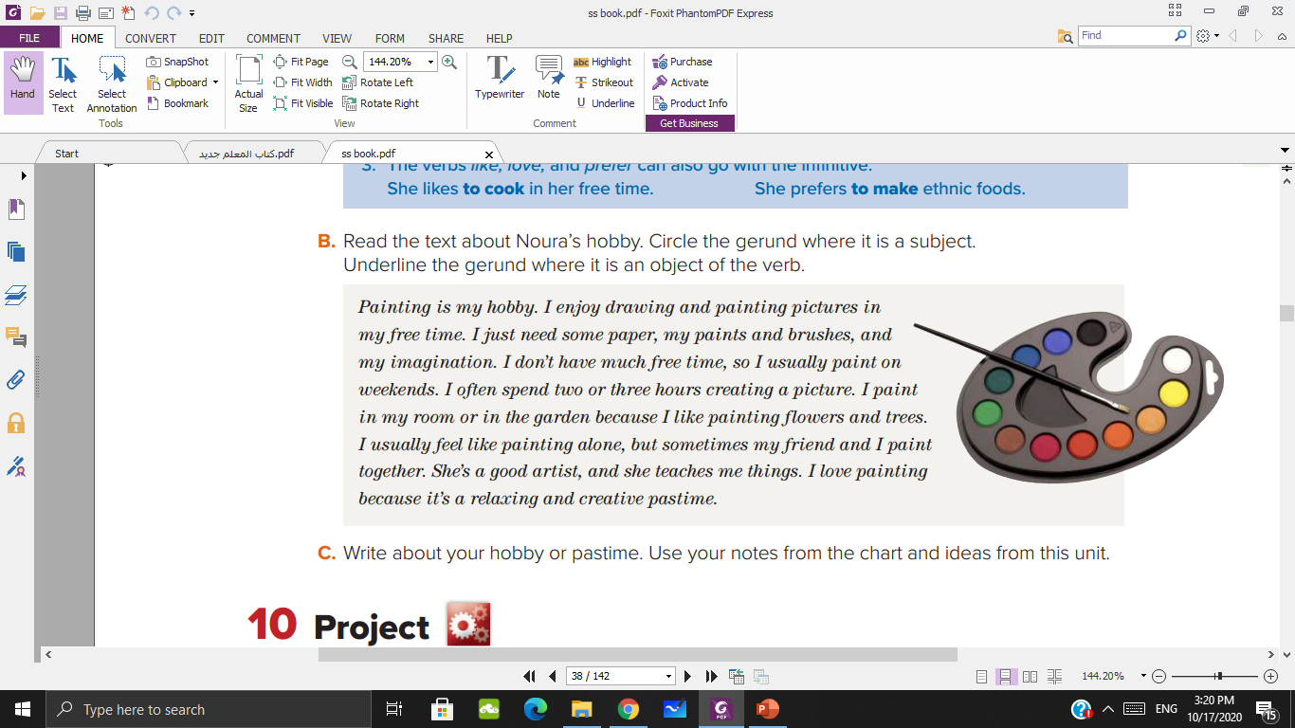

Slide 12

Write about your hobby or pastime.
Use your notes from the chart and
ideas from this unit

