Slide 1
Unit 3
What Will They Think of Next?
Conversation & Listening
Mega Goal 3.1
Done by : Entisar Al-Obaidallah

Slide 2




Lesso Objectives
Listen
for specific details
Use
the "real talk" phrases in a conversation.
Answer
Some questions about the conversation
Match
the words with their meanings

Slide 3
Warm Up

Slide 4
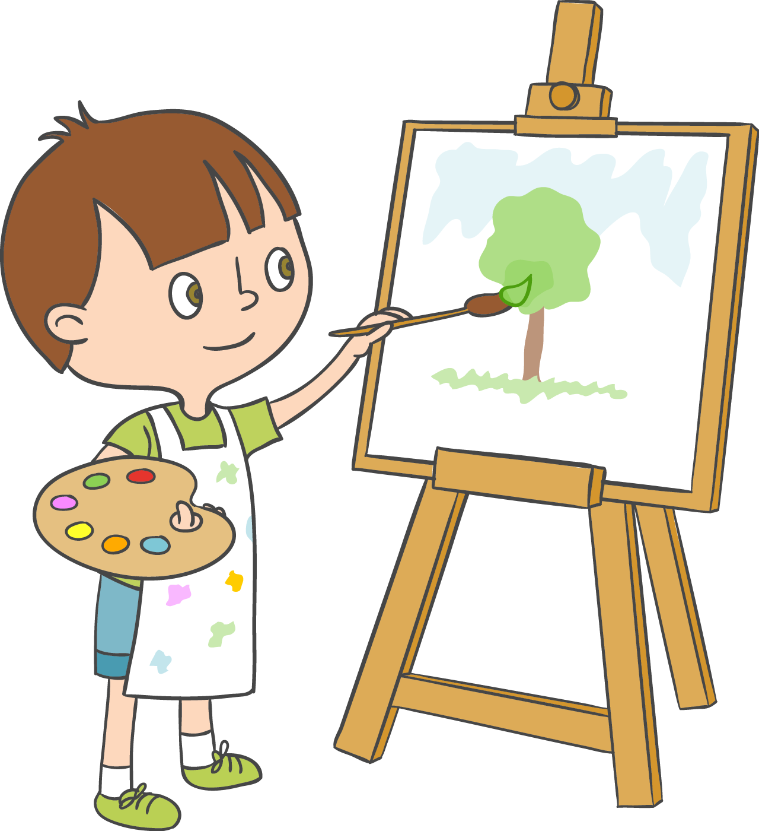


Warm Up
What is your favorite hobby?
Reading
drawing
swimming

Slide 5
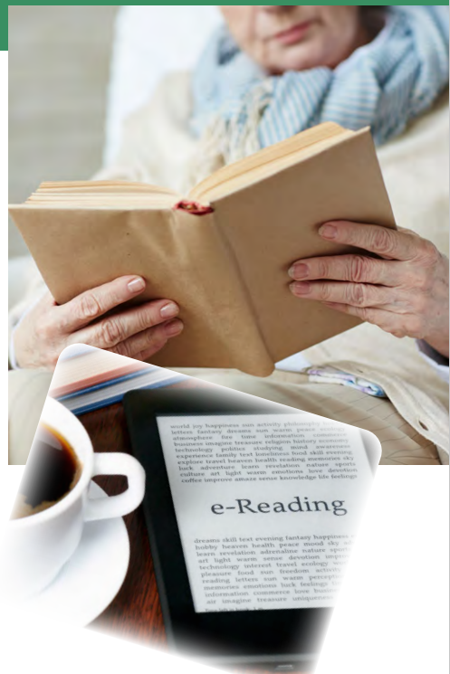

What do you
think the old lady is doing?
She is reading a book.
What device do you see?
an electronic book reader
or e-reader

Slide 6

Do any of you use an
e-reader?
What do you like about it? What don’t you
like about it?
How many books can it hold?

Slide 7
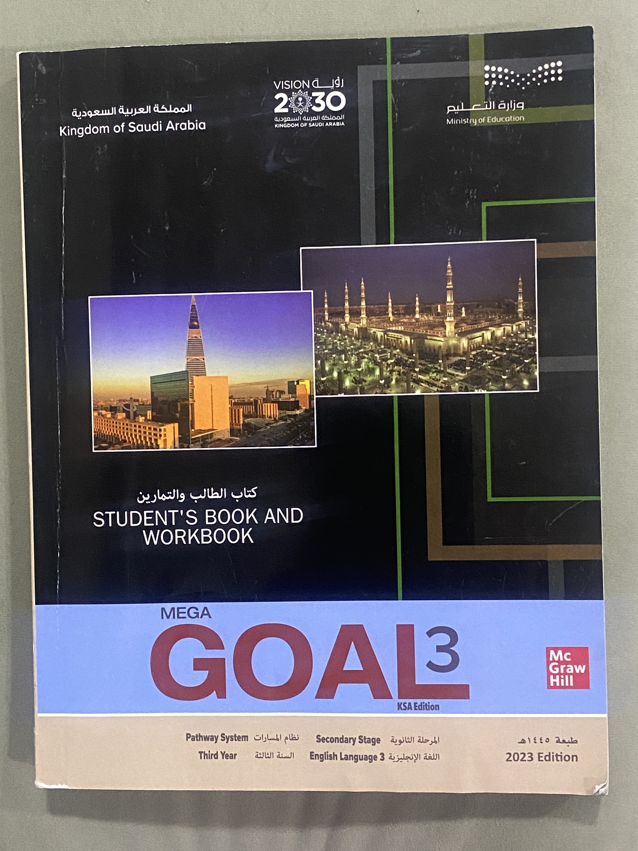
Open
Your student’s book Page(38)

Slide 8
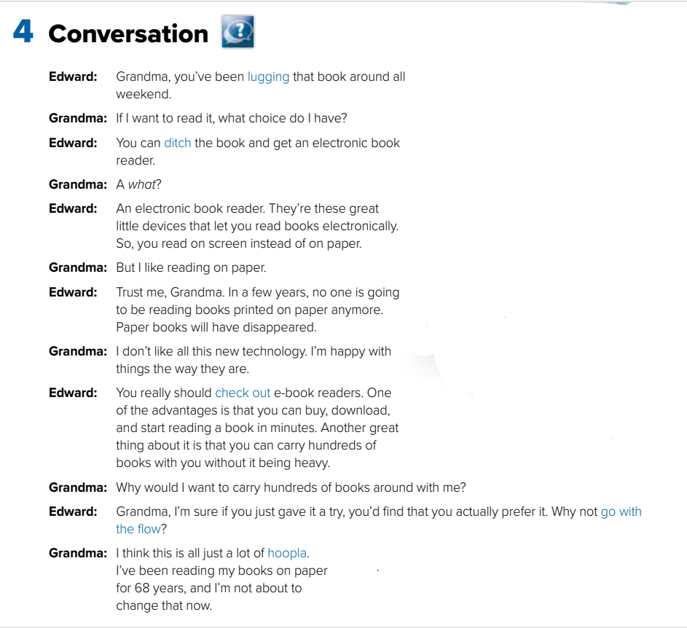
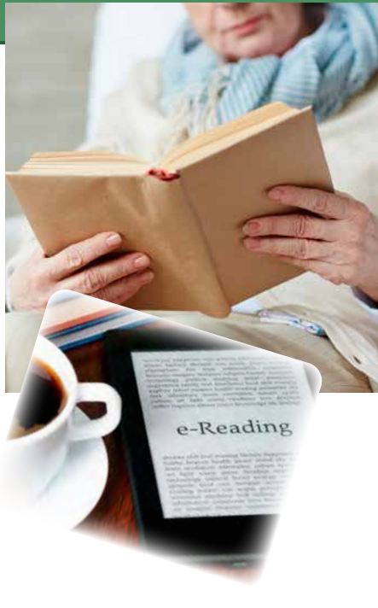


Open
UR book p.(38)
Listen & Discuss

Slide 9
What is Grandma lugging around?
Her book
What does Edward want Grandma to ditch?
Her book
What does Edward suggest Grandma check out?
e-book readers)
If Grandma goes with the flow, what will she do?
read from e-book readers rather than books
Why does Grandma think using e-book readers is hoopla?
She thinks they are just the latest fad.

Slide 10
Listen to the conversation again and underline the expressions written in blue

Slide 11
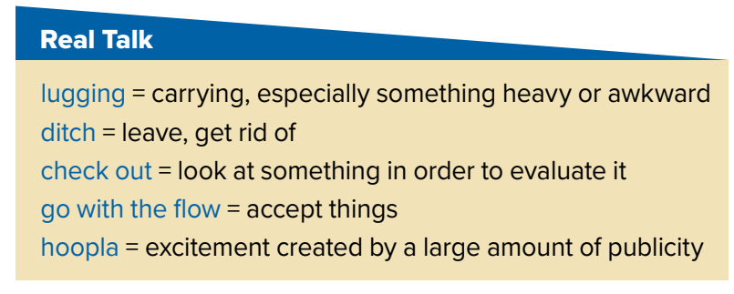
Read the words and their meaning:

Slide 12
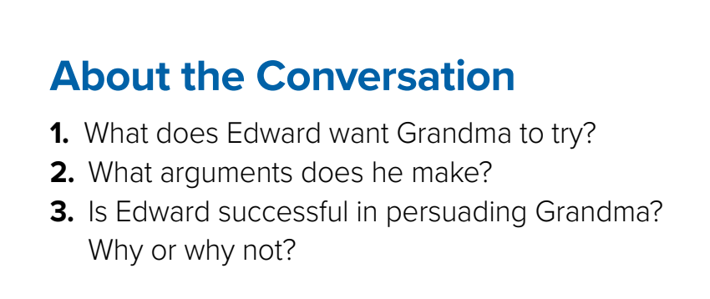
1. He wants her to try reading on an electronic book reader.
2. E-book readers can hold hundreds of books. You can buy, download,
and start reading a book in minutes.
3. Edward does not persuade Grandma. She doesn’t want to change

Slide 13
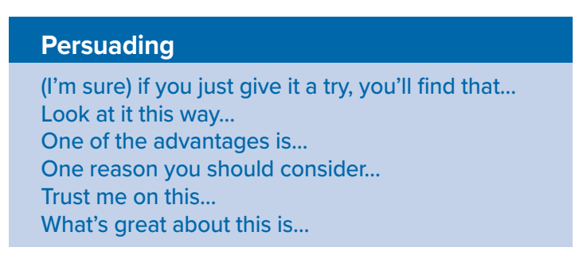


These phrases used to make some one agree to do something by giving reasons why should.

Slide 14
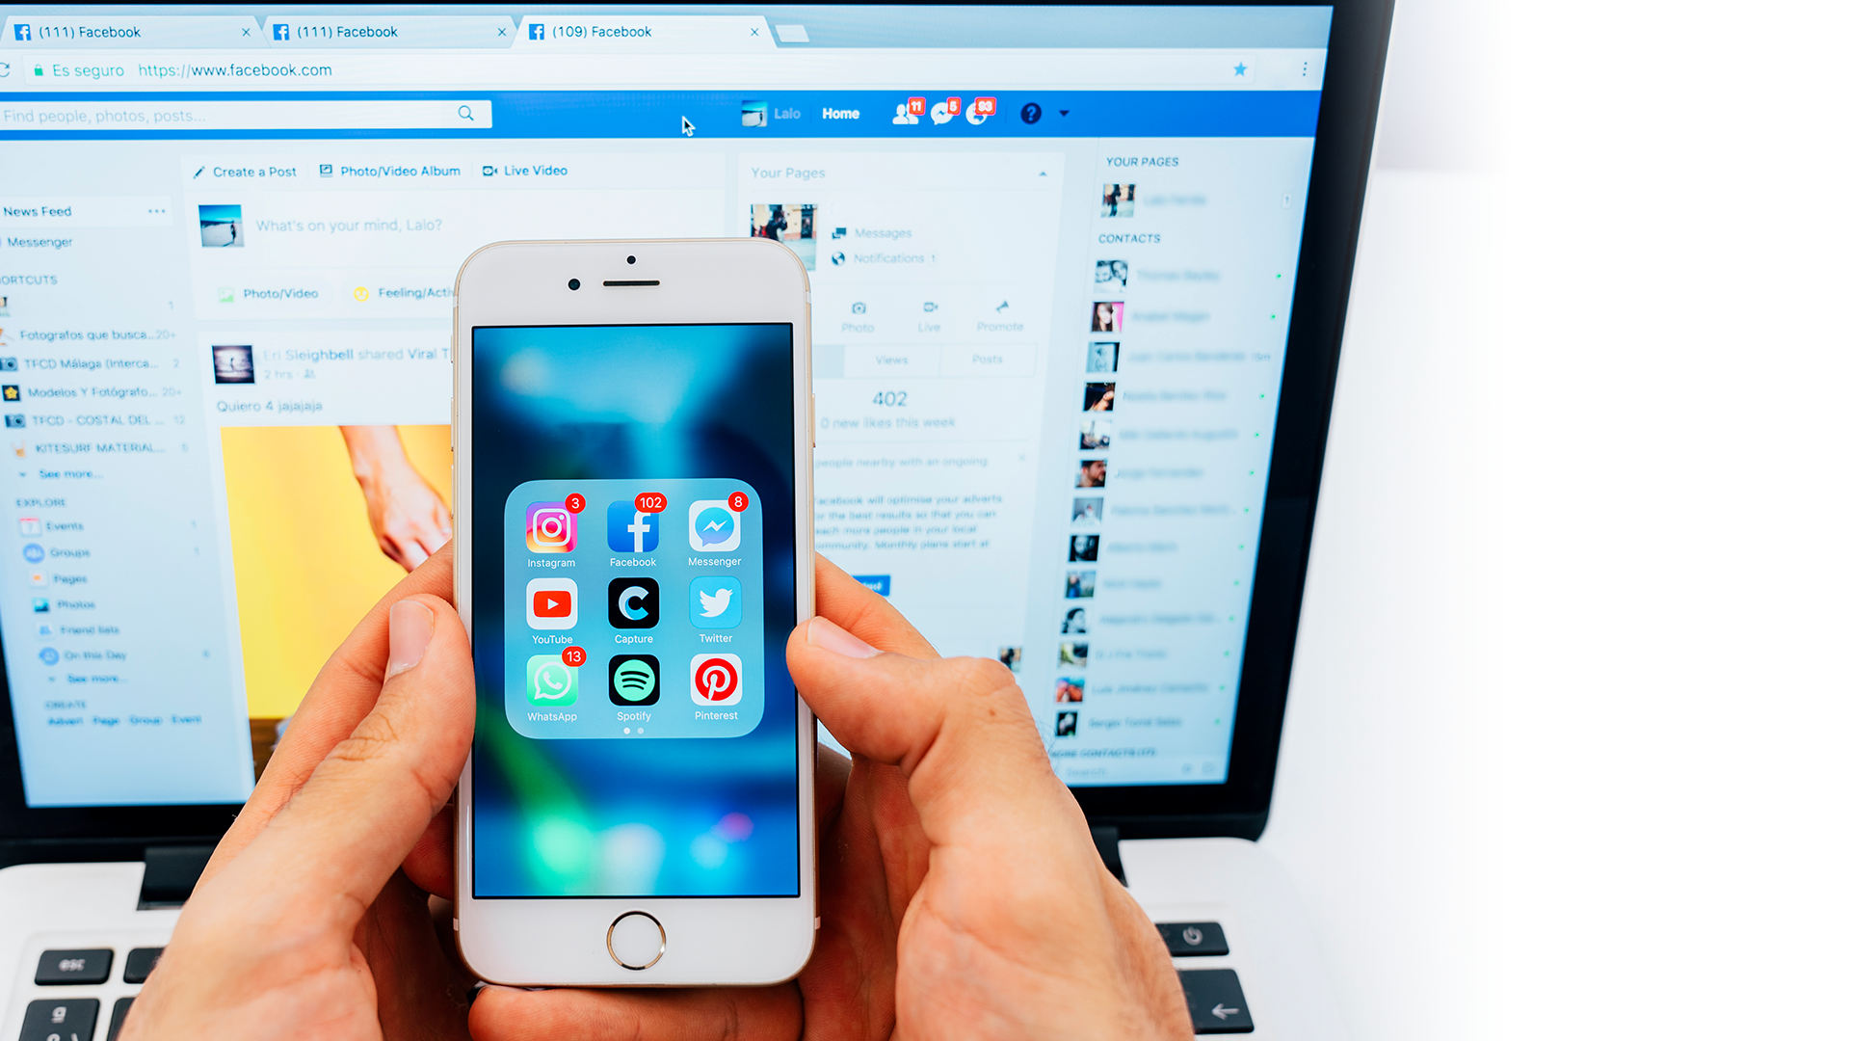
Open your student’s book p.( 39 )

Slide 15
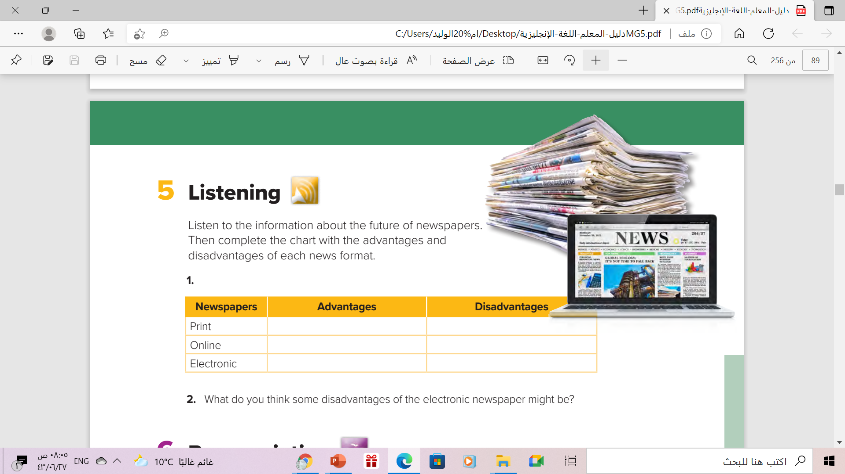
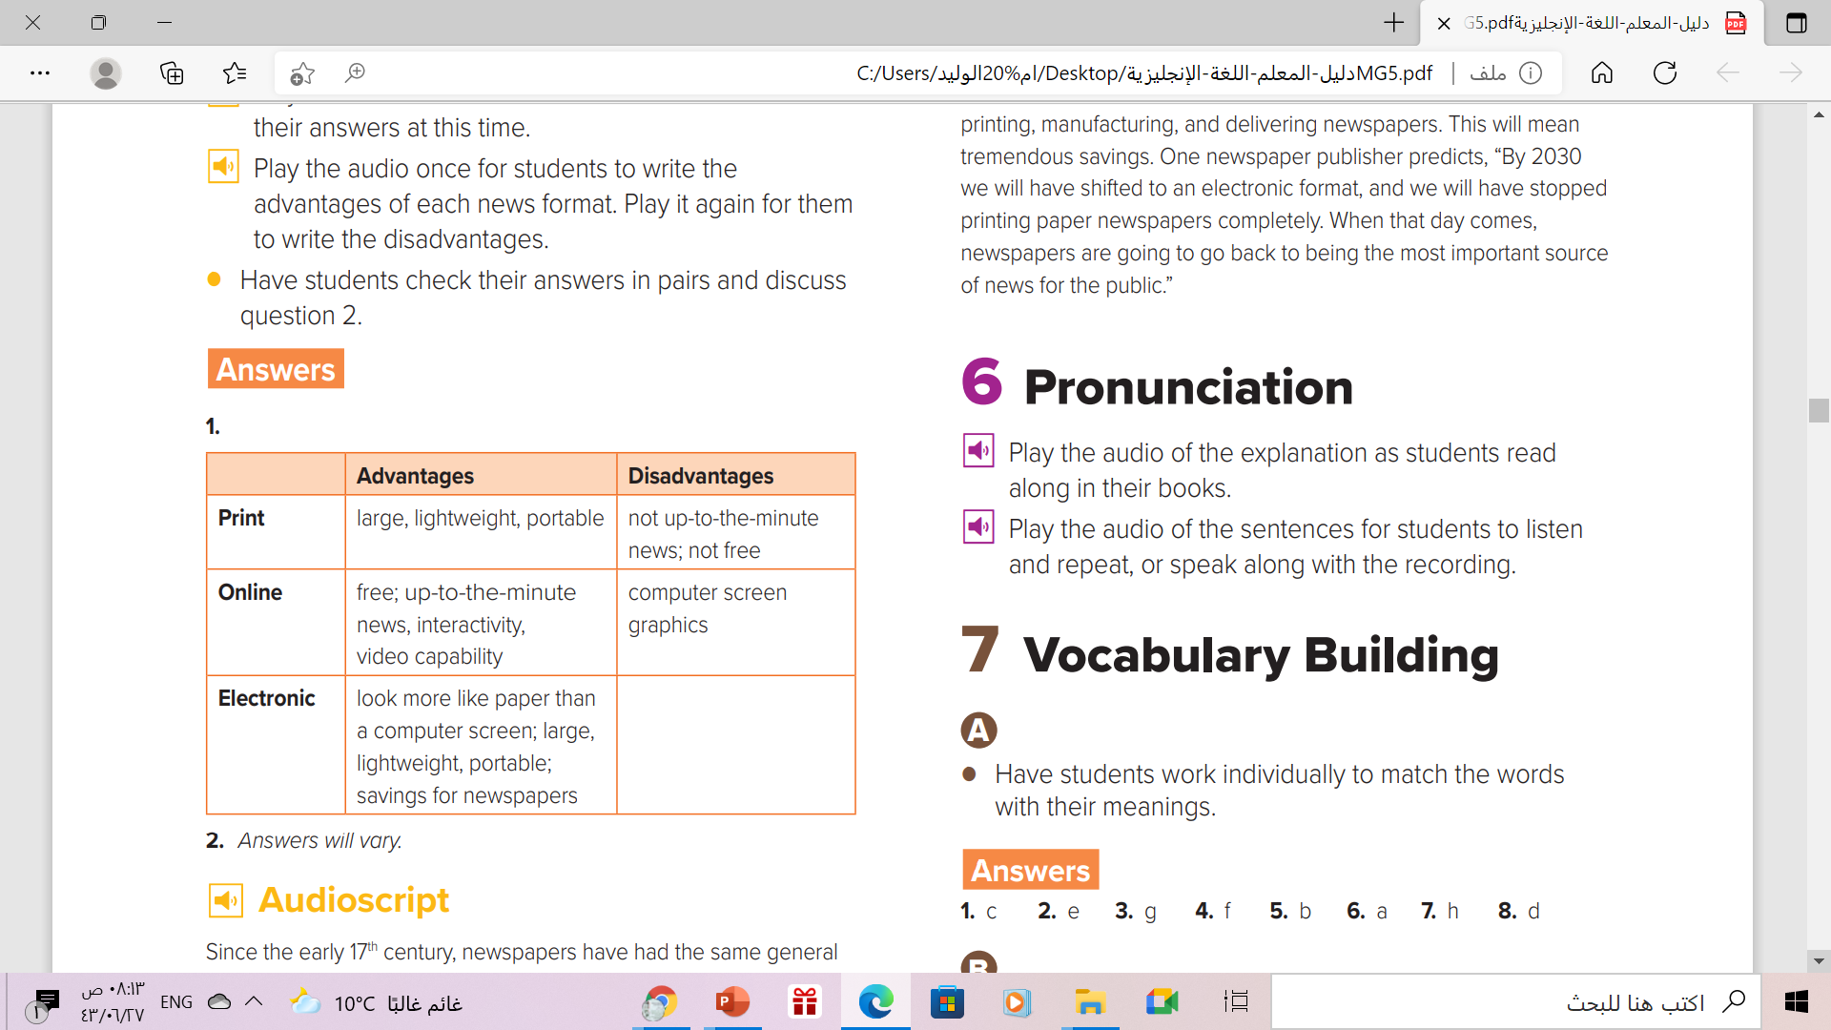
Listening

Slide 16
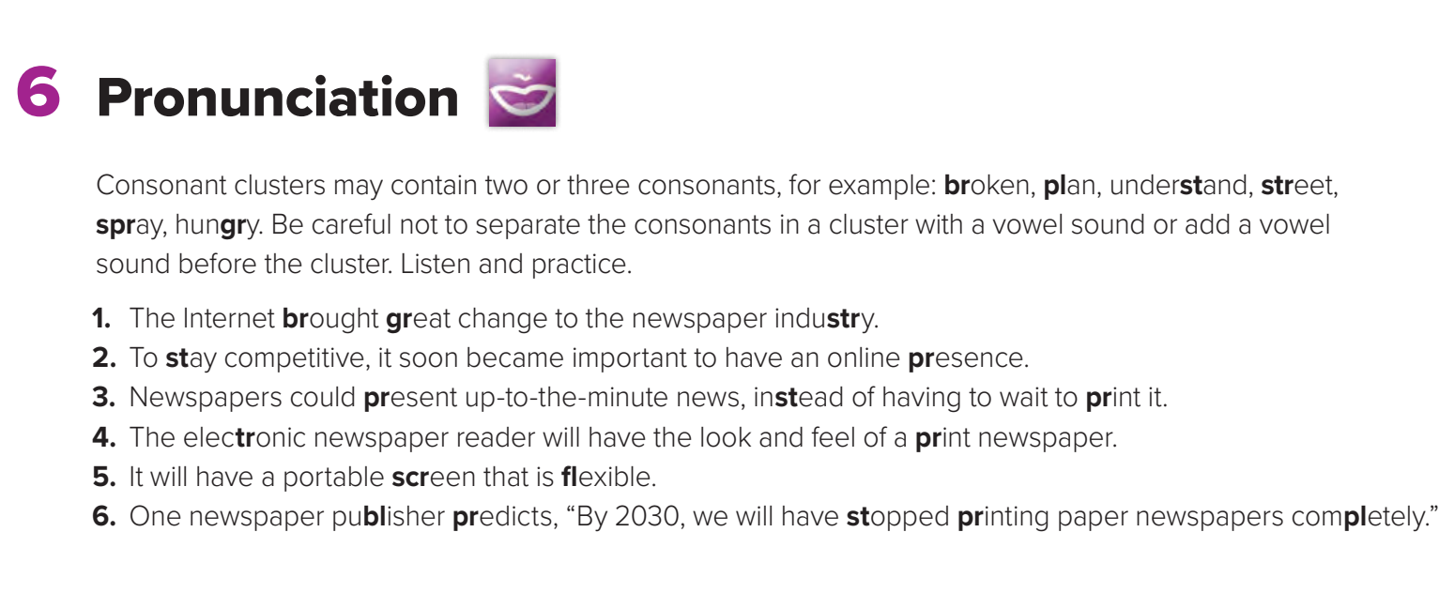

Slide 17
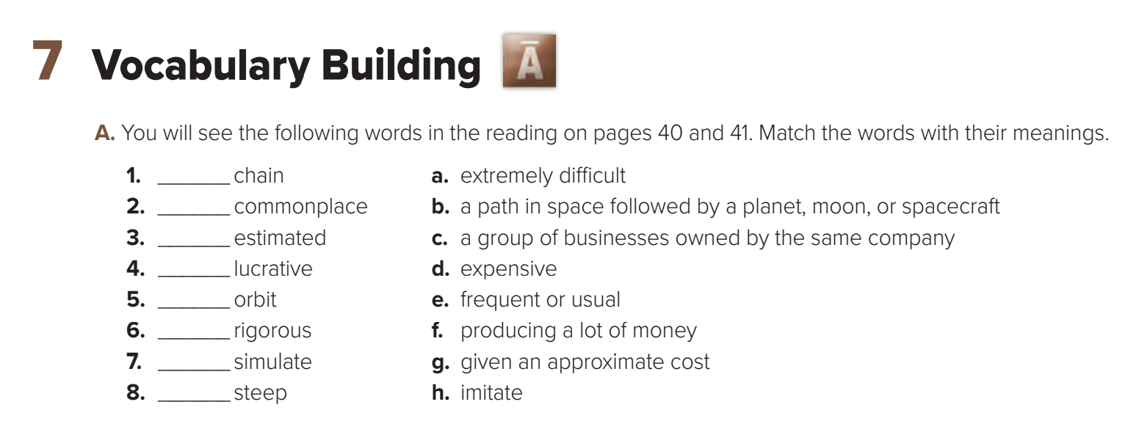
c
e
g
f
b
a
h
d

Slide 18
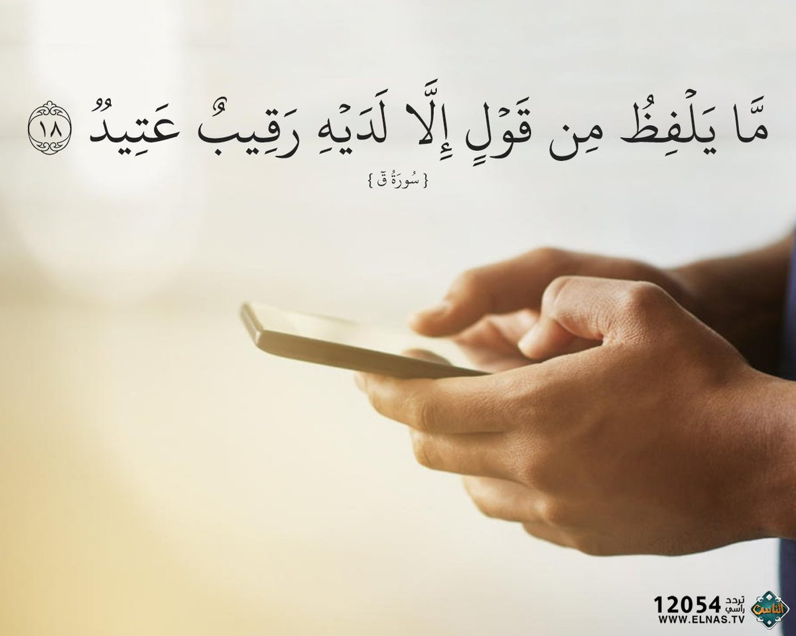
From The Holy Qura’an

Slide 19

Homework
Work book, exercise (H) ,
p.( 244)

Slide 20

Thanks

