Slide 1

Super goal 1
Unit 4
Lesson 1 listening & discuss + pair work
اعداد المعلم / يحيى المنقري متوسطة المأمون بالهفوف

Slide 2

Learning Objectives
*By the end of this lesson, Ss will be able to:
1-answer about countries and nationalities.
2- ask about countries and nationalities.
3-answer .questions related to pictures.

Slide 3


Slide 4
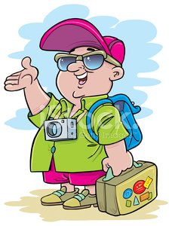




Tourist
Mexican
Egyptian

Slide 5
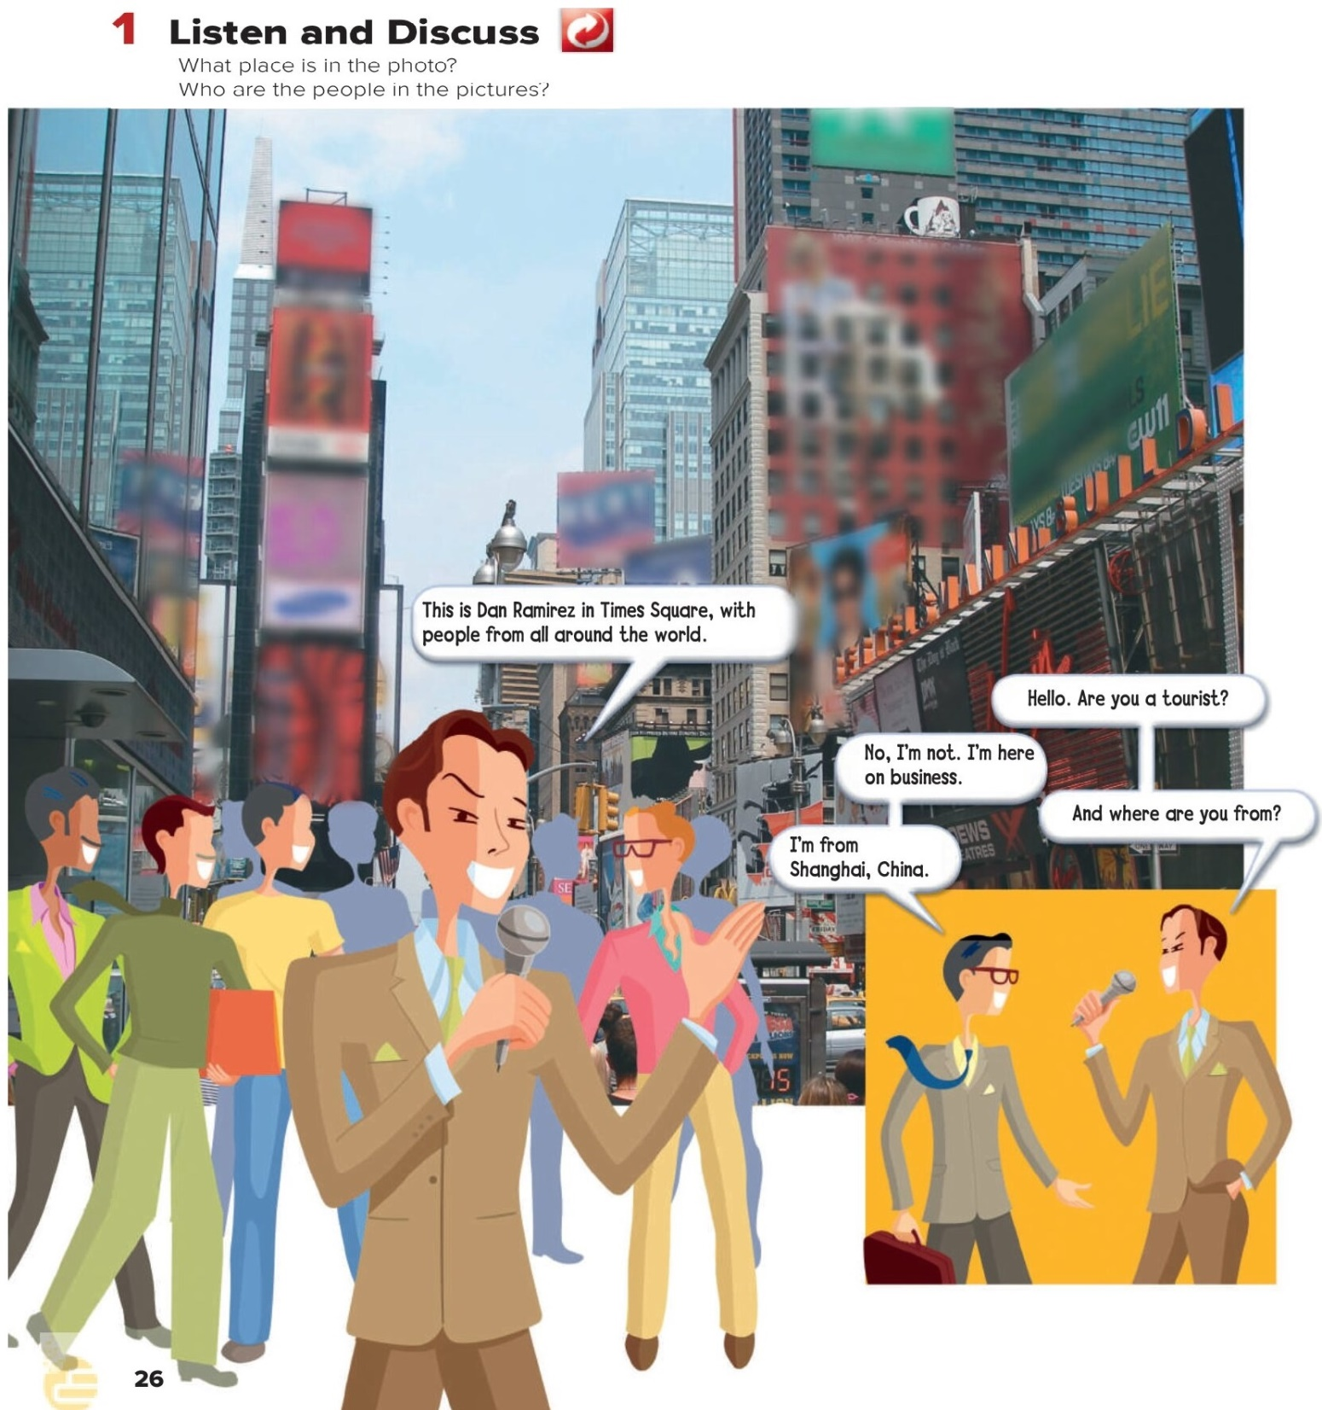

Slide 6
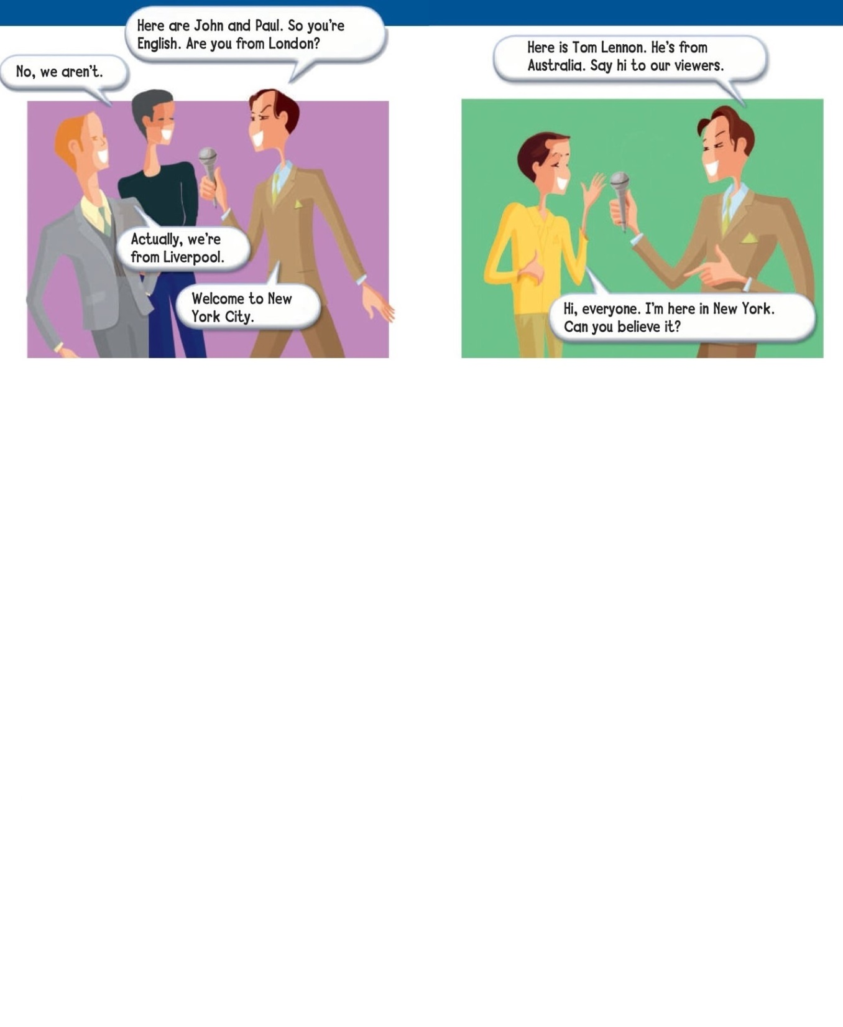
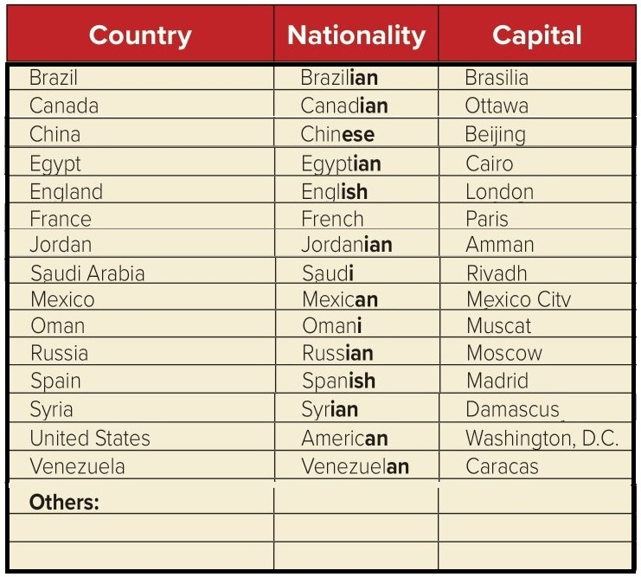

Slide 7
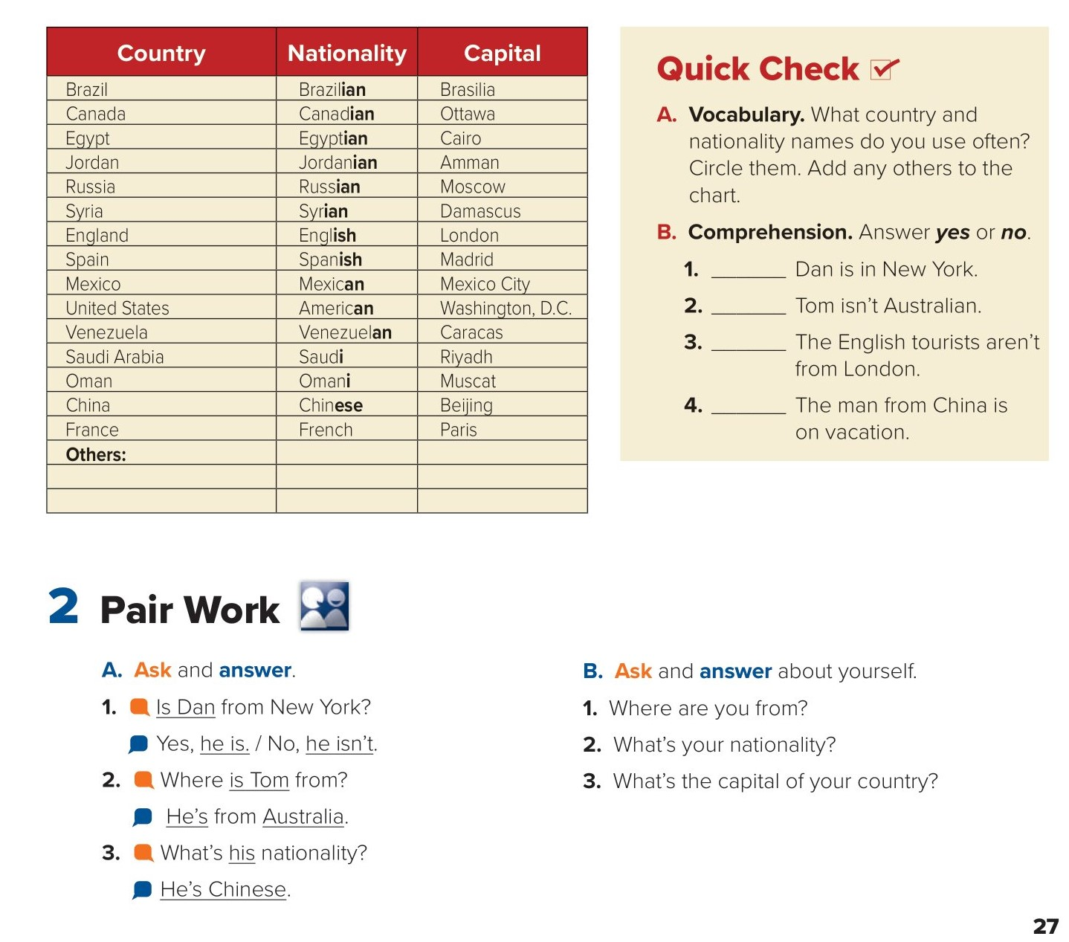
yes
no
is
yes
no
business
Kuwait
Kuwaiti
Kuwait

Slide 8
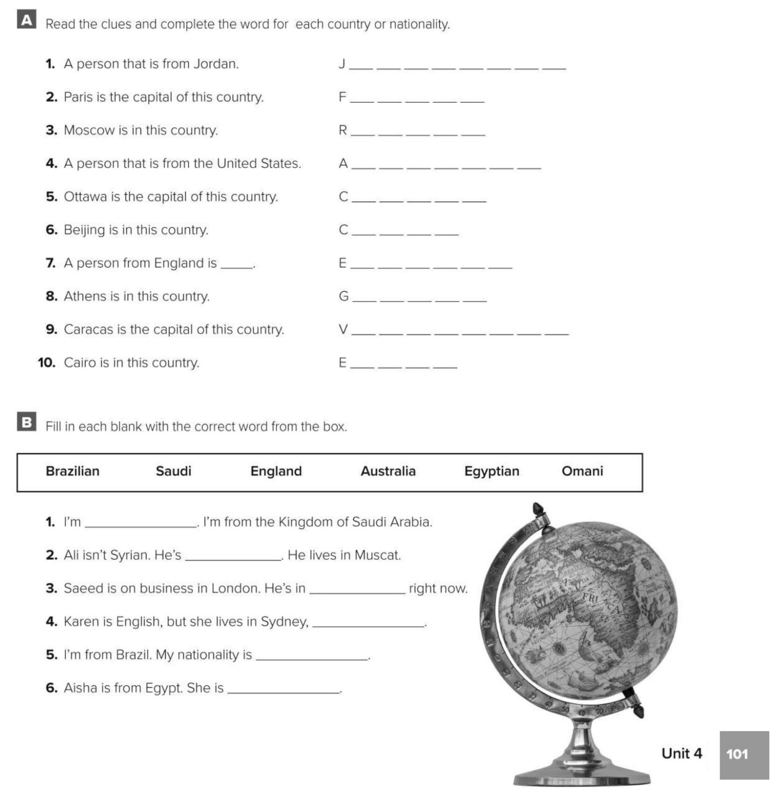
o r d a n i a n
r a n c e
u s s i a
m e r i c a n
a n a d a
h i n a
n g l i s h
r e e c e
e n e z u e l a
g y p t
Saudi
Omani
England
Australia
Brazilian
Egyptian

Slide 9


Choose the correct answer :
1-
He’s from Spain . (He is …… )
Spainian
Spanish
2-
I am from America my nationality is …...
Washington dc
American
Write their nationalities
3-
4-
Mexico
Saudi Arabia
Mexican
Saudi

Slide 10


Slide 11


Back

Slide 12


Back

