Slide 1
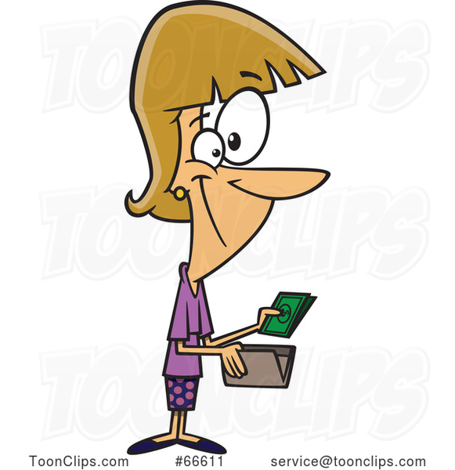
What do I need to buy
Super Goal 5
Unit:4
Lesson:1
Tr: Kholoud AlGhamdi

Slide 2
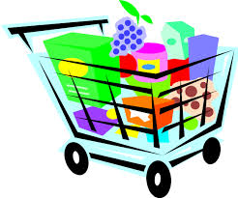
How often do you go to supermarket ?
What do you usually buy?

Slide 3
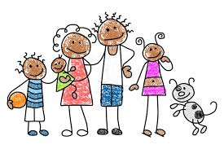

Who buys the food and supplies in your family?
Dad ?
Mom ?

Slide 4
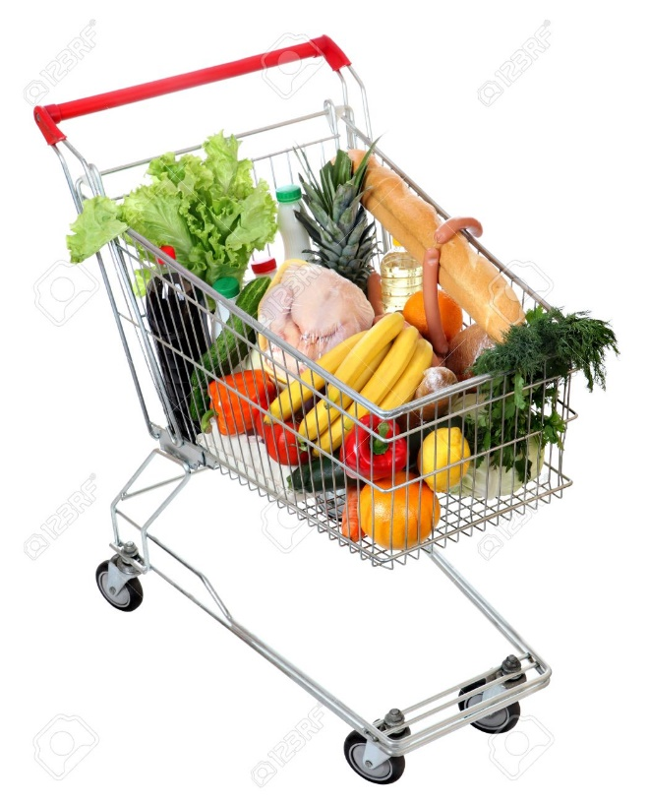
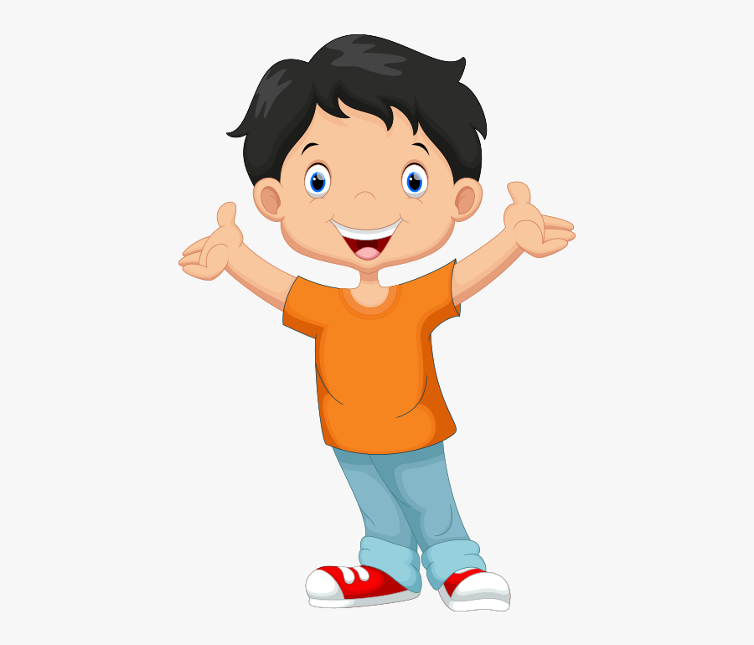
Can you give names of supermarkets you know ?

Slide 5
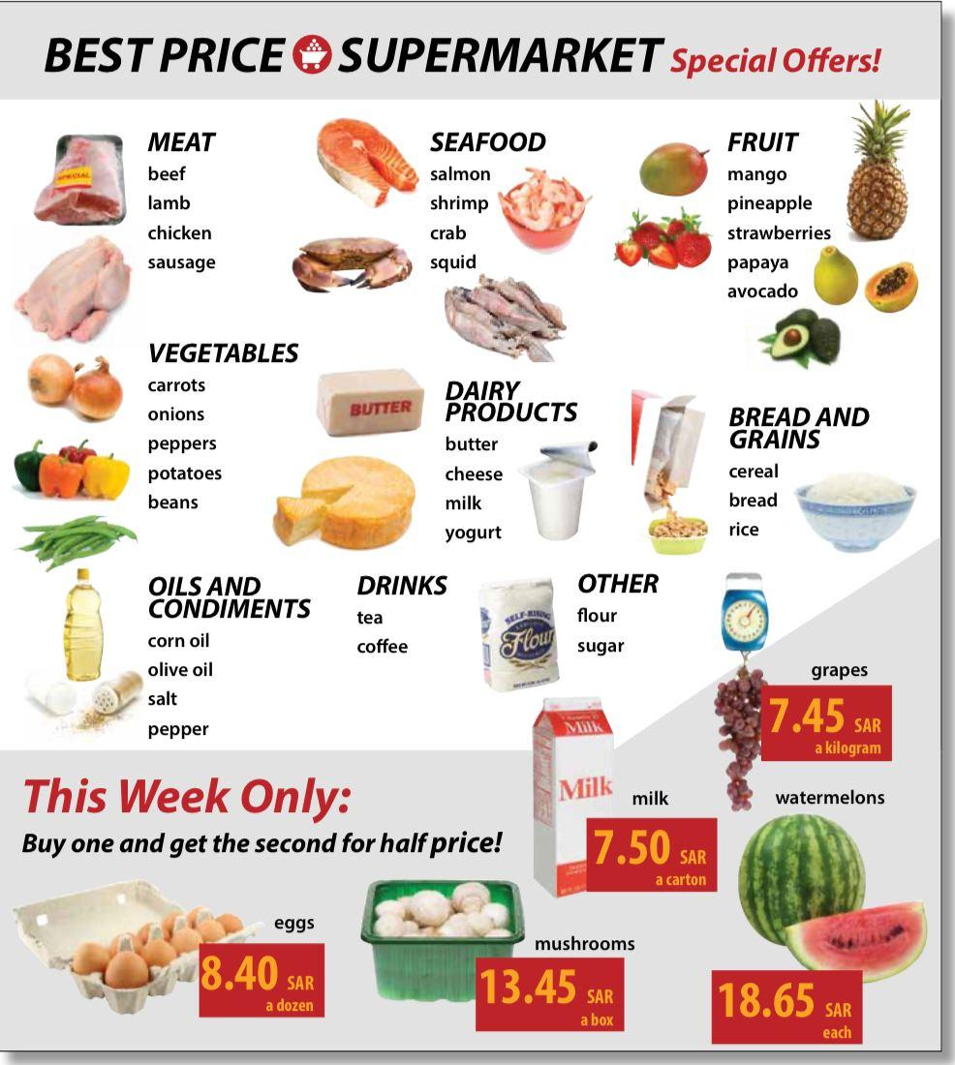
What kind of food do you like ?
What kind of food you don’t like ?
Open your books ,page 38

Slide 6

How much is a box of Mushrooms ?
How much is the watermelon ?
Role play

Slide 7
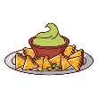
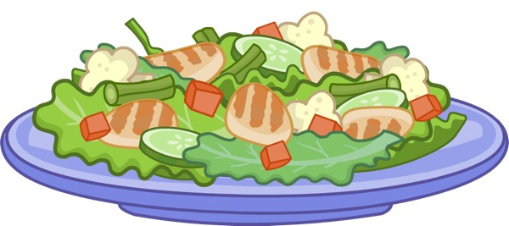
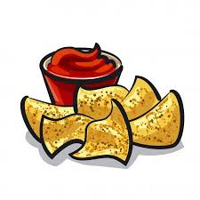
Appetizer

Slide 8
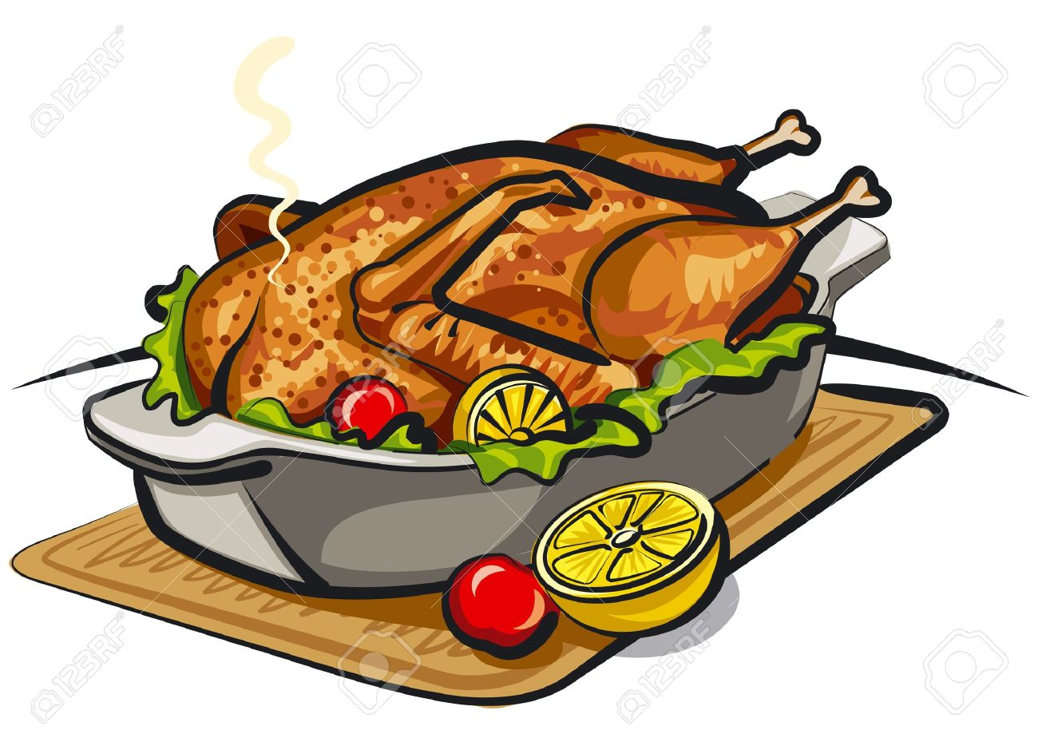
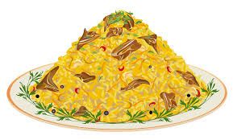
Main dish

Slide 9
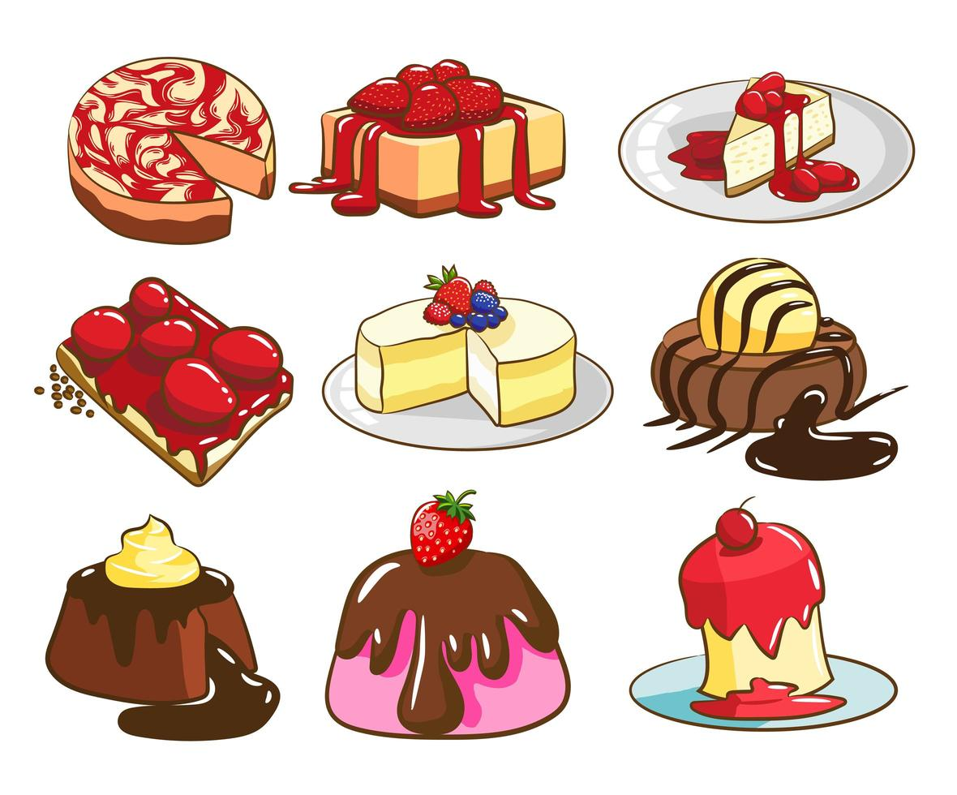
Dessert

Slide 10
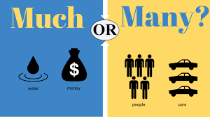
How much rice ?
How many eggs ?

Slide 11
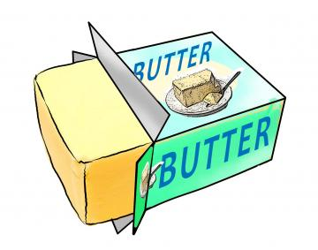
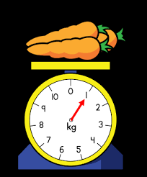
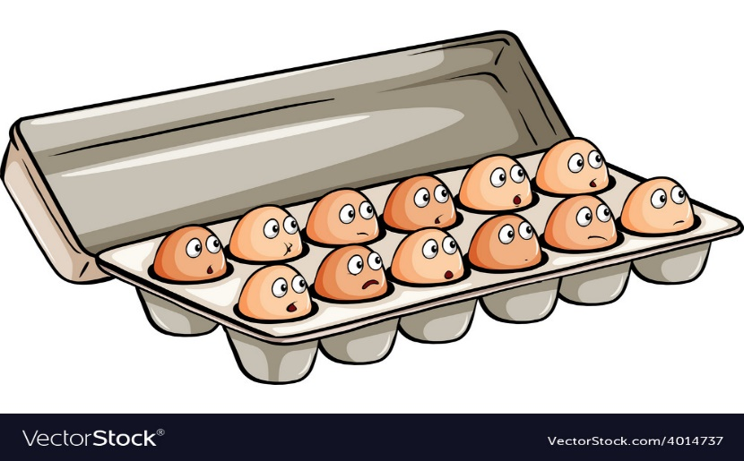

How much and How many :
A package of butter
A dozen of eggs
A Kilogram of Carrot
A bar of chocolate

Slide 12
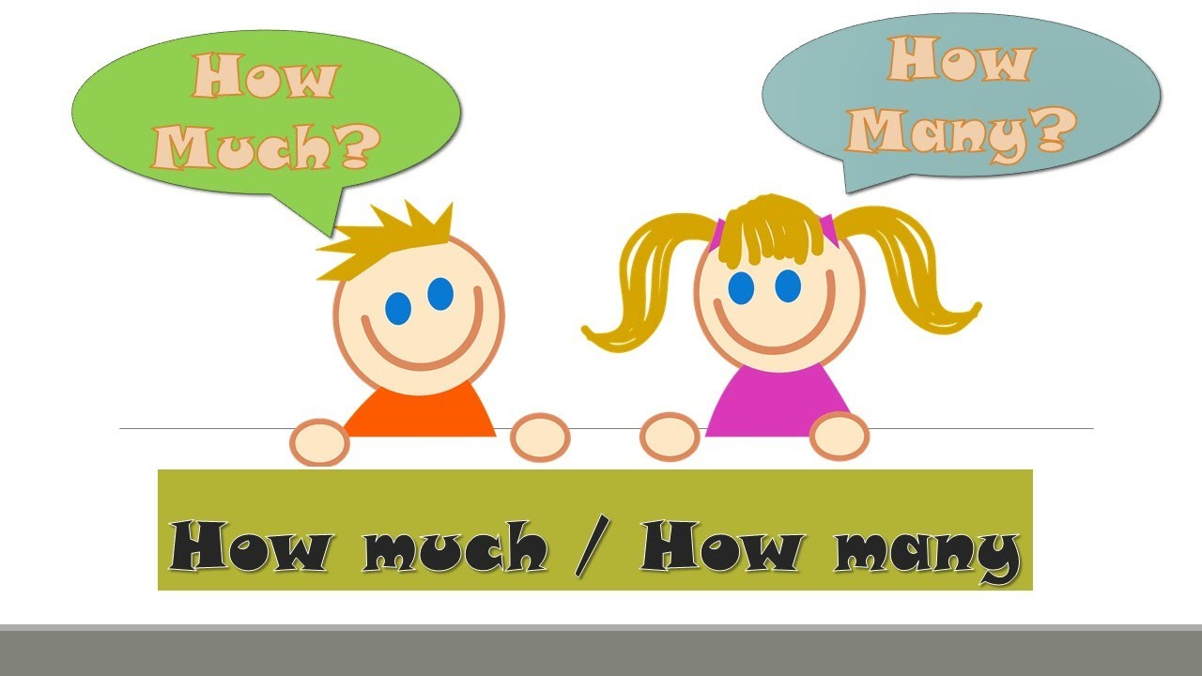
Let’s practice ..
apples
water
Onions
bread
Sugar
Few # many
Little # much
Milk

Slide 13

Have a nice day
Tr : Kholoud AlGhamdi

