Slide 1
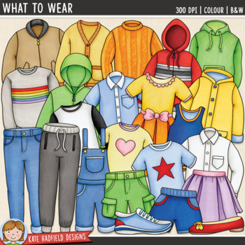


Slide 2
subåject
We can 2
Unit 2
Lesson (2) Talk time
Page (12)
Unit
lesson
lesson
Title
Things we wear
Done: T. Haya B.

Slide 3

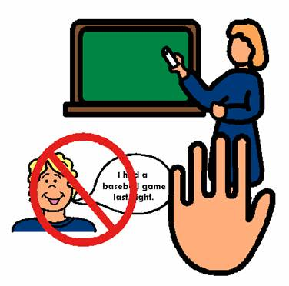



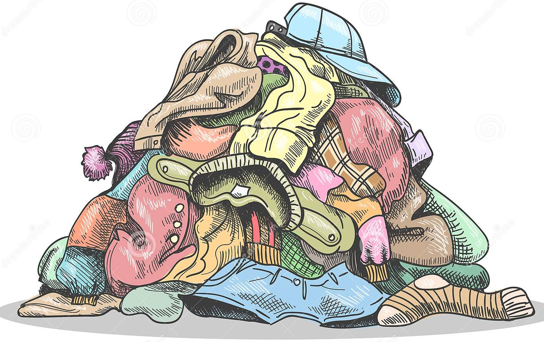

Rules of the
classroom
4- don’t interrupt your teacher or friend
3- raise your hand
2- speak English
1- Be quiet.

Slide 4


Days and dates
What is the day today?
What is the date?

Slide 5
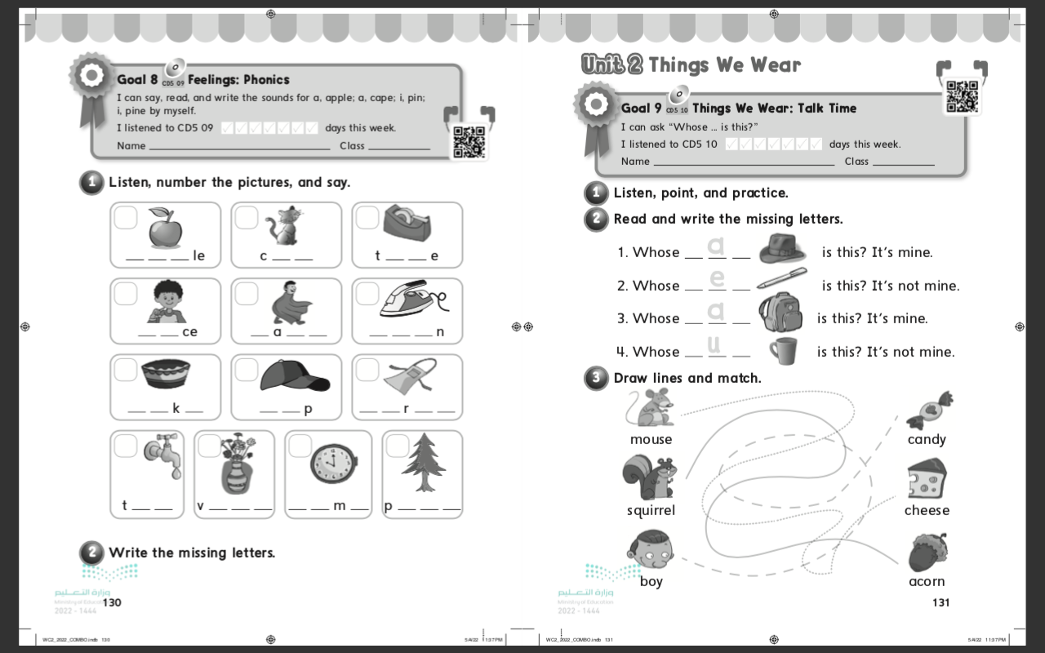
Check homework
Workbook @
130
1

Slide 6

Revision:-
By using colored cards strategy, choose one of these cards and answer
1- Question
o
3- Question
good
Complete
h….t
i / e
Complete
t……m….
2- Question
Read
Pin / pine

Slide 7

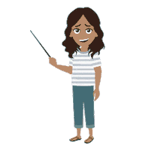
Student’s book @
12
Open page 12

Slide 8
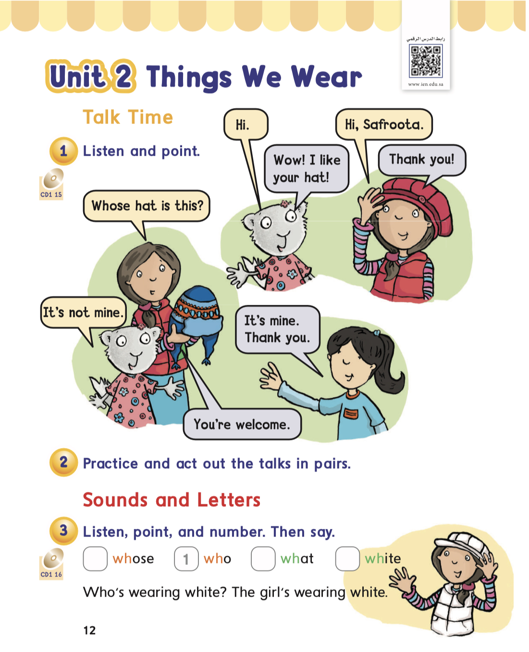
Student’s book @
12

Slide 9

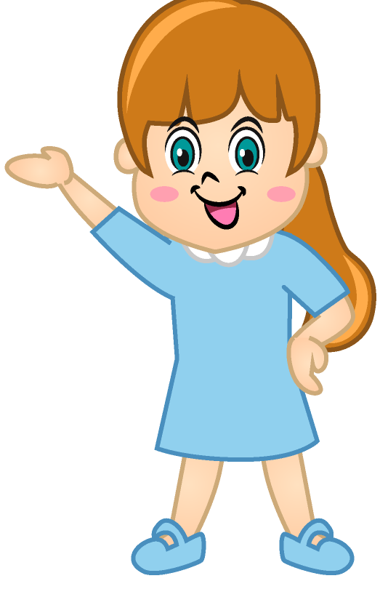
objectives
At the end of the lesson:
* I can ask whose ….. Is this?.
* I can meet someone and say, ‘ I like your ….’.

Slide 10

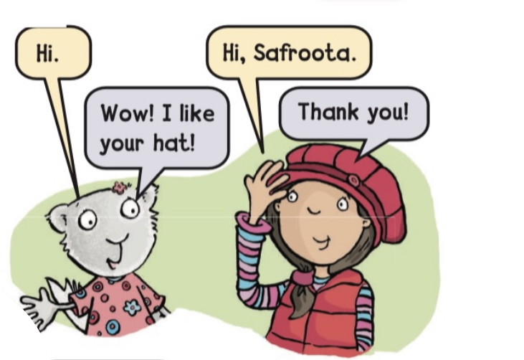

Student’s book @
Listen and point
12

Slide 11
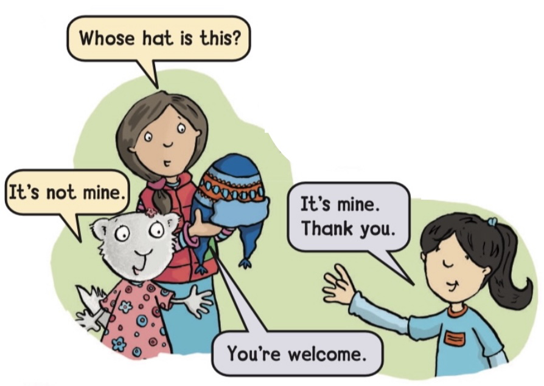
Student’s book @
Listen and point
12

Slide 12

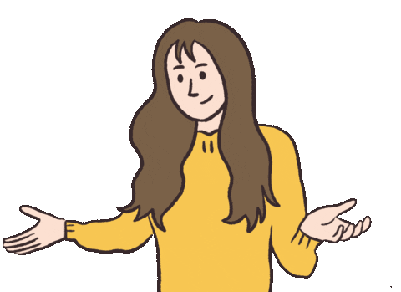
Student’s book @
2
Practice the talks in pairs
12

Slide 13

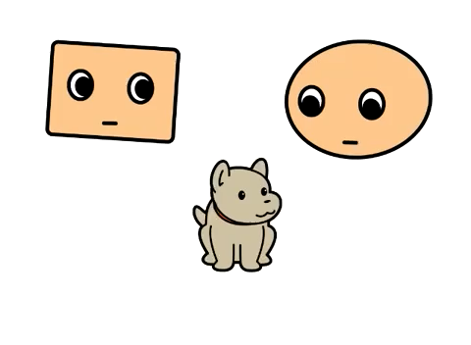
Watch and listen

Slide 14


Whose Question:
I like this cat

Slide 15

Whose Question:
Q - Whose
Cat is this?

Slide 16

Whose Question:
Q – it’s
mine

Slide 17
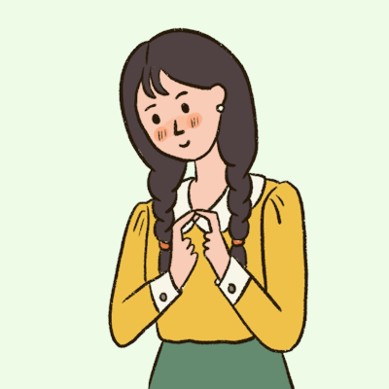


Whose Question:
By using cooperative learning strategy ,make question and then answer

Slide 18


Whose Question:
By using cooperative learning strategy ,make question and then answer

Slide 19

Whose Question:
By using cooperative learning strategy ,make question and then answer

Slide 20
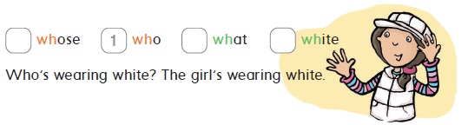
Student’s book @
3
Listen, point, and number. Then say
12

Slide 21



الآية: ﴿ يَا بَنِي آدَمَ قَدْ أَنْزَلْنَا عَلَيْكُمْ لِبَاسًا يُوَارِي سَوْآتِكُمْ وَرِيشًا وَلِبَاسُ التَّقْوَى ذَلِكَ خَيْرٌ ذَلِكَ مِنْ آيَاتِ اللَّهِ لَعَلَّهُمْ يَذَّكَّرُونَ ﴾.
♦ السورة ورقم الآية: الأعراف (26).

Slide 22

Can you guess?

Slide 23

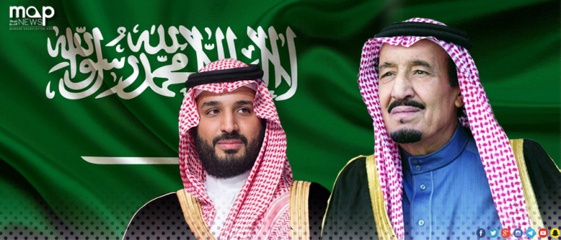
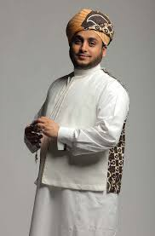
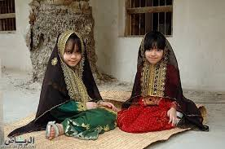
Patriotic aim
Whose cloth is this?
Alhejaz
Riyadh

Slide 24
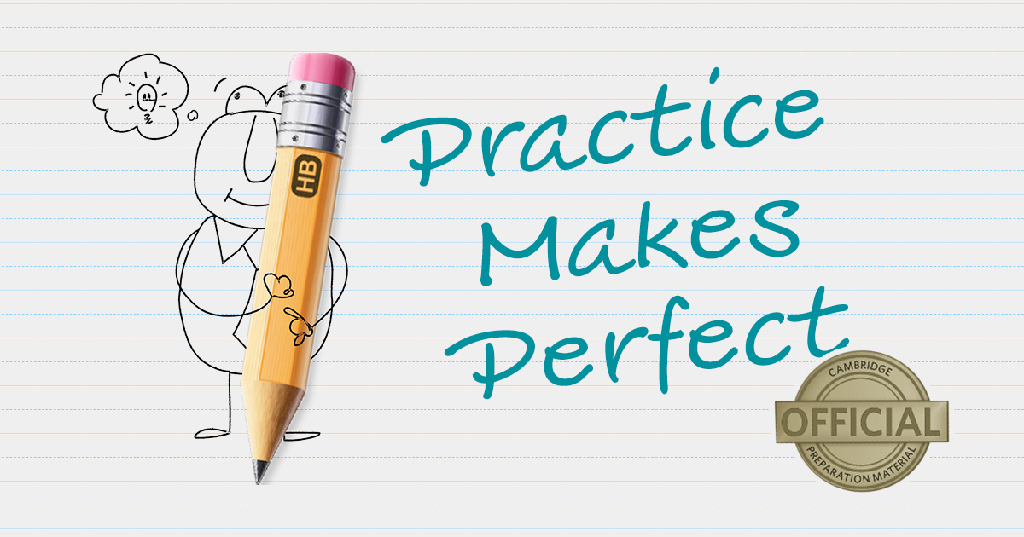

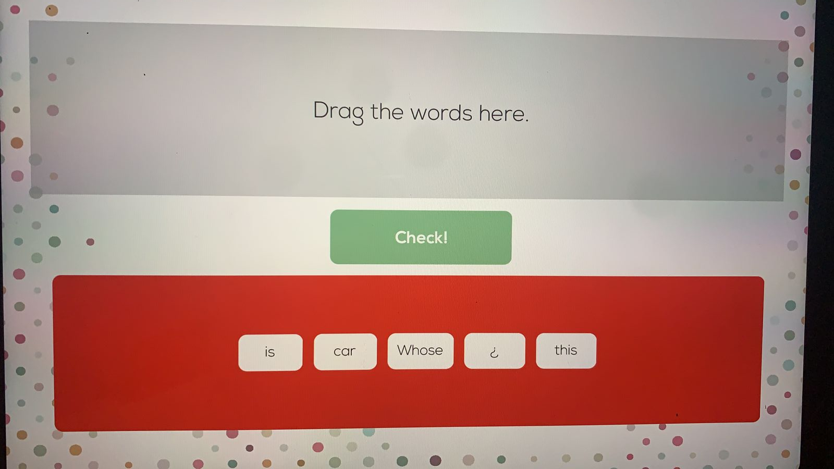
Worksheet

Slide 25

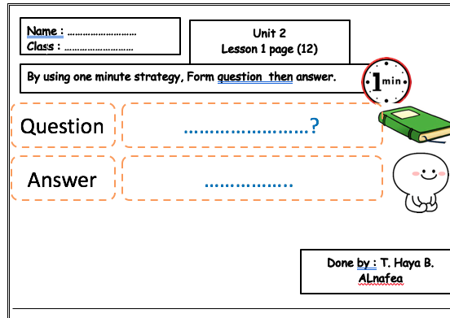
Worksheet
By using cooperative learning strategy, answer the worksheet

Slide 26
homework
Work book @
131
2+3

Slide 27


