Slide 1
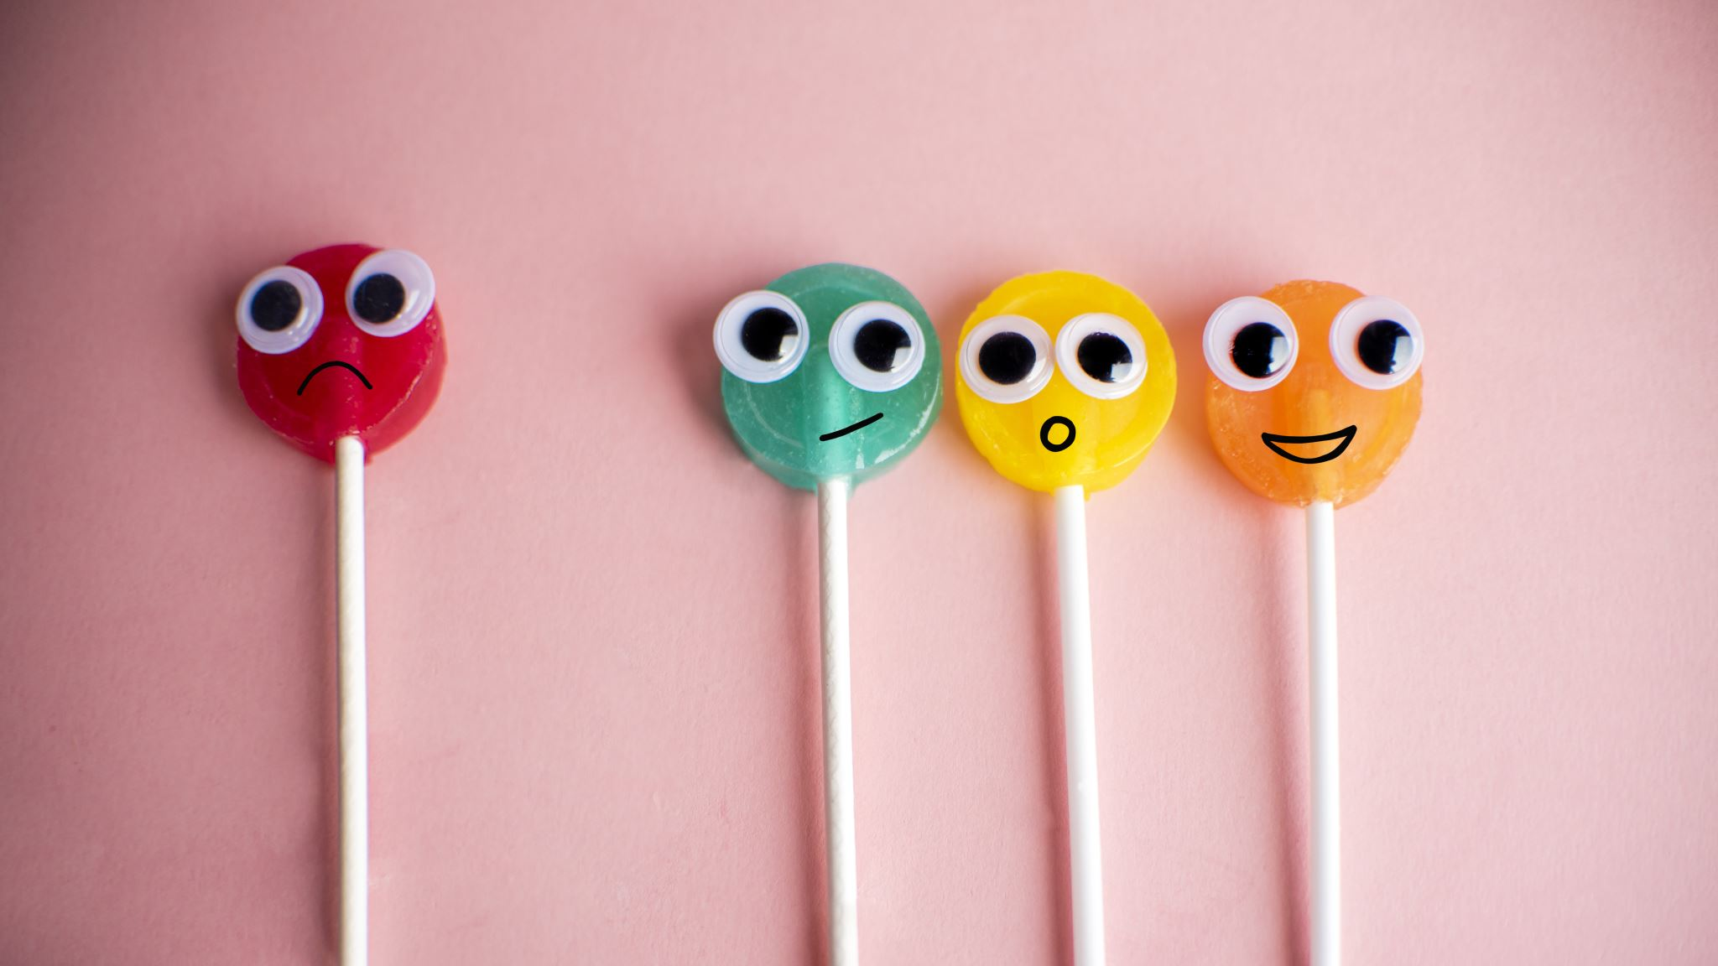
Things we wear

Slide 2
objectives
Say “ I like your….”
Ask “ whose …..is this?
Name some clothes.
Use whose, who ,what and white

Slide 3
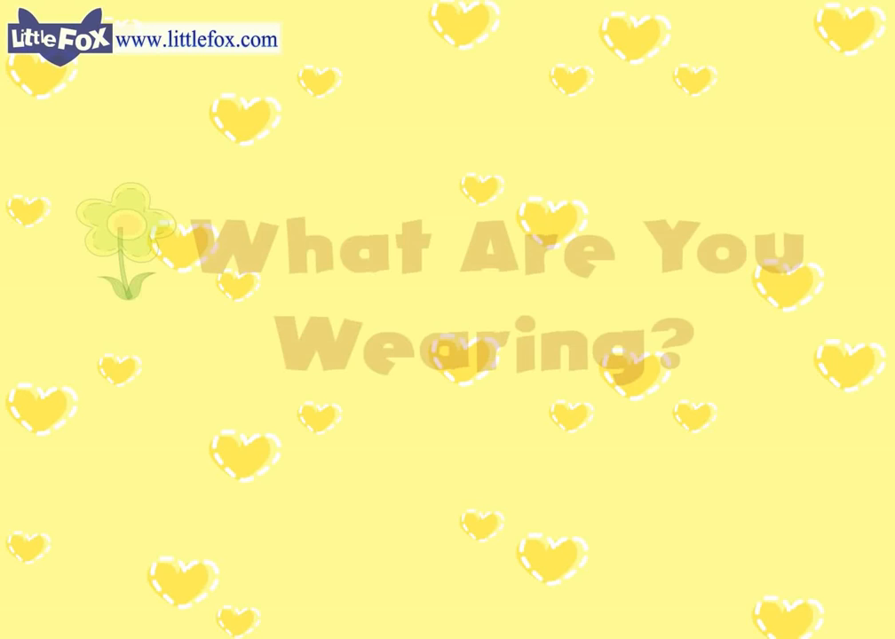
Watch and answer”

Slide 4
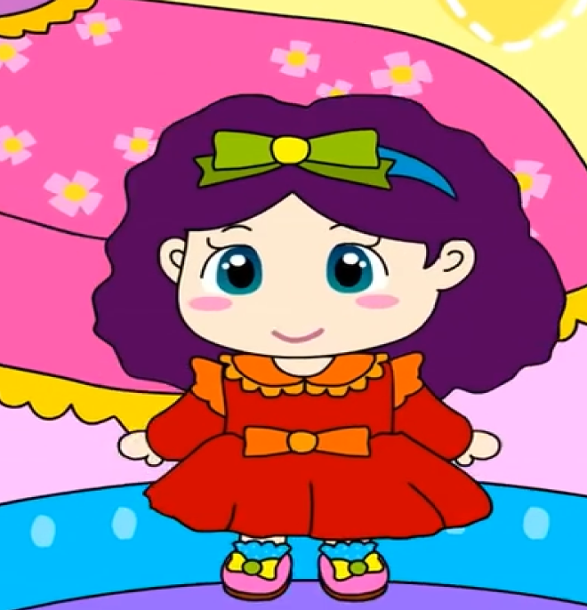

Tick ✅ the correct answer

Slide 5
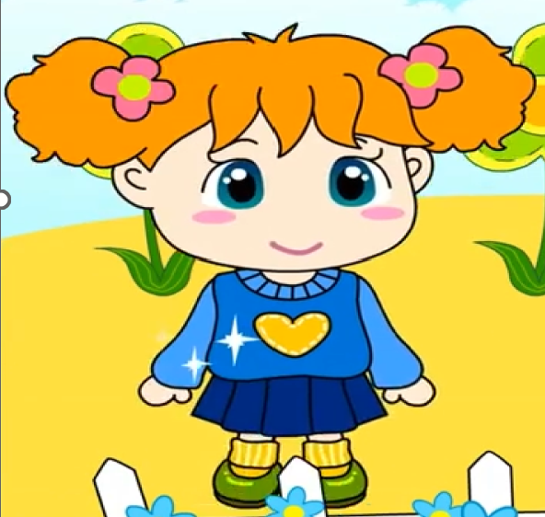
Tick ✅ the correct answer

Slide 6
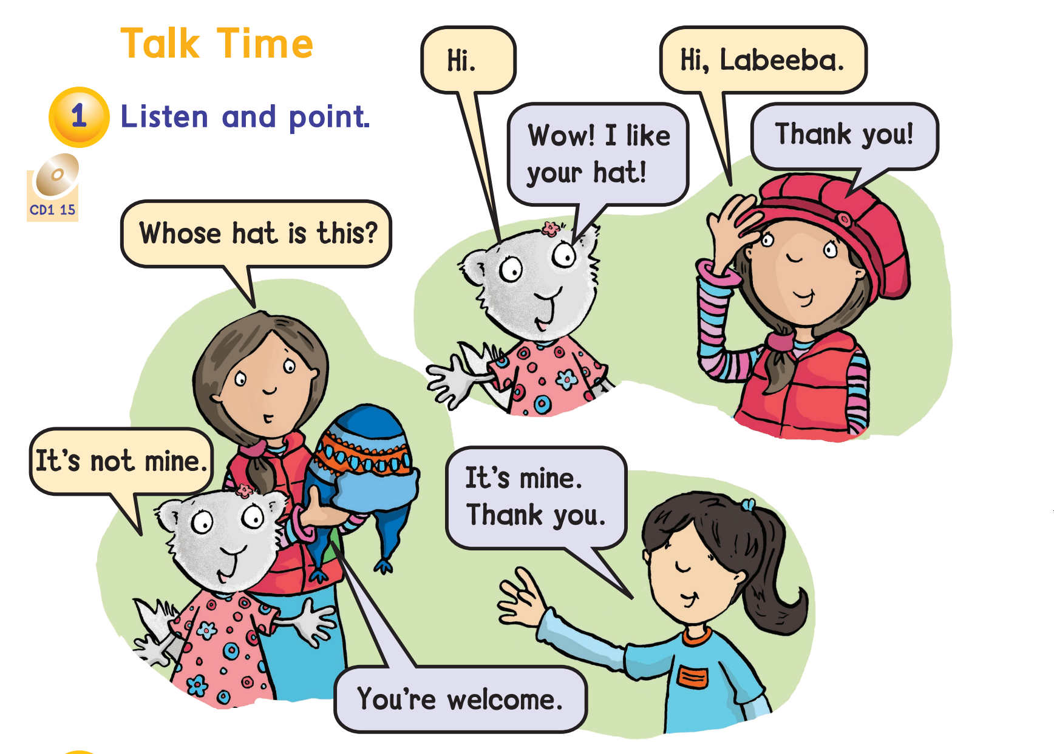


Slide 7

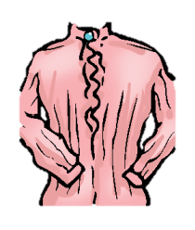

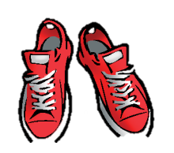
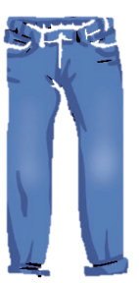

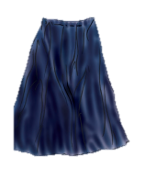

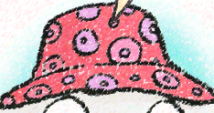


Make a sentence
I like your ………
shoes
jeans
pen
hat
cap
dress
T-shirt
bag
skirt

Slide 8
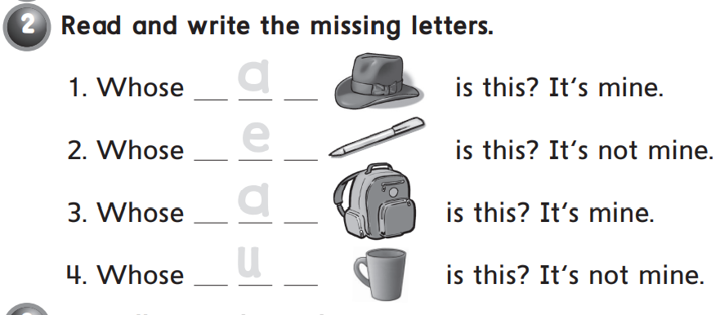

Slide 9
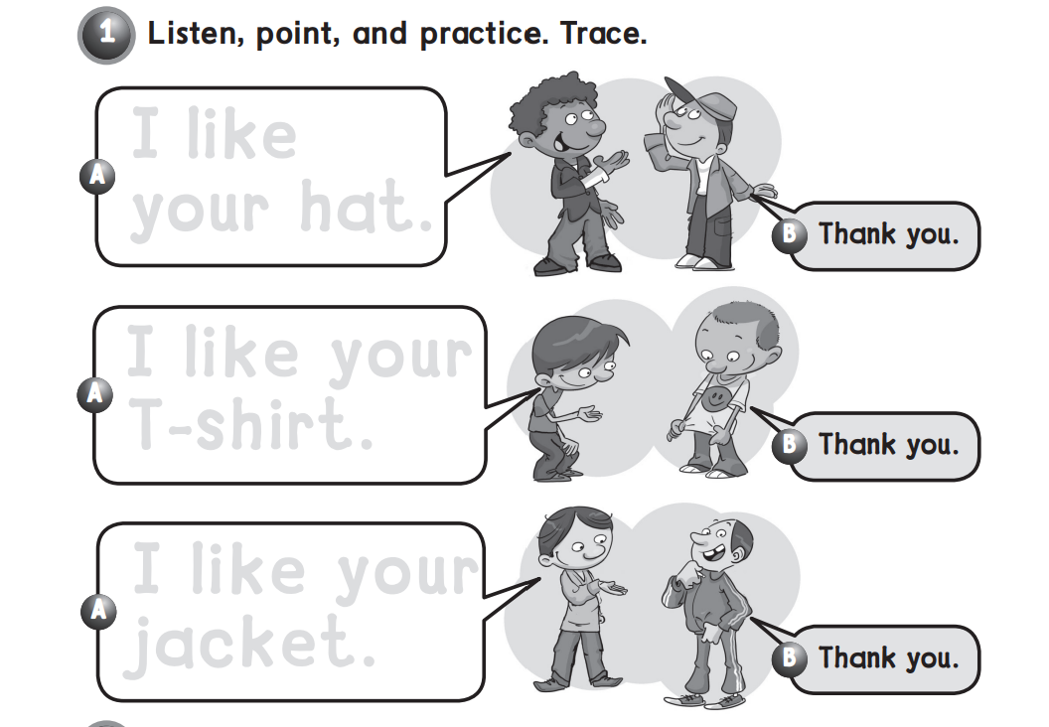

Slide 10
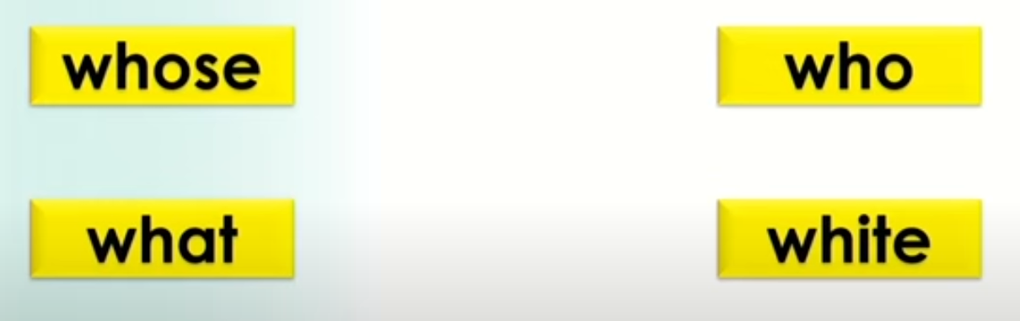
Let’s read and notice 👂👄

Slide 11
Read and tick the silent w

Slide 12
Read and circle the w sound

Slide 13
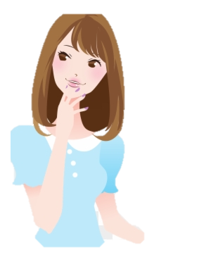

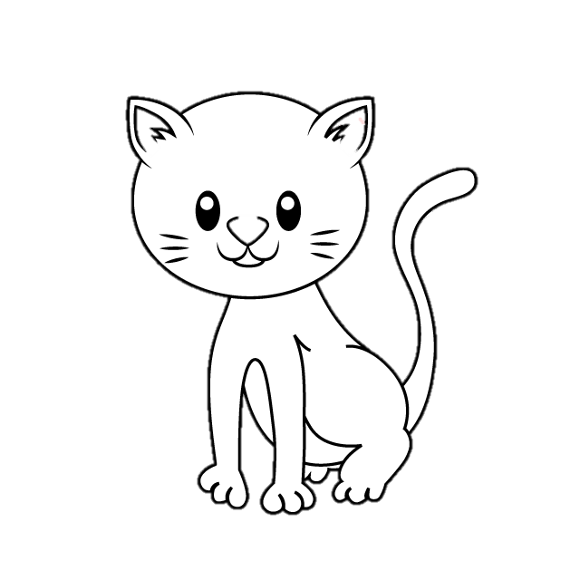

Whose
Who
Whose hat is this?
Who’s this girl ?
white
what
What is this ?

Slide 14

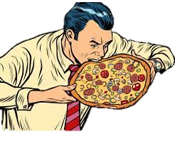
Choose the correct answer
(Whose – who’s )hat is this?
(Whose – who’s ) this girl ?
(Whose – who’s )dress is this?
(Whose - Who) eats my pizza?

Slide 15

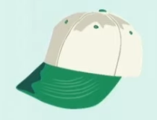
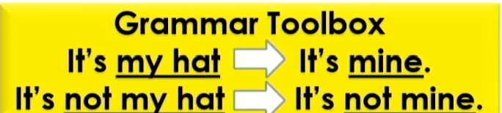

Slide 16
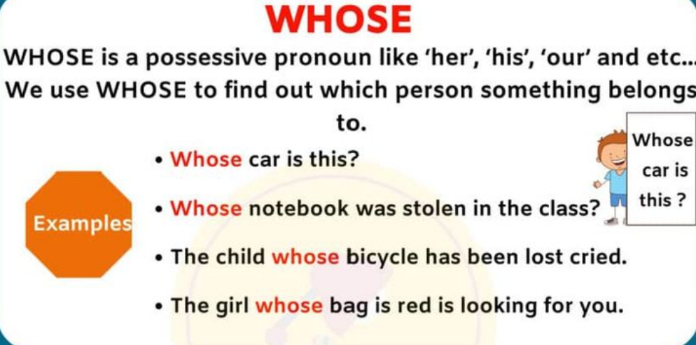
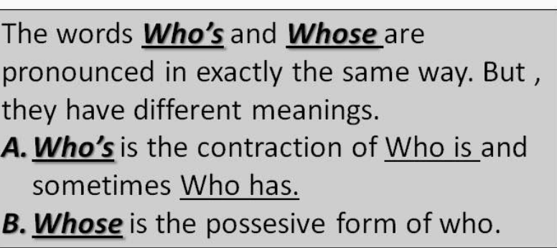
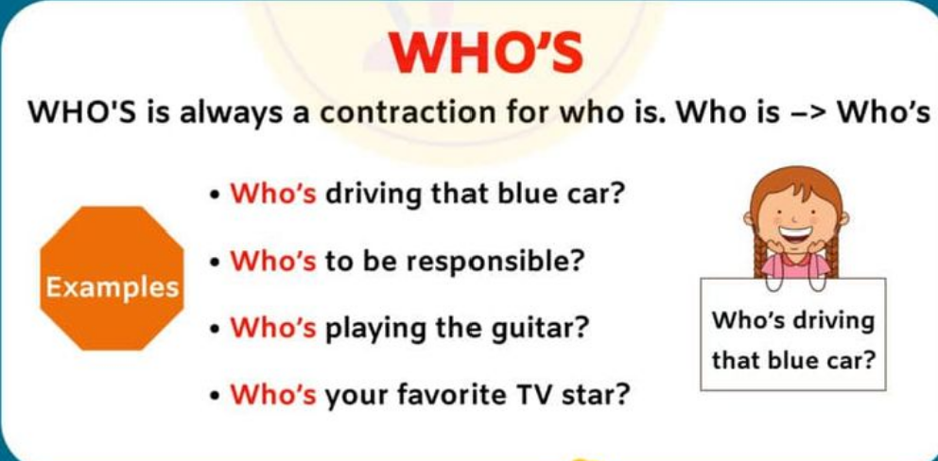
Things
Person

Slide 17
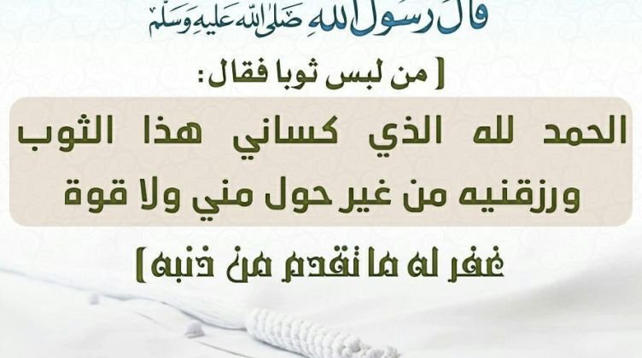

Slide 18
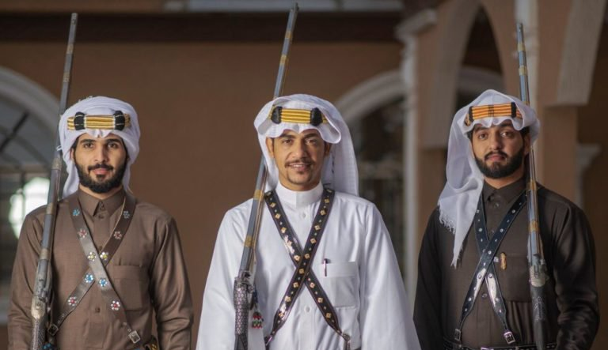
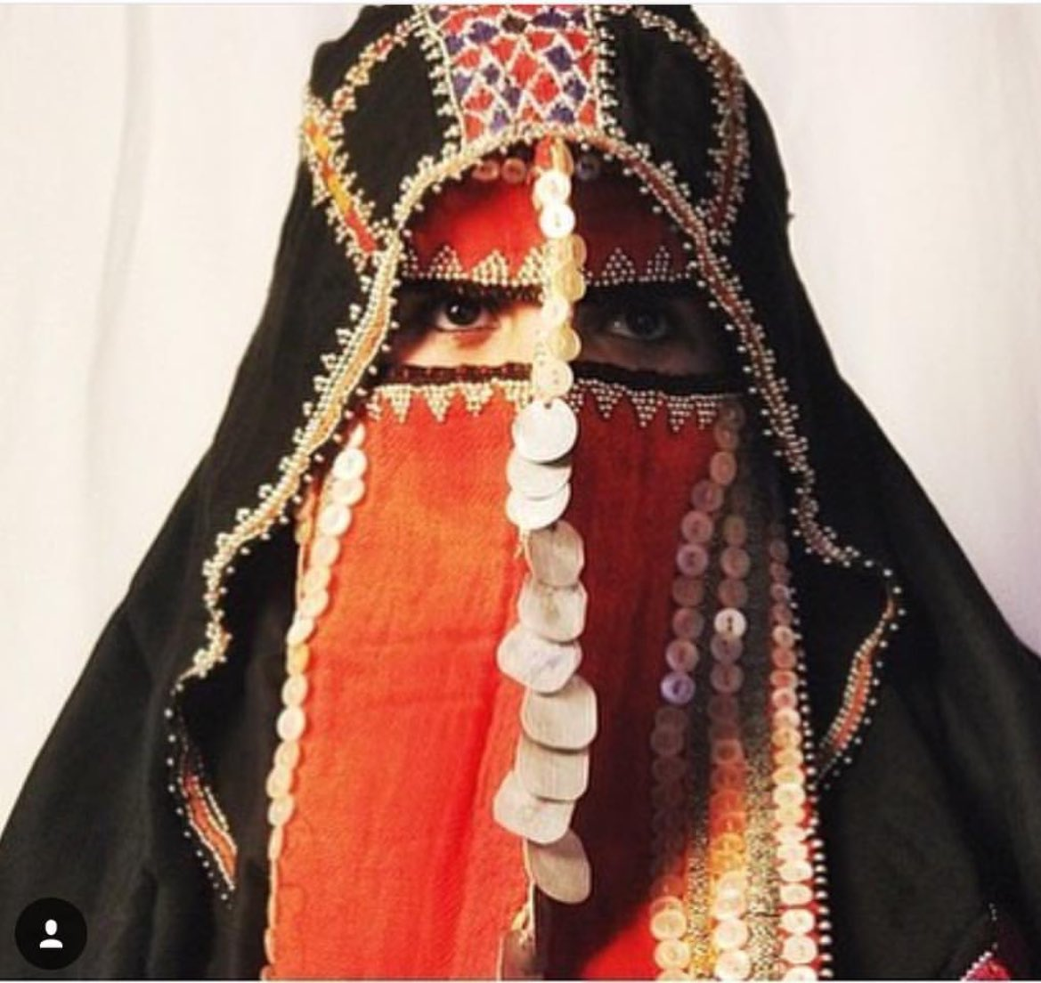
Our traditional customs in
AL HIJAZ

Slide 19

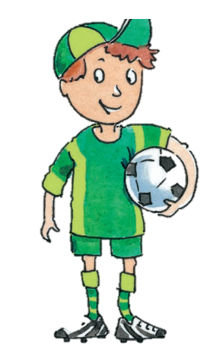
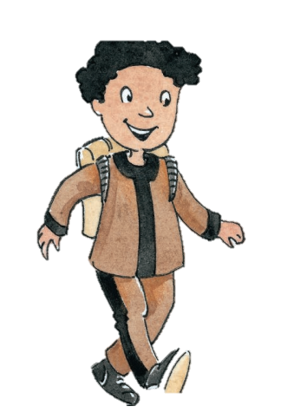
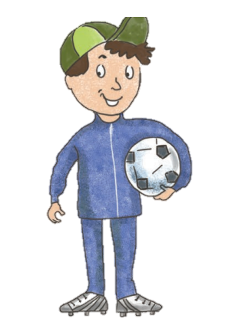

Slide 20
Revision
https://wordwall.net/play/35826/349/594
Spell :
W-h-o-s-e

Slide 21
Objectives:
Chant who is wearing green.
Say three color that I’M wearing today
Write letters
A – B – C

Slide 22
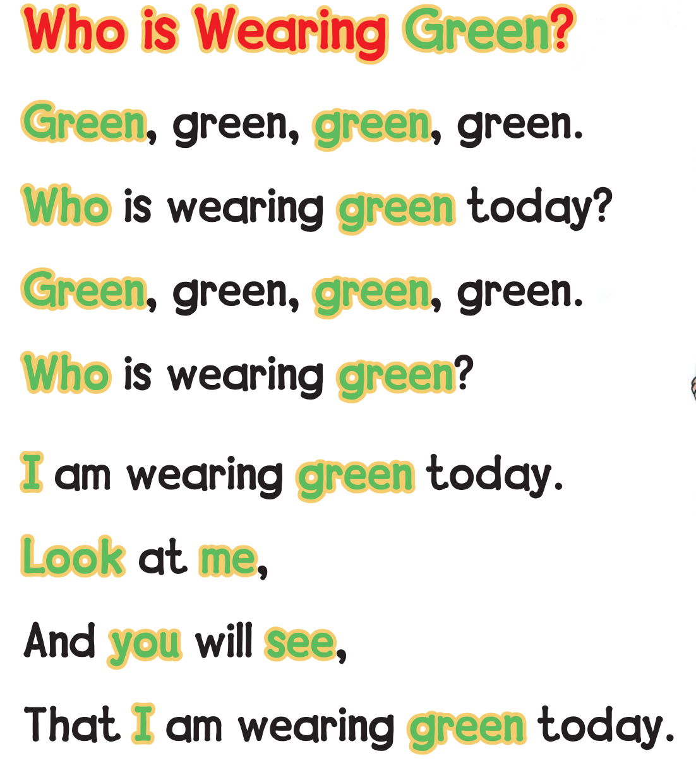

Slide 23
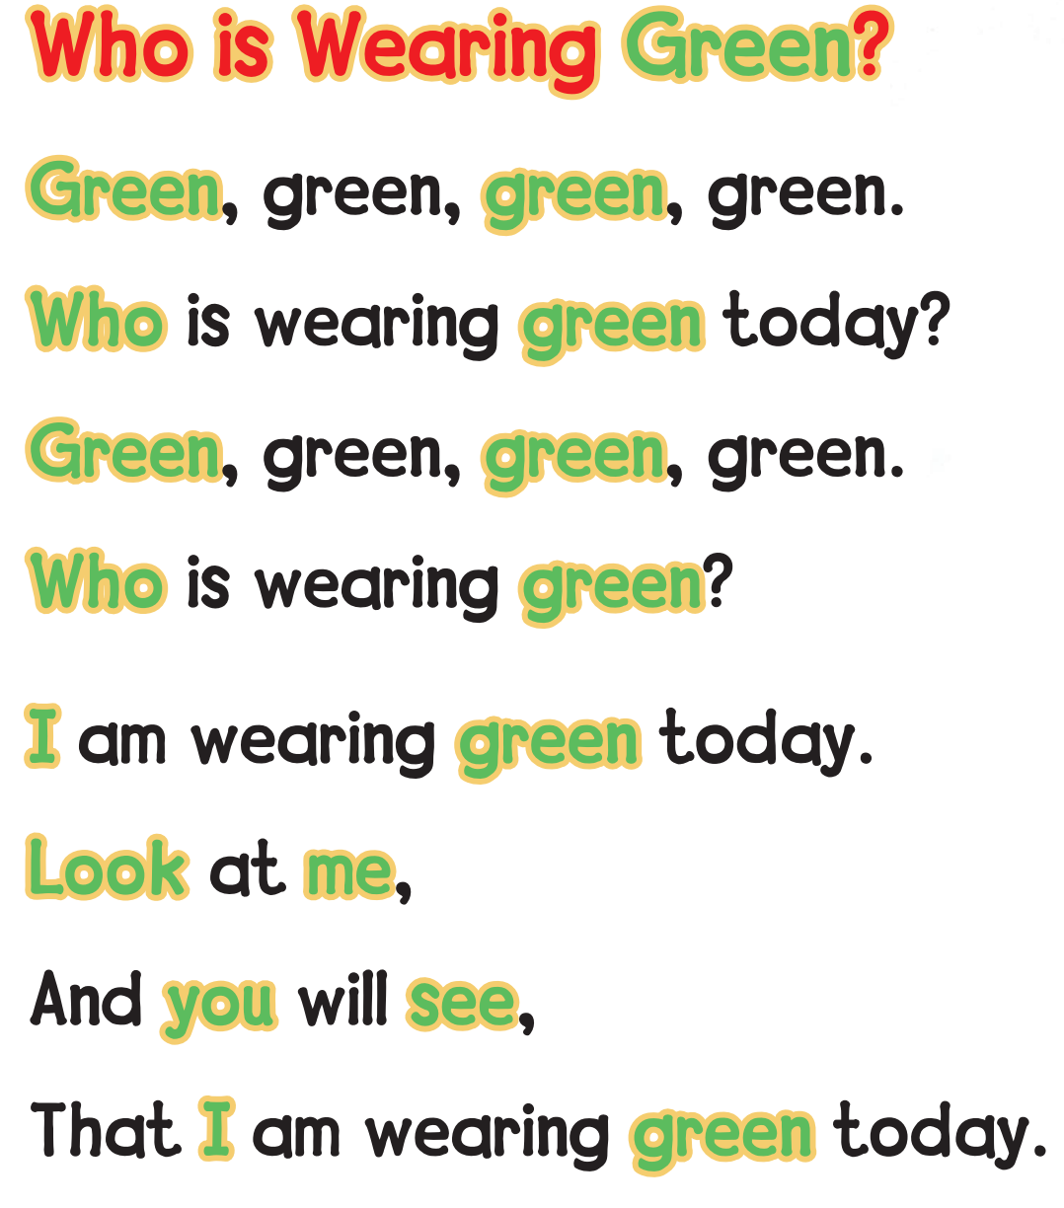
Brown ?
Brown
brown
brown
brown
who
brown
Brown
brown
who
brown
I
brown
look
me
you
see
I
brown

Slide 24
Blue
Blue
blue
blue
blue
who
Blue
Blue
blue
who
blue
I
blue
look
me
you
see
I
blue

Slide 25

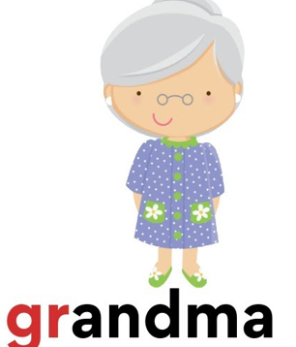
gr

Slide 26


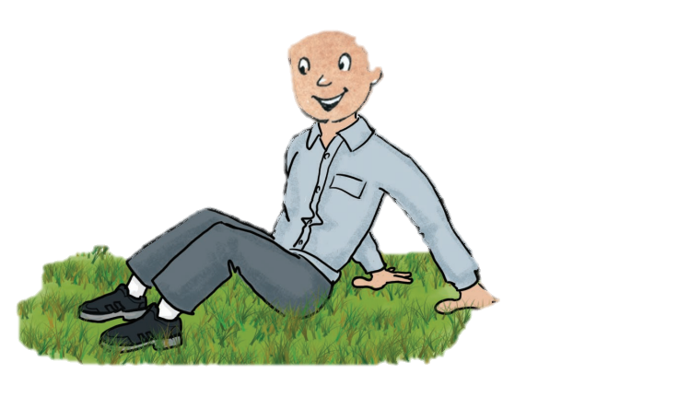
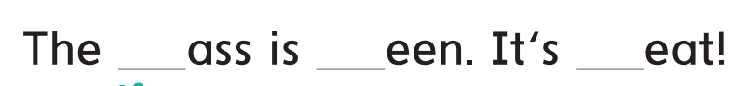
gr
gr
gr
gr

Slide 27
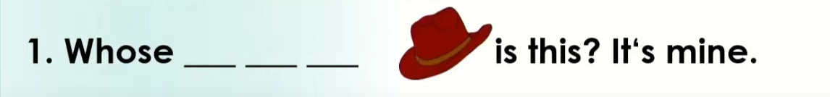
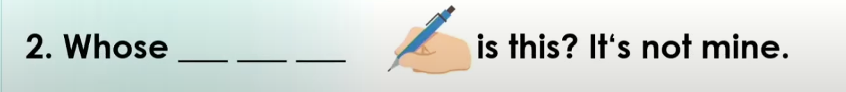
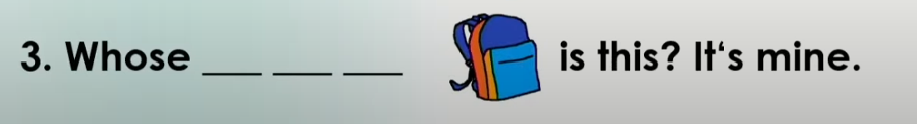
Read and write the missing words
h
a
t
p
e
n
b
a
g

Slide 28
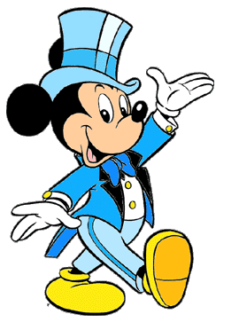
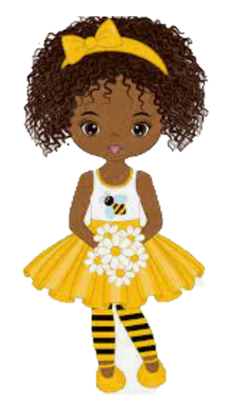
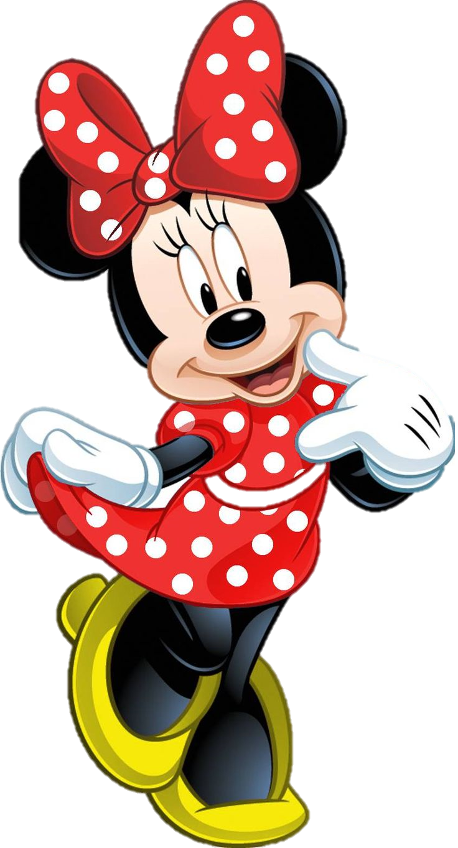
Who’s wearing red ?
LoLo
Minnie
mickey

Slide 29
Who’s wearing yellow?
LoLo
Minnie
mickey

Slide 30
Who’s wearing blue ?
mickey
LoLo
Minnie

Slide 31
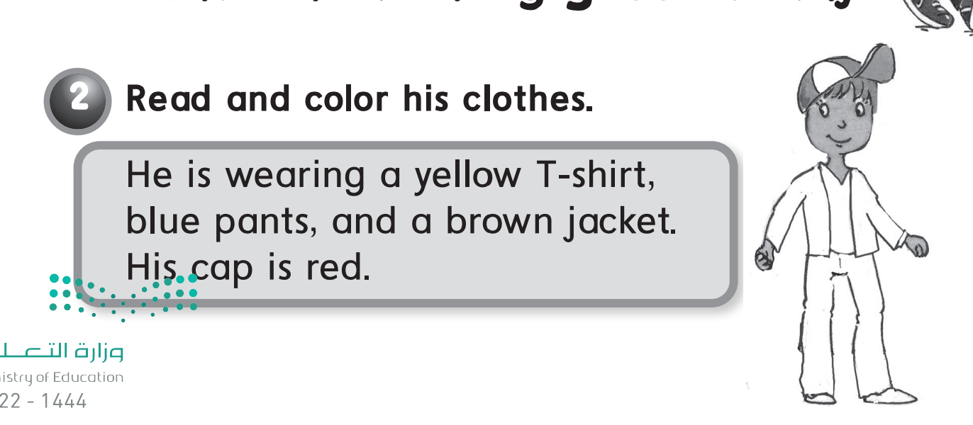




Open your book :55

Slide 32
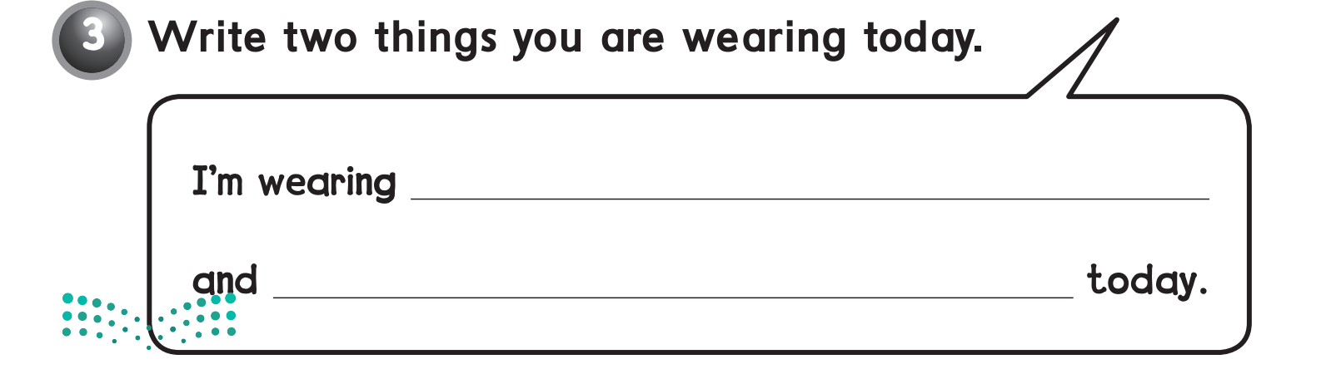
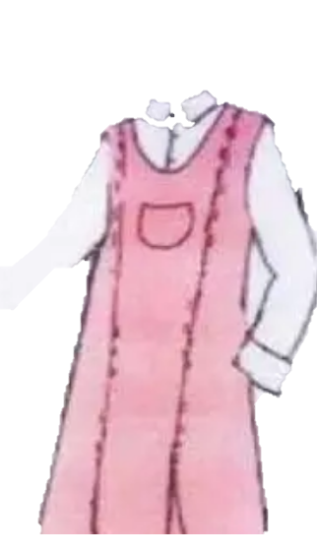
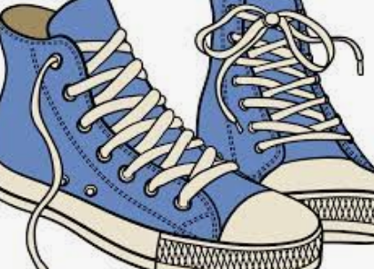
Open your book :56

Slide 33
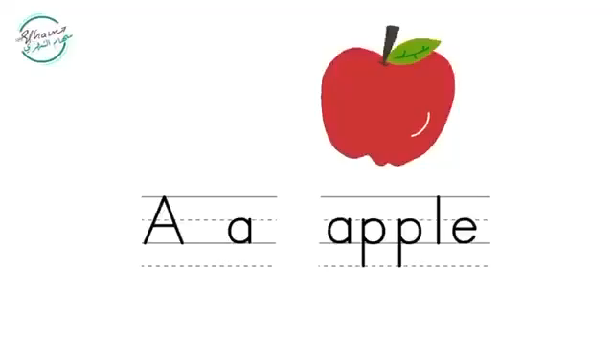
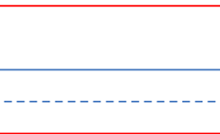

Slide 35
Homework ;
56 / 1 - 2

Slide 36

classify the clothes according to the girl/ boy
list as much clothes as you can
play touch the screen game

Slide 37
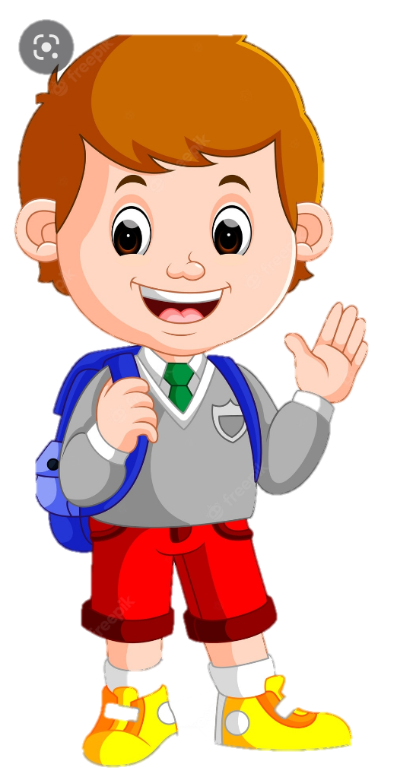
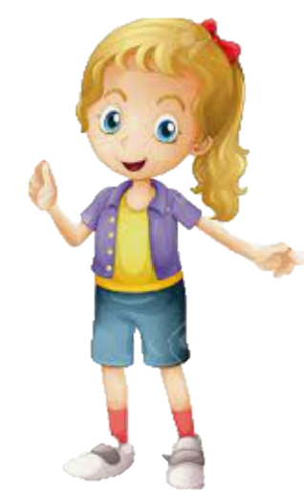
How many person in the picture
2

Slide 38

point to the BOY

Slide 39
point to the GIRL

Slide 40
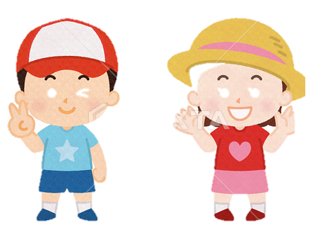
cross the different between them

Slide 41
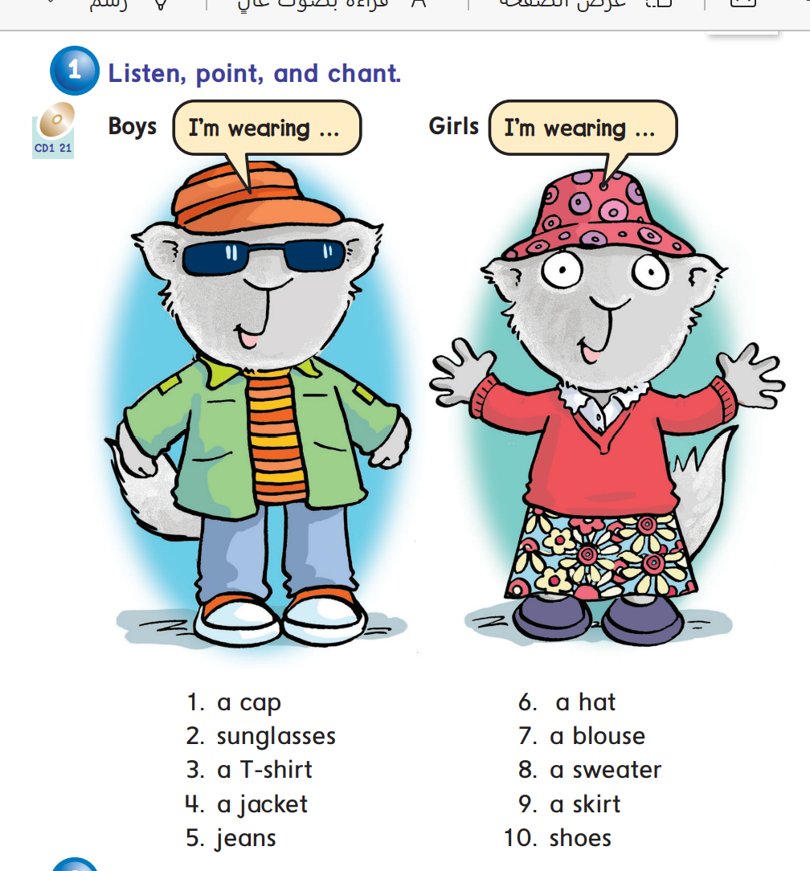

Slide 42
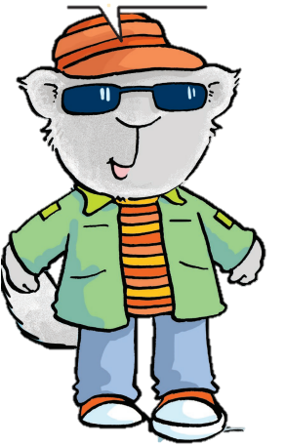
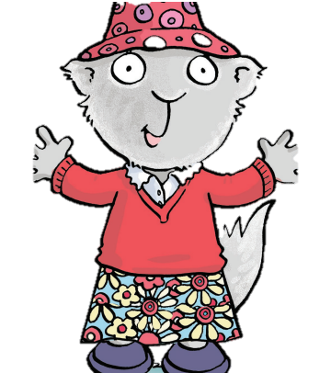
hat | Cap
blouse | T-shirt
dress | jeans
skirt | glass
sandals | shoes
She
girl
He
boy
classifying

Slide 43

Listen and circle

Slide 44



Slide 45

Open your
Workbook
and write

Slide 46

PHONICS

Slide 47
objectives
differentiate between voiced and unvoiced letters
supply the missing letters
list words pronounced in the same way

Slide 48
Fill in the missing letters

Slide 49
Fill in the missing letters

Slide 50



Slide 51


Slide 52




Panda
Parrot
Pear
Palette

Slide 53



Banana
Bed
Bear

Slide 54

Panda
Banana
Parrot
Bed
Pear
Bear
Palette

Slide 55

Pl & bl

Slide 56
Open your workbook

Slide 57


Slide 58

Fill in he missing sound

Slide 59

Write in your notebook

Slide 60


