Slide 1
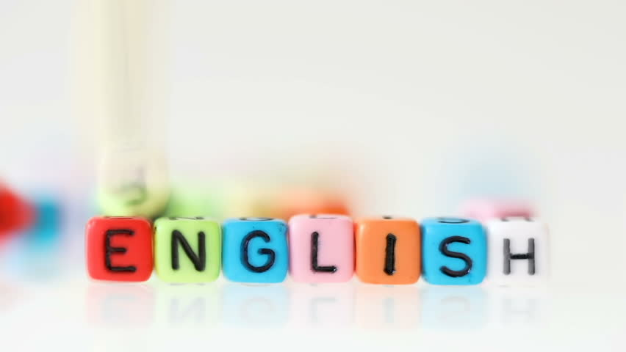
Super goal 5
Unit 3
Lesson 4 conversation
اعداد المعلم / يحيى المنقري متوسطة المأمون بالهفوف

Slide 2

Learning Objectives
*By the end of this lesson, Ss will be able to:
1- Use the "real talk" in new sentences.
2- Listen for specific information in a conversation between travelers .

Slide 3
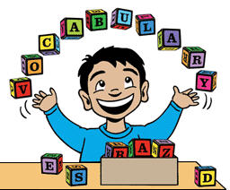

Slide 4

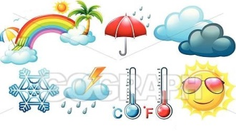
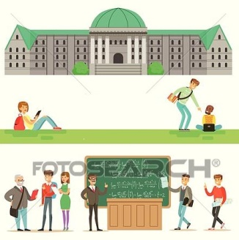


Conference
Climate
University

Slide 5
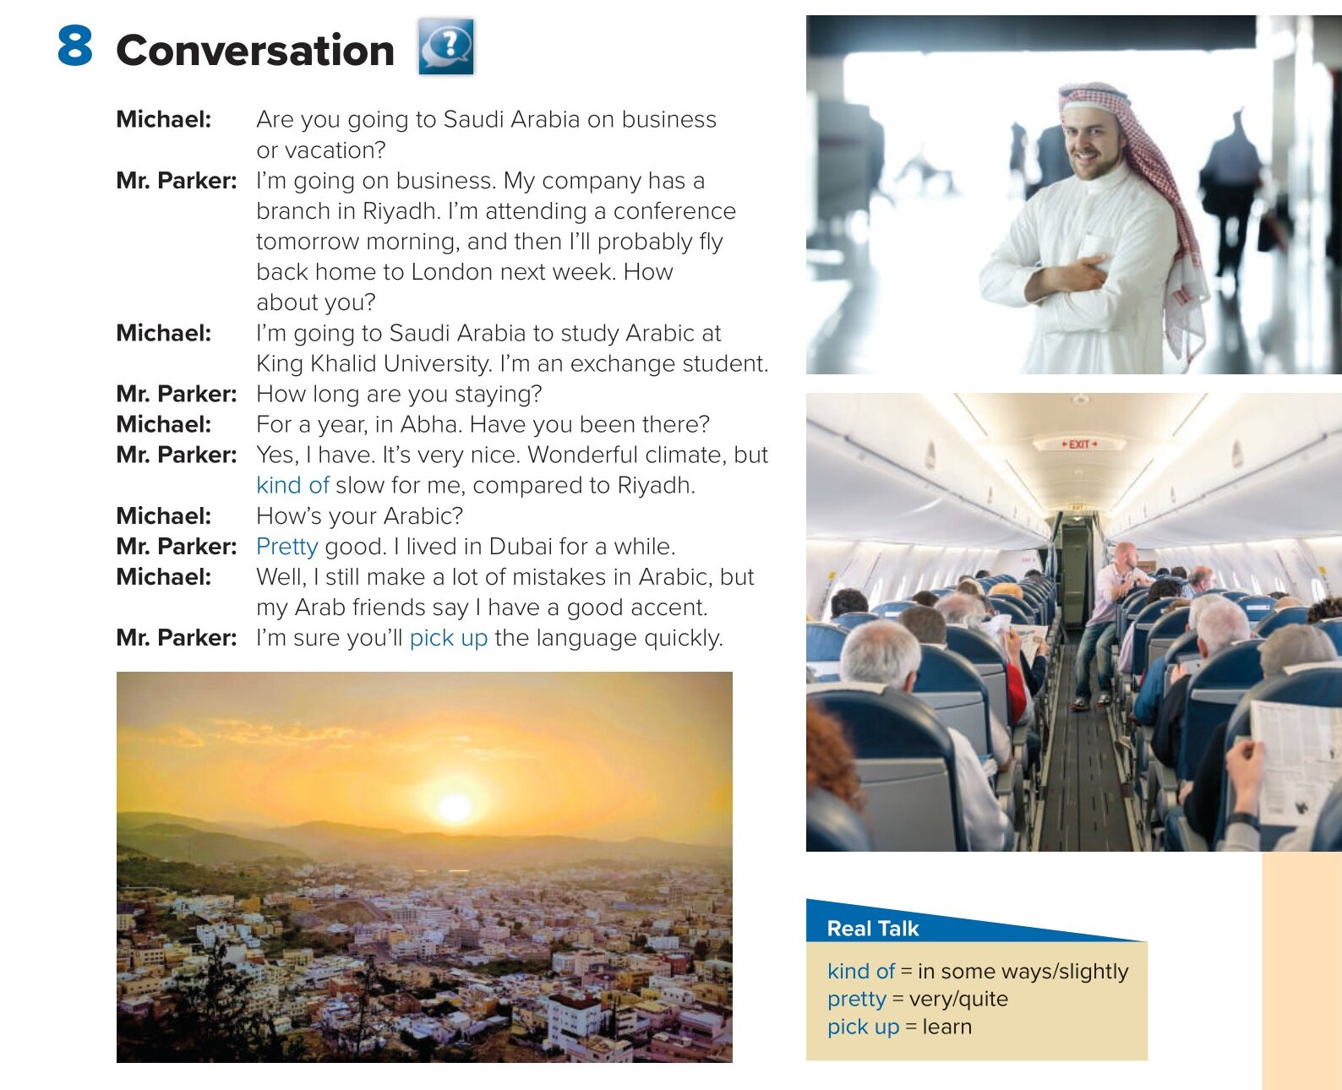

Slide 6
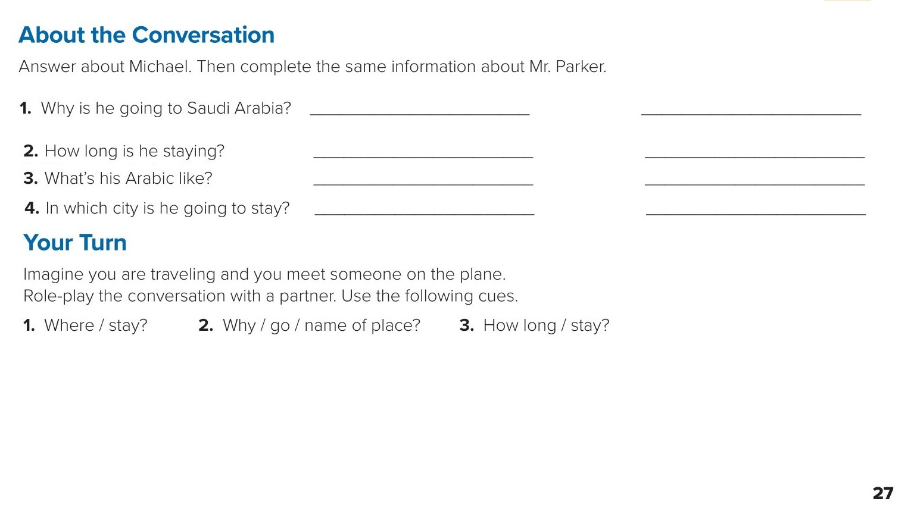
Michael
Mr. Parker
He’s going to Saudi Arabia
to study Arabic.
He’s going to Saudi Arabia
on business.
He’s staying for a year.
He’s staying for a few days.
He still makes mistakes in Arabic.
His Arabic is pretty good.
He’s going to stay in Abha
He’s going to stay in Riyadh.

Slide 7
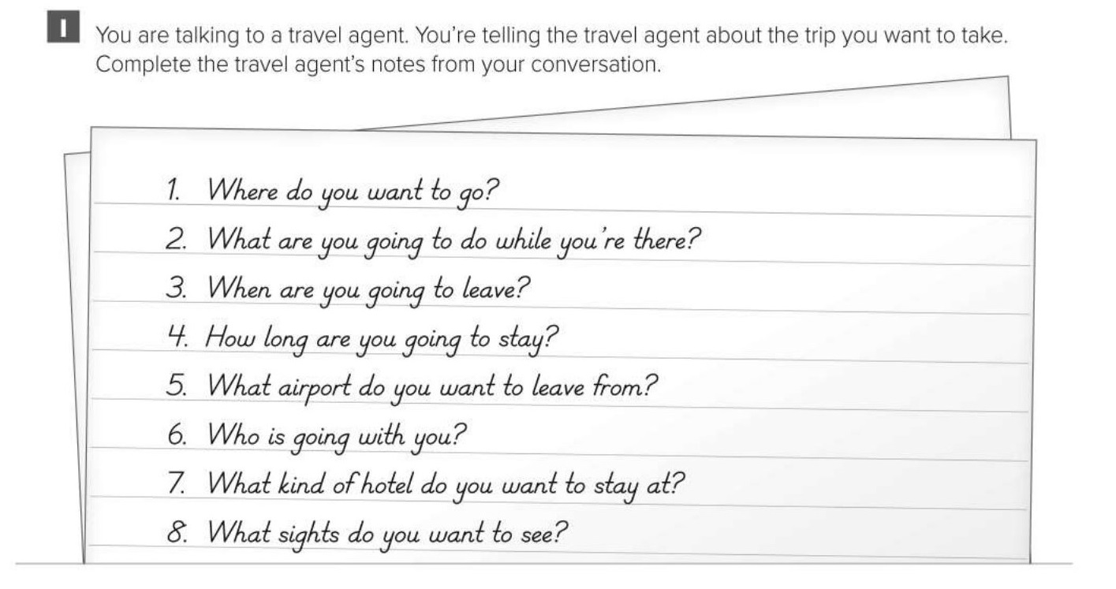
I want to go to Costa Rica.
I’m going to surf.
I’m going to leave in September.
I’m going to stay for one week.
I want to leave from JFK in New York.
My brother is going with me.
I want to stay at a cheap hotel.
I want to see rainforests and a volcano, too.

Slide 8
Choose the correct answer :
1-
Pick up =
learn
in some ways
2-
kind of =
very/quite
in some ways
3-
4-
Climate
Museum
Sun
Conference

Slide 9


Slide 10

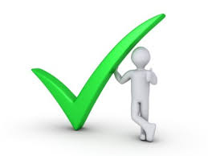
Back

Slide 11
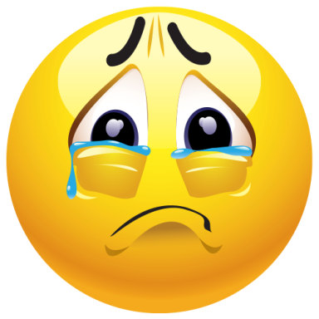

Back

