Slide 1
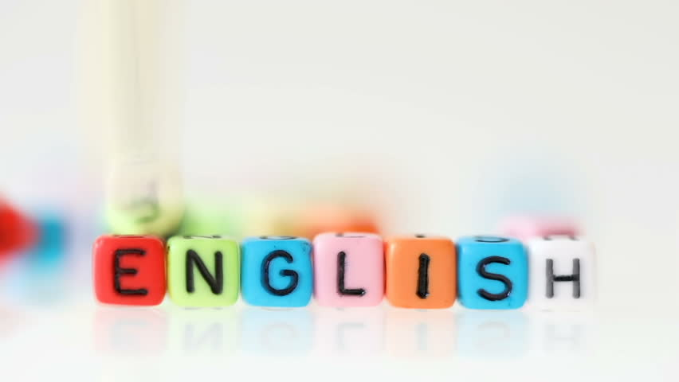
Super goal 5
Unit 3
Lesson 6 writing
اعداد المعلم / يحيى المنقري متوسطة المأمون بالهفوف

Slide 2

Learning Objectives
*By the end of this lesson, Ss will be able to:
1-Use intensifiers to make the adjectives stronger .
2- Write key information for an email.

Slide 3
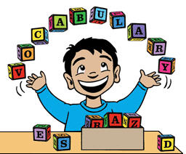

Slide 4
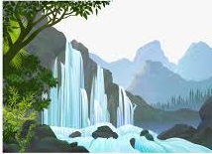
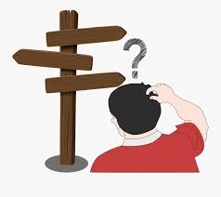



falls
Classmates
Directions

Slide 5
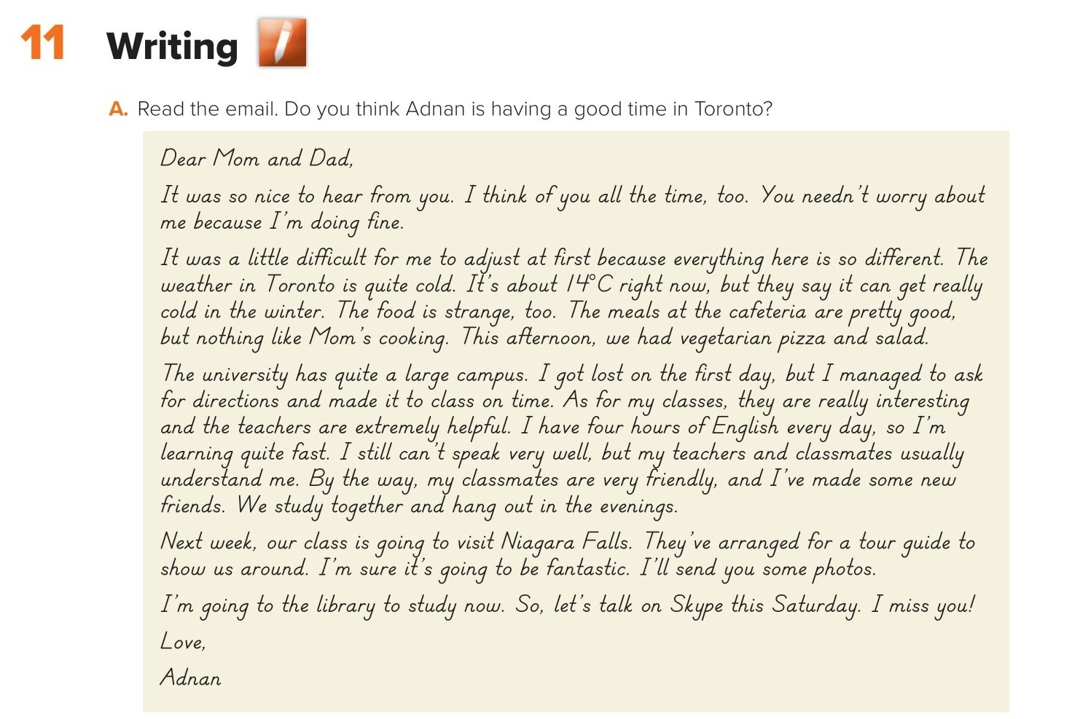
Yes, he is quite happy .

Slide 6
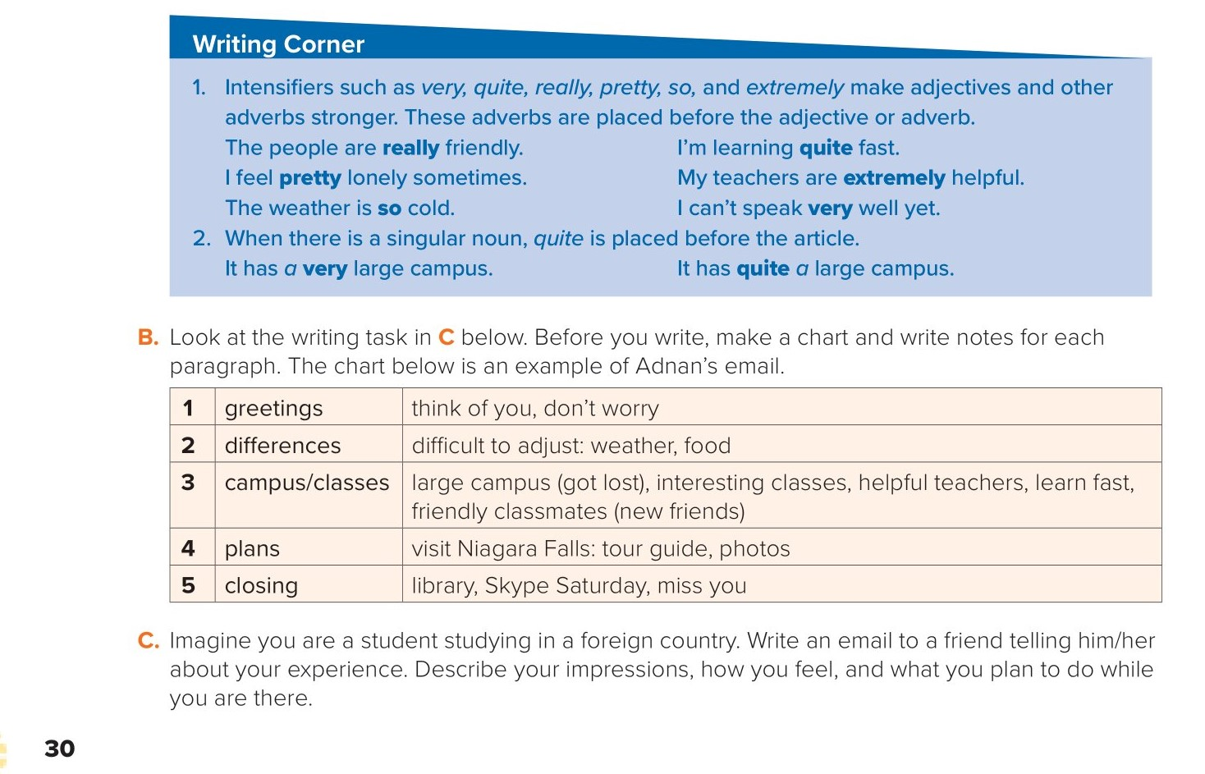
Make
adjectives
and
adverbs
stronger

Slide 7
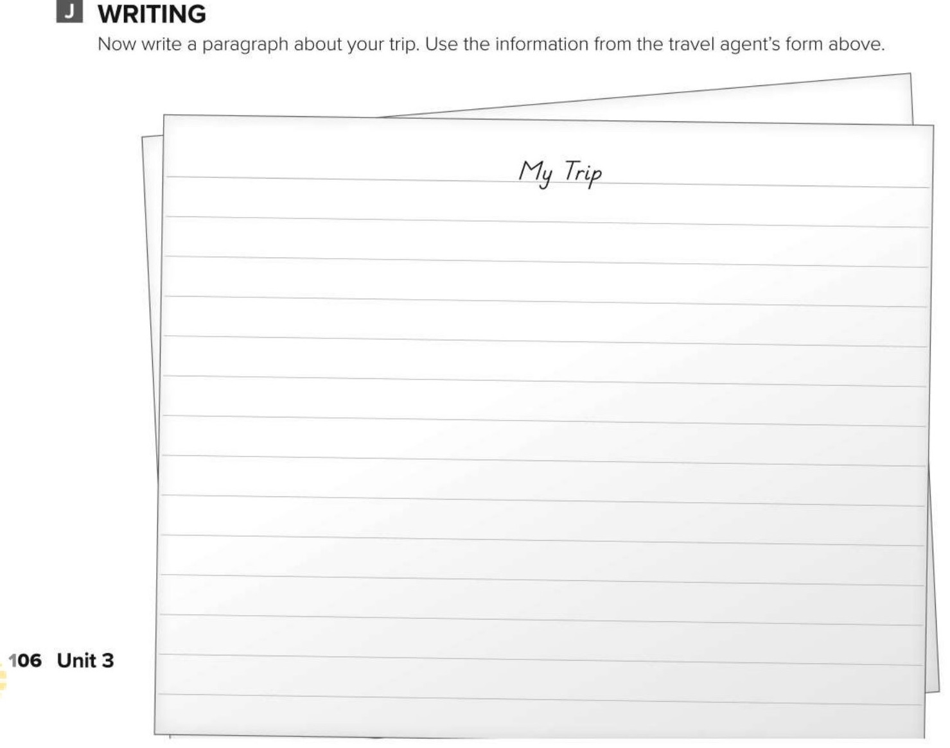
I’m going to take a trip to Costa Rica. I’m going to surf most of the time. I’m going to leave in September and stay for one week. I will probably leave from JFK in New York. My brother is going to go with me. We’re going to stay at a cheap hotel. May be we’ll see rainforests and a volcano, too.

Slide 8
Choose the correct answer :
1-
I am learning …………… .
fast quite
quite fast
2-
I want to ……. at cheap hotel .
stay
staying
3-
4-
Sea
Strangers
Falls
Classmates

Slide 9


Slide 10

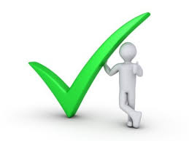
Back

Slide 11
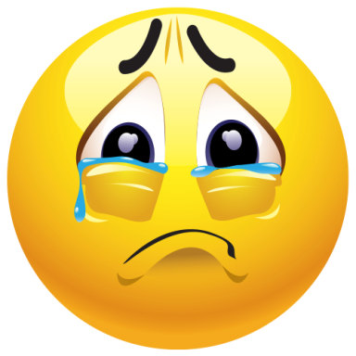

Back

