Slide 1
WELCOME

Slide 2
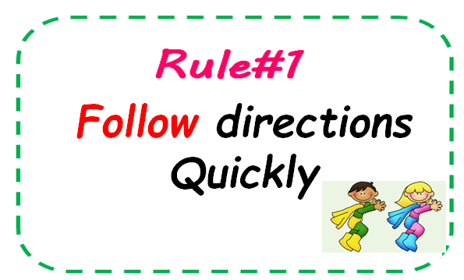
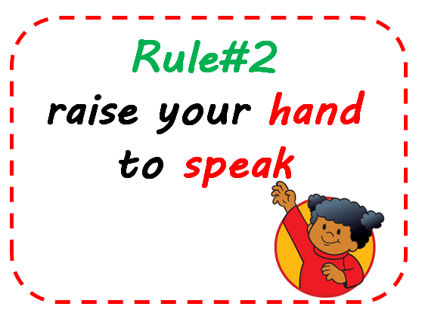


Classroom Rules

Slide 3
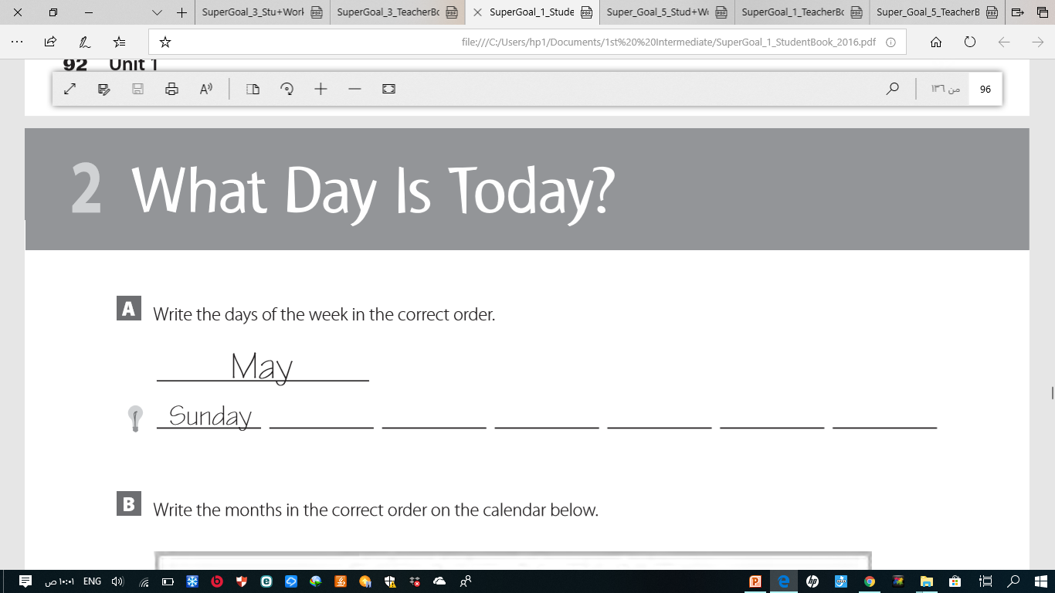
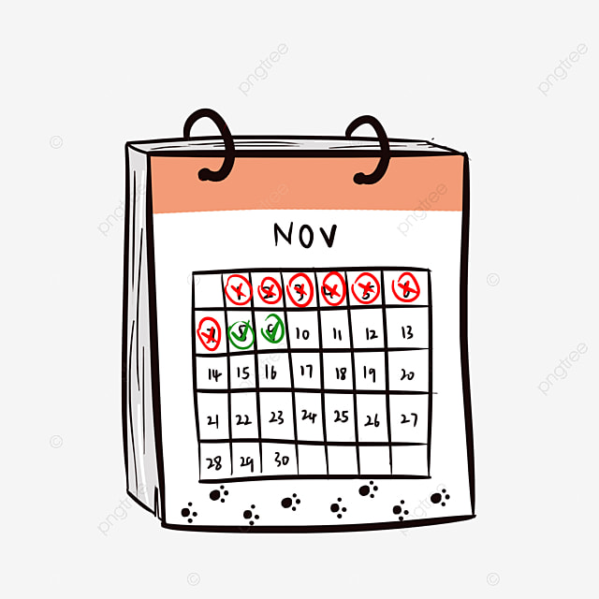

Review
Monday
Tuesday
Wednesday
Thursday
Friday
Saturday

Slide 4








Find our unit’s tittle
What is the first litter of each picture ?
Fish
Apple
Moon
Ink
Lemon
Yellow
Family

Slide 5
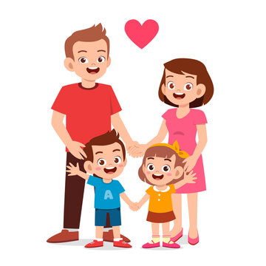



Families,
Families
Listen and Discuss
unit 5

Slide 6


What are we going to learn today ?
1-Name family members.
2-Act the conversation correctly.

Slide 7

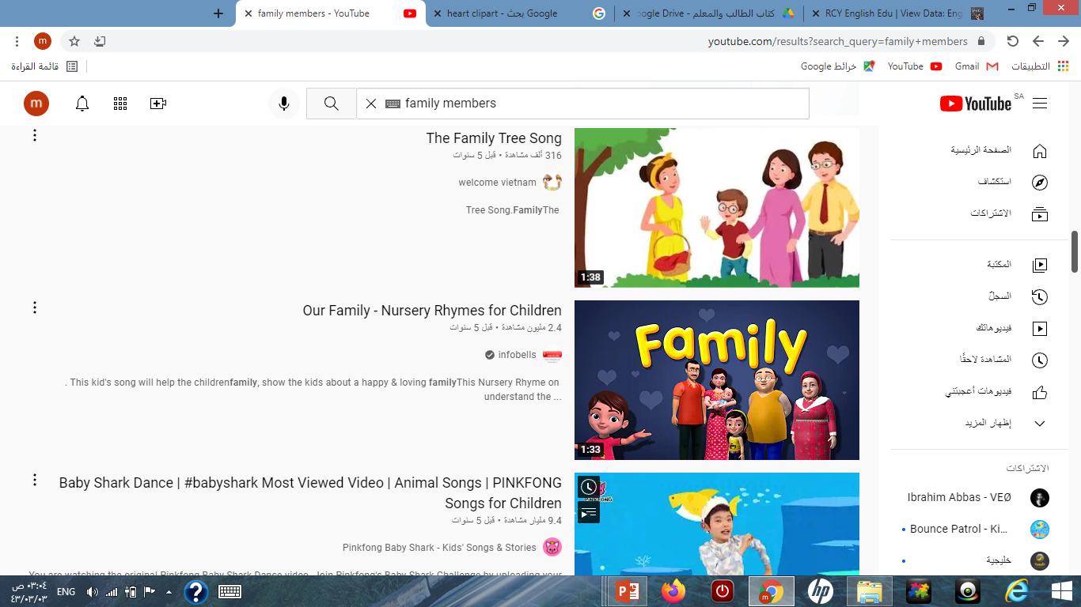
Let’s watch a video
What’s your father name?

Slide 8




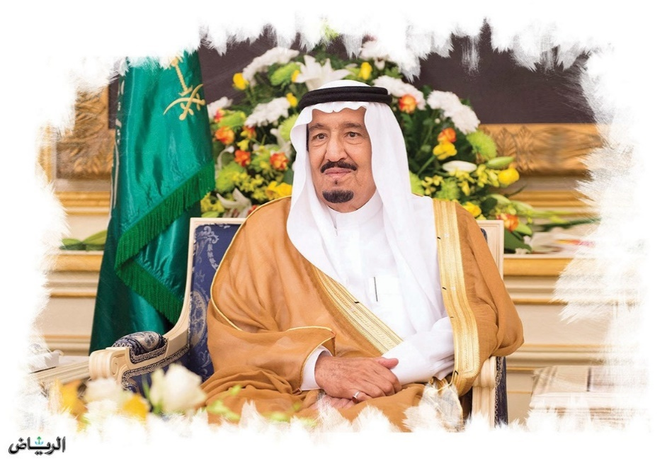

Who is Saudi’s Father ?
Do people in Saudi Arabia have small or big families ?

Slide 9
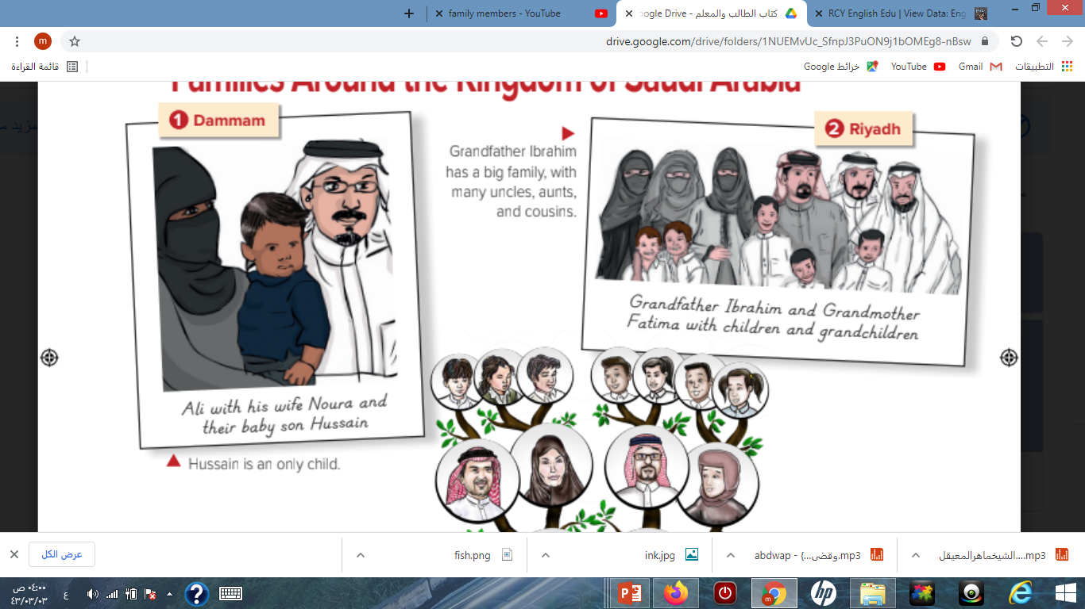
Page 40
Which family in the pictures is must like yours ?

Slide 10
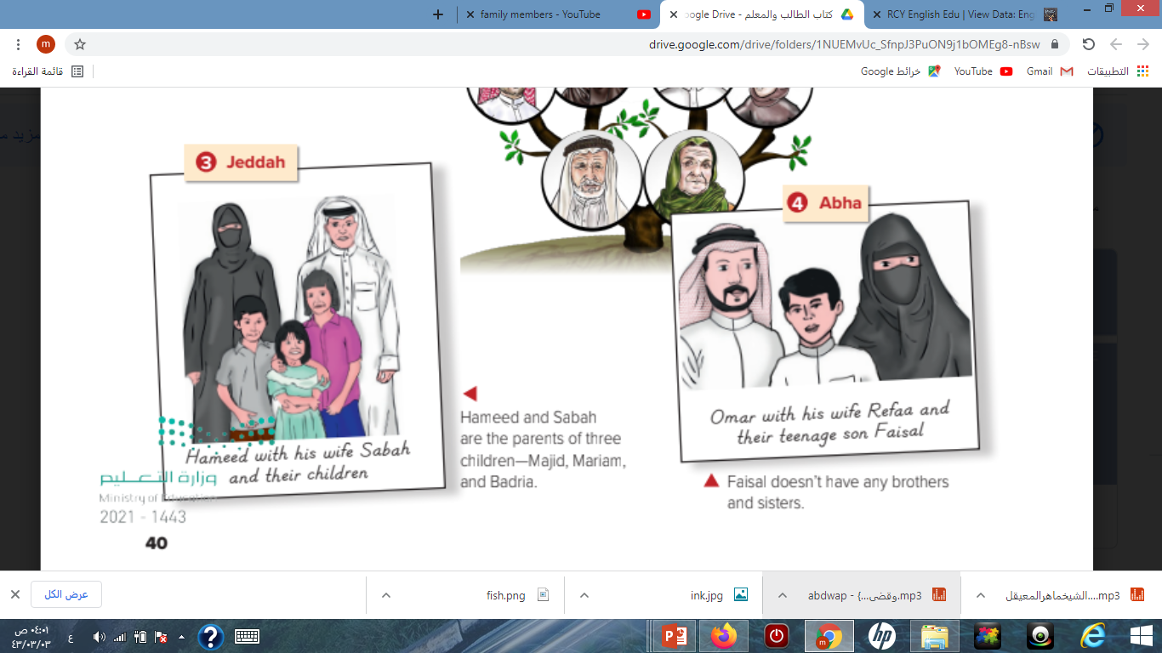
Mark the cities on the map.

Slide 11


Mark the cities on the map.
Dammam – Riyadh- Jeddah - abha

Slide 12
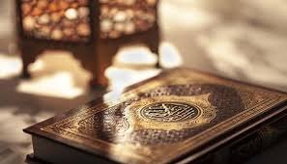

دللي من القرآن الكريم على فضل الوالدين

Slide 13
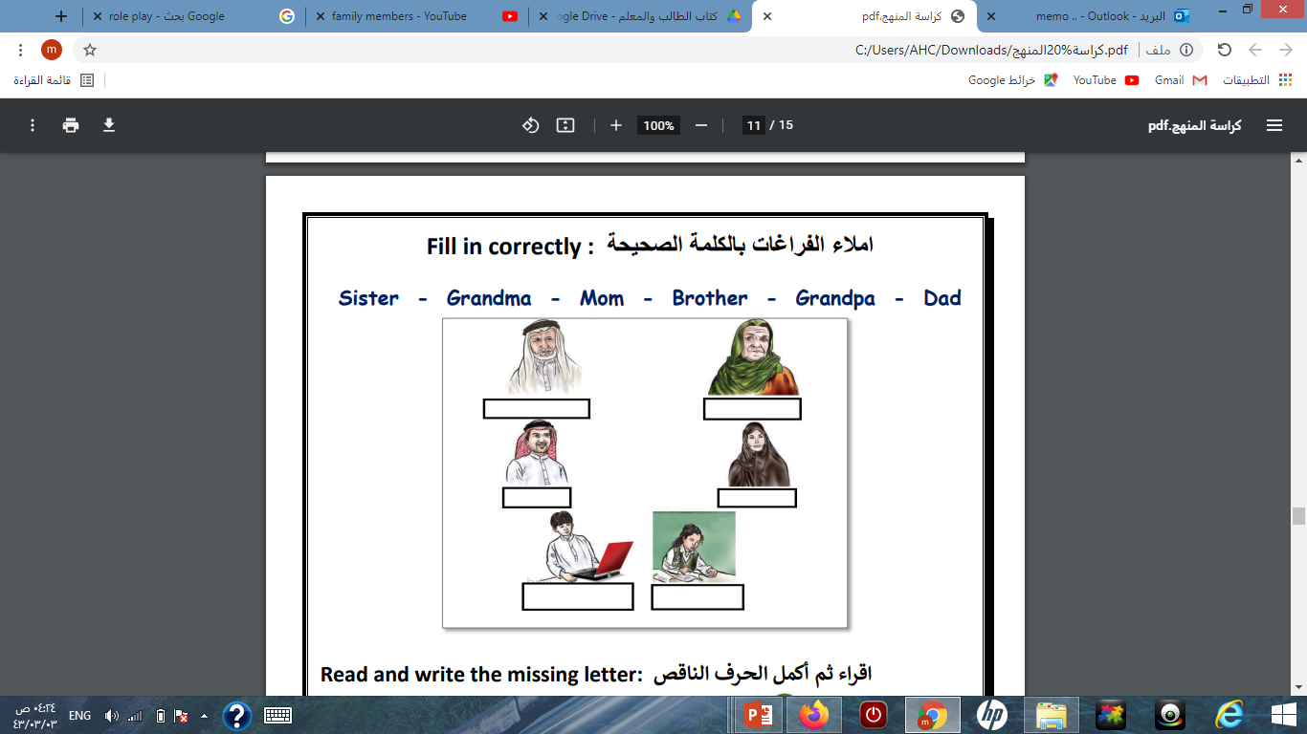

Slide 14
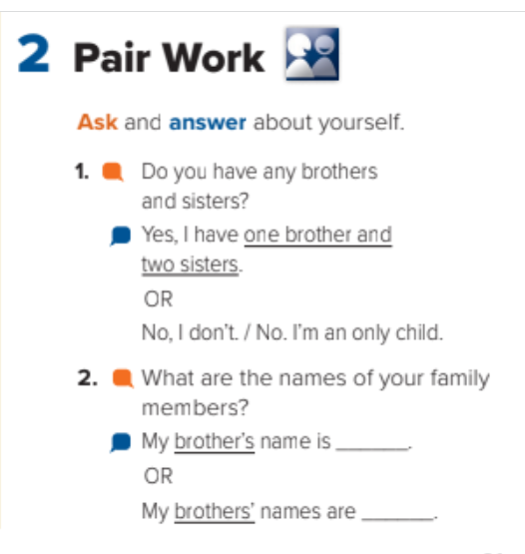


Slide 15

Homework
Exercise A p.103

