Slide 1
Good morning

Slide 2


Where are you from?
How old are
you?
SPIN
What’s your
friend’s name?
How do you spell
Your name?
How are you today?
tekhnologic
Notes:
5 Segments

Slide 3


word chain
English
h
happy
h

Slide 4

Unit :4
Around the World
28
قال تعالى :( يَا أَيُّهَا النَّاسُ إِنَّا خَلَقْنَاكُمْ مِنْ ذَكَرٍ وَأُنْثَى وَجَعَلْنَاكُمْ شُعُوبًا وَقَبَائِلَ لِتَعَارَفُوا إِنَّ أَكْرَمَكُمْ عِنْدَ اللَّهِ أَتْقَاكُمْ إِنَّ اللَّهَ عَلِيمٌ خَبِيرٌ)

Slide 5
1. use verb to be in negative and in questions
2. use prepositions in sentences
Objectives:
3. make questions using WHERE

Slide 6

Watch the video
& draw a mind map.
Verbs be

Slide 7


Slide 8
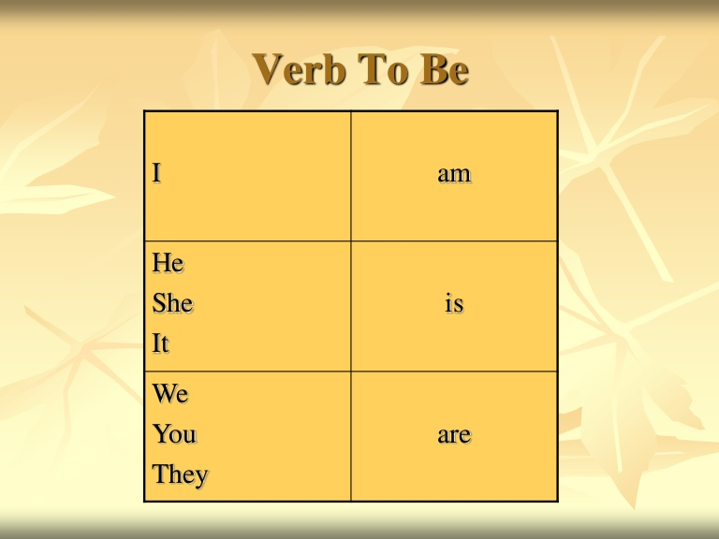

Slide 9
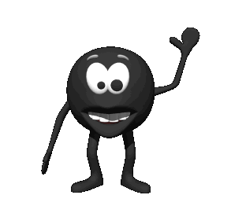
Pronouns
Verb To Be
I
He
She
IT
They
We
You
negative
am
is
are
not
happy.

Slide 10

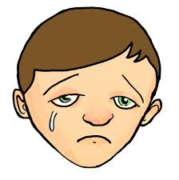


affirmative
negative
I am happy
He is sad
They are friends
She is beautiful.
I am not happy
He is not sad
They are not friends
She is not beautiful.
Notes:
Give student 5 Minute for answers

Slide 11




Is she a student?
Yes, she is.
No, she is not.
Are they doctors?
??questions
Yes, they are.
No, they are not.

Slide 12
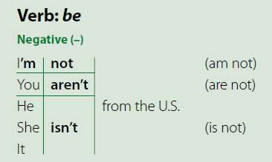
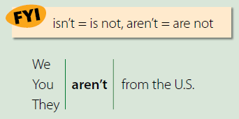
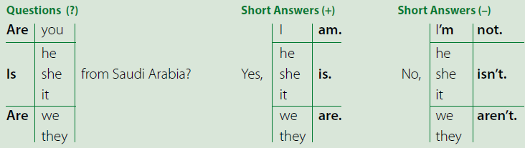
28
What’s the contraction for is not?
isn’t
What’s the contraction for are not?
aren’t
☺☺ the apostrophe replaces the omitted letter o.

Slide 13
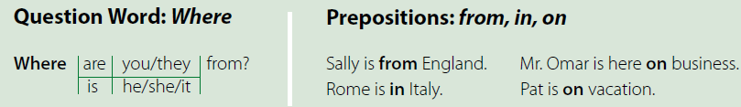
28
Questions with Where and other question words use the same inversion of subject and verb as the yes/no questions.

Slide 14



Practice
Practice

Slide 15
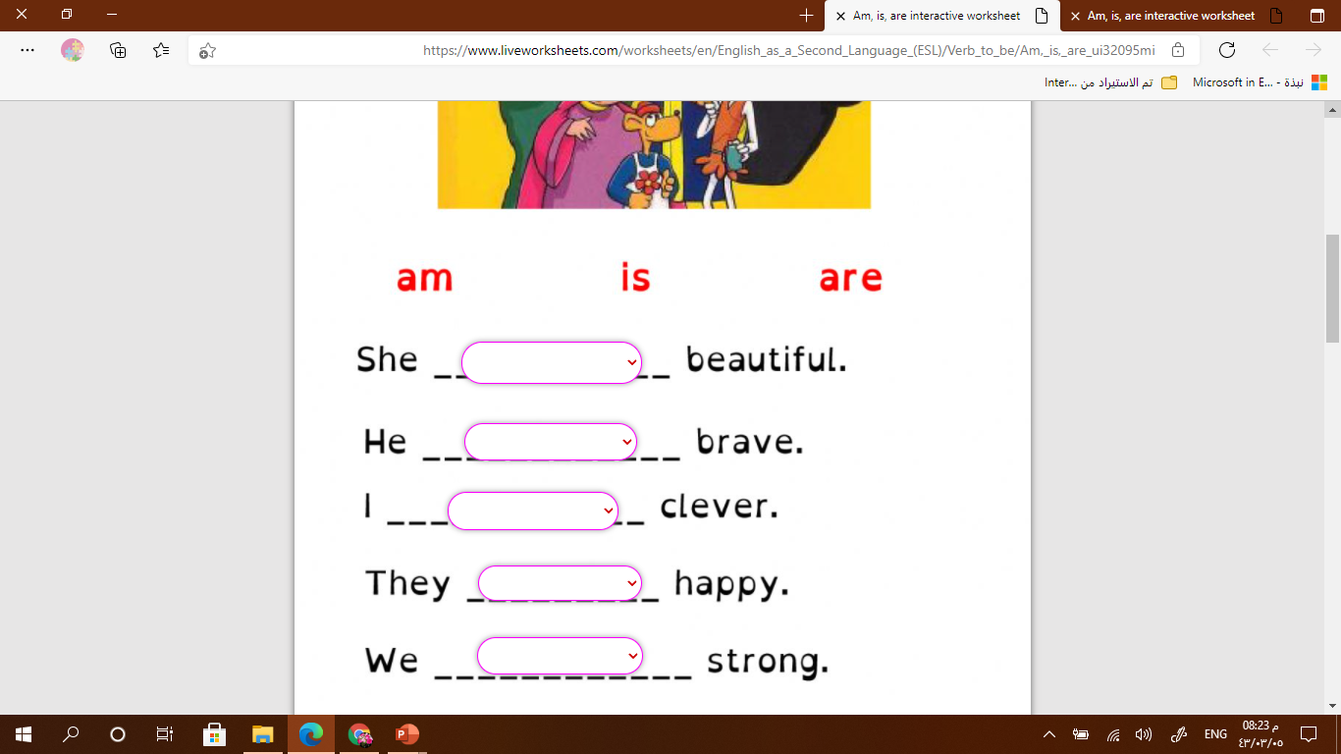
Let’s practice
https://www.liveworksheets.com/ui32095mi
is
is
am
are
are

Slide 16

Ali ( are – is - am ) a teacher.
We ( are – is - am ) doctors.
I ( are – is - am ) happy.

Slide 17



Make a sentence:

Slide 18
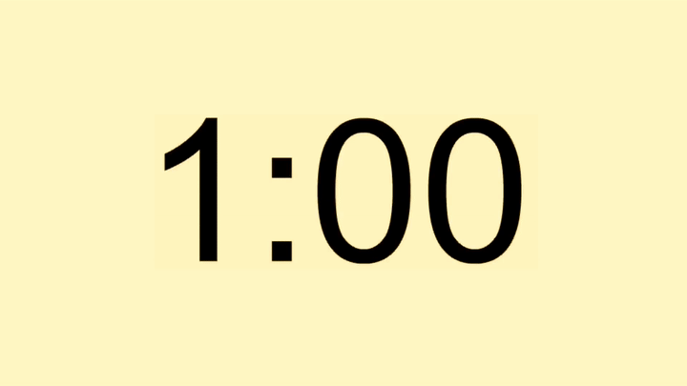

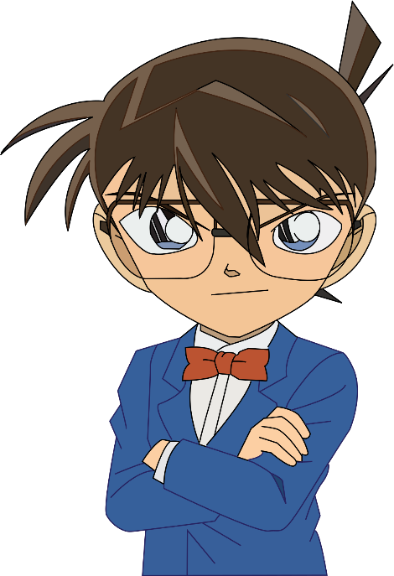
Find the fib
I is from Saudi Arabia.
I am from Saudi Arabia.

Slide 19
Find the fib
She are on vacation.
She is on vacation.

Slide 20
Find the fib
She is an vacation.
She is on vacation.

Slide 21
Find the fib
I am on Saudi Arabia.
I am from Saudi Arabia.

Slide 22
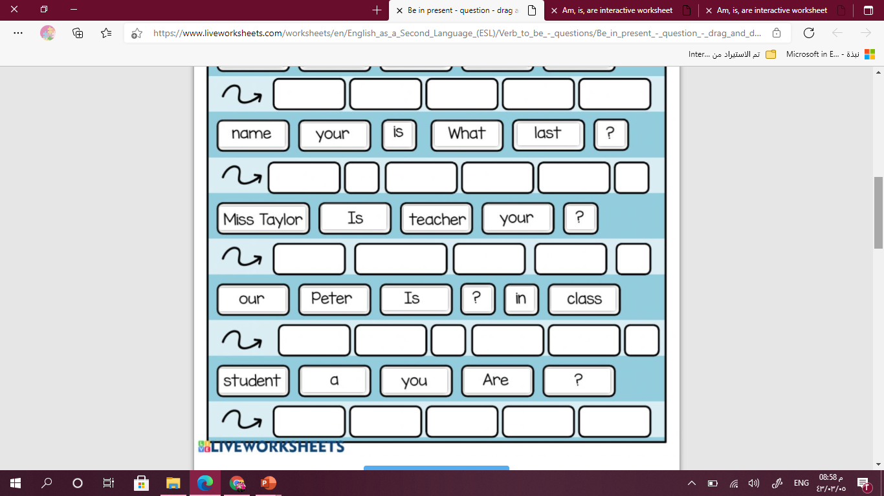
Evaluation
28
https://www.liveworksheets.com/mi253298mq
Is Miss.Taylor your teacher?
Are you a student?

Slide 23
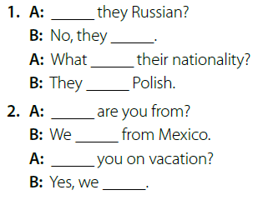
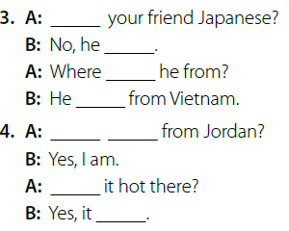
28
Are
Is
aren’t
isn’t
’s
is
’re
’s
Where
Are you
are
Are
Is
are
is

Slide 24

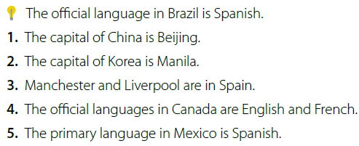
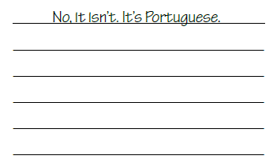
28
agree by using the short answer form Yes, it is.
to disagree. (No, it isn’t.)
if you aren’t sure of an answer you can guess or say I don’t know.
1. Yes, it is.
2.No, it isn’t. The capital of Korea is Seoul.
1
0
3.No, they aren’t. Manchester and Liverpool are in England.
4.Yes, they are.
5.Yes, it is.

Slide 25


Unit :4
Around the World
29

Slide 26
1. answer questions about address
2. listen for specific information
Objectives:
3. make questions using WHERE

Slide 27


Slide 28

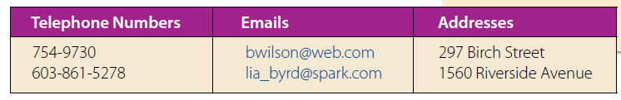
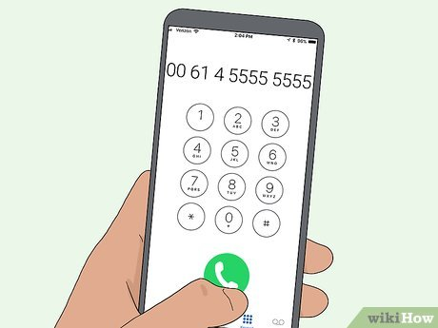
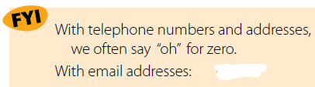



29

Slide 29
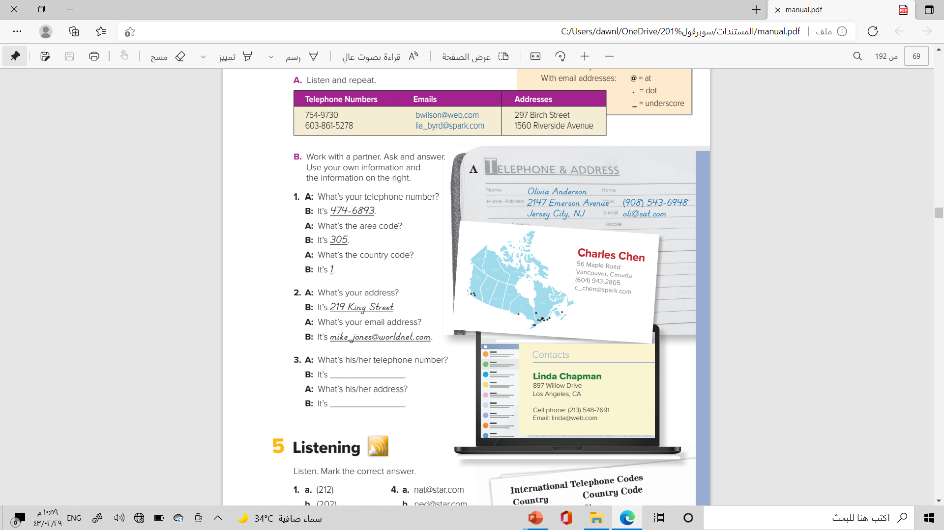
29
the personal profiles

Slide 30
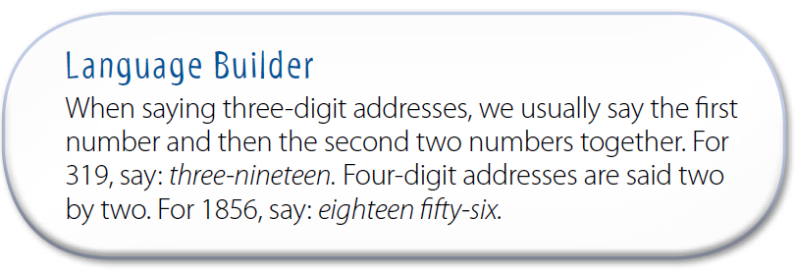

Slide 31
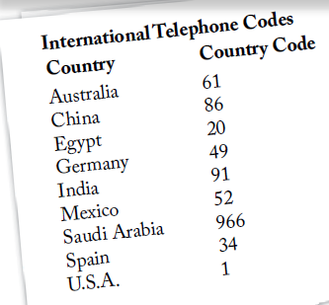
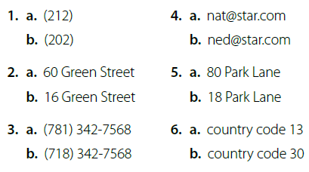

29
You are going to hear different phone numbers, email addresses, and street addresses. You should read the choices and circle the one they hear.

Slide 32

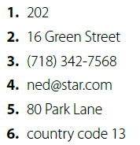

Slide 33
Evaluation
https://www.liveworksheets.com/sq541353qr

Slide 34

Bye
Thank you

Slide 35

homework

