Slide 1

Day :
Date :

Slide 2
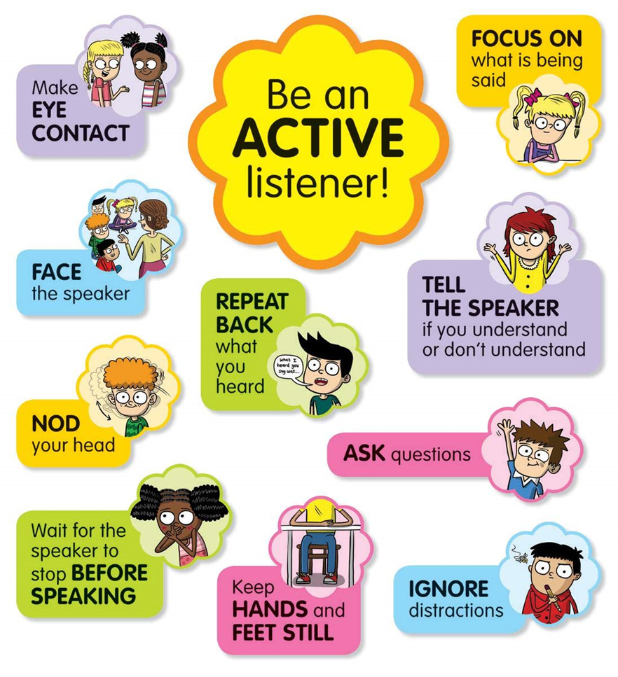

Read it you have 1 Min

Slide 3


What have we learnt last class?
USE YOUR WHITE BORD ,PLEASE

Slide 4
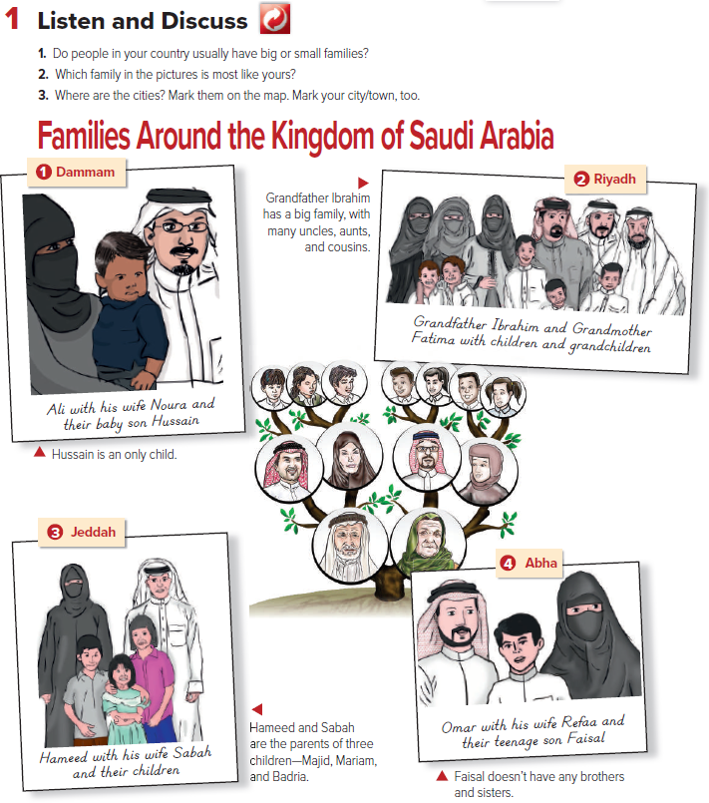
Underline sentences with
has or have
Guess what is our class talking about ?

Slide 5
Unit 5
Families, Families
Grammar

Slide 6
Lesson objectives
01
02
03
04
Recall
Apply
Identify
Recall what have we learnt last class
Identify the grammar rule
Apply the grammar rule
Analyze
Evaluate
05
06
Create
Evaluate each other’s sentences
Create sentences
Test the grammar rule against other examples

Slide 7
01
GRAMMAR RULE
Open your book page 36

Slide 8
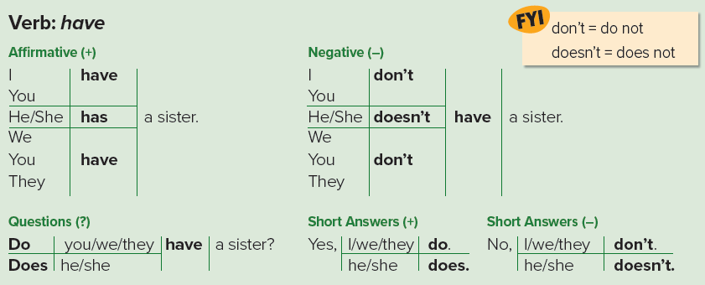
Page 42
For negative forms, use don’t and doesn’t + have (not has).
As in negative forms, questions always use have, not has, after the auxiliary (do/does).

Slide 9
Page 42
They have a sister.
The question form: Do they have a sister? The subject goes between Do or Does and the main verb (have).

Slide 10
Page 42
It isn’t necessary to use the verb have in the short answer, just do or does. Say: No, I don’t. or Yes, I do.

Slide 11

TABLET APP
As a Group
Create sentences using the affirmative and negative forms of the verb have
Form a question using the verb have and the auxiliary do/does
You can replace the image on the screen with your own work. Just right-click on it and select “Replace image”
Evaluate each other questions.

Slide 12
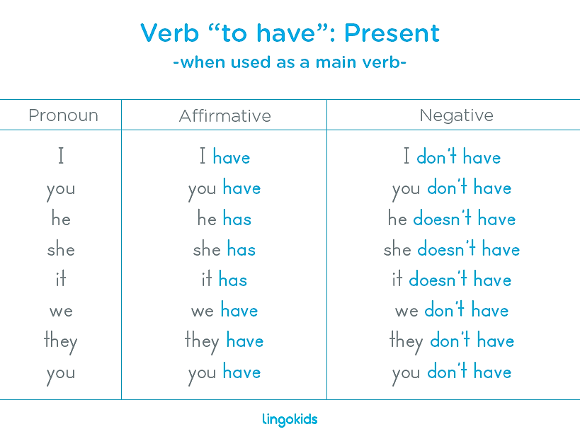
Page 42

Slide 13
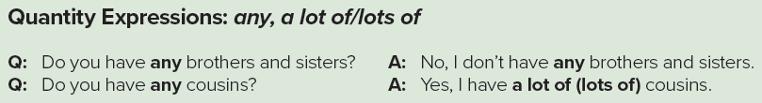
Page 42
We use any in questions and negative
statements.
A lot of or lots of means a large number of something.

Slide 14
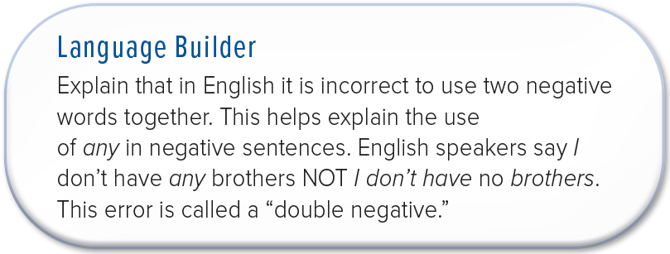
Page 42

Slide 15

TABLET APP
As a Group
Create two sentences using quantity expressions: any, a lot of/lots of
You can replace the image on the screen with your own work. Just right-click on it and select “Replace image”
Evaluate each other sentences.

Slide 16
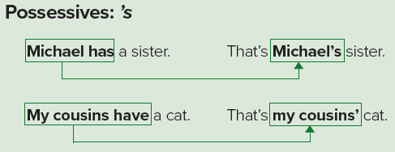
Page 42

Slide 17
Page 42
The ’s in the possessive form is not a
Contraction (a shot form of a word).
Tom's a student = Tom is a student.
Tom's book is on the desk.
The first sentence, Tom’s is a contraction for Tom is. In the second sentence, Tom’s is a possessive form.
The singular possessive is ’s. For plural
words like cousins, the apostrophe comes after the -s.

Slide 18
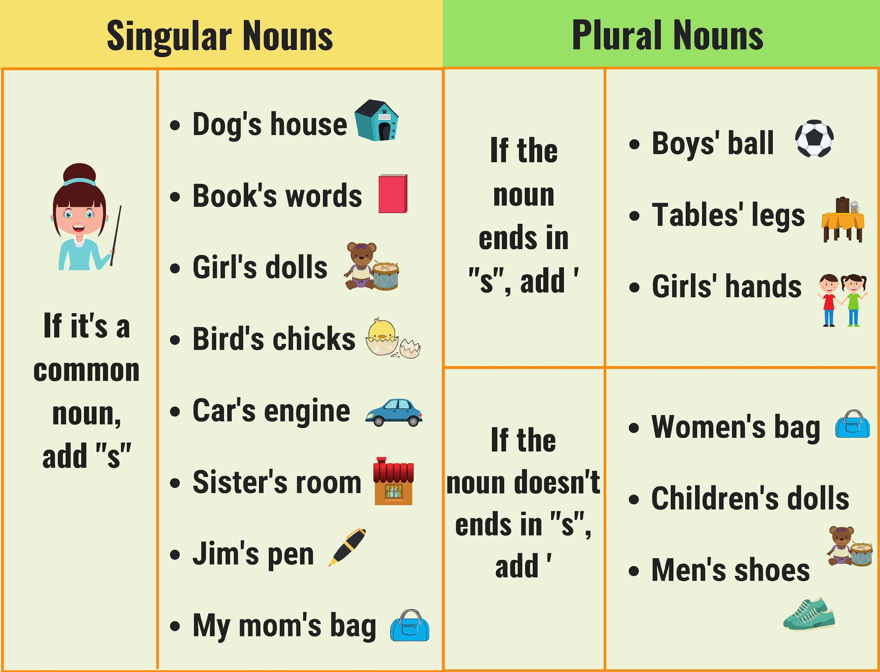

Slide 19
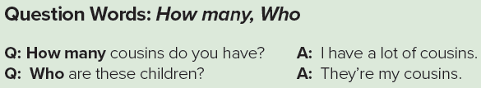
Page 42
We use How many to ask about the number of people or things.
We use who to ask which person or people pr tp ask what someone’s name is. Who’s she?

Slide 20
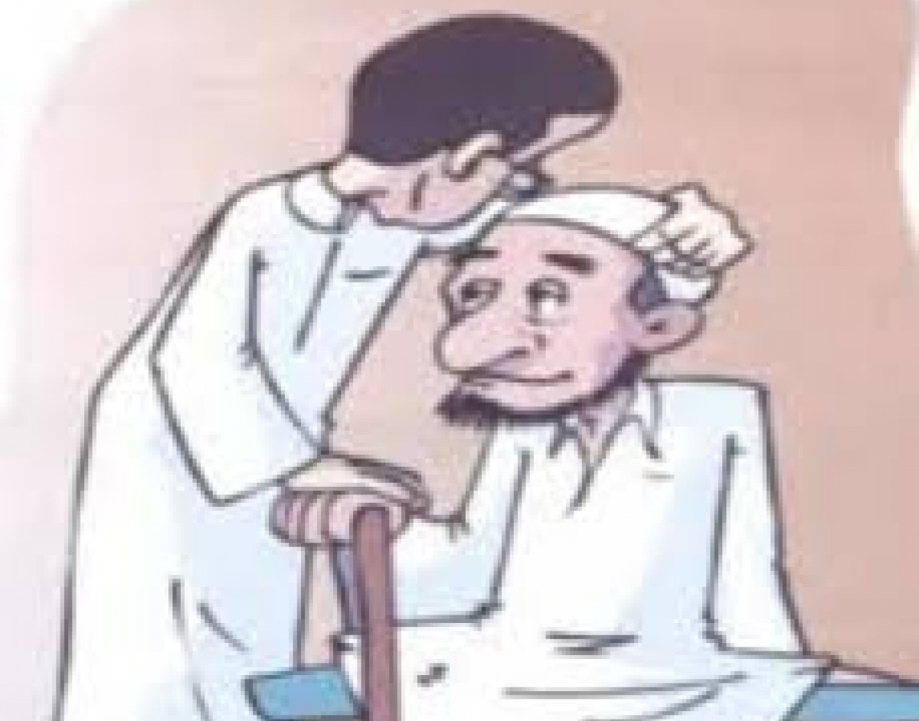
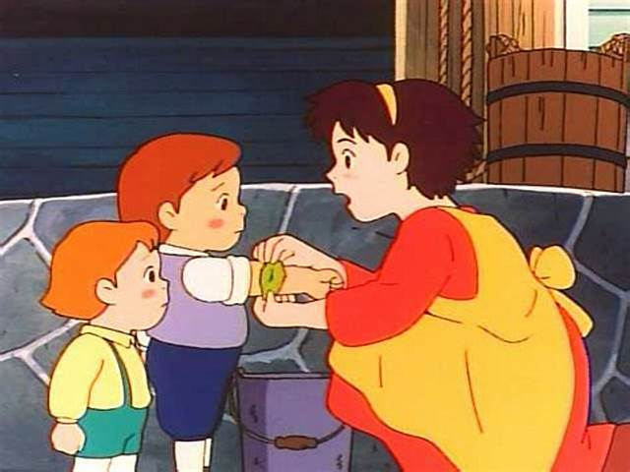
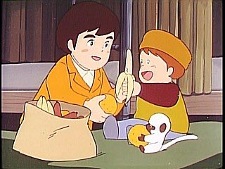
How do you respect your brother and sister ?
What Islam says about brother , sister or any one bigger than you ?
قال الرسول صل الله عليه وسلم
(( من ليس منا من لم يرحم صغيرنا و يوقر كبيرنا ))

Slide 21
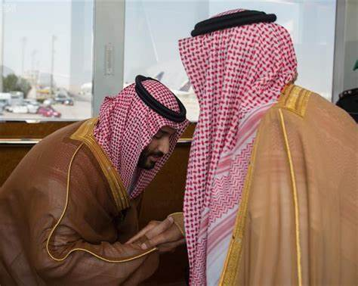
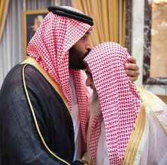
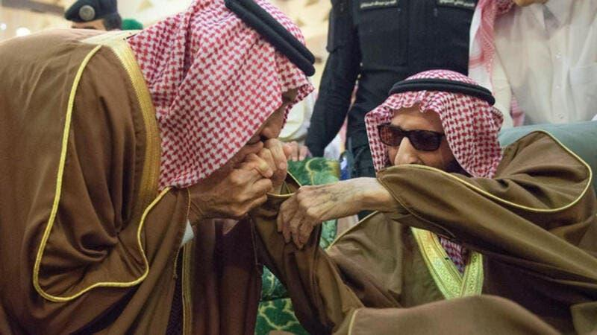

What do you think about these pictures ?
Do you Know them ?
What are they doing ?

Slide 22
Answering comprehention questions

Slide 23
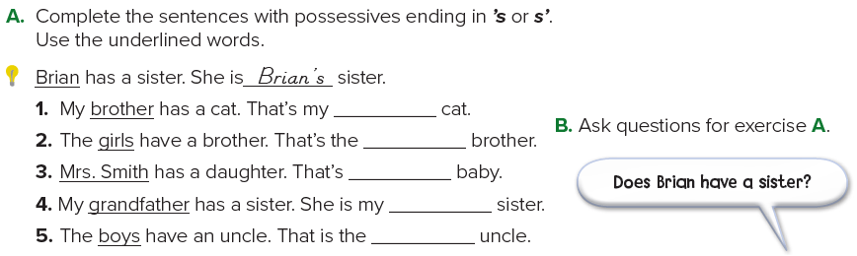
Page 42
brother’s
girls’
Mrs. Smith’s
grandfather’s
boys’

Slide 24
Page 42
Brian has a sister.
The question: Does Brian have a sister?
1. Does your brother have a cat?
2. Do the girls have a brother?
3. Does Mrs. Smith have a daughter?
4. Does your grandfather have a sister?
5. Do the boys have an uncle?

Slide 25
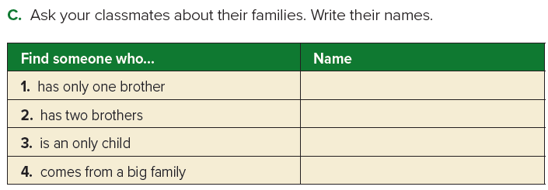
Do you have any brothers?
How many brothers do you have?
Are you an only child?
Do you come from a big family?

Slide 26
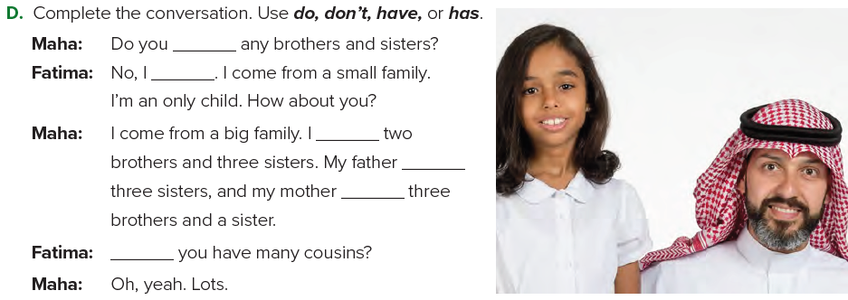
Page 42
have
don’t
have
has
has
Do

Slide 27
Homework
Page 203-204

Slide 28
https://wordwall.net/resource/26553436
A https://wordwall.net/resource/36382010
B https://wordwall.net/resource/36382006
C

