Slide 1

Day : date :

Slide 2


Read it you have 1 Min

Slide 3
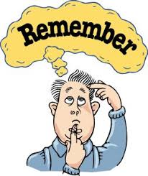
What have we learnt last class?
Use your white bord ,please .
timer

Slide 4

What did you see in this video ?
How many types of families we have in this video ?
Give me examples for the names of families ?

Slide 5
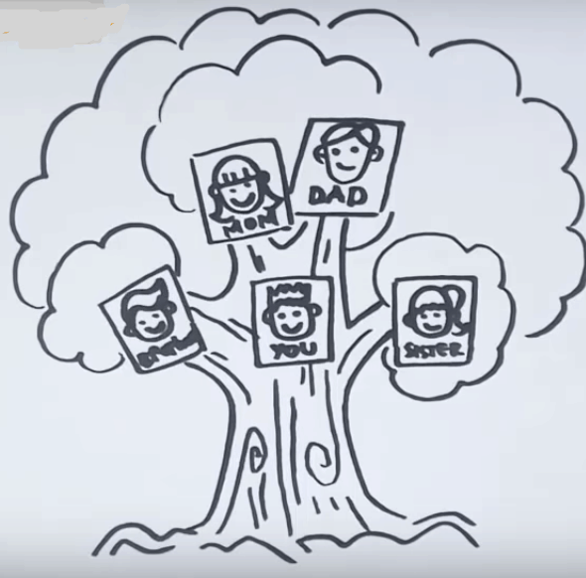
Do you have big or small family ?

Slide 6
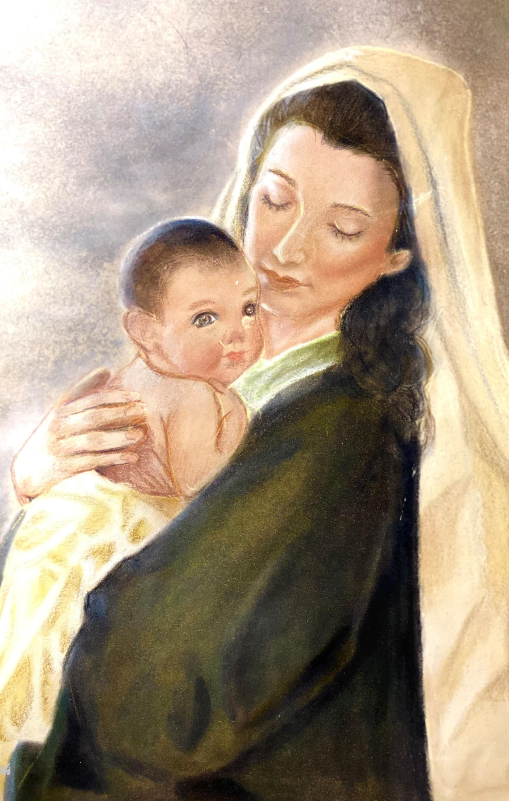
Why are mothers more respected than fathers in Islam ?
حديث :
عن ابي هريرة رضي الله عنه قال : ( جاء رجل الى رسول الله قال : يا رسول الله , من احق الناس بحسن الصحبة ؟ قال : امك , ثم امك , ثم امك , ثم ابوك , ثم ادناك ادناك .

Slide 7
families
TEXT HERE
What is inside the box ?
Guess what are we talking about today?

Slide 8
families

Slide 9
families

Slide 10
Unit 5
Families, Families
Ms. Nora

Slide 11



the student will be able to : recall what did we teak last class. identify family members. describe families.
Express opinions .
Create a mind map to sum up .

Slide 12
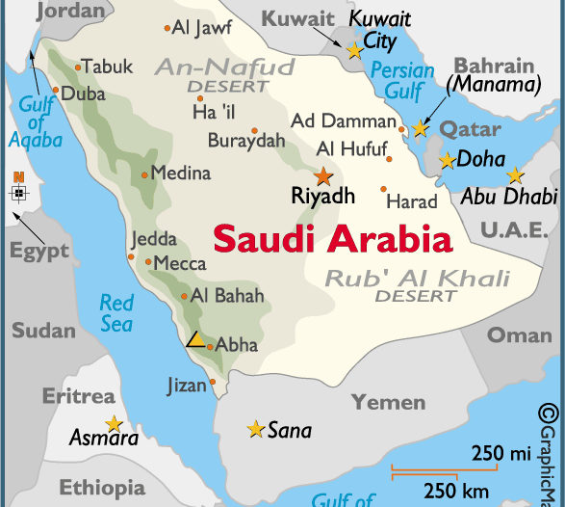
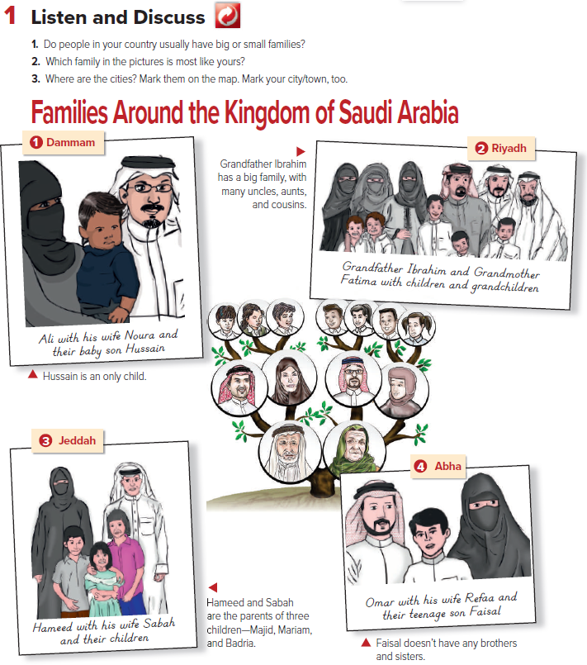

Slide 13


Slide 14

Underline words about family
Pg : 38-39

Slide 15
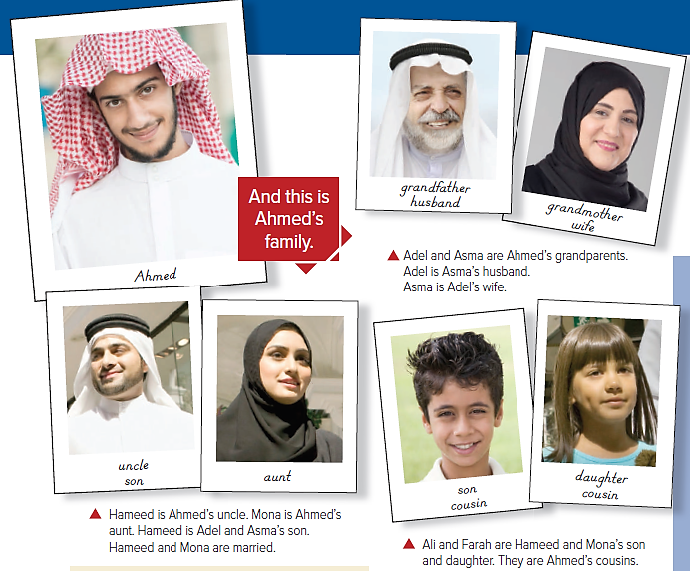

Slide 16
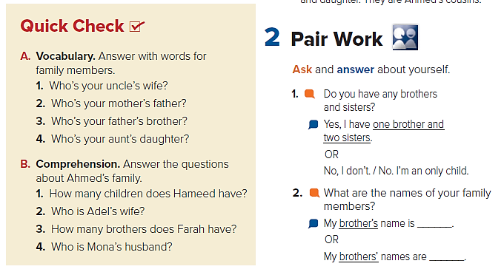
What is the meaning of family members ?
My aunt
My grandfather
My uncle
My cousin
Timer

Slide 17

1.He has two children, a son and a daughter.
2.Adel’s wife is Asma.
3.Farah has one brother.
4.Mona’s husband is Hameed.
Timer

Slide 18


Slide 19

What are you going to do if, you wake up and find yourself between another family ?

Slide 20
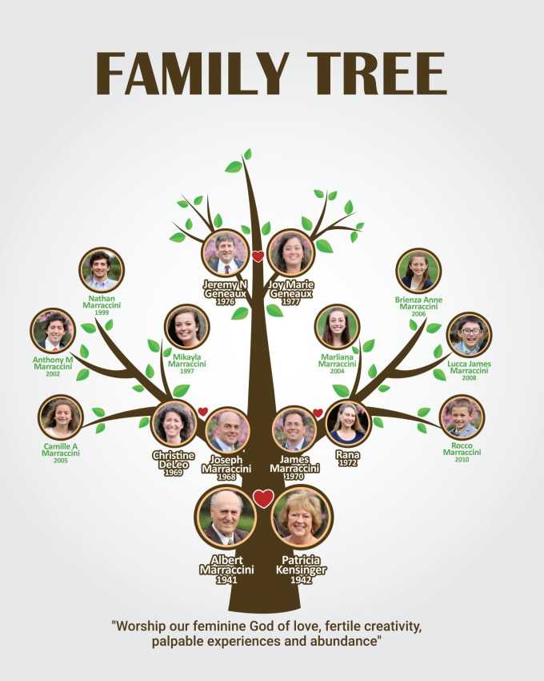

Draw your family tree

Slide 21

Homework pg. 203

