Slide 1
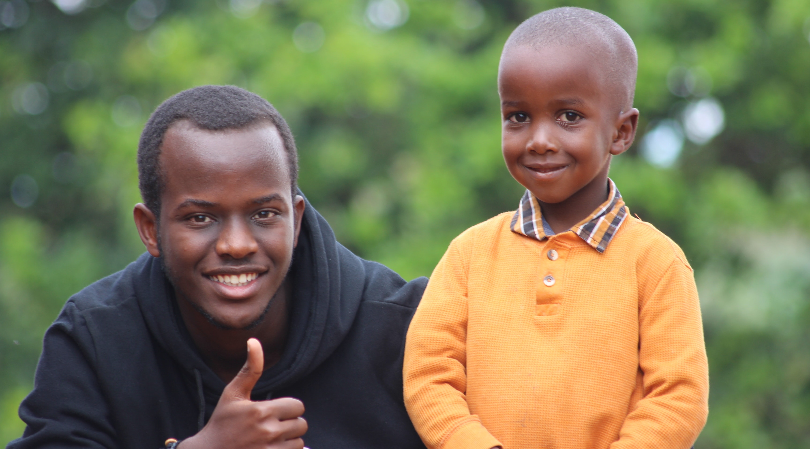
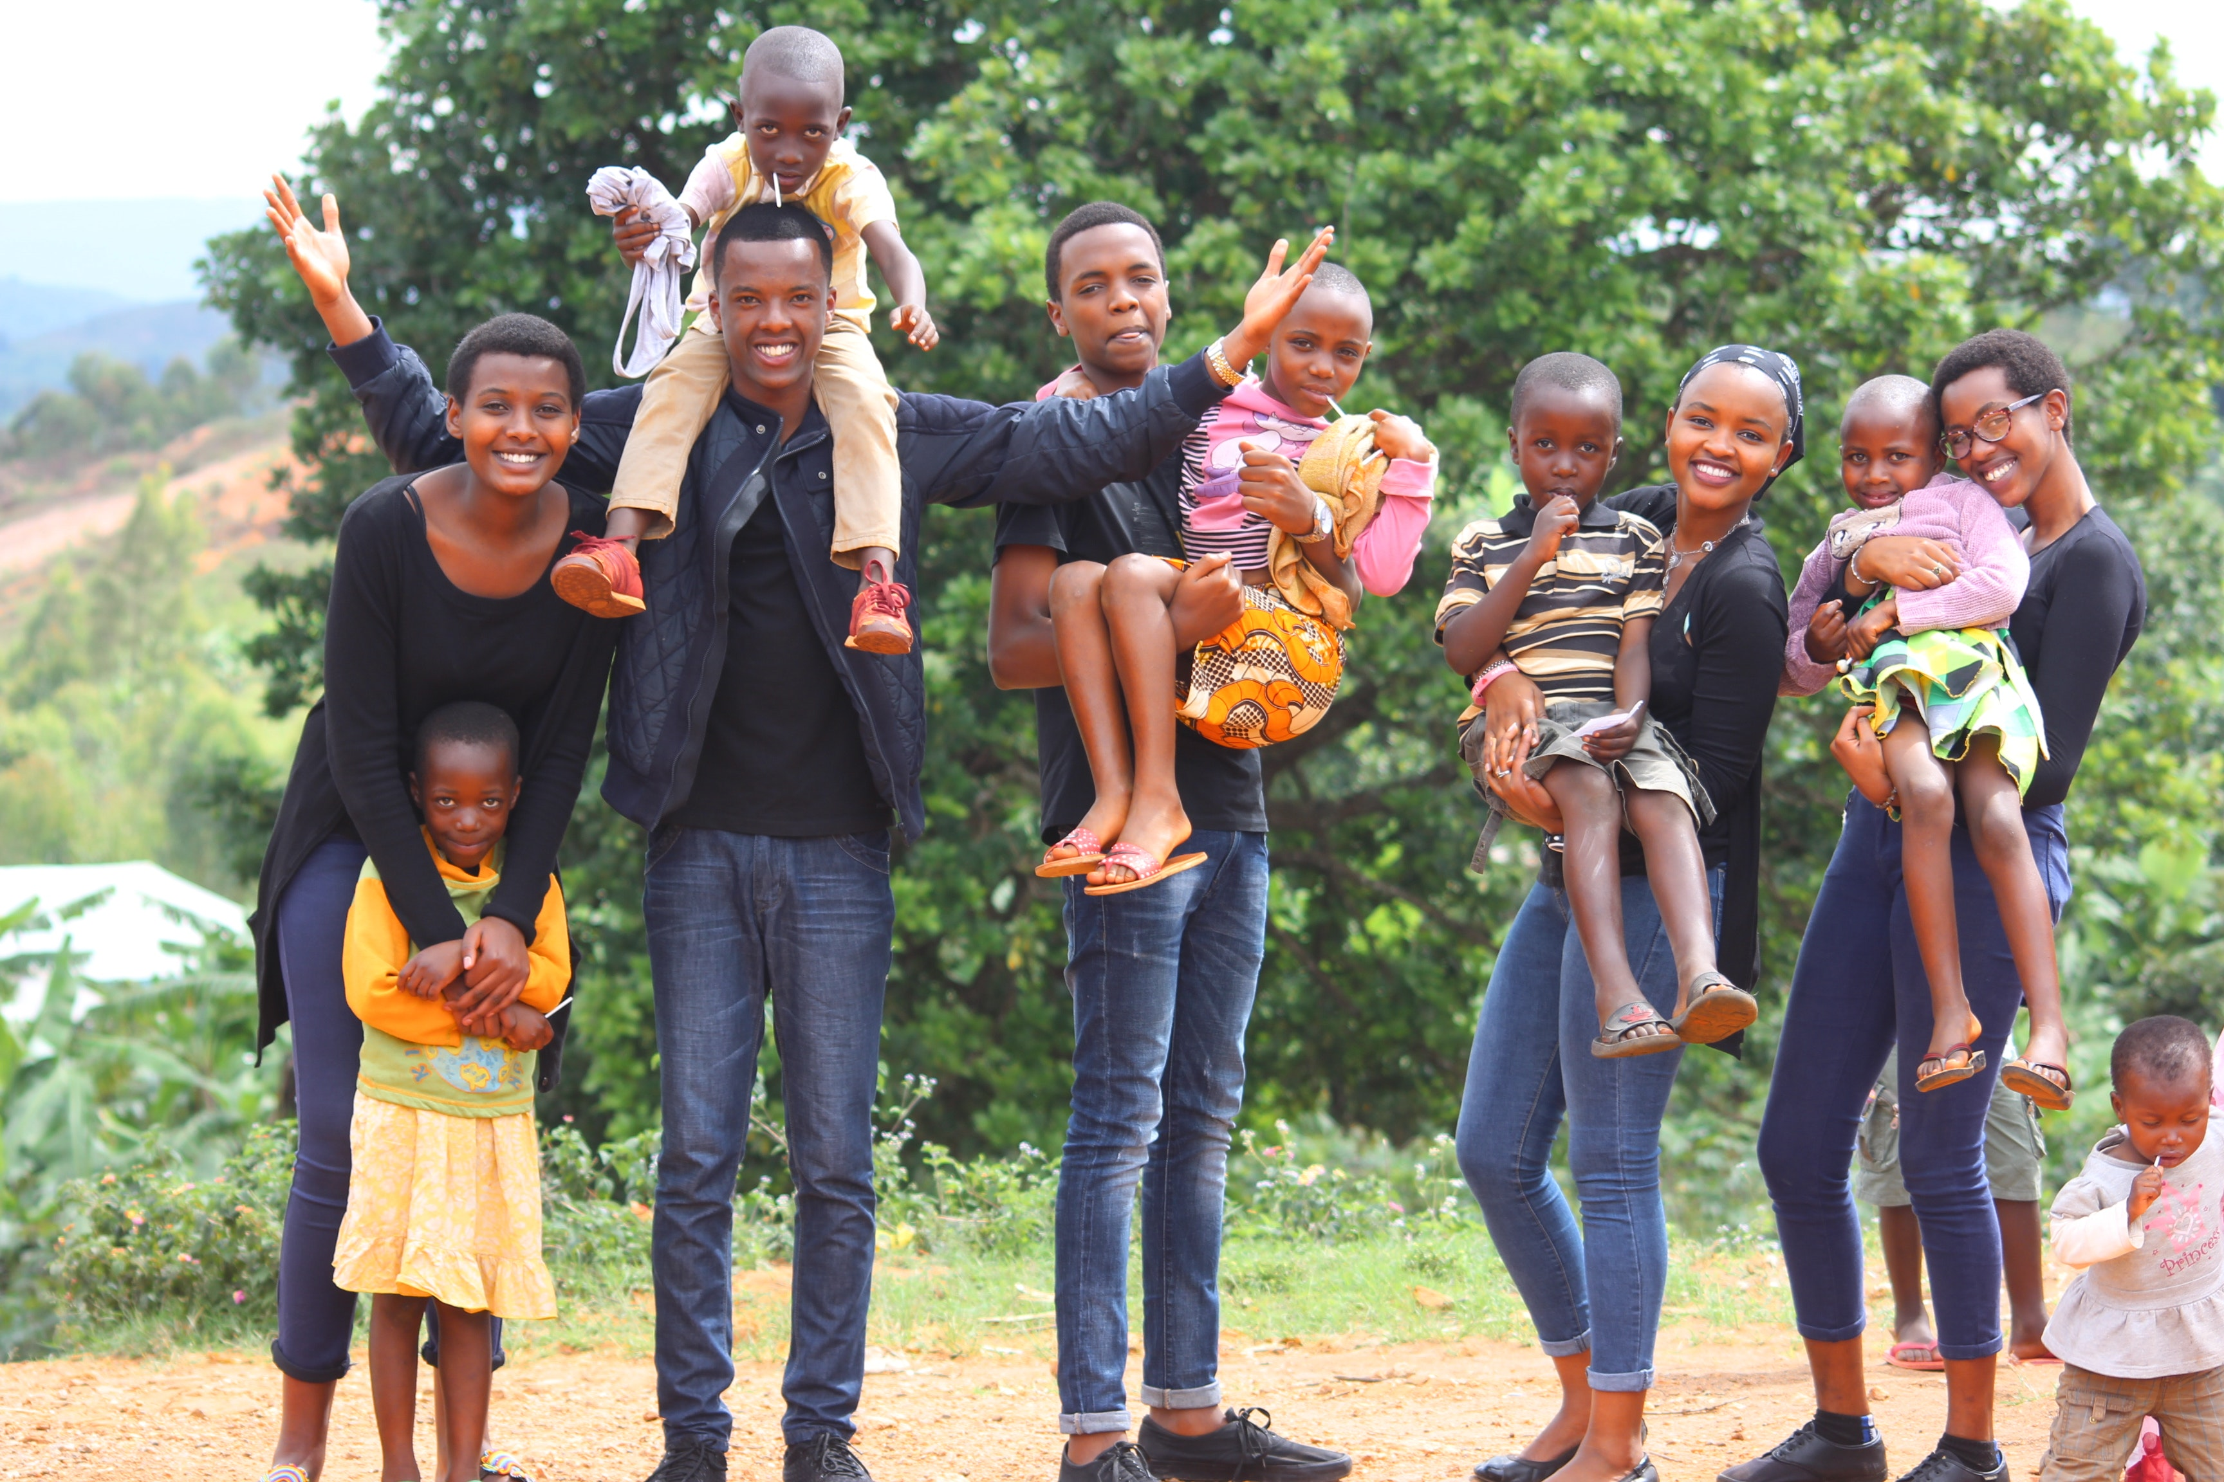
unit : 5 Families, Families
{ وَآتِ ذَا الْقُرْبَى حَقَّهُ }

Slide 2
How many brothers, sisters do you have?
Page 47
Is your family big or small?

Slide 3
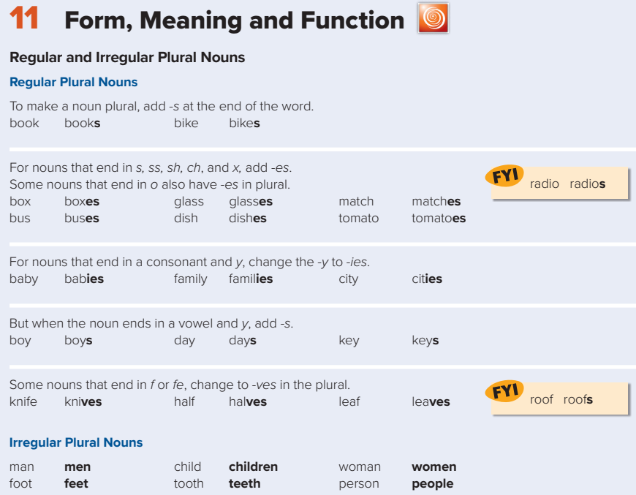
Page 47

Slide 4
Objectives:
Answer questions on page 47 correctly.
Use regular and irregular plural nouns correctly.

Slide 5
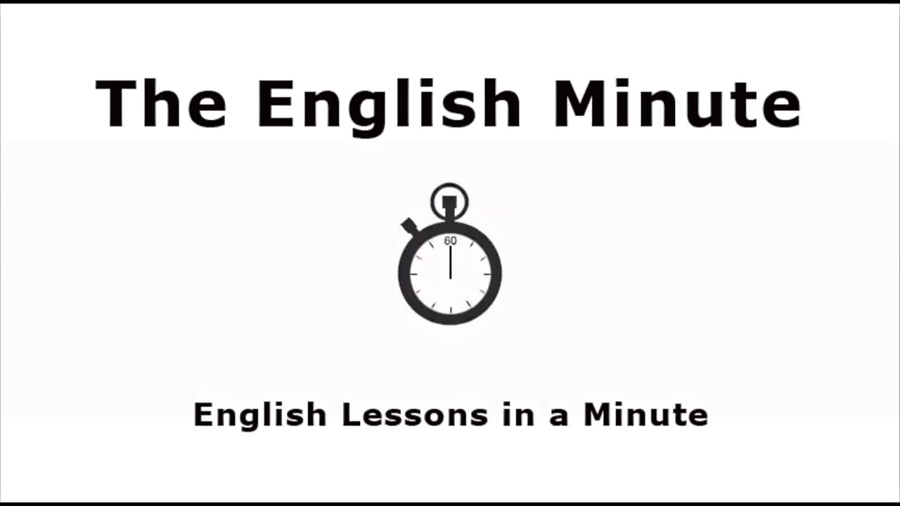
Watch the video:

Slide 6

Watch the video:

Slide 7
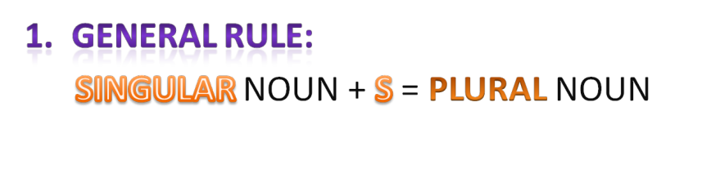
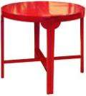


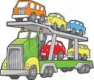




Plural nouns

Slide 8
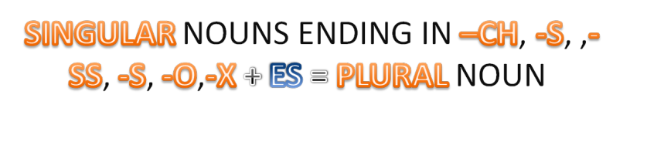

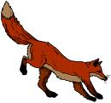

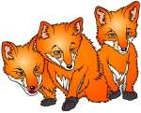






Slide 9
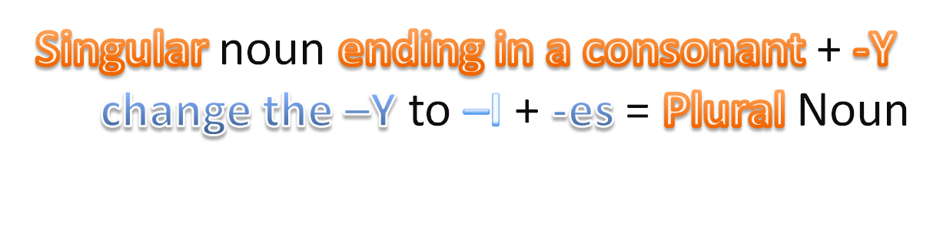

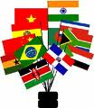








Slide 10
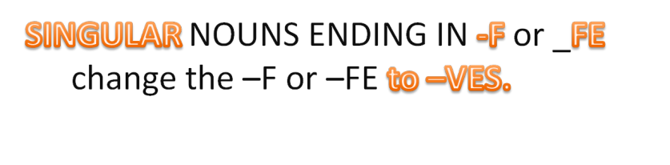

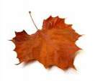


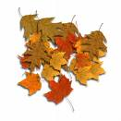





Slide 11


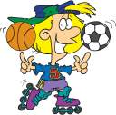
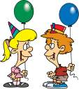
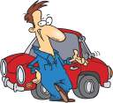
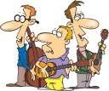




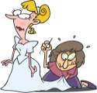



Slide 12
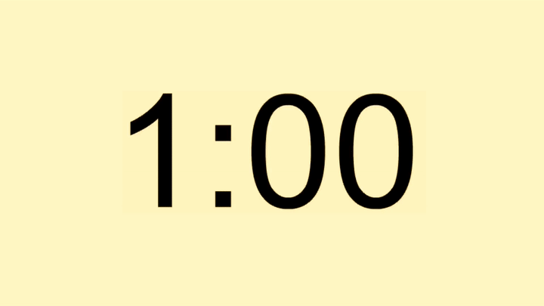

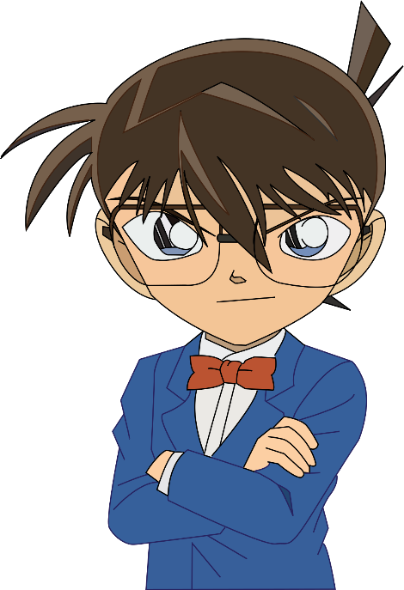
Find the fib
Mona has three sister.
Mona has three sisters.

Slide 13
Find the fib
There are four child in my family.
There are four children in my family.

Slide 14
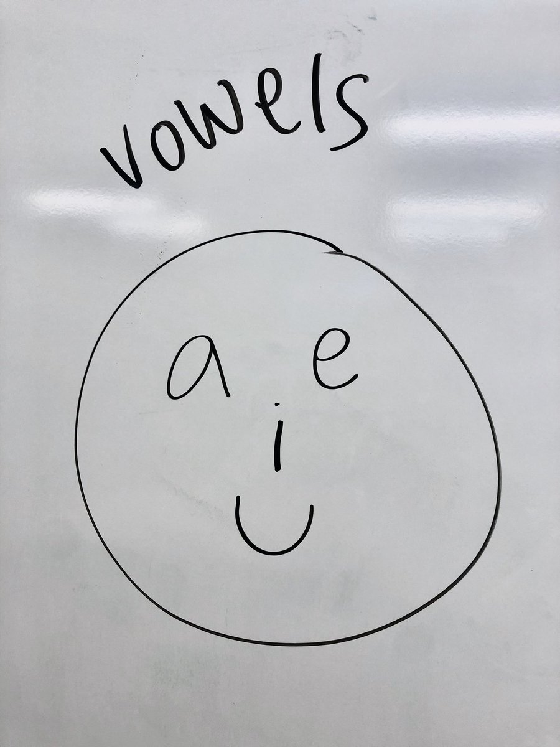
Page 47

Slide 15
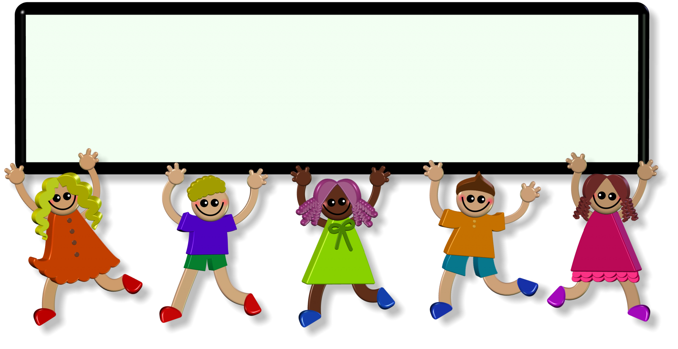

Evaluation
https://quizizz.com/admin/quiz/5f9eeebb3b84b0001bcf0066
https://www.liveworksheets.com/nt578475je

Slide 16
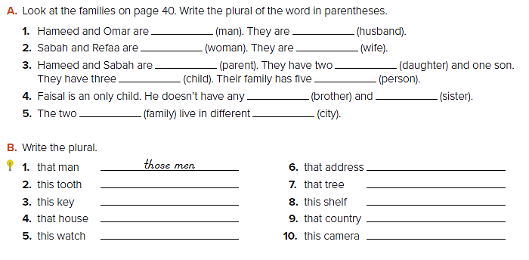

Page 47
men
women
parents
children
brothers
families
husbands
wives
daughters
people
sisters
cities
Those addresses
Those trees
These shelves
Those countries
These cameras
These teeth
These keys
Those houses
These watches

Slide 17
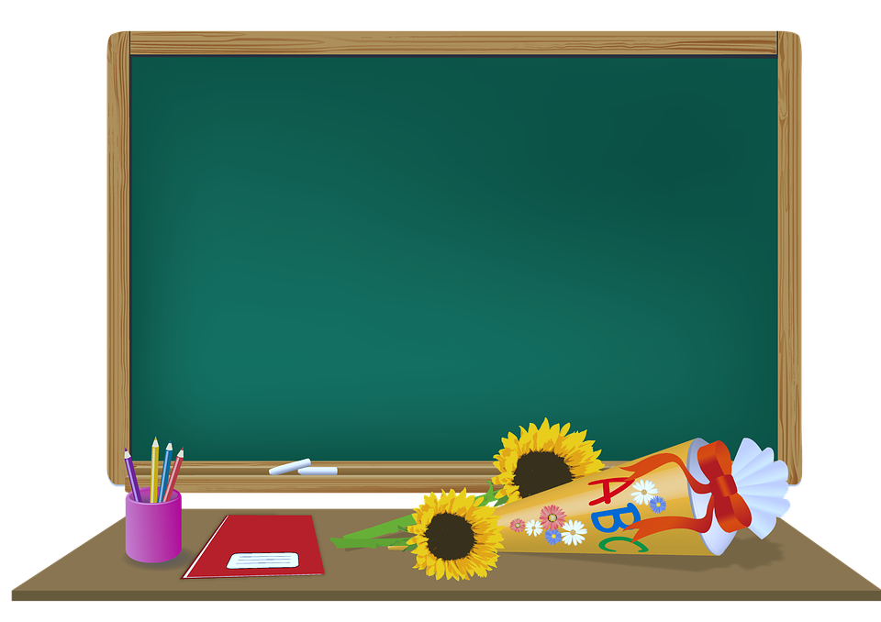
Homework:
Page: 110

Slide 18
Thank you
Have a nice day

