Slide 1




Unit 4:
Around the World

Slide 2
قال تعالى :( يَا أَيُّهَا النَّاسُ إِنَّا خَلَقْنَاكُمْ مِنْ ذَكَرٍ وَأُنْثَى وَجَعَلْنَاكُمْ شُعُوبًا وَقَبَائِلَ لِتَعَارَفُوا إِنَّ أَكْرَمَكُمْ عِنْدَ اللَّهِ أَتْقَاكُمْ إِنَّ اللَّهَ عَلِيمٌ خَبِيرٌ)

Slide 3



Slide 4

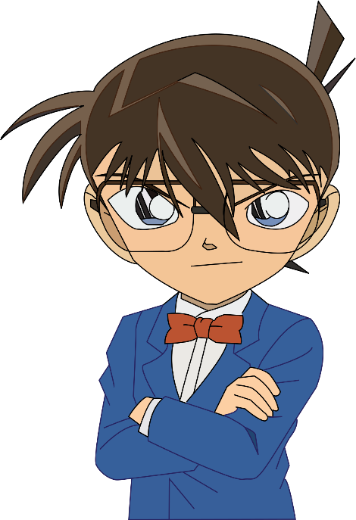
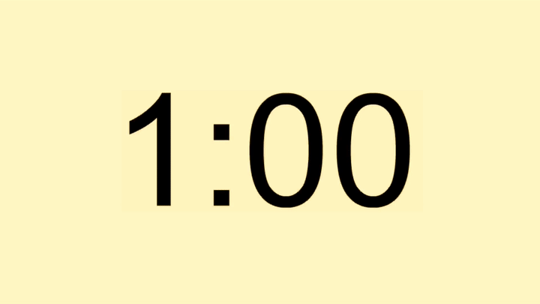
Find the fib
I is from Saudi Arabia.
I am from Saudi Arabia.

Slide 5
Find the fib
She are on vacation.
She is on vacation.

Slide 6
Find the fib
I am on Saudi Arabia.
I am from Saudi Arabia.

Slide 7
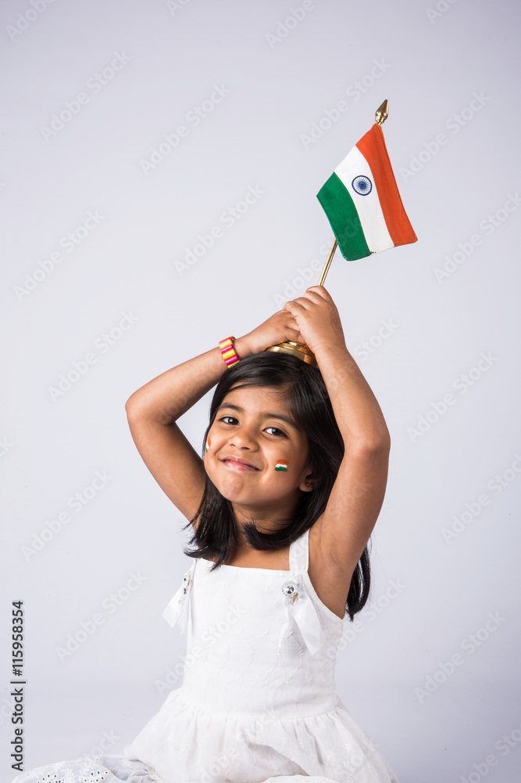
Find the fib
Is she Saudi?
No, she is.
Is she Saudi?
No, she isn’t.

Slide 8
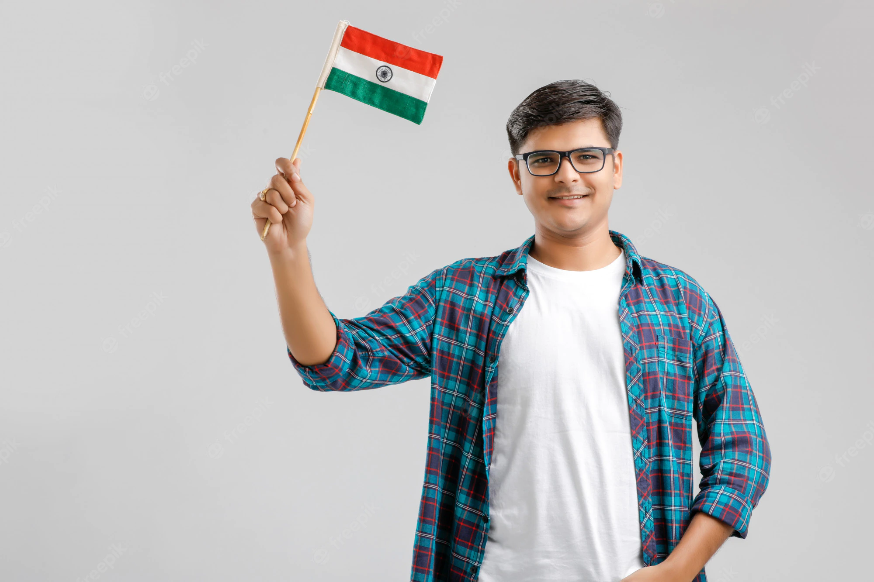
Find the fib
Is he Saudi?
No, she isn’t.
Is he Saudi?
No, he isn’t.

Slide 9

Unit 4:
Around the World
6 Conversation
Page
30

Slide 10
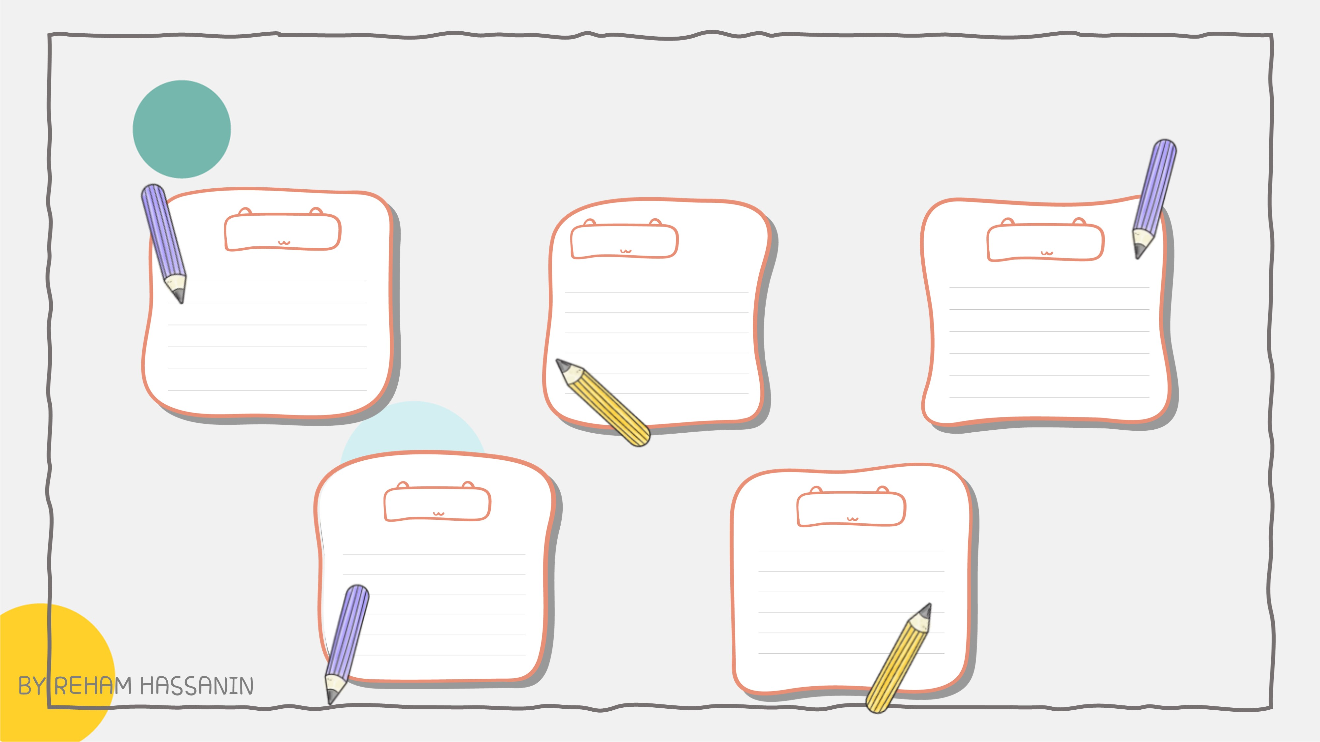


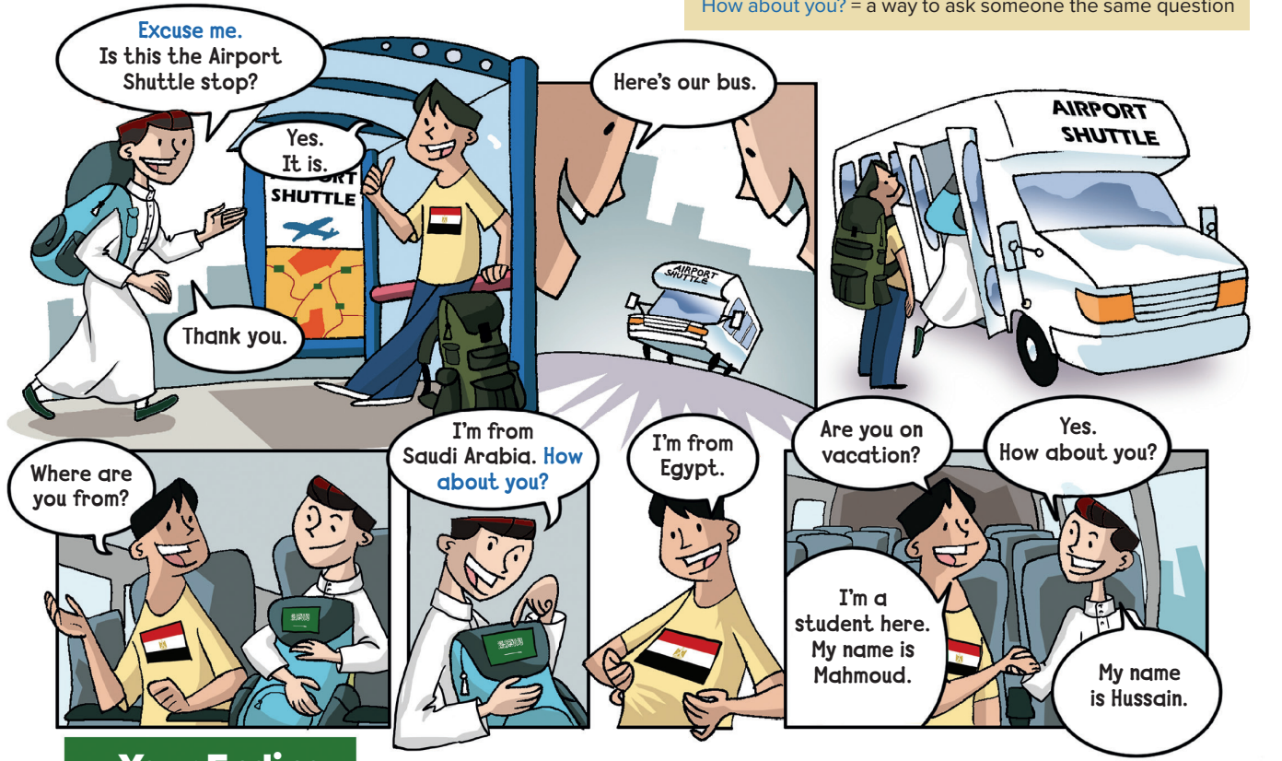
Practice the conversation
Goals :
answer questions about the conversation
Answer questions about personal information

Slide 11



Slide 12
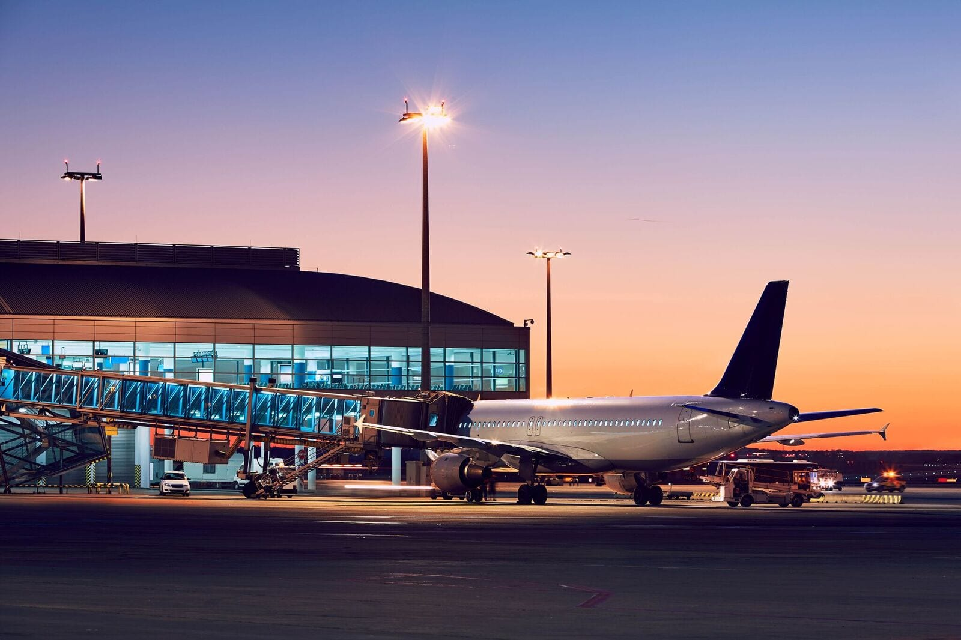
At the airport

Slide 13
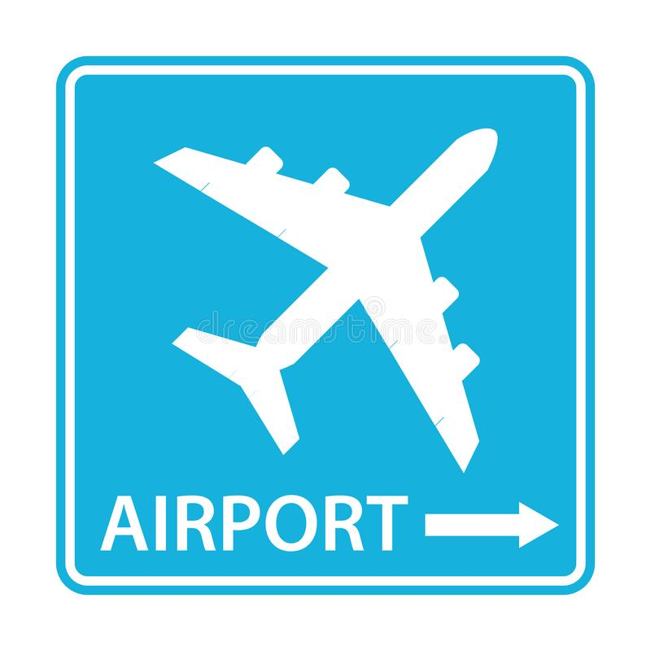
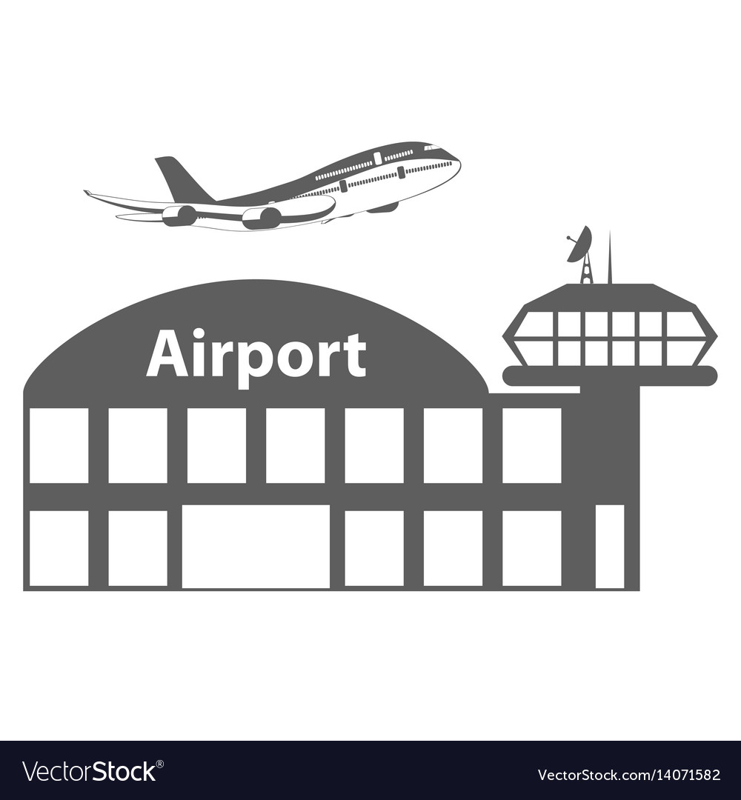
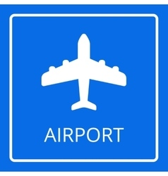

Slide 14
Airports in Saudi Arabia

Slide 15
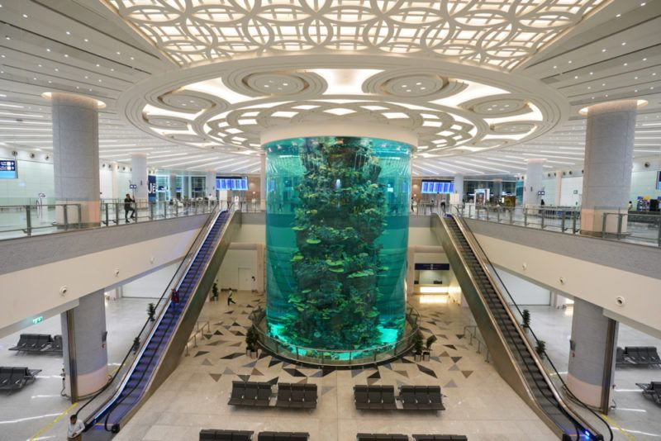
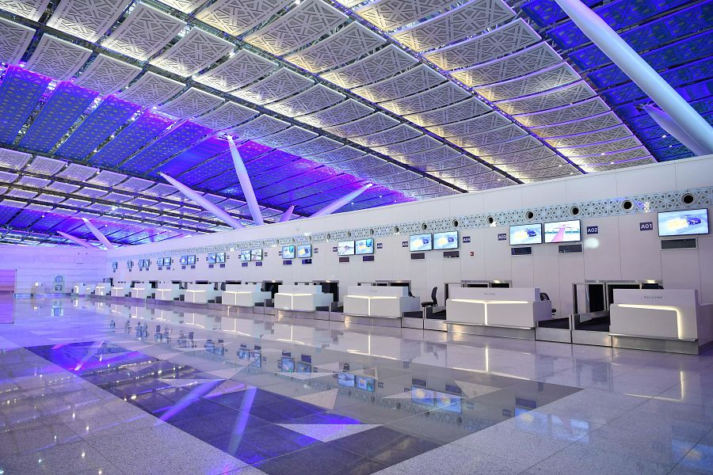
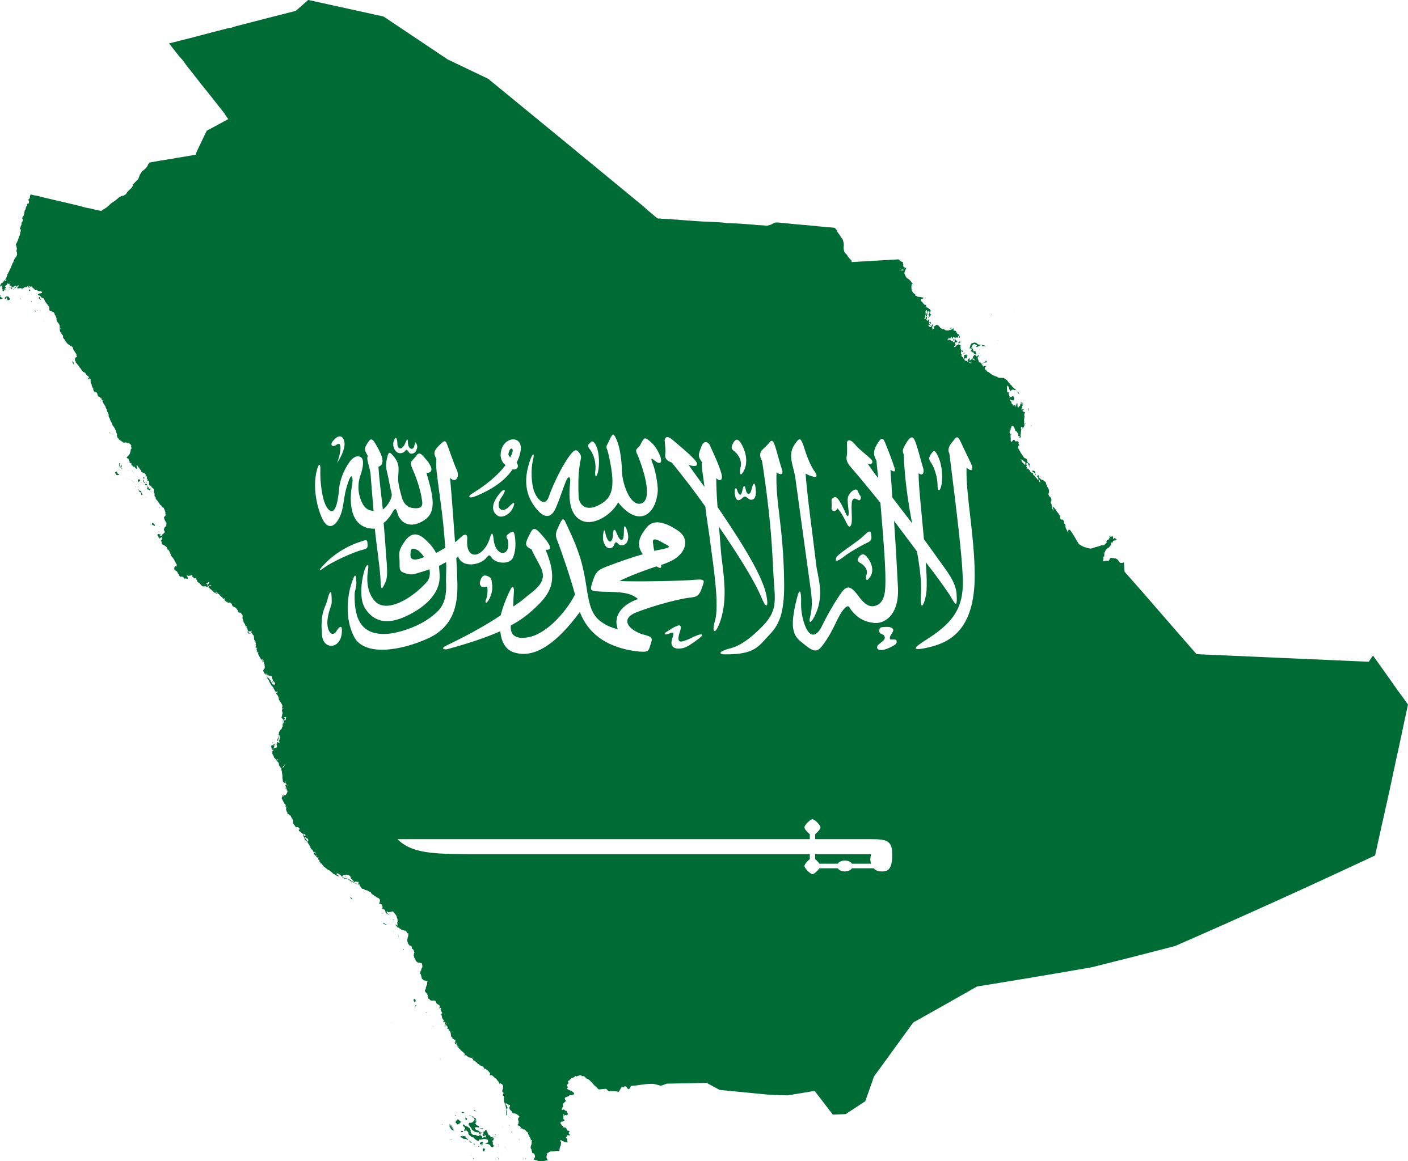

This is King Abdulaziz Airport in Jeddah

Slide 16
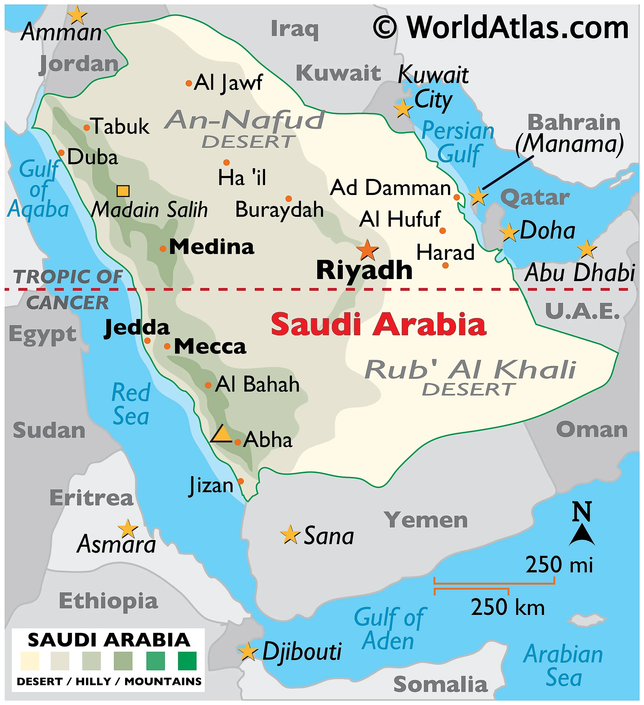
Saudi Arabia
The capital of
Saudi Arabia is Riyadh.

Slide 17

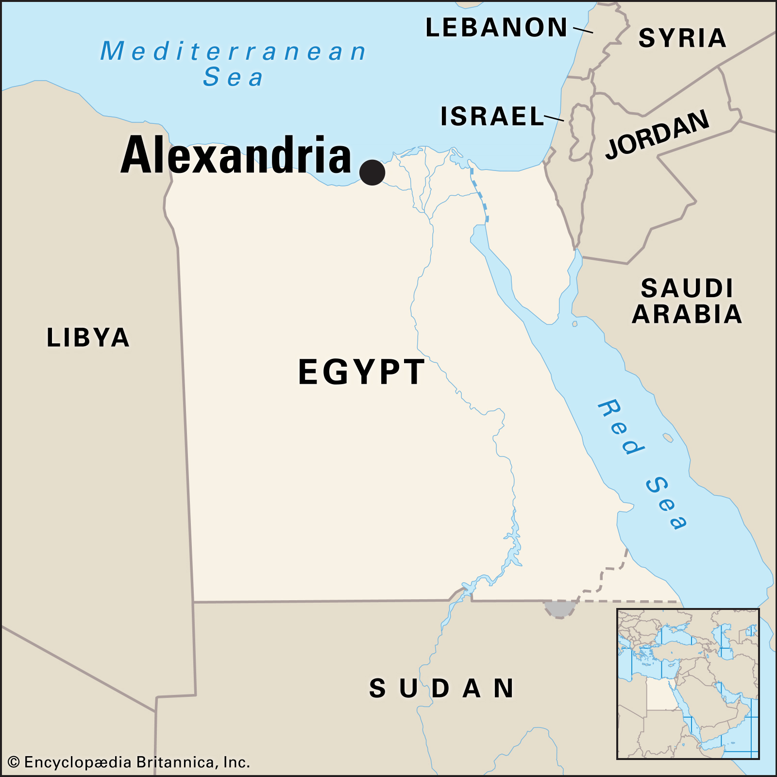
Egypt
The capital of …….
is Cairo.

Slide 18
Excuse me
Excuse me, Where is the bathroom?

Slide 19

Excuse me
https://www.youtube.com/watch?v=jKZSL3_UDRc

Slide 20

Page
30

Slide 21
thirty
30

Slide 22
thirteen
13

Slide 24
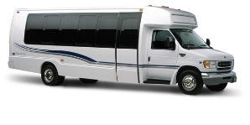

30
Where are the people?
At the Airport

Slide 25
What are their names?
Mahmoud and Hussain
Where is Hussain from?
Saudi Arabia

Slide 26
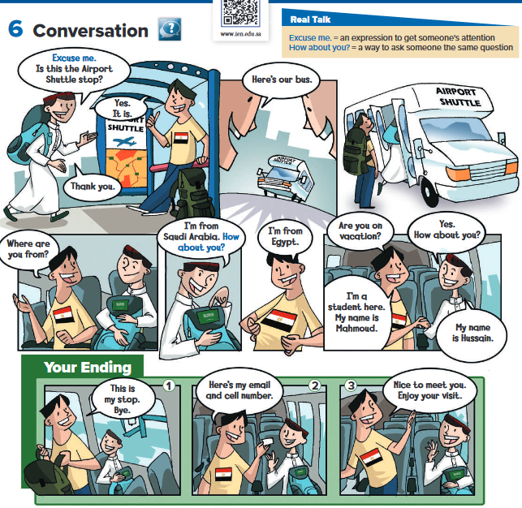
Which ending you think is the most likely?
30
Why did you choose each ending?

Slide 27

30

Slide 28
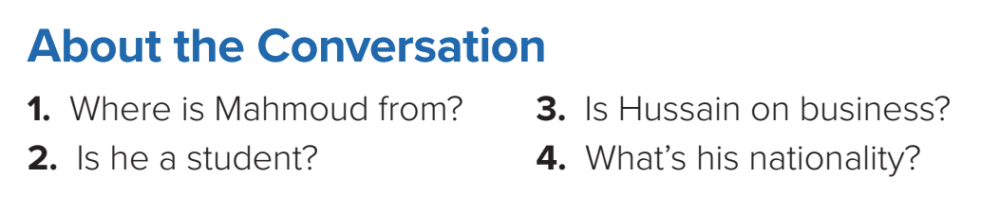
1. He’s from Egypt.
2. Yes, he is.
3. No, he isn’t. He’s on vacation.
4. He’s Saudi.

Slide 29
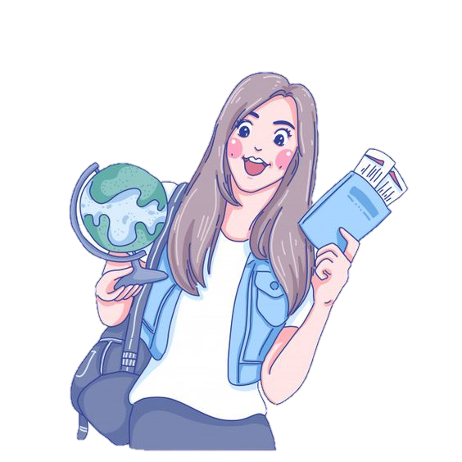



Slide 30

Vocabulary

Slide 31
Vocabulary
language

Slide 32
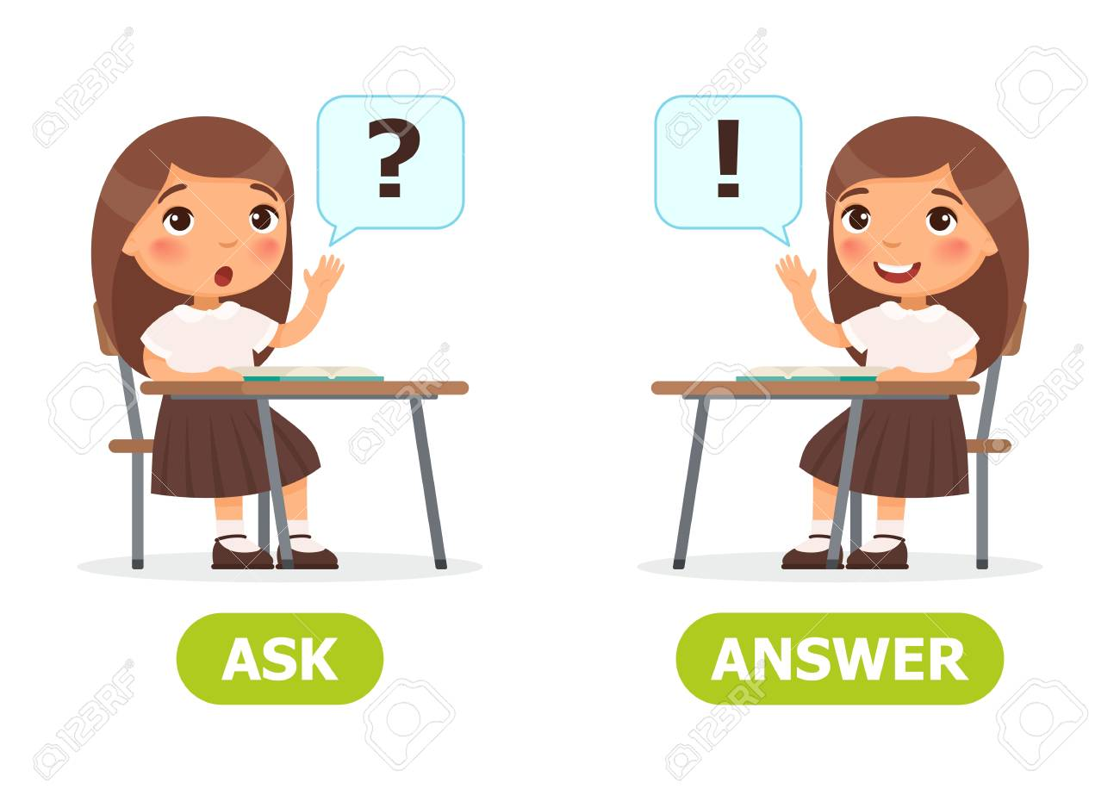

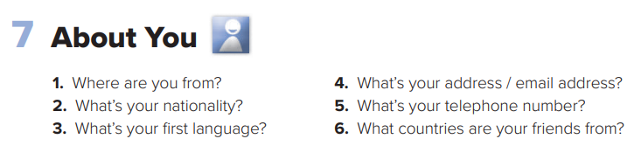

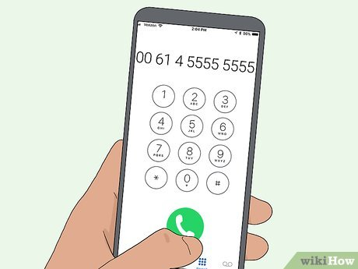

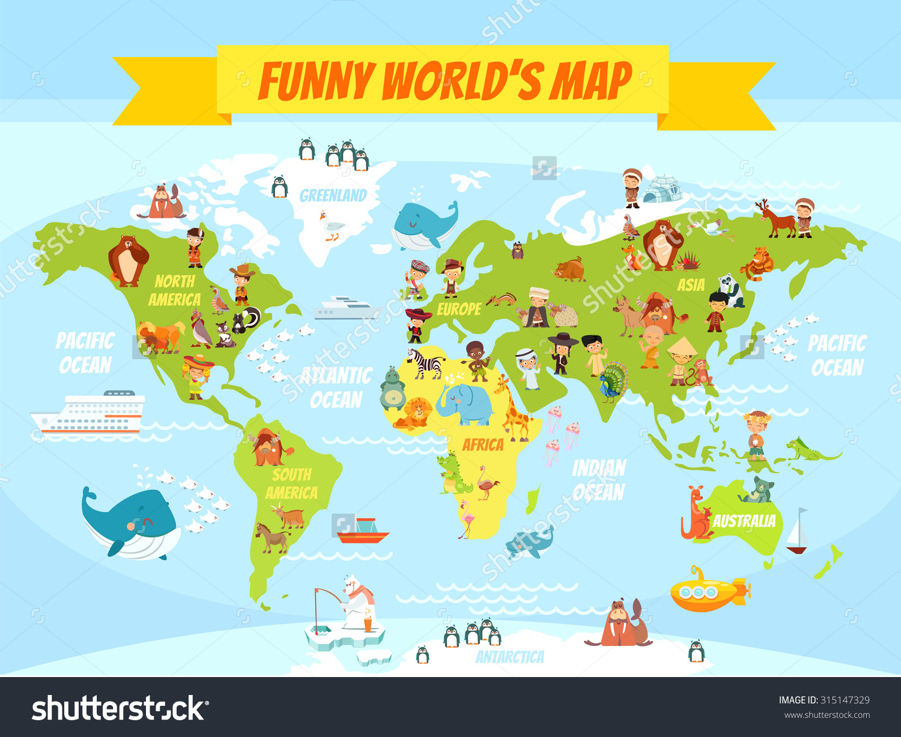
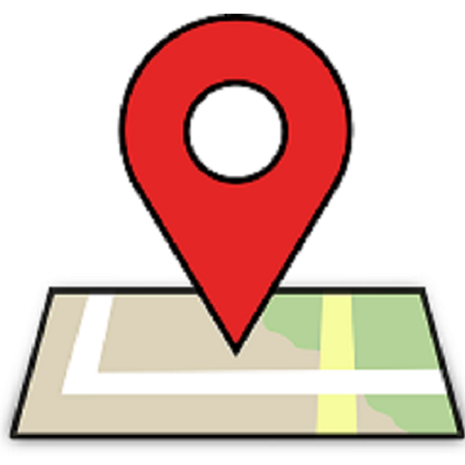
30

Slide 33

30

Slide 34

Page:201
Exercise:
( F)

Slide 35







Assign page 201 for completing the conversation
Exercise F

Slide 36

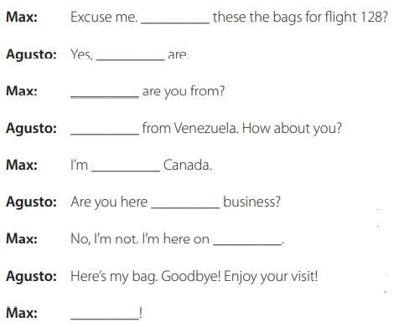
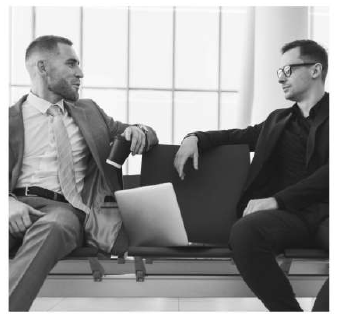
Page 201
Are
they
Where
I’m
from
on
vacation.
Bye!

Slide 37



