Slide 1
Unit 3 what’s that?
Workbook pages (195 – 198)

Slide 2
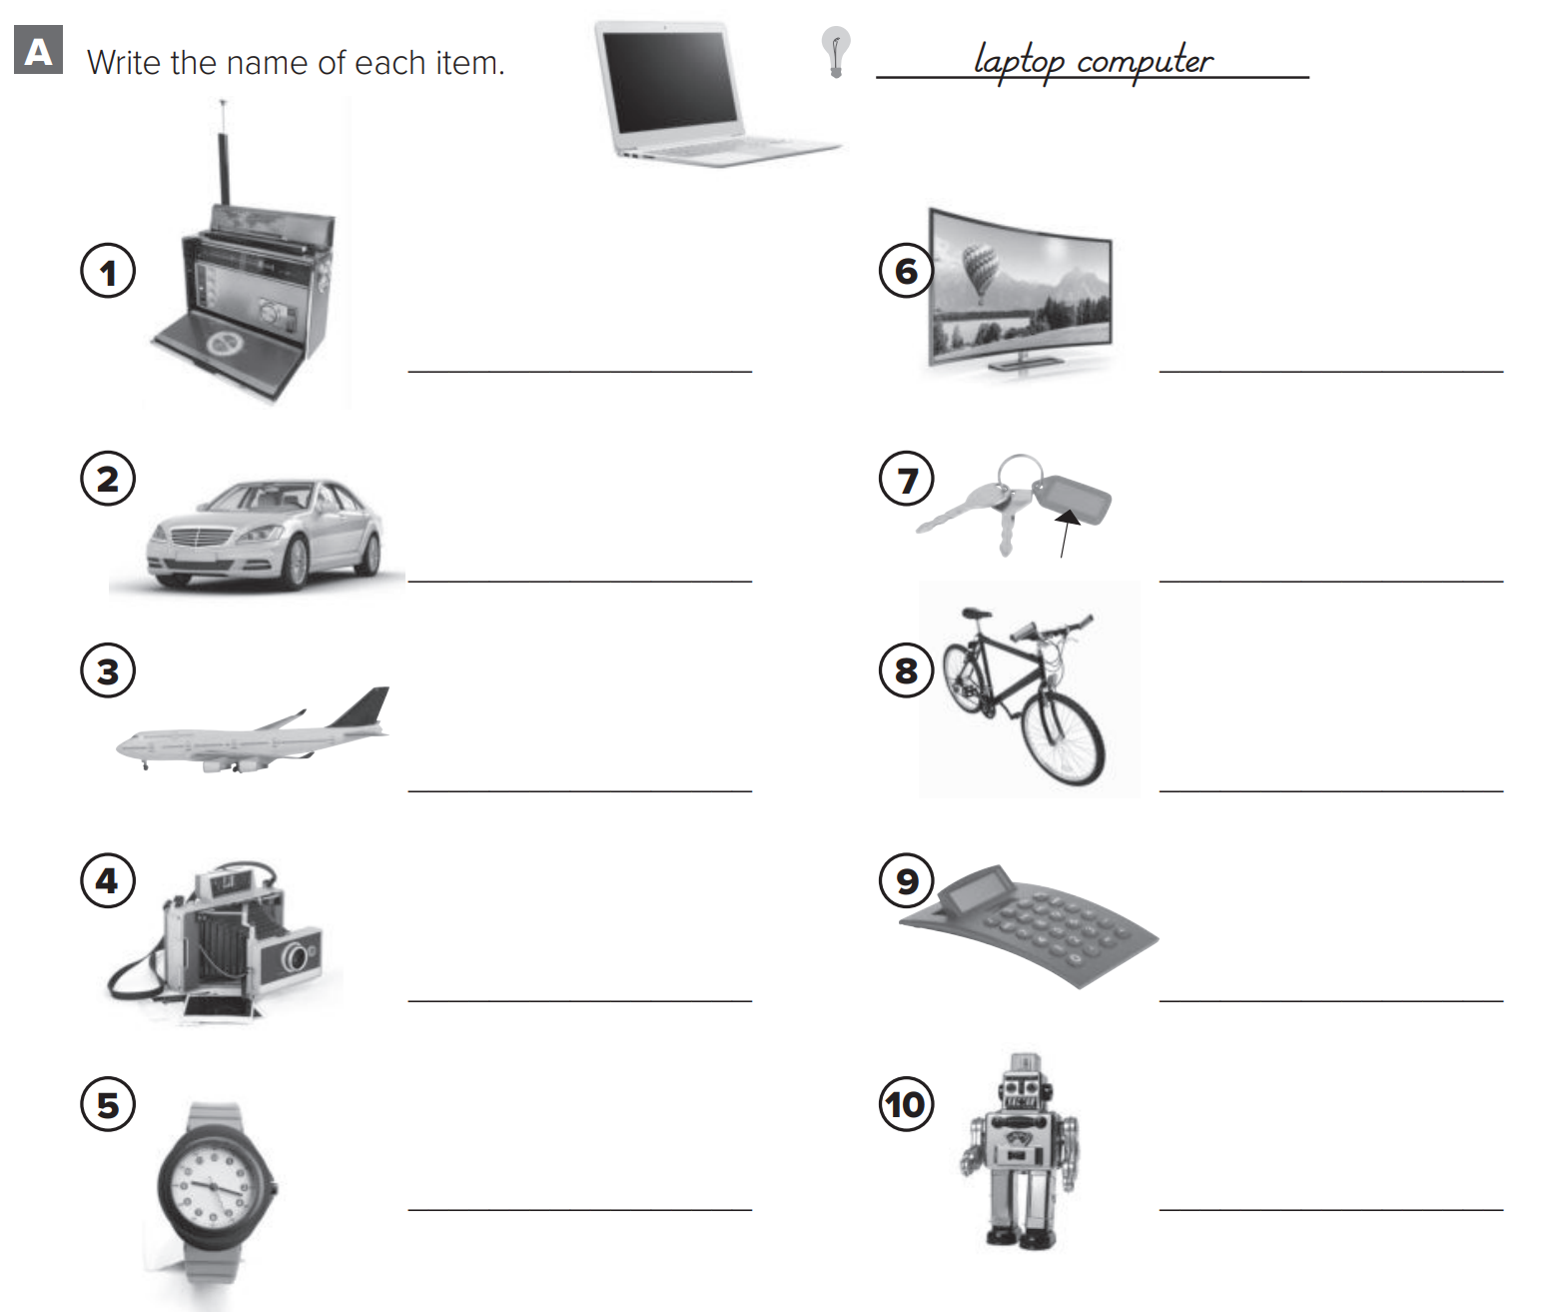
p.195
television
radio
car
Key chain
airplane
bicycle
camera
calculator
watch
toy

Slide 3
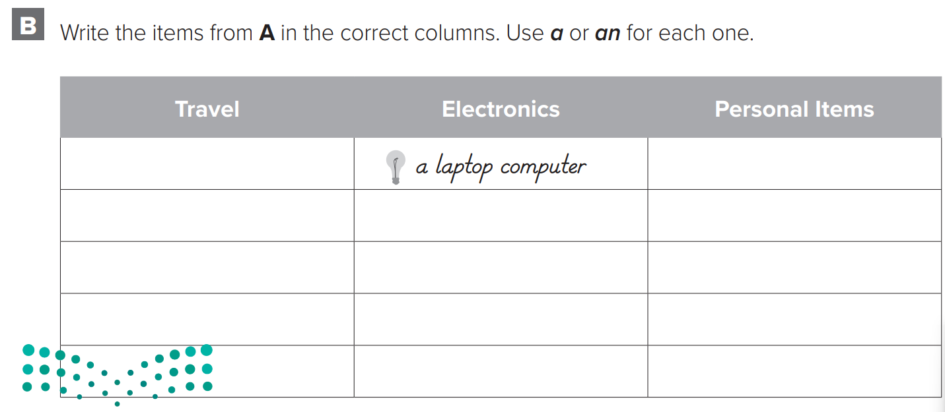
p.195
a bicycle
a watch
an airplane
a radio
a key chain
a car
a camera
a toy
a television
a calculator

Slide 4
p.196
What are those?
They’re calculators
They’re pencils
They’re my keys
Those are cars
They’re her paintings

Slide 5
p.196
Please close the door
Please open the window
Please don’t use cell phone
Please don’t take photographs
Please don’t talk

Slide 6
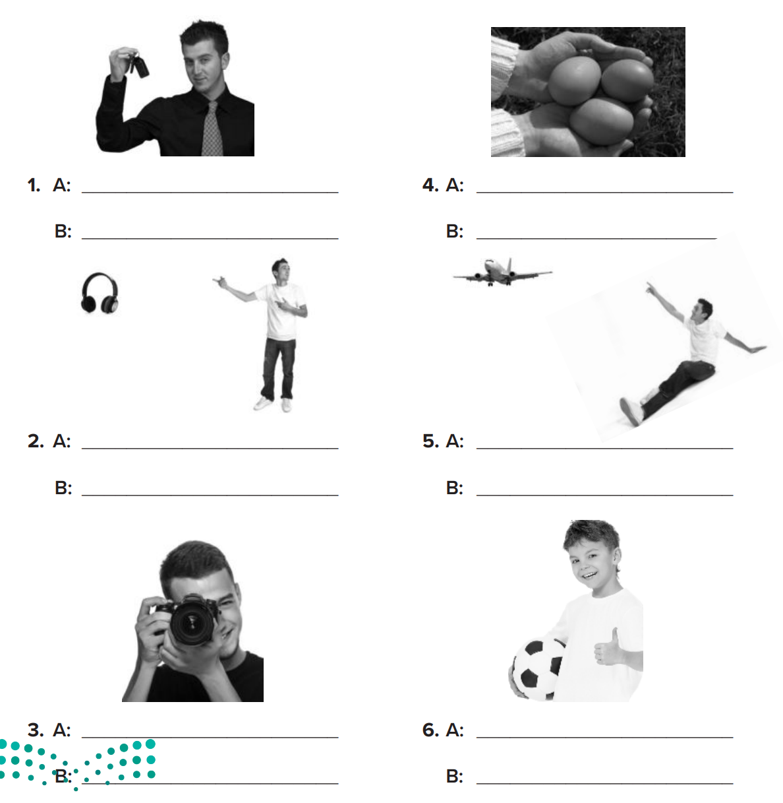
p.197
What are these?
What are these?
They’re keys.
They’re eggs.
What are those?
What is that?
They’re headphones.
It’s an airplane.
What is this?
What is this?
It’s a camera.
It’s a ball.

Slide 7
p.198
These telephones
That pencil
These watches
That dinosaur
These radios

Slide 8
p.198
a key
a toy
a keychain
an egg
a car

Slide 9
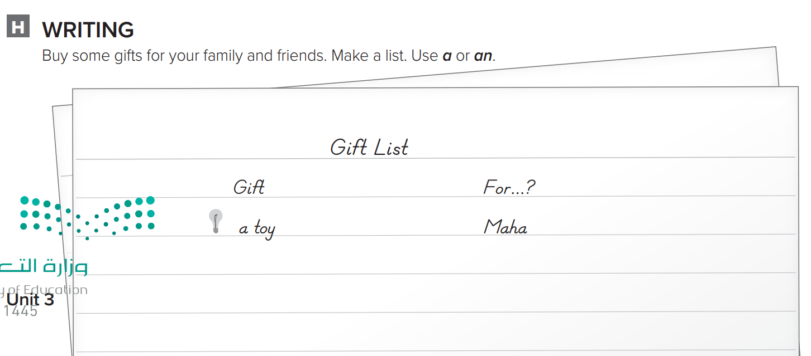
p.198
a cell phone
Wa’ad
a dress
Mom
a cup
My brother

