Slide 1
Revision unit 3
What’s that?
Page 18-25
WB 195 -198

Slide 2
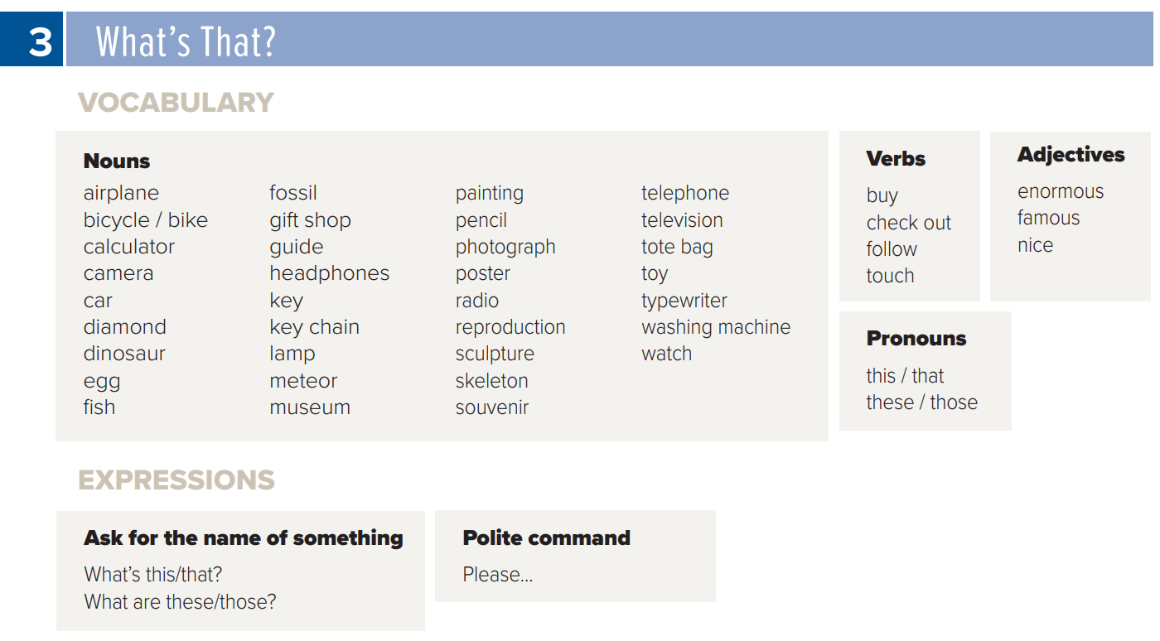
New words
Page 157

Slide 3
vocabulary

Slide 4
It is a …………..
dinosaur
museum
fossil

Slide 5
Please don’t take ………..
photographs
money

Slide 6
It is an old ……….
radio
television

Slide 7
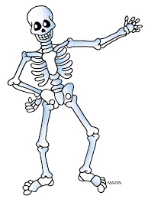
This is a ………….. of a man.
fossil
skeleton
spacecraft

Slide 8
It’s a big ……………
dinosaur
skeleton

Slide 9
We study about our body in ………….
Math
History
science

Slide 10
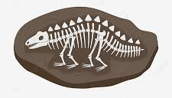
This is a very old …………..
Fish
Fossil
heart

Slide 11
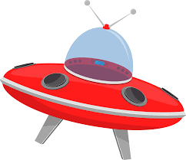
It’s the first …………. to go around the moon
Car
airplane
spacecraft

Slide 12
It is an old ……….
sculpture
watch

Slide 13
1
Choose the correct answer:
……………. is something kids play with.
A
B
C
toy
watch
telephone

Slide 14
2
painting is a ……………………..
A
B
C
souvenir
poster
gift

Slide 15
3
Check out those bags. = ……
A
B
C
take
get
Look at

Slide 16
4
The opposite of enormous# …
A
B
C
small
big
huge

Slide 17
5
This museum has many exhibits = …………………..
A
B
C
rocks
years
shows

Slide 18
6
………….. is something new.
A
B
C
old
invention
big

Slide 19
7
The skeleton of a dinosaur is ….
A
B
C
Very big
small
new

Slide 20
8
The opposite of ……….. # old
A
B
C
new
small
short

Slide 21
grammar

Slide 22
Rearrange:
like those in the sky I stars
I like those stars in the sky.

Slide 23
01
Choose the correct answer:
Please , ………. down
A
B
C
sits
sitting
sit

Slide 24
02
(+) Please come in
(-) please ………… come in
A
B
C
no
don’t
not

Slide 25
03
……………. books are mine.
A
B
C
That
This
These

Slide 26
04
He likes ………… car
A
B
C
that
these
those

Slide 27
05
This is a classroom. …….. classroom is small.
A
B
C
The
a
an

Slide 28
06
I see ……… airplane. The airplane is big
A
B
C
the
a
an

Slide 29
07
look in …….. sky. You can see the moon
A
B
C
the
a
an

Slide 30
08
…….Riyadh is the capital of KSA.
A
B
C
The
A
-----

Slide 31
09
A: what ………. Those ?
B: They’re keys.
A
B
C
is
are
am

Slide 32
10
……………. open your book.
A
B
C
Thank you
What
Please

Slide 33
Correct the mistake:
I want this dresses.
I want these dresses

Slide 34
Listen & Say

Slide 35
Listen and
Answer about you:

Slide 36
Prepared By
Dalal Al-Juaid
t.me/dalalforenglish

