Slide 1
1 Listen & discuss 2 pair work
Today:
Date:
- -1445
Page 26
By: Dalal Al-Juaid

Slide 2
answer questions related to pictures
ask questions about countries and nationalities
Warm up
1-Listen
identify capitals of given countries
New words
Quick check
Perform a conversation about countries.
2-Pair work

Slide 3
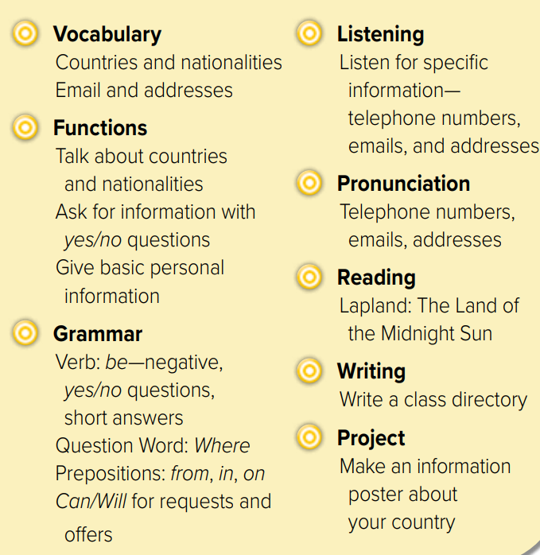

Slide 4
Make a question
Warm up
1-Listen
New words
Quick check
2-Pair work

Slide 5
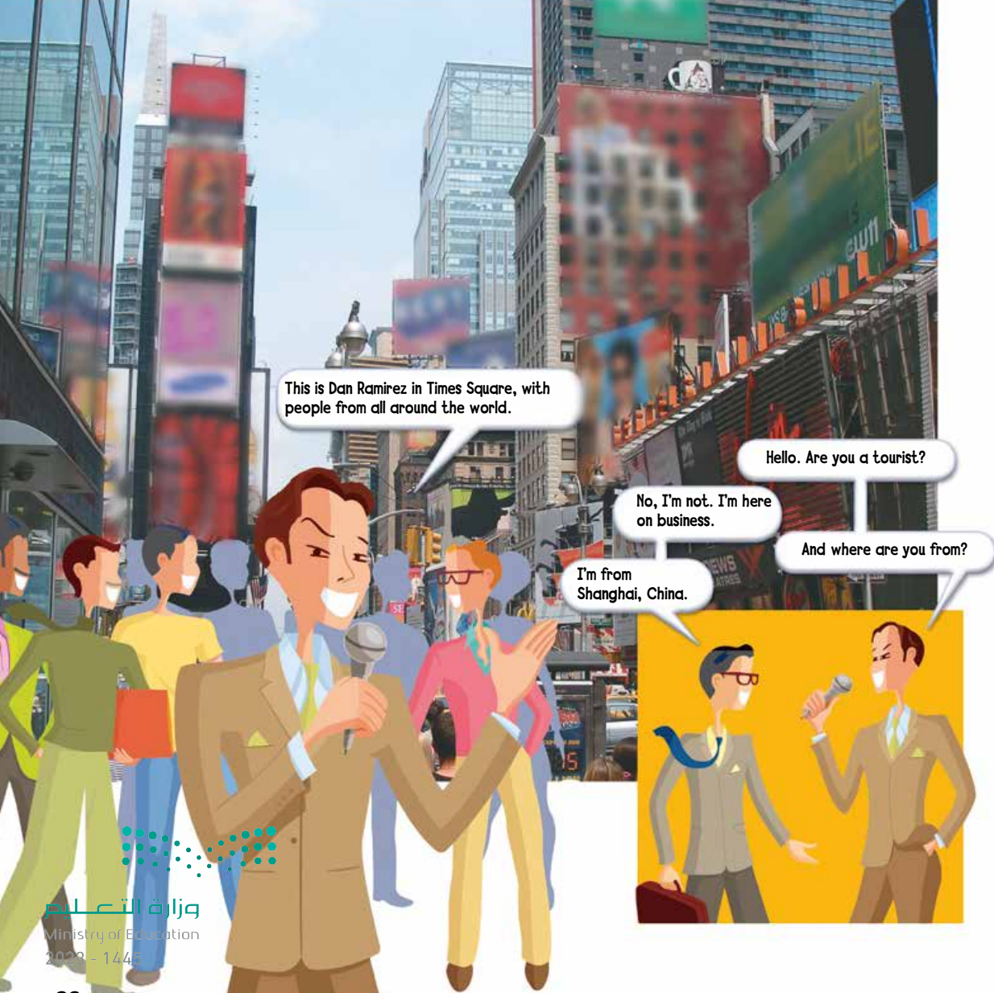
Find a name of a country
Warm up
1-Listen
New words
Quick check
Who is this man?
2-Pair work

Slide 6
Page 26
Where are they?
Warm up
1-Listen
New words
Quick check
2-Pair work

Slide 7
Where are John & Paul from?
Page 27
What’s their nationality?
Warm up
1-Listen
New words
Where is Tom from?
Quick check
What’s his nationality?
2-Pair work

Slide 8
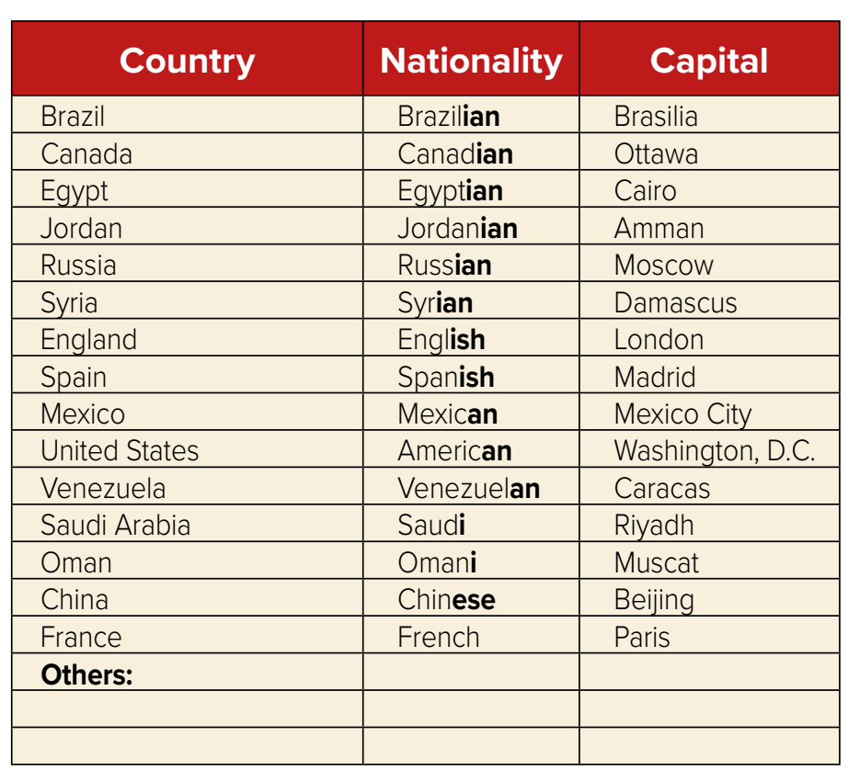
What’s your nationality?
Where are you from?
Page 27
Warm up
1-Listen
New words
Quick check
2-Pair work

Slide 9
viewers
people who are watching the television program
New Words
tourist
someone traveling
on vacation
The world
country
Saudi Arabia
nationality
Saudi
capital
Riyadh
On business
On vacation
#
for work
for fun

Slide 10
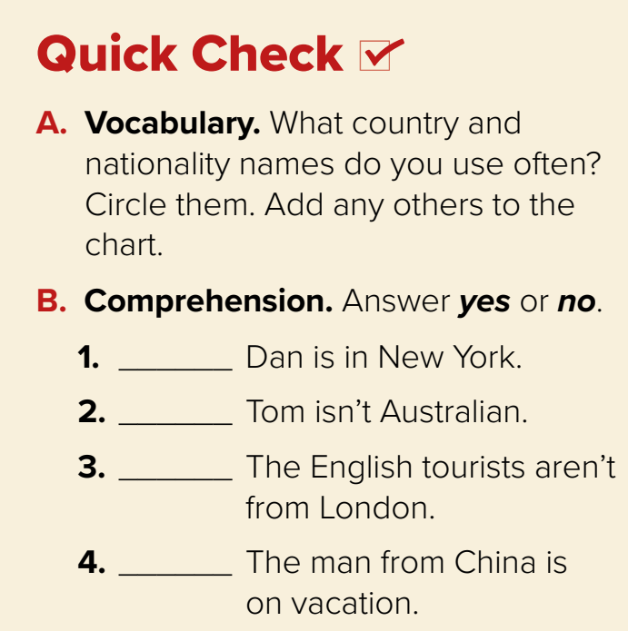
Think pair share
yes
no
Warm up
1-Listen
yes
New words
no
Quick check
2-Pair work

Slide 11
Lets play
Warm up
1-Listen
New words
Quick check
2-Pair work

Slide 12
Warm up
1-Listen
New words
Quick check
2-Pair work

Slide 13
page 199 Ex(A-B)
for practice new words
Warm up
1-Listen
New words
Quick check
2-Pair work

Slide 14
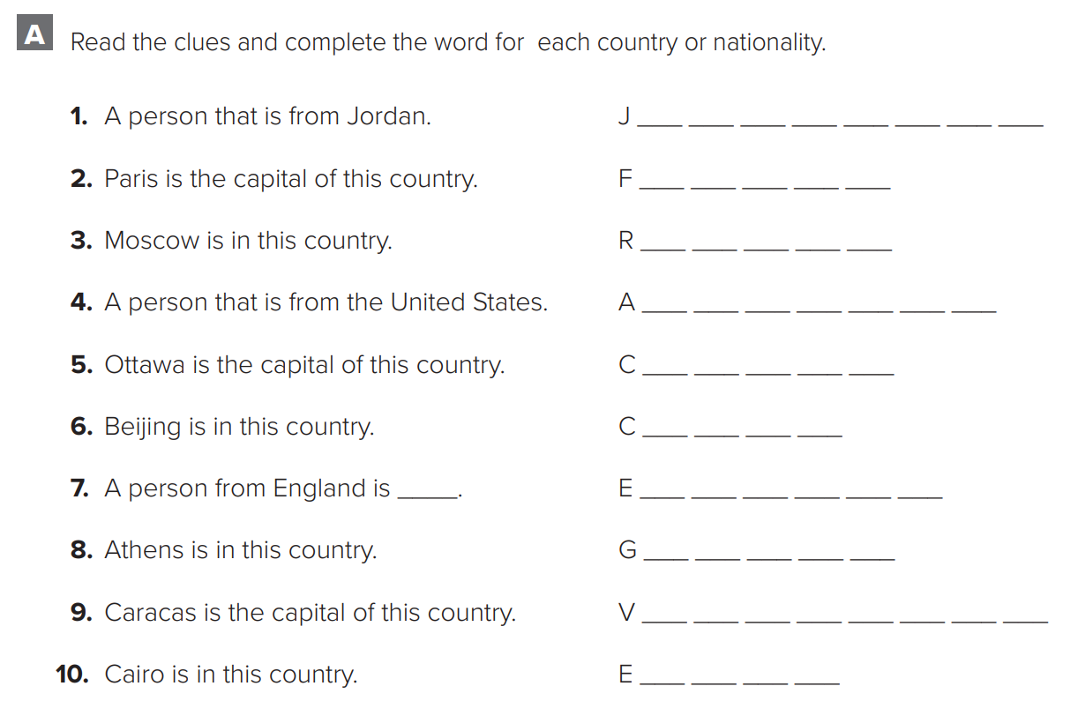
p.199
o
r
d
a
n
i
a
n
r
a
n
c
e
u
s
s
i
a
m
e
r
e
c
a
n
a
n
a
d
a
h
i
n
a
Warm up
n
g
l
i
s
h
1-Listen
r
e
e
c
e
New words
e
n
e
z
u
e
l
a
Quick check
g
y
p
t
2-Pair work

Slide 15
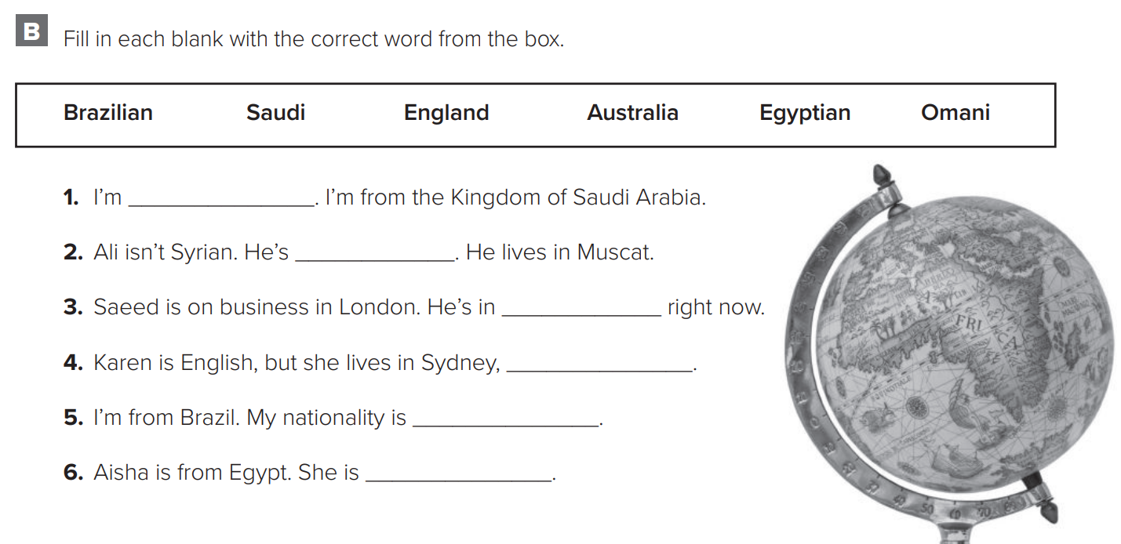
p.199
Saudi
Omani
England
Australia
Warm up
Brazilian
1-Listen
Egyptian
New words
Quick check
2-Pair work

