Slide 1
We can 3

Slide 2


Slide 3
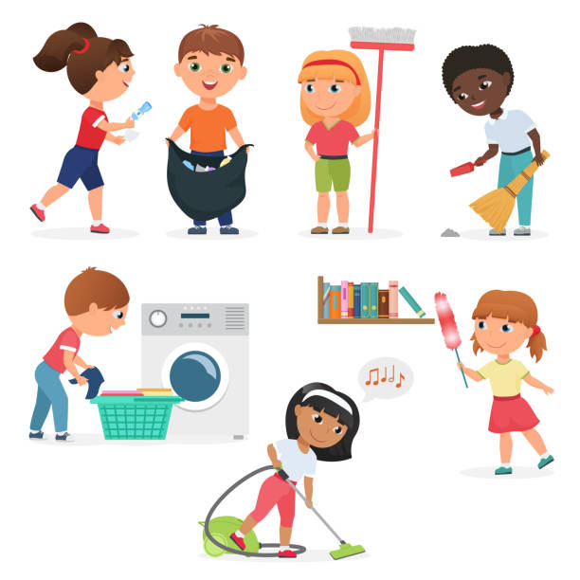


1-What chores do you do?

Slide 4



Slide 5
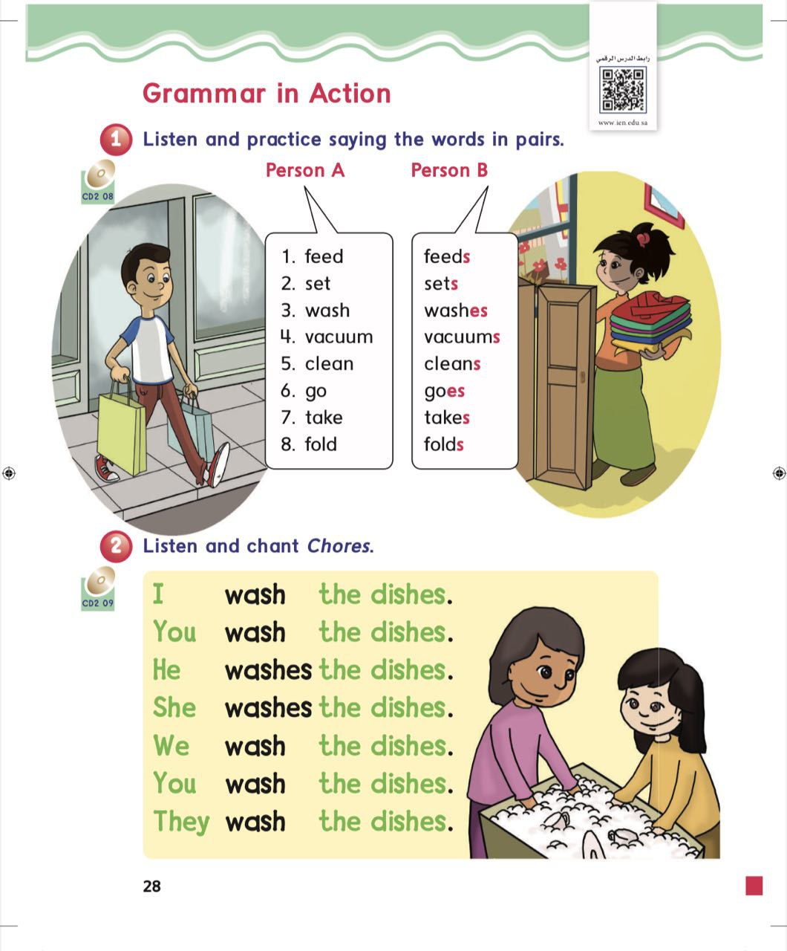
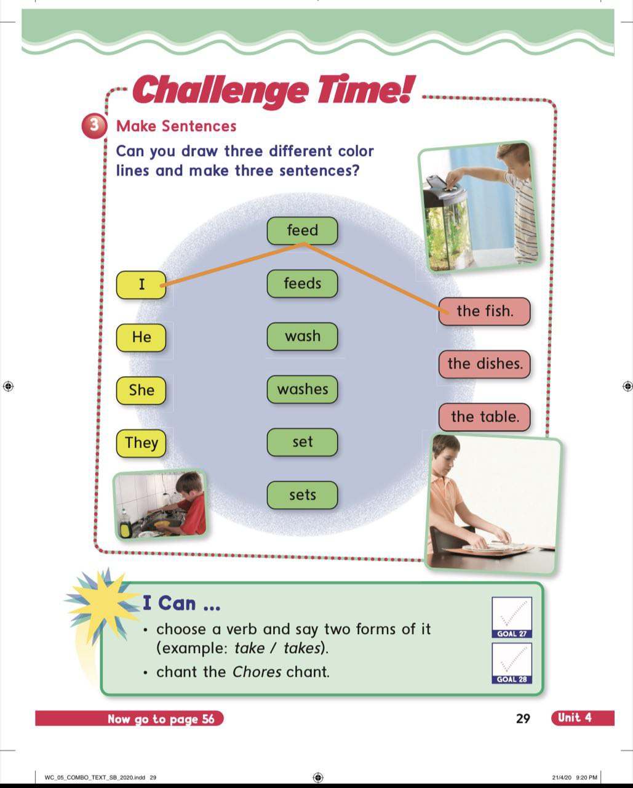

Slide 6
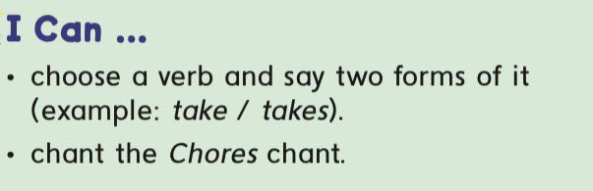
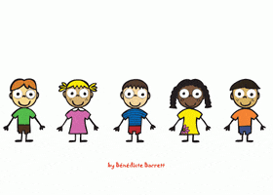

Slide 7
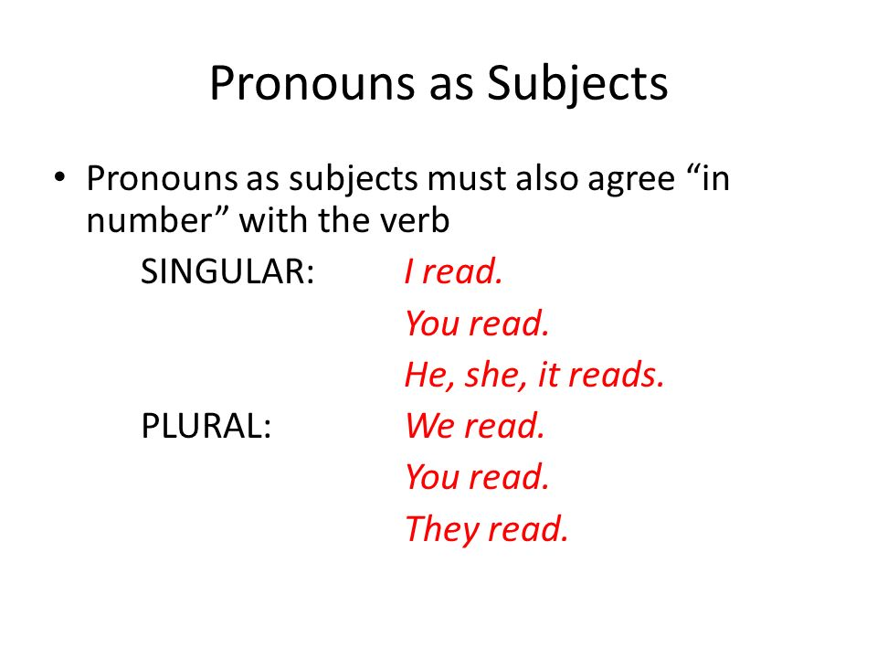

Slide 8
he
she
it
Verb + s

Slide 9

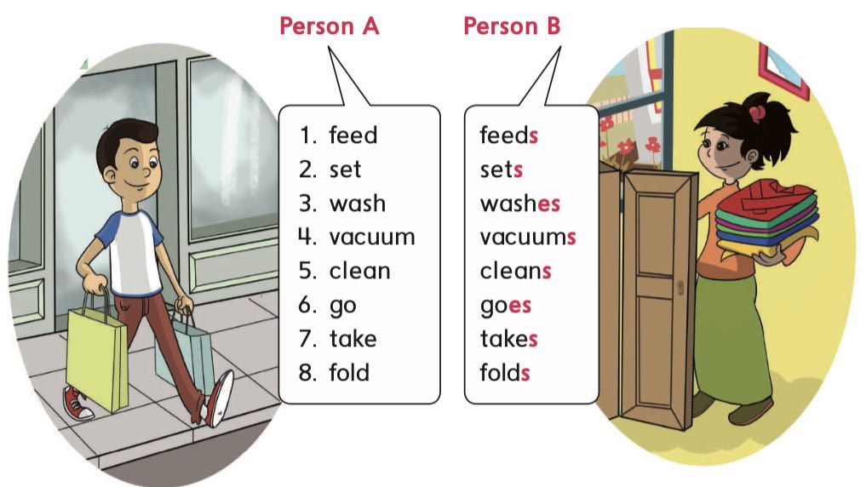

Slide 10

She washes the dishes

Slide 11
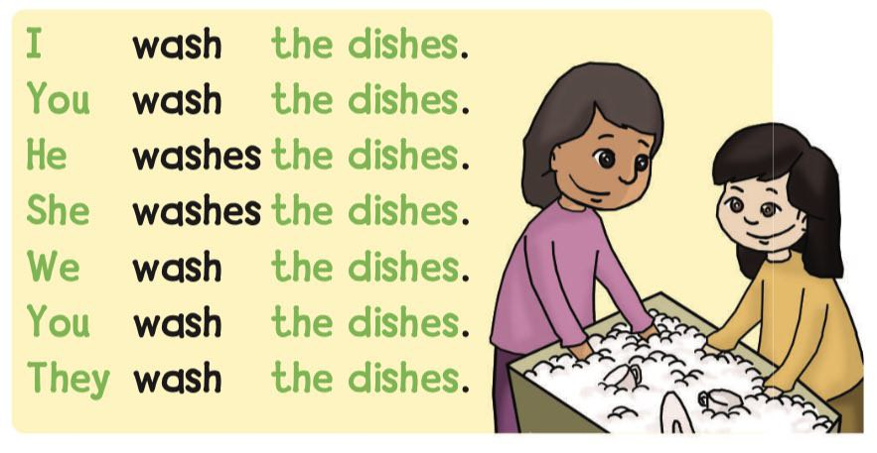

Slide 12
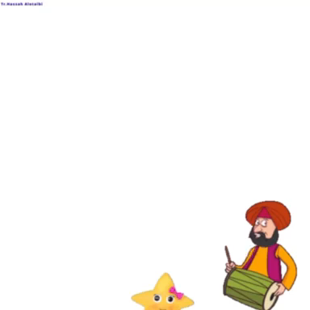


Slide 13


Slide 14
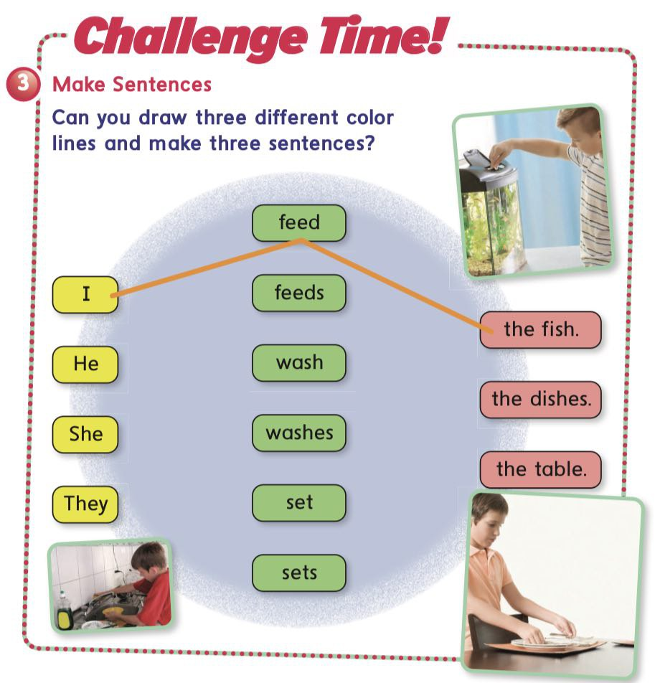

Slide 15


Slide 16











Slide 17

she
feed
The fish
they
feeds

Slide 18
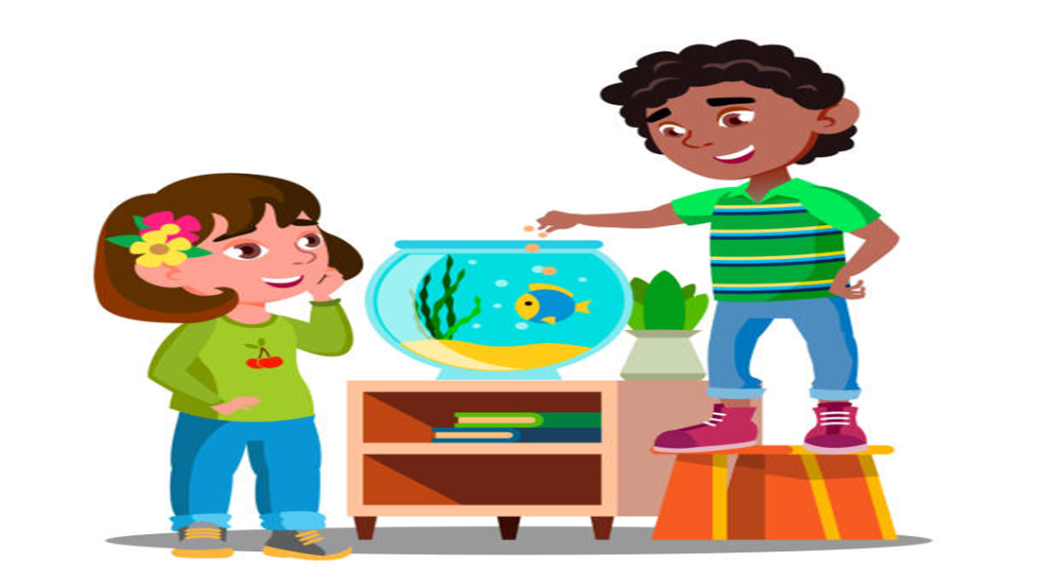
she
feed
The fish
they
feeds

Slide 19
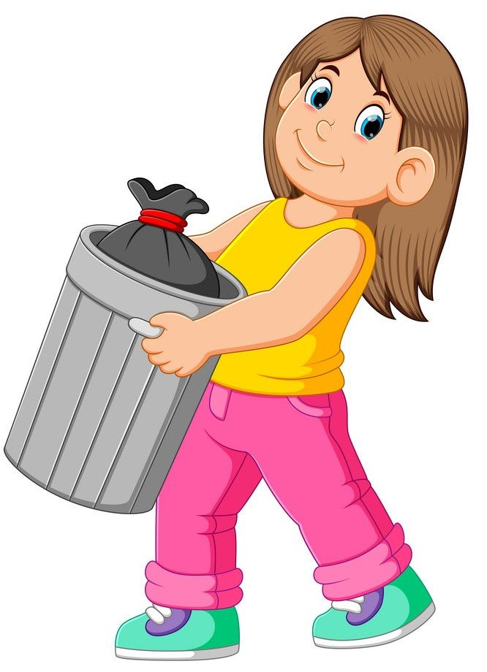
she
take
out the trash
they
takes

Slide 20

she
wash
the dishes
they
washes

Slide 21
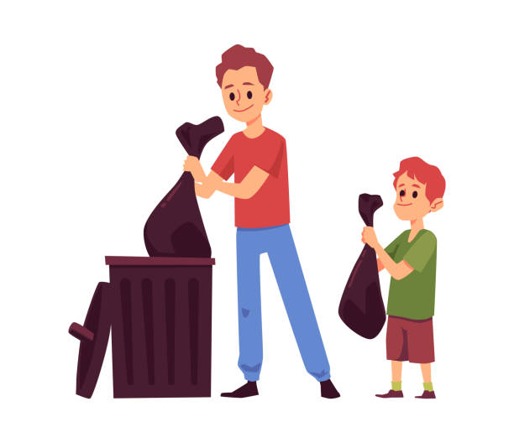
she
take
out the trash
they
takes

Slide 22
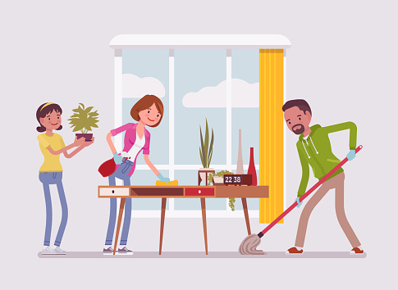
she
clean
the room
they
cleans

Slide 23
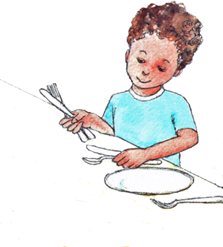
he
sets
the table
they
set

Slide 24

she
goes
shopping
they
go

Slide 25

she
vacuum
the floor
they
vacuums

Slide 26
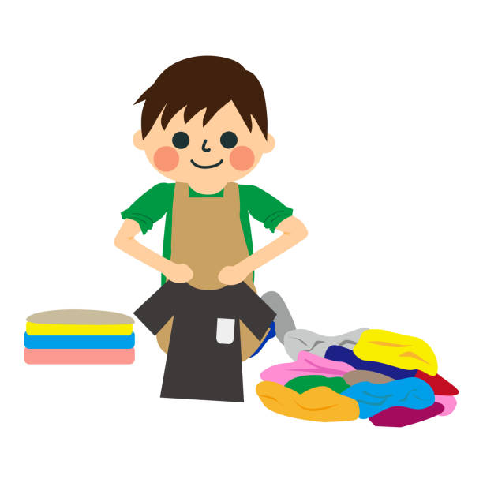
he
folds
the laundry
they
fold

Slide 27



Slide 28



Slide 29





We
He
She
I
They

Slide 30


Slide 34


Slide 39


Slide 44



Slide 49
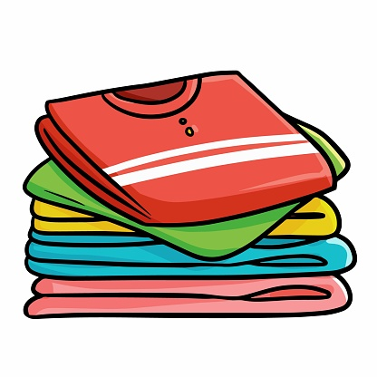

Slide 54


Slide 59



Slide 60

HOMEWORK

Slide 61


Goodbye

