Slide 1
We can 3

Slide 2
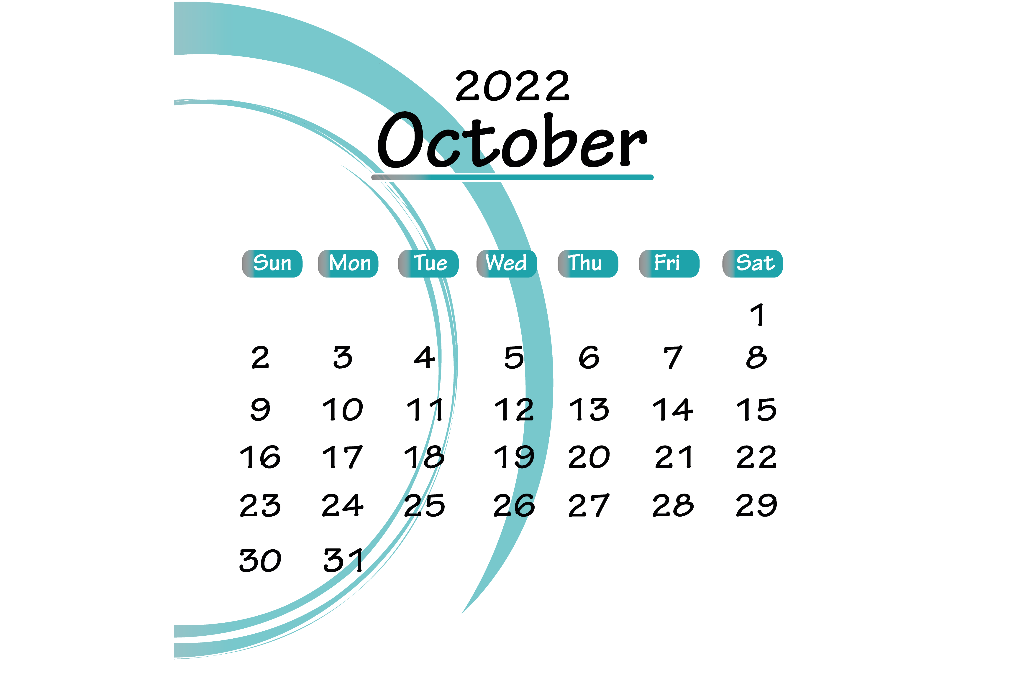

Slide 3
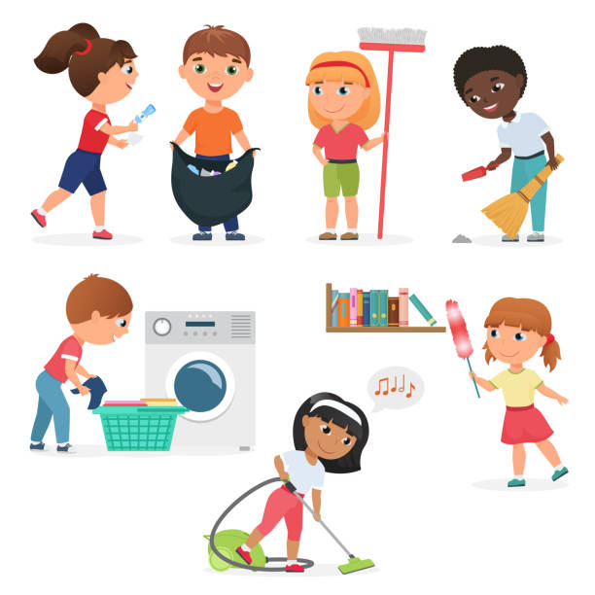


1-What chores do you do?

Slide 4
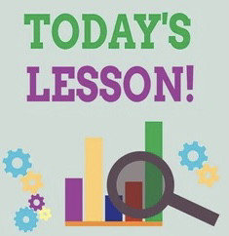
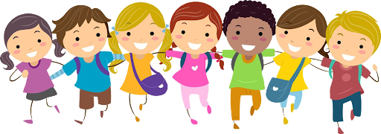

Slide 5
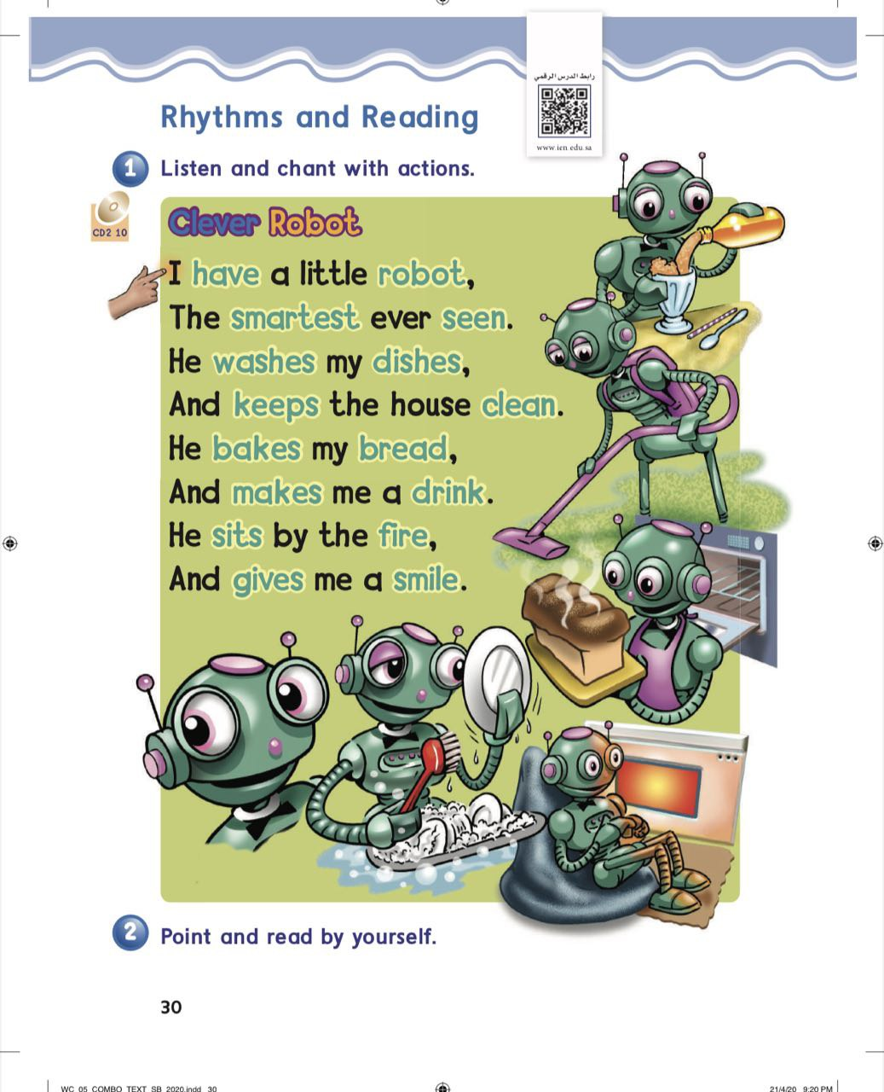
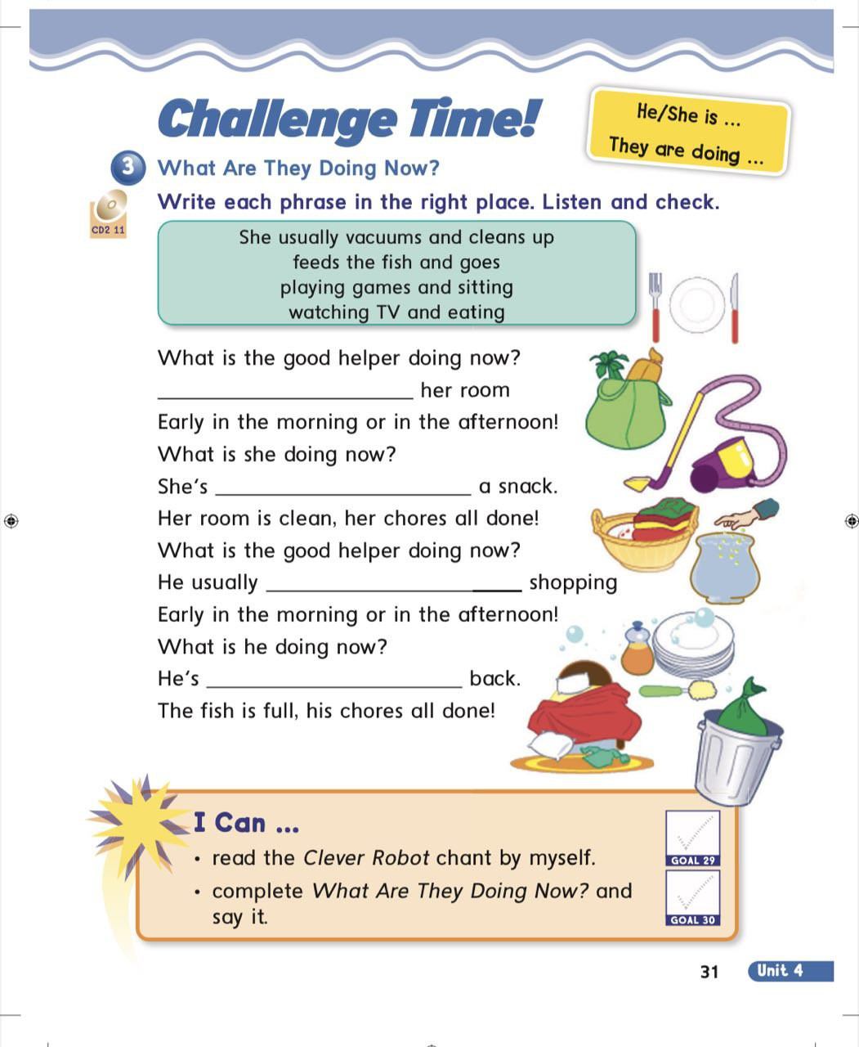

Slide 6
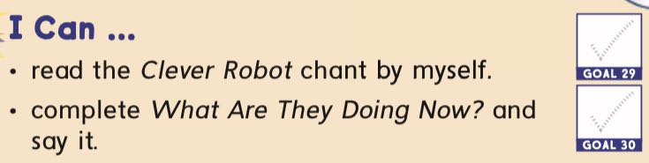
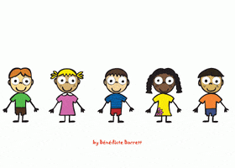

Slide 7



Slide 8
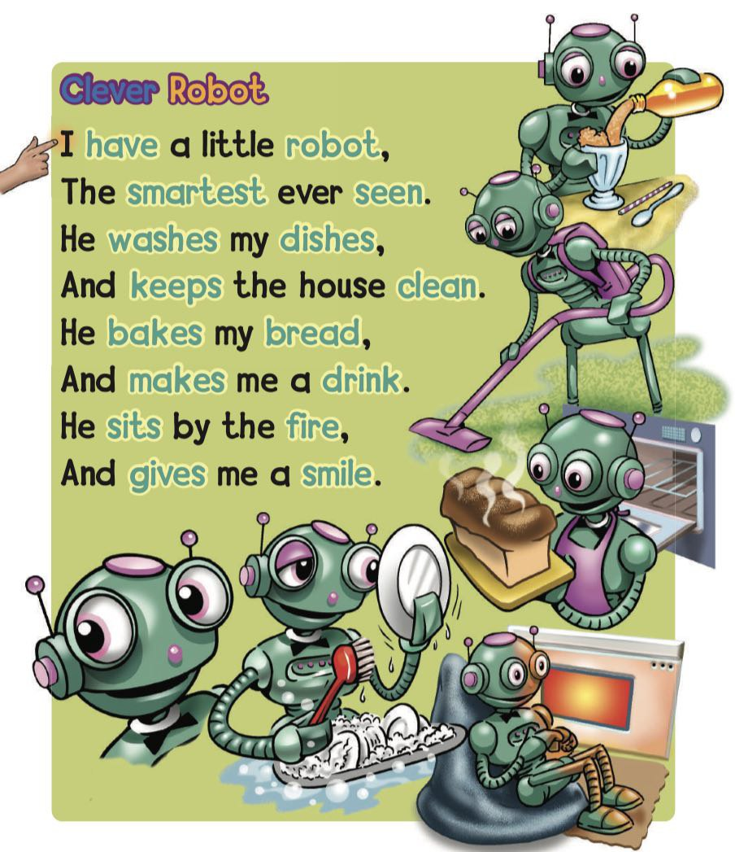

Slide 9


Slide 11


Slide 12
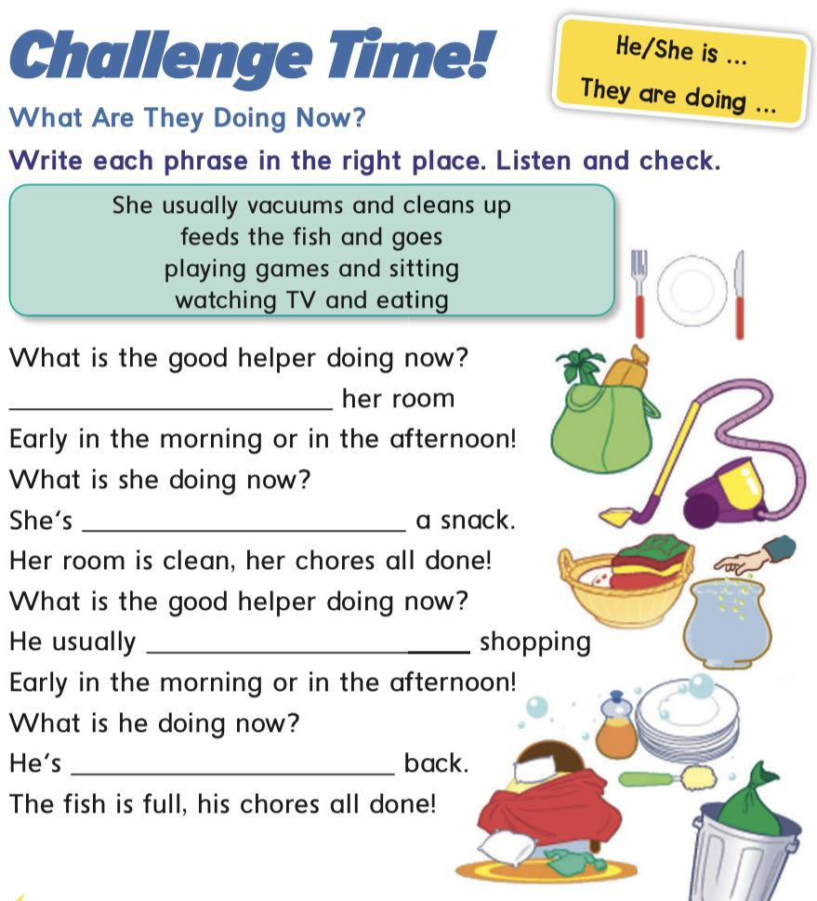

Slide 13
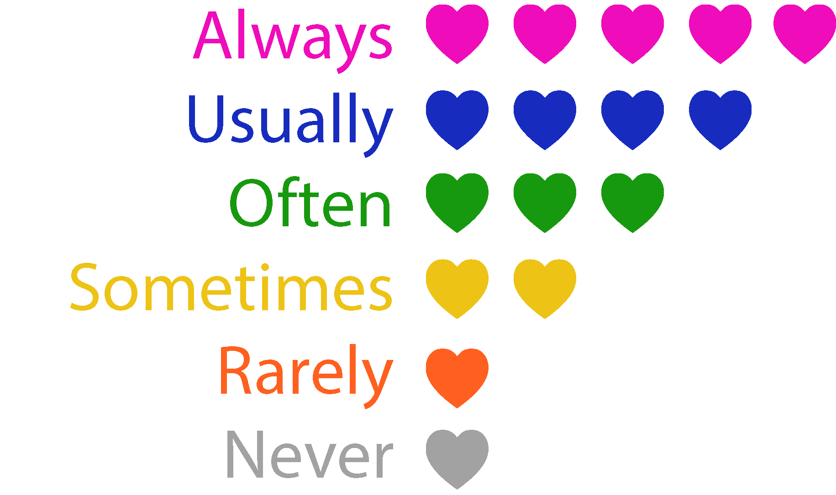

Slide 14
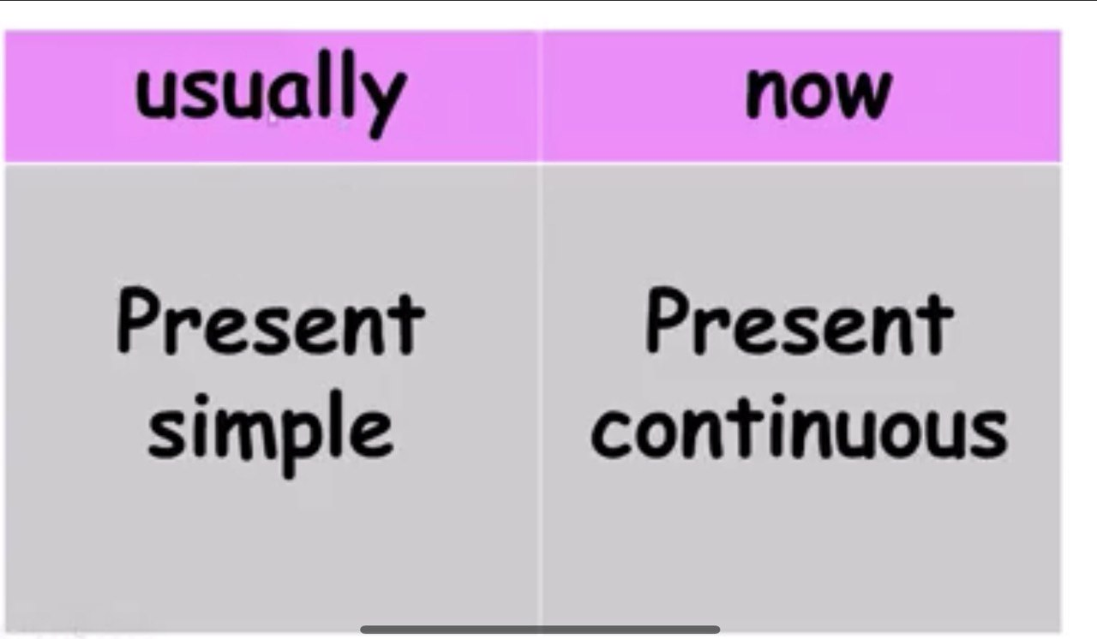

He
she +vs
it
He
she +is + ving
it
you +are + ving
they
we
I
you +v
they
we
I +am + ving

Slide 15
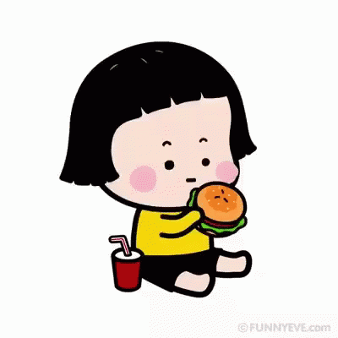
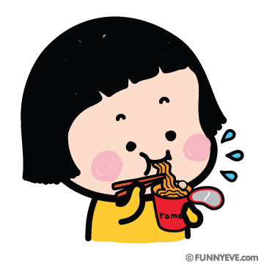
usually
now
she eats noodles
she is eating burger

Slide 16
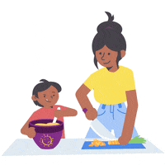

usually
now
My mom and I read
We are cooking

Slide 17
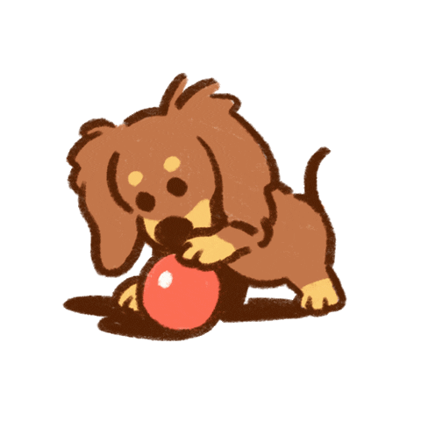
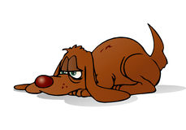
usually
now
The dog sleeps
It is playing with a a ball

Slide 18


Slide 19





Slide 20
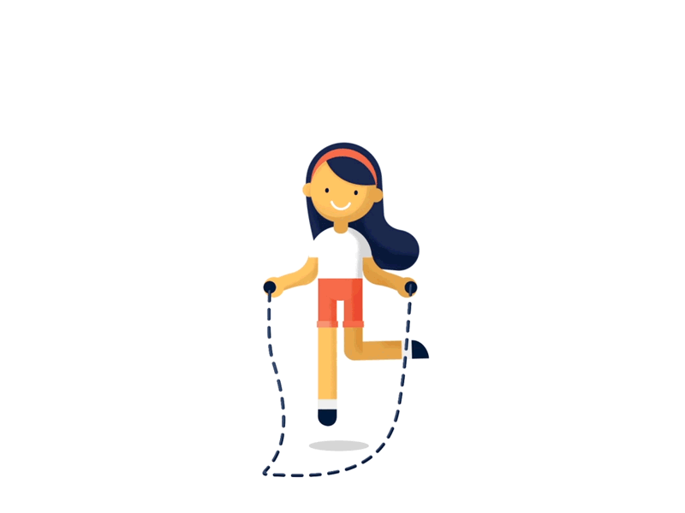
She is jumping
usually
or
now

Slide 21

He reads the book.
usually
or
now

Slide 22

they read story
usually
or
now

Slide 23
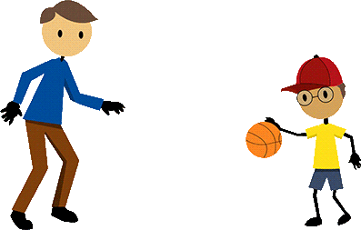
they are playing basketball
usually
or
now

Slide 24



Slide 25



Slide 26
Read the images

Slide 27



usually
now

Slide 28


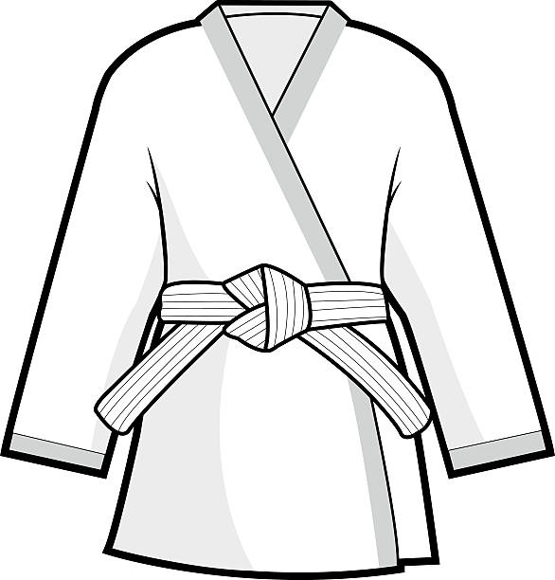
usually
now

Slide 29
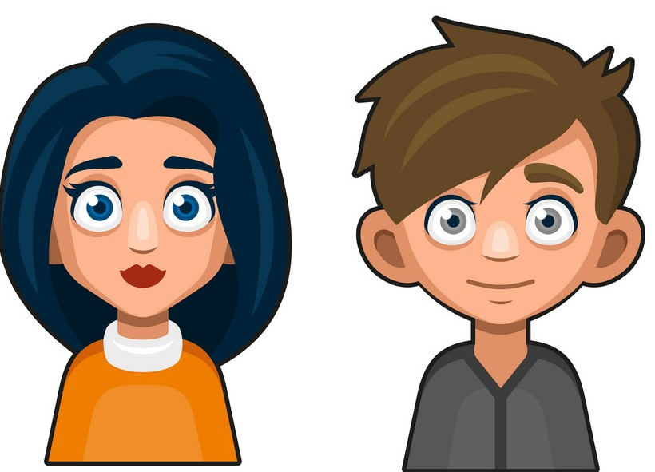
usually
now

Slide 30
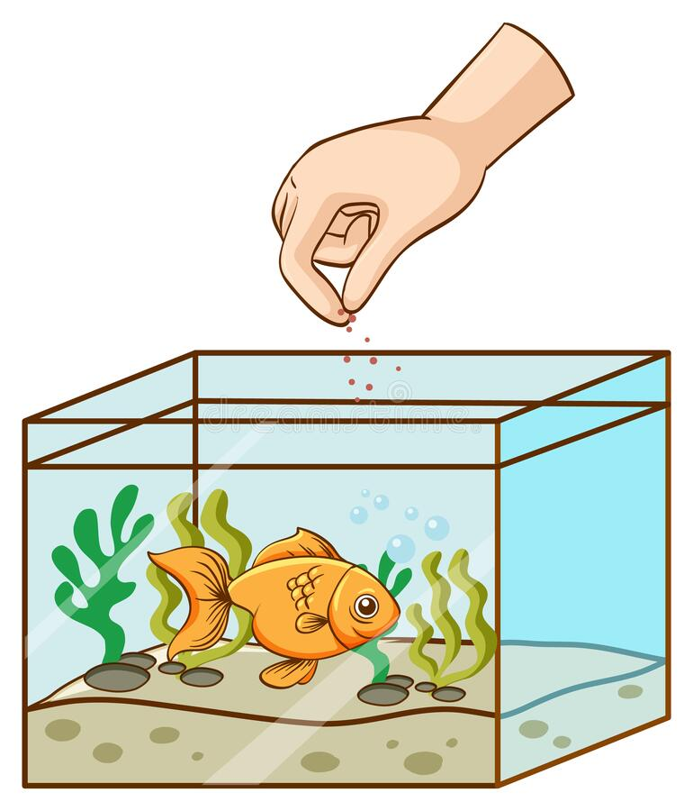
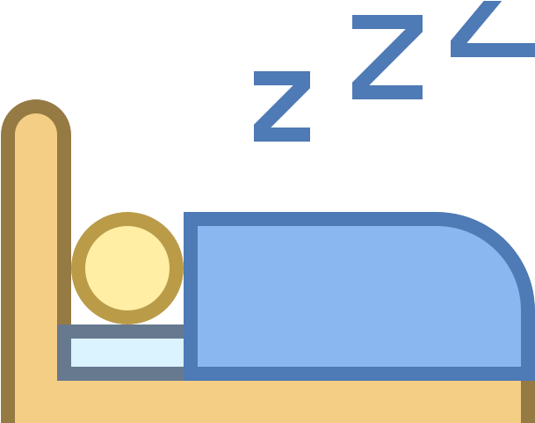
usually
now

Slide 31



Slide 32
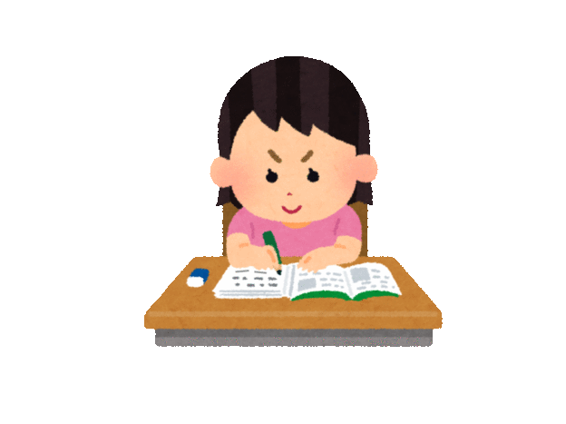
HOMEWORK

Slide 33


Slide 34


Goodbye

