Slide 1




Unit 4:
Around the World

Slide 2
قال تعالى :( يَا أَيُّهَا النَّاسُ إِنَّا خَلَقْنَاكُمْ مِنْ ذَكَرٍ وَأُنْثَى وَجَعَلْنَاكُمْ شُعُوبًا وَقَبَائِلَ لِتَعَارَفُوا إِنَّ أَكْرَمَكُمْ عِنْدَ اللَّهِ أَتْقَاكُمْ إِنَّ اللَّهَ عَلِيمٌ خَبِيرٌ)

Slide 3



Slide 4



Where are you from?

Slide 5


What’s your nationality?

Slide 6

What’s the capital of your country?

Slide 7


How old are
you?

Slide 8

Unit 4:
Around the World
Conversation
Page
30

Slide 9



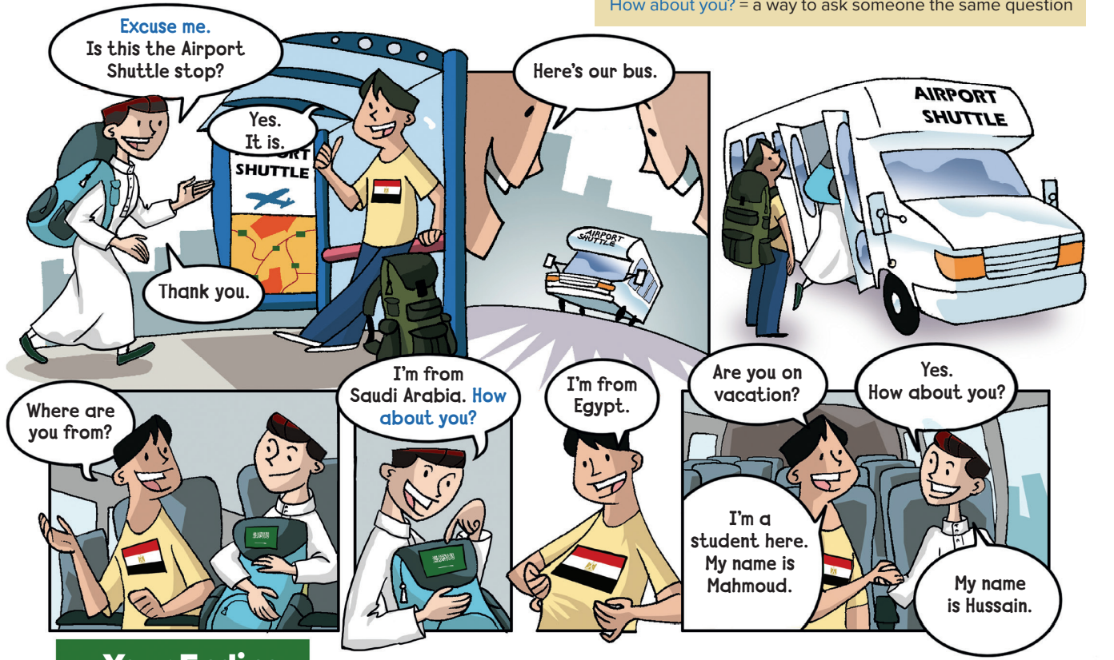
Practice the conversation
answer questions about the conversation
Objectives:
Page
30

Slide 10



Slide 11
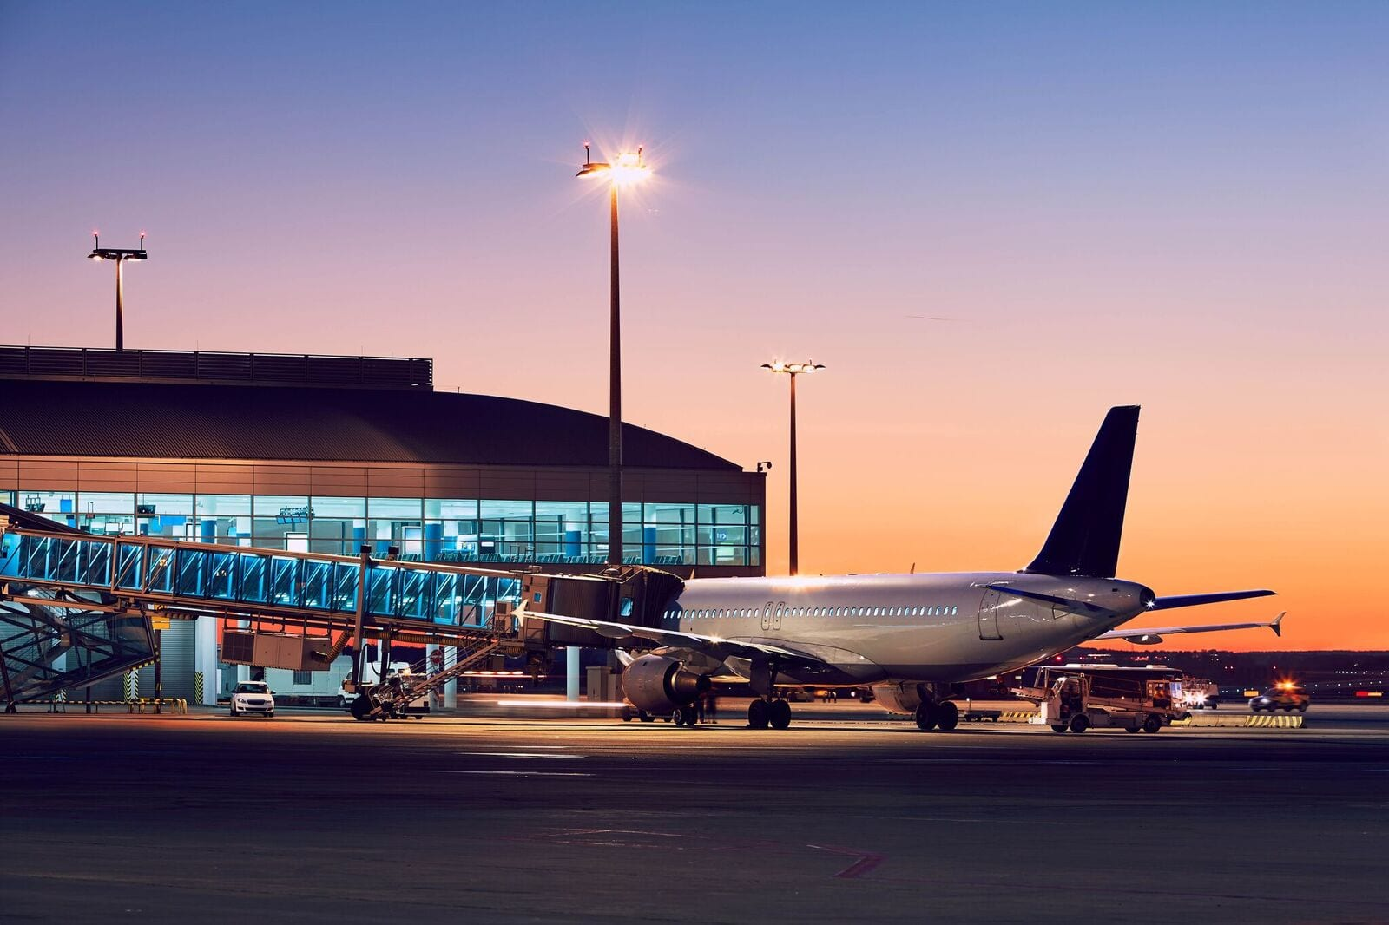
At the airport

Slide 12
Airplanes in Saudi Arabia

Slide 13
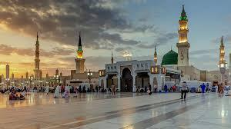

Slide 14

Page
30

Slide 17

30

Slide 19
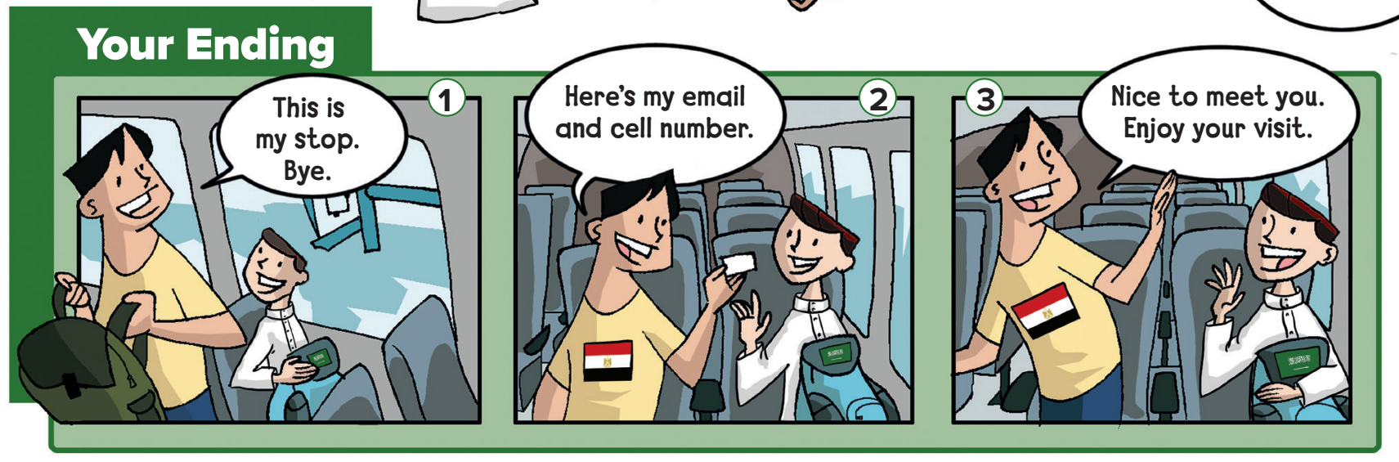
Which ending you think is the most likely?

Slide 20
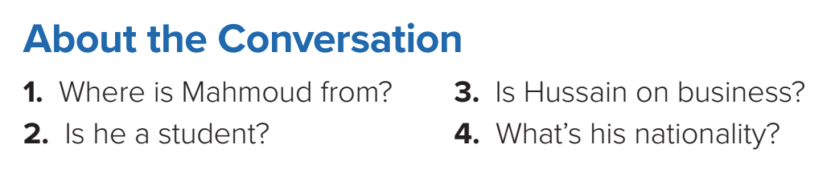
1. He’s from Egypt.
2. Yes, he is.
3. No, he isn’t. He’s on vacation.
4. He’s Saudi.

Slide 21




Slide 22

P.201
( F)

Slide 23



