Slide 1
Reading Lapland
Uint 4

Slide 2
Objectives
By the end of the lesson students should be able to:
01
02
Scan the passage for specific details
Skim the reading passage for certain information
03
Complete the chart from the passage

Slide 3
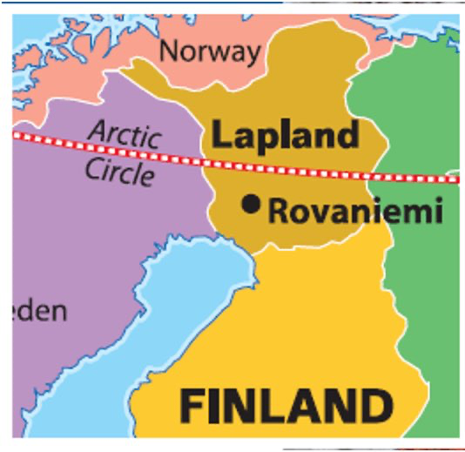
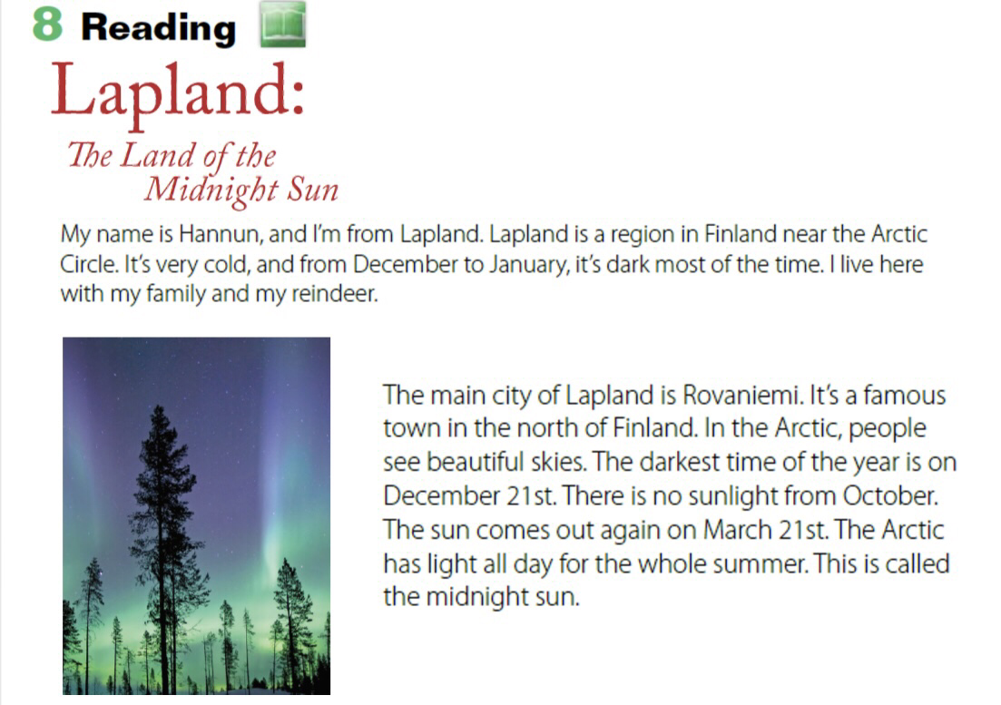
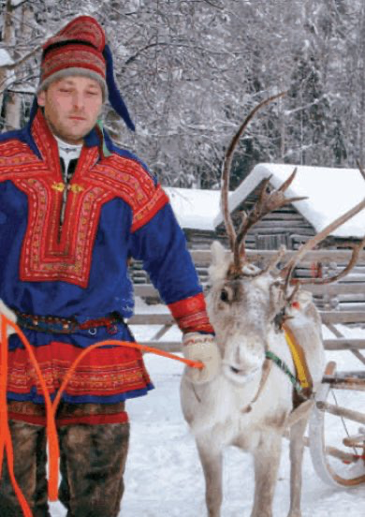
What is the title?

Slide 4
How many paragraphs?

Slide 5
What do you see?

Slide 6
When is the darkest time of the the month?

Slide 7
Is there sunlight in November?

Slide 8
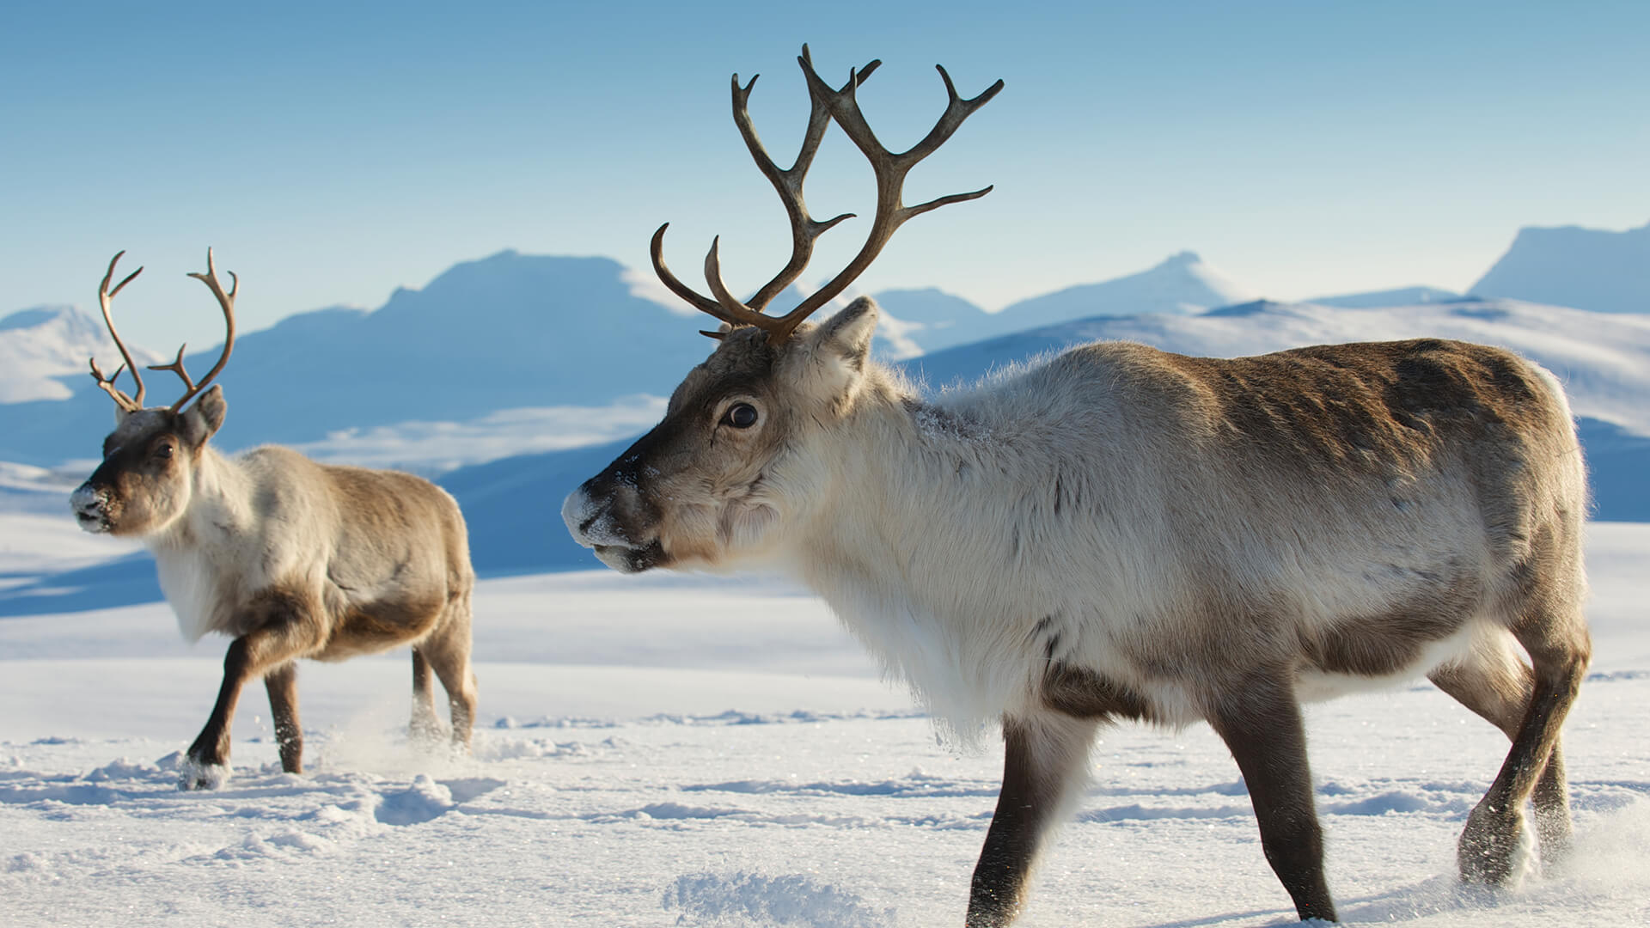
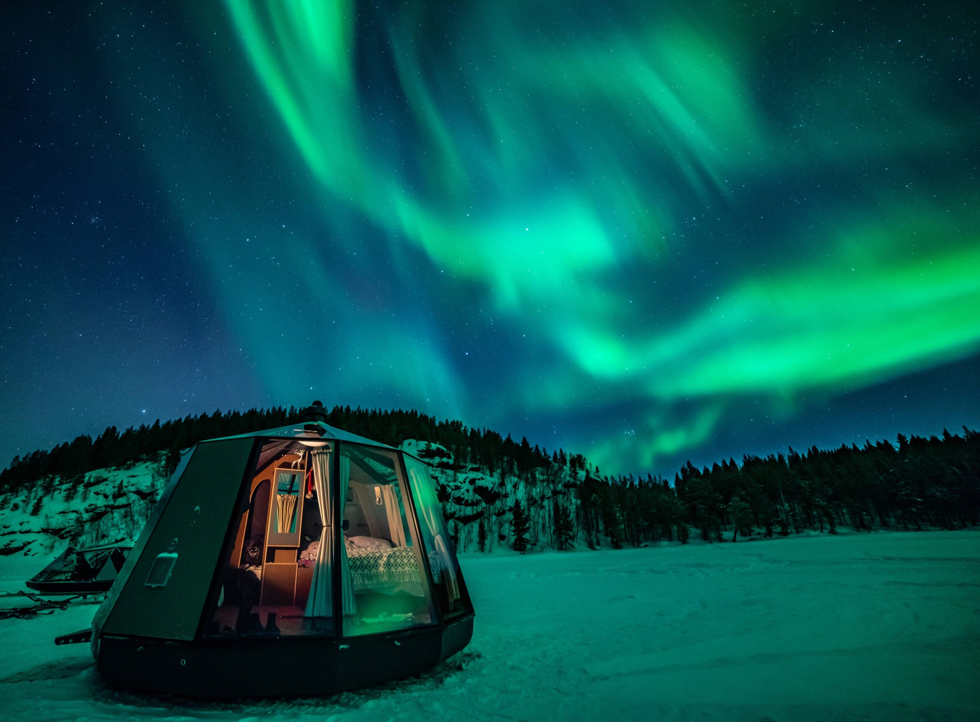
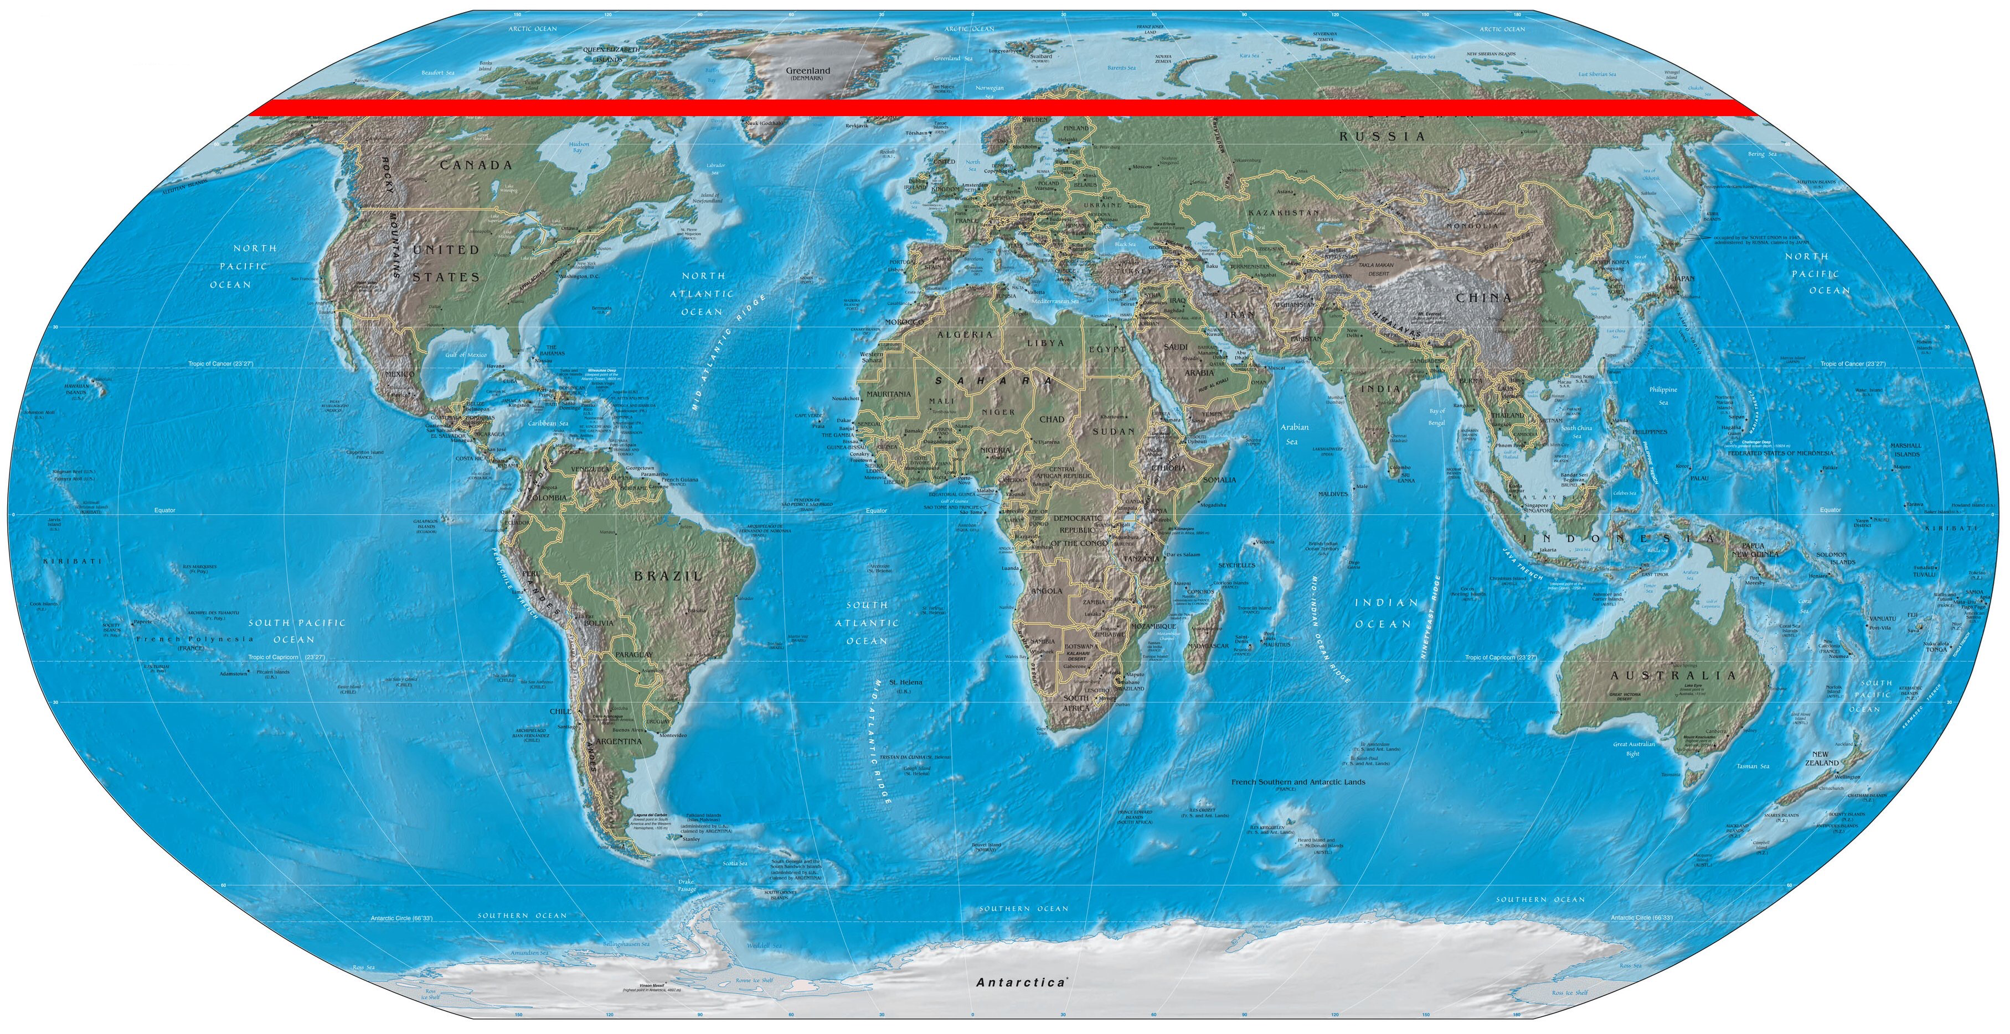
New Words
Arctic Circle
Reindeer
Northern Lights

Slide 9
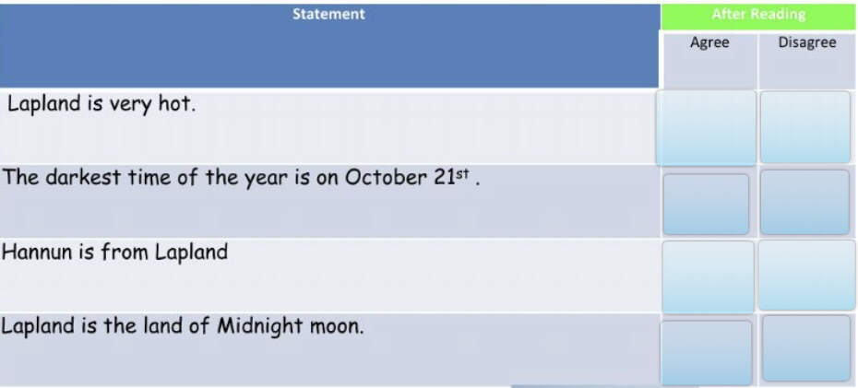
Worksheet

Slide 10
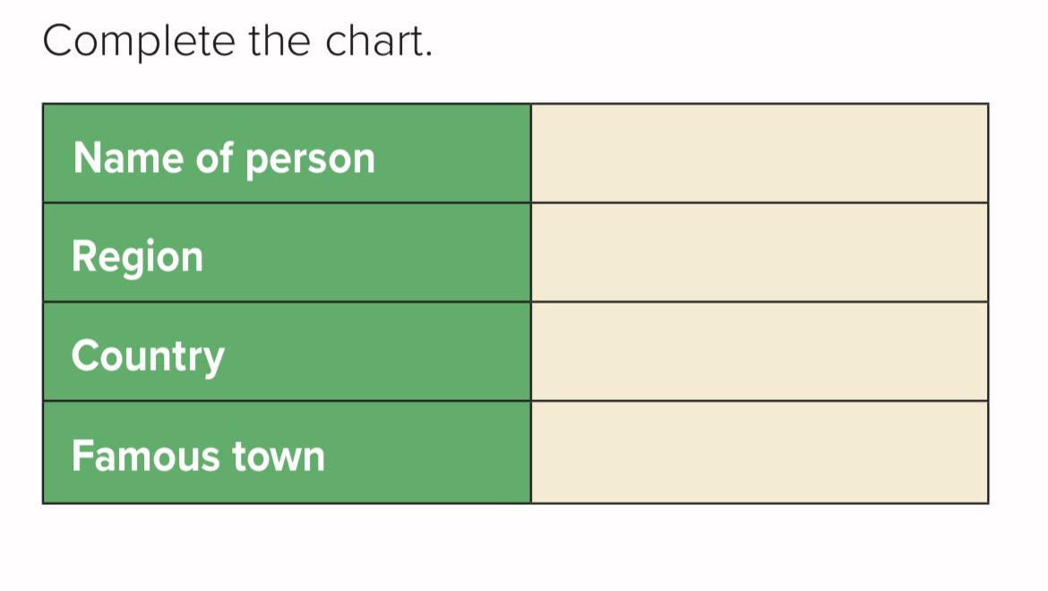
After Reading

Slide 11

Activity
https://wordwall.net/resource/5157523/around-the-world

Slide 12

Thank You
T.Bushra Alnouh

