Slide 1


Slide 2


Good Morning

Slide 3
Mega Goal3.1
Influential People

Slide 4
Form , Meaning & Function

Slide 5
Present Perfect Simple Tense
Time Expressions with For and Since
Questions with How Long
Past Simple versus Present Perfect
Asking and Telling about Personal Experience Have you ever ...?

Slide 6
Goals:
1.Form sentences with the present perfect
2.Use time expressions with for and since correctly
3.Use the question form (How long) to ask about duration
4.Differentiate between the past simple and the present perfect tense
5.Ask about personal experiences using the phrase (Have you ever

Slide 7



Pop Questions:
Present Perfect simple? Yes | No
Key Words
He has done homework
They ate the launch.
They have arrested the criminal.
They have stolen a car last year.
They are playing football right now.
Sara will see her teacher at the library.

Slide 8

Present Perfect Simple

Slide 9


Present Perfect Simple
Q: Have you been to Kuwait? A: Yes, I’ve been to Kuwait.
I have visited many places in the Middle East
Use the present perfect to talk about actions that started at an indefinite time in the past. It is often used to talk about time from the past to now in a person’s life.

Slide 10
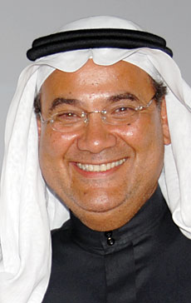
Present Perfect Simple
Mohammad Abdul Latif Jameel has contributed greatly to the government’s Saudization program in the Kingdom.
Use the present perfect to talk about recently completed actions

Slide 11
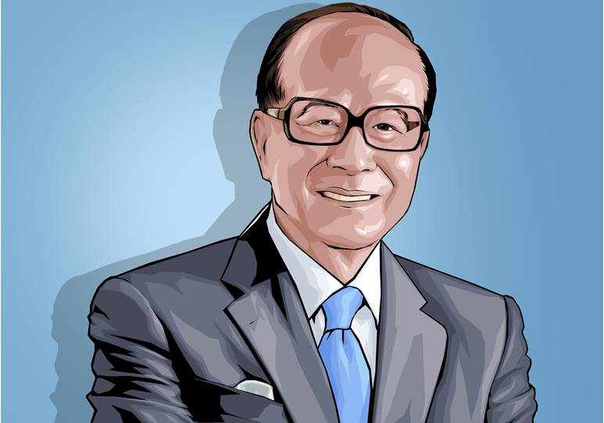
Present Perfect Simple
Li Ka-shing has lived in China for all his life.
Use the present perfect simple to emphasis an action that started in the past and has continued until now and may continue in the future.

Slide 12






Present Perfect Simple
I
You
We
They
have
V3
He
She
It
has
Past
Now

Slide 13
Time Expressions with For and Since

Slide 14
Time Expressions with For and Since
since30 years
for 30 years
I have visited many places in the Middle East
Mohammad ALJ has contributed greatly to the government’s Saudization program in the Kingdom.
For along time
since 1990
Li Ka-shing has lived in China
For all his life.
Since he born.

Slide 15
Questions with How Long

Slide 16
Questions with How Long
Q: How long has the clothing store been in operation?
A: It’s been in operation since 1975.
It’s been in operation for about 50 years

Slide 17
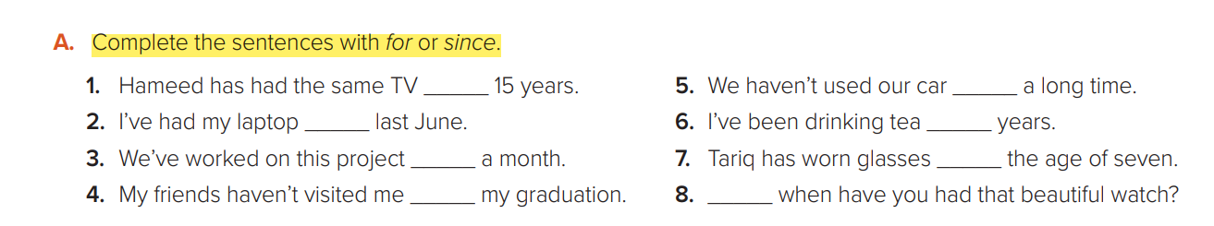
for
for
since
for
for
since
since
since

Slide 18
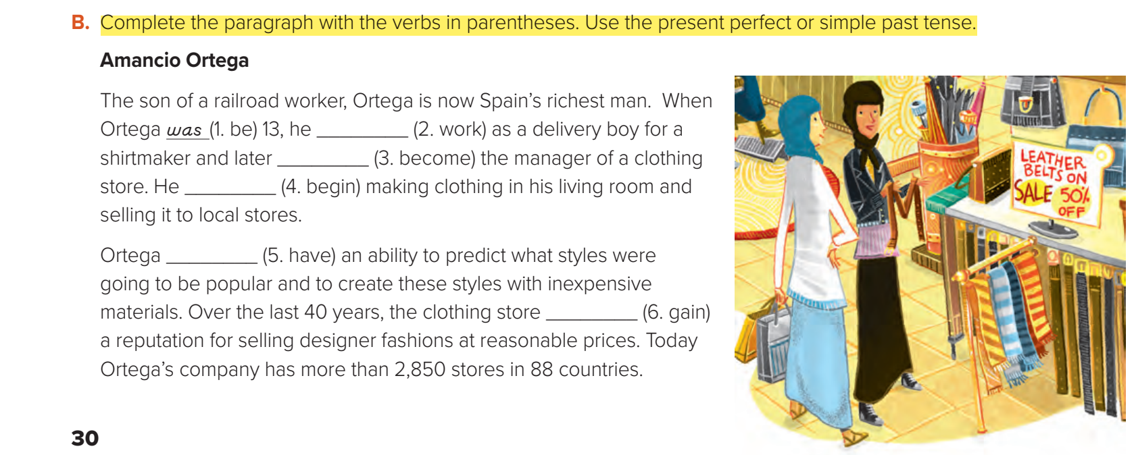
worked
became
began
had
has gained

Slide 19
Past Simple versus Present Perfect

Slide 20

Past Simple
Present Perfect
A: When did he start the company?
B: He started the company in the late 70s.
A: Have you ever met a billionaire?
B: No, I’ve never met a billionaire.
Use the simple past tense when the exact time is given.
Use the present perfect to talk about an action that happened in the past when the exact time isn’t known or isn’t important.
Note: Time expressions we can use with the present perfect are: yet, so far, ever, never, already, recently, lately, once, twice, etc

Slide 21
Asking and Telling about Personal Experiences: Have you ever ...?

Slide 22

Asking and Telling about Personal Experiences: Have you ever ...?

Slide 23
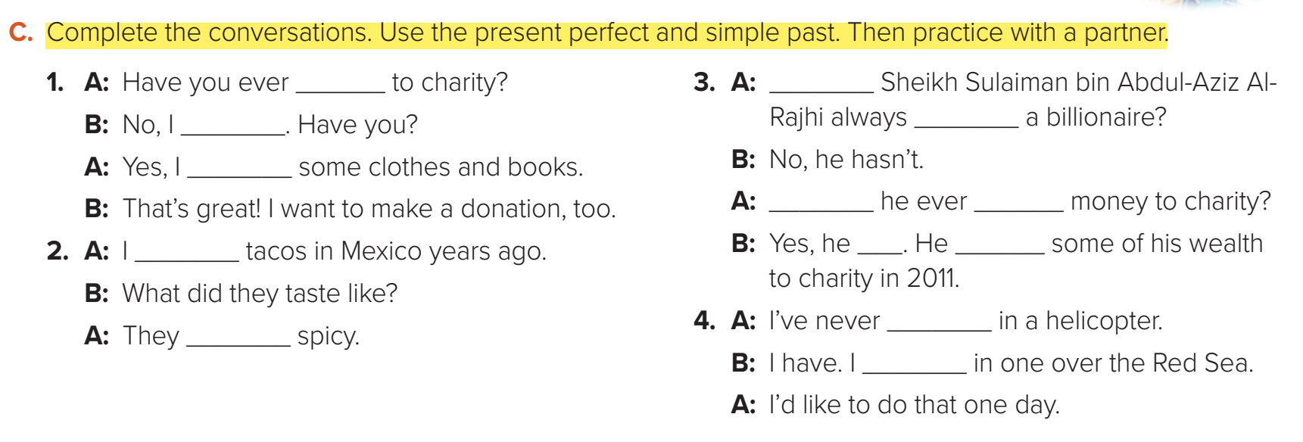
given
Has
been
haven’t
gave
has
given
ate
has
gave
were
been,
flew

Slide 24

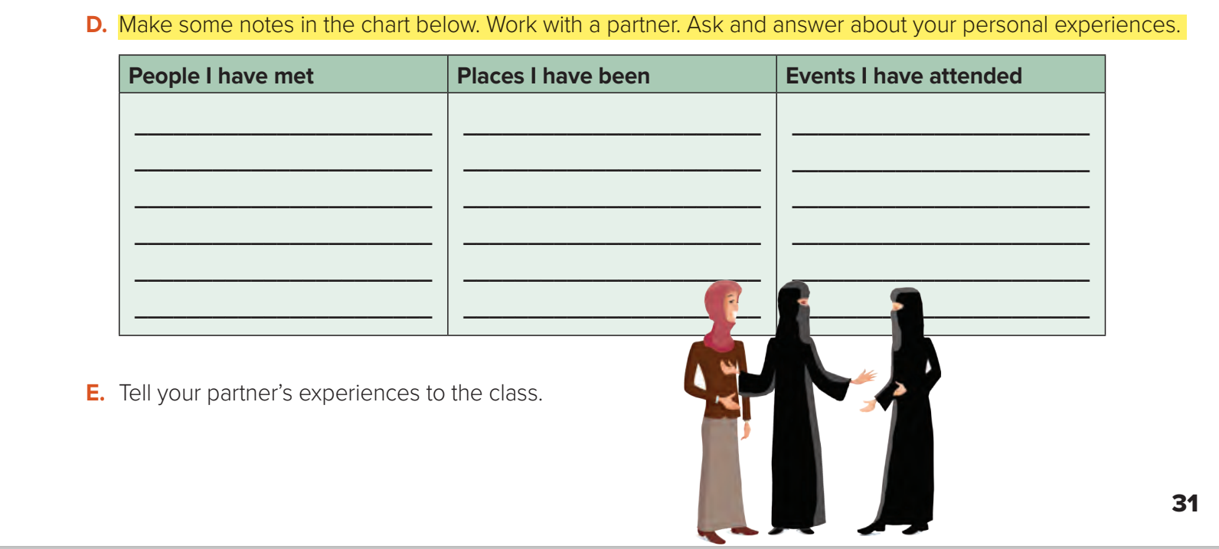

Slide 25


