Slide 1



Slide 2
Good Morning

Slide 3
Unit-4-
The Art of Advertising
L11
Form , Meaning & Function

Slide 4
Demonstrative Pronouns
Imperatives
Indefinite Articles: a/an
Possessive Adjectives
Possessive Pronouns
Question Word: Whose
Pronoun: One/Ones
Quantitative: Too, Enough

Slide 5
Demonstrative Pronouns
Imperatives
Indefinite Articles: a/an

Slide 6


Objectives
Use demonstrative pronouns to ask about things around
Write a meaningful slogan for his life
Choose a suitable indefinite article: a/an
Share Positively in pair work
Turn the sentences into imperative
Use possessive adjectives and pronouns correctly
Ask with "whose
Use quantitative "too, enough" correctly
Use "one/ones" correctly
Share positively in pair work

Slide 7
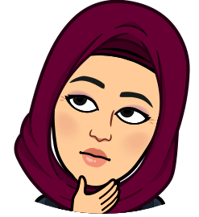
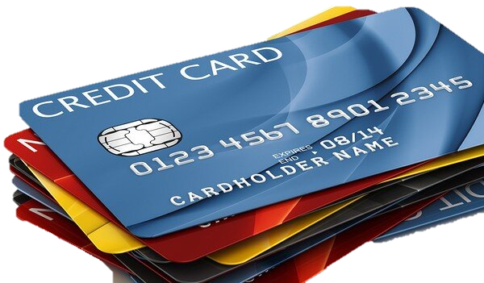
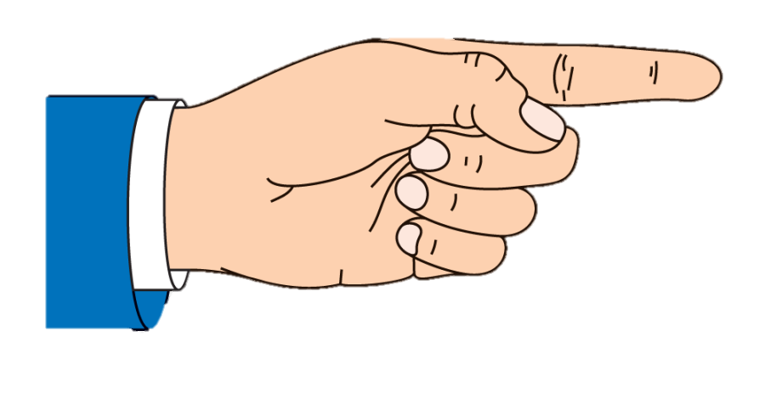
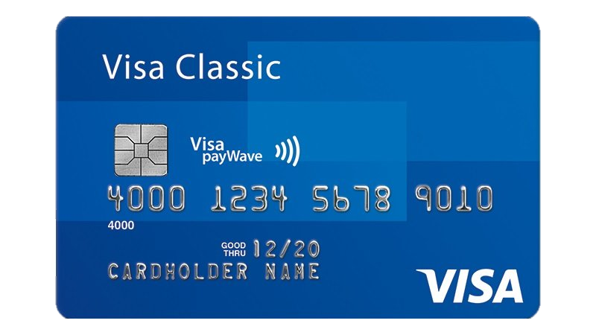
Demonstrative Pronouns
Singular
Plural
This
That
These
Those
What is that?
What are those?
What is this?
What are these?
Notes:
Language Builder
Explain that’s is a contraction for that is. Point out that there is no contraction for this is

Slide 8



Slide 9
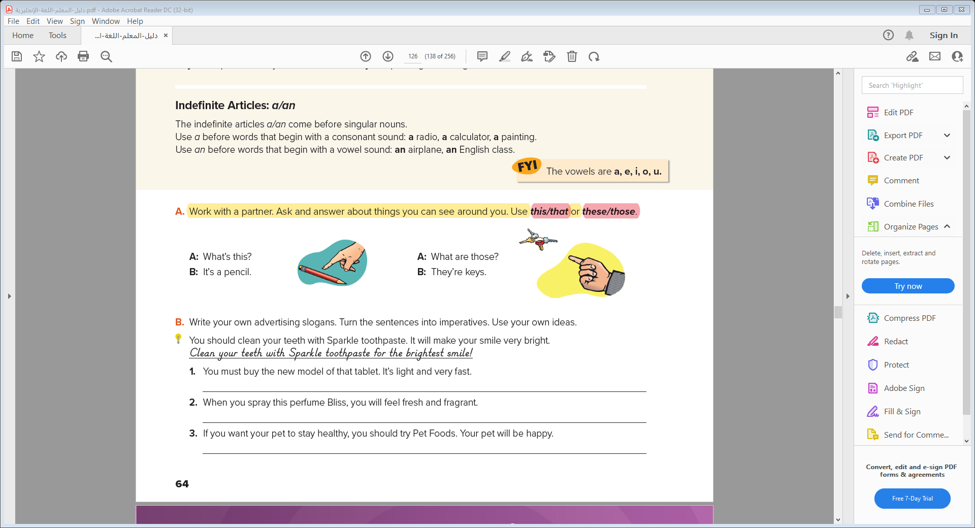


Slide 10

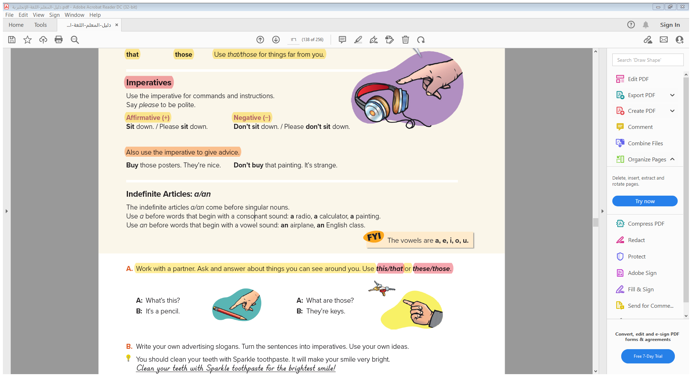

Slide 12
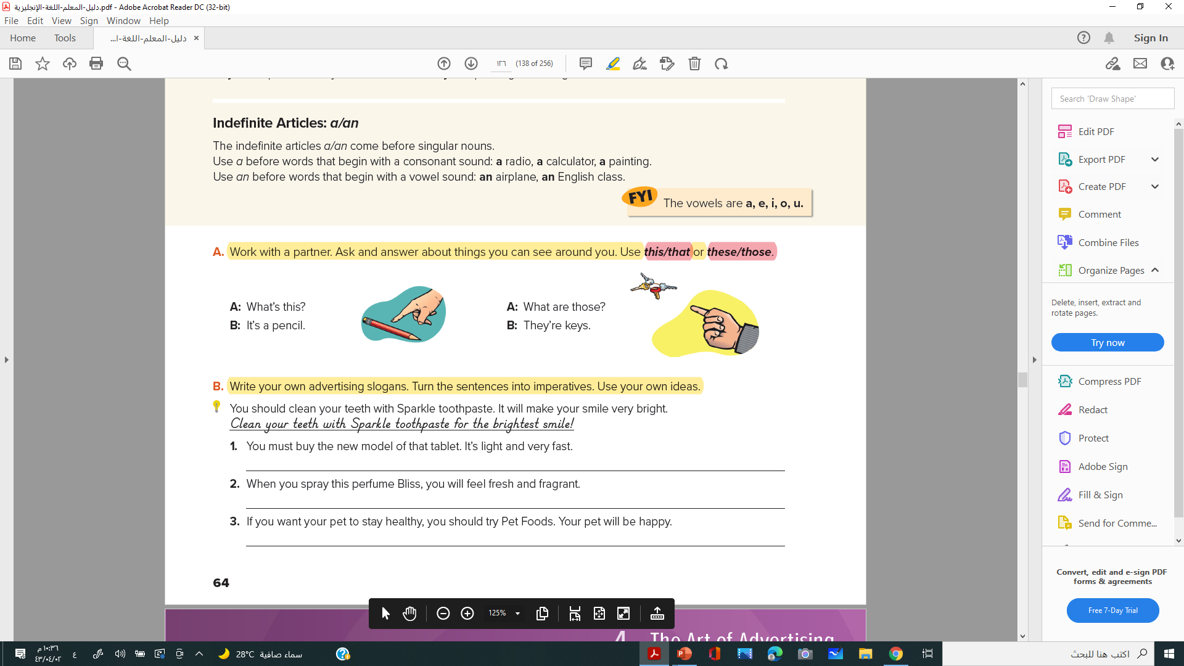
Buy the best, lightest and fastest tablet
Feel fresh with just one spray of Bliss
Try Pet Foods for healthy and happy pets!

Slide 13
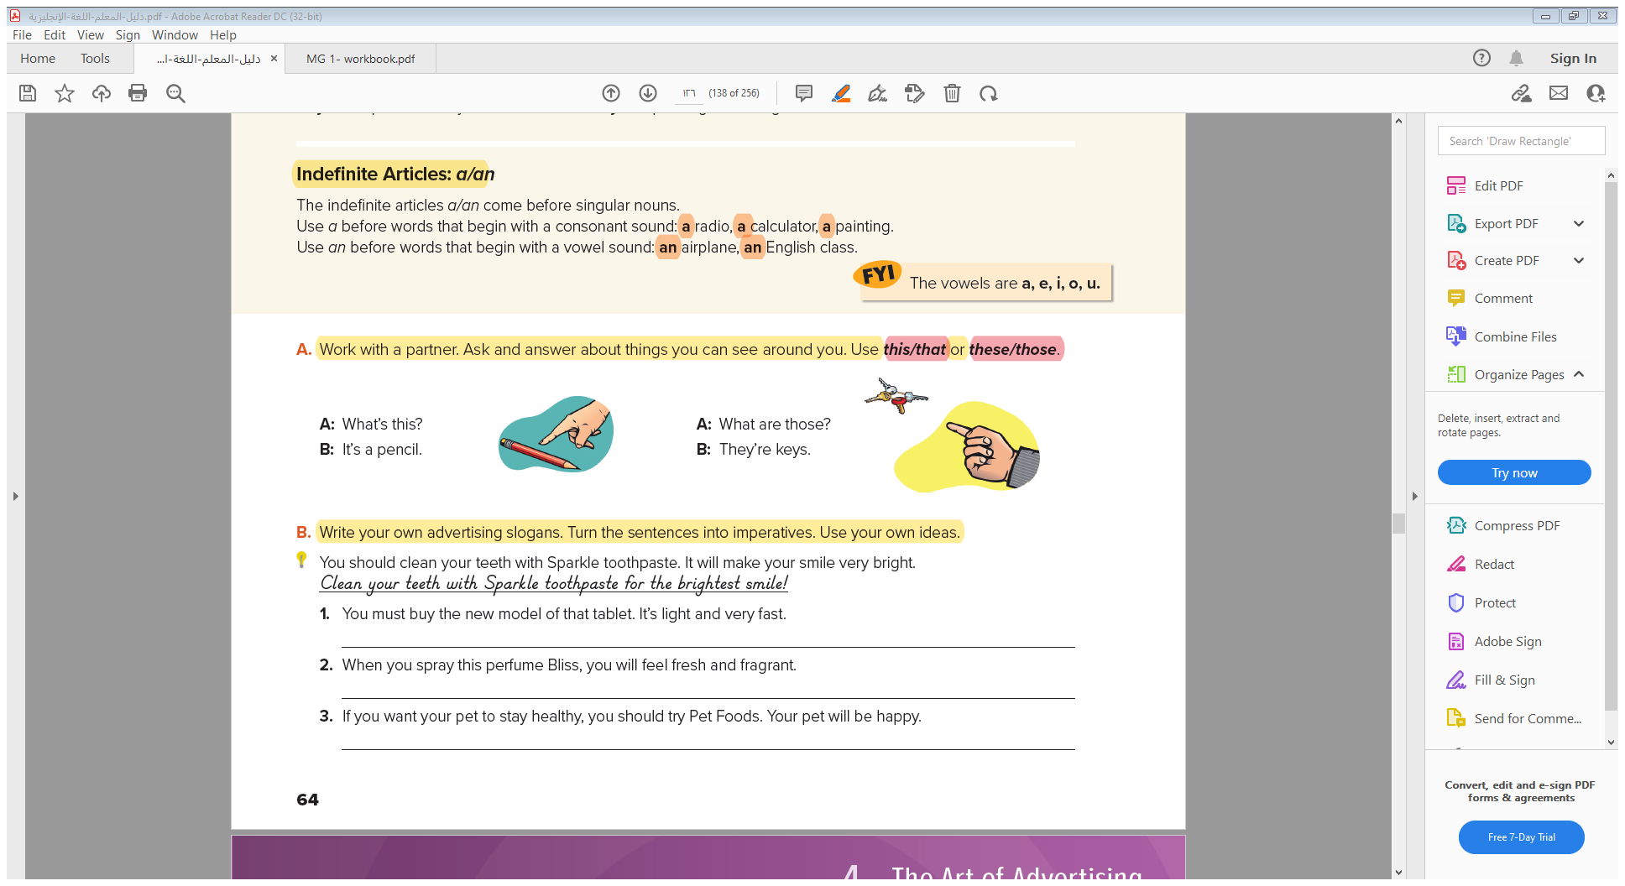


Slide 14
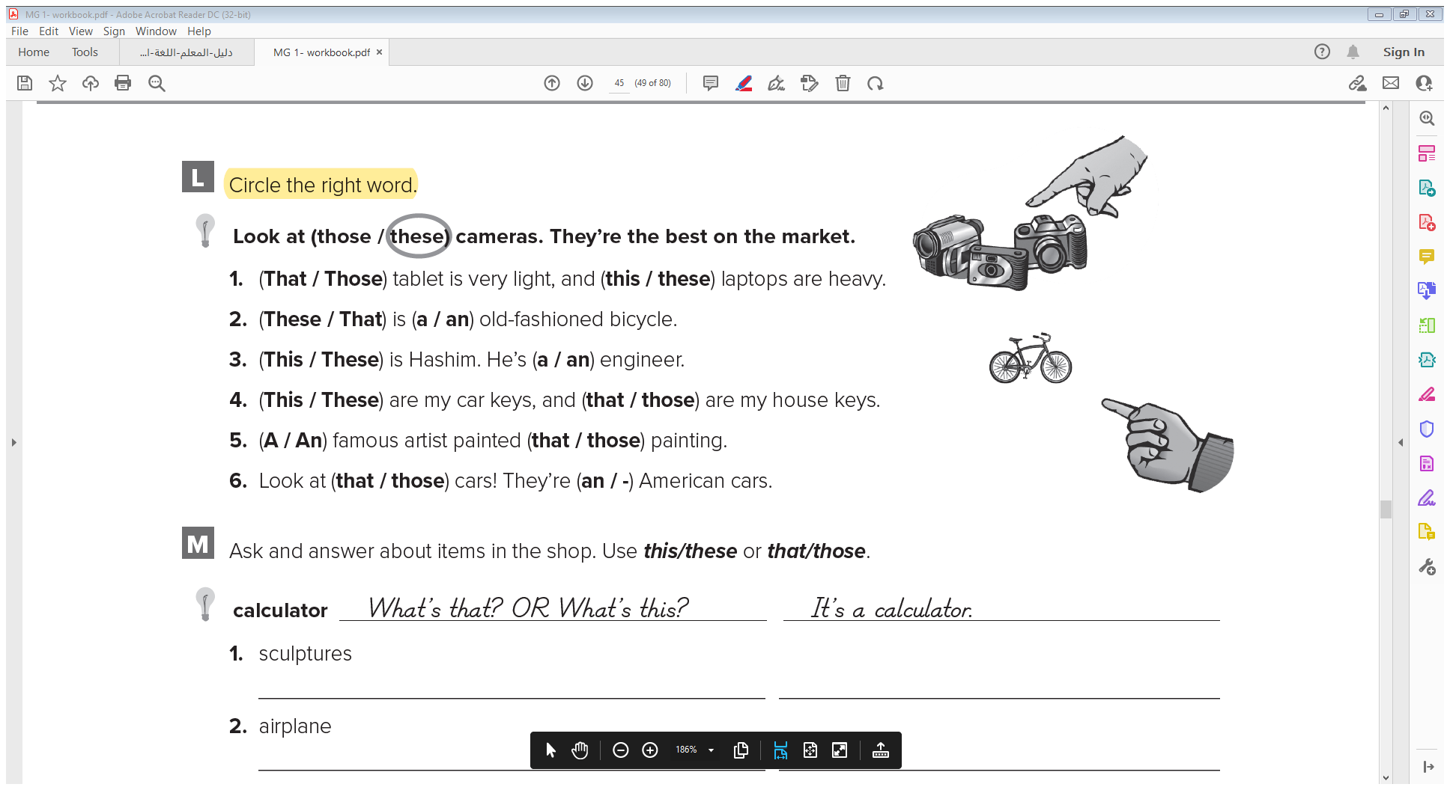
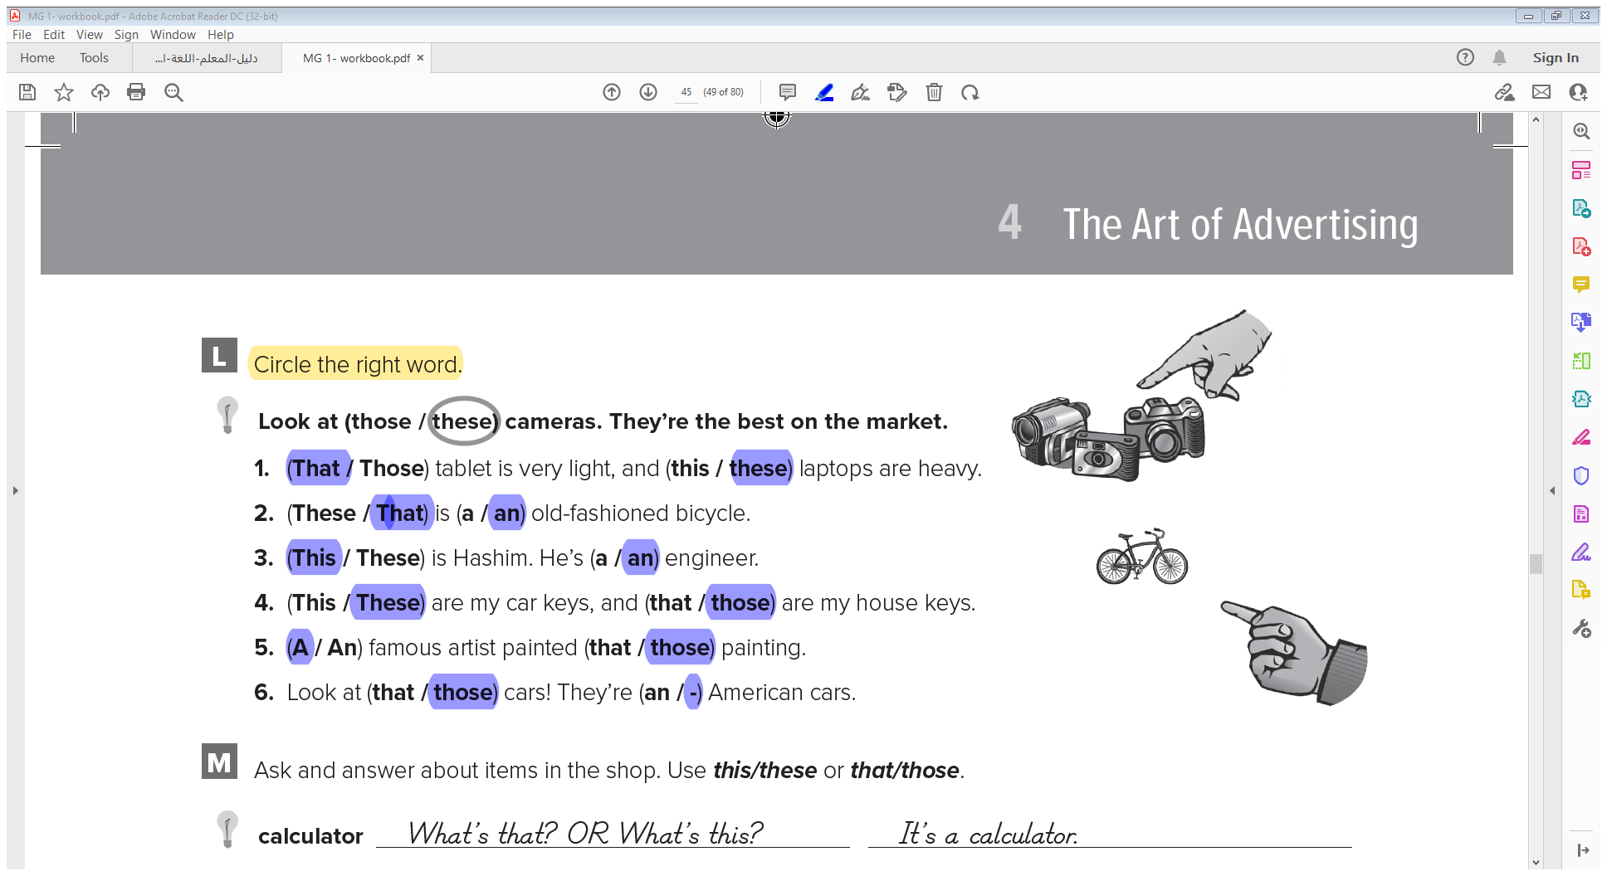
W.B.P 117:

Slide 15
Possessive Adjectives
Possessive Pronouns
Question Word: Whose
Pronoun: One/Ones
Quantitative: Too, Enough

Slide 16
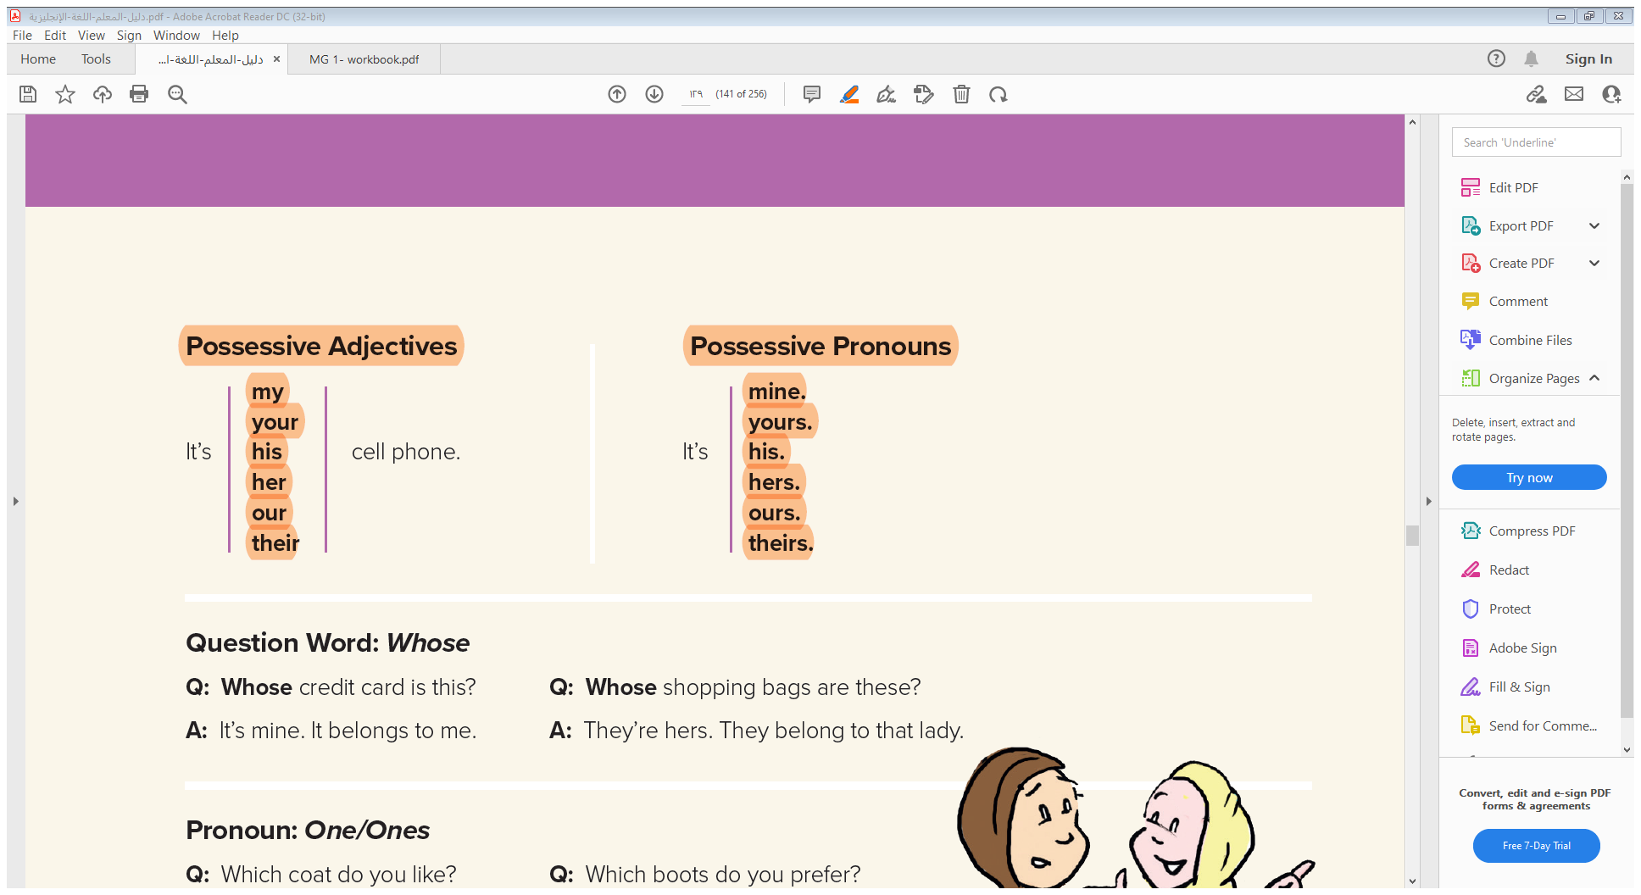
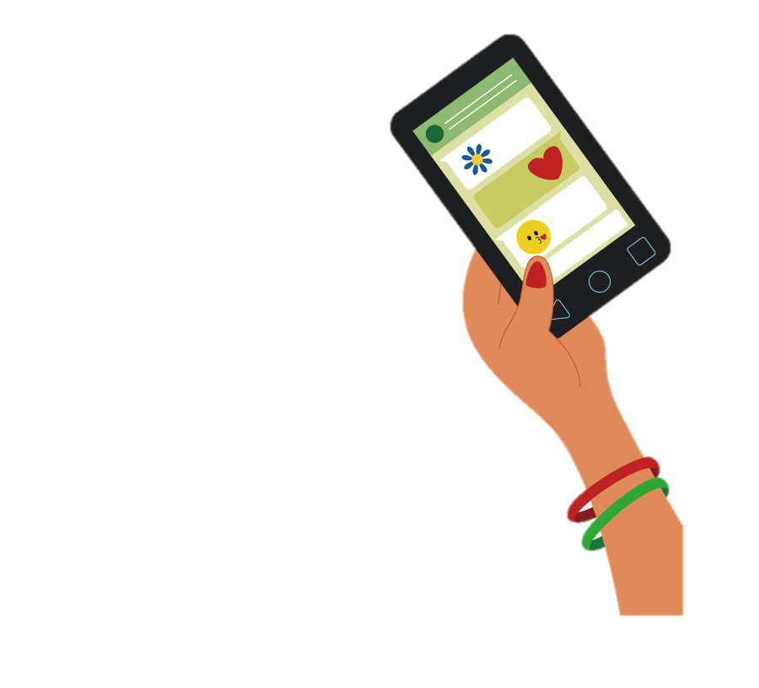
Possessive Adjectives
Notes:
Language Builder
Point out that in English the possessive form agrees with the person, not with the thing. Fahd’s book = his book.

Slide 17

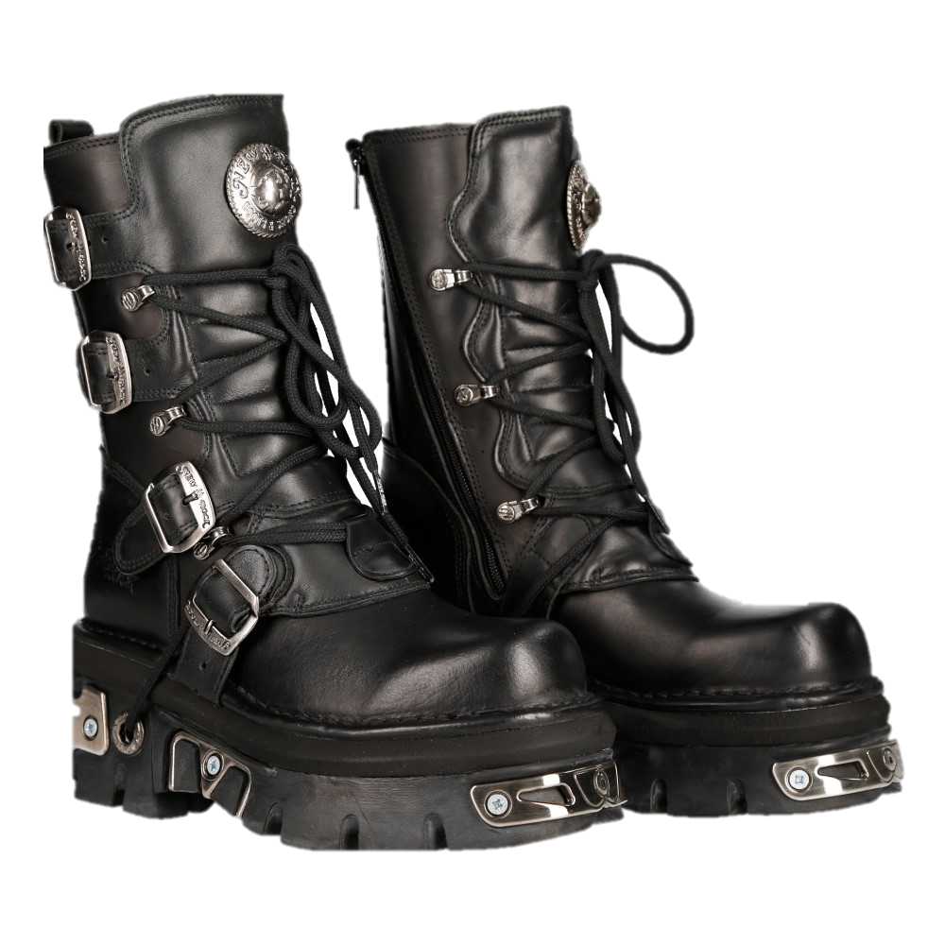
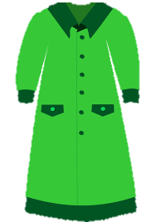
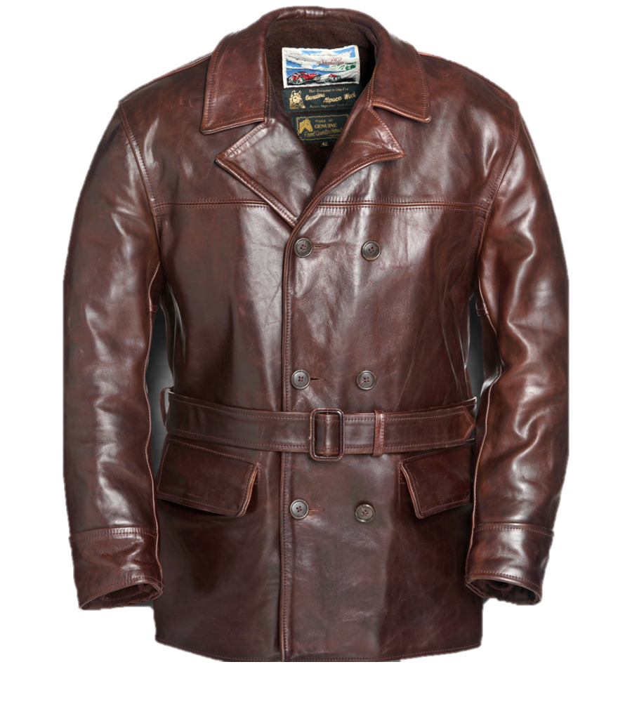
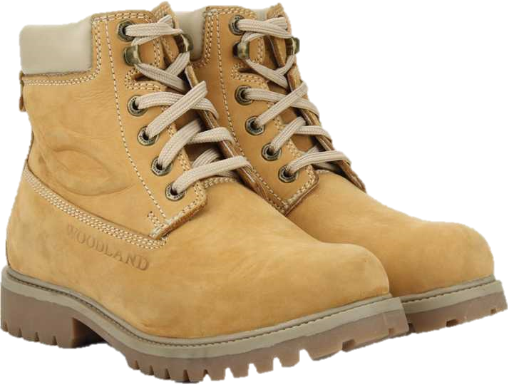
Question Word: Whose
Q: Whose credit card is this? Q: Whose shopping bags are these?
A: It’s mine. It belongs to me. A: They’re hers. They belong to that lady.
Pronoun: One/Ones
Q: Which coat do you like? Q: Which boots do you prefer?
A: The green one. A: The leather ones.

Slide 18
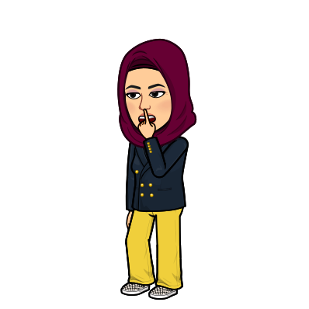
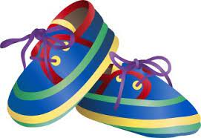
Quantitative: Too, Enough
This jacket is too small for me, and the shoes are too big.
The jacket is not big enough for me, and the shoes are not small enough.

Slide 19
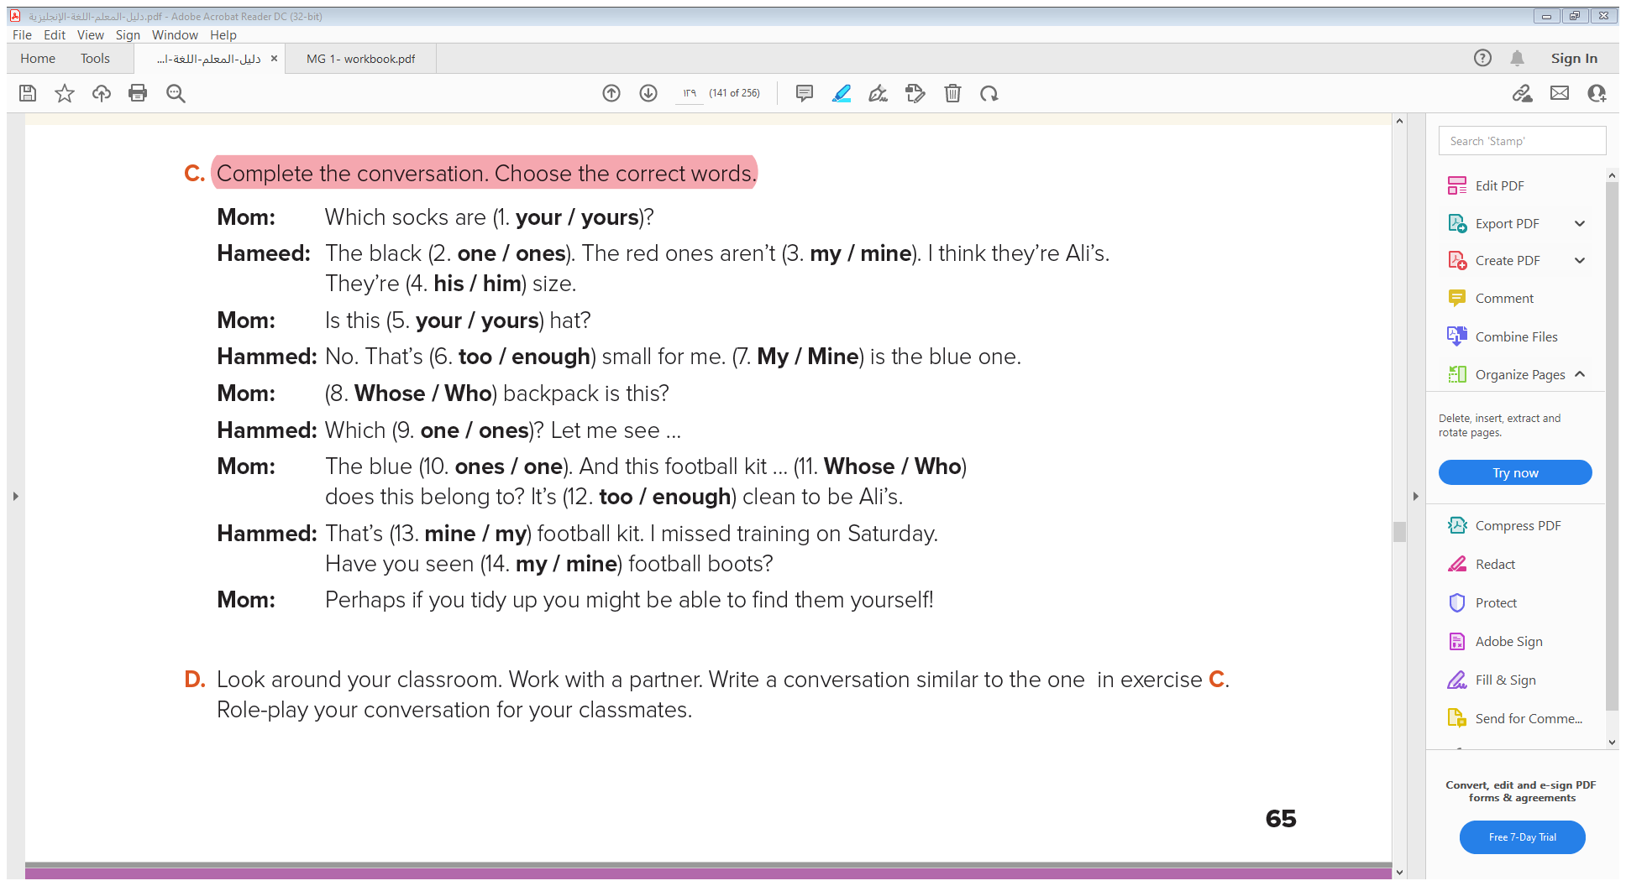
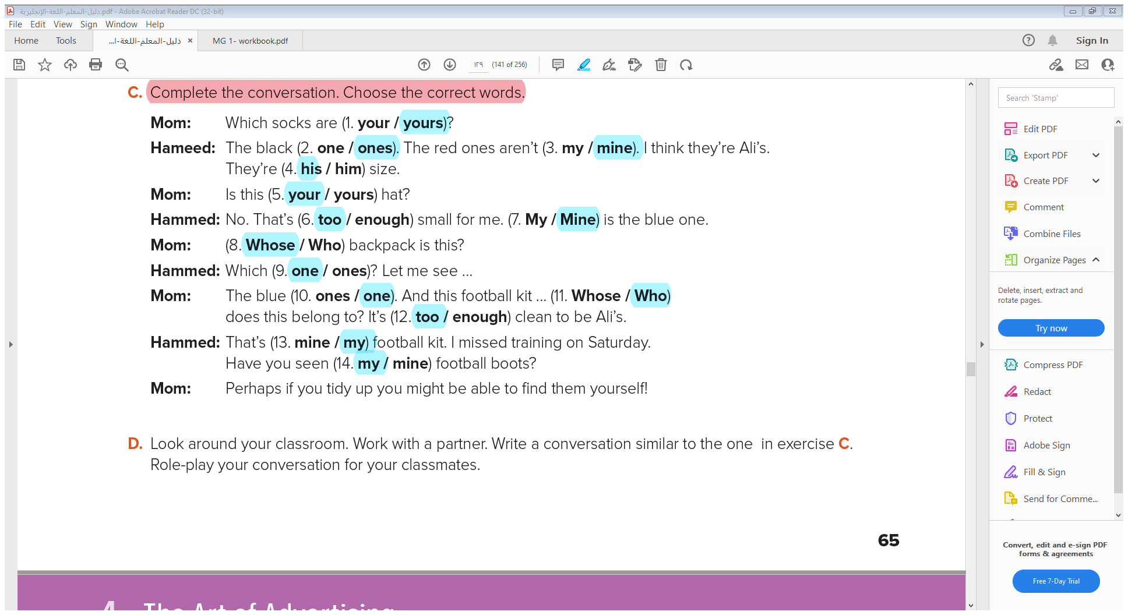

Slide 20

Have a good day

