Slide 1



Slide 2

Good Morning

Slide 3
Unit-4-
The Art of Advertising
9 Reading

Slide 4


Objectives:
Discuss the meaning of the word “plastic “ in the title
1
Analyze the ideas of the passage
2
3
Organize events according to a timeline
4
Find the meanings of new words in the text
Recognize words that are related to "credit cards
5
6
Write words that start with prefixes meaning “not
7
Share positively in pair work
8
Say Aya or hadith about how to spend money

Slide 5
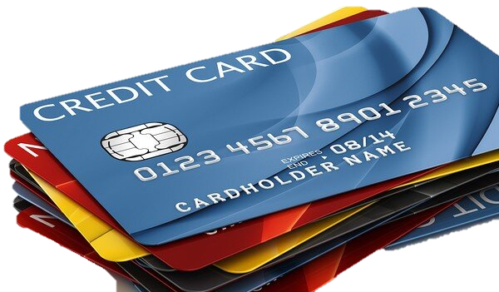
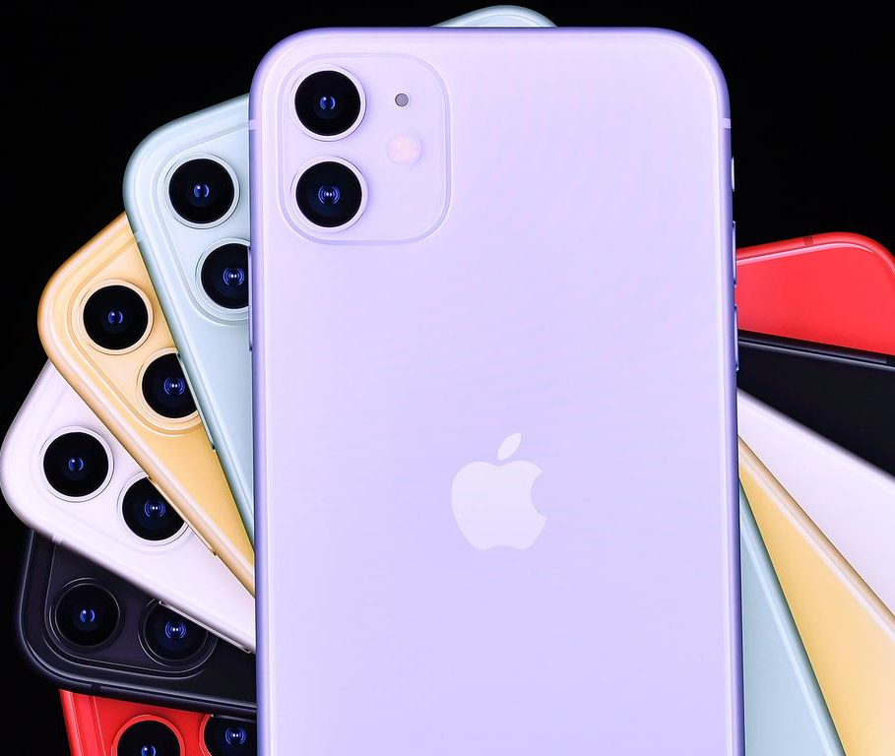
Warm Up:
Find the another half of the word of the picture:
Cash
Credit
Mobile

Slide 6
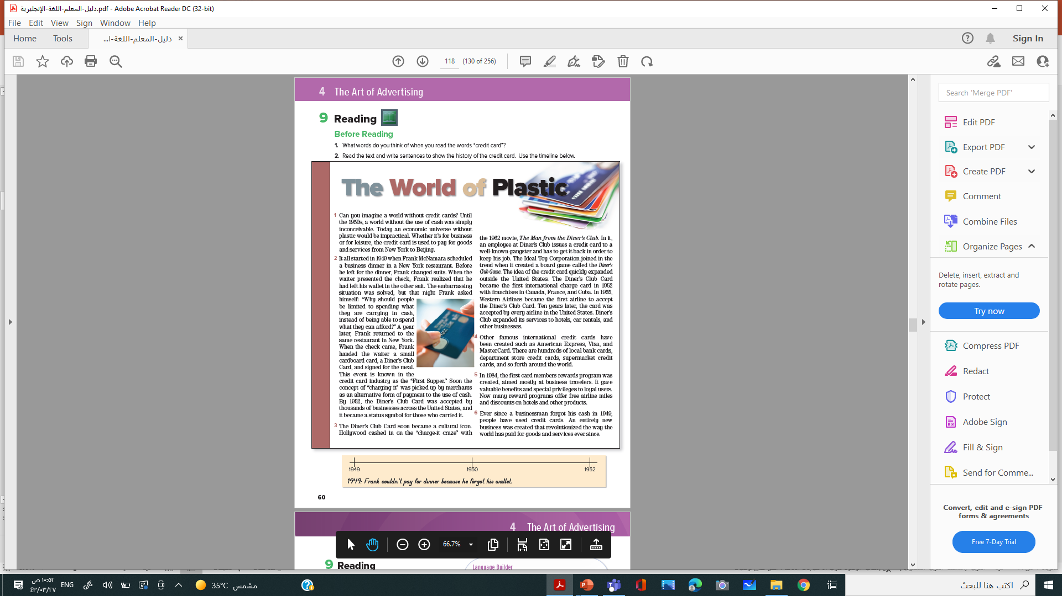
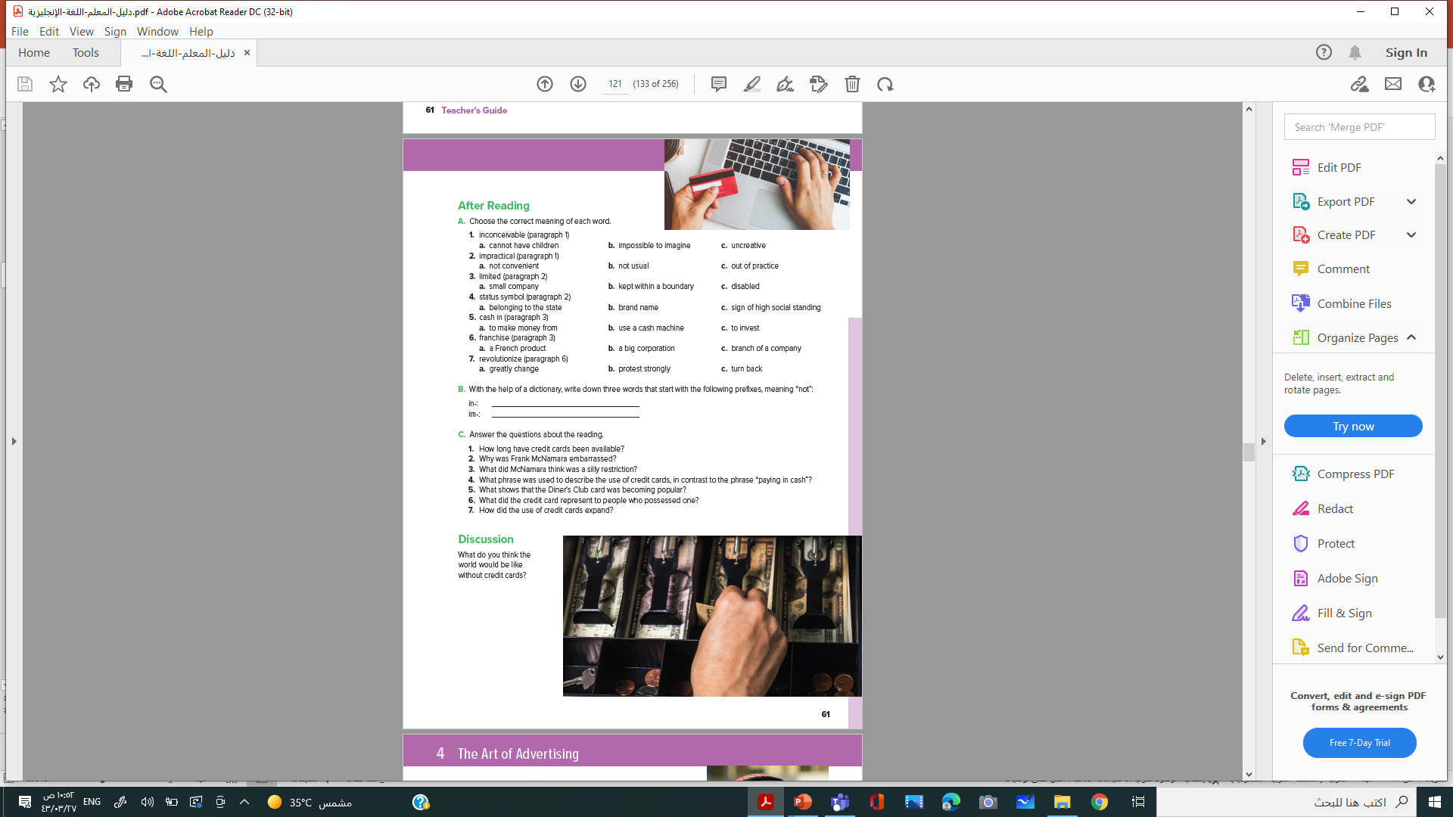

Student Book
P.54-54

Slide 7
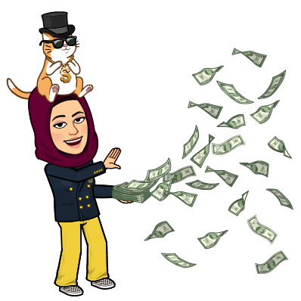
Before Reading

Slide 8

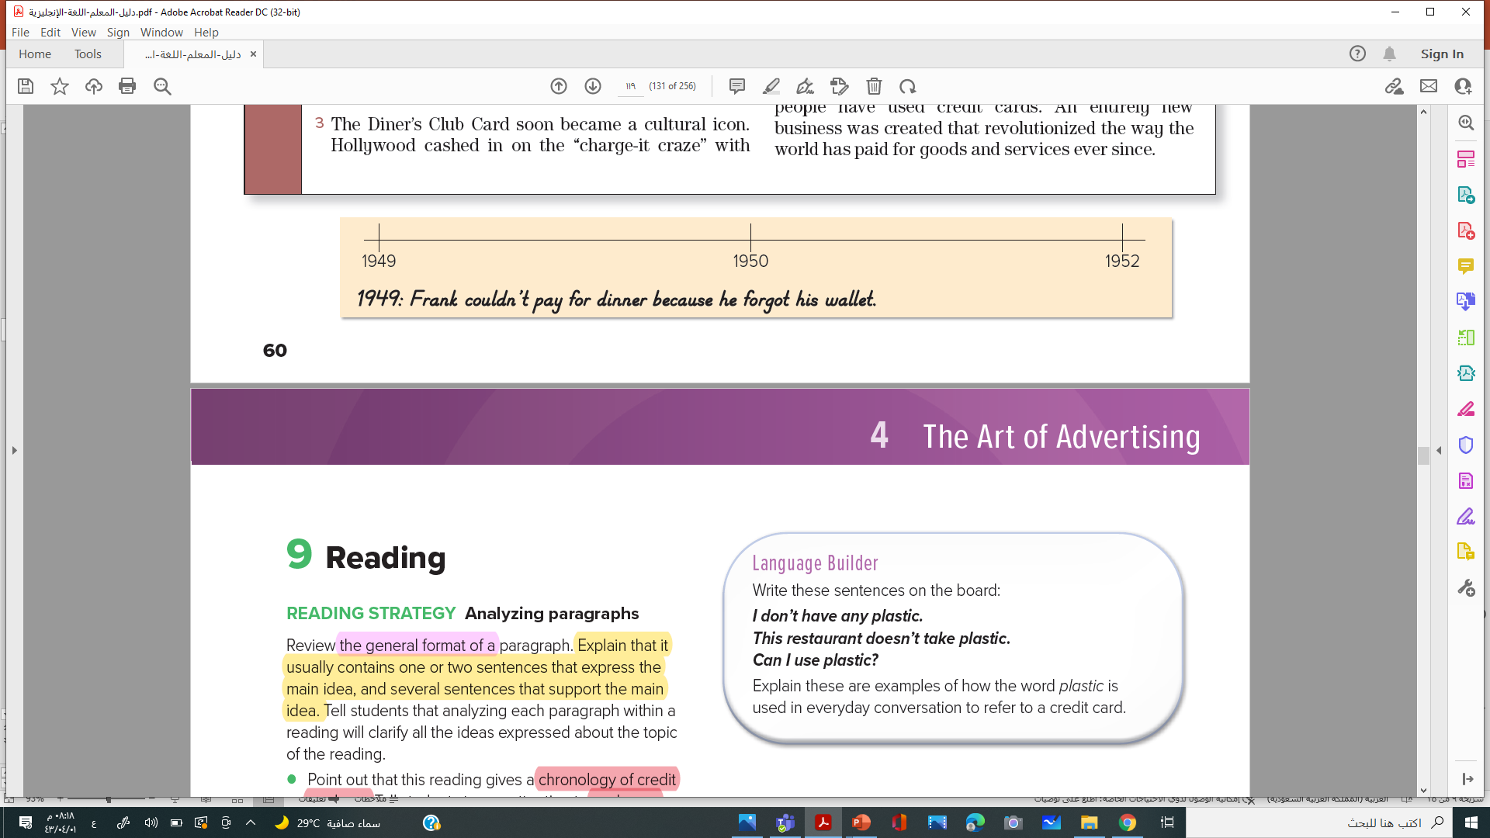
o
P-54
1. What words do you think of when you read the words “credit card”?
2. Read the text and write sentences to show the history of the credit card. Use the timeline below.

Slide 9

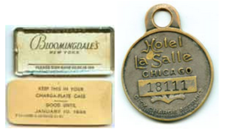
History of the Credit Card
Western Airlines became the first airline to accept the Diner’s Club Card.
The Diner’s Club Card became the first international charge card
the first card members rewards program was created,
world without the use of cash was simply inconceivable
: Frank couldn’t pay for dinner because he forgot his wallet
Hollywood cashed in on the “charge-it craze” with the 1962 movie
1949s
1955s
1950s
1952s
1962
1984
--are the pros + of using credit cards?
---are the cons - of using credit cards?
What is the meaning of the title: The World of Plastic.

Slide 10
Skimming:
What is the meaning of the title: The World of Plastic.
---are the cons - of using credit cards?
--are the pros + of using credit cards?
Notes:
Language Builder
Write these sentences on the board:
I don’t have any plastic. This restaurant doesn’t take plastic. Can I use plastic?
Explain these are examples of how the word plastic is used in everyday conversation to refer to a credit card.

Slide 11

The World of Plastic
1 Can you imagine a world without credit cards? Until the 1950s, a world without the use of cash was simply inconceivable. Today an economic universe without plastic would be impractical. Whether it’s for business or for leisure, the credit card is used to pay for goods and services from New York to Beijing.
2 It all started in 1949 when Frank McNamara scheduled a business dinner in a New York restaurant. Before he left for the dinner, Frank changed suits. When the waiter presented the check, Frank realized that he had left his wallet in the other suit. The embarrassing situation was solved, but that night Frank asked himself: “Why should people be limited to spending what they are carrying in cash, instead of being able to spend what they can afford?” A year later, Frank returned to the same restaurant in New York. When the check came, Frank handed the waiter a small cardboard card, a Diner’s Club Card, and signed for the meal. This event is known in the credit card industry as the “First Supper.” Soon the concept of “charging it” was picked up by merchants as an alternative form of payment to the use of cash. By 1952, the Diner’s Club Card was accepted by thousands of businesses across the United States, and it became a status symbol for those who carried it.

Slide 12
3 The Diner’s Club Card soon became a cultural icon. Hollywood cashed in on the “charge-it craze” with
the 1962 movie, The Man from the Diner’s Club. In it, an employee at Diner’s Club issues a credit card to a well-known gangster and has to get it back in order to keep his job. The Ideal Toy Corporation joined in the trend when it created a board game called the Diner’s Club Game. The idea of the credit card quickly expanded outside the United States. The Diner’s Club Card became the first international charge card in 1952 with franchises in Canada, France, and Cuba. In 1955, Western Airlines became the first airline to accept the Diner’s Club Card. Ten years later, the card was accepted by every airline in the United States. Diner’s Club expanded its services to hotels, car rentals, and other businesses.
4 Other famous international credit cards have been created such as American Express, Visa, and MasterCard. There are hundreds of local bank cards, department store credit cards, supermarket credit cards, and so forth around the world.
5 In 1984, the first card members rewards program was created, aimed mostly at business travelers. It gave valuable benefits and special privileges to loyal users. Now many reward programs offer free airline miles and discounts on hotels and other products.
6 Ever since a businessman forgot his cash in 1949, people have used credit cards. An entirely new business was created that revolutionized the way the world has paid for goods and services ever since

Slide 13
After reading

Slide 14
o
Choose the correct meaning of each word.
1. inconceivable (paragraph 1)
a. cannot have children b. impossible to imagine c. uncreative
2. impractical (paragraph 1)
a-not convenient b. not usual c. out of practice
3. limited (paragraph 2)
a. small company b. kept within a boundary c. disabled
4. status symbol (paragraph 2)
a. belonging to the state b. brand name c. sign of high social standing
5. cash in (paragraph 3)
a- to make money from b. use a cash machine c. to invest
6. franchise (paragraph 3)
a. a French product b. a big corporation c. branch of a company
7. revolutionize (paragraph 6)
a. greatly change b. protest strongly c. turn back
P-55

Slide 15
B. With the help of a dictionary, write down three words that start with the following prefixes, meaning “not”:
in-: __________________________________
im-: __________________________________

Slide 16
o
P-55
C. Answer the questions about the reading.
1-How long have credit cards been available?
2. Why was Frank McNamara embarrassed?
3. What did McNamara think was a silly restriction?
4. What phrase was used to describe the use of credit cards, in contrast to the phrase “paying in cash”?
5. What shows that the Diner’s Club card was becoming popular?
6. What did the credit card represent to people who possessed one?
7. How did the use of credit cards expand ?
1. Since the 1950s.
2. He didn’t have enough money to pay for a business dinner.
3. He thought people should be able to spend what they could afford, not only what they are carrying in cash.
4. “charging it”
5. Hollywood made a film about it, and a board game called Diner’s Club was created.
6. It became a status symbol.
7. It started for use in restaurants and then expanded to other businesses and to other countries.

Slide 17

o
P-55
Discussion
What do you think the world would be like without credit cards?

Slide 18
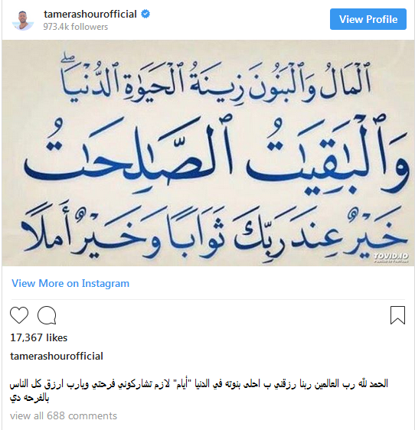

Slide 19

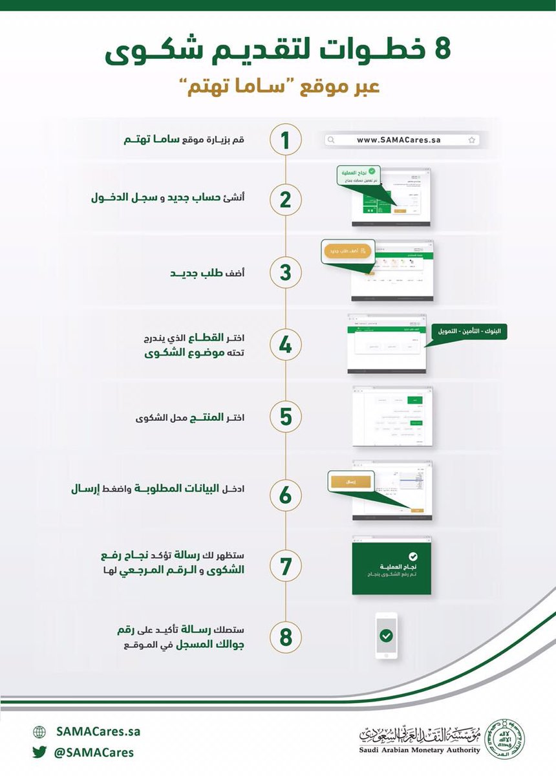

Have a good day

Slide 20
Have a good day

