Slide 1

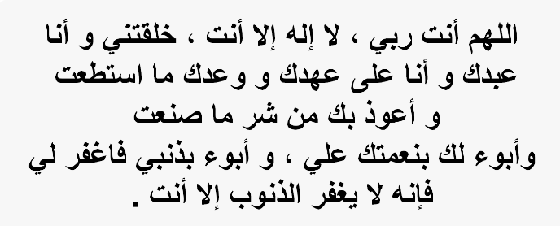

Slide 2
Good Morning

Slide 3

Unit-4-
The Art of Advertising
L3 Grammar

Slide 4
The Passive
Comparatives and Superlatives
As … As
Verbs Look, Smell, Sound, Taste with Like + Noun

Slide 5


Objectives:
1
Build a sentence focusing on the action
2
Compare two different things correctly
3
Form correct passive sentences
4
Use the correct verb form for the passive
5
Use comparative and superlative forms correctly

Slide 6

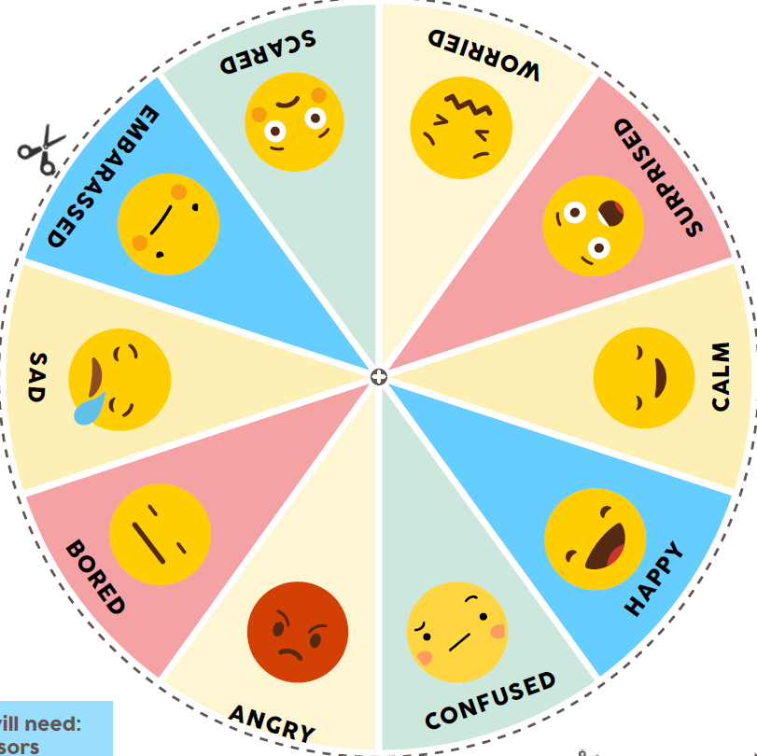
Tell me about your Emotions today

Slide 7
The Passive

Slide 8
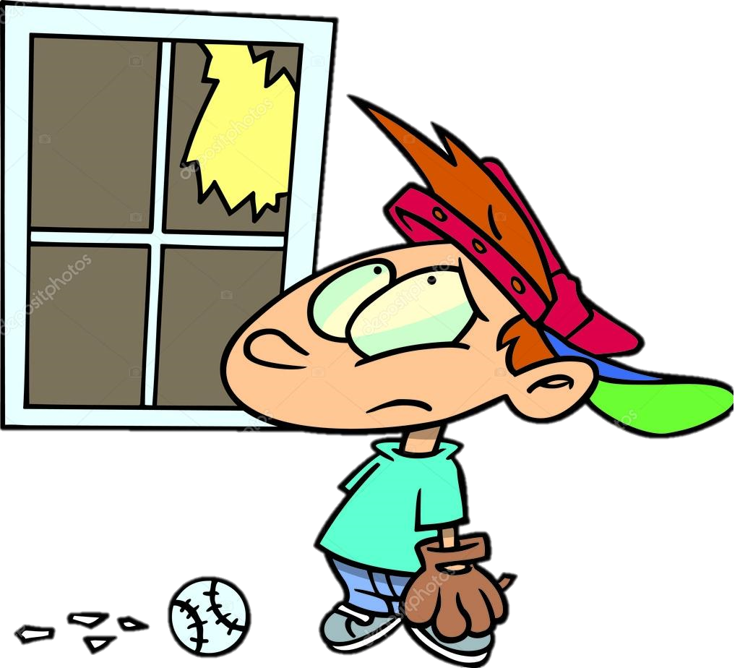
Warm Up
Is it active Or passive?.
Who broke the window?.
The boy broke the window.

Slide 9

Is it active Or passive?.
Who cleans the room?.
The room is cleaned.

Slide 10

Use the passive to
1- emphasize what was done
2- or not interested in the agent (doer)
Examples :
1- The window was broken
2-The lunch was cooked

Slide 11
Passive Is formed by:
active
The boy broke the window.
S + V + O
The boy broke the window.
passive
The room is cleaned by mother
O + Be + V3 + by doer
The room is cleaned

Slide 12
Simple Present:
A company is making a car in Japan
This car is made in Japan
Simple Past:
A company developed the suitcase
The suitcase was developed in the Netherlands

Slide 13
Present Perfect:
Travelers have used Our products
Our products have been used by travelers all over the world
Future:
The factory will produce a clean engine in the future
A clean engine will be produced in the future.

Slide 14



Slide 15

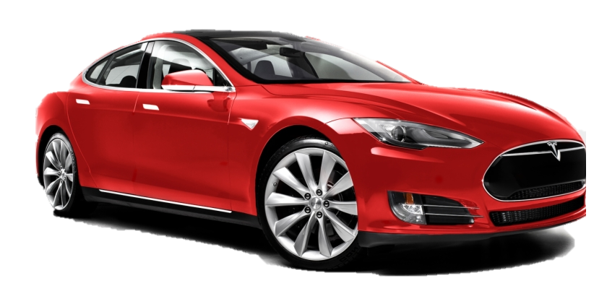
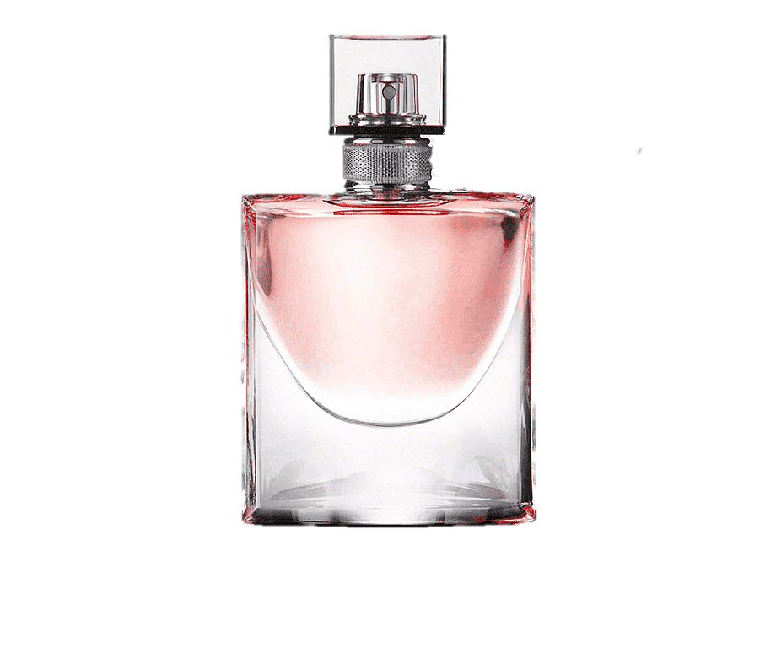
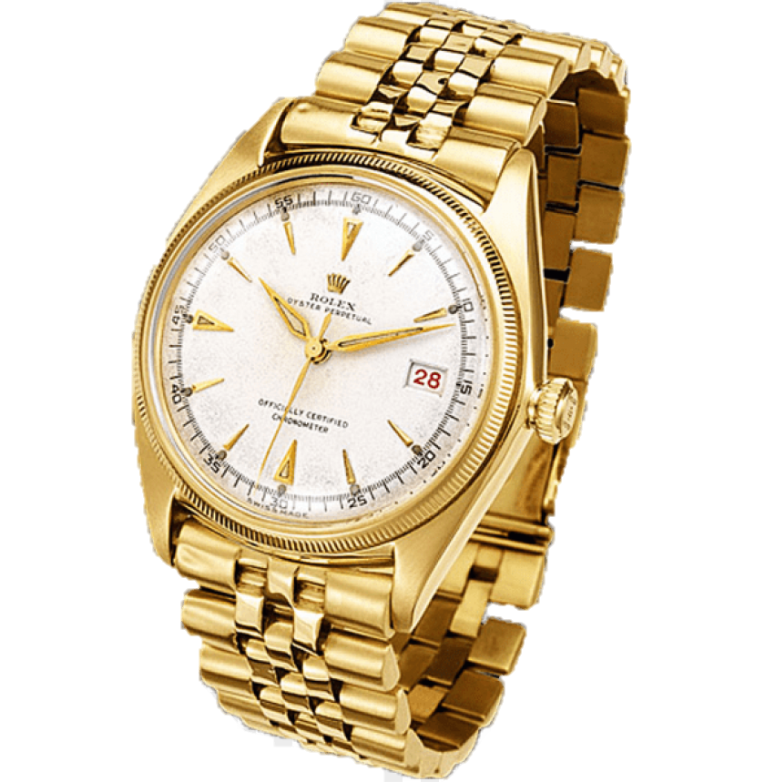
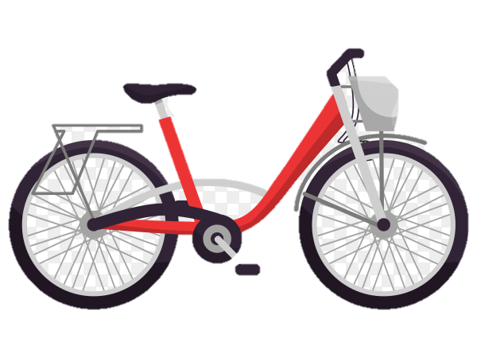
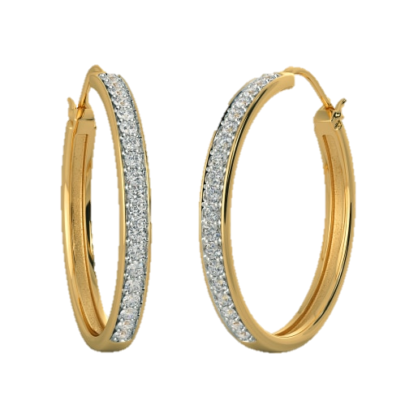
A. Change the sentences from the active voice to the passive voice.
A company in Japan makes the car. The car is made by a company in Japan.
The company has opened a new factory. A new factory has been opened by the company.
1. Karl Benz made the first car in 1886.
2. Companies all the over world produce cars nowadays.
3. In the future, people will drive smaller and smaller cars.
4. Cartier makes perfume, watches, and jewelry.
5. Francois Coty started the perfume industry in the late 1800s.
6. The French have produced famous perfumes for many years.
7. In the future, people will buy more and more hybrid cars.
8. In the past, many people used bikes to go to work.
1. The first car was made by Karl Benz in 1886.
2. Cars are produced (by companies) all over the world nowadays.
3. In the future, smaller and smaller cars will be driven (by people).
4. Perfume, watches, and jewelry are made by Cartier.
5. The perfume industry was started by Francois Coty in the late 1800s.
6. Famous perfumes have been produced by the French for many years.
7. In the future, more and more hybrid cars will be bought (by people).
8. In the past, bikes were used by many people to go to work.

Slide 17
Good Morning

Slide 18
Objectives:
1
Compare two different things correctly
2
Use the verbs "look, smell, sound, taste" with like + noun
3
Use comparative and superlative forms correctly
4
Compare two things using "as-as
5
Say verse of Aya about comparisons

Slide 19
Unit-4-
The Art of Advertising
L3 Grammar

Slide 20
Comparatives and Superlatives

Slide 21
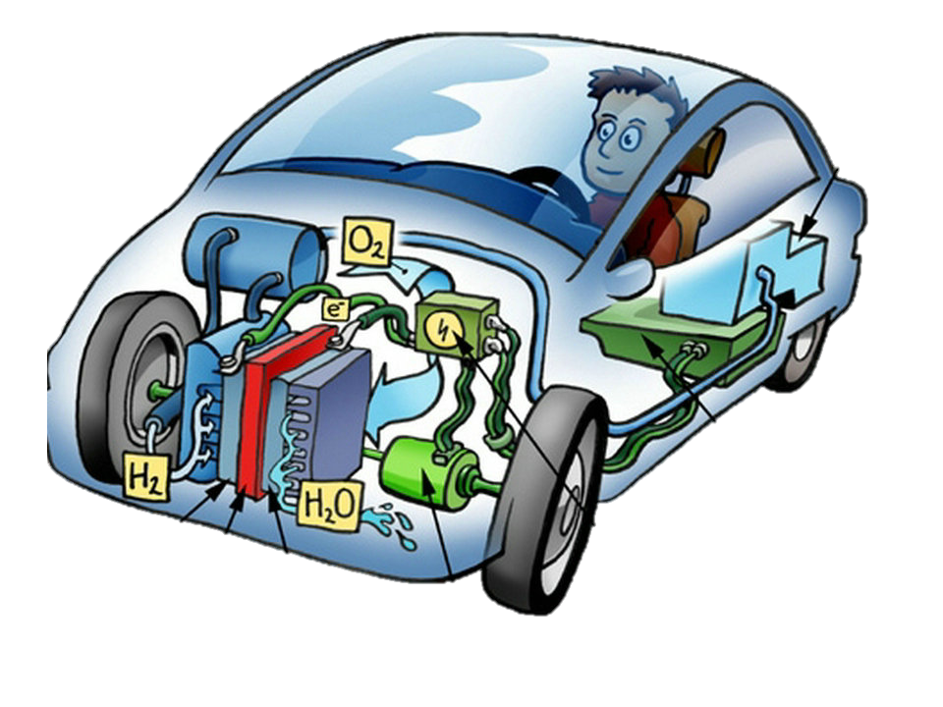
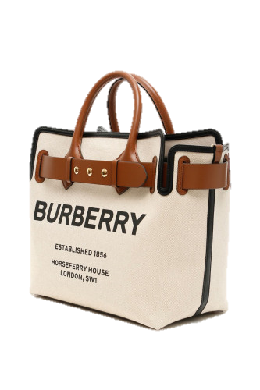
Superlative Form | Comparative Form | Adjective
It’s the cleanest car of all. | It’s cleaner than other models. | The hydrogen car is clean.
It’s the most expensive bag | It’s more expensive than others. | The bag is expensive
The hydrogen car is fast the gas car
Faster than
The hydrogen car is fast the gas car
The Fastest
The bag is beautiful my bag
more
than
The bag is beautiful bag
The most

Slide 23
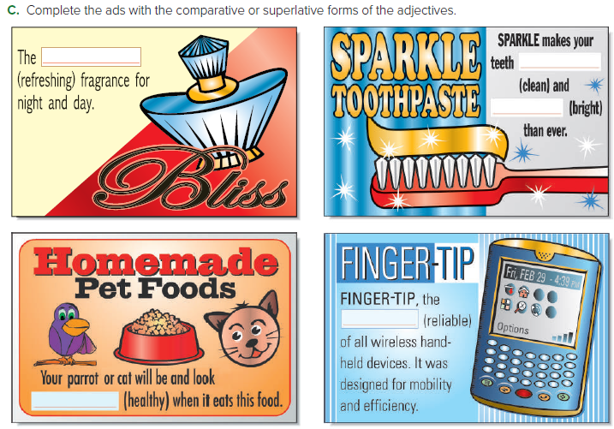
Most refreshing
cleaner
brighter
Most reliable
healthier

Slide 24
As ………..As
Not as………..as

Slide 25
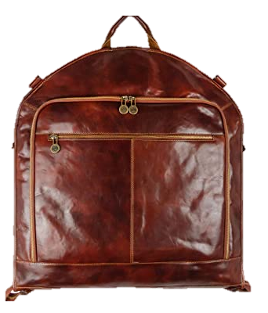
100,000 S.R
100,000 S.R
The special suitcase is as expensive as a car.
Use as … as to show two items are the same in some way
The fold-up bicycle is not as bulky as a regular bicycle
Use not as … as to show that two items are not the same
in some way.

Slide 27
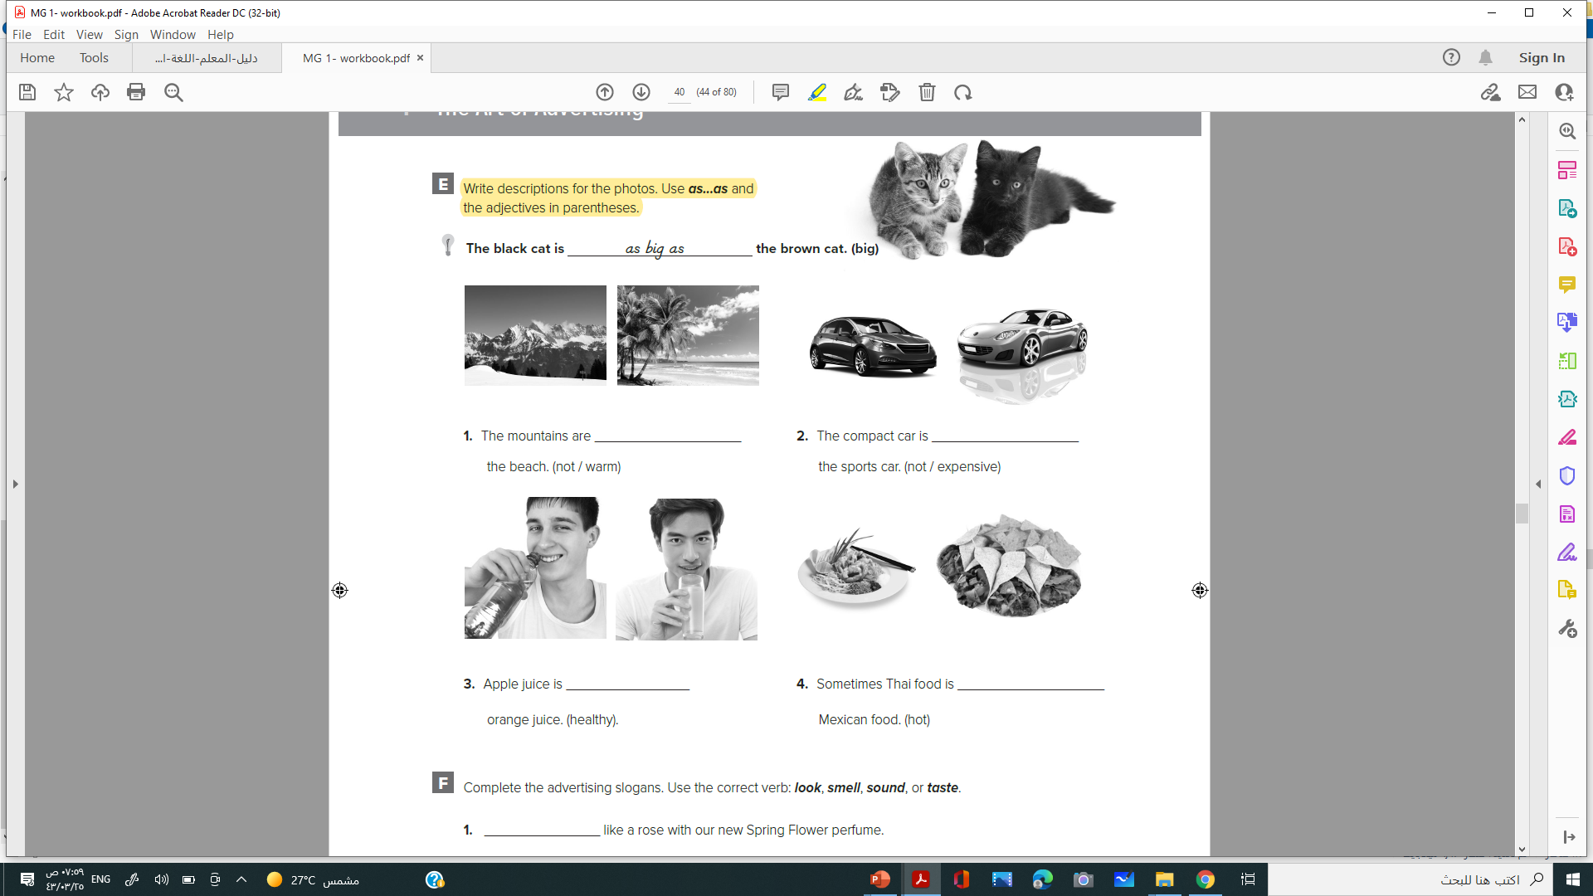
112
not as warm as
not as expensive as
as healthy as
as hot as

Slide 28
Verbs Look, Smell, Sound, Taste with Like + Noun

Slide 29

look like + noun
smell like + noun
sound like + noun
taste like + noun
The new compact car looks like a bug.
That sounds like a good idea.

Slide 31
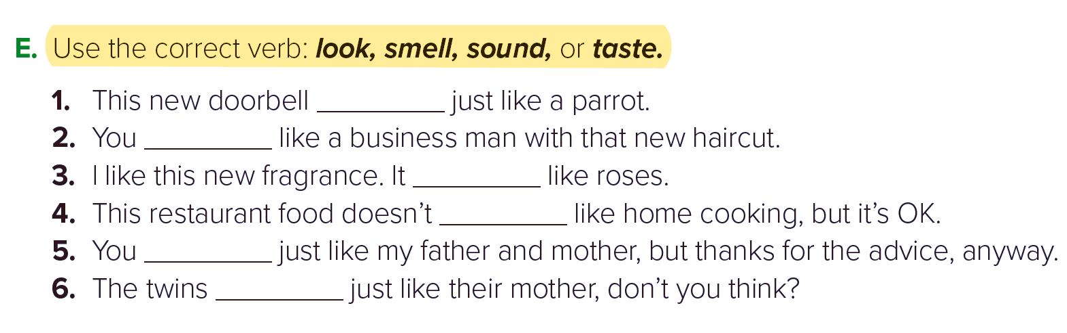
sounds
look
smells
taste
sound
look

Slide 32

فَلَمَّا وَضَعَتْهَا قَالَتْ رَبِّ إِنِّي وَضَعْتُهَا أُنثَىٰ وَاللَّهُ أَعْلَمُ بِمَا وَضَعَتْ وَلَيْسَ الذَّكَرُ كَالْأُنثَىٰ ۖ وَإِنِّي سَمَّيْتُهَا مَرْيَمَ وَإِنِّي أُعِيذُهَا بِكَ وَذُرِّيَّتَهَا مِنَ الشَّيْطَانِ الرَّجِيمِ
قال تعالى:

Slide 33


