Slide 1
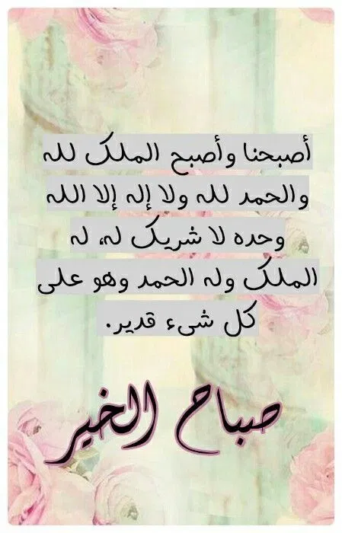

Good Morning
Mega Goal 2.1

Slide 2
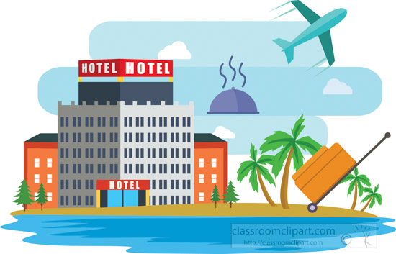
Good Morning
Mega Goal 2.1
Unit -3-
Far and Away
Reading
Speaking
Conversation

Slide 3
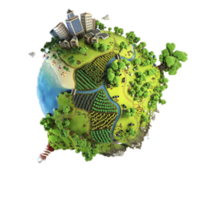
Unit -3-
Far and Away
Reading
Speaking
Good Morning
Mega Goal 2.1

Slide 4
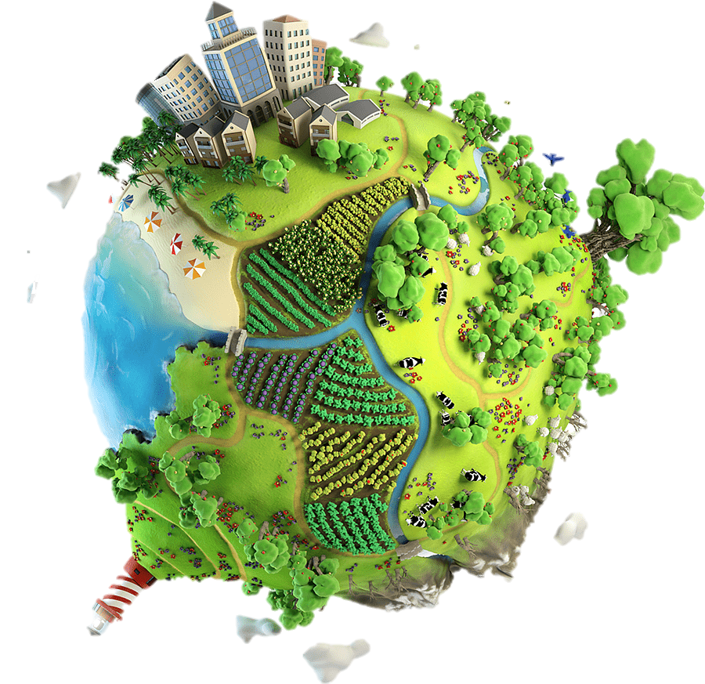
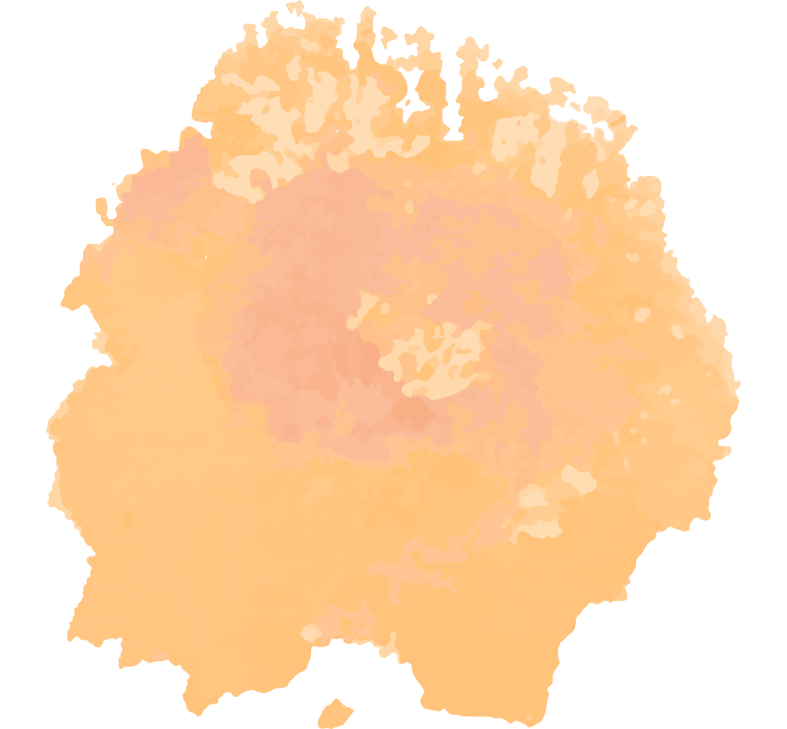

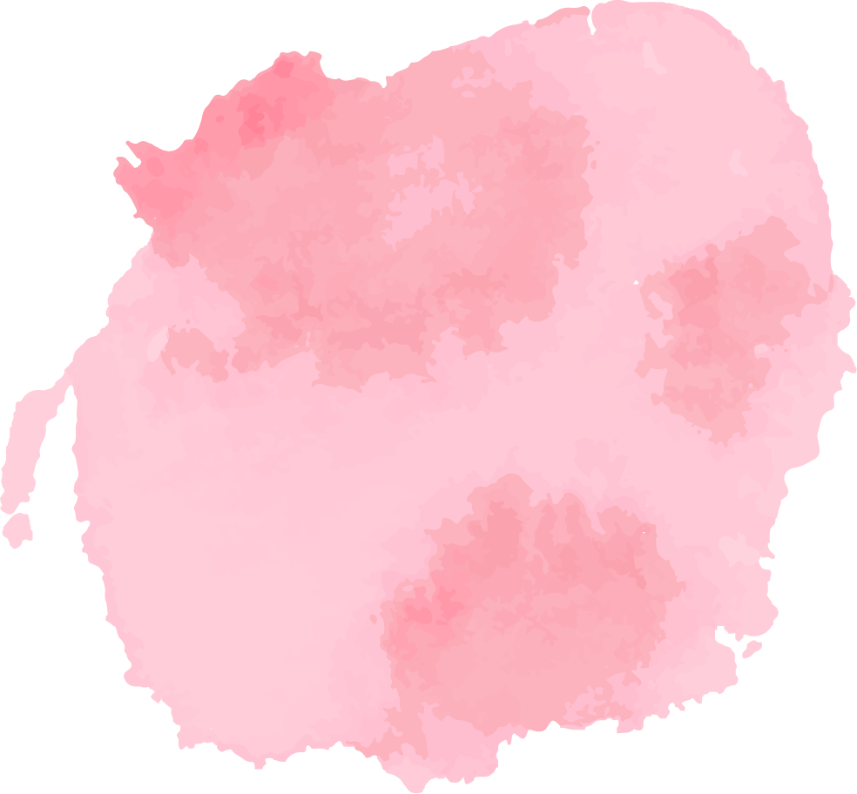
Objectives:
1
2
3
Make use of the text topic to make questions .
Find the meaning of ecotourism .
Mark phrases related to the word (ecotourism)
4
5
Complete sentences about the text .
Find the meaning of new words in the text .
Unit -3-
Far and Away
Reading
Speaking

Slide 5
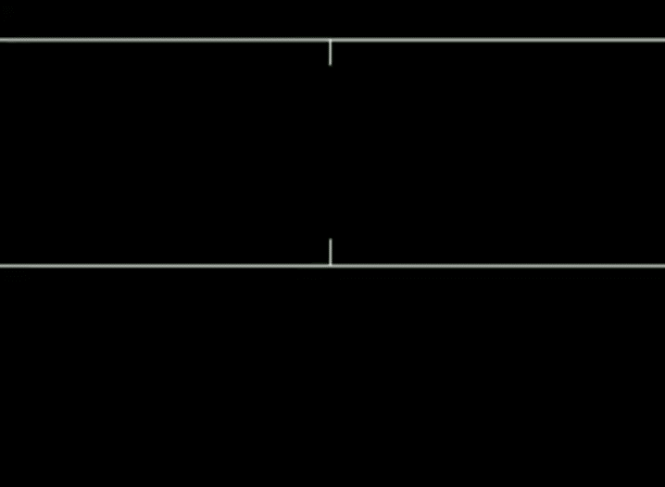
Reading

Slide 6
Reading

Slide 7

Warm Up
What does Eco- mean?
Guess
related
to the earth
to the environment

Slide 8
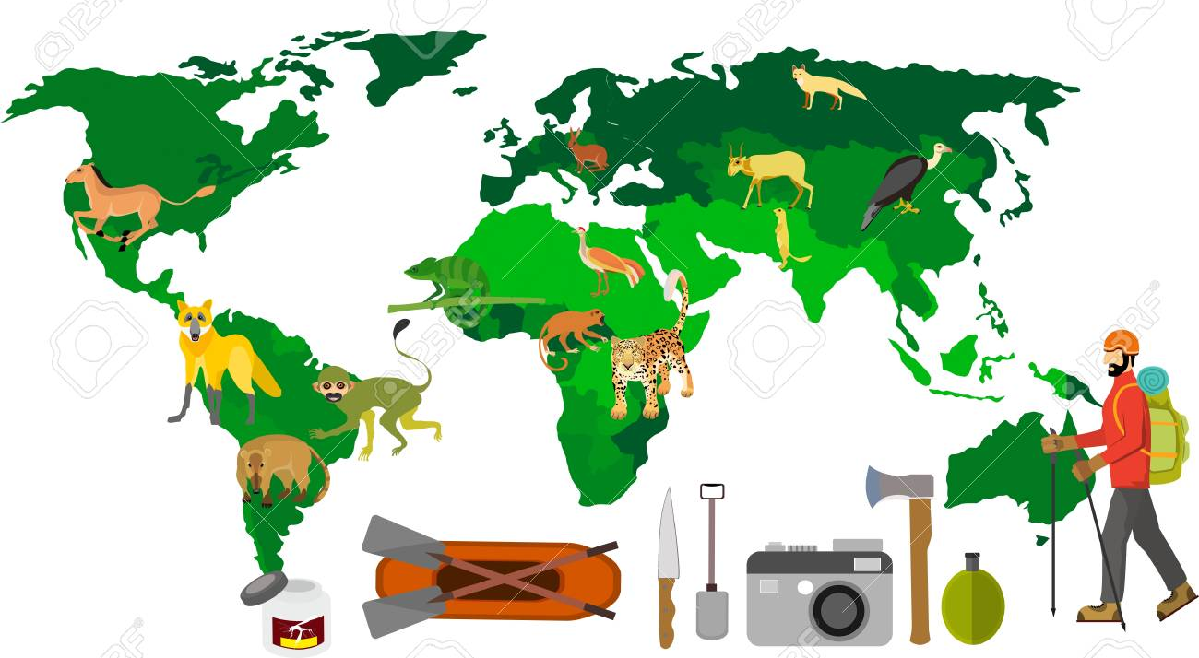
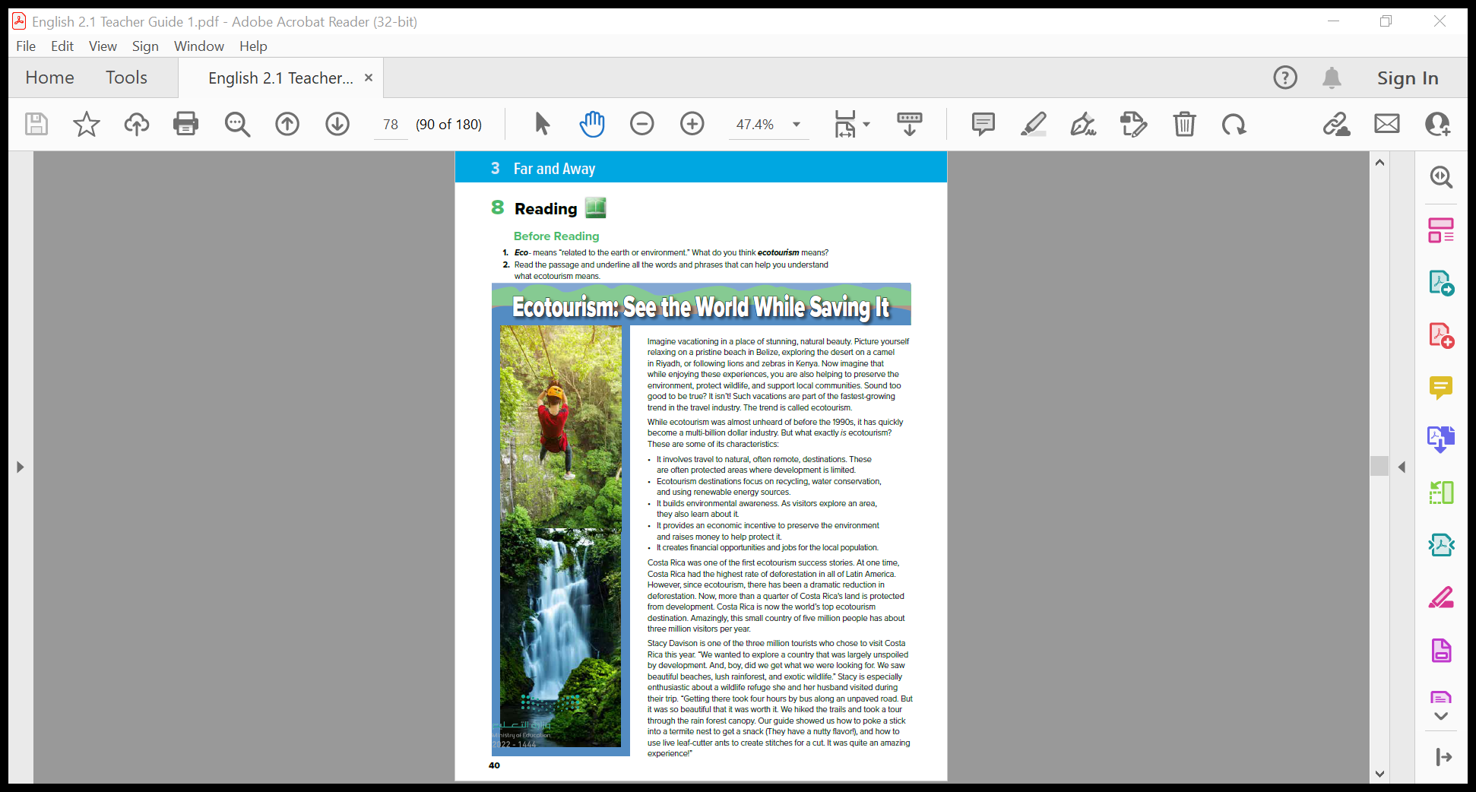
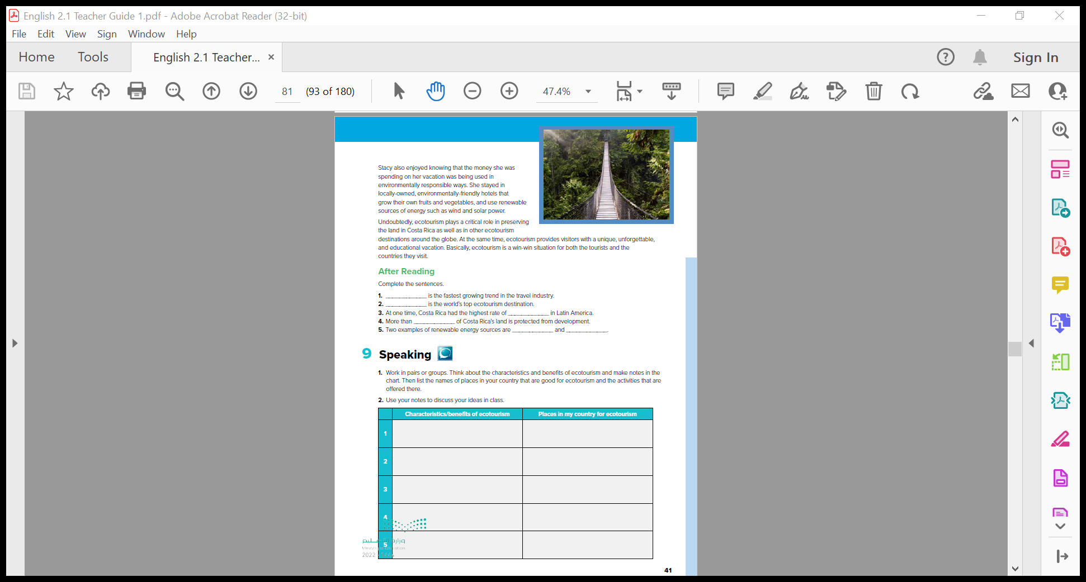
Eco
tourism

Slide 9
5
6
1
.. the title?
2
What do you think the main idea of the article is going to be?
like the places?
……Pictures?
3
Have you ever experienced?
.. # of paragraphs?
4
Places have services or facilities?
Notes:
Elicit students’ responses and make notes
on the board, but don’t indicate if any answers are right
or wrong at this point.

Slide 10



Read as long you as Listen

Slide 11
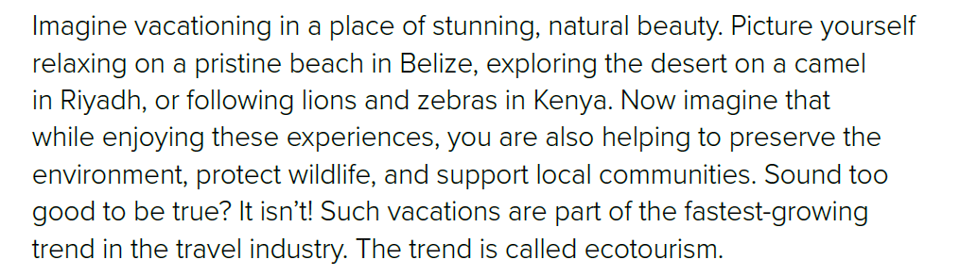
Places’ names ?
Animals’ names ?
What is a pristine beach ?
It’s a beach in its original condition . There aren’t a lot of hotels or restaurants . It’s clean and without a lot of garbage .

Slide 12
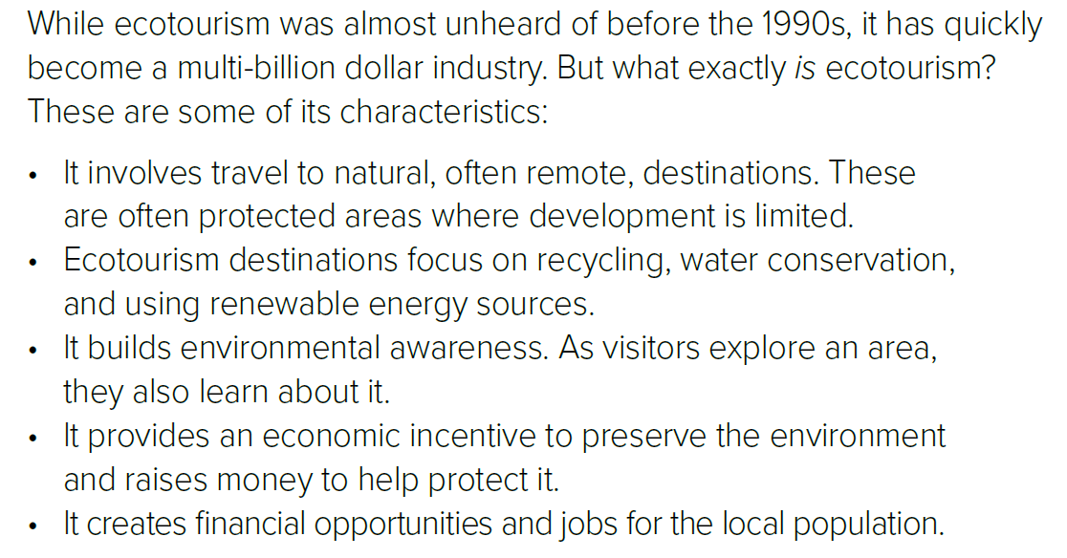
✓
✓
✓
✓
✓
When was ecotourism first heard ?
What are the characteristics of ecotourism ?

Slide 13
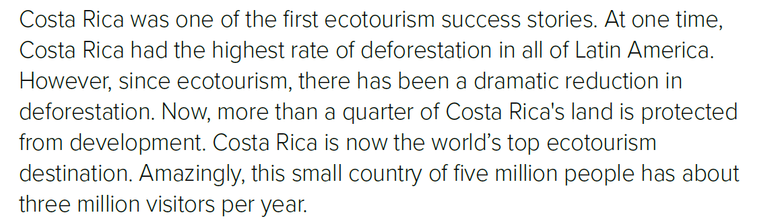
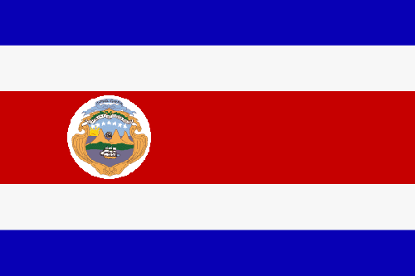
Where does Costa Rica locate ?
What does deforestation mean ?
Cutting down trees .
Which a country had the highest rate of deforestation in all of Latin America ?
How many visitors does Costa Rica have per year ?

Slide 14
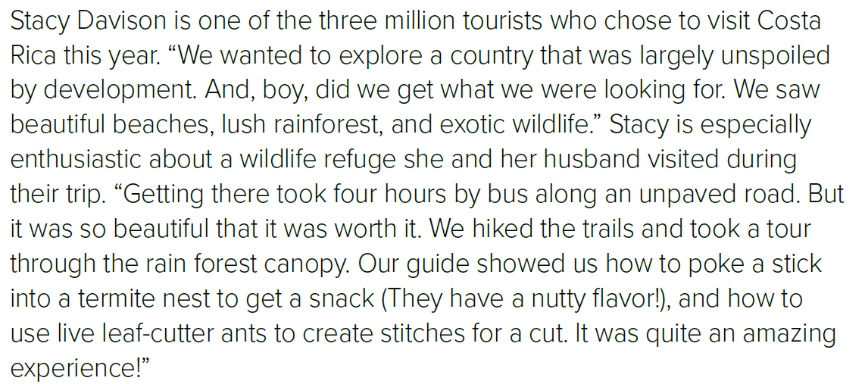
Name ?
What did they see ?
How many hours did you need to get there by bus ?
What did the guide show them ?

Slide 15
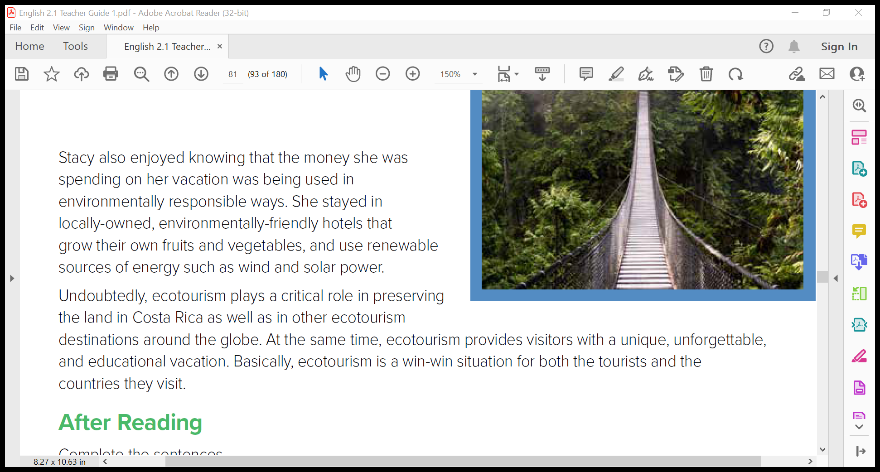
Undoubtedly, ecotourism plays a critical role in preserving
the land in Costa Rica as well as in other ecotourism
destinations around the globe. At the same time, ecotourism provides visitors with a unique, unforgettable, and educational vacation. Basically, ecotourism is a win-win situation for both the tourists and the countries they visit.
What did Stacy enjoy ?
Where did Stacy stay ?
Give example of renewable sources of energy?
What does ecotourism provide ?

Slide 16

READING STRATEGY
Summarizing

Slide 17
5
6
1
2
Summarize each paragraph in you own words
3
4

Slide 18
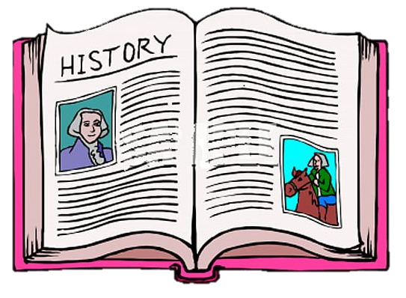
Words and Meanings
preserve the environment =
= protect the plants, animals, water and land)
conservation water =
saving water; keeping it clean)
incentive economic =
possibility of earning money while doing something)
deforestation highest rate of =
Costa Rica was cutting down more trees than any other country)
characteristics some of its =
some of ecotourism’s features; things that are special about it)
remote destinations =
places that are far away and difficult to get to)
reduction a dramatic in deforestation =
cutting down many fewer trees than in the past)
lush rainforest =
forest full of green trees and many other plants)

Slide 19
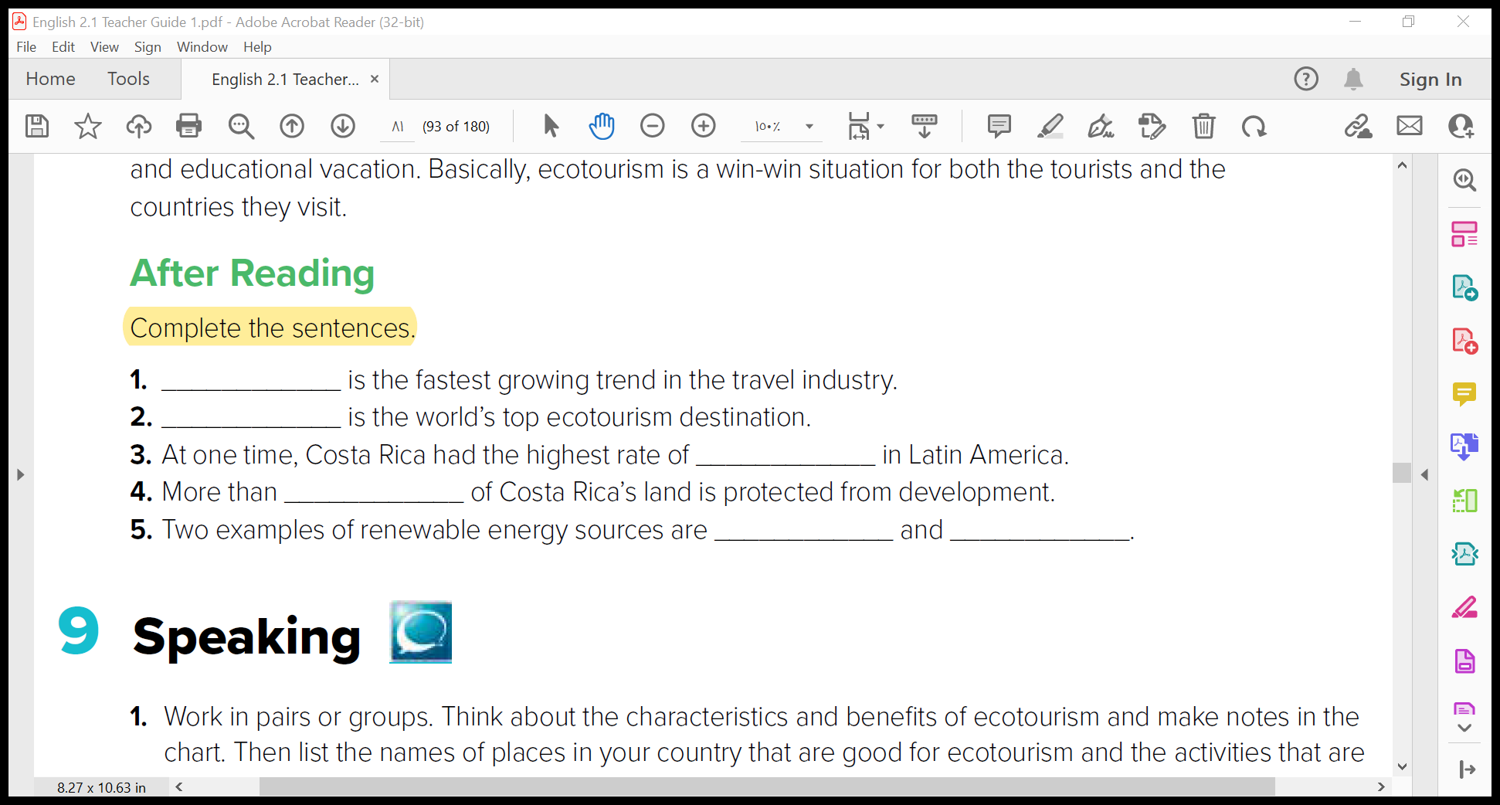
Speaking
ecotourism
Costa Rica
deforestation
a quarter
wind
solar power

Slide 20
Speaking

Slide 21

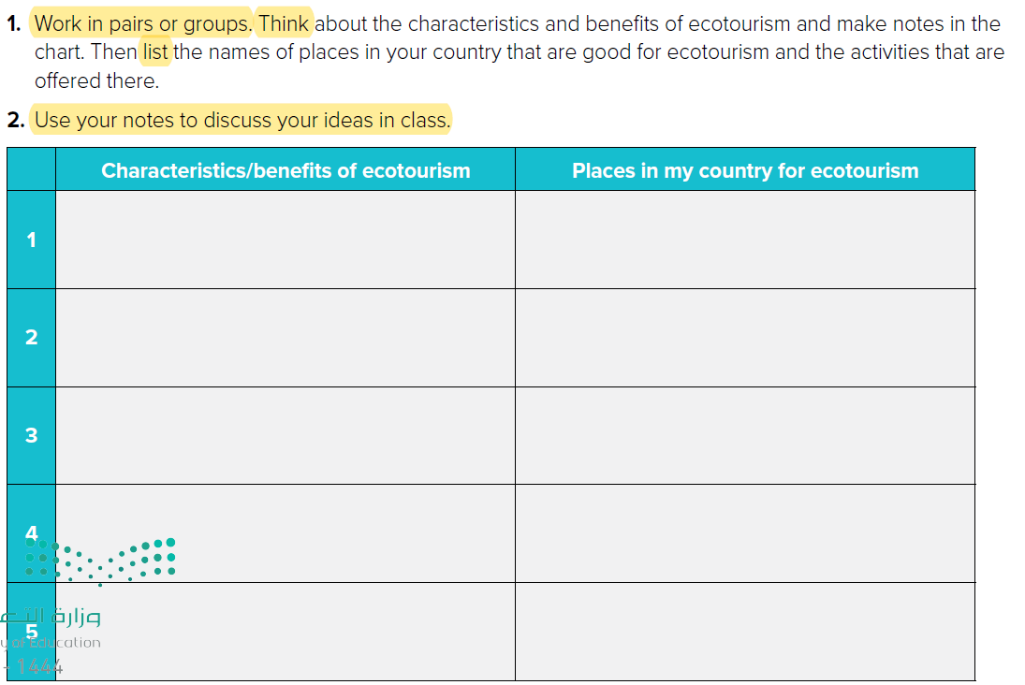

Slide 22
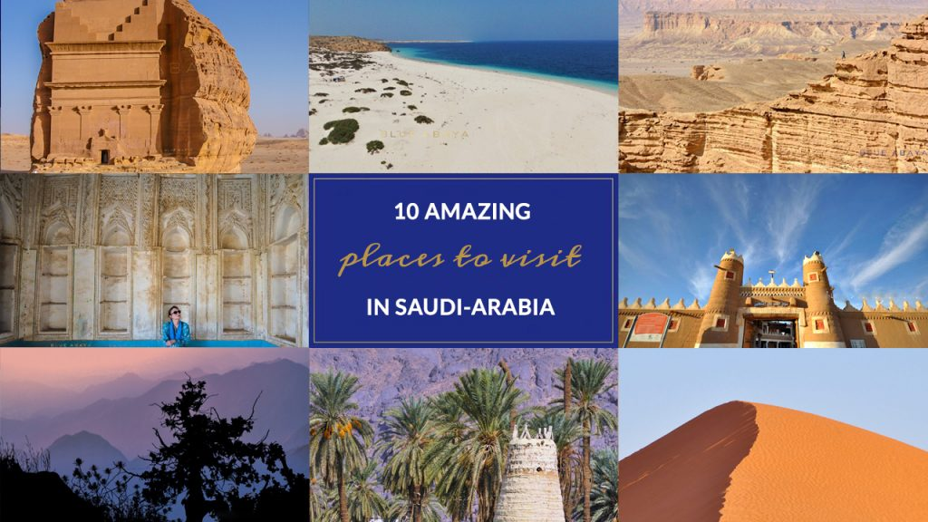
TEN AMAZING PLACES TO VISIT IN SAUDI-ARABIA

Slide 23


Quick Check

Slide 24


