Slide 1

Good Morning
Mega Goal 2.1

Slide 2

Good Morning
Mega Goal 2.1
Unit -3-
Far and Away
Grammar

Slide 3
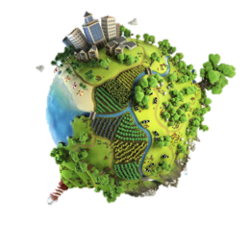
Unit -3-
Far and Away
Grammar
Good Morning
Adverbs of Degree
Sentence Adverbs
Mega Goal 2.1

Slide 4
Adverbs of Degree
Sentence Adverbs
Unit -3-
Far and Away
Grammar

Slide 5

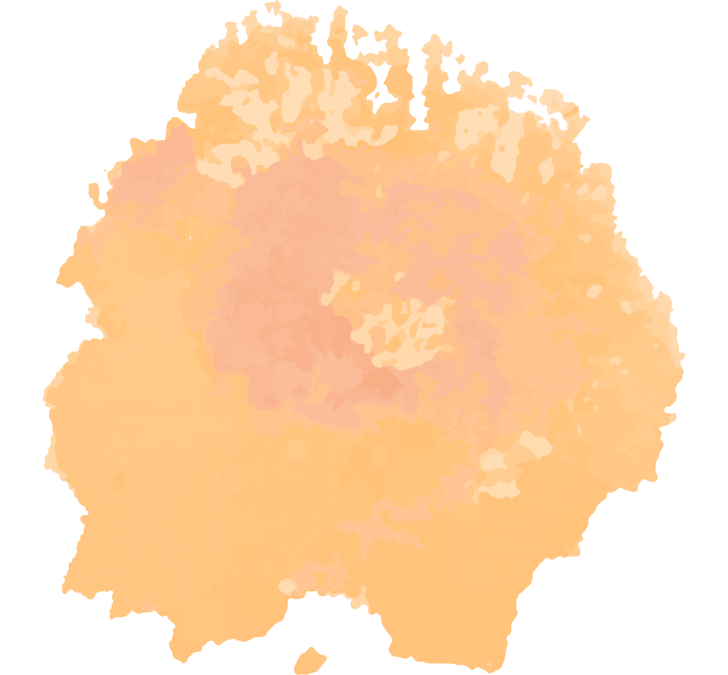


Objectives:
2
3
4
1
Rewrite sentences using adverbs of degree
Use sentence adverbs correctly
Use adverbs of degree with adjectives .
.
Classify the adverbs according to their degree
5
6
7
8
Use "enough" with adverbs of degree.
Use sentence adverbs with "simple tenses “
Use sentence adverbs with compound verbs“.
.
Use adverbs of degree with adverbs .
Adverbs of Degree
Sentence Adverbs

Slide 6
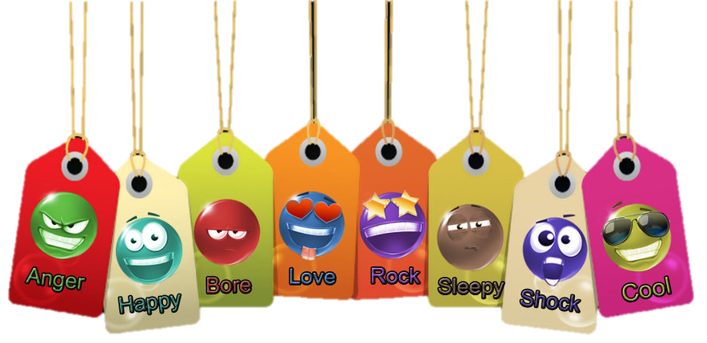

How is Your Mood Today?
Adverbs of Degree

Slide 7
Adverbs of Degree

Slide 8
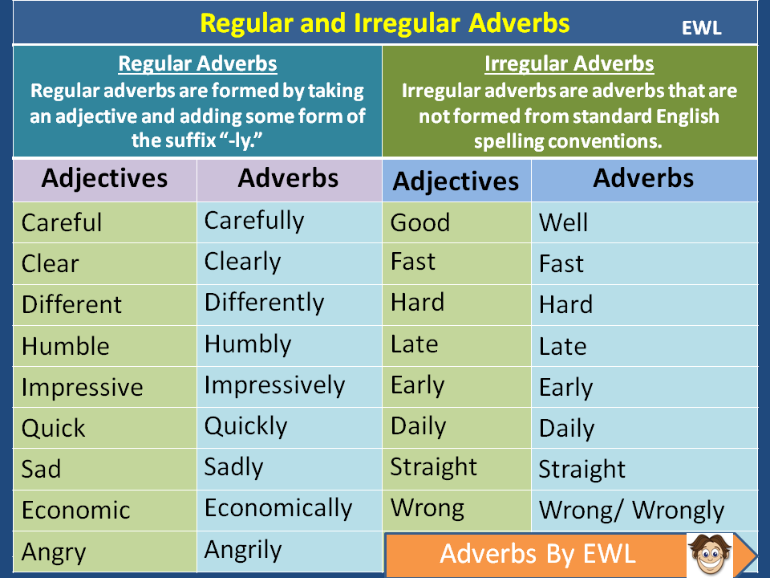
What is an adverb ?
A word that describes or modifies a verb, an adjective or another adverb .
Adverb Form
We make many adverbs by adding -ly to an adjective, for example:
adjective
adverb
quickly
quick
careful
carefully
beautiful
beautifully

Slide 9
Irregular adverbs
adjective
adverb
Regular adverbs
adjective
adverb
quick
quickly
careful
carefully
beautiful
beautifully

Slide 10

The water was extremely cold .
adverb
adjective
He hardly noticed what she was saying .
adverb
verb
Why are you eating the popcorn so quickly ?
adverb
adverb

Slide 11
Adverbs of degree tell us about the intensity of a verb, adjective, or other adverbs.
Some common adverbs of degree are:
absolutely
completely
hardly
quite
so
Almost
enough
just
rather
too
barely
extremely
nearly
scarcely
very

Slide 12

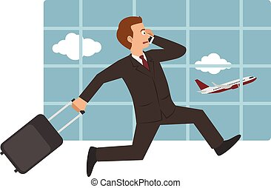


Adverbs of degree usually go before the main verb they modify.
I’ve almost finished packing. I nearly missed my flight.
Adverbs of degree usually go before the adjective or adverb they modify.
The travel agent was extremely helpful.
He read the map very carefully.
When enough is used as an adverb of degree, it is placed after adjectives and adverbs.
Is your coffee hot enough? You are not speaking loudly enough

Slide 13

hardly
barely
scarcely
Negative words

Slide 14
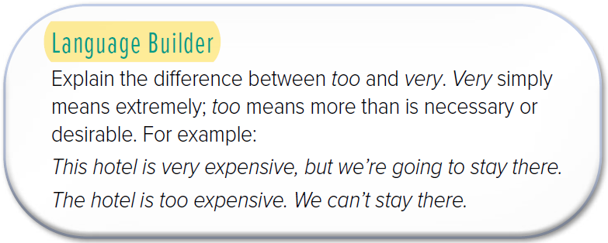
They can’t be used with another negative .
hardly
barely
scarcely
It’s very dark. I can hardly see .
I can barely hear you .
He could scarcely eat anything
Negative words

Slide 15
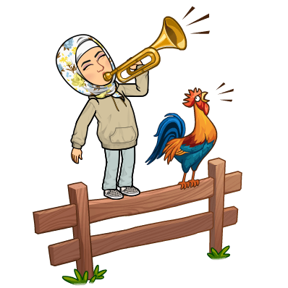

Slide 16
Practice Time

Slide 17
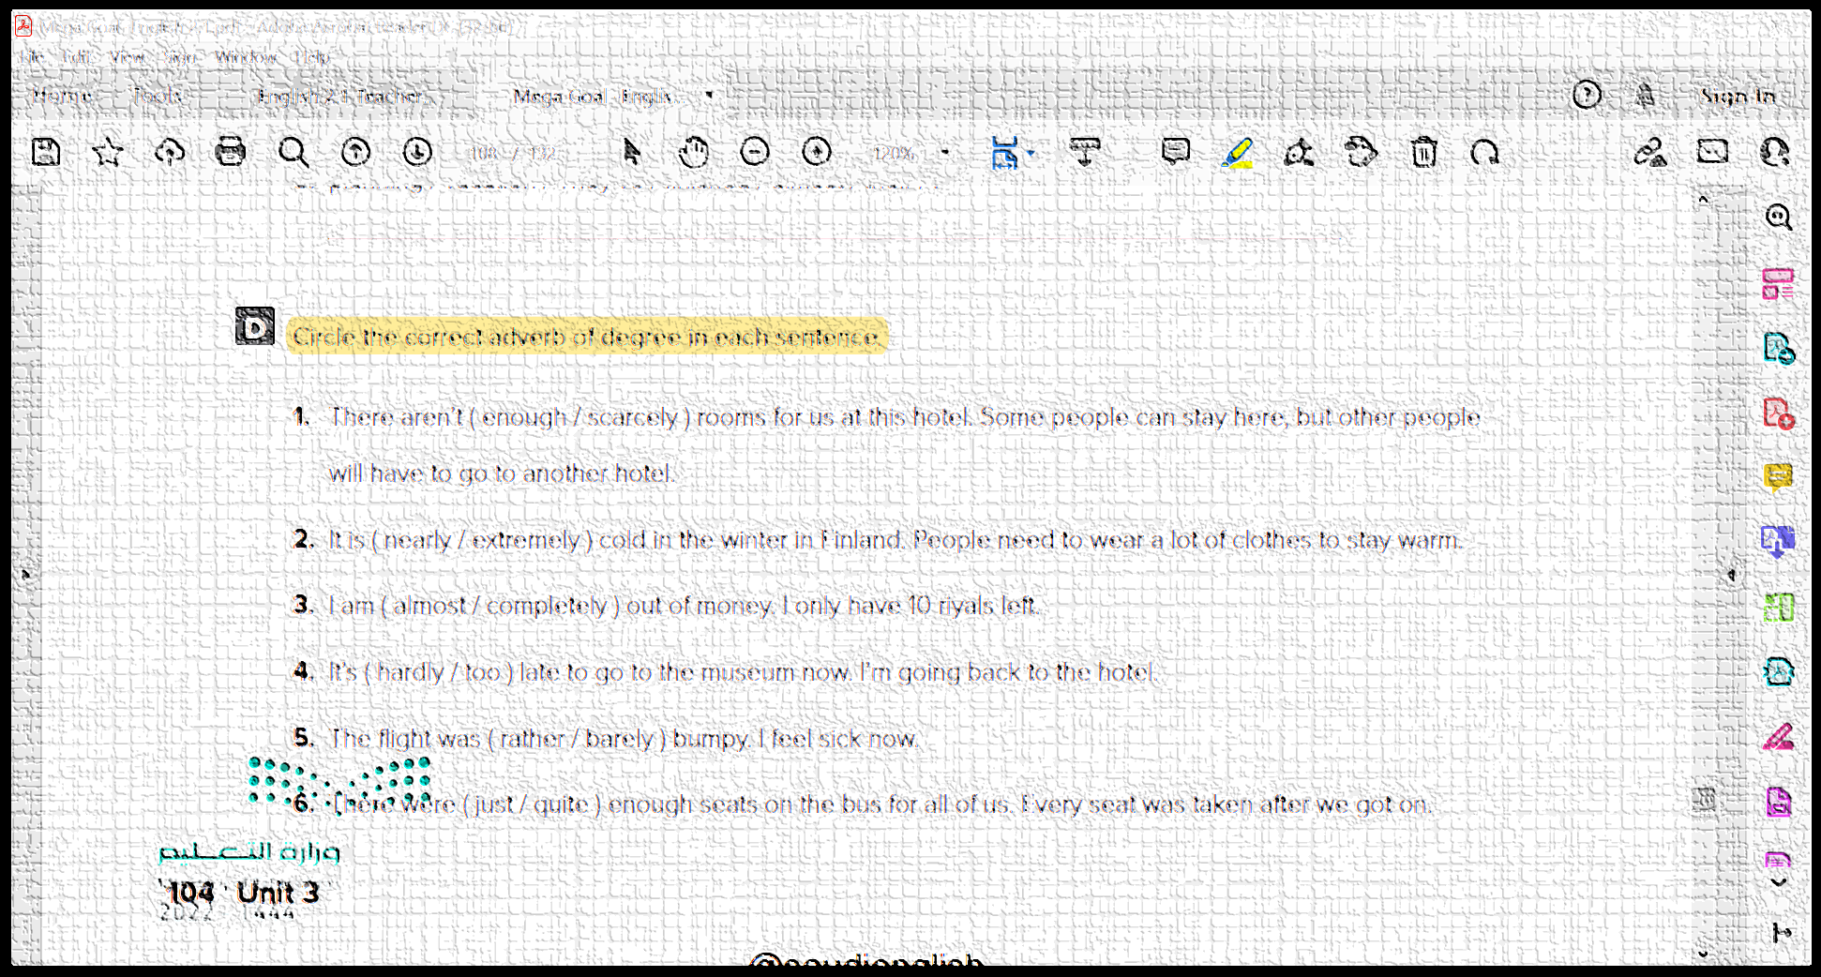
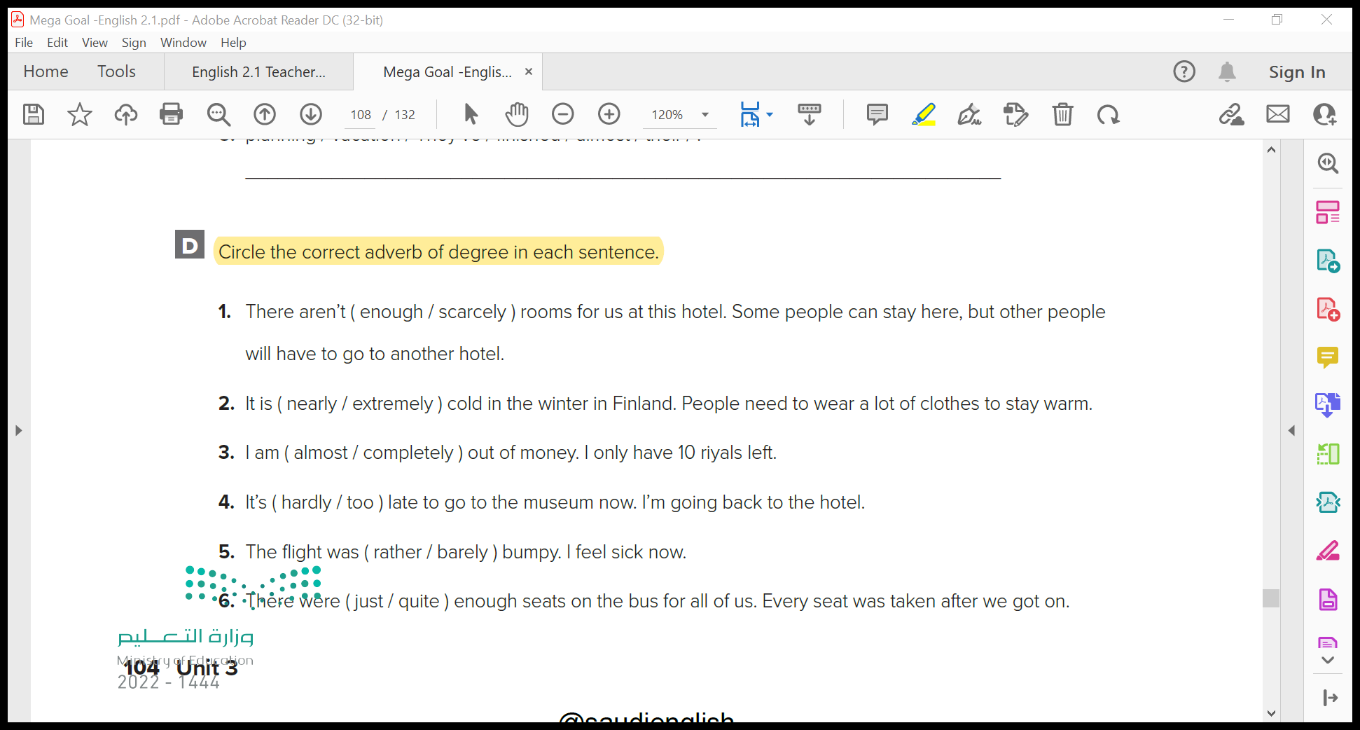
W.B.P.104

Slide 18

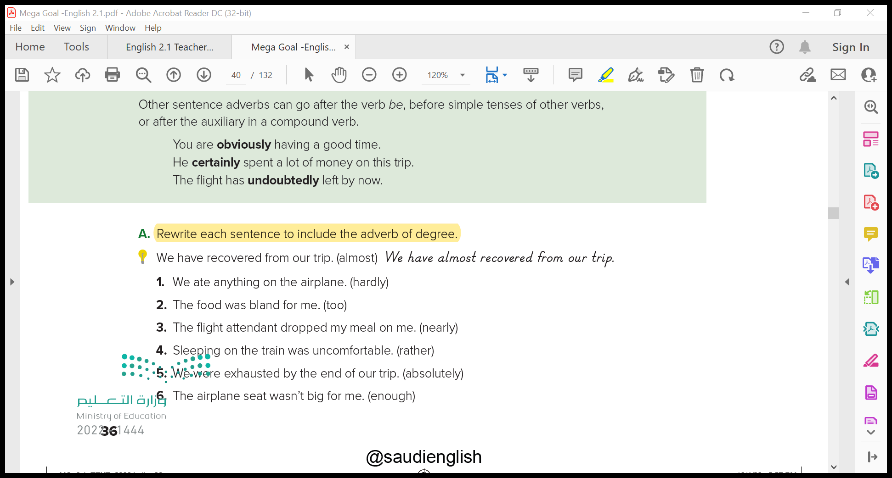
1- We hardly ate anything on the airplane .
2- The food was too bland for me .
3- The flight attendant nearly dropped my meal on me .
4- Sleeping on the train was rather uncomfortable .
5- We were absolutely exhausted by the end of our trip .
6- The airplane seat wasn’t big enough for me .
Sentence Adverbs

Slide 19
Sentence Adverbs

Slide 20
Sentence adverbs modify an entire sentence, or a whole clause within a sentence.
They indicate the attitude of the speaker. Some common sentence adverbs are:
Actually certainly frankly * obviously probably
admittedly* clearly honestly* officially* undoubtedly
Apparently evidently naturally * presumably (un)fortunately*

Slide 21

Clearly, this man is not a fighter .
Sadly, the forests are now under threat .
Obviously, he is the best of the students we’ve seen so far .
Honestly, I spent that money in the mall .
Actually certainly frankly * obviously probably
admittedly* clearly honestly* officially* undoubtedly
Apparently evidently naturally * presumably (un)fortunately*

Slide 22
Some sentence adverbs usually go at the beginning of a sentence.
Frankly, I'm disappointed in the quality of this hotel.
Other sentence adverbs can go after the verb be, before simple tenses of other verbs, or after the auxiliary in a compound verb
You are obviously having a good time.
He certainly spent a lot of money on this trip.
The flight has undoubtedly left by now.
His eyes were actually filled with tears .
He probably wanted to say good-bye privately .
She had certainly been under a lot of stress .

Slide 23
``````````````````````
Practice Time

Slide 24
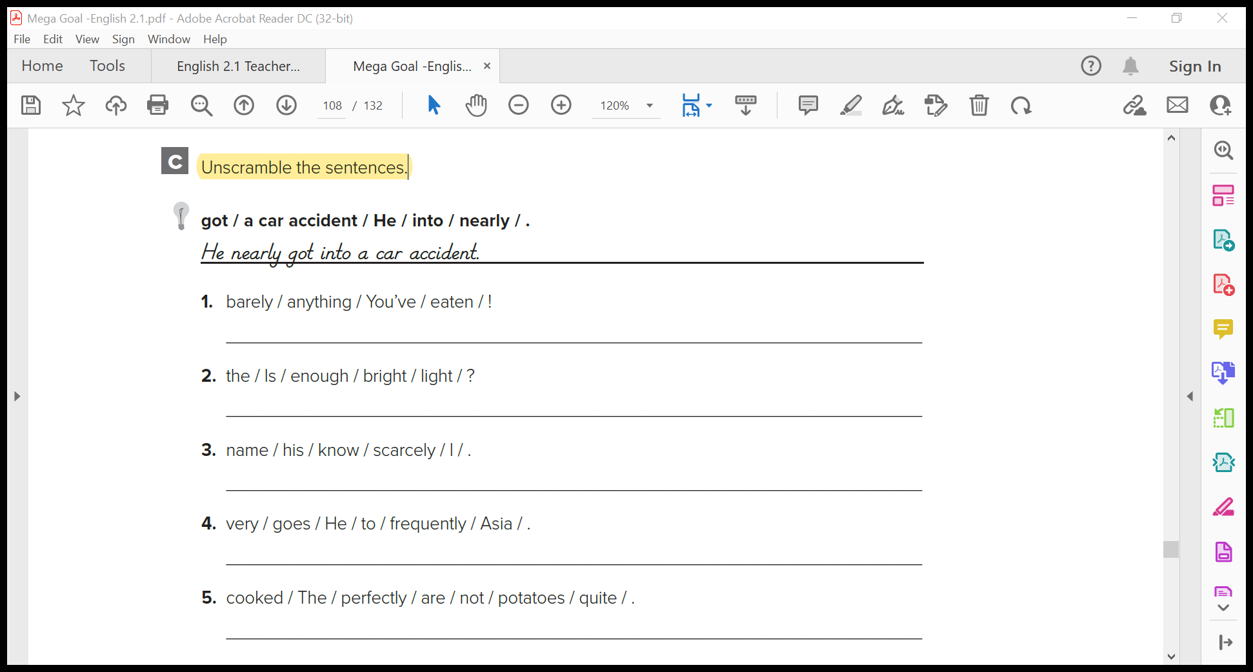
W.B.P.104
You’ve barely eaten anything !
Is the light bright enough?
I scarcely know his name.
He goes to Asia very frequently.

Slide 25
Summarize the Grammar
Sentences Adverbs
Adverbs of Degree
Before the Verb
Before the Adj /Adv
Enough After the Adj /Adv
Beginning
After the Helping verb
Before the Verb
Be ( am - is – are )
Has / Have / Had

Slide 26


