Slide 1
MEGA GOAL 3

Slide 2
UNIT 4

Slide 3
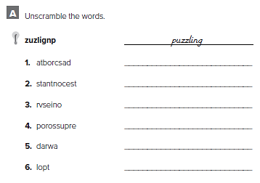
broadcast
contestants
version
prosperous
award
plot

Slide 4
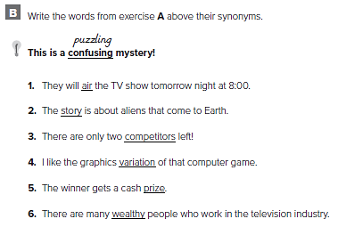
1- broadcast
2- plot
3- contestants
4- version
5- award
6- prosperous

Slide 5
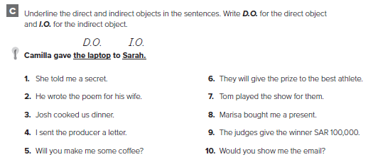
1. D.O. = a secret I.O. = me
2. D.O. = the poem I.O. = his wife
3. D.O. = dinner I.O. = us
4. D.O. = a letter I.O. = the producer
5. D.O. = coffee I.O. = me
6. D.O. = the prize I.O. = the best athlete
7. D.O. = the show I.O. = them
8. D.O. = a present I.O. = me
9. D.O. = SR 100,00 I.O. = the winner
1 0 . D.O. = the email I.O. = me

Slide 6
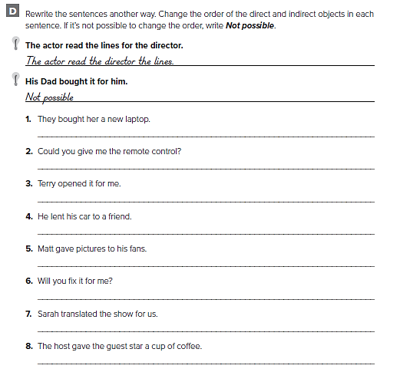
They bought a new DVD player for her.
Could you give the remote control to me?
Not possible
He lent a friend his car.
Matt gave his fans pictures.
Not possible
Not possible
The host gave a cup of coffee to the guest star.

Slide 7
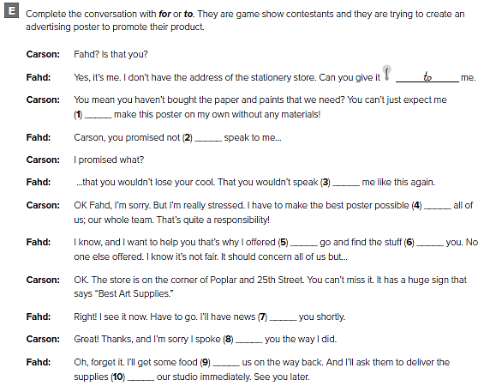
to
to
to
for
to
for
for
to
for
to

Slide 8
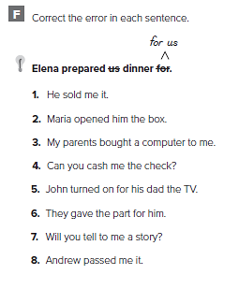
1. He sold it to me.
2. Maria opened the box for him.
3. My parents bought a computer for me.
4. Can you cash the check for me?
5. John turned on the TV for his dad.
6. They gave the part to him.
7. Will you tell me a story?
8. Andrew passed it to me.

Slide 9
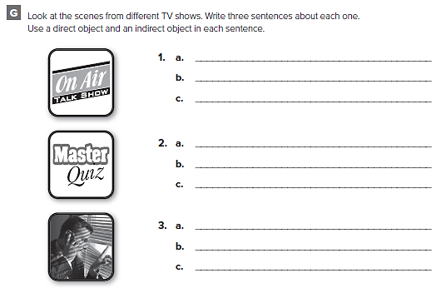
كل طالب يضع اجاباته الخاصة

Slide 10
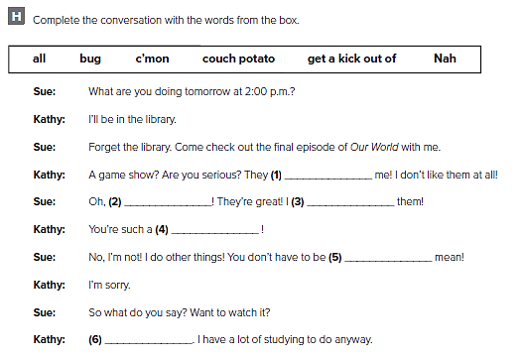
bug
c’mon
Get a kick out of
couch potato
all
Nah

Slide 11
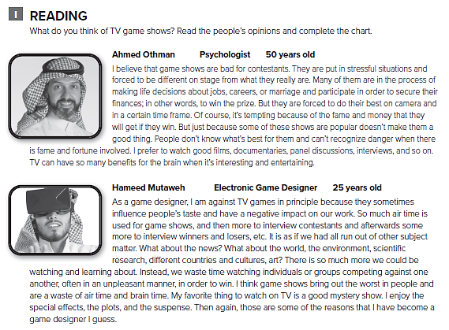

Slide 12
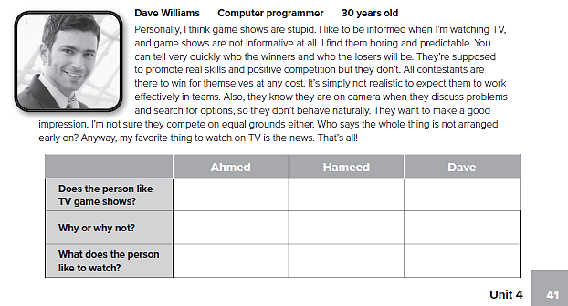
No No No
The situations Bad decisions A waste of
Are boring time
The news Films Shows

Slide 13
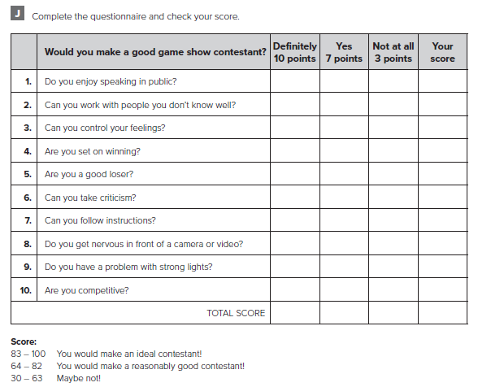
أكمل الاستبيان ثم قم بجمع نقاطك

Slide 14
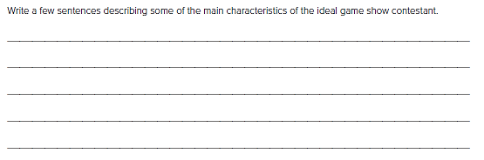
من الممكن أن تختلف الإجابات
The ideal game show contestant likes speaking in public. He can work with people he has met recently and can control his feelings. He is keen to win but he is also a good loser who doesn’t hold grudges. He can take criticism and follow instructions. He is competitive and likes being in front of a camera, a video or strong lights

Slide 15
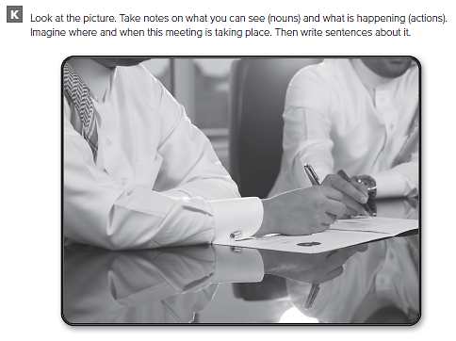

Slide 16
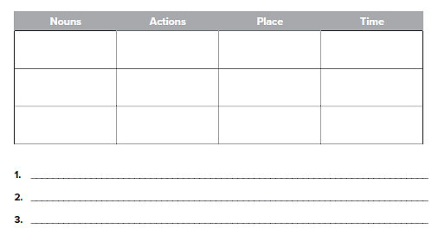
Men
Pens
Office
Sit
Talk
Smile
Office
Company
City
Morning
Noon
Evening
They are sitting in their office or meeting room
One of them is about to write or sign something
من الممكن أن تختلف الإجابات

Slide 17
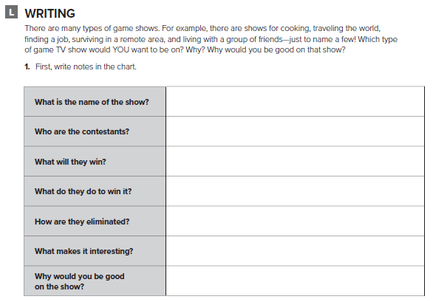
تحدث عن نوع برنامج المسابقات الذي تحبه

Slide 18
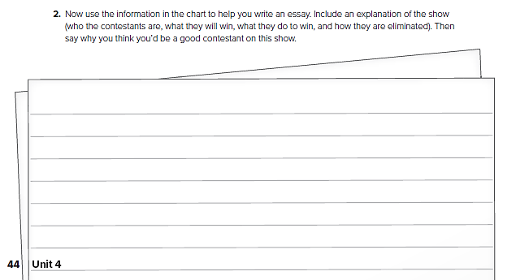
اكتب مقال عن نوع برنامج المسابقات الذي تحبه

Slide 19
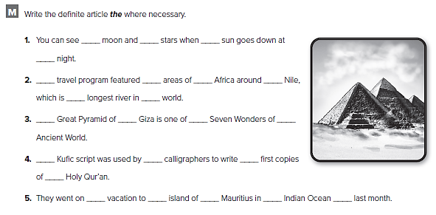
the
the
The
the
the
the
The
the
the
the
the
the
the

Slide 20
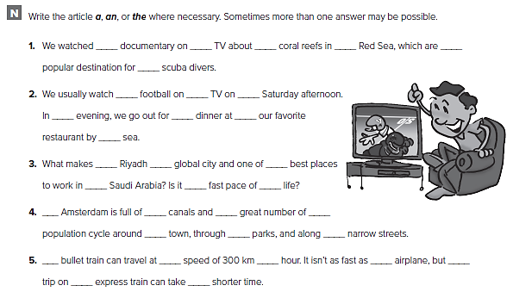
the
the
the
a
the
the
a
the
the
a
the
the
the
the
A
a
an
an
a
an
a

Slide 21
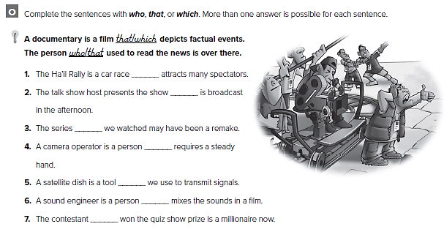
which
that
which
that
which
that
who
that
which
that
who
that
who
that

Slide 22
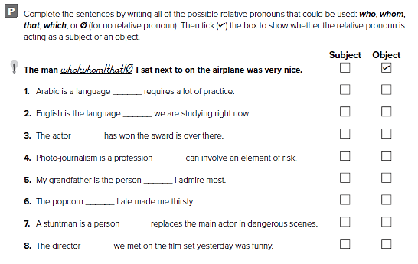

which that
which/that/Ø
who/that
which that
who/that/ Ø;
which that Ø
who/that
who/that/ Ø;

Slide 23
Prepared by
Teacher : Bader Al shehri

