Slide 1
U 4 p 26-27 favorite pastimes
Tr. Nora Khalid

Slide 2
Goals:
Listen for specific information about freetime activities
Know vocabularies related to pastimes, hobbies and leisure activities

Slide 3
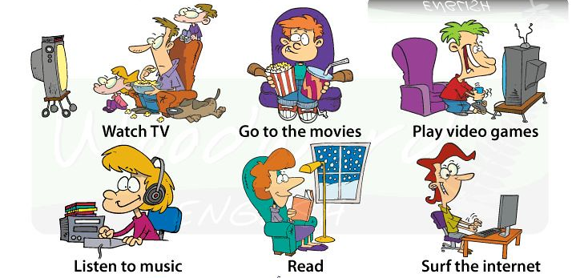
What do you do in your free time?

Slide 4
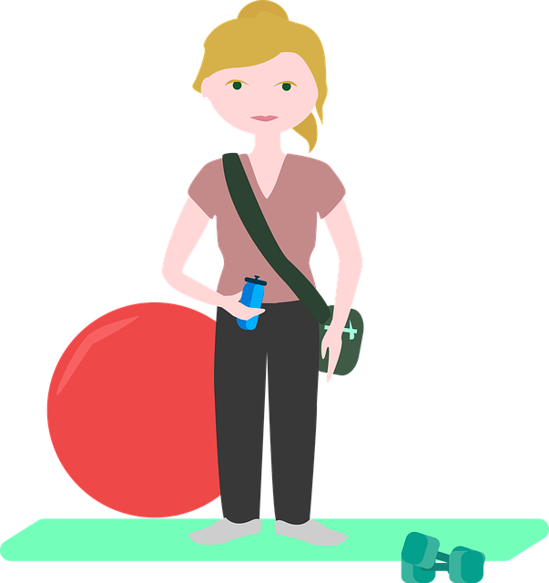
What do you do in your free time?
I go to the gym three times a week.

Slide 5
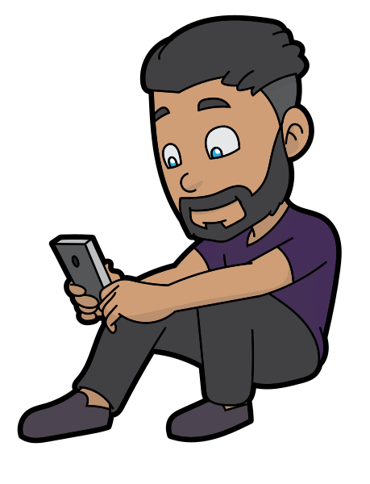
What do you do in your free time?
I surf the Internet two or three times a week.

Slide 6
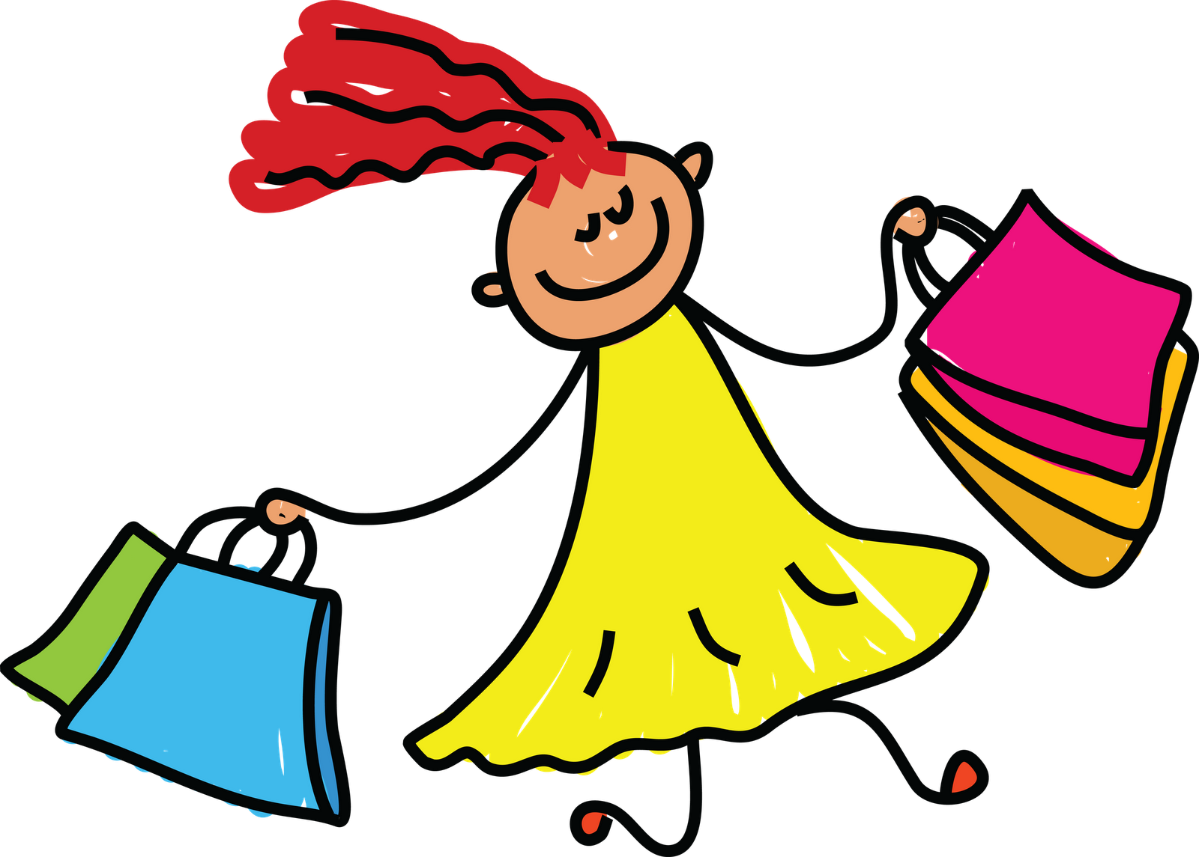
What do you do in your free time?
I go to the mall once or twice
a month.

Slide 8
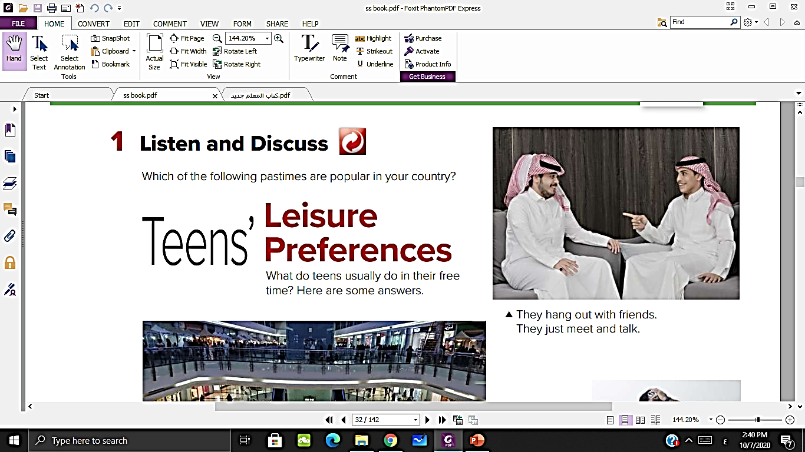
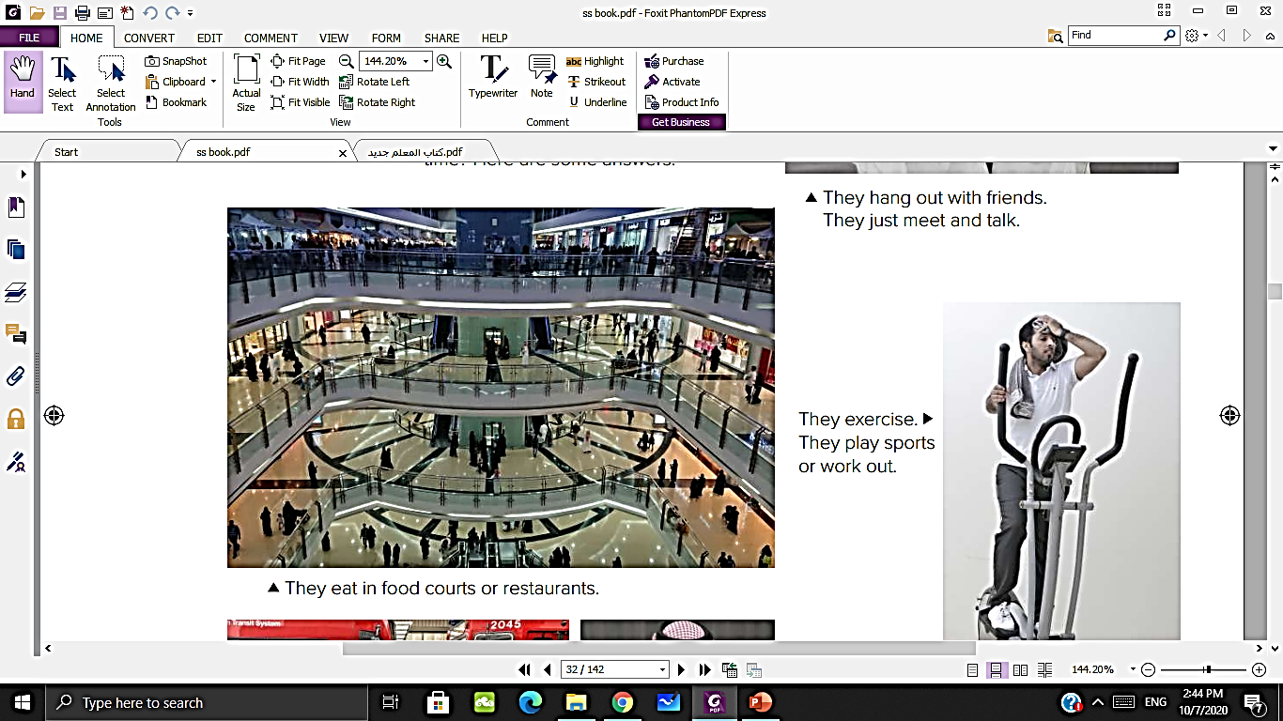
What are the people doing in these pictures?

Slide 9
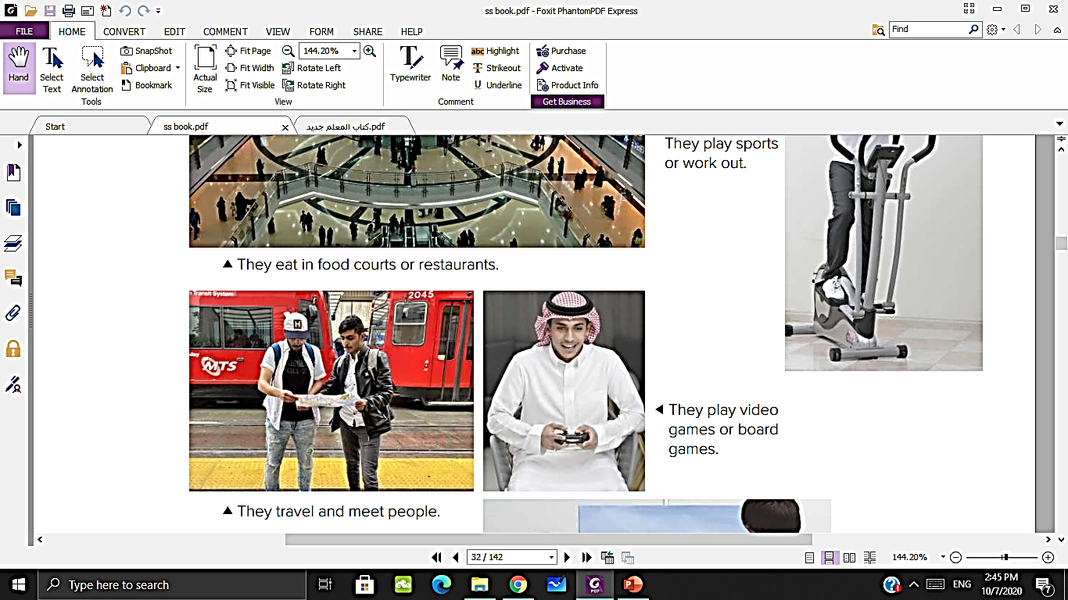
What are the people doing in these pictures?

Slide 10
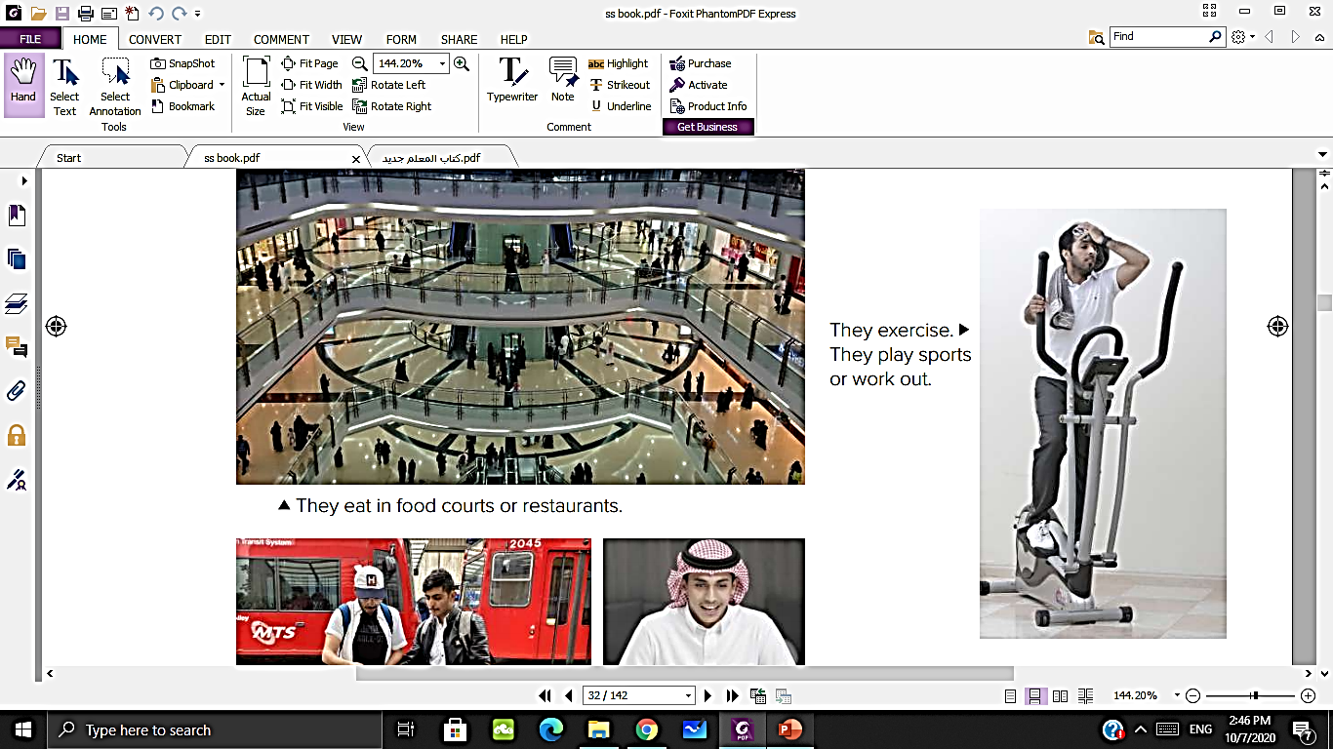
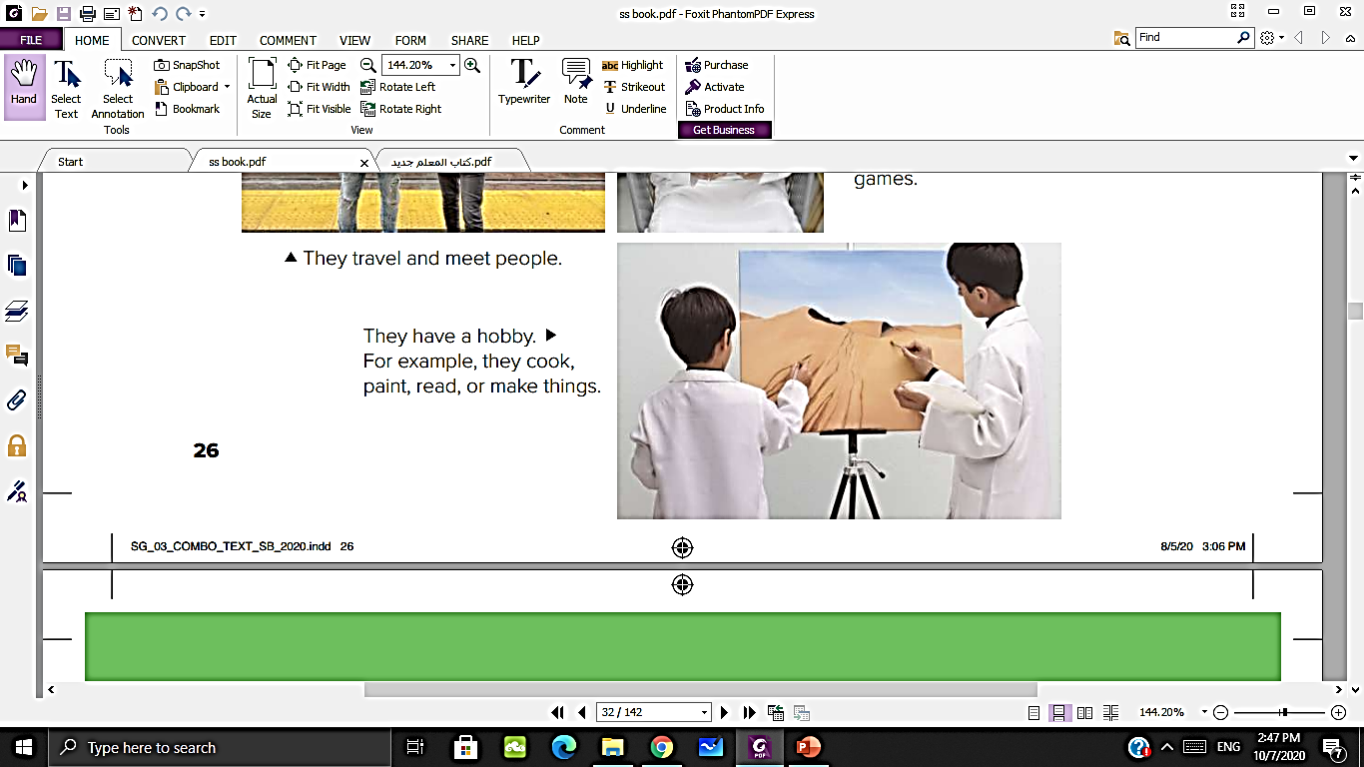
What are the people doing in these pictures?

Slide 11
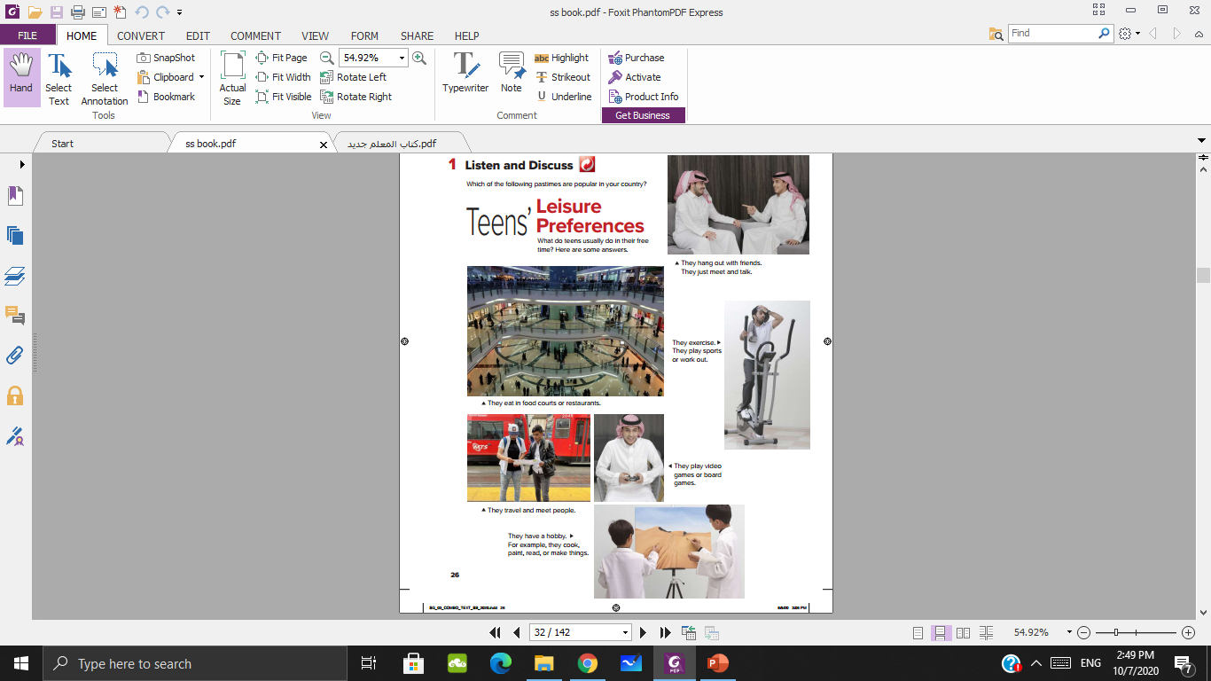
What do the pictures have in common?
They all show pastimes or hobbies.

Slide 12
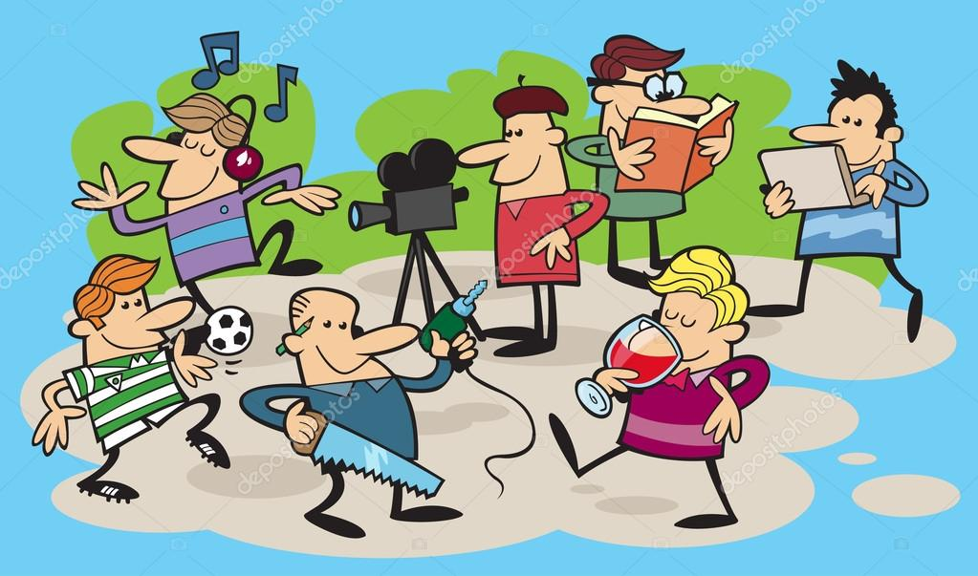
Pastimes

Slide 13

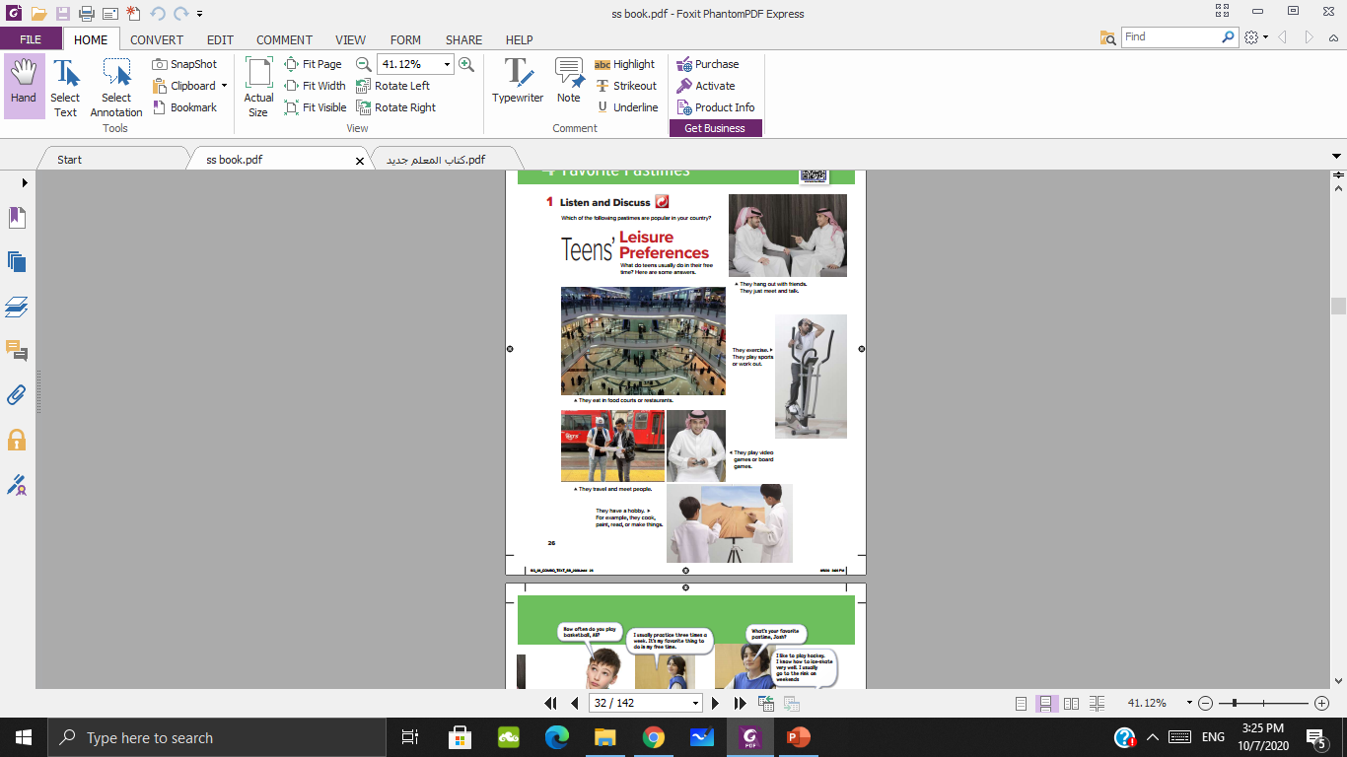
1
2
3
4
5
6

Slide 14
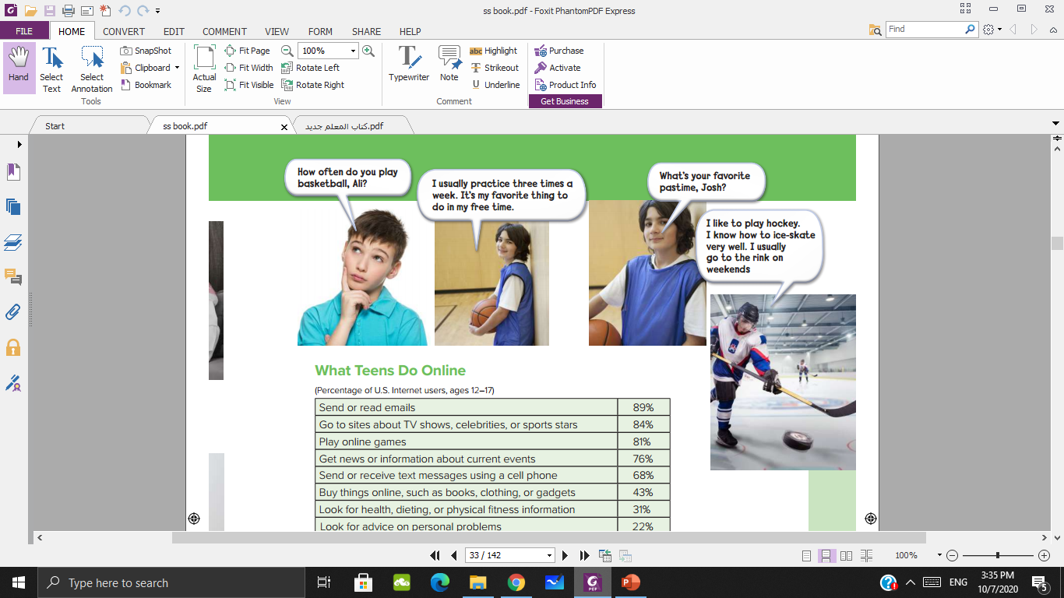

Slide 15
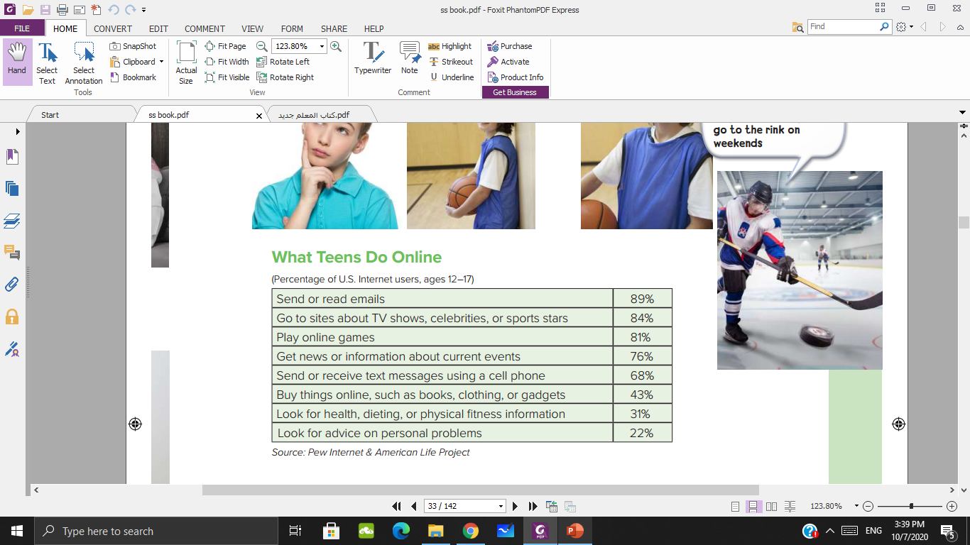
This is a survey
How old are the people who gave answers in the survey?
What is the second most popular?
What is the subject of the survey?
What is the most popular online activity?

Slide 16

This is a survey

Slide 17

Do you think the survey results are the same for teens in this country? If not, what’s different?

Slide 18
Free time
Spare time
Leisure time
Time

Slide 19
three times a week
Time

Slide 20
A pastime is a hobby or activity people do in their
free time.
Time

Slide 21
How often do you ….
Always
Usually
Often
Sometimes
70-60%
I often watch movies
-40%
I sometimes go to gym
80%
I usually read books
100%
I always surf the web

Slide 22

Tick ( ) the activities you often do.

Slide 23
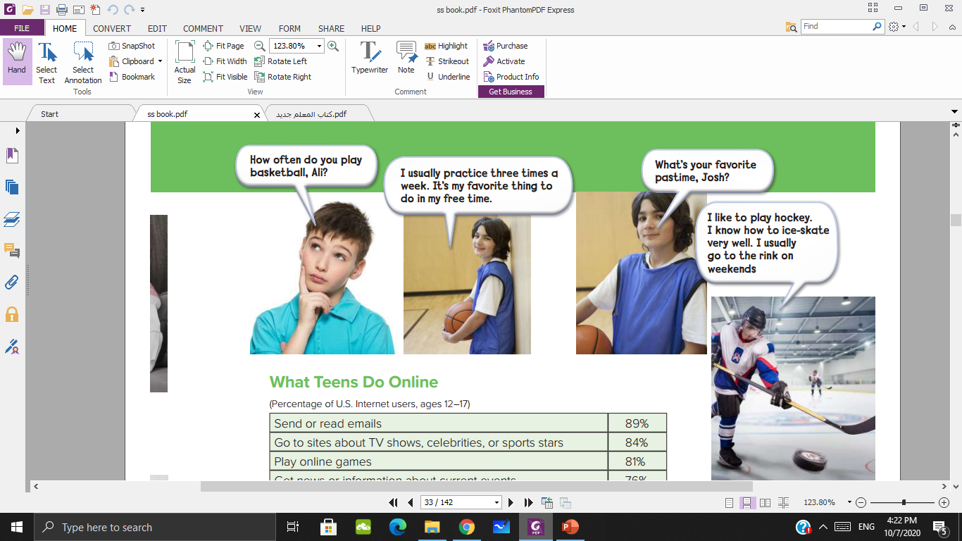
Who’s Ali? Who’s Josh?
Josh
Ali

Slide 24
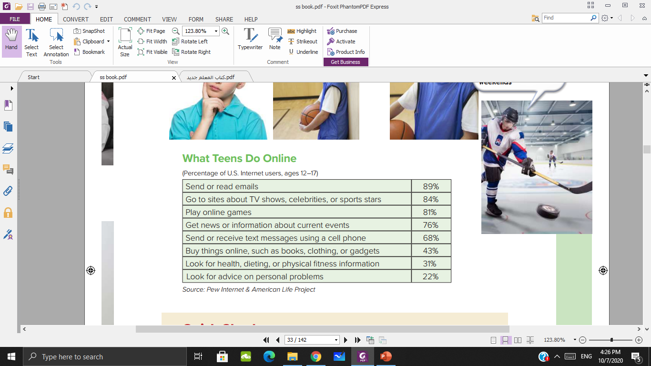
Where is the information about teens’ online habits?
In the survey.

Slide 25
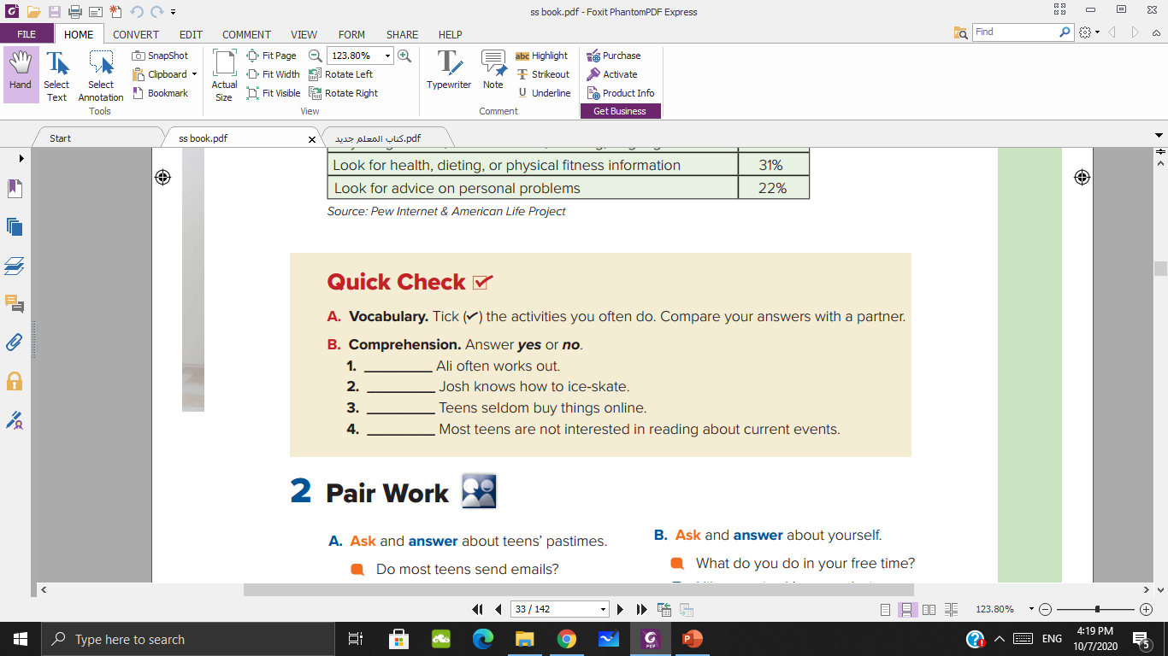
yes
yes
No
No

Slide 26

Homework p 101
A

