Slide 1

Skills Enhancement SG1
1st intermediate

Slide 2

Goals(skills):
4-Ask & answer question about things she/he has.
19 -20 -Associate verbal with visual information.
14-Give reasons & explanations for opinions & plans.
10- Understand the main points of clear standard input on familiar matters regularly encountered in work, school ….

Slide 3




She / he has

Slide 4
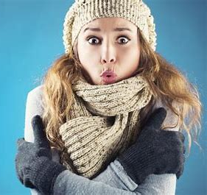

She ……. a scarf
has
have

Slide 5

She ………..…. a scarf
has
She
He has
it

Slide 6


They ………….. jeans
has
have

Slide 7

have
They ………… jeans
They
We have
You
I

Slide 8


He have a book
or
She has a bag

Slide 9
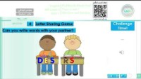
Watch here
Go to >
قنوات عين دروس
https://www.youtube.com/watch?t=642&v=G77_6-bAADM&embeds_referring_euri=https%3A%2F%2Fsahl.io%2F&feature=emb_imp_woyt

Slide 10
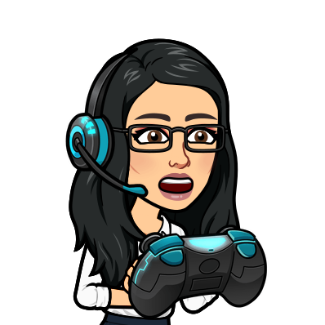

Play here

Slide 11
Pictures & words

Slide 12
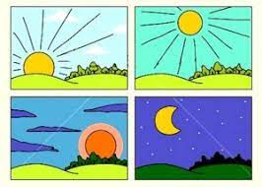




Match:
Good morning
Good afternoon
Good evening
Good night

Slide 13


e - p - n
pen
t - a - c
cat

Slide 14

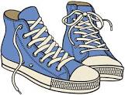
e – o – n – r – a - g
orange
h – o – o – s- e
shoes

Slide 15
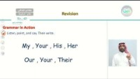
Watch here
Go to >
قنوات عين دروس
https://www.youtube.com/watch?v=pnjEOhJ9nE8

Slide 16
Play here
words
letters

Slide 17
Reasons opinions

Slide 18

Rearrange:
because tired sleep I I’m
I sleep because I’m tired.

Slide 19

He has a headache because ……
he drinks water
he plays video games

Slide 20
Why did you sleep here?
Because I was sleepy
Because I am cute

Slide 21
I sleep early because I’m cute
or
I drink water because I’m thirsty

Slide 22
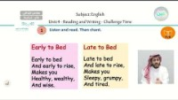
Watch here
Go to >
قنوات عين دروس
https://youtu.be/1dBicZHO6oc?si=h-nUd4HUFTKYNnaG

Slide 23
Play here

Slide 24
Work & school

Slide 25

01
I like to study ………….
A
B
C
bag
English
dinner

Slide 26
02
who is your best friend?
A
B
C
Hala
13 years
book

Slide 27
03
What do you do ?
- …………..
A
B
C
I’m 13 years
I’m from Taif
I’m a teacher

Slide 28
04
Do you like school ?
A
B
Yes , I do
Yes , I am

Slide 29
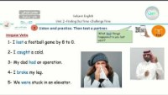
Watch here
Go to >
قنوات عين دروس
https://www.youtube.com/watch?t=138&v=mvg-tgVTGOQ&embeds_referring_euri=https%3A%2F%2Fsahl.io%2F&feature=emb_imp_woyt

Slide 30
Play here

Slide 31
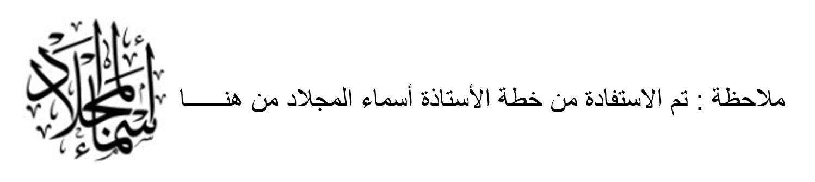
Prepared By
Dalal Al-Juaid
t.me/dalalforenglish

