Slide 1
Direct & Indirect
Quiz
MG2.1 Grammar
U: 4 L:3
Direct & Indirect Objects
By: Essa Al Hussaini

Slide 2
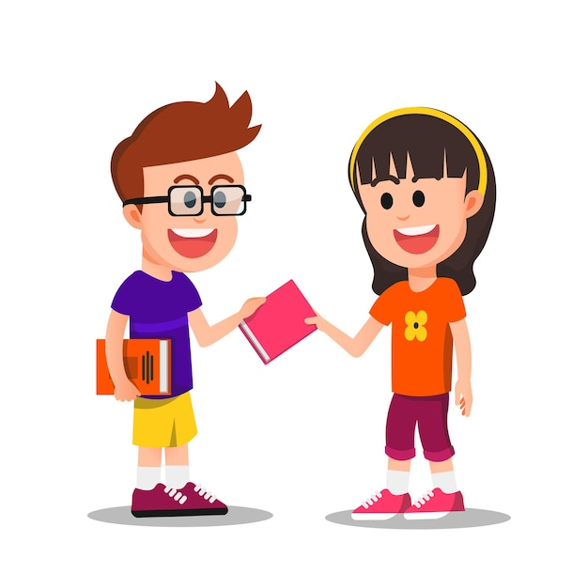
The colored word is a/an
direct object
Ali gave that book to me.
indirect object

Slide 3
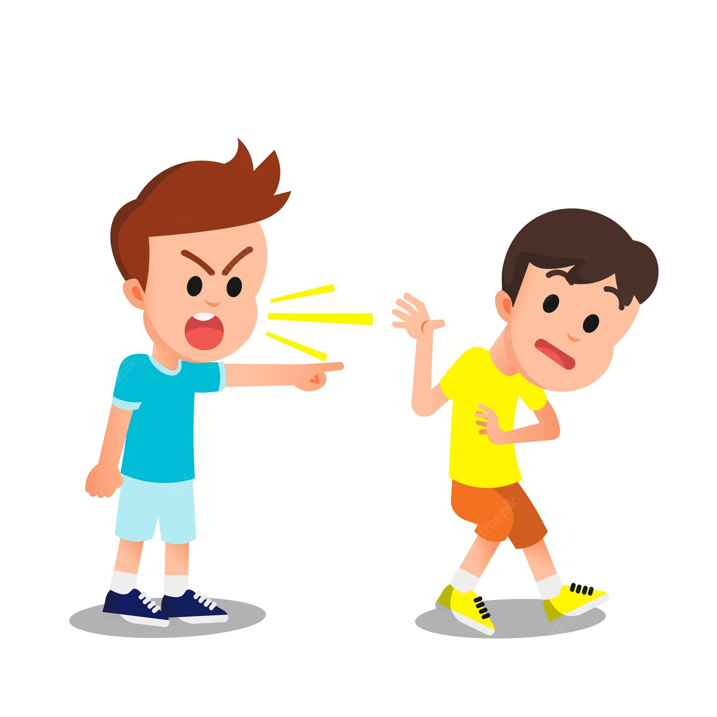
The colored word is a/an
direct object
Ali bugs Adnan every day.
indirect object

Slide 4
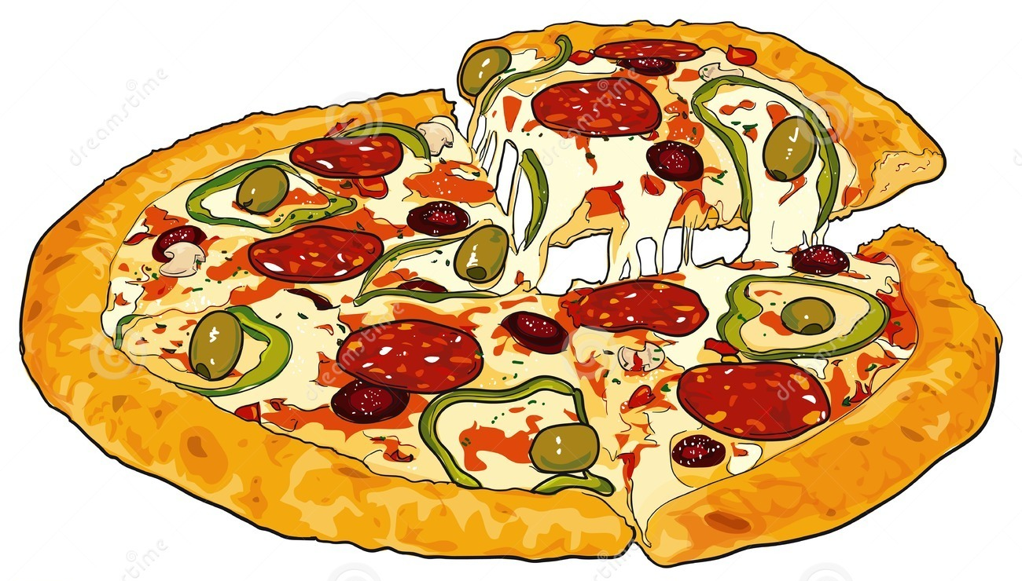
The colored word is a/an
direct object
My father bought us pizza.
indirect object

Slide 5
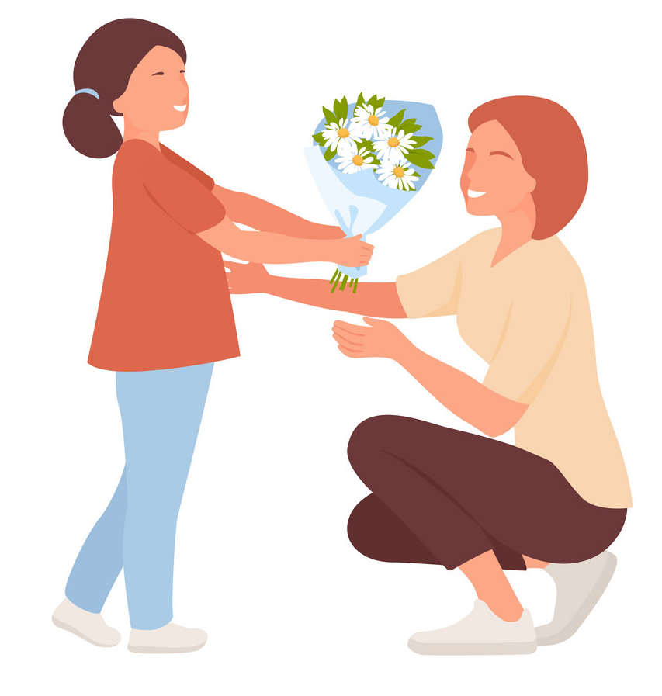
Find out the DIRECT object
Amal
Amal offered flowers to Jinan.
offered
flowers
to Jinan

Slide 6

Find out the DIRECT object
I read
I read a story to my grandma.
a story
to
my grandma

Slide 7
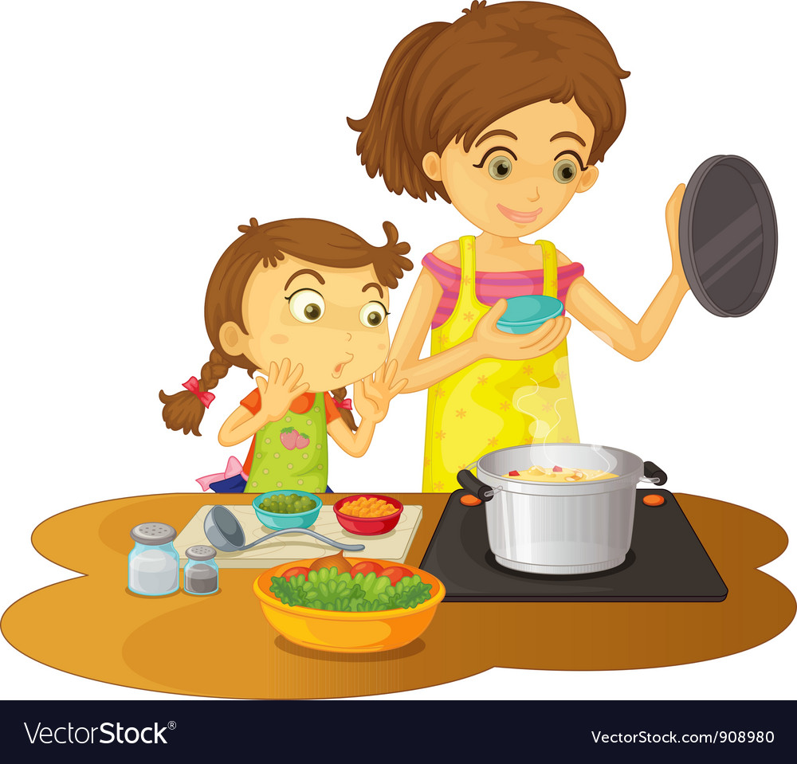
Find out the INDIRECT object
My mother
My mother cooked a nice meal for us.
cooked
a nice meal for
us

Slide 8
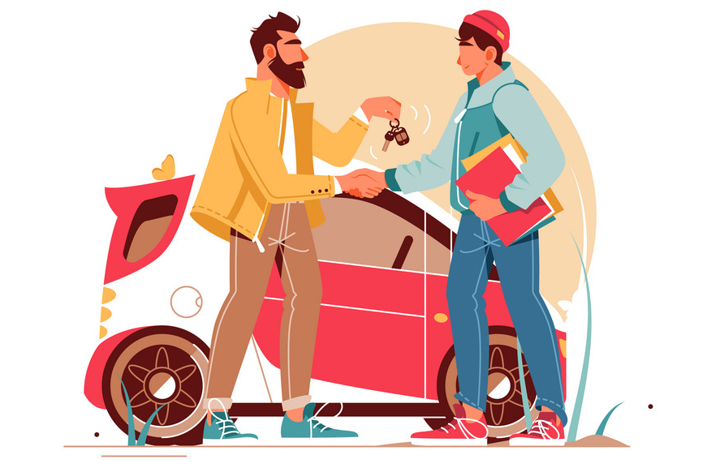
Find out the INDIRECT object
Ali
My father bought a car for Ali.
bought
a car for
My father

Slide 9

Complete with for or to
for
I sent the an email _____ Adnan.
to

Slide 10


Complete with for or to
for
The chef made a dessert _____ us.
to

Slide 11
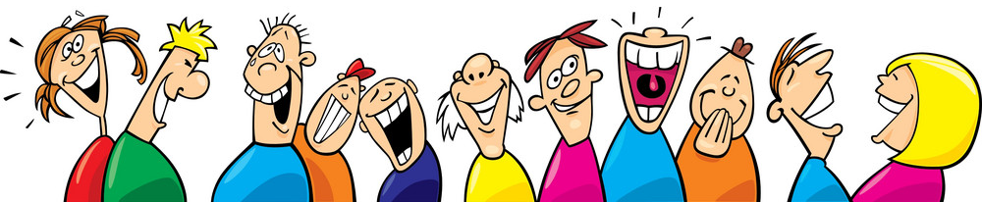
Choose the CORRECT sentence form
Sara told a joke to us.
Sara told to us a joke.
Sara told a joke for us.

Slide 12
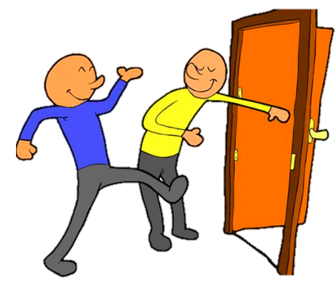
Choose the CORRECT sentence form
Ali opened the door to me.
Ali opened me the door.
Ali opened the door for me.

Slide 13

Choose the CORRECT sentence form
He gave to me it.
He gave it to me
He gave me it.

Slide 14
THANK
YOU
done by: Essa Al Hussaini

