Slide 1
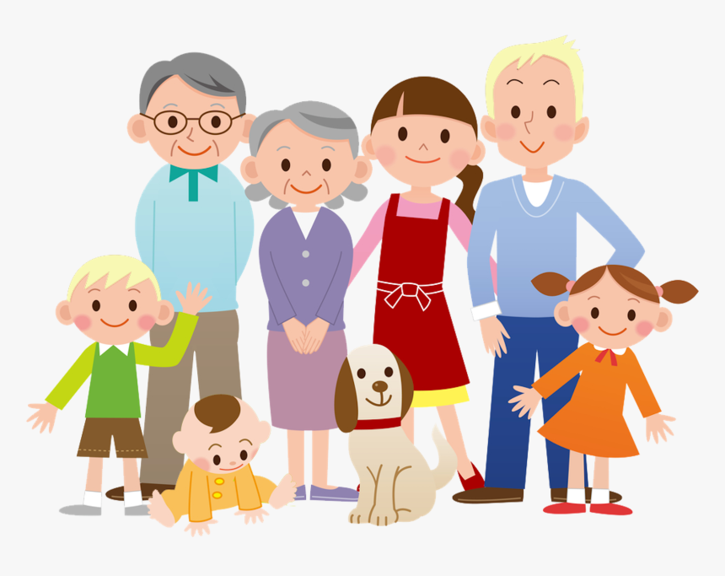
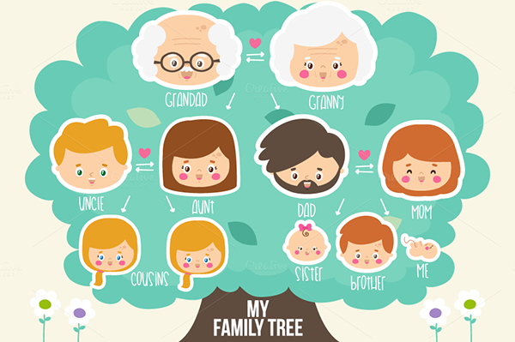
Super Goal 1
Unit 5
Lesson 1
Listen and discuss (40 & 41)
Families, families

Slide 2

Check Homework

Slide 3
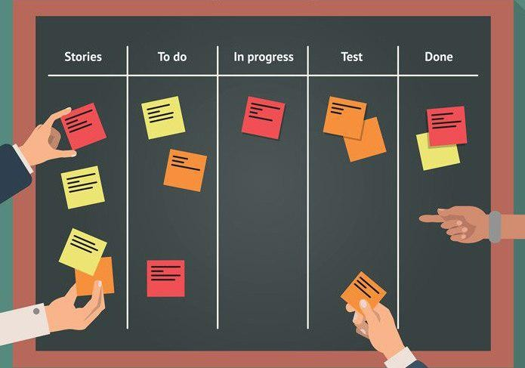
Check students’ tasks

Slide 4


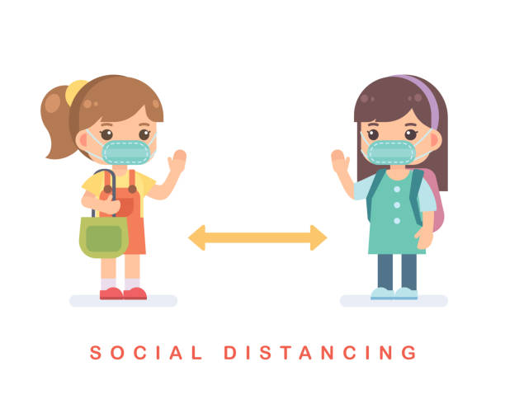
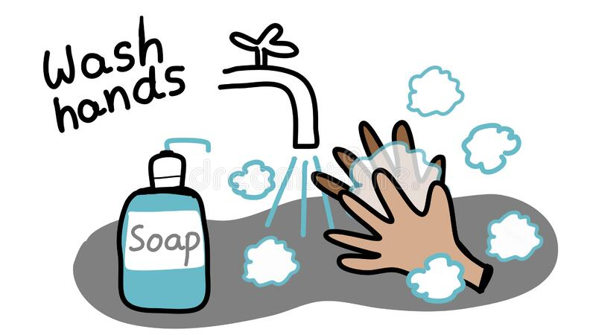

Rules of the classroom
1- avoid gathering.
2- we must wear mask.
3- social distancing is not a choice , it is a must.
4- Wash hands.
5- If you want to answer or ask, please, raise your hand

Slide 5


Objectives :
open your book on (40 & 41)
1- read the paragraph
2- answer the questions.
3- name the family’s
Members.
4- identify family relationships.

Slide 6

Revision:
B- By using find the fib strategy, answer the questions
A- Give example about verb Be
1- She are a new teacher..
2- they is my friends..
3- I not am from Oman..
4- he is on business?

Slide 7
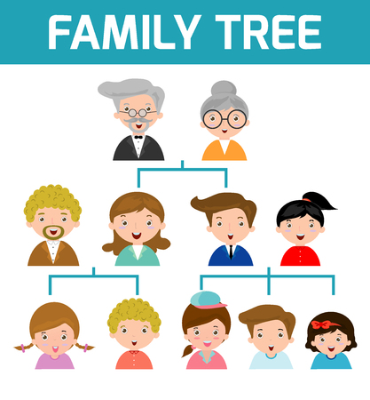
warm up:
By using brainstorm strategy, name the family memeber

Slide 8
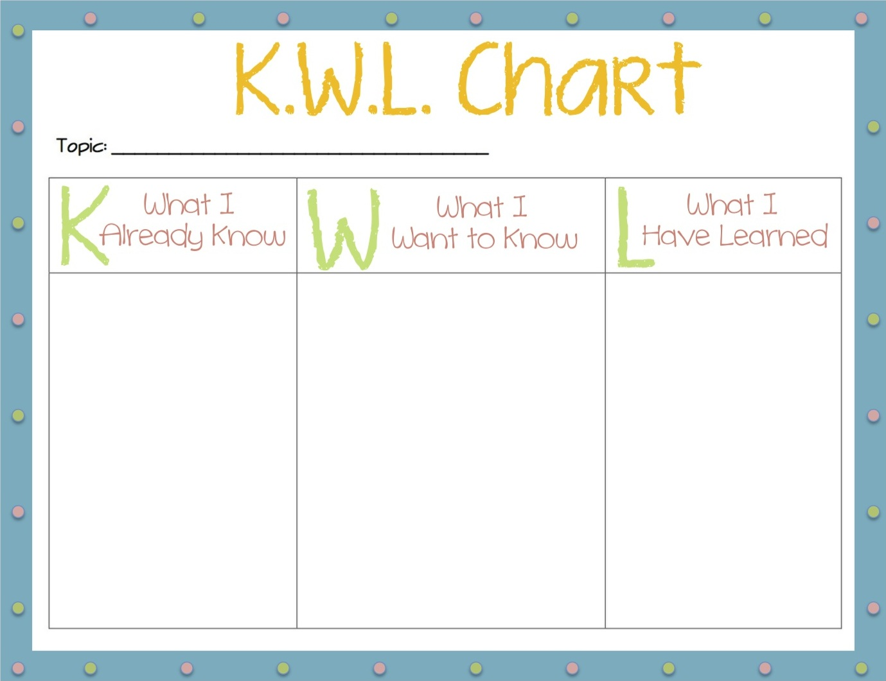
warm up:
By using KWL strategy, Complete the chart.

Slide 9

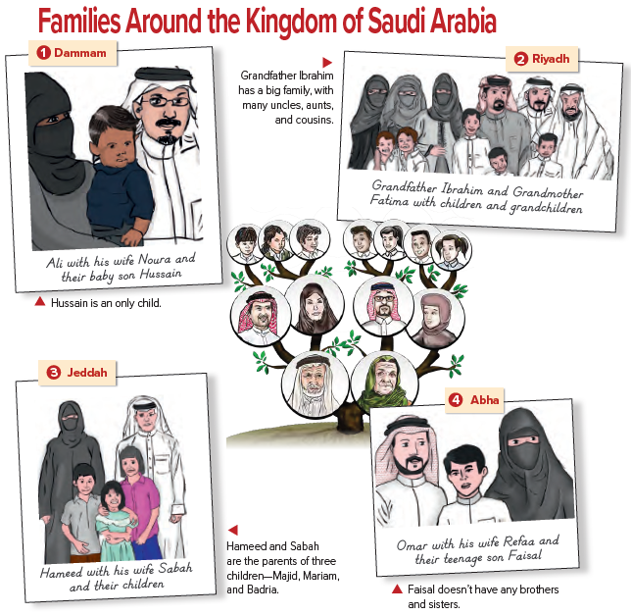
Listen and Discuss:
40
Sq3r
Strategy
Before listen
1-how many family do you see?
4 families
2- which family is a big family?
Ibrahim’s family
3- which family has three children?
Hameed’s family

Slide 10

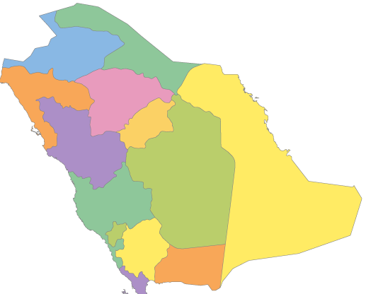
Listen and Discuss:
40
Sq3r
Strategy
Before listen
Where are these families from?
(point at the map)

Slide 11


Listen and Discuss:
40
During listening
Sq3r
Strategy

Slide 12
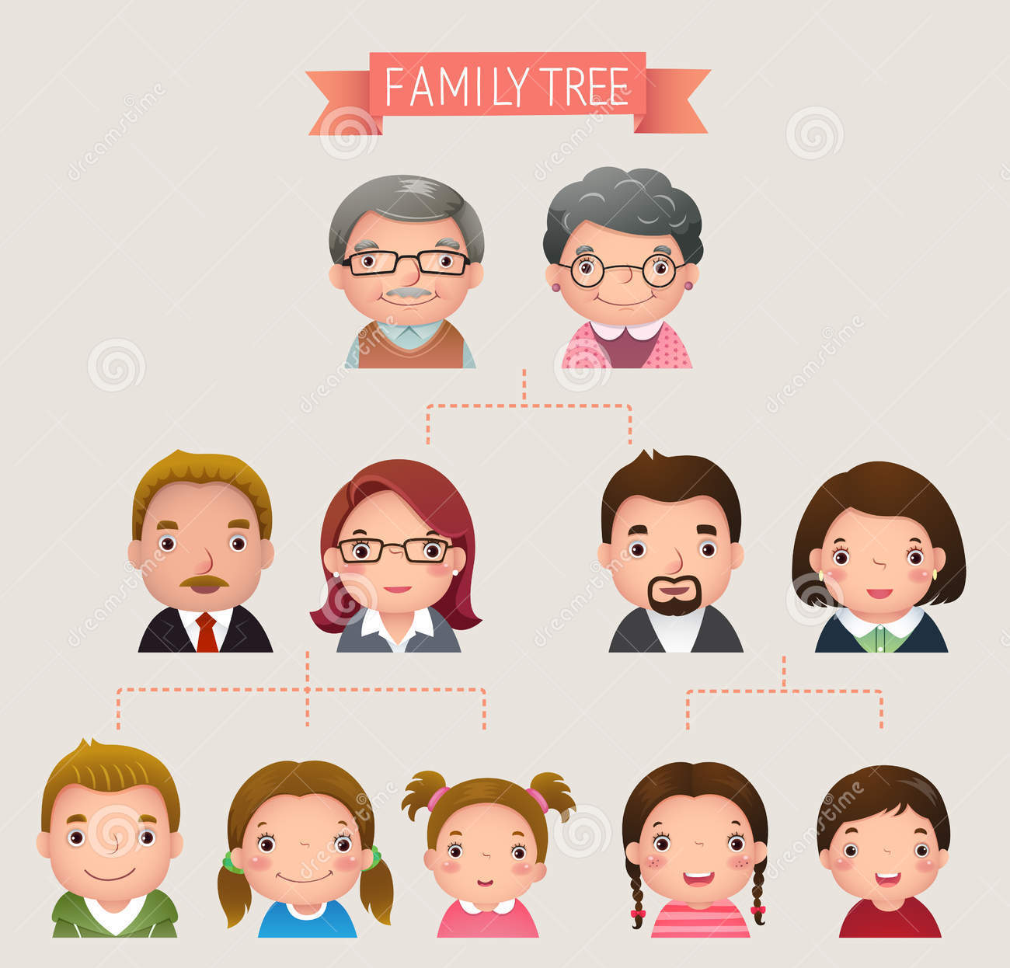

Listen and Discuss:
40
3 Generations
grandparents
parents
children

Slide 13
Listen and Discuss:
40
During listening
Sq3r
Strategy
Who is Ibrahim’s wife?
Who is Hussain’s father?
Fatima
Ali

Slide 14
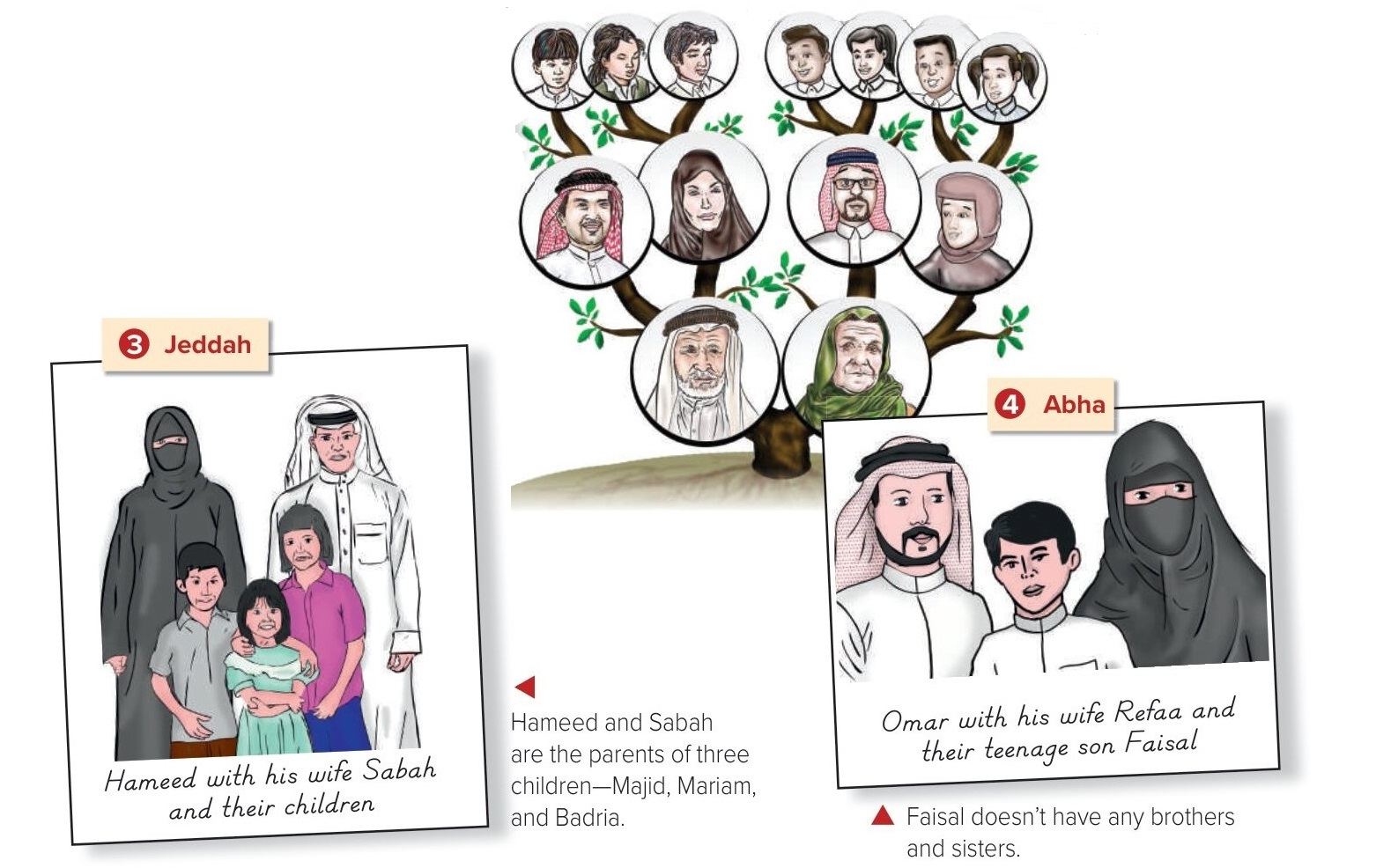
Listen and Discuss:
40
During listening
Sq3r
Strategy
Who is Sabah’s husband?
Hammed
Where are Omar and Refaa from?
They are from Abha

Slide 15
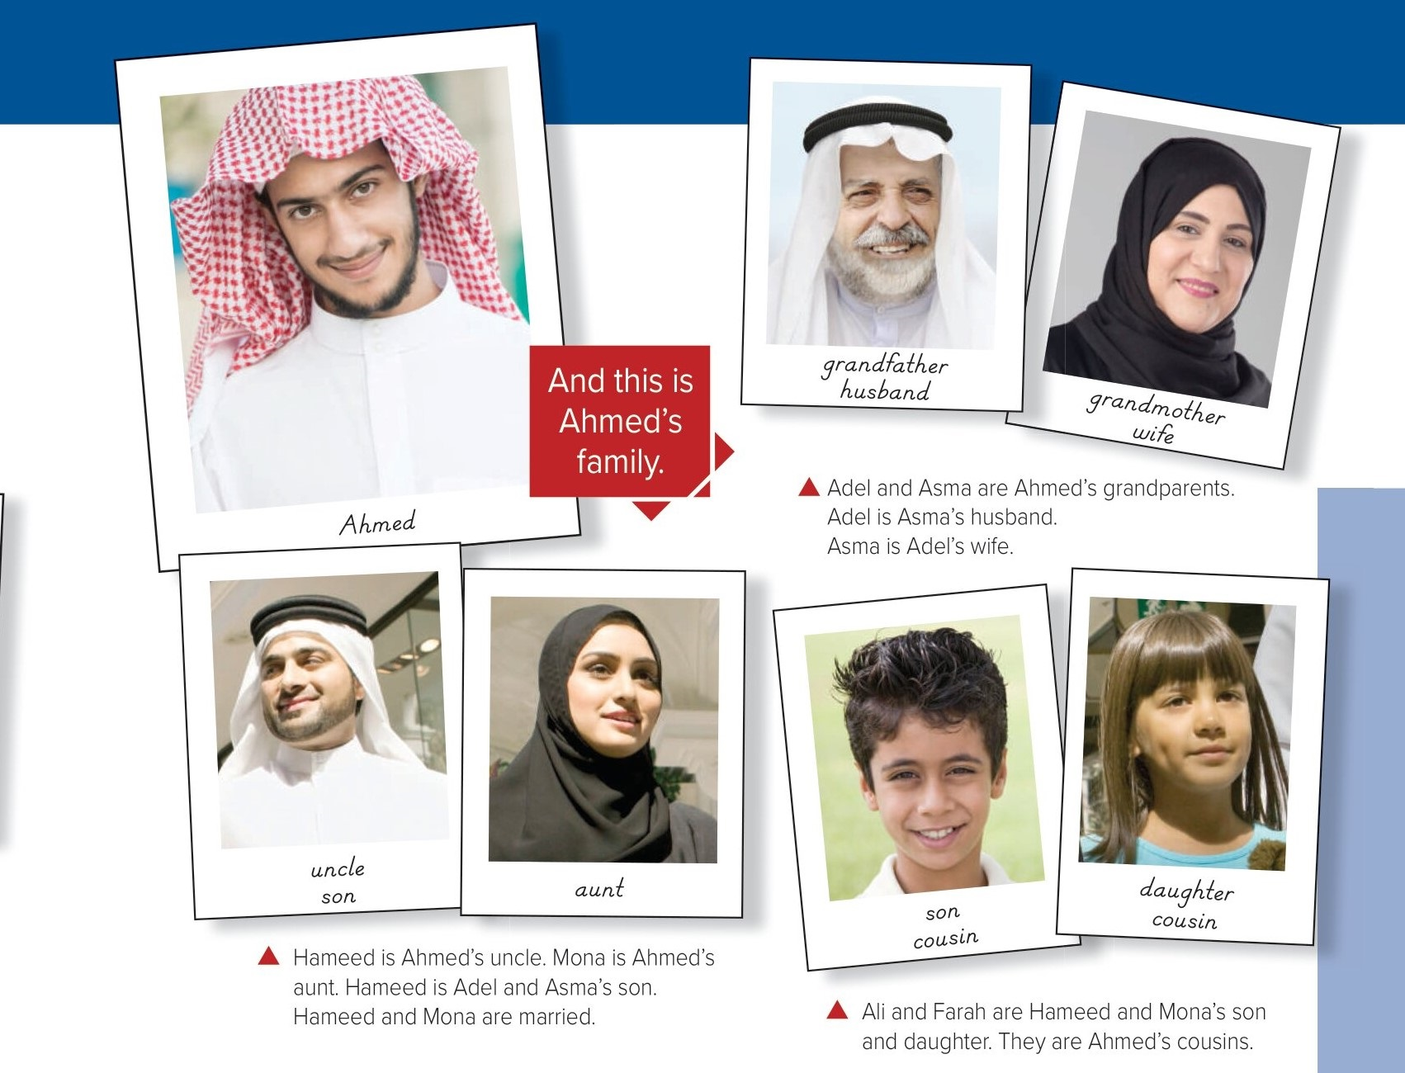
Listen and Discuss:
41
During listening
Sq3r
Strategy
Who is Farah’s mother?
Mona
Who is Ali’s grandmother?
Asma
Who is Ahmed’s uncle?
Hameed
Who is Asma’s husband?
Adel

Slide 16

Let’s play:-
41
https://wordwall.net/resource/6131922

Slide 17
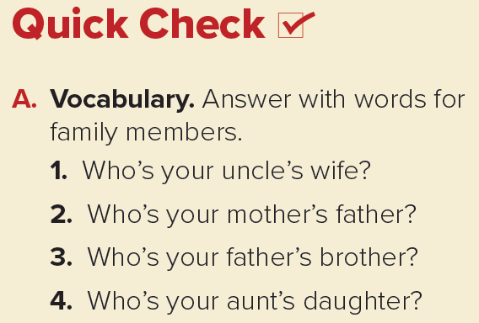
Quick check:-
41
after listening
Sq3r
Strategy
My aunt
My grandfather
My uncle
My cousin

Slide 18
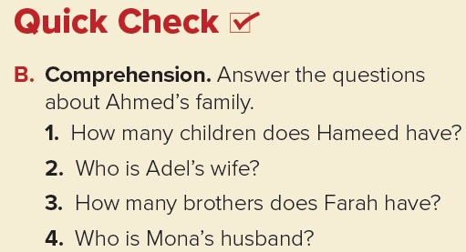
Quick check:-
41
after listening
1. He has two children, a son and a daughter.
2. Adel’s wife is Asma.
3. Farah has one brother.
4. Mona’s husband is Hameed.

Slide 19
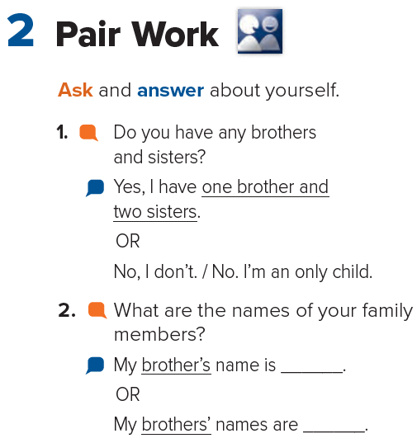
Pair work:-
41

Slide 20


Task:-
Draw a family tree and
name the family’s member

Slide 21

قال سبحانه
﴿ وَقَضَى رَبُّكَ أَلَّا تَعْبُدُوا إِلَّا إِيَّاهُ وَبِالْوَالِدَيْنِ إِحْسَانًا إِمَّا يَبْلُغَنَّ عِنْدَكَ الْكِبَرَ أَحَدُهُمَا أَوْ كِلَاهُمَا فَلَا تَقُلْ لَهُمَا أُفٍّ وَلَا تَنْهَرْهُمَا وَقُلْ لَهُمَا قَوْلًا كَرِيمًا * وَاخْفِضْ لَهُمَا جَنَاحَ الذُّلِّ مِنَ الرَّحْمَةِ وَقُلْ رَبِّ ارْحَمْهُمَا كَمَا رَبَّيَانِي صَغِيرًا * رَبُّكُمْ أَعْلَمُ بِمَا فِي نُفُوسِكُمْ إِنْ تَكُونُوا صَالِحِينَ فَإِنَّهُ كَانَ لِلْأَوَّابِينَ غَفُورًا ﴾
[الإسراء: 23 - 25].
And your Lord has decreed that you worship not except Him, and to parents, good treatment. Whether one or both of them reach old age [while] with you, say not to them [so much as], "uff,"[735] and do not repel them but speak to them a noble word.
And lower to them the wing of humility out of mercy and say, "My Lord, have mercy upon them as they brought me up [when I was] small."

Slide 22

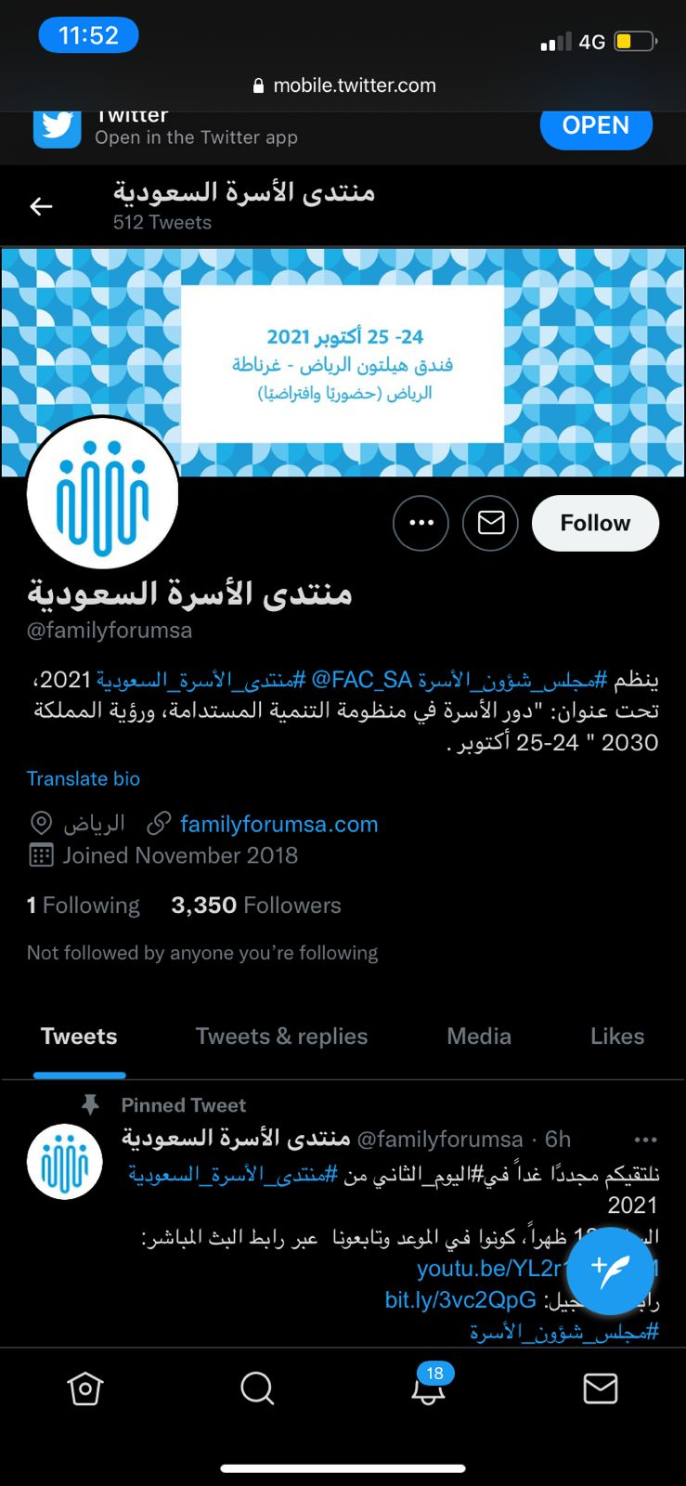


Family council organizes Saudi family forum.
Titled ( family’s role in development system)

Slide 23

Workbook (page 107) ( A+B )

Slide 24


