Slide 1
Form, Meaning & Function
Simple Past used to - would
Done By: Essa Al-Hussaini

Slide 2
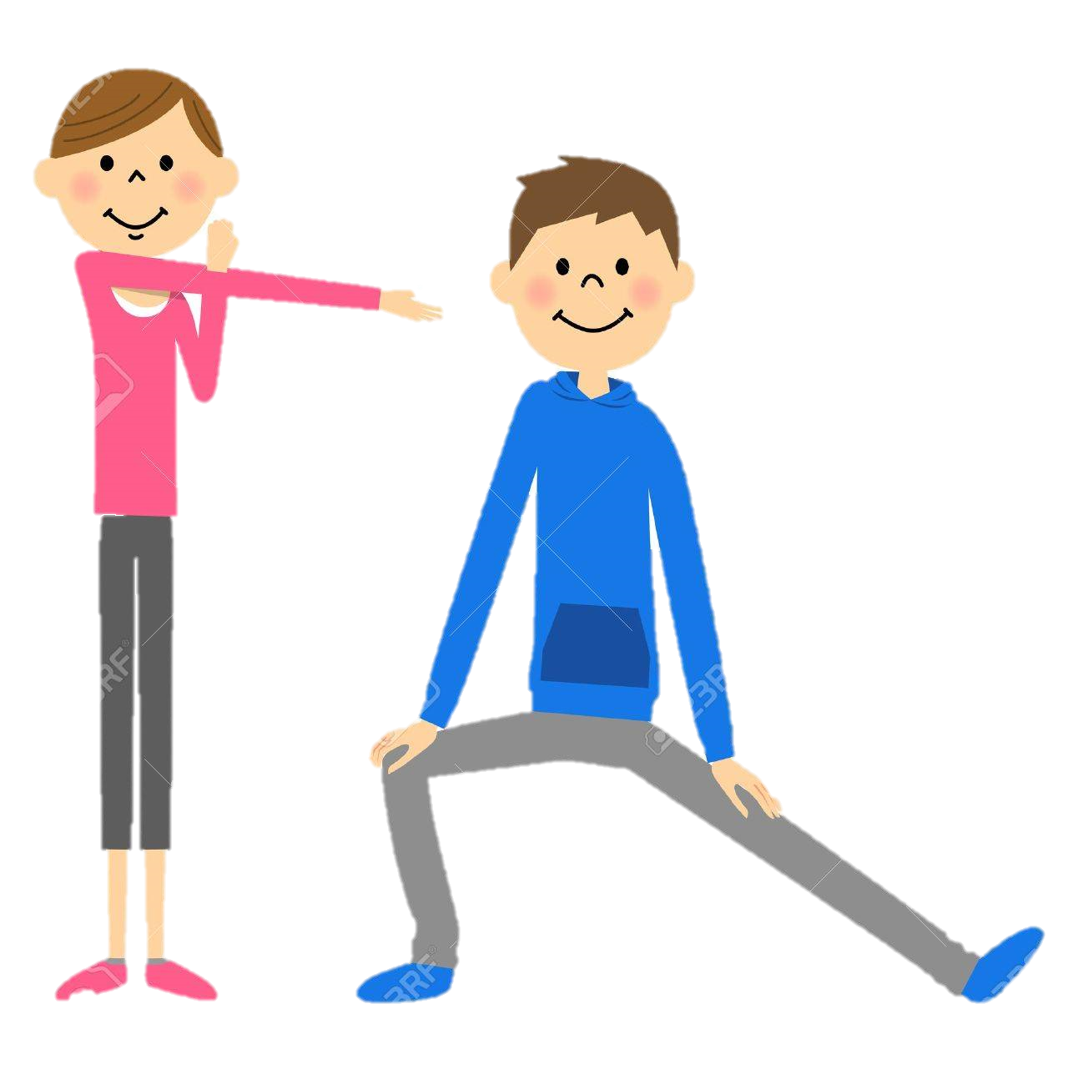


Warming up
https://quizizz.com/admin/quiz/5f7b89b2d0215e001b037f4f

Slide 3
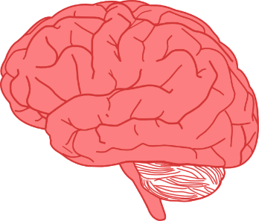

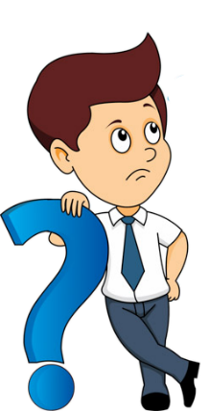
Refresh your memory
Simple Past? Yes | No
They are playing football right now.

He was a teacher.
Sara will see her teacher at the library.

They arrested the criminal.
They have eaten the launch.

They stole a car last year.

The criminal did not escape.

Slide 4
Refresh your memory
Simple Past key words?
They are playing football right now.

He was a teacher.
Sara will see her teacher at the library.

They arrested the criminal.
They have eaten the launch.

They stole a car last year.

The criminal did not escape.

Slide 5

Lesson’s Elements
1- Simple Past Tense: Be
2- Simple Past Tense: Regular and Irregular Verbs
3- Time Expressions for the Past
4- The Past with Used to and Would

Slide 6
Be = was / were

He was a teacher.

They arrested the criminal.

They stole a car last year.

The criminal did not escape.

Slide 7
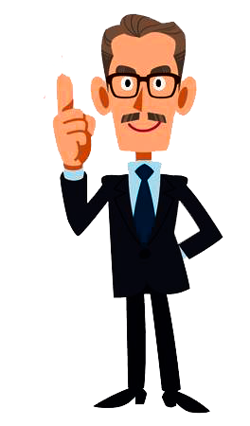
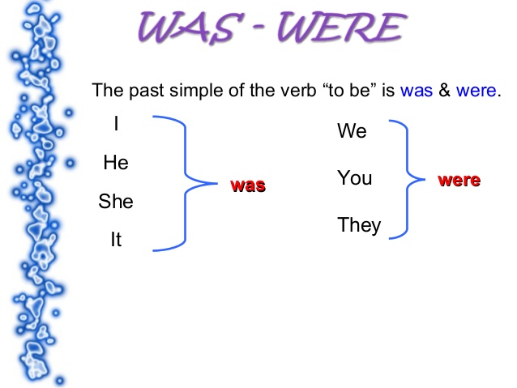
Be = was / were

He was a teacher.
They were burglars.

Slide 8
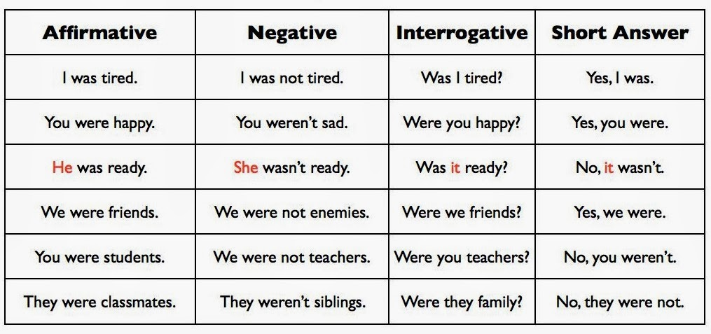

Slide 9


Regular & Irregular Verbs

They arrested the criminal.
arrest + ed

They stole a car last year.
steal
106

Slide 10
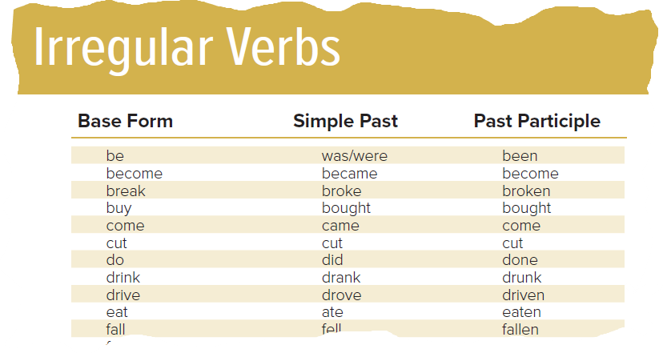
106

Slide 11

Regular & Irregular Verbs
Negative Form
They arrested the criminal.
(v1)
They didn’t arrest the criminal.
arrested
He stole a car last year.
(v1)
He didn’t steal a car last year.
stolen

Slide 12
Regular & Irregular Verbs
Question Form
They arrested the criminal.
When did they arrest the criminal?
He stole a car last year.
Did they steal a car last year?

Slide 13
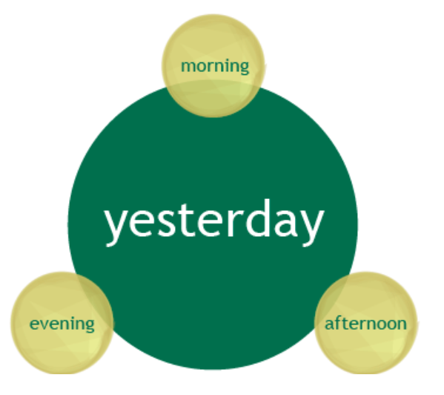
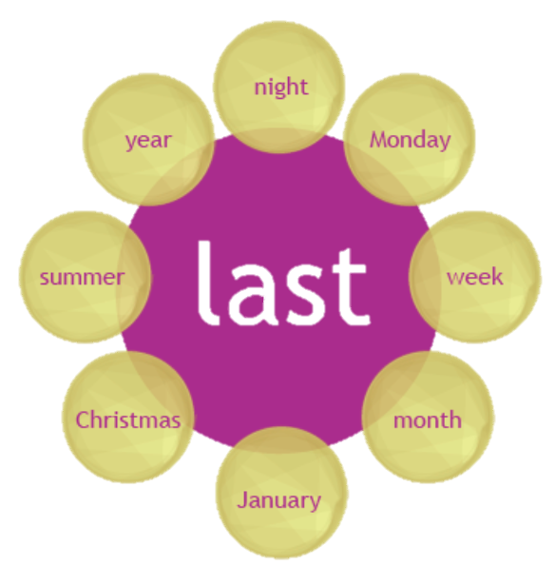
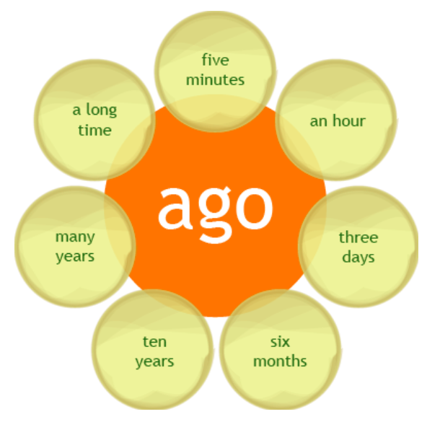
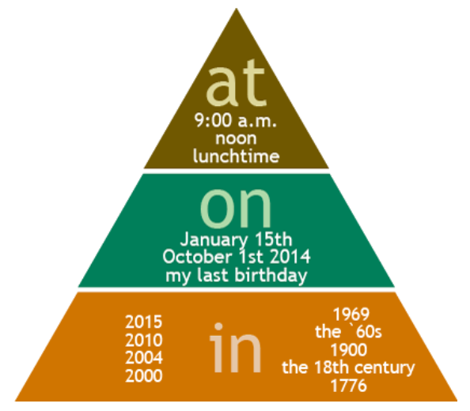
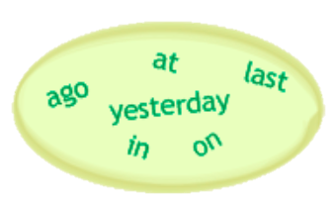
Time Expressions
The armed robber stole a car yesterday.
The burglar went to jail in 2006.
Nathalie forgot to lock the door last night.
I went to Oman three years ago.

Slide 14
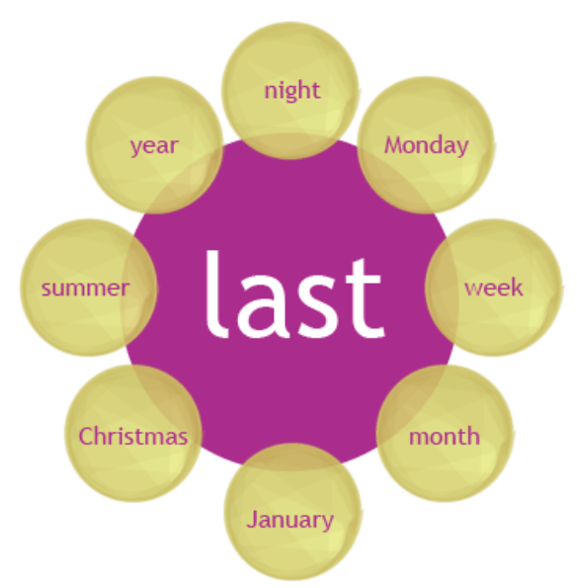
Time Expressions

Slide 15
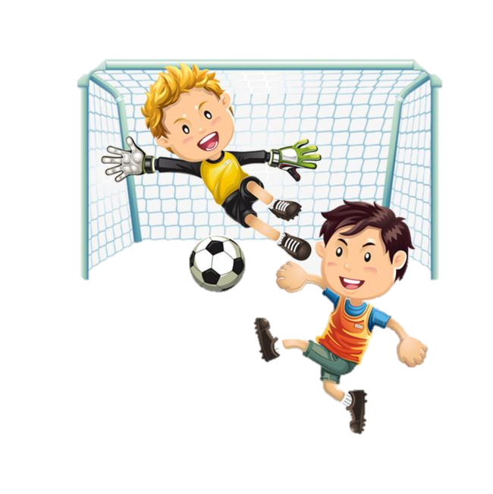
Used to & Would
We use used to + be // would
  to talk about past habits that are no longer true
actions / routines
I used to play football, but I don’t play now.
I would play football, but I don’t play now.
used to play football
don’t play football
Past
Now

Slide 16
Used to
Negative Form
I used to play football, but I don’t play now.
I didn’t use to play football,…...
used to

Slide 17

Used to & Would
We use used to + be
  to talk about past states that are no longer true
I used to be afraid of dark, but not any more.
I would be afraid of dark, but not any more.
used to be afraid of
don’t be afraid
Past
Now

Slide 18
Used to & Would
We use used to + be
  to talk about past states that are no longer true
I used to be afraid of dark, but not any more.
I would be afraid of dark, but not any more.
He would be a good boy before.
They would be live in Riyadh.

Slide 19

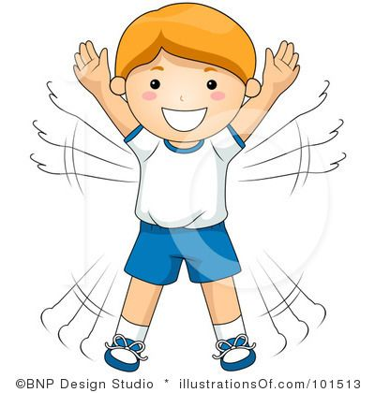

Practice makes Perfect
---
https://forms.office.com/Pages/ShareFormPage.aspx?id=b4OQU5QpqkK9sELnf3f9C0tUDGzPRYpDjgbnhRSJpRlUN043NE1QQUJJSTBVT0NZU0lWQVVNT0VWWC4u&sharetoken=T41QxIkQ9KMeyWl2glx7
https://quizizz.com/admin/quiz/5f7b97517cfe02001b34dbed

Slide 20
Open your Student’s book at page: 30

Slide 21
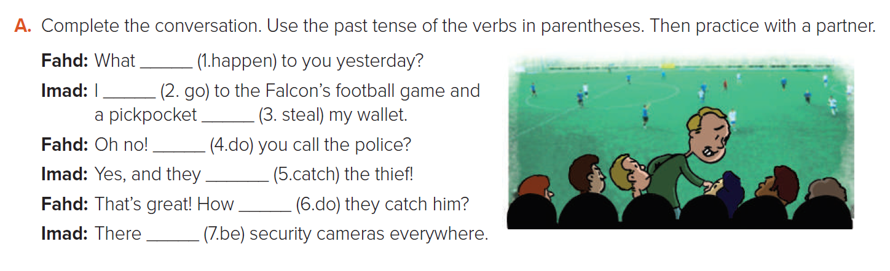
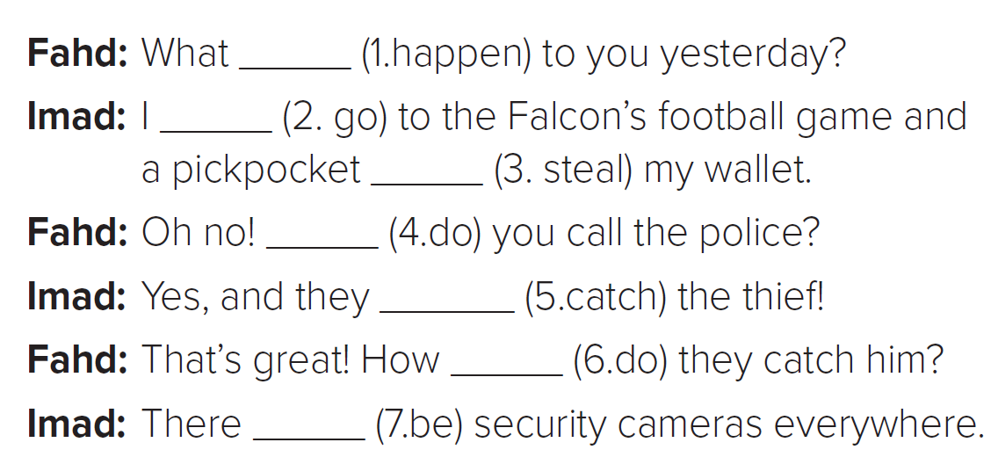

happened
went
stole
Did
caught
did
were

Slide 22
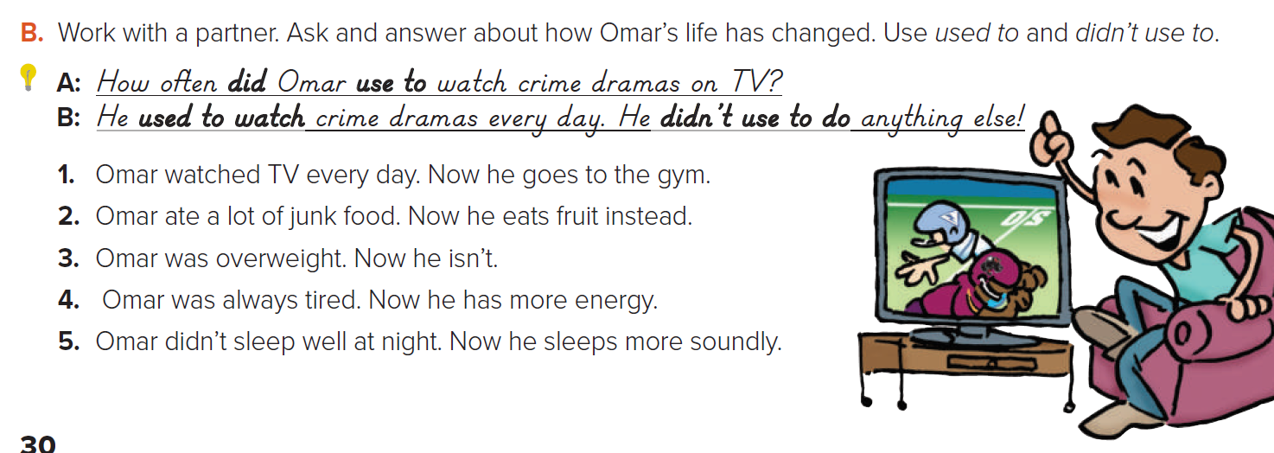
Suggested :
1. A: What did Omar use to do every day?
B: He used to (would) watch TV every day. He didn’t use to go the gym.
2. A: What did Omar use to eat?
B. He used to (would) eat a lot of junk food. He didn’t use to eat fruit.
3. A: What did Omar use to look like?
B: Omar used to be overweight. He didn’t use to be slim.
4. A:How did Omar use to feel?
B: Omar used to always feel tired. He didn’t use to have much energy.
5. A: How did Omar use to sleep?
B: Omar didn’t use to sleep well.
He used to be awake most of the night/ have insomnia

Slide 23

Open your WORKBOOK at page: 19

Slide 24
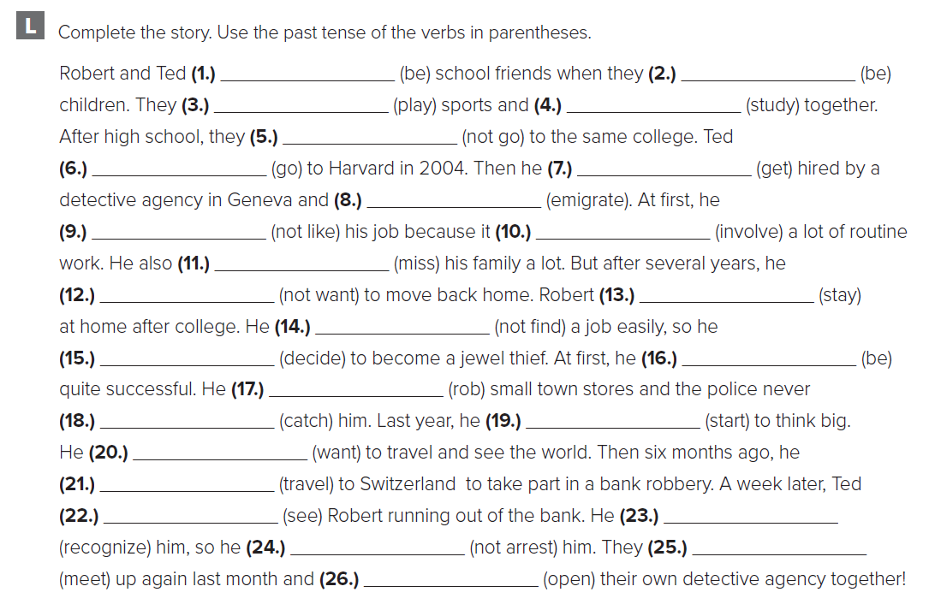
were
were
played
studied
didn’t go
went
got
emigrated
didn’t like
involved
missed
didn’t want
stayed
didn’t find
decided
was
robbed
caught
started
wanted
traveled
saw
recognized
didn’t arrest
met
opened

Slide 25
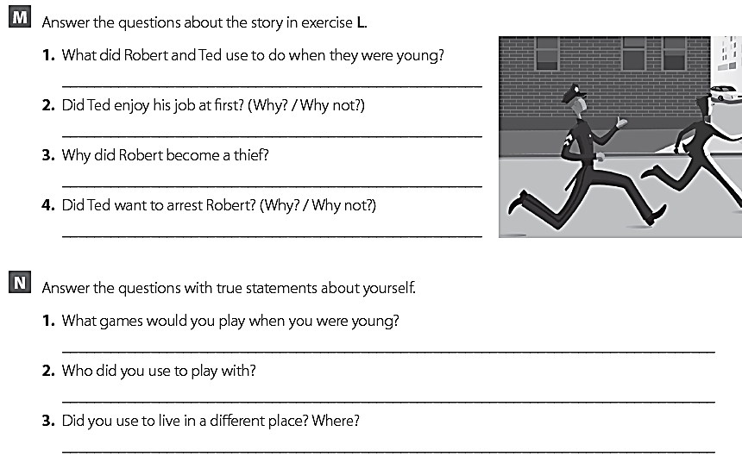
They used to play sports and study together
No, he didn’t because it involved a lot of routine work.
He became a thief because he couldn’t find a job easily.
No, he didn’t, because they were school friends

Slide 26

Have a nice day

Slide 29
---
---

