Slide 1

Mega Goal 3
Forming, Meaning & Function
U: 3 L:11
By: Essa Al Hussaini

Slide 2
Lesson Goals & Outcomes
1
2
3
4
5
Using
Making
Making
Using
Using
be going to for the future
Wh- information questions
Statements of places using adjectives
Present progressive
for future arrangement
GOING TO & WILL for plans

Slide 3

Quick Check
Future? Yes | No
They are playing football right now.
We will travel to Jeddah.
I was playing football at 4:30.
I’m going to visit my old friend.
He is going to take the car.
Sara is meeting her sister at the moment.
They are going to stay in the hotel.

Slide 4
Quick Check
Future key words?
We will travel to Jeddah.
I’m going to visit my old friend.
He is going to take the car.
They are going to stay in the hotel.
They are playing football right now.
We will travel to Jeddah.
I was playing football at 4:30.
I’m going to visit my old friend.
He is going to take the car.
Sara is meeting her sister at the moment.
They are going to stay in the hotel.

Slide 5

01
Future with Be Going To
to talk about plans, actions & intentions have been decided on
Use:
PLANNED actions
I am going to visit my old friend.
He is going to take the car.
They are going to stay in the hotel.
your plan for tonight / tomorrow / next week?

Slide 6
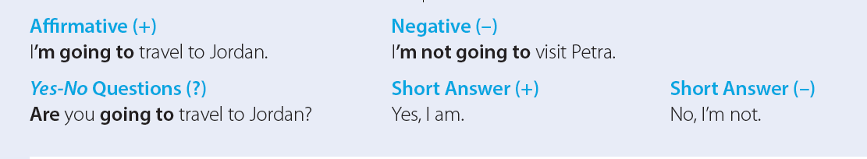

01
Future with Be Going To
to talk about plans, actions & intentions have been decided on
Use:
KEEP in MIND
word-order in questions

Slide 7
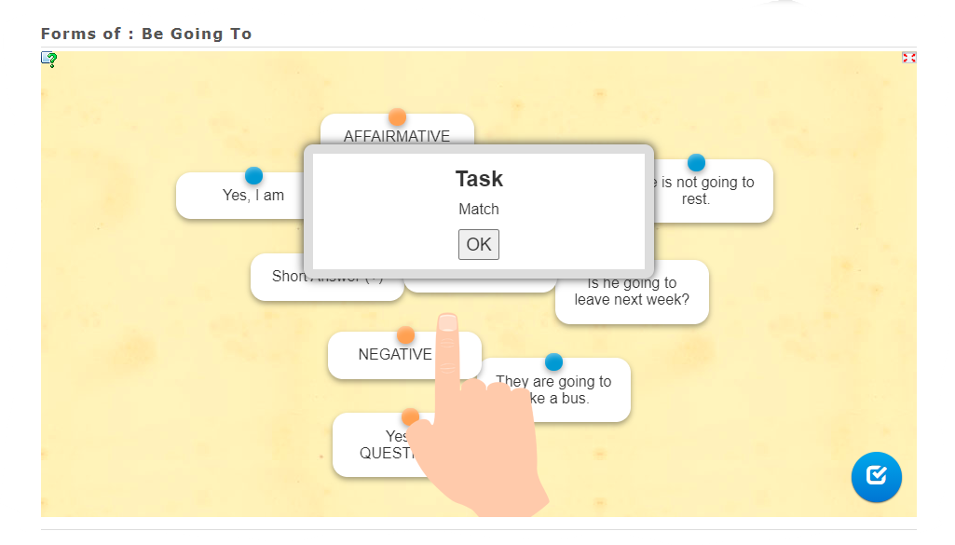

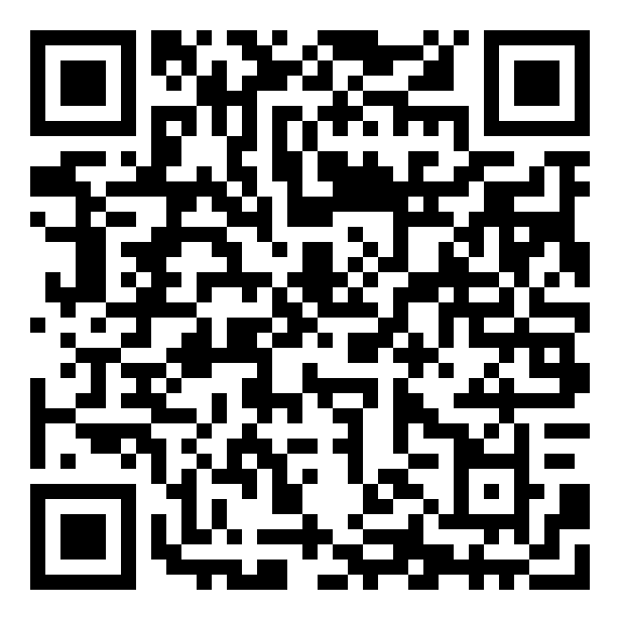

Quick Check
a volunteer’s control
https://learningapps.org/watch?v=pgzw3o3fj20

Slide 8
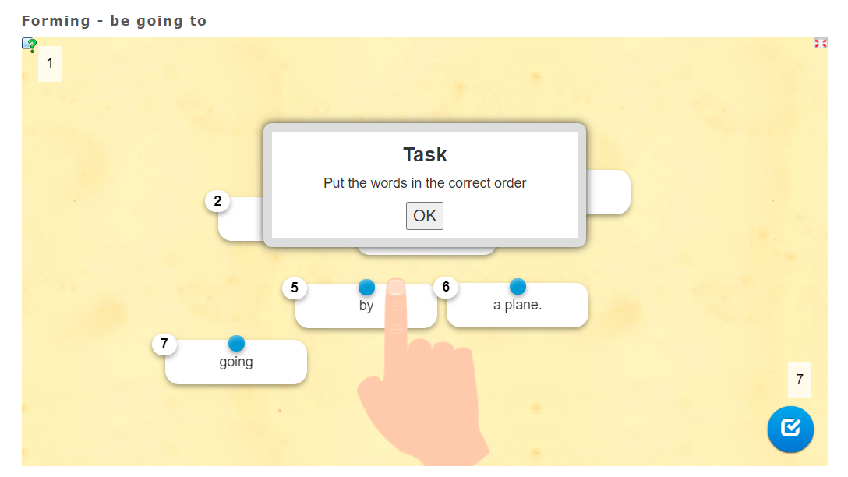
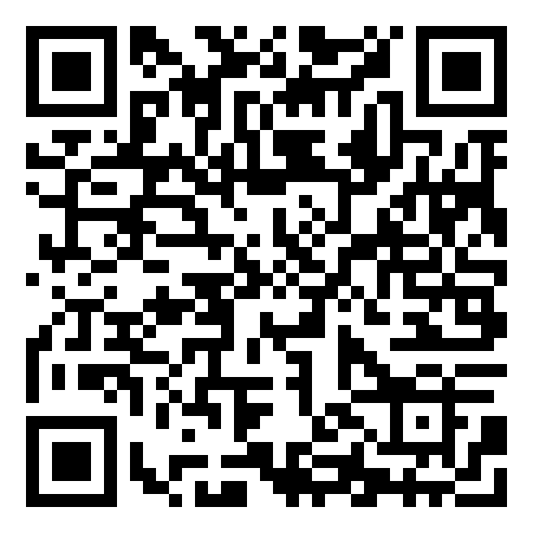
Quick Check
a volunteer’s control
https://learningapps.org/watch?v=pfi8dd9yt20

Slide 9
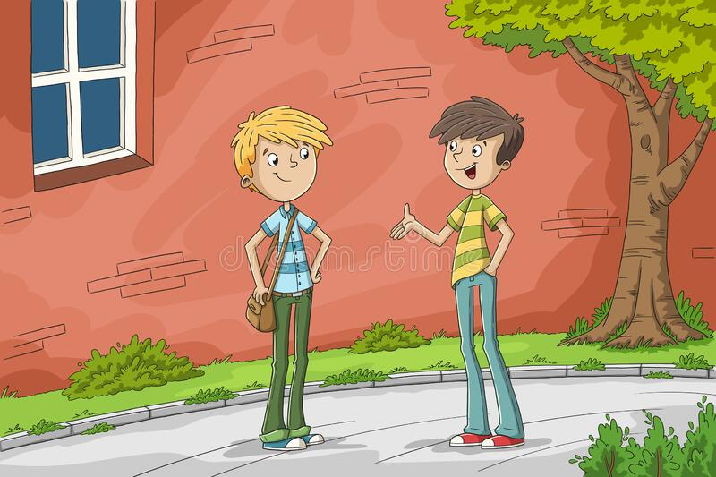
I'm going to visit her at 8:15.
My father is going to go with me
I'm going to visit my sister.
……… are you going to visit her?
……… are you going to do tonight?
……… is your sister?
……… is going to go with you?
She is fine.
Complete

Slide 10

The Question
words used
are known as ..?
for a person
WH question word
is used ….
Wh-
Question
words
for a thing
for a place
for time
for a reason
for an amount or the way
about choice
WHICH?
Notes:
when we ask questions with a Wh-question word,
we can make a contraction with is,
but not with are.
For example,
When’s he going to leave?
Who’s going to travel with them?

Slide 11
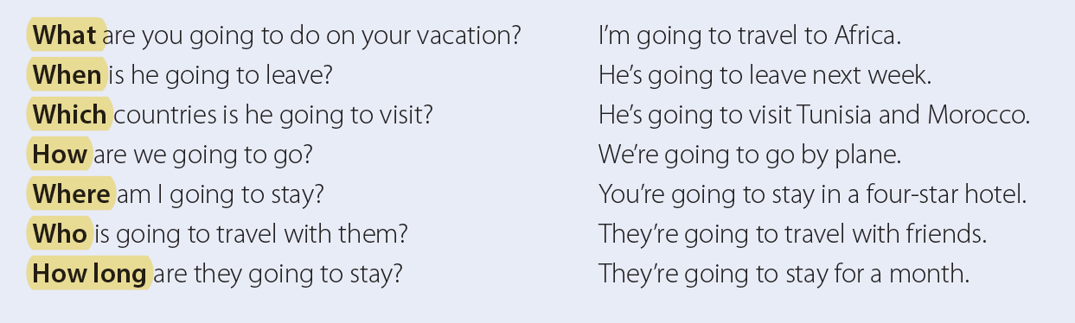
02
Information Questions
Notes:
when we ask questions with a Wh-question word,
we can make a contraction with is,
but not with are.
For example,
When’s he going to leave?
Who’s going to travel with them?

Slide 12
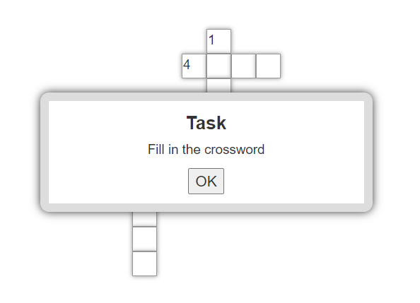
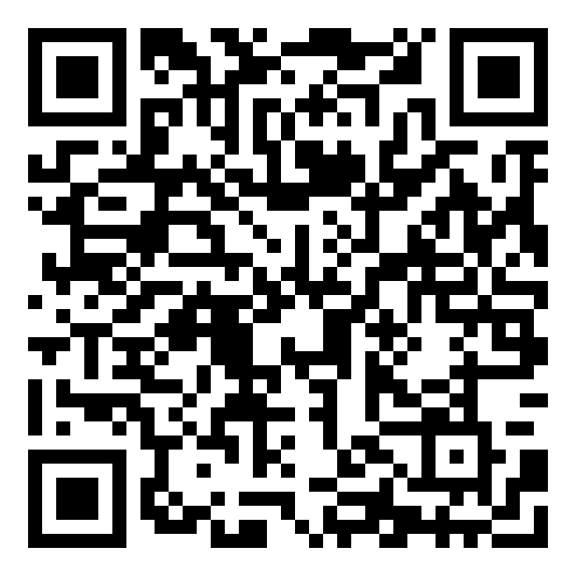
Quick Check
a volunteer’s control
https://learningapps.org/watch?v=puut26iak20

Slide 13
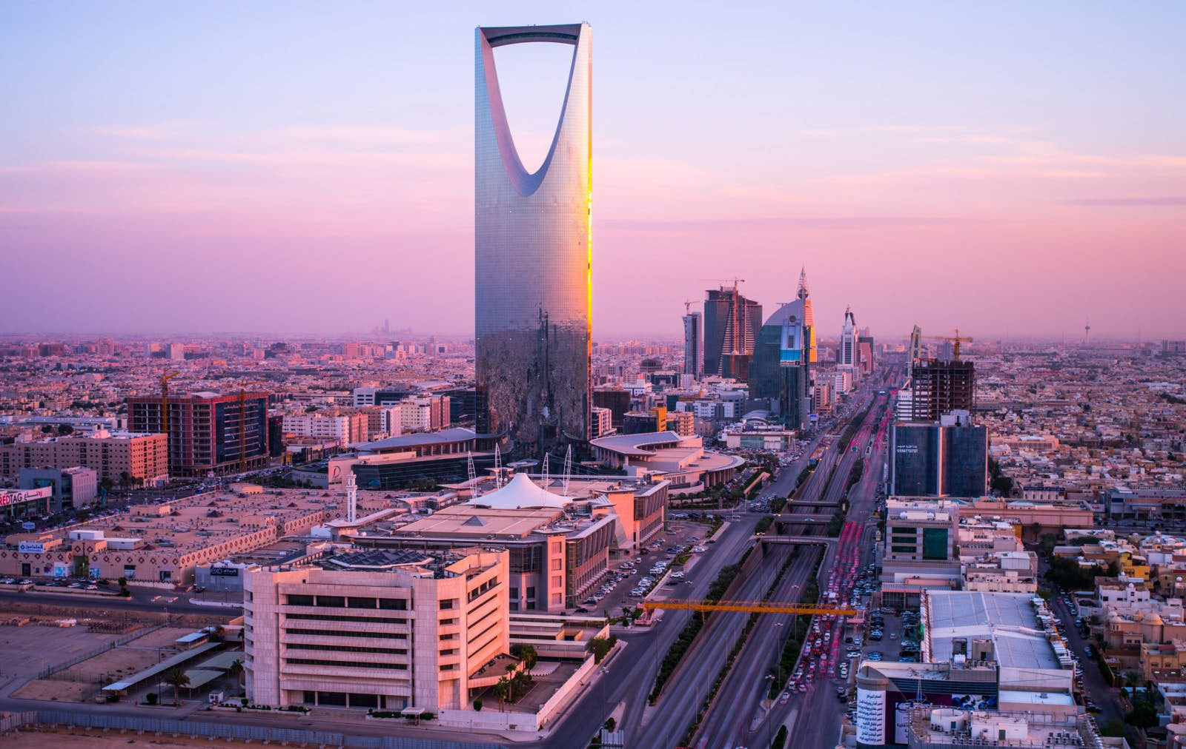
Position of Adjectives
.. the placement of the adjective?
03
.. Adj placement changes for
sgl / plr nouns?
Riyadh is an interesting city.
Riyadh and Dammam are interesting cities.
goes
before nouns
after verbs
NO

Slide 14
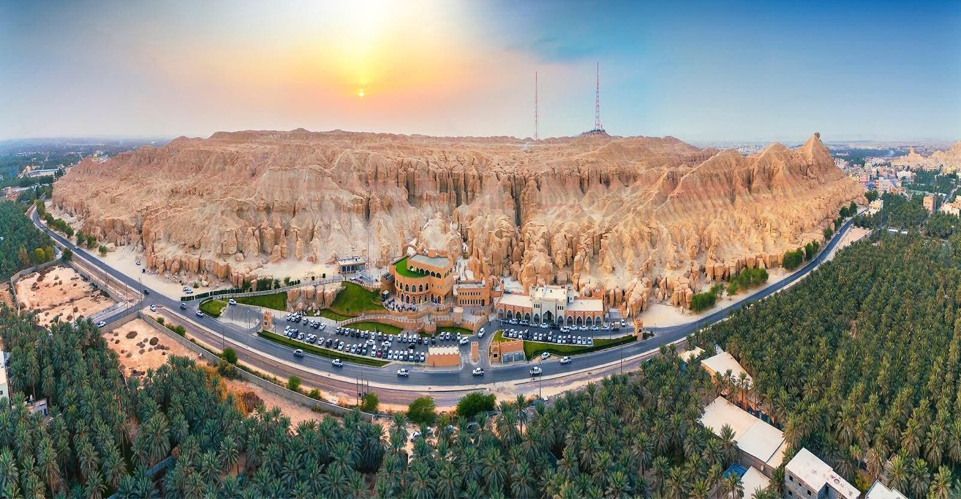

Al-Ahsa is a/an …………… governorate.
wonderful
beautiful
big
calm
humid
charming
peaceful
.. your words
??
Notes:
Language Builder
the use of the articles a/an in most phrases with singular nouns.
For example:
Saudi Arabia is an interesting place.
Riyadh is a wonderful city.

Slide 15
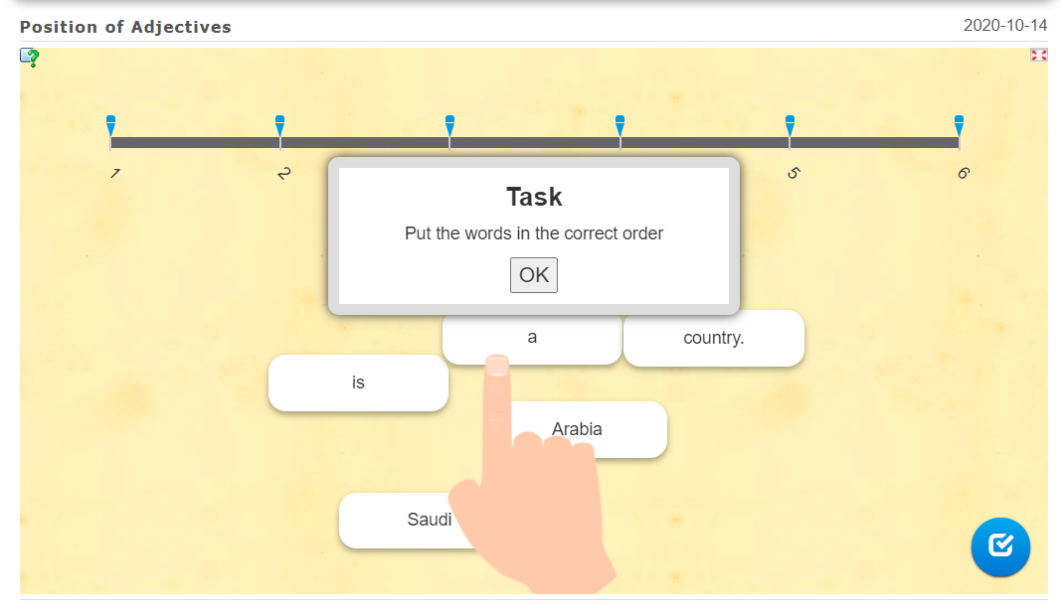
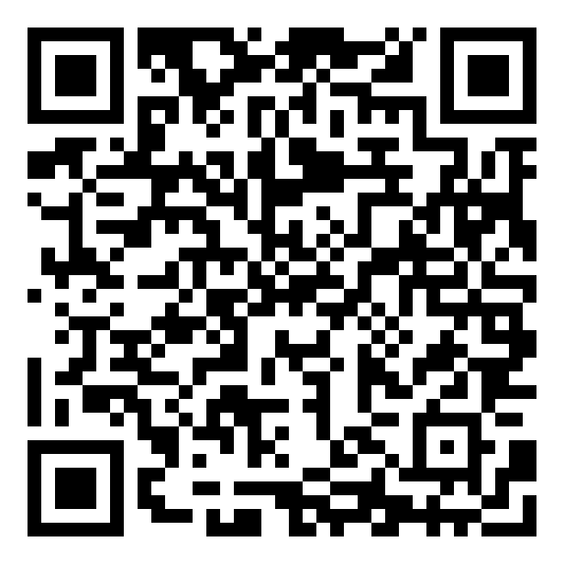
Quick Check
a volunteer’s control
https://learningapps.org/watch?v=pj1iajr6c20

Slide 16

Quick Check
St Book: 44

Slide 17
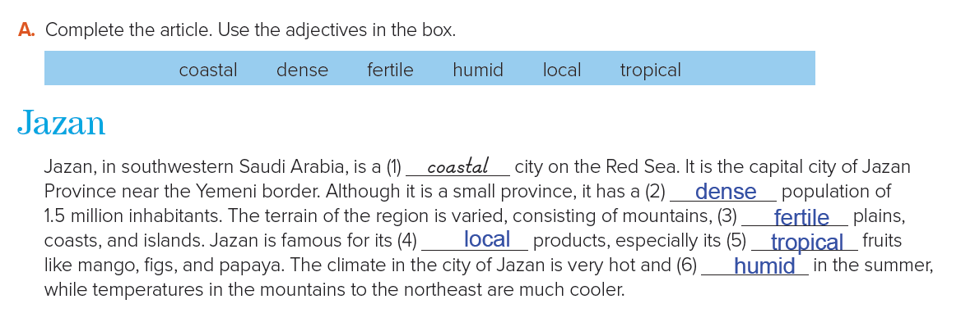

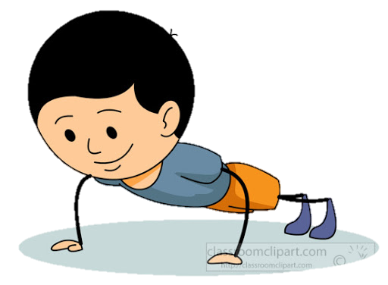
Student’s Book: 44

Slide 18
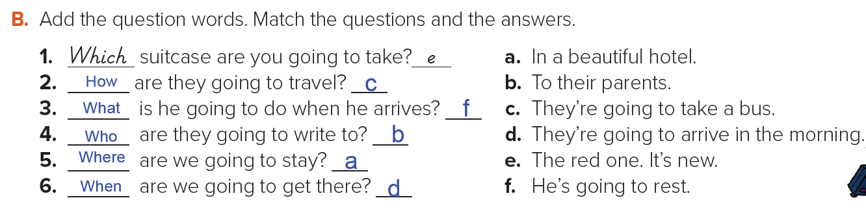
Student’s Book: 44

Slide 19
Have a nice day
THANK YOU!
Lesson done by: Essa Al Hussaini

