Slide 1



المعدل الثابت للتغير
@ amal_almazroai
@ ma3aly_alharbi

Slide 2

فكرة الدرس
المفردات
أعين العلاقات الخطية المتناسبة
و غير المتناسبة من خلال إيجاد معدل ثابت للتغير
العلاقة الخطية
المعدل الثابت للتغير
@ amal_almazroai
@ ma3aly_alharbi

Slide 3
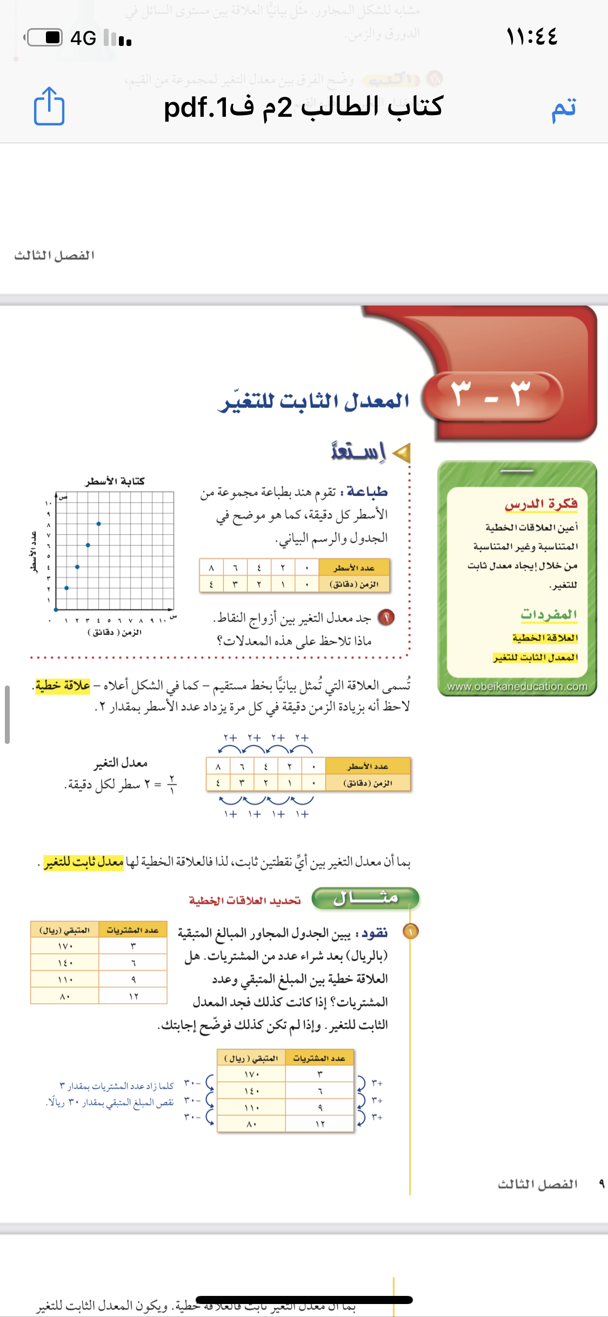
Contents of this template
Here’s what you’ll find in this Slidesgo template:
A slide structure based on a business portfolio presentation, which you can easily adapt to your needs. For more info on how to edit the template, please visit Slidesgo School or read our FAQs.
An assortment of graphic resources that are suitable for use in the presentation can be found in the alternative resources slides.
A thanks slide, which you must keep so that proper credits for our design are given.
In the resources slide, where you’ll find links to all the elements used in the template.
Instructions for use.
Final slides with:
The fonts and colors used in the template.
A selection of illustrations. You can also customize and animate them as you wish with the online editor. Visit Storyset to find more.
More infographic resources, whose size and color can be edited.
Sets of customizable icons of the following themes: general, business, avatar, creative process, education, help & support, medical, nature, performing arts, SEO & marketing, and teamwork.
You can delete this slide when you’re done editing the presentation.

Slide 4
Contents of this template
Here’s what you’ll find in this Slidesgo template:
A slide structure based on a business portfolio presentation, which you can easily adapt to your needs. For more info on how to edit the template, please visit Slidesgo School or read our FAQs.
An assortment of graphic resources that are suitable for use in the presentation can be found in the alternative resources slides.
A thanks slide, which you must keep so that proper credits for our design are given.
In the resources slide, where you’ll find links to all the elements used in the template.
Instructions for use.
Final slides with:
The fonts and colors used in the template.
A selection of illustrations. You can also customize and animate them as you wish with the online editor. Visit Storyset to find more.
More infographic resources, whose size and color can be edited.
Sets of customizable icons of the following themes: general, business, avatar, creative process, education, help & support, medical, nature, performing arts, SEO & marketing, and teamwork.
You can delete this slide when you’re done editing the presentation.
@ amal_almazroai
@ ma3aly_alharbi

Slide 5
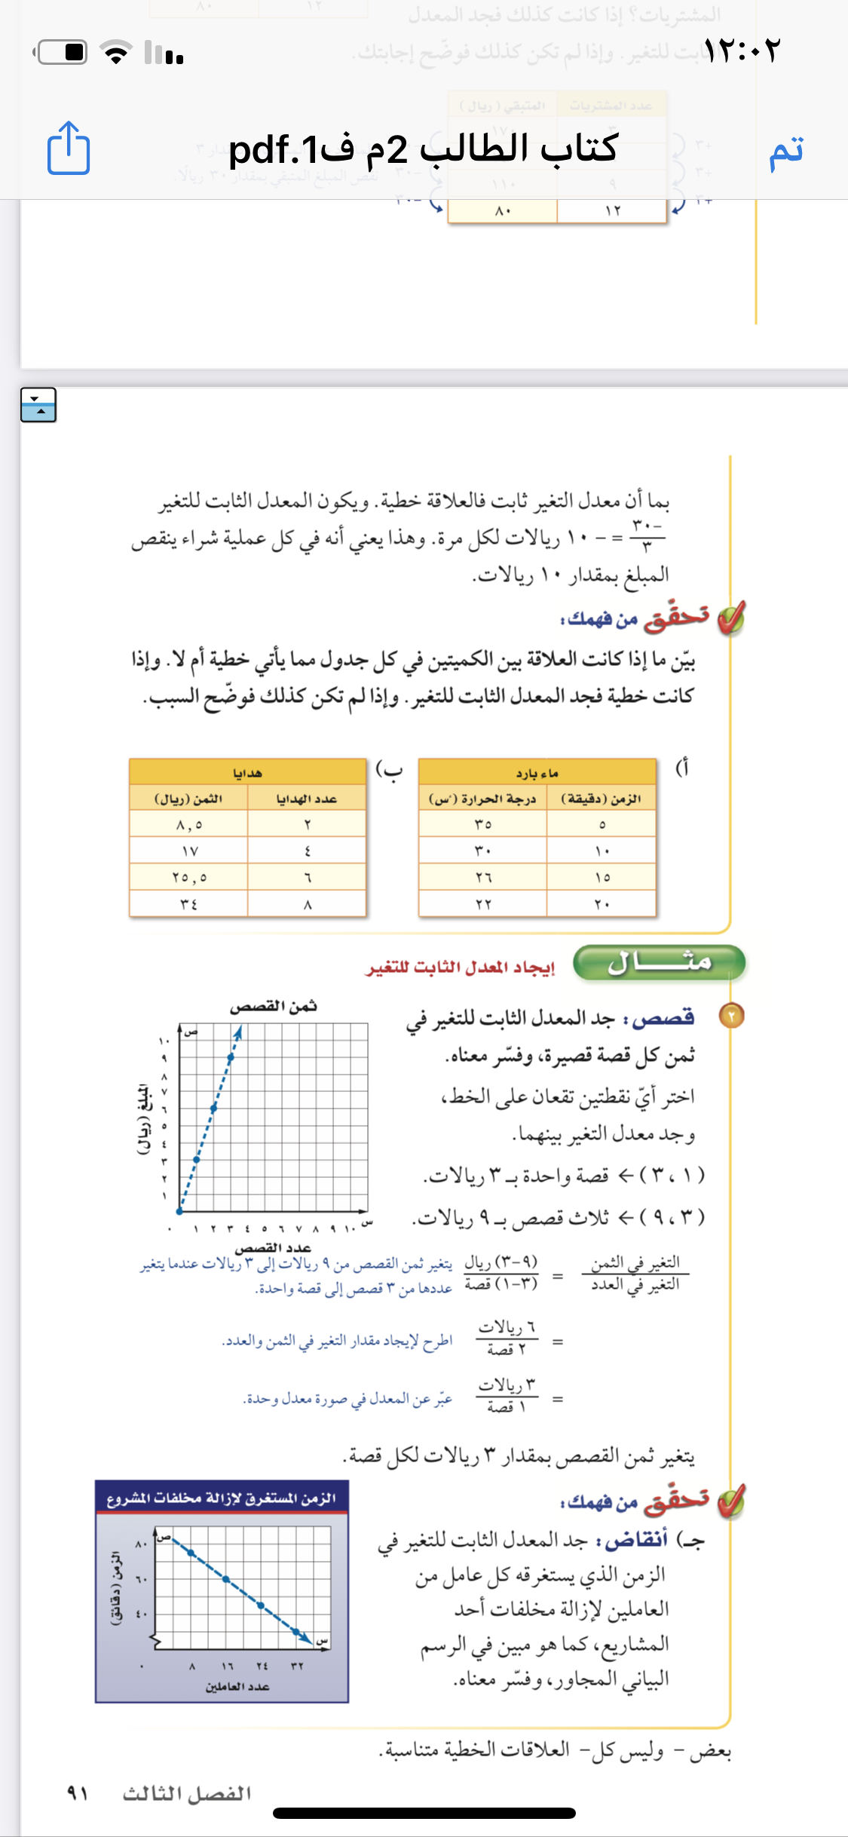
Contents of this template
Here’s what you’ll find in this Slidesgo template:
A slide structure based on a business portfolio presentation, which you can easily adapt to your needs. For more info on how to edit the template, please visit Slidesgo School or read our FAQs.
An assortment of graphic resources that are suitable for use in the presentation can be found in the alternative resources slides.
A thanks slide, which you must keep so that proper credits for our design are given.
In the resources slide, where you’ll find links to all the elements used in the template.
Instructions for use.
Final slides with:
The fonts and colors used in the template.
A selection of illustrations. You can also customize and animate them as you wish with the online editor. Visit Storyset to find more.
More infographic resources, whose size and color can be edited.
Sets of customizable icons of the following themes: general, business, avatar, creative process, education, help & support, medical, nature, performing arts, SEO & marketing, and teamwork.
You can delete this slide when you’re done editing the presentation.

Slide 6
Contents of this template
Here’s what you’ll find in this Slidesgo template:
A slide structure based on a business portfolio presentation, which you can easily adapt to your needs. For more info on how to edit the template, please visit Slidesgo School or read our FAQs.
An assortment of graphic resources that are suitable for use in the presentation can be found in the alternative resources slides.
A thanks slide, which you must keep so that proper credits for our design are given.
In the resources slide, where you’ll find links to all the elements used in the template.
Instructions for use.
Final slides with:
The fonts and colors used in the template.
A selection of illustrations. You can also customize and animate them as you wish with the online editor. Visit Storyset to find more.
More infographic resources, whose size and color can be edited.
Sets of customizable icons of the following themes: general, business, avatar, creative process, education, help & support, medical, nature, performing arts, SEO & marketing, and teamwork.
You can delete this slide when you’re done editing the presentation.

Slide 7
Contents of this template
Here’s what you’ll find in this Slidesgo template:
A slide structure based on a business portfolio presentation, which you can easily adapt to your needs. For more info on how to edit the template, please visit Slidesgo School or read our FAQs.
An assortment of graphic resources that are suitable for use in the presentation can be found in the alternative resources slides.
A thanks slide, which you must keep so that proper credits for our design are given.
In the resources slide, where you’ll find links to all the elements used in the template.
Instructions for use.
Final slides with:
The fonts and colors used in the template.
A selection of illustrations. You can also customize and animate them as you wish with the online editor. Visit Storyset to find more.
More infographic resources, whose size and color can be edited.
Sets of customizable icons of the following themes: general, business, avatar, creative process, education, help & support, medical, nature, performing arts, SEO & marketing, and teamwork.
You can delete this slide when you’re done editing the presentation.

Slide 8
Contents of this template
Here’s what you’ll find in this Slidesgo template:
A slide structure based on a business portfolio presentation, which you can easily adapt to your needs. For more info on how to edit the template, please visit Slidesgo School or read our FAQs.
An assortment of graphic resources that are suitable for use in the presentation can be found in the alternative resources slides.
A thanks slide, which you must keep so that proper credits for our design are given.
In the resources slide, where you’ll find links to all the elements used in the template.
Instructions for use.
Final slides with:
The fonts and colors used in the template.
A selection of illustrations. You can also customize and animate them as you wish with the online editor. Visit Storyset to find more.
More infographic resources, whose size and color can be edited.
Sets of customizable icons of the following themes: general, business, avatar, creative process, education, help & support, medical, nature, performing arts, SEO & marketing, and teamwork.
You can delete this slide when you’re done editing the presentation.
@ amal_almazroai
@ ma3aly_alharbi

Slide 9
Contents of this template
Here’s what you’ll find in this Slidesgo template:
A slide structure based on a business portfolio presentation, which you can easily adapt to your needs. For more info on how to edit the template, please visit Slidesgo School or read our FAQs.
An assortment of graphic resources that are suitable for use in the presentation can be found in the alternative resources slides.
A thanks slide, which you must keep so that proper credits for our design are given.
In the resources slide, where you’ll find links to all the elements used in the template.
Instructions for use.
Final slides with:
The fonts and colors used in the template.
A selection of illustrations. You can also customize and animate them as you wish with the online editor. Visit Storyset to find more.
More infographic resources, whose size and color can be edited.
Sets of customizable icons of the following themes: general, business, avatar, creative process, education, help & support, medical, nature, performing arts, SEO & marketing, and teamwork.
You can delete this slide when you’re done editing the presentation.
@ amal_almazroai
@ ma3aly_alharbi

Slide 10
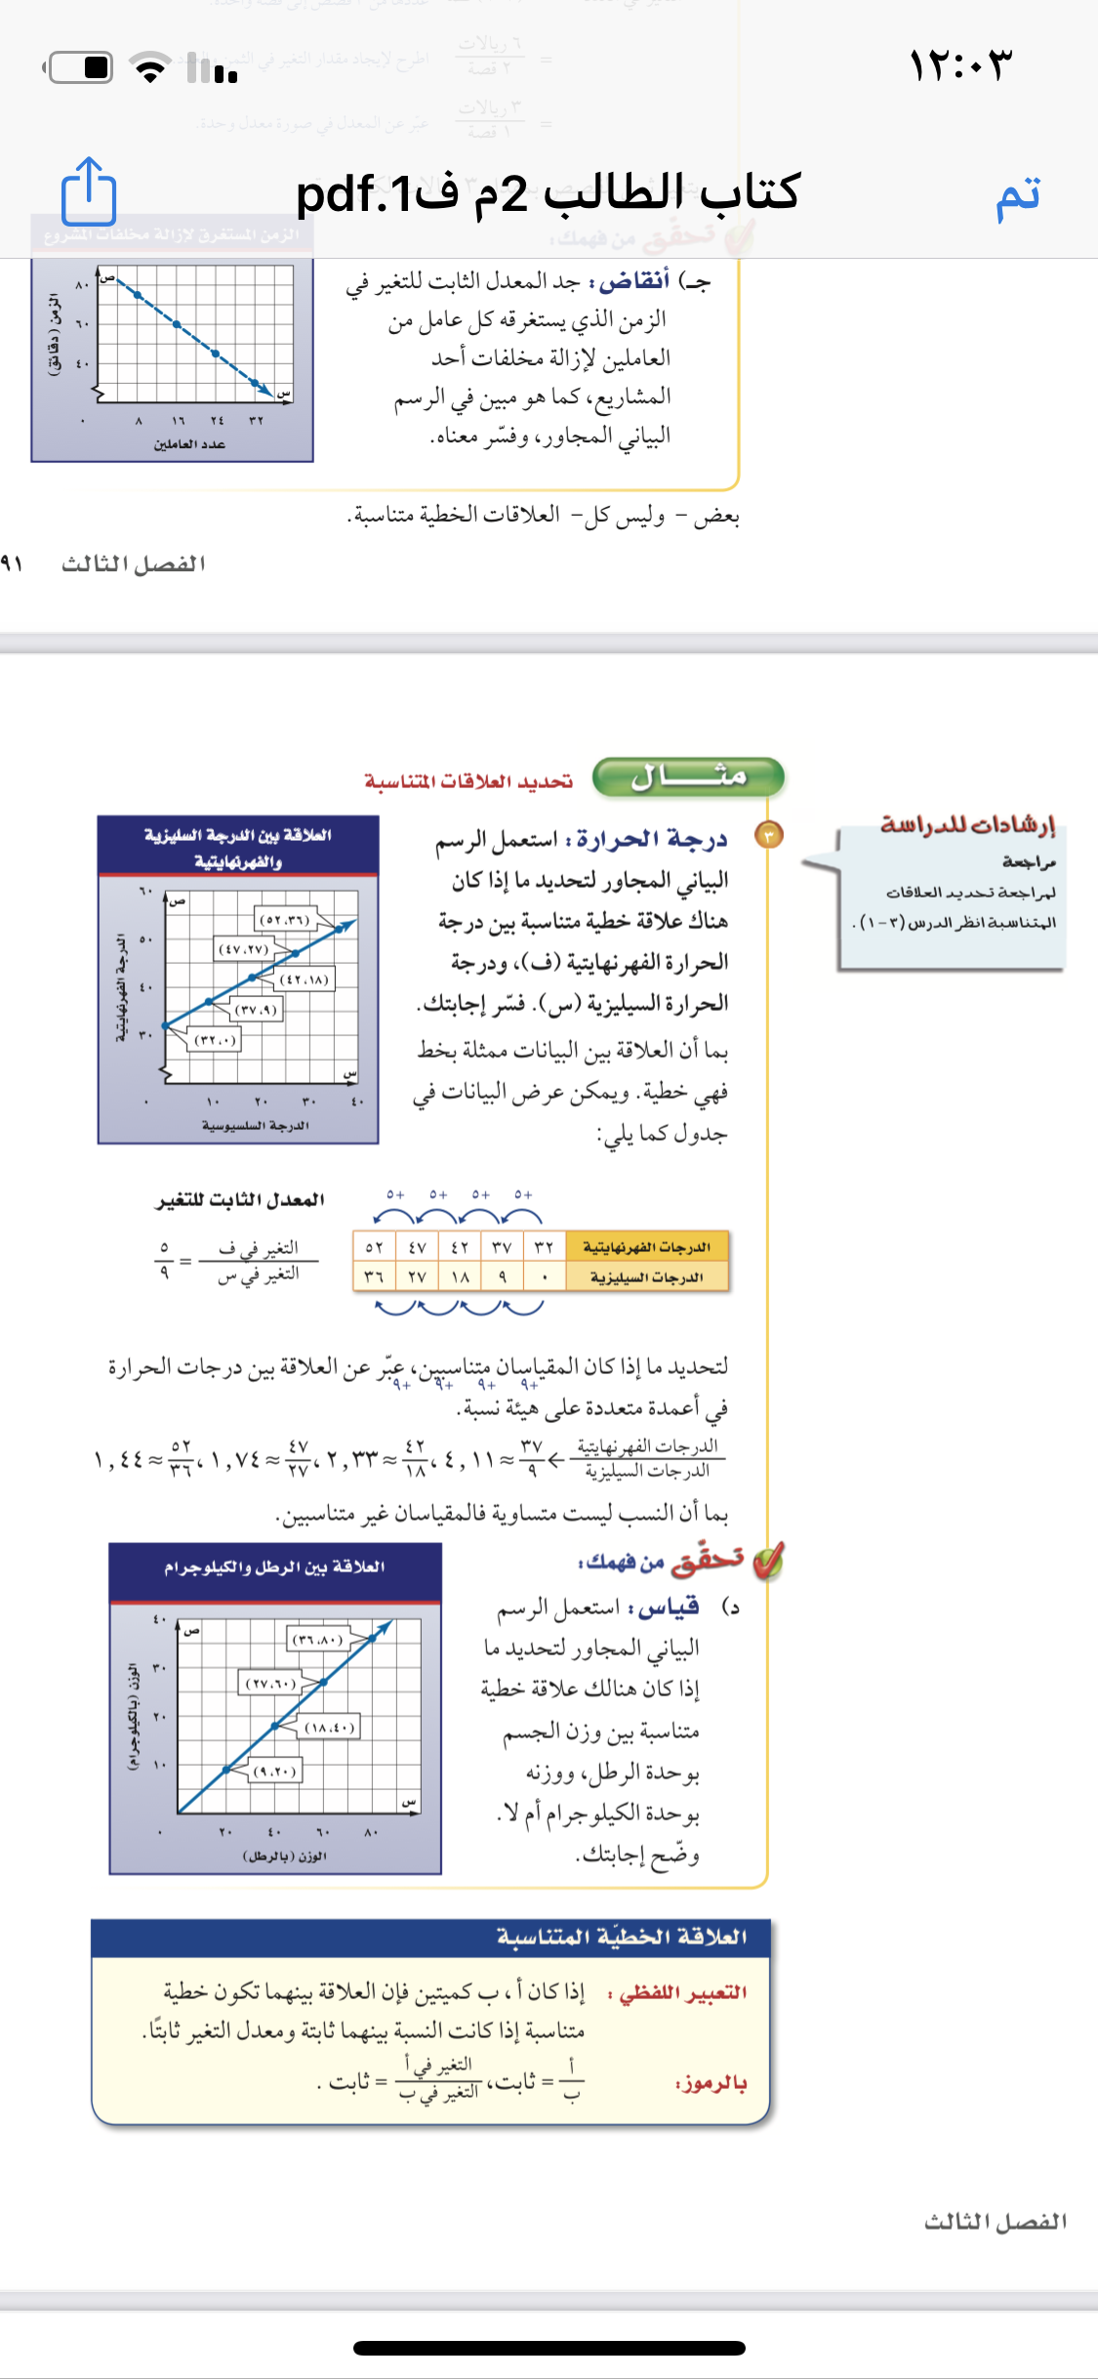
Contents of this template
Here’s what you’ll find in this Slidesgo template:
A slide structure based on a business portfolio presentation, which you can easily adapt to your needs. For more info on how to edit the template, please visit Slidesgo School or read our FAQs.
An assortment of graphic resources that are suitable for use in the presentation can be found in the alternative resources slides.
A thanks slide, which you must keep so that proper credits for our design are given.
In the resources slide, where you’ll find links to all the elements used in the template.
Instructions for use.
Final slides with:
The fonts and colors used in the template.
A selection of illustrations. You can also customize and animate them as you wish with the online editor. Visit Storyset to find more.
More infographic resources, whose size and color can be edited.
Sets of customizable icons of the following themes: general, business, avatar, creative process, education, help & support, medical, nature, performing arts, SEO & marketing, and teamwork.
You can delete this slide when you’re done editing the presentation.

Slide 11
Contents of this template
Here’s what you’ll find in this Slidesgo template:
A slide structure based on a business portfolio presentation, which you can easily adapt to your needs. For more info on how to edit the template, please visit Slidesgo School or read our FAQs.
An assortment of graphic resources that are suitable for use in the presentation can be found in the alternative resources slides.
A thanks slide, which you must keep so that proper credits for our design are given.
In the resources slide, where you’ll find links to all the elements used in the template.
Instructions for use.
Final slides with:
The fonts and colors used in the template.
A selection of illustrations. You can also customize and animate them as you wish with the online editor. Visit Storyset to find more.
More infographic resources, whose size and color can be edited.
Sets of customizable icons of the following themes: general, business, avatar, creative process, education, help & support, medical, nature, performing arts, SEO & marketing, and teamwork.
You can delete this slide when you’re done editing the presentation.

Slide 12
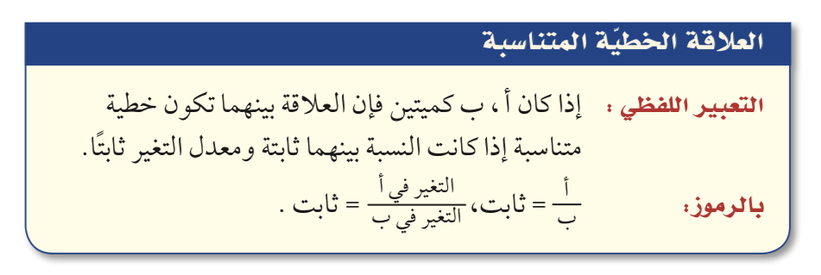
Contents of this template
ملخص المفهوم
Here’s what you’ll find in this Slidesgo template:
A slide structure based on a business portfolio presentation, which you can easily adapt to your needs. For more info on how to edit the template, please visit Slidesgo School or read our FAQs.
An assortment of graphic resources that are suitable for use in the presentation can be found in the alternative resources slides.
A thanks slide, which you must keep so that proper credits for our design are given.
In the resources slide, where you’ll find links to all the elements used in the template.
Instructions for use.
Final slides with:
The fonts and colors used in the template.
A selection of illustrations. You can also customize and animate them as you wish with the online editor. Visit Storyset to find more.
More infographic resources, whose size and color can be edited.
Sets of customizable icons of the following themes: general, business, avatar, creative process, education, help & support, medical, nature, performing arts, SEO & marketing, and teamwork.
You can delete this slide when you’re done editing the presentation.

Slide 13
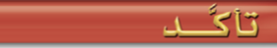
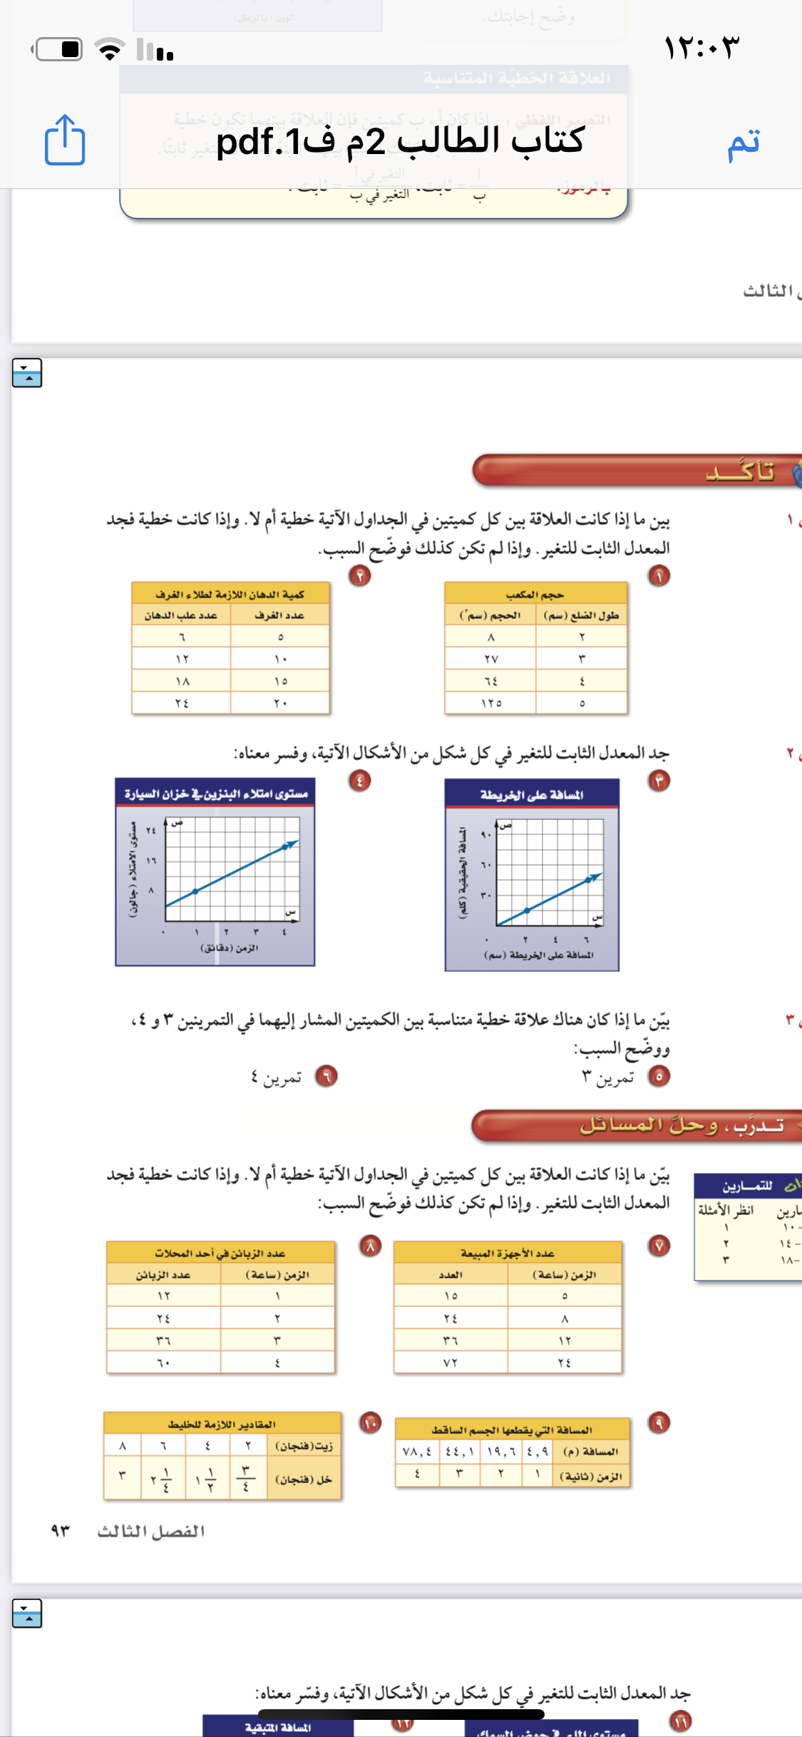
Here’s what you’ll find in this Slidesgo template:
A slide structure based on a business portfolio presentation, which you can easily adapt to your needs. For more info on how to edit the template, please visit Slidesgo School or read our FAQs.
An assortment of graphic resources that are suitable for use in the presentation can be found in the alternative resources slides.
A thanks slide, which you must keep so that proper credits for our design are given.
In the resources slide, where you’ll find links to all the elements used in the template.
Instructions for use.
Final slides with:
The fonts and colors used in the template.
A selection of illustrations. You can also customize and animate them as you wish with the online editor. Visit Storyset to find more.
More infographic resources, whose size and color can be edited.
Sets of customizable icons of the following themes: general, business, avatar, creative process, education, help & support, medical, nature, performing arts, SEO & marketing, and teamwork.
You can delete this slide when you’re done editing the presentation.

Slide 14
Here’s what you’ll find in this Slidesgo template:
A slide structure based on a business portfolio presentation, which you can easily adapt to your needs. For more info on how to edit the template, please visit Slidesgo School or read our FAQs.
An assortment of graphic resources that are suitable for use in the presentation can be found in the alternative resources slides.
A thanks slide, which you must keep so that proper credits for our design are given.
In the resources slide, where you’ll find links to all the elements used in the template.
Instructions for use.
Final slides with:
The fonts and colors used in the template.
A selection of illustrations. You can also customize and animate them as you wish with the online editor. Visit Storyset to find more.
More infographic resources, whose size and color can be edited.
Sets of customizable icons of the following themes: general, business, avatar, creative process, education, help & support, medical, nature, performing arts, SEO & marketing, and teamwork.
You can delete this slide when you’re done editing the presentation.

Slide 15
Here’s what you’ll find in this Slidesgo template:
A slide structure based on a business portfolio presentation, which you can easily adapt to your needs. For more info on how to edit the template, please visit Slidesgo School or read our FAQs.
An assortment of graphic resources that are suitable for use in the presentation can be found in the alternative resources slides.
A thanks slide, which you must keep so that proper credits for our design are given.
In the resources slide, where you’ll find links to all the elements used in the template.
Instructions for use.
Final slides with:
The fonts and colors used in the template.
A selection of illustrations. You can also customize and animate them as you wish with the online editor. Visit Storyset to find more.
More infographic resources, whose size and color can be edited.
Sets of customizable icons of the following themes: general, business, avatar, creative process, education, help & support, medical, nature, performing arts, SEO & marketing, and teamwork.
You can delete this slide when you’re done editing the presentation.

Slide 16
Here’s what you’ll find in this Slidesgo template:
A slide structure based on a business portfolio presentation, which you can easily adapt to your needs. For more info on how to edit the template, please visit Slidesgo School or read our FAQs.
An assortment of graphic resources that are suitable for use in the presentation can be found in the alternative resources slides.
A thanks slide, which you must keep so that proper credits for our design are given.
In the resources slide, where you’ll find links to all the elements used in the template.
Instructions for use.
Final slides with:
The fonts and colors used in the template.
A selection of illustrations. You can also customize and animate them as you wish with the online editor. Visit Storyset to find more.
More infographic resources, whose size and color can be edited.
Sets of customizable icons of the following themes: general, business, avatar, creative process, education, help & support, medical, nature, performing arts, SEO & marketing, and teamwork.
You can delete this slide when you’re done editing the presentation.

Slide 17
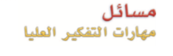
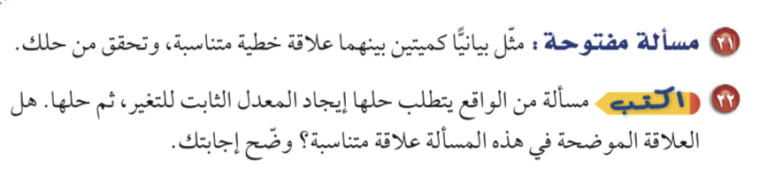
Contents of this template
Here’s what you’ll find in this Slidesgo template:
A slide structure based on a business portfolio presentation, which you can easily adapt to your needs. For more info on how to edit the template, please visit Slidesgo School or read our FAQs.
An assortment of graphic resources that are suitable for use in the presentation can be found in the alternative resources slides.
A thanks slide, which you must keep so that proper credits for our design are given.
In the resources slide, where you’ll find links to all the elements used in the template.
Instructions for use.
Final slides with:
The fonts and colors used in the template.
A selection of illustrations. You can also customize and animate them as you wish with the online editor. Visit Storyset to find more.
More infographic resources, whose size and color can be edited.
Sets of customizable icons of the following themes: general, business, avatar, creative process, education, help & support, medical, nature, performing arts, SEO & marketing, and teamwork.
You can delete this slide when you’re done editing the presentation.

Slide 18
ماذا تعلمت ؟
@ amal_almazroai
@ ma3aly_alharbi

Slide 19
Contents of this template
الواجب
@ amal_almazroai
@ ma3aly_alharbi

