Slide 1
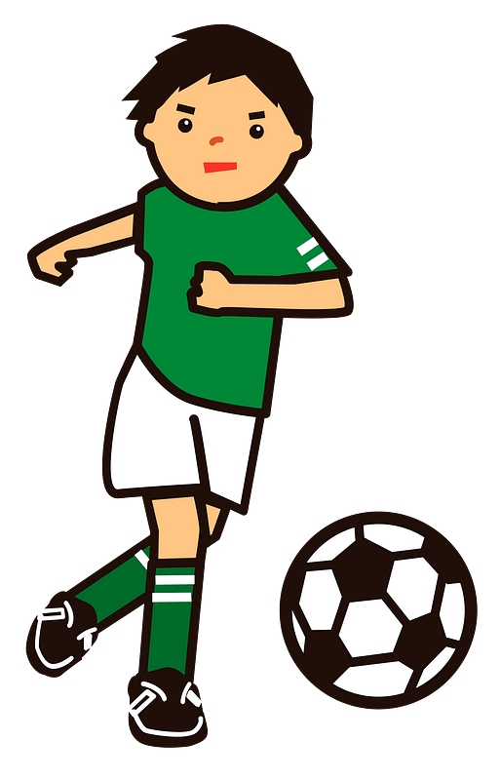
Things We Do
Talk Time

Slide 2
objectives
Describe the current event.
Match each word to its picture.
Build a telephone conversation.

Slide 5
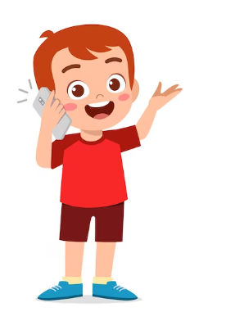
Hello
Hi
What are they doing?
I am fine thank you.
How are you ?

Slide 6
What am doing now?
Hello , I am your teacher.
Am I watching T.V?
I am teaching .

Slide 7
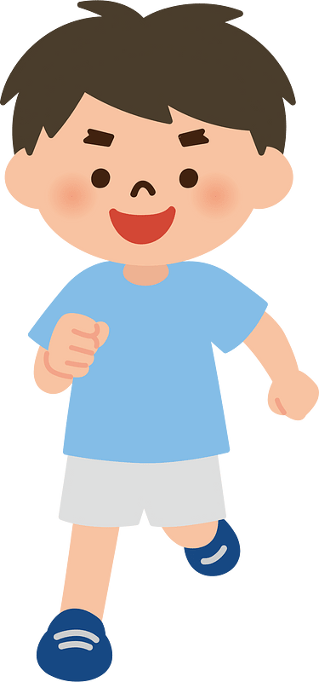
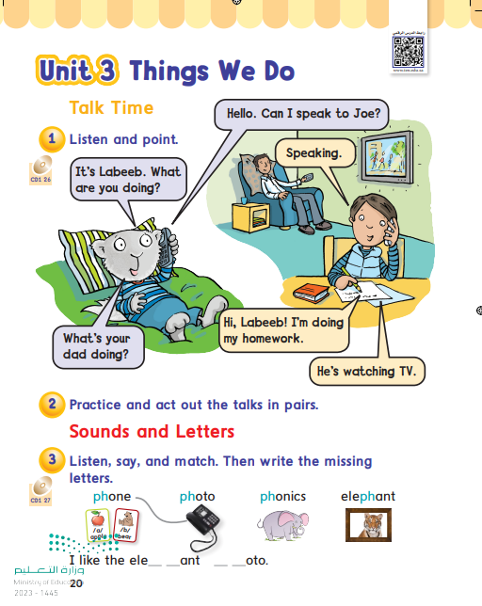
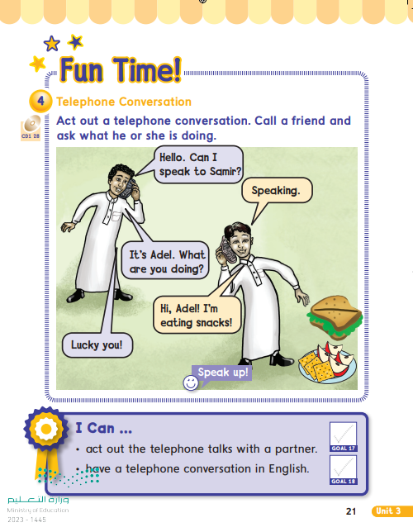

Slide 8
Logic –line -ups
d
i
n
n
d
o
o
g
g
i
I doing my homework .

Slide 9
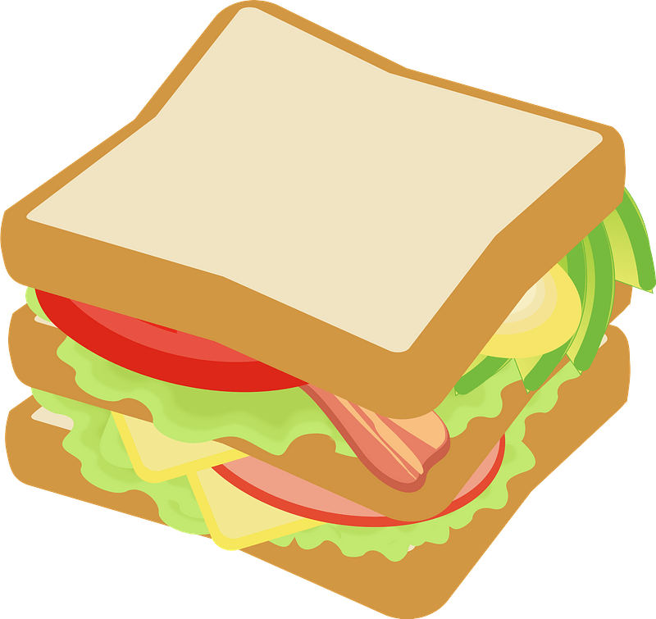
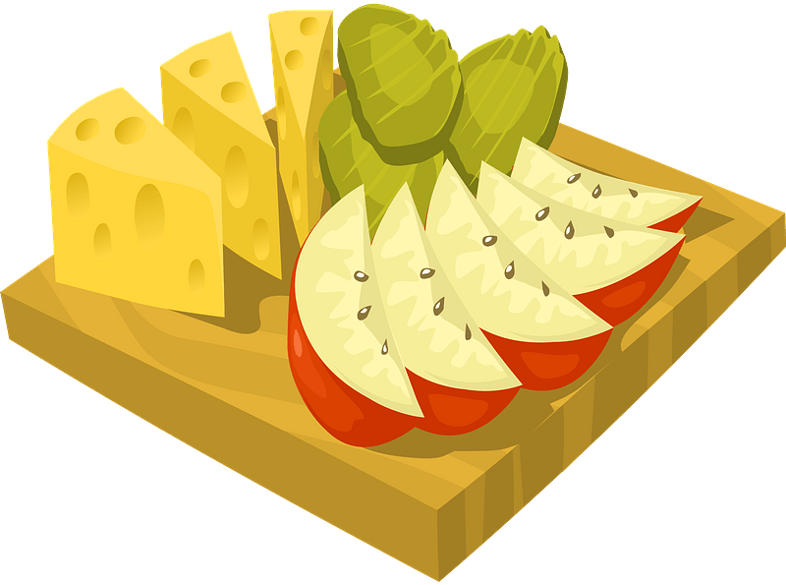
s
n
a
c
k
Write the FIRST letter of each word THEN guess the word.

Slide 10
What is she doing?
She is eating
……………………………..
snacks

Slide 11
What is he doing?
He is watching
……………………………..
T.V

Slide 12
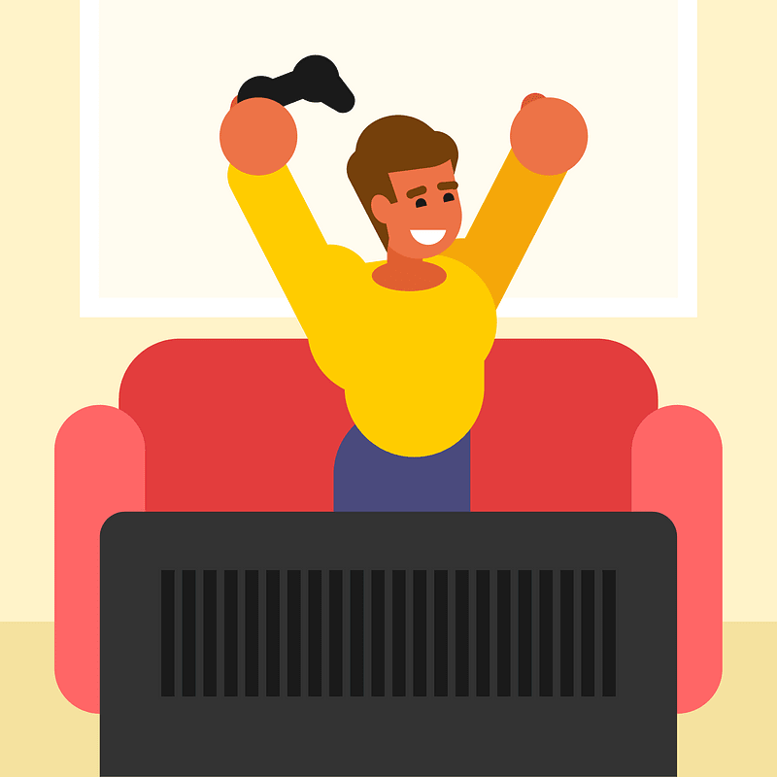
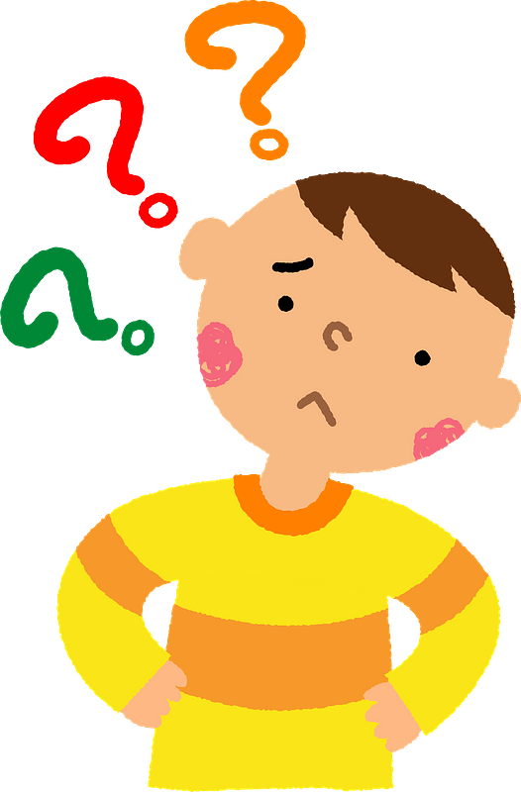
What is he doing?
playing
He is ……….………….video games.

Slide 13
What are you doing?

Slide 15
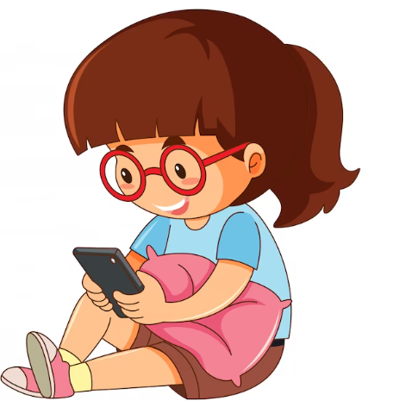
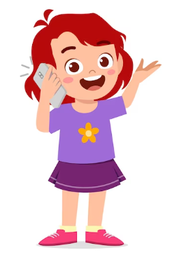

Slide 16
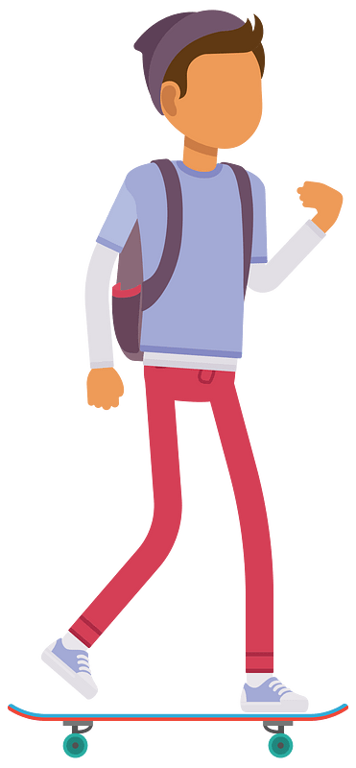
ph

Slide 17
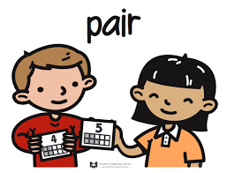
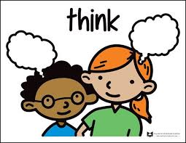
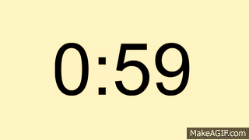
ph
ph

Slide 18
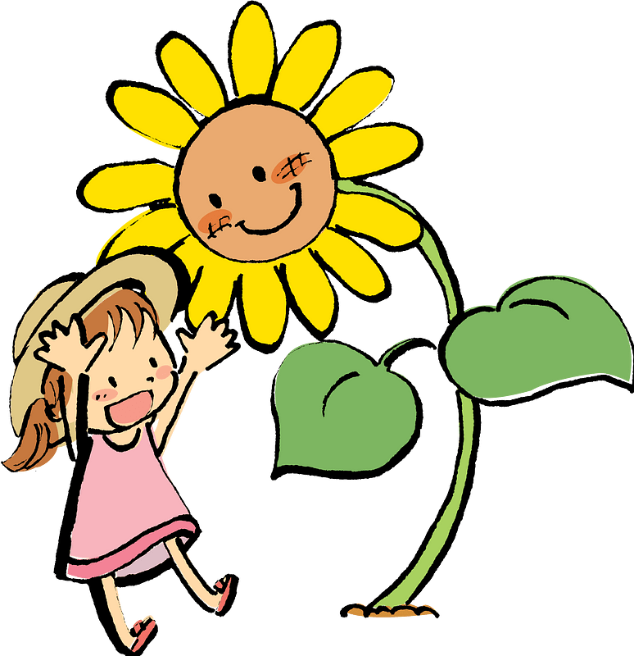
look cover write check
photo

Slide 19
look cover write check
phone

Slide 20
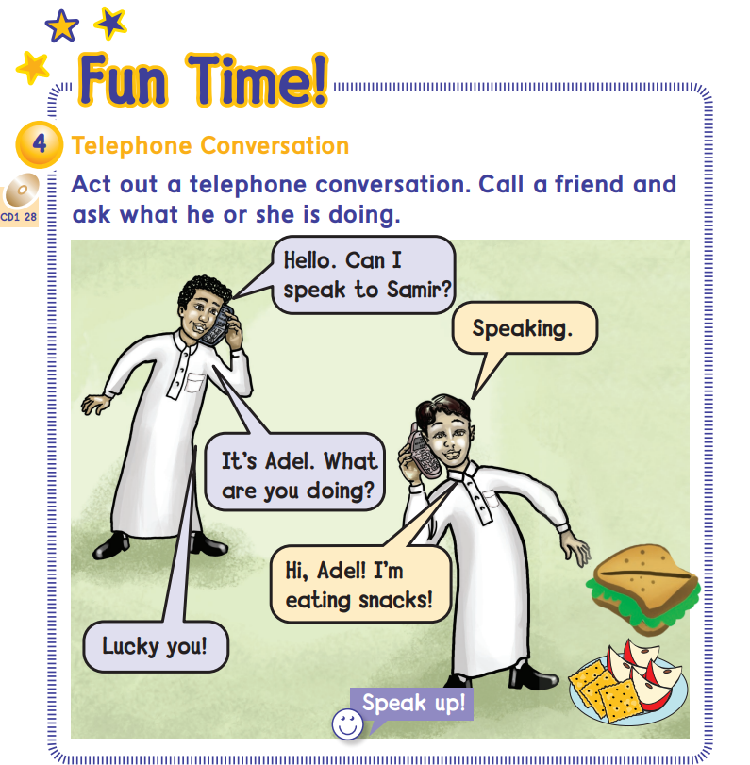

Slide 21
snacks
photo
elephant
phonics

Slide 23
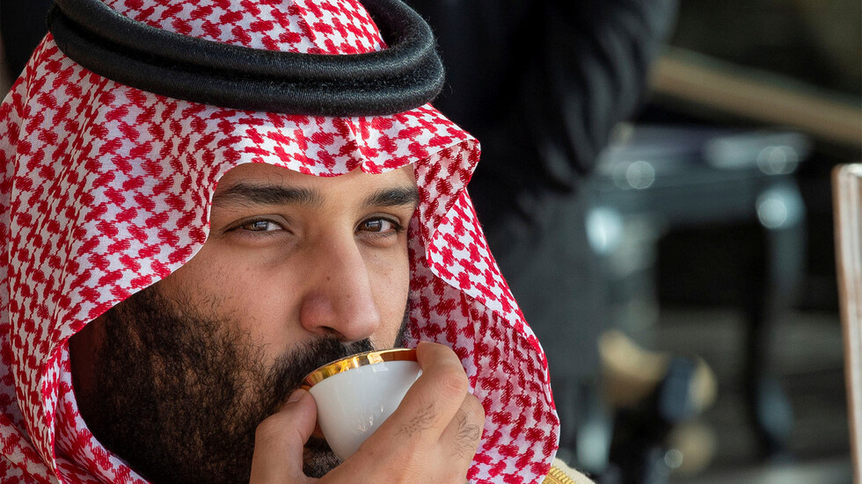
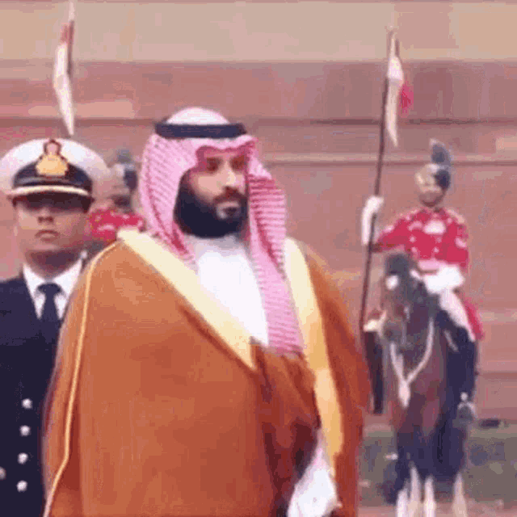
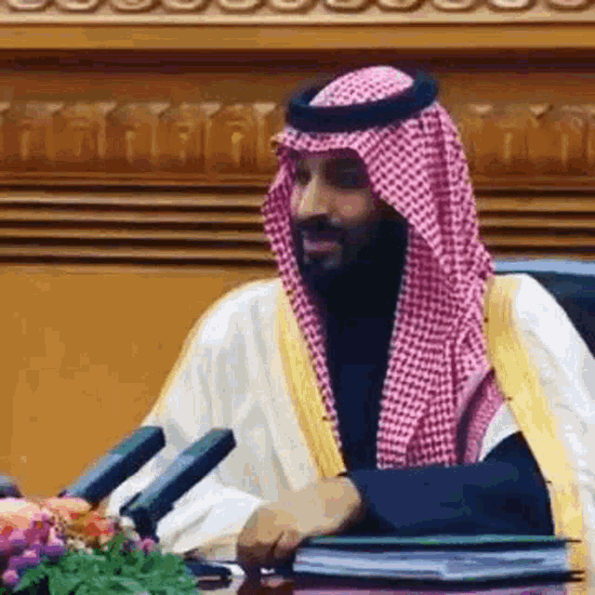
What is he doing?

Slide 24
…….oto
ph
gh

Slide 25
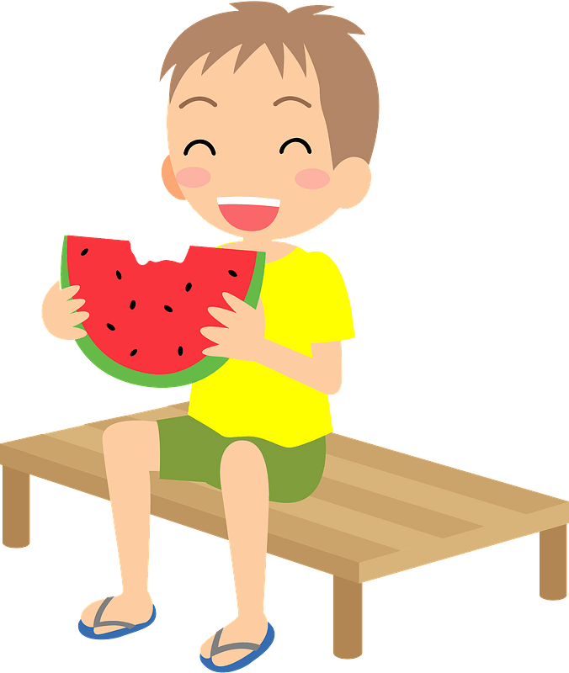
I am ……snacks
playing
eating

Slide 26
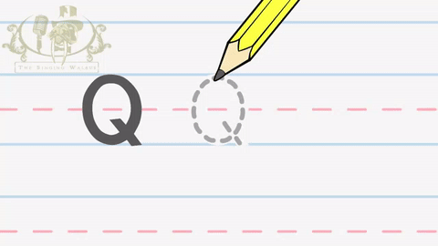
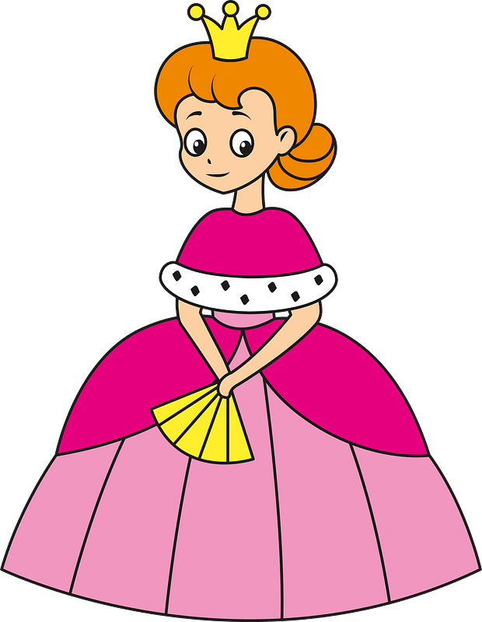

Slide 29
Work
book

