Slide 1
4/Around the world
Form, Meaning and function
Requests and Offers: can/will

Slide 2
Our objectives for today:
1-make a request using can/will
2-Agree and refuse requests
3-make an offer using can/will
4-Accept/refuse offers.

Slide 3
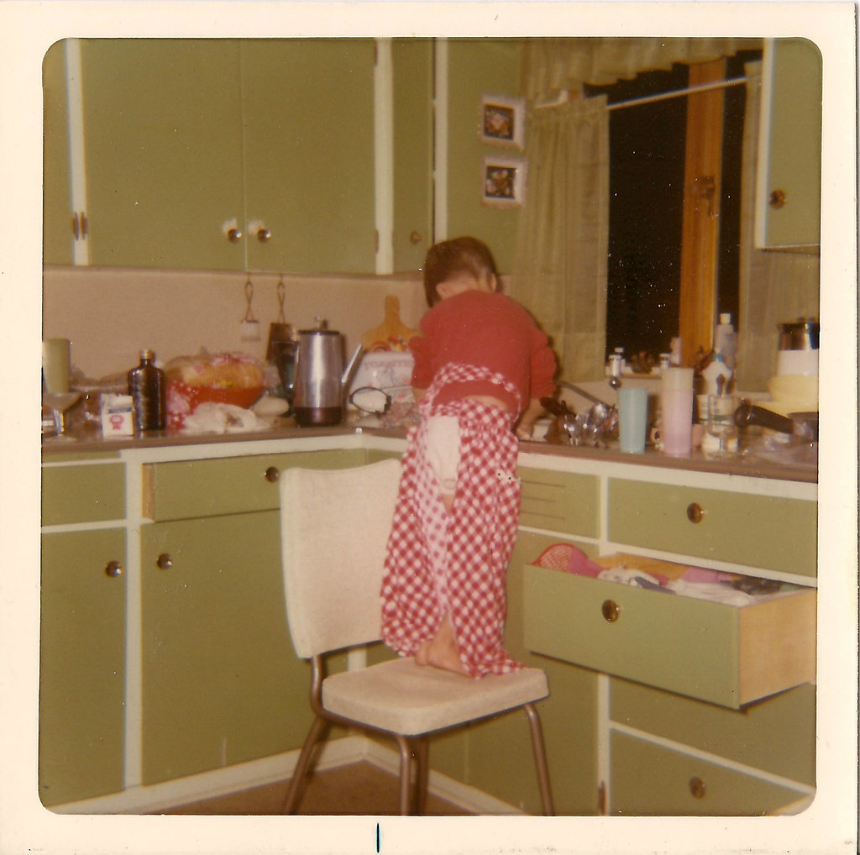
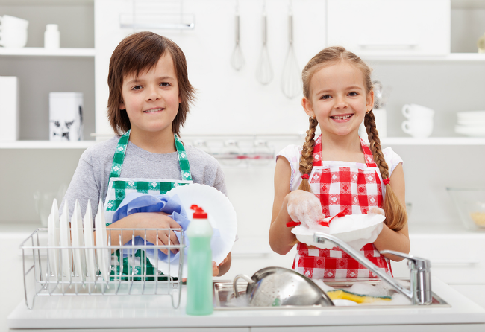
Requests using (can /will):
Can/will you help me?
Of course.
No problem
agree

Slide 4

Requests using (can/will)
Can/will you help me?
Sorry. I can’t
Sorry. I’m busy
refuse

Slide 5
How to make a request?
Requests
Can/Will
you
request..?

Slide 6

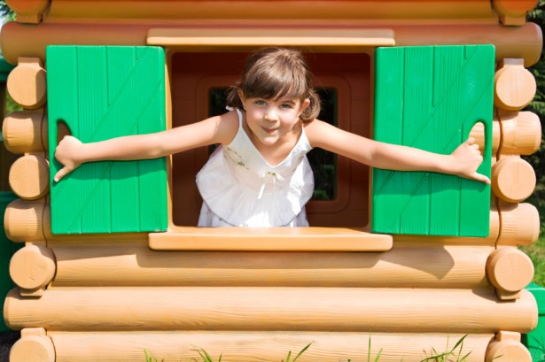
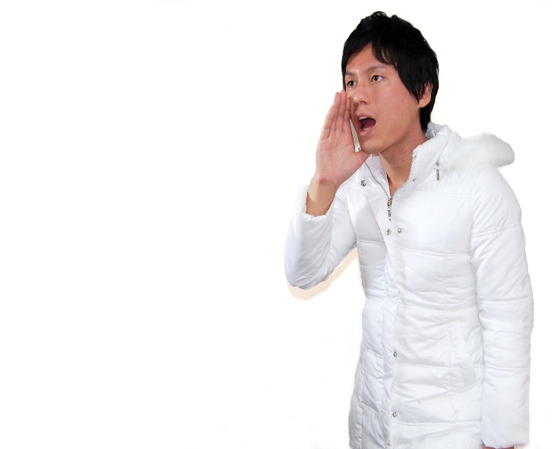
Make a request using (can/will)
Role play strategy
Open the window
Sure/Of course/Ok/No problem
agree
Can/will you open the window?

Slide 7
Make a request using (can/will)
Open the window
Sorry. I’m busy./Sorry. I can’t.
refuse
Can/will you open the window?

Slide 8

Make a request using (can/will)
Rearrange .
You can the close door?
Use the
(chat box)
to write your
answer
هذه الصورة بواسطة كاتب غير معروف مرخصة بالاسم CC BY-NC

Slide 9
Rearrange .
You can the close door?
بدء المؤقت
Done!
30
25
5
20
10
15
You only have 30 sec

Slide 10
Make a request using (can/will)
Rearrange .
You can the close door?
Rearrange .
can you close the door?

Slide 11



Make an offer using (can/will)
I’m tired I have a lot of work to do
I will help you.
offer
قال تعالى : (وبالوالدين احسانا)

Slide 12
Make an offer using (can/will)
Thank you
Accept
I will help you.
offer

Slide 13
Make an offer using (can/will)
All right.
Accept
I will help you.
offer

Slide 14
Make an offer using (can/will)
Ok/Thanks
Accept
I will/can help you.
offer

Slide 15
Make an offer using (can/will)
No thanks
Refuse
I will/can help you.
offer

Slide 16
Make an offer using (can/will)
No, that’s all right
Refuse
I will/can help you.
offer

Slide 17
Make an offer using (can/will)
No, that’s OK.
Refuse
I will/can help you.
offer

Slide 18
How to make an offer ?
Offer
I
can/will
offer.

Slide 19
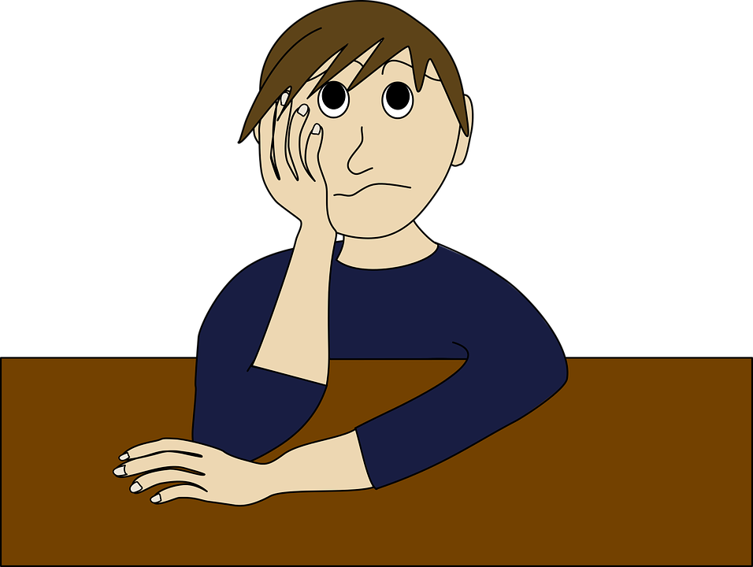

Make an offer using (can/will)
I need a pencil
►Offer your help
►I can give you a pencil.
A friend in need is a friend indeed

Slide 20
Rearrange .
I window the open will
بدء المؤقت
Done!
30
25
5
20
10
15
You only have 30 sec

Slide 21

Be polite
Say (please/thank you/you’re welcome)
Will you help me ?
,please?
هذه الصورة بواسطة كاتب غير معروف مرخصة بالاسم CC BY-NC

Slide 22
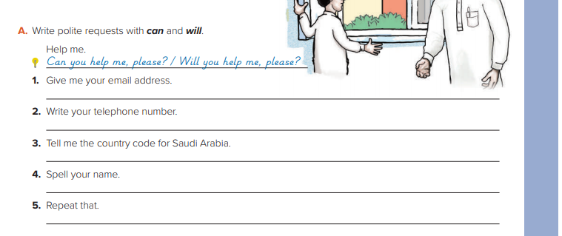
Open your books to page 33

Slide 23


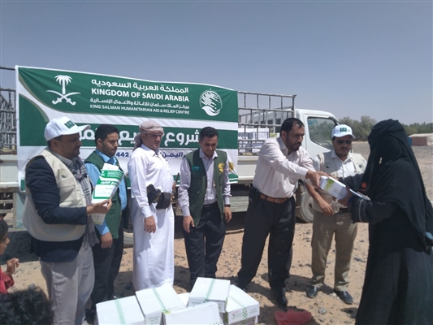
قال رسول الله صلى الله عليه وسلم
مثل المؤمنين في توادهم وتراحمهم وتعاطفهم مثل الجسد إذا اشتكى منه عضو تداعى له سائر الجسد بالسهر والحمى

