Slide 1
Unit 4
The Art of Advertising
Mega Goal 3.1
%
Reading
Done by: Entisar Al-Obaidallah

Slide 2
Lesson Objectives
01
02
03
04
Analyze
Read
the ideas of the reading passage
About the history of credit cards
Deduce
Answer
The meaning of new words correctly
Some comprehension questions

Slide 3

Open
Your student’s book
p.(54)

Slide 4
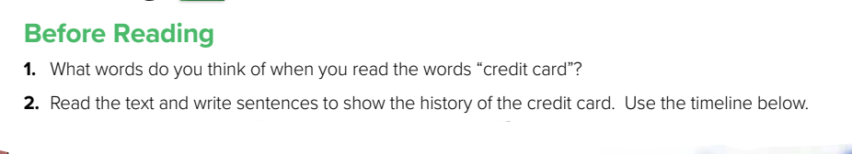

Slide 5
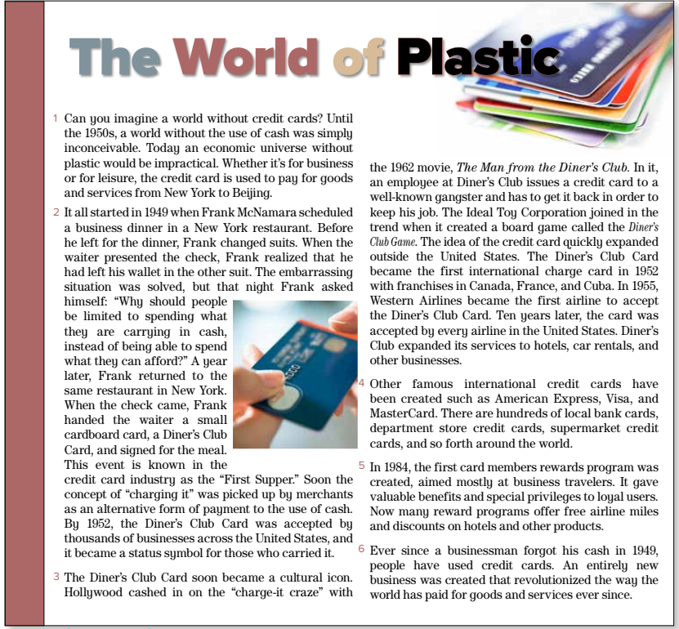

Credit card
What is the title ?
How many paragraphs are there ?
What does the picture show?

Slide 6
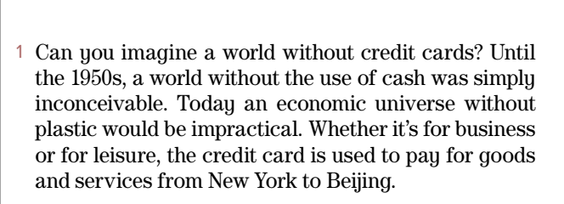

What is the credit card used to ?

Slide 7
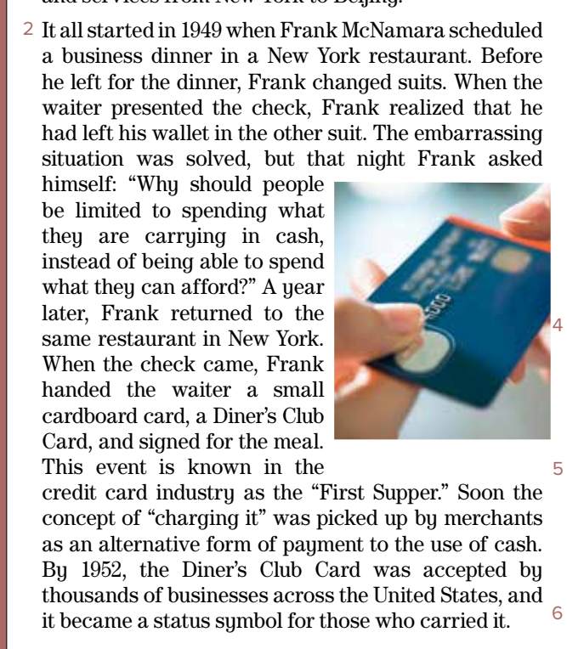
What was the “First Supper” in the credit card industry?
the first time Frank McNamara used
a credit card

Slide 8
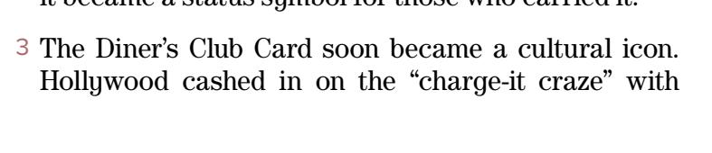
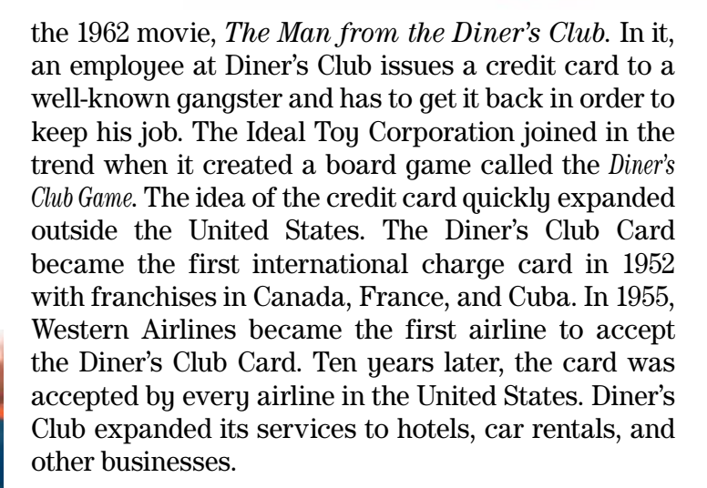
Did the credit card expand outside USA ?
Where did it expand ?

Slide 9
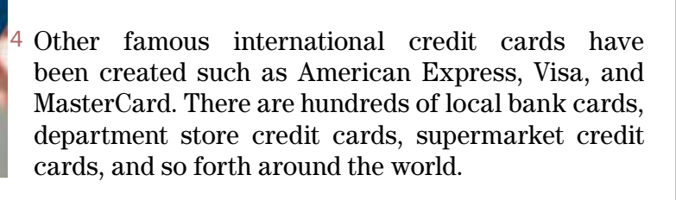
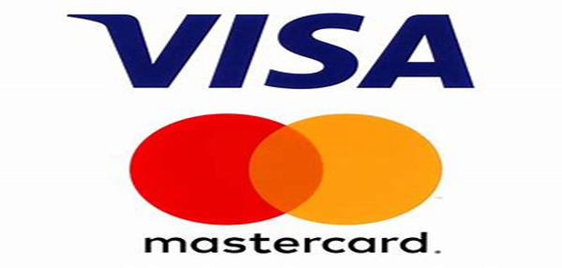
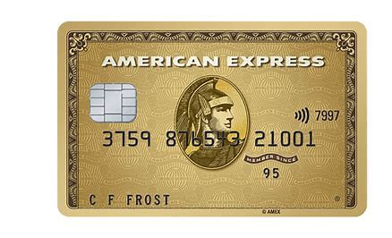
What are other famous international credit cards have been created s ?

Slide 10
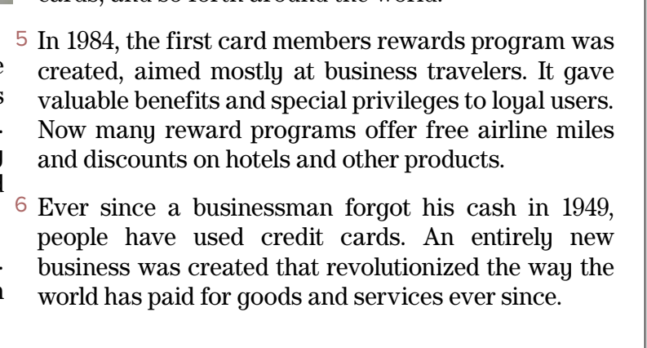
When was the first card members rewards program created?
When have people used credit cards?
What did the first card members rewards program mostly aim?

Slide 11
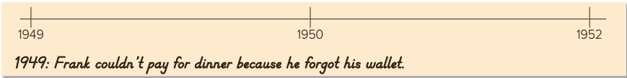
In 1950, Frank returned to the same place and paid the money with Diner’s Club Card .
In 1952, The Diner’s Club Credit was accepted by thousands of businesses across USA.
In 1952, The Diner’s Club Credit became the first international charge card.

Slide 12
Open
Student’s book , p.( 55)

Slide 13
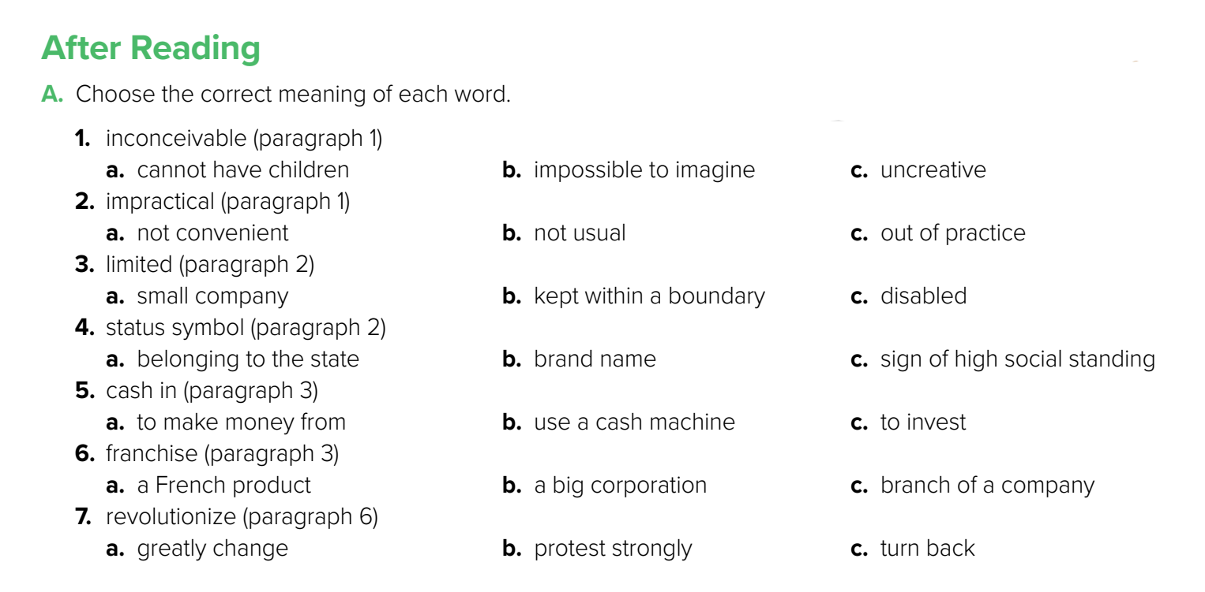

Slide 14
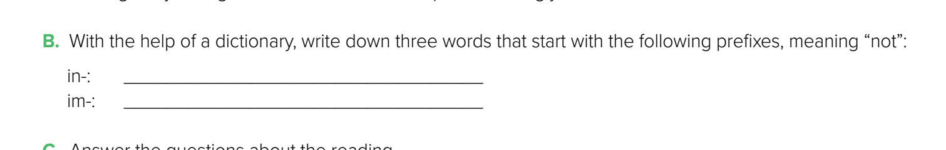
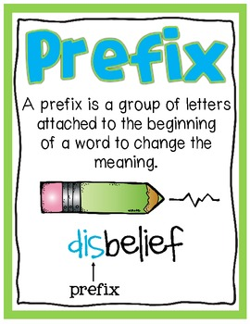
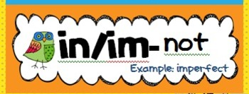
incorrect – incomplete – informal - invalid
impolite – impossible – impatient - immoral

Slide 15
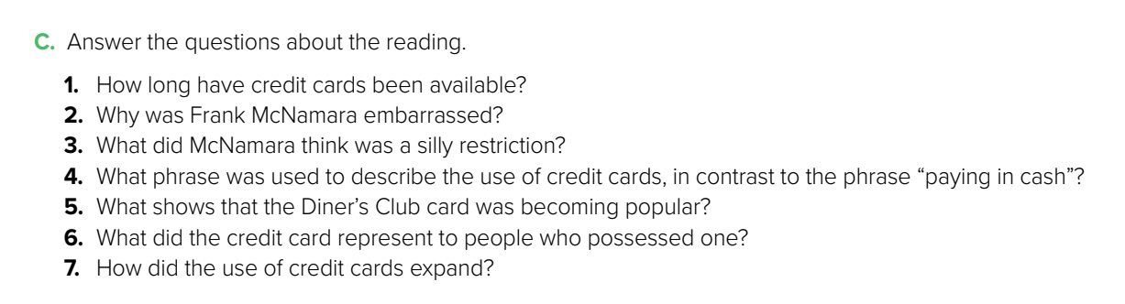

Since the 1950s.
He didn’t have enough money to pay for a business dinner.
He thought people should be able to spend what they could afford, not only what they are carrying in cash.
“charging it”
Hollywood made a film about it, and a board game called Diner’s Club was created.
It became a status symbol.
It started for use in restaurants and then expanded to other businesses and to other countries

Slide 16

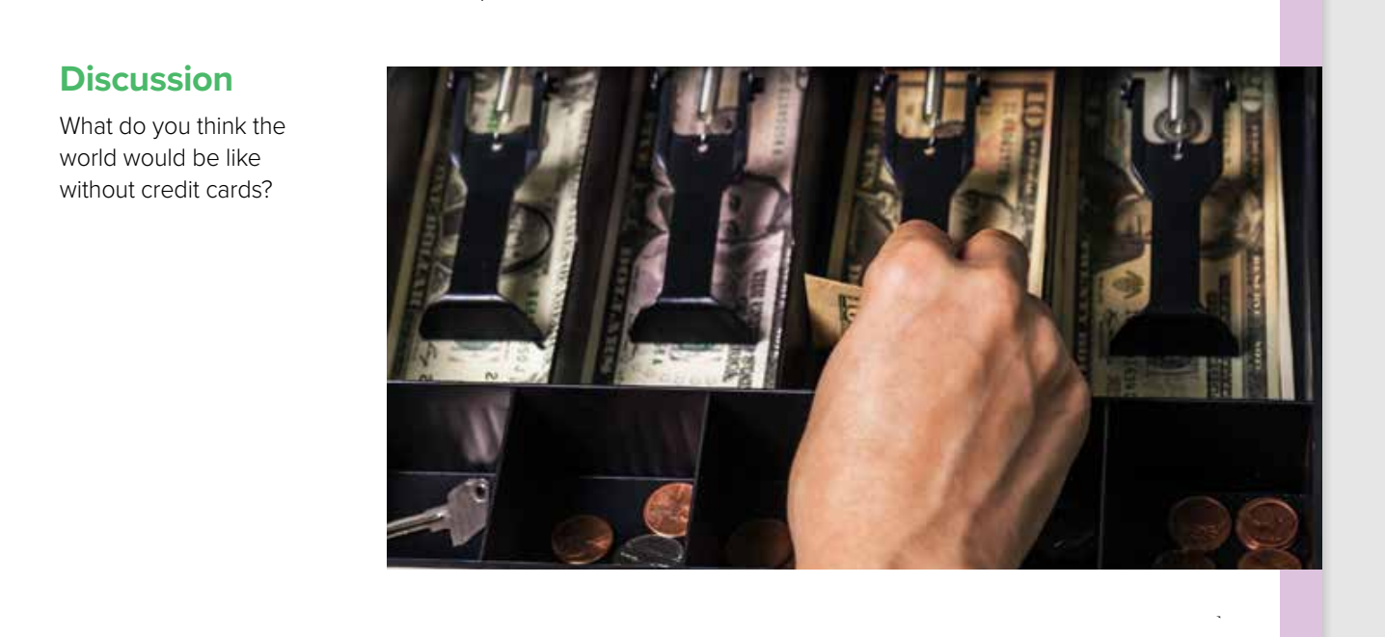


Slide 17
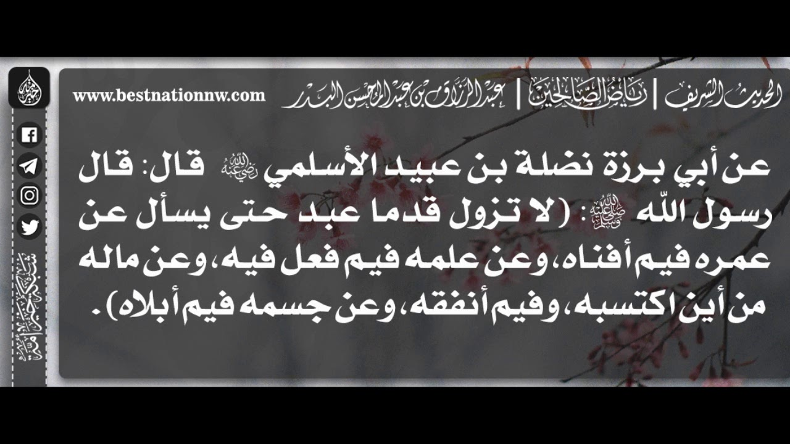
Remember ..

Slide 18
Homework
Workbook , exercise ( g) , p. (251)

Slide 19

THANKS!
Please keep this slide for attribution

Slide 20
ALTERNATIVE RESOURCES
Here’s an assortment of alternative resources whose style fits the one of this template:
Money infographics with different types of payment
Banking icons

