Slide 1
Unit 4
The Art of Advertising
Writing
Mega Goal 1.1
Done by: Entisar Al-Obaidallah

Slide 2
Lesson Objectives
Write notes about a product.
Discuss the reading passage.
Find out some information about a product.
Put the information on a timeline.

Slide 3

Open
Your student’s book ,
P. (56)

Slide 4
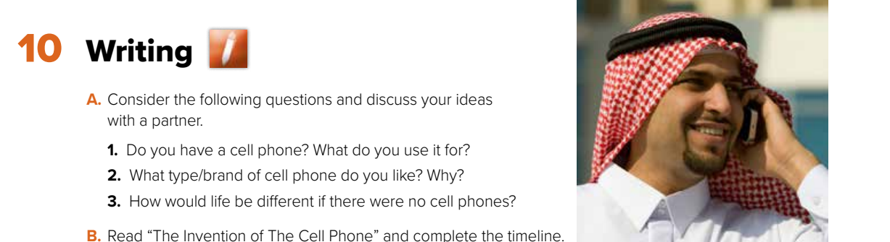
Let’s discuss the following questions

Slide 5
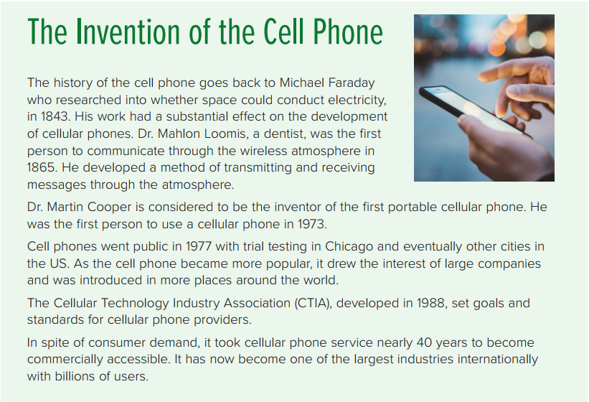

Is the cell phone a new invention?
When do you think it was invented?
What kind of information do you expect to find in the
text?

Slide 6
What is the title ?
Name three persons are mentioned in this text?
What does CTIA stands for?

Slide 7
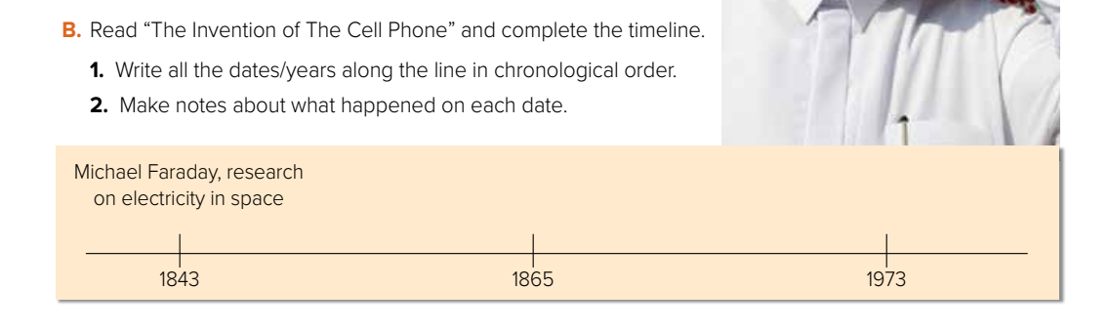
Dr. Mahlon Loomis, communication through wireless atmosphere
Dr Martin Cooper, first user of cellular phone
1977 Cell phones go public in USA
1988 CTIA, goals & standards for cellular phone providers

Slide 8
Open
Your student’s book ,
P. (57)

Slide 9
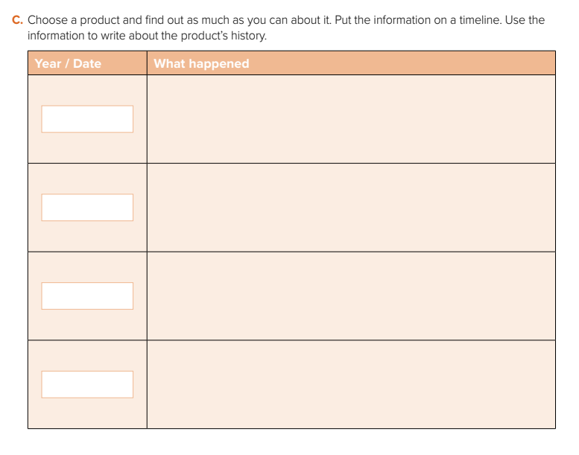
Steve Jobs announced the first iPhone
will be released.
Jan. 9 ,2007
June 11,2007
The first iPhone was released.
Apple released the iPhone 3G and launched apple store with an initial 500 applications available.
2008
Apple introduced the iphone 4S with
a beta version of Siri.
2011

Slide 10
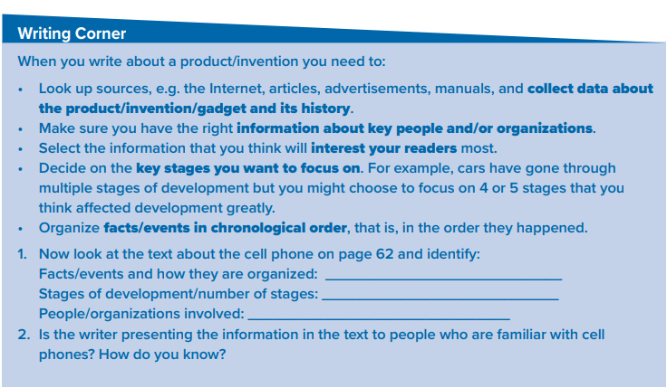
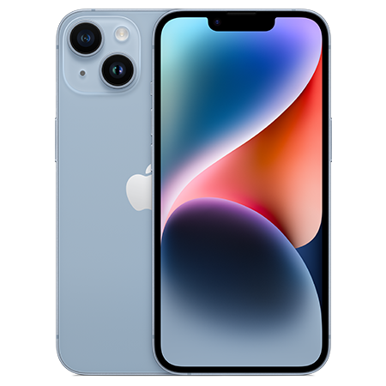
Follow these steps when you write about a product

Slide 11
Homework
Workbook P. (254) ,
exercise (K)

Slide 12

Thanks!

