Slide 1

Mega Goal 3.1
Unit4
The World of TV
Writing
Done by: Entisar Al-Obaidallah

Slide 2
Lesson Objectives
1- Give the reason for choosing the movie genre
2- Explain the reasons for disliking a movie.
3- Read the text for specific information
4- Use diagram to make notes before writing
5-Write an expository essay about the formula of TV film genre

Slide 3
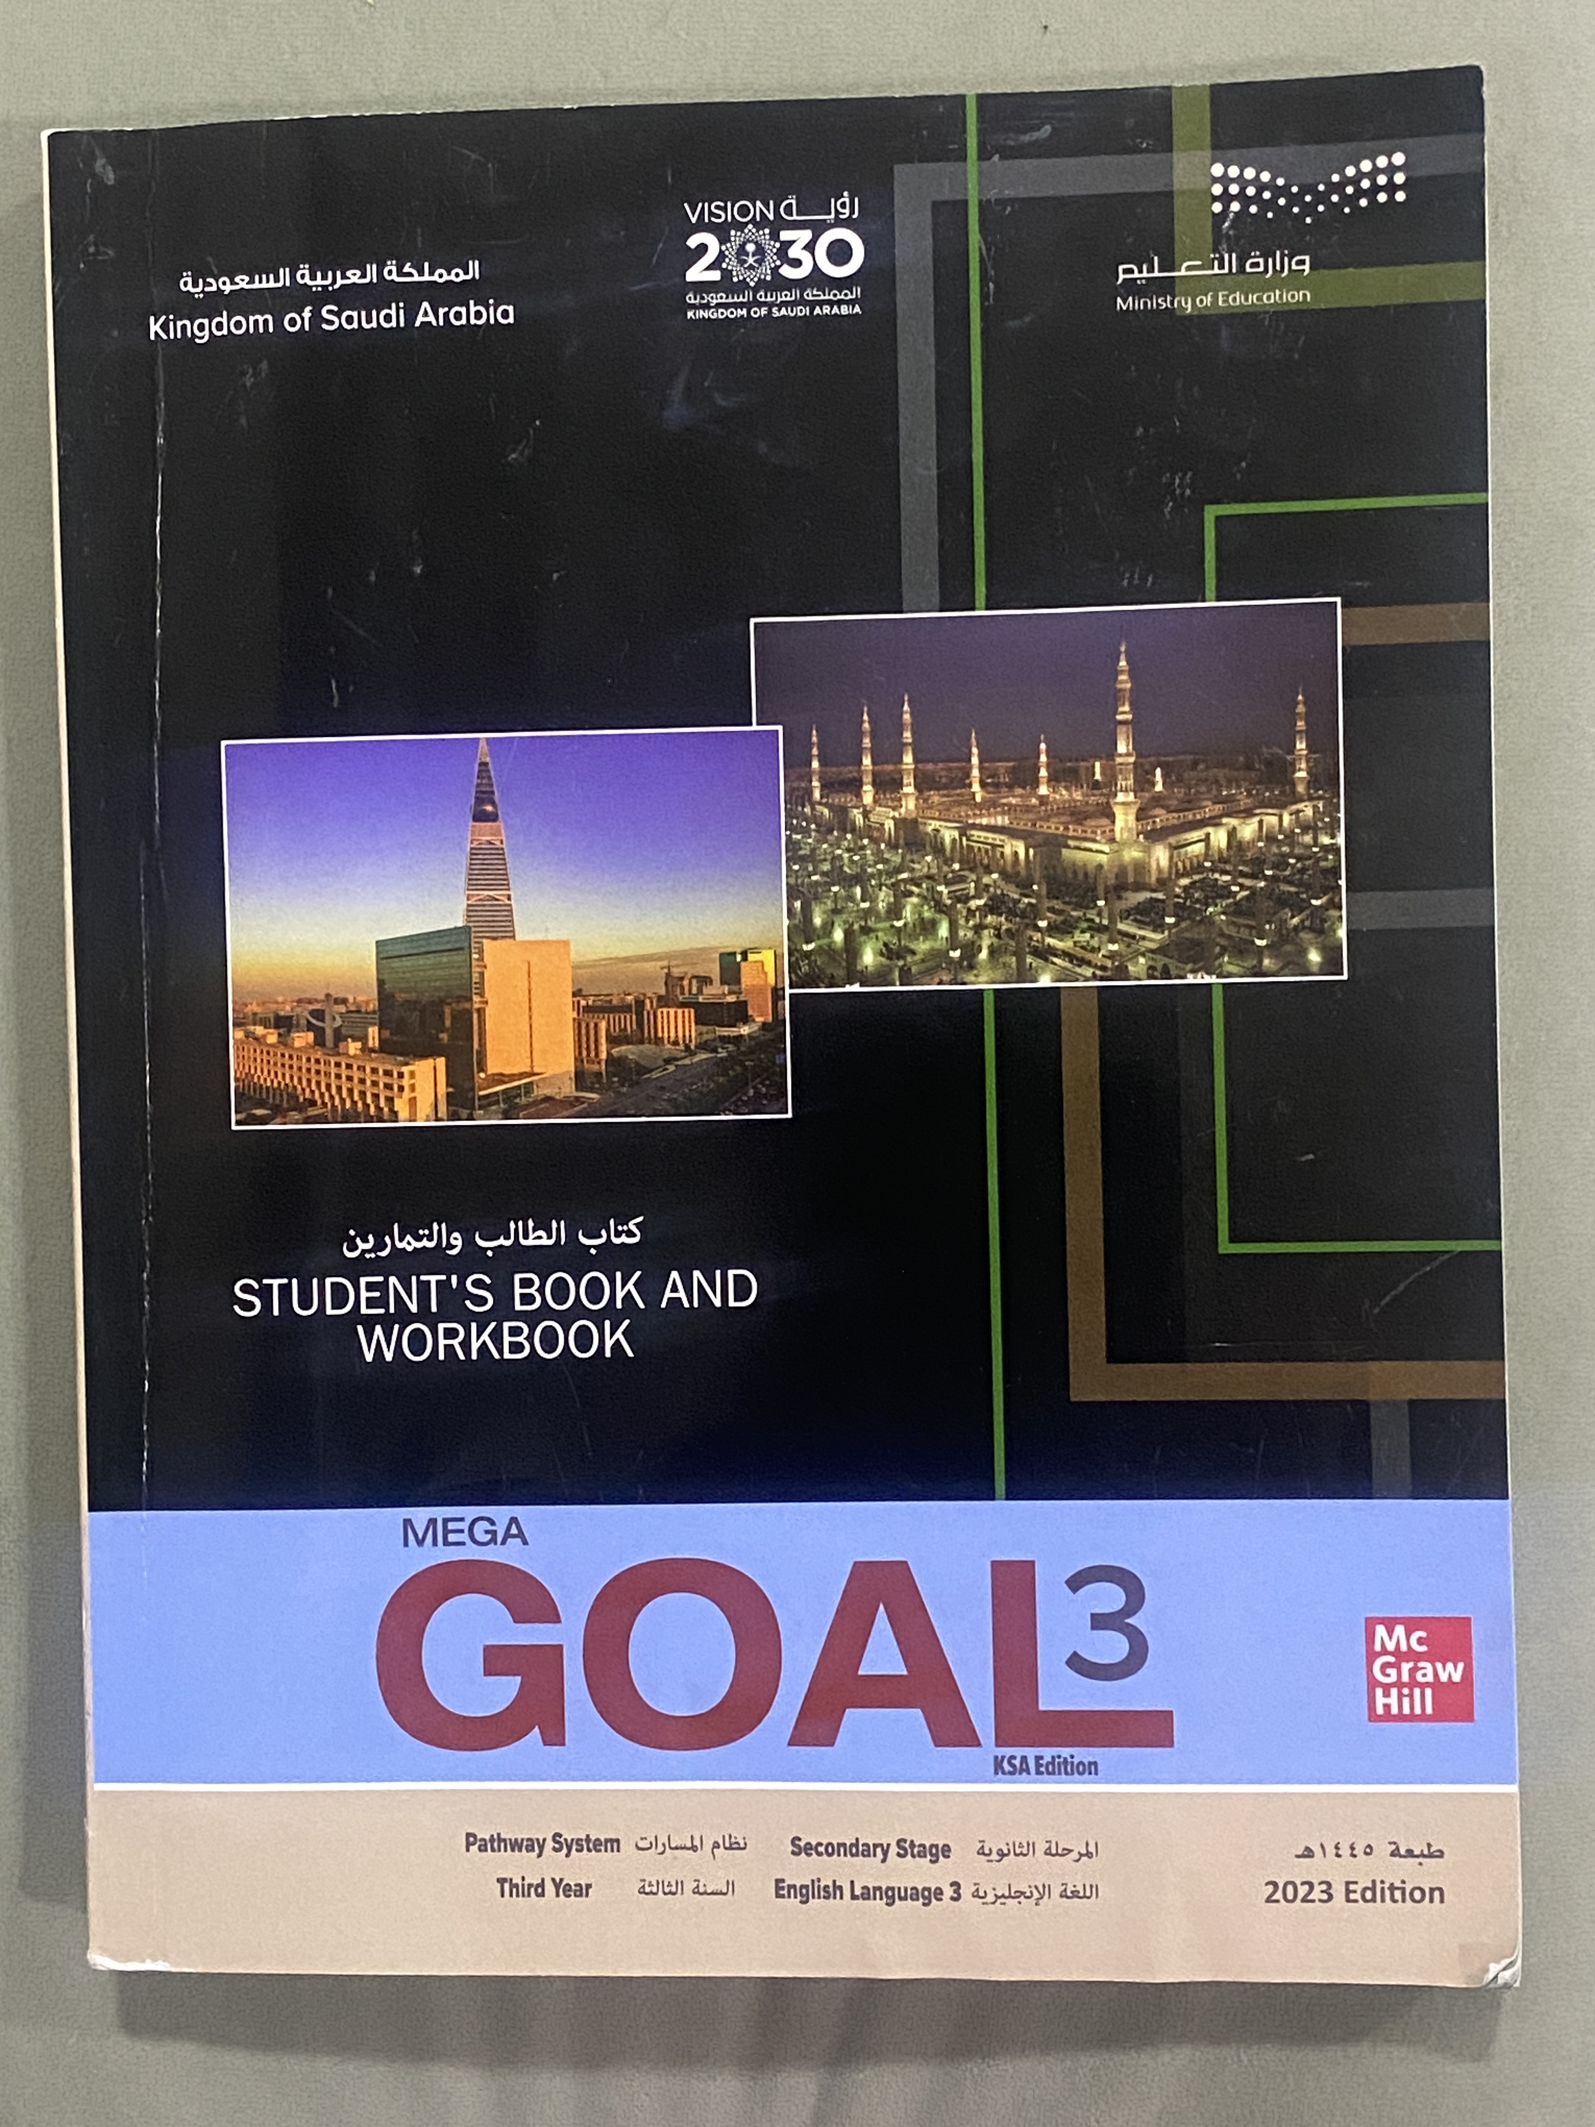
Open
Your student’s book
p. 62

Slide 4
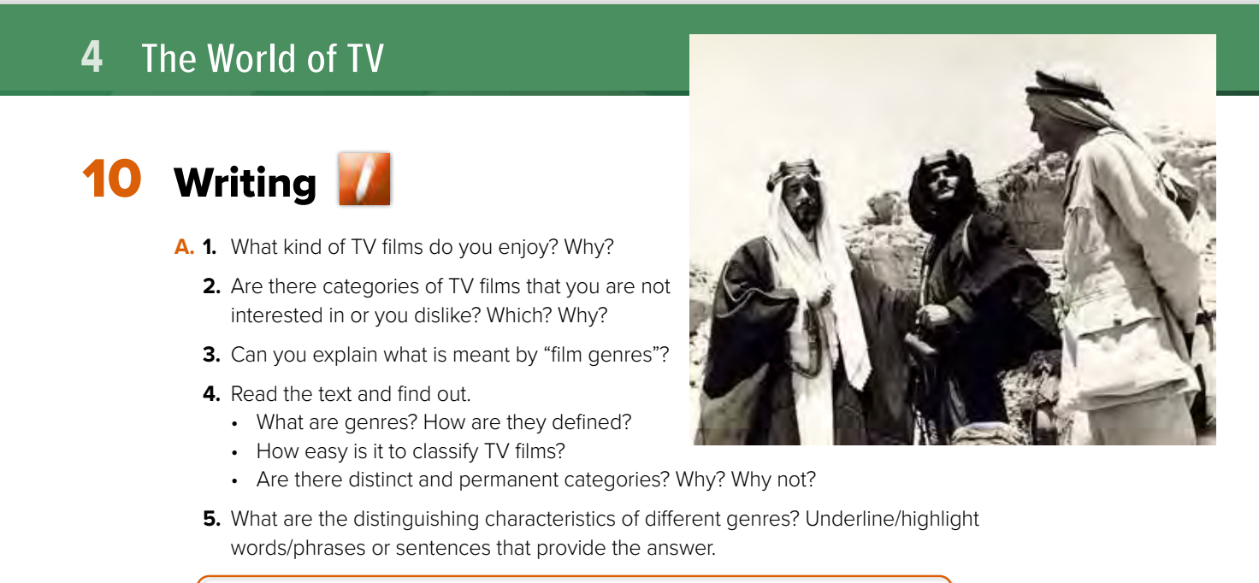

Slide 5
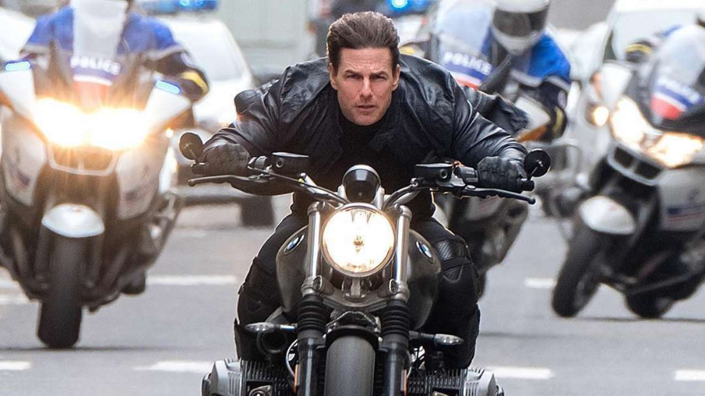

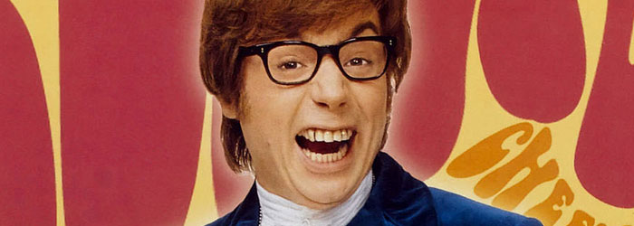
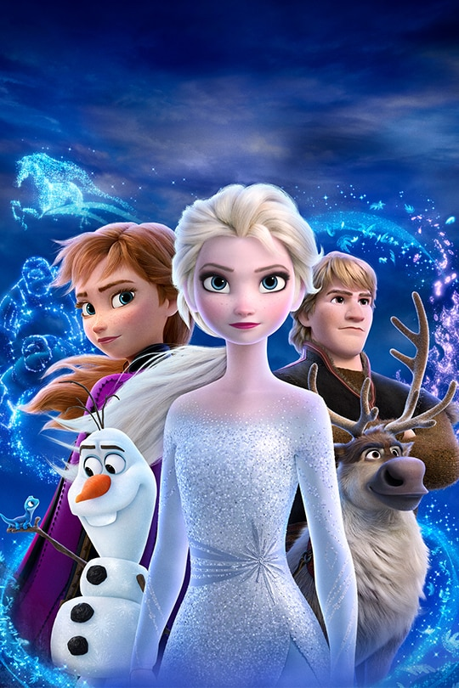

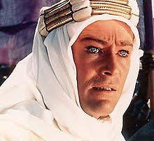
What kind of TV films do you enjoy?
comedy
action
adventure
drama
biopics
animation

Slide 6
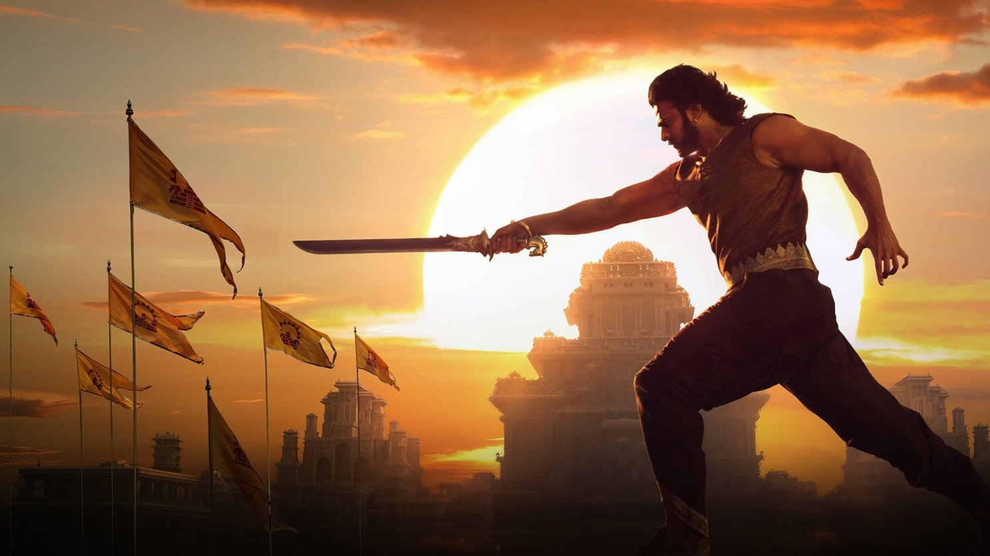


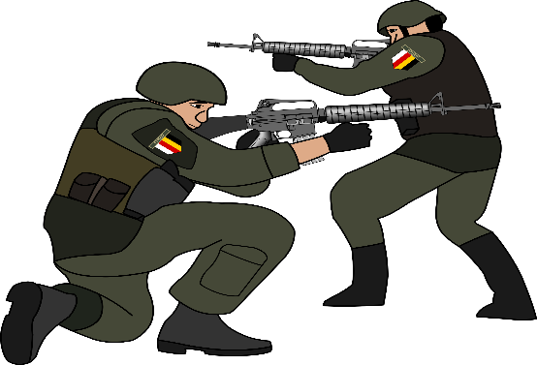
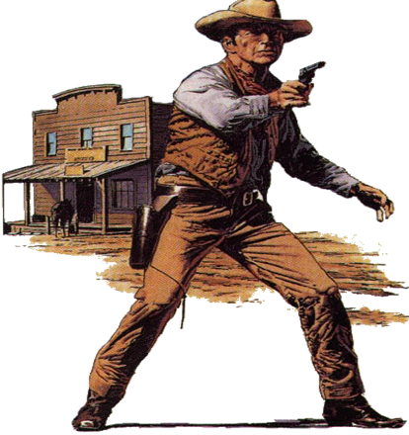
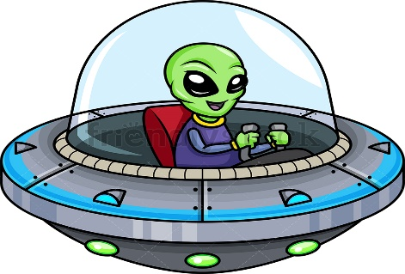
What kind of TV films do you enjoy?
epic
detective
horror
war
western
Science fiction

Slide 7
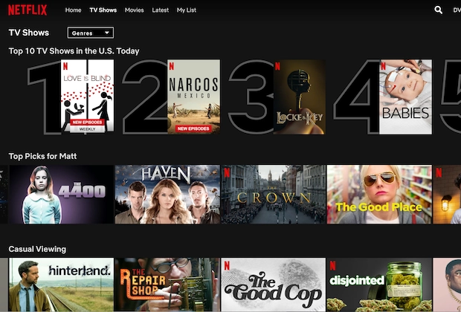
Are there categories of TV films that you are NOT interested in or you dislike? Which? Why?

Slide 8

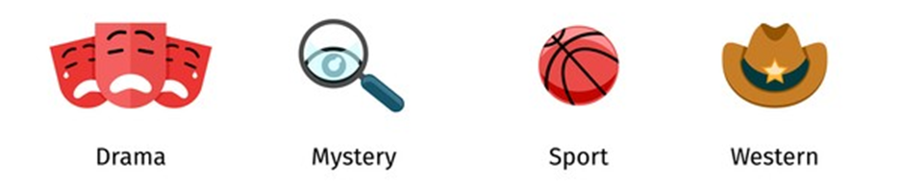



Print master
Can you explain what is meant by “film genres”?
type
genre
category

Slide 9

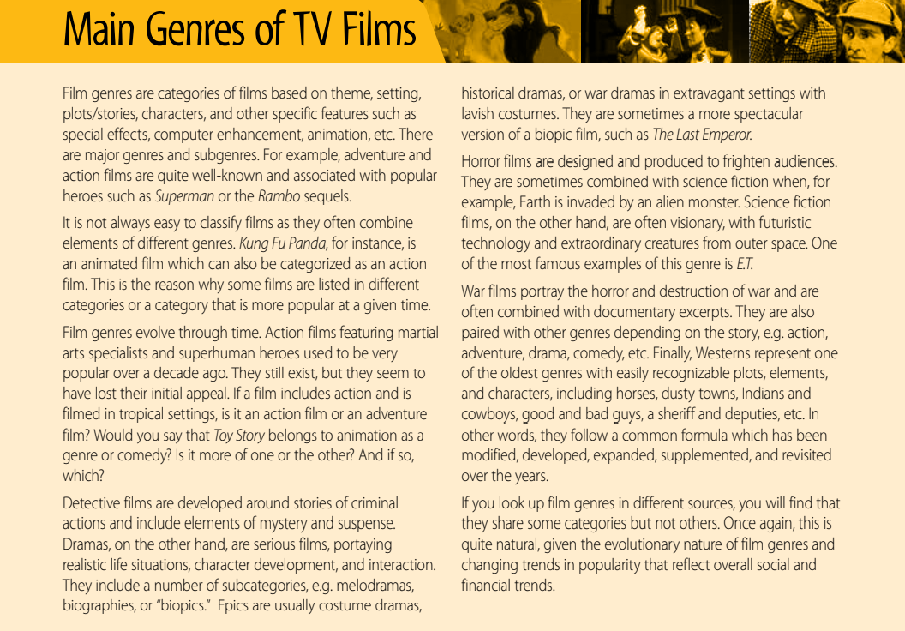
Read the text and answer the following question.

Slide 10
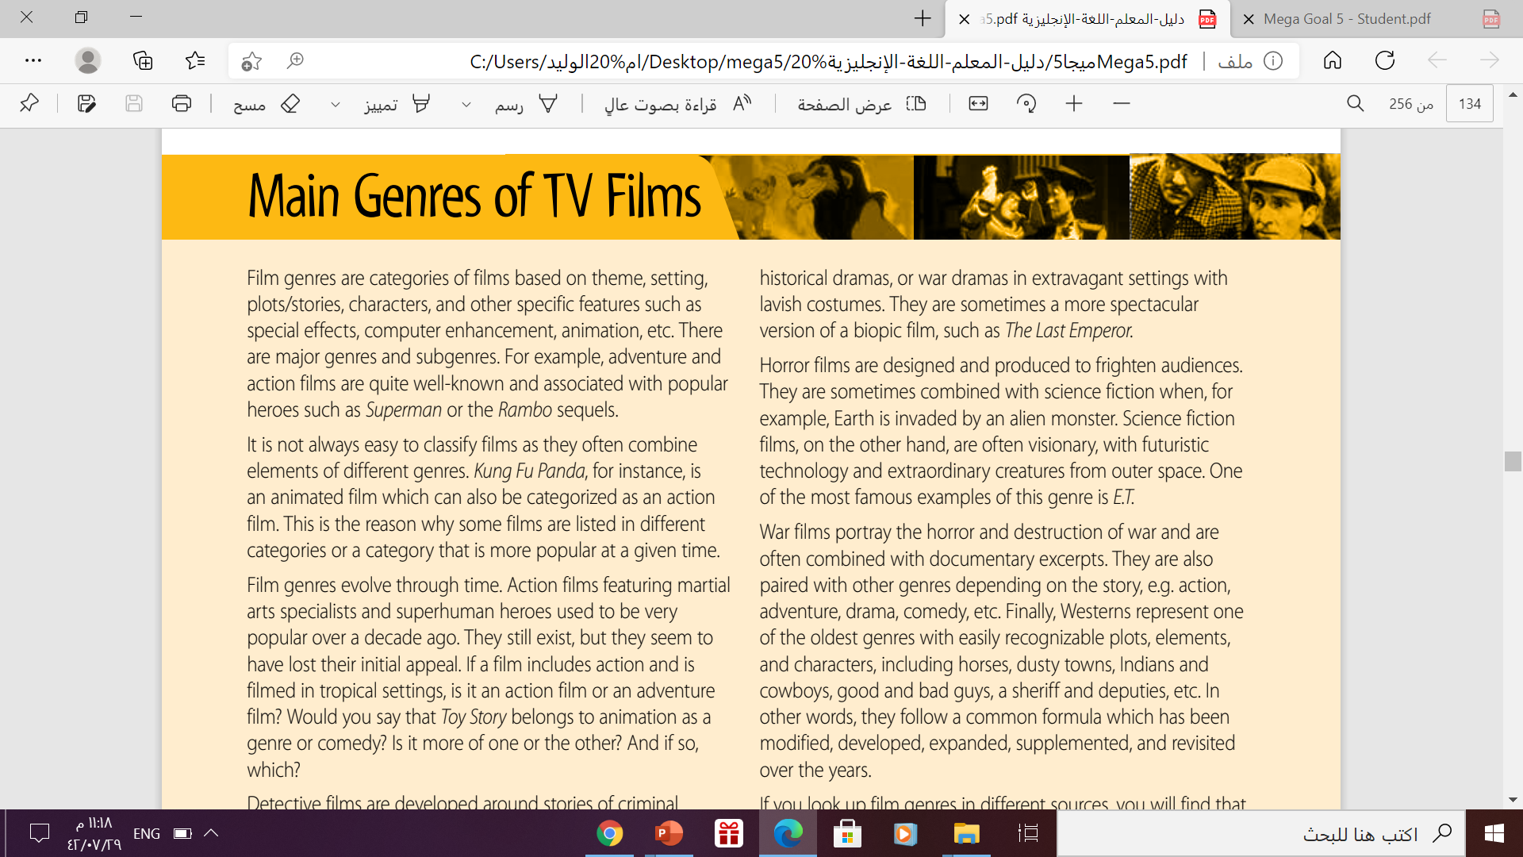
Print master
What are genres? How are they defined?
Categories of films based on theme, setting, plots/ stories, characters, and other specific features such as special effects, computer enhancement, animation, etc.
There are major genres and subgenres.

Slide 11

How easy is it to classify TV films?
It is not always easy to classify films as they often combine
elements of different genres.

Slide 12
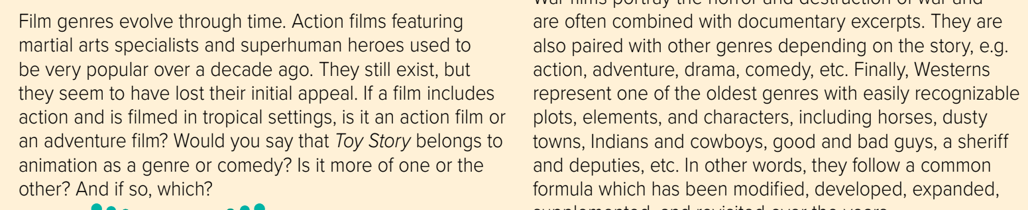
Are there distinct and permanent categories?
Why? Why not?
→No there aren’t because film genres evolve according to appeal.
→For example action films with superhuman heroes used to be popular over a decade ago. They’re not so popular any longer.

Slide 13
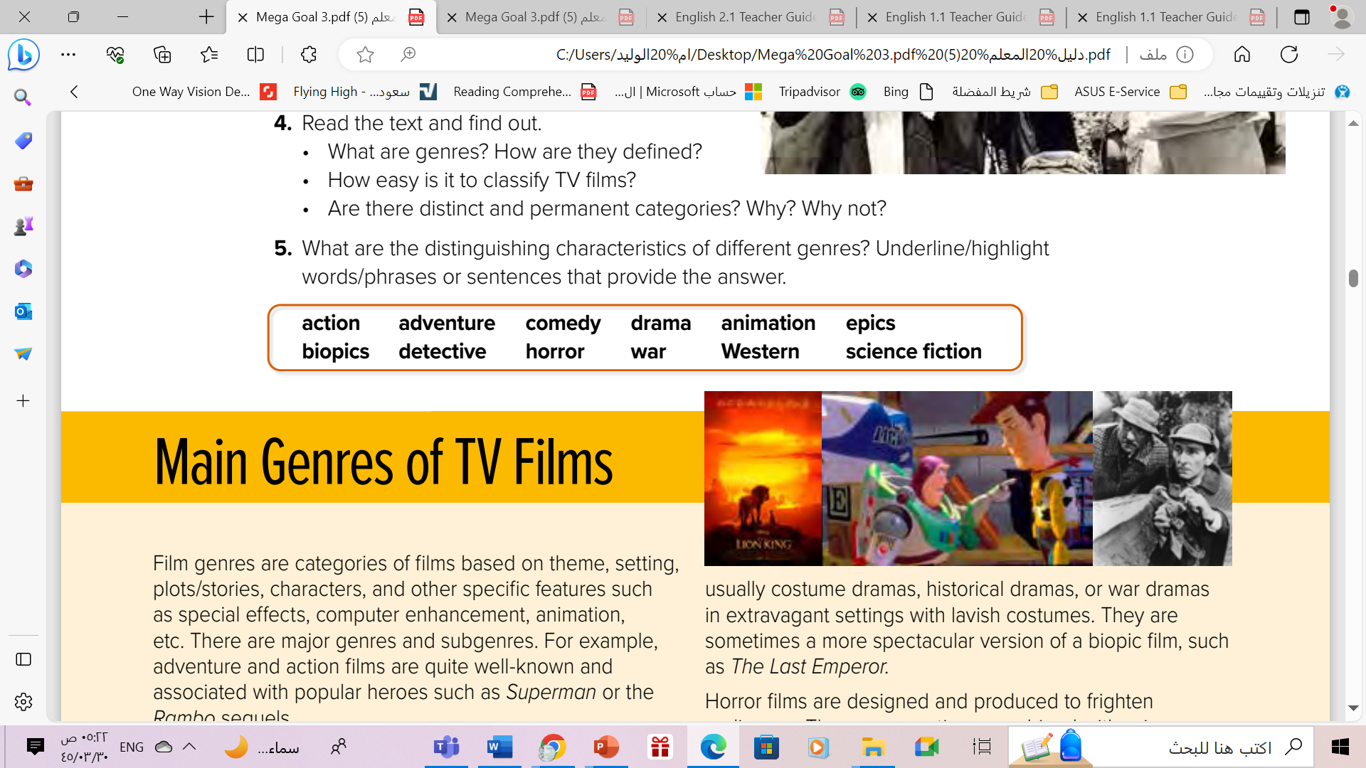

Slide 14


Slide 15
Open
Your student’s book
p. 63

Slide 16
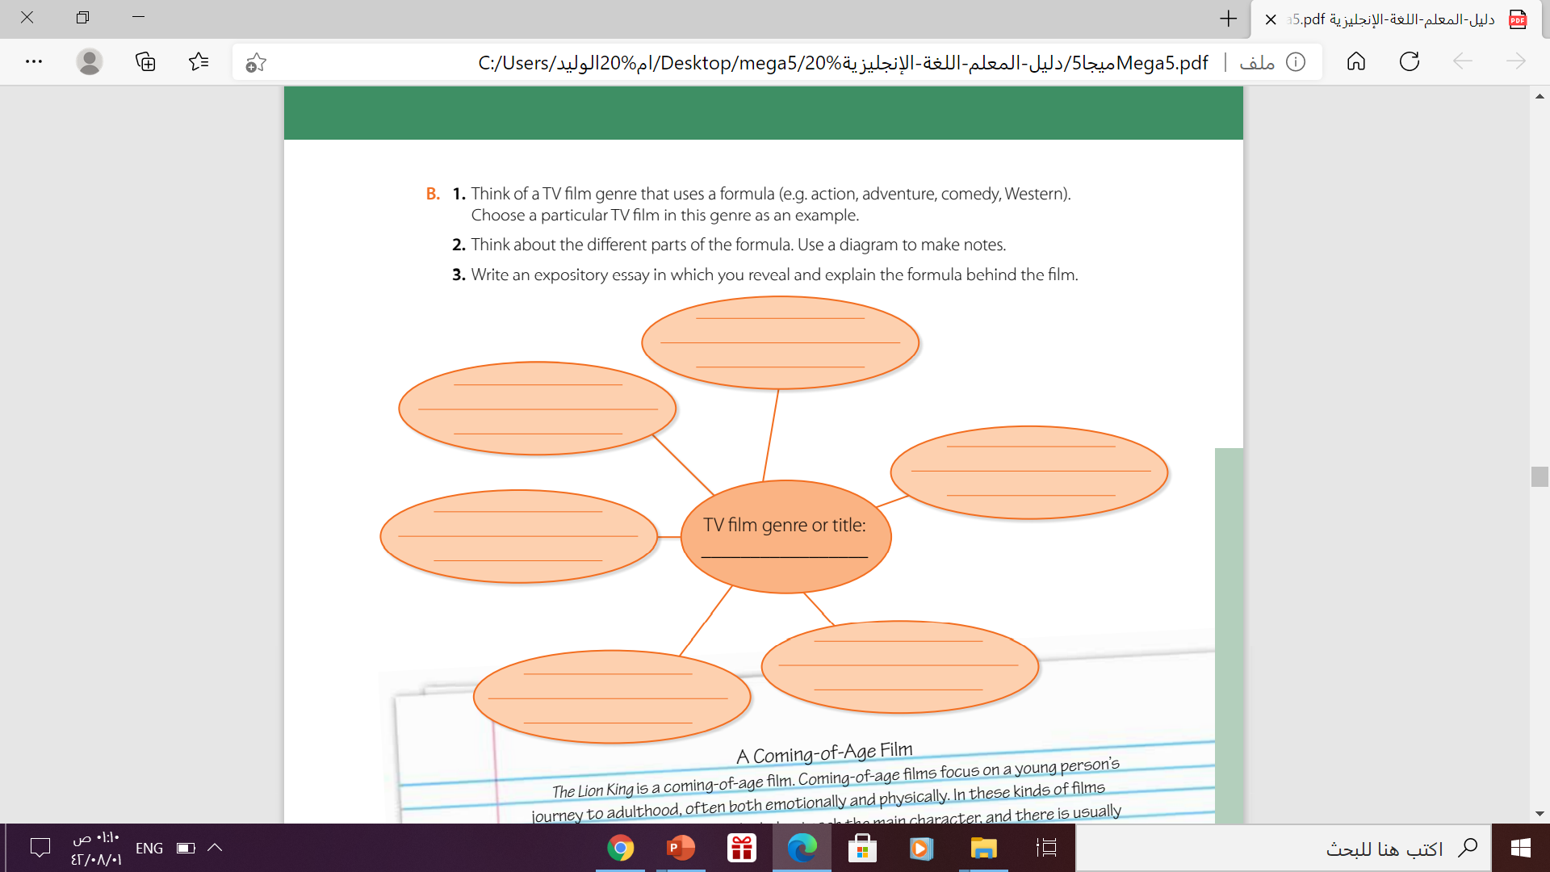
Health, social and
financial challenges
Bonds , feuds , and losses
dramedy
Emotional effects
Drama
Serious , real ,
new attitude
family

Slide 17
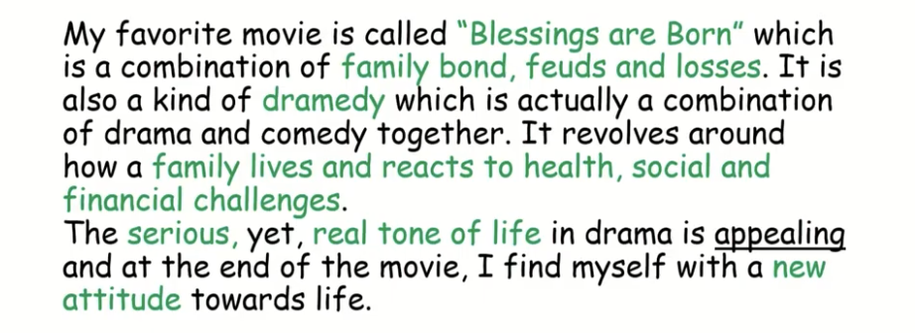
This is the essay:
Blessing are Born

Slide 18
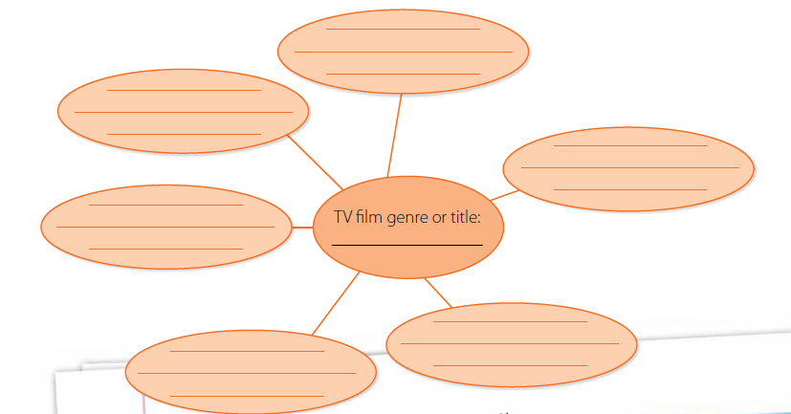
Another Example:
This genre reflects peoples’ lives
Simba had to accept his role as the king of the jungle
Focus on a young person’s journey to adulthood
Lion king is a good example
A coming-of-age
Film/ Lion King
There is a role model who teaches the main character
There is a test that the main character undergoes

Slide 19
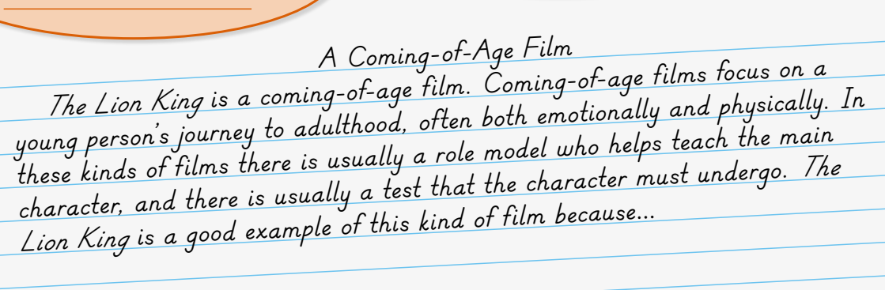
The Expository Essay

Slide 20
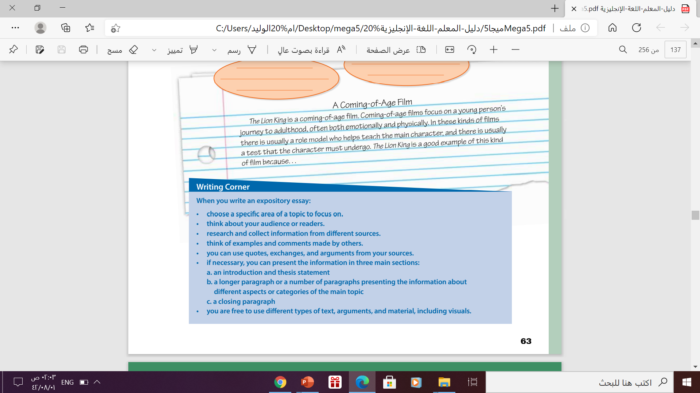
Follow these steps to write the expository essay

Slide 21

Let’s Practice
https://wordwall.net/play/12413/149/419

Slide 22

Thanks!

