Slide 1
Unit 4
The Worlf of TV
Grammar
Mega Goal 3.1
Done by: Entisar Al-Obaidallah

Slide 2
Lesson Objectives
01
02
03
04
Join
Rewrite
Sentences using paired conjunction correctly
The sentences using
a coordinating conjunction correctly
Form
Apply
Independent clauses with And , But, Or, So , and Yet
The rules to do the exercises correctly

Slide 3
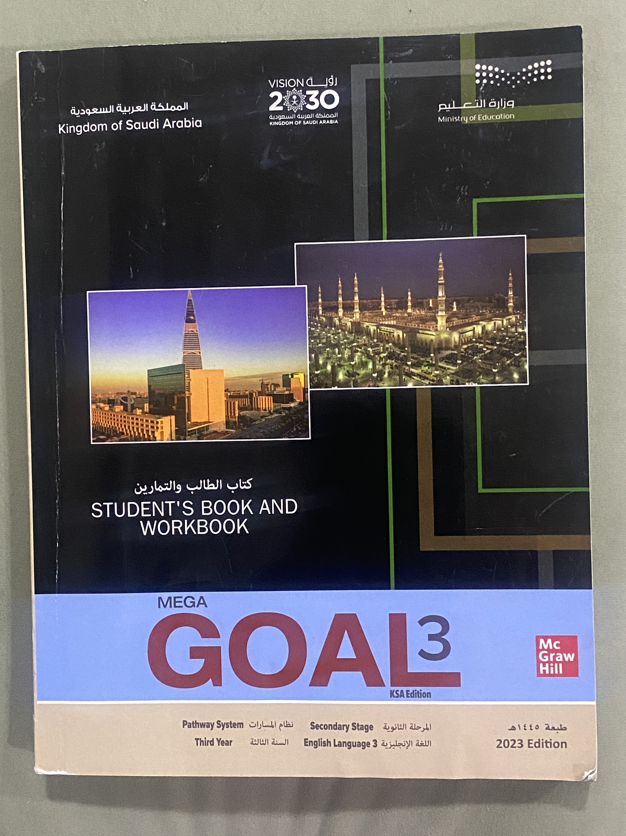
Open
Your student’s book p. (56)

Slide 4
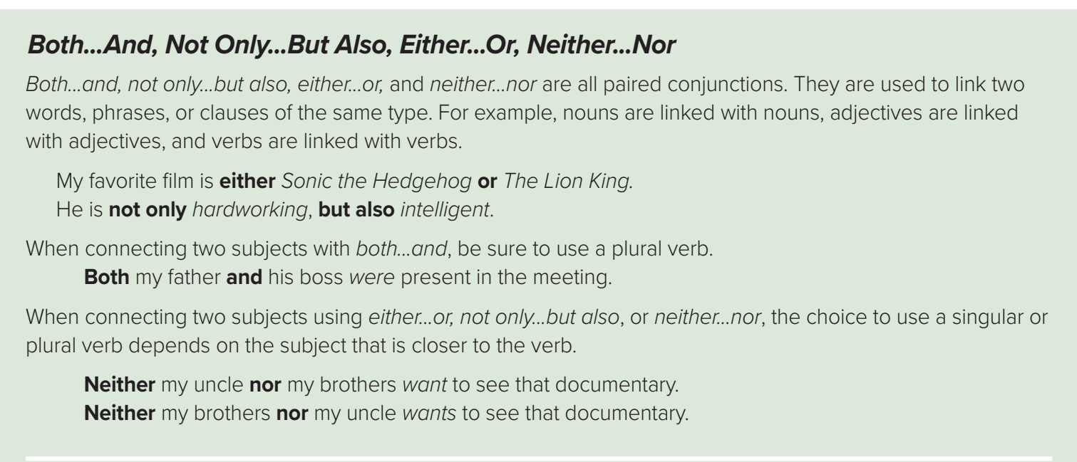
Conjunctions

Slide 5
Conjunctions
Warm Up
What are Conjunctions ?
Conjunctions are ( joiners) words that link other words, phrases, or clauses together to make them one sentence.

Slide 6
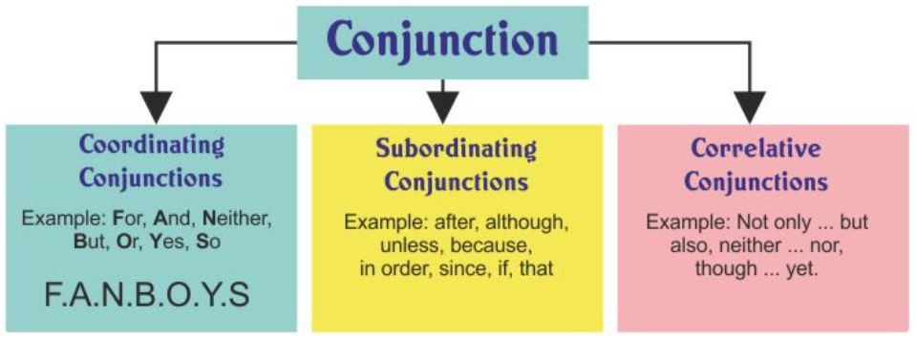
Conjunctions
Warm Up
How many kinds of conjunctions are there?
There are three kinds

Slide 7
01
Correlative Conjunctions

Slide 8
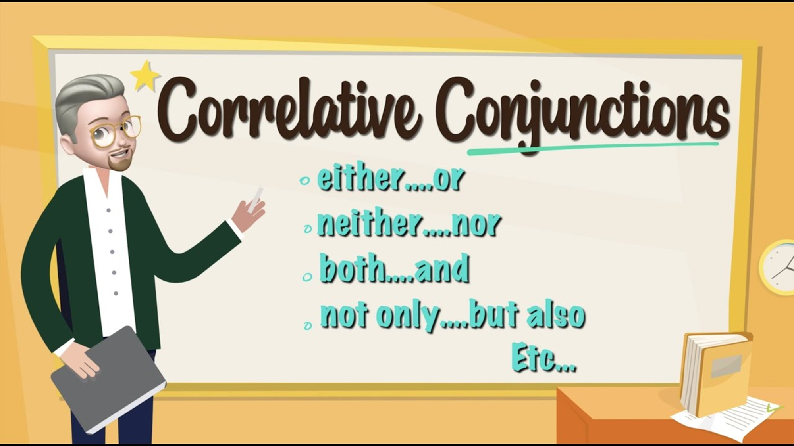

Slide 9

Correlative Conjunctions ( paired )
→Correlative conjunctions work in pairs to join words, phrases, or clauses. It is also called
( paired conjunction)
→The common correlative conjunctions are either...or, neither...nor, both...and, not only...but also .

Slide 10
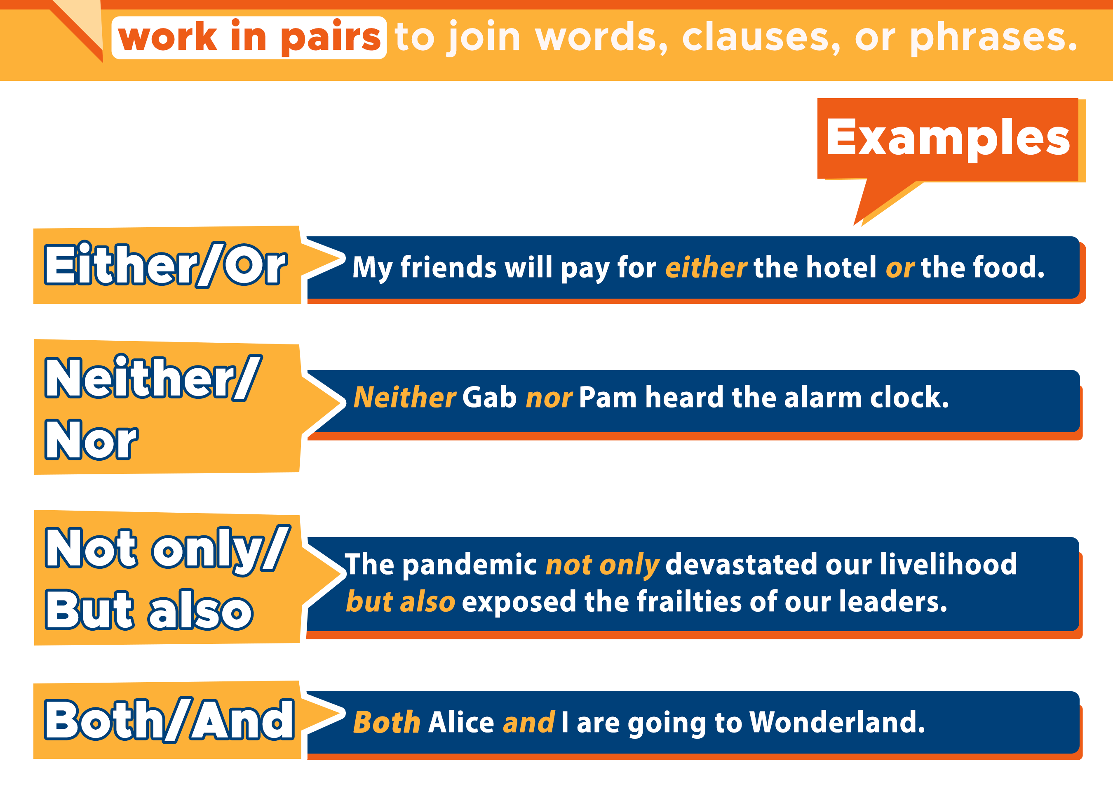

Slide 11
Either..or
The expression either … or means to make a choice between the first one or the second one..
Example:
You either cook or clean the house
Ali can either play football or basketball.
We could either go to Dammam or to Al-Khobar.

Slide 12
Neither …..nor
Neither … nor is used to join two negative or contrast ideas. Neither makes negative statement about two people or two things
Example:
Neither Ali nor Ahmed could solve the problem.
She neither speaks English nor French .
I will neither call him nor send him a message anymore.

Slide 13
Both……and
Both …… and is used to talk about two people, things, places or actions within the same context.
Example:
Both Sara and Nora are from Kuwait.
He can speak both English and Spanish fluently.
I spoke to both the teacher and the headmaster about your problems.

Slide 14
Not only….but also
Not only…but also is used to connect and emphasize two phrases or two words at the same position.
Example:
- He is not only hardworking but also intelligent
- They visited not only Makkah but also Al-Madinah
- I like not only cheesecake but also cake

Slide 15
02
Independent clauses with
And , But , Or , So , & Yet

Slide 16
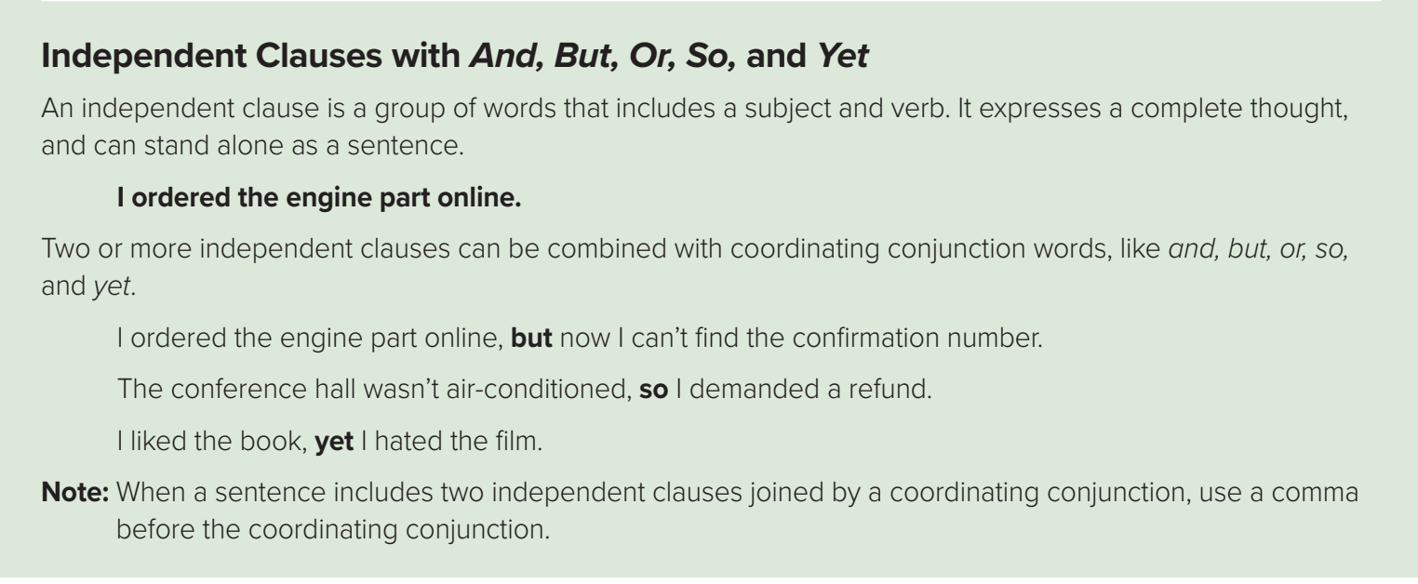
Coordenating Conjunctions
What is independent clause?
An independent clause is a group of words that includes:
subject + verb
It expresses a complete thought and can stand alone as a sentence

Slide 17
Example:
I ordered the engine part online
subject
verb
Two or more independent clauses can be combined with Coordinating conjunction words like :
and
but
or
so
yet
I ordered the engine online ,but I can’t find the confirmation number .
1ST clause
Coordinating
conjunction
2nd clause

Slide 18
Note
Neither …nor
not only …but also
Either .. or
Neither …nor
When connecting
two subjects with
both...and, be
sure to use
a plural verb
verb agrees with
2nd noun
verb agrees with
2nd noun
verb agrees with
2nd noun

Slide 19


Slide 20
https://wordwall.net/ar/resource/12183617
https://wordwall.net/play/12185/577/170
https://wordwall.net/resource/12153645

Slide 21
Homework
Workbook p.(252) ,
exercise ( D)

Slide 22

THANKS

