Slide 1
TV
Unit 4
The World of TV
Listen & Discuss
Done by : Entisar Al-Obaidallah

Slide 2
01
02
Lesson
Objectives
03
04
Talk
About TV films and
documentaries
Identify
genres of TV films
Listen
For specific information
Answer
Some comprehension questions

Slide 3

Open
Your
student’s book
p. (48-49)

Slide 4
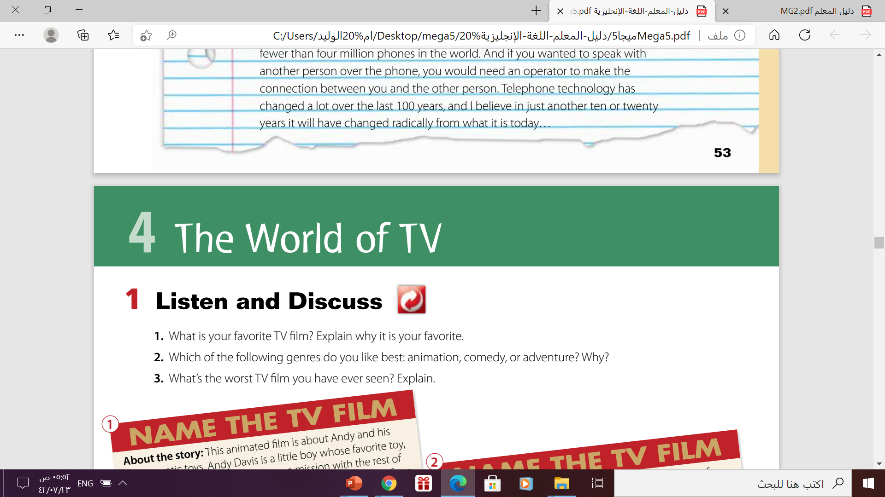
TV films
What is your favorite TV film ? Why ?

Slide 5
Which of the following genres do you like the best ?
Adventure
animation
reality
comedy
fantasy
Drama
Horror
Science fiction
policy
Romance

Slide 6
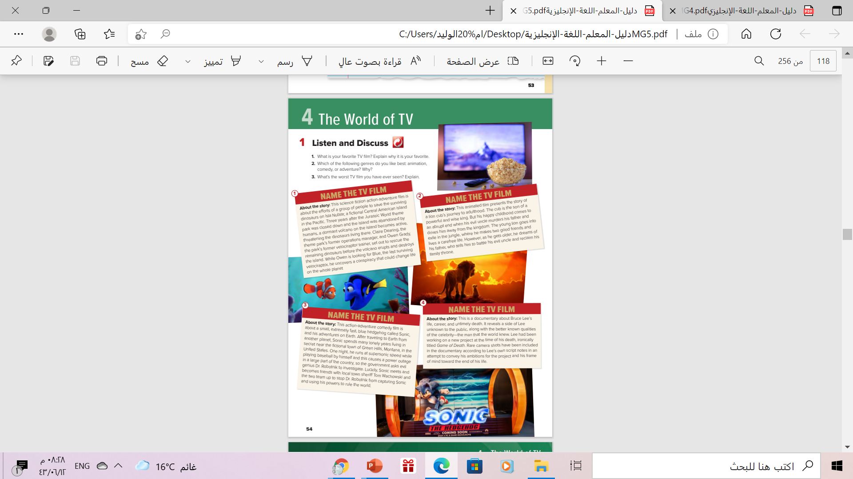
1

Slide 7


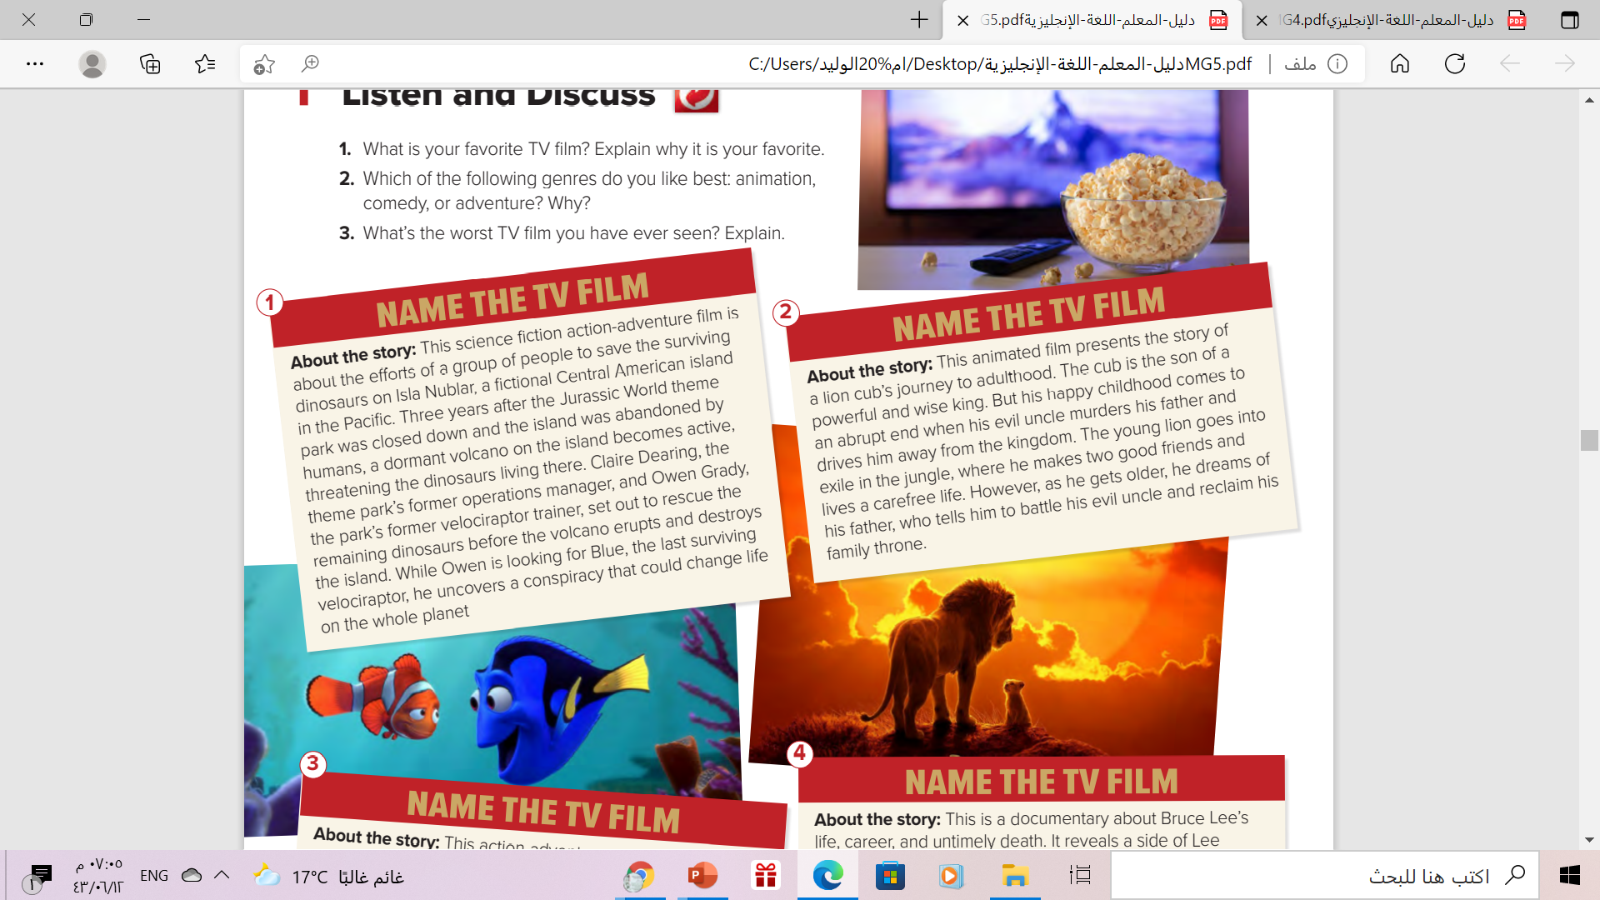

01

Slide 8

The film is : Jurassic World: Fallen Kingdom

Slide 9
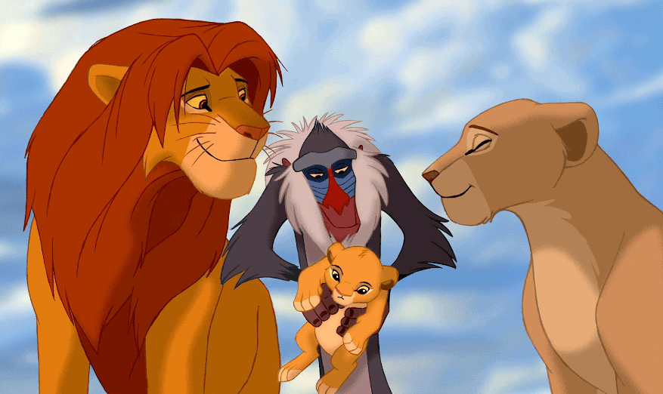
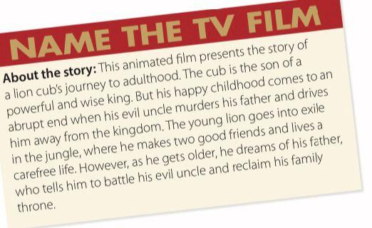
02

Slide 10

The film is :
The Lion King

Slide 11
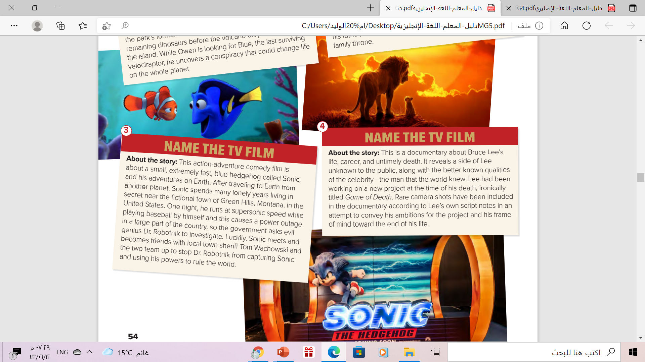
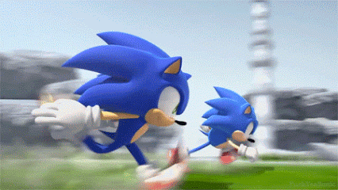

03
3

Slide 12


The film is :
Sonic the Hedgehog

Slide 13
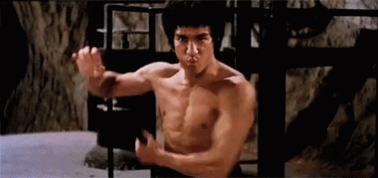

04

Slide 14

The film is :
Bruce Lee: A Warrior’s Journey

Slide 15
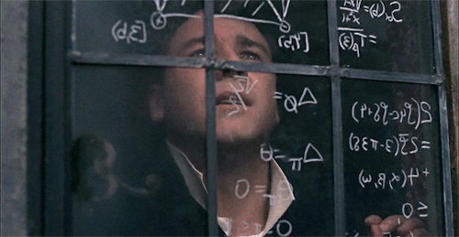
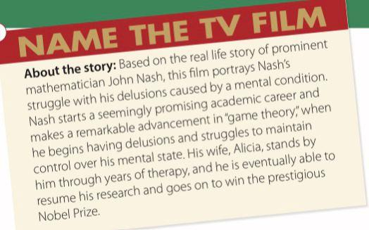
05

Slide 16

The film is :
A beautiful Mind

Slide 17





Films genres are :
Science fiction
animation
Action-
adventure
documentary
biography

Slide 18
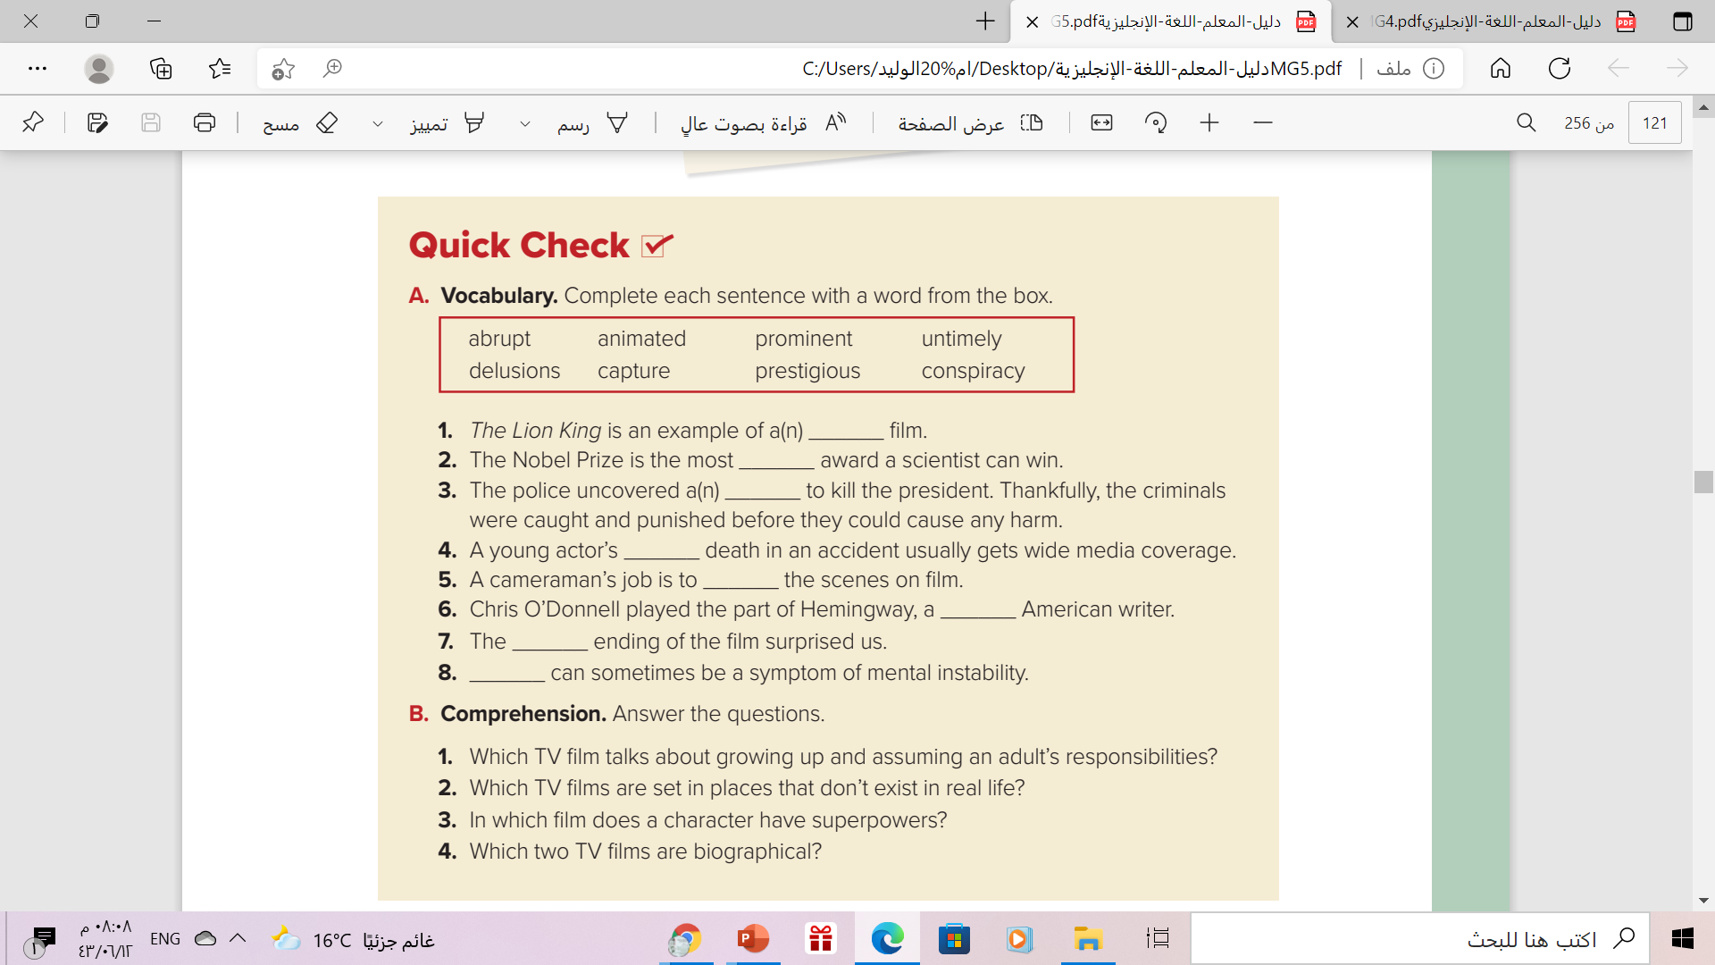
animated
prestigious
conspiracy
untimely
capture
prominent
abrupt
delusion

Slide 19
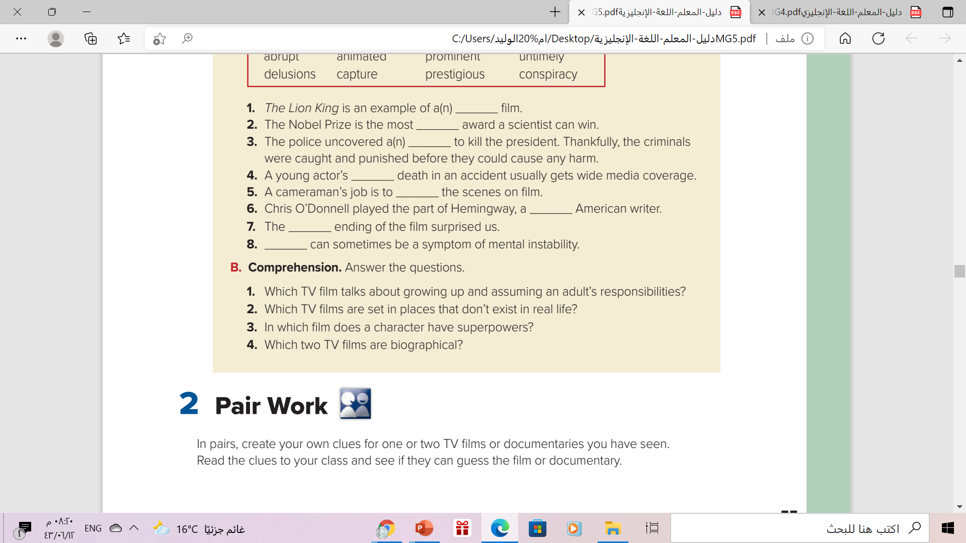
The Lion King
Jurassic World: Fallen Kingdom
Sonic the Hedgehog
Sonic the Hedgehog
Bruce Lee: A Warrior’s Journey
A Beautiful Mind

Slide 20
Lets practice
https://wordwall.net/resource/8539519
https://wordwall.net/play/12132/061/71

Slide 21


Slide 22
Homework
Your workbook p.251
exercise(A)

Slide 23

Thank you!

