Slide 1
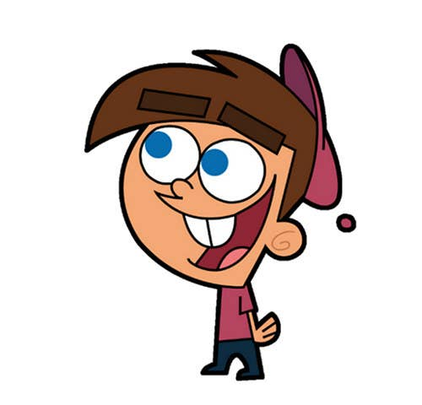


Welcome to class
T.Hanan Allaheeb

Slide 2
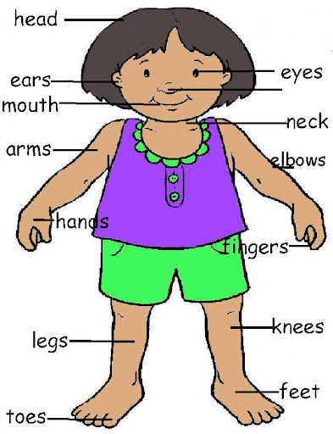
My body

Slide 3
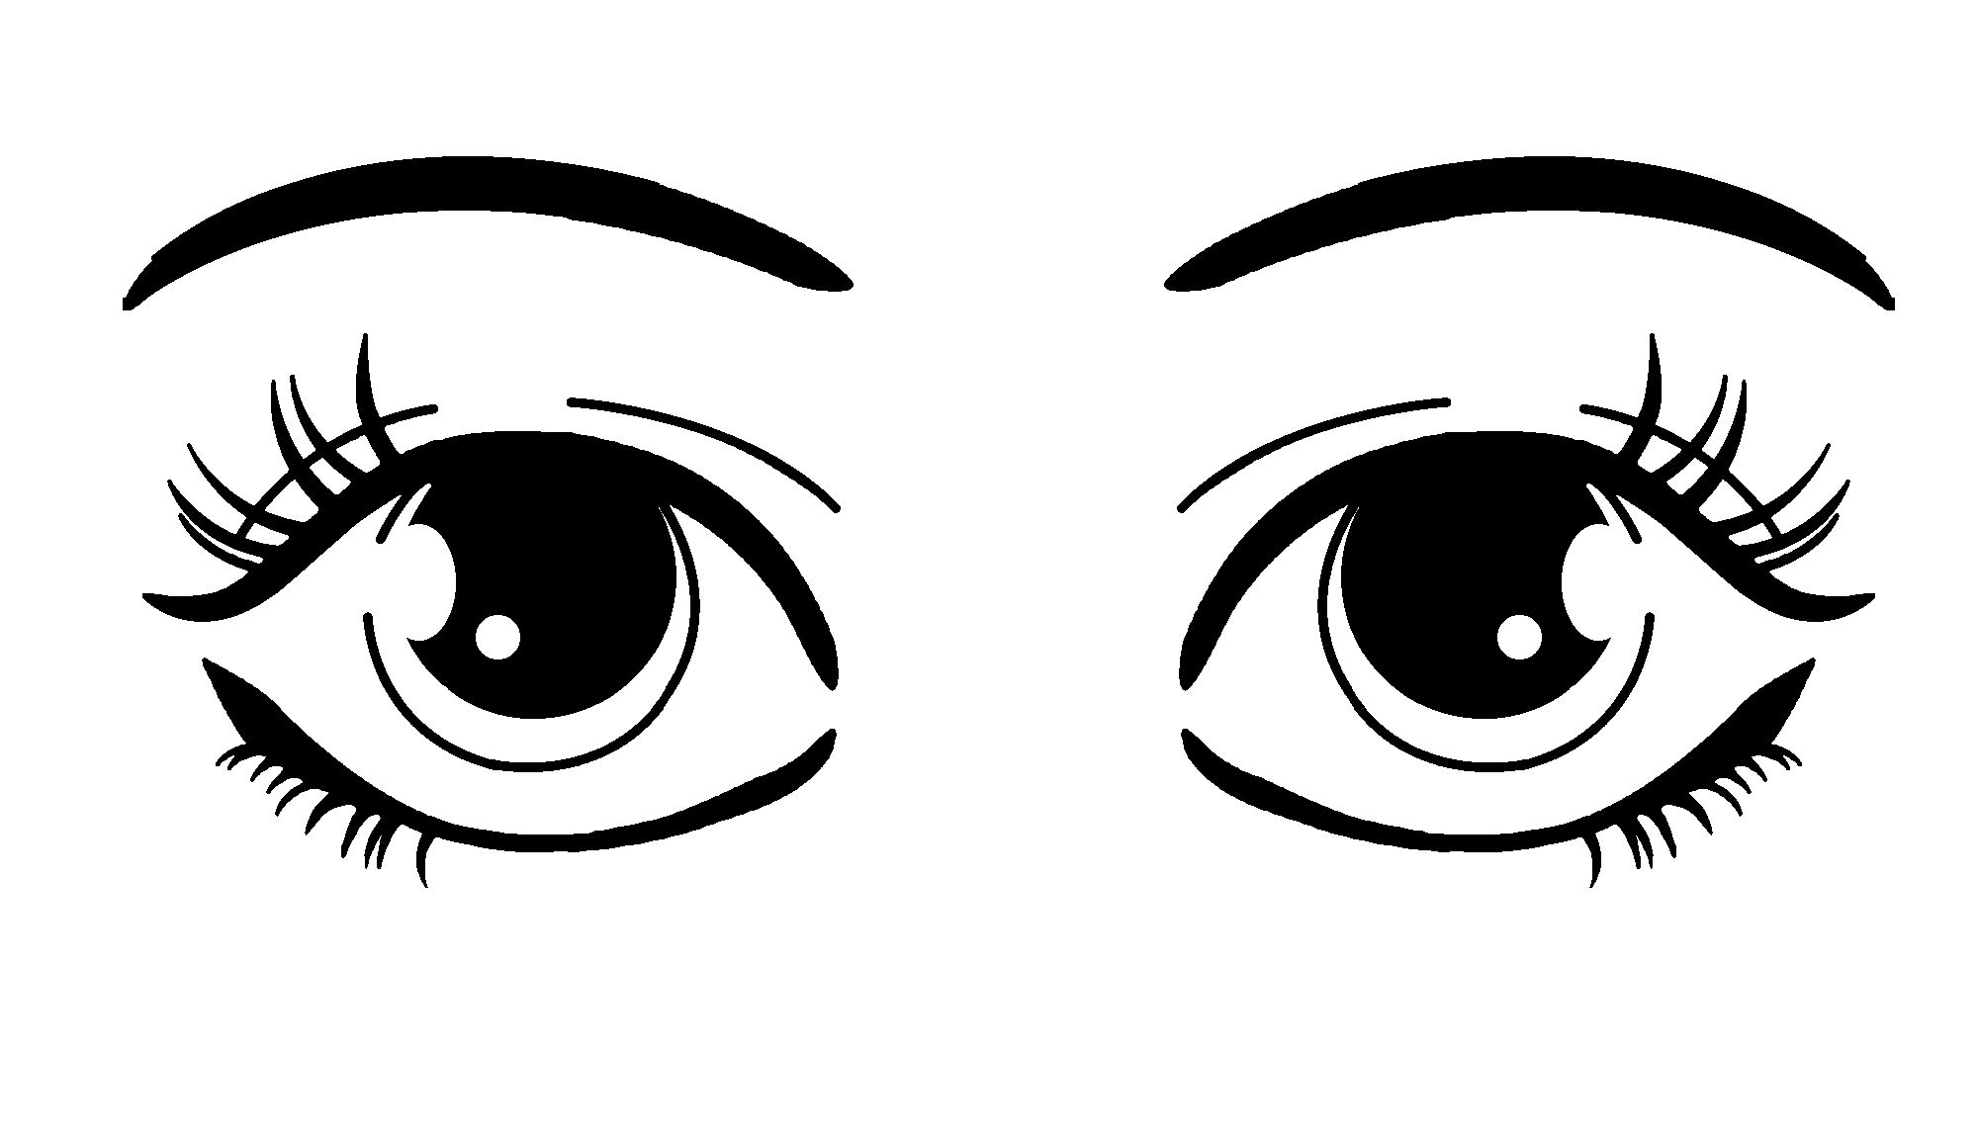
Eyes

Slide 4
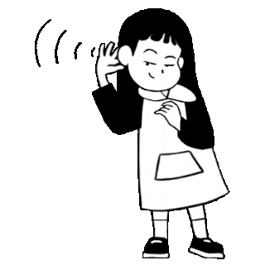
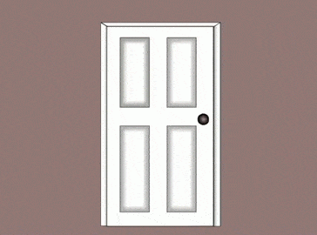
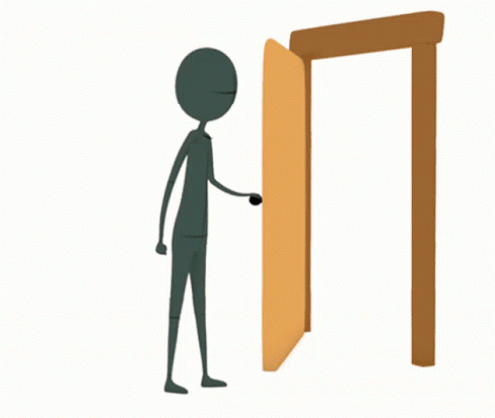
close
Listen
open

Slide 5

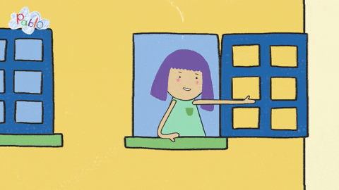

Say the words for the pictures

Slide 6


Listen
Open your eyes
Close your eyes

Slide 7

Listen
Say Yes or NO

Slide 8

Listen
Say Yes or NO

Slide 9
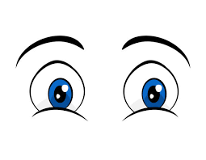
Listen
Say Yes or NO

Slide 10

Listen
Say Yes or NO

Slide 11
Listen
Say Yes or NO

Slide 12

Listen
Say Yes or NO

Slide 13
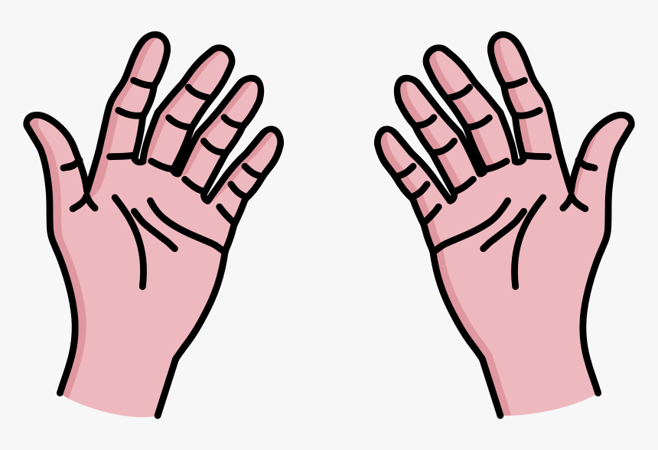
hands

Slide 14

Raise your hands
Listen

Slide 15

Clap your hands
Listen

Slide 16

Listen
Say Yes or NO

Slide 17

Listen
Say Yes or NO

Slide 18
Listen
Say Yes or NO

Slide 19

Listen
Say Yes or NO

Slide 20


Say the sentences for the pictures

Slide 21

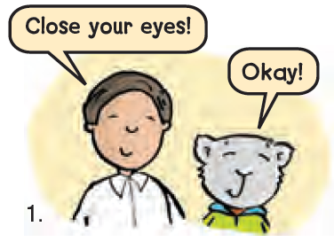
Listen
Practice and do in pairs

Slide 22
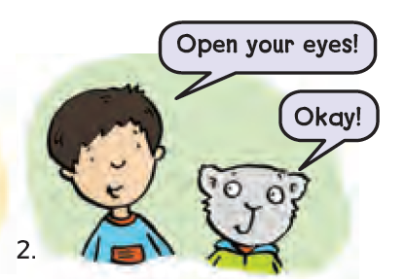
Listen
Practice and do in pairs

Slide 23
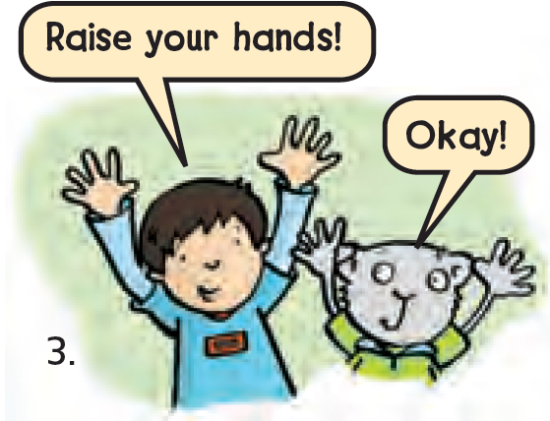
Listen
Practice and do in pairs

Slide 24
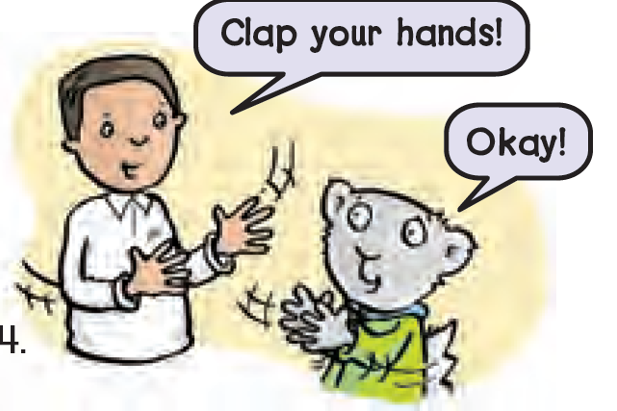
Listen
Practice and do in pairs

Slide 25

https://www.liveworksheets.com/gq1197031vp

