Slide 1
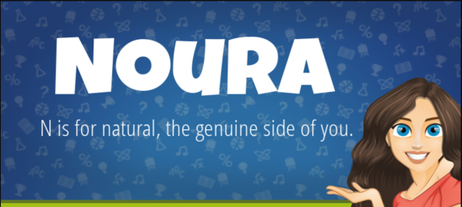
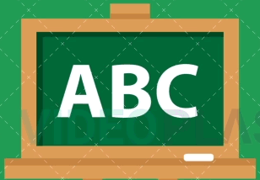

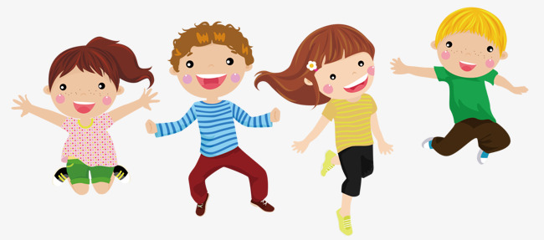

T

Slide 2

Recap

Slide 3
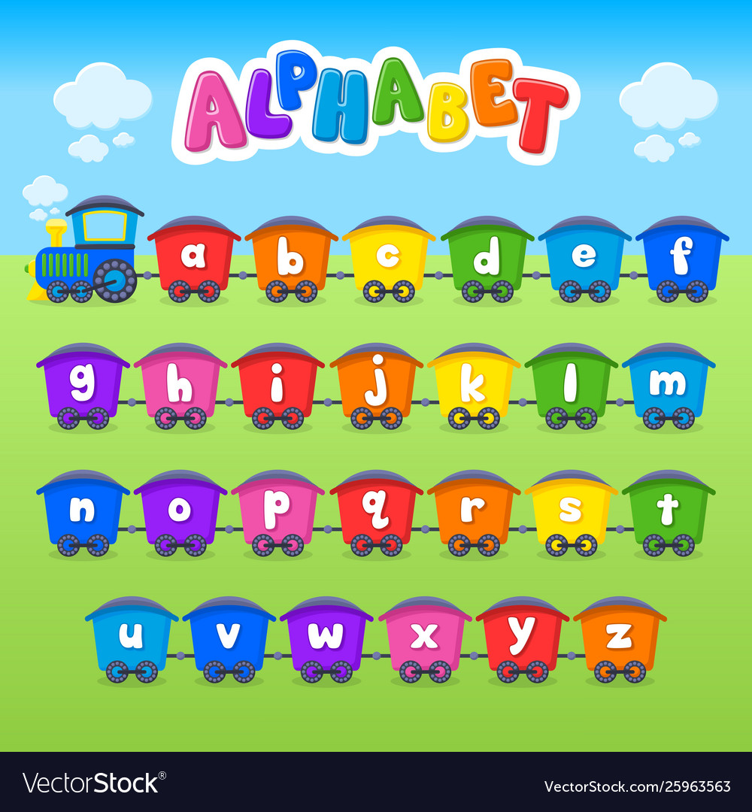


Slide 4
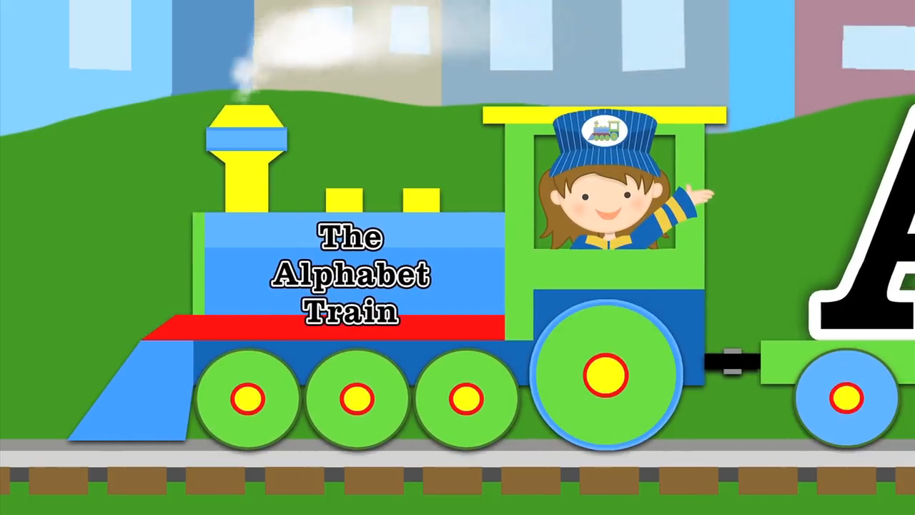

Slide 5


Match upper and lower case letters
A
d
a
c
B
e
f
b
C
c
a
i
D
f
d
a

Slide 6
Match upper and lower case letters
E
d
e
c
F
g
f
h
G
i
a
g
H
h
d
e

Slide 7
Match upper and lower case letters
I
d
i
c
J
j
f
b
K
l
K
i
L
l
d
a

Slide 8


Slide 9
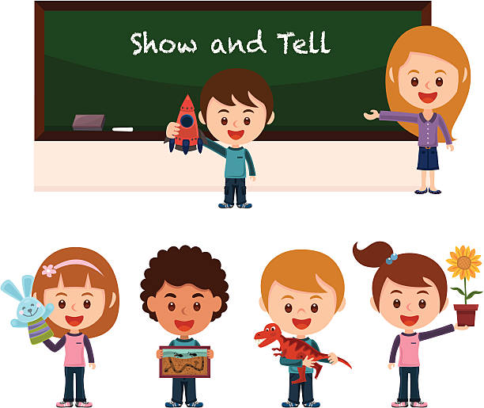
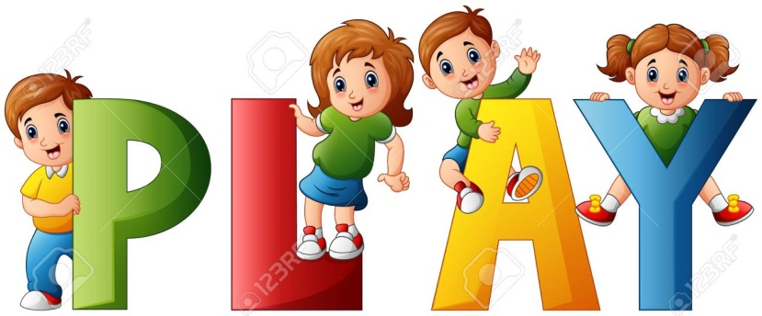

Slide 10
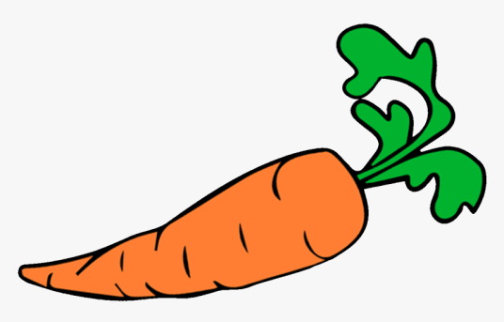
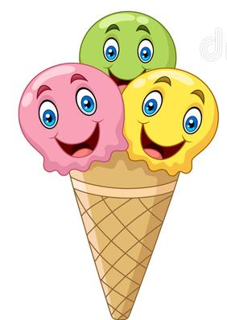
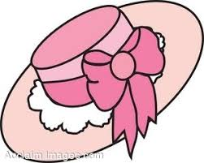

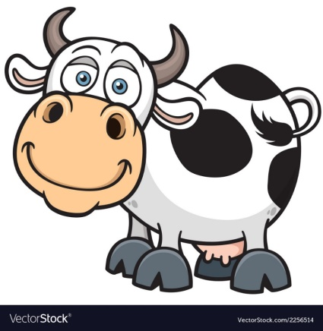

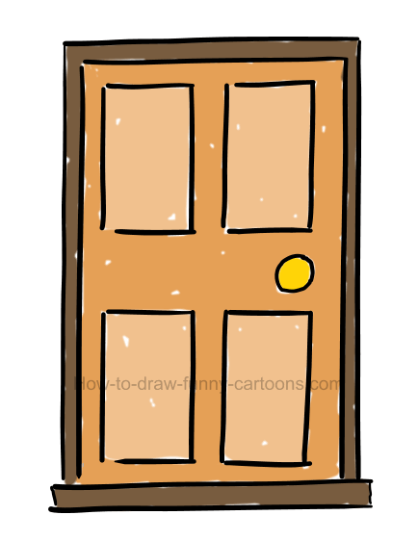


carrot
Hat
Ice cream
apple
cow
House
door

Slide 11

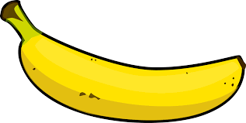

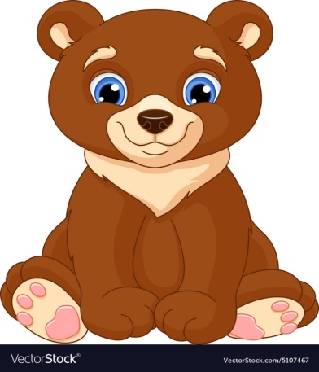

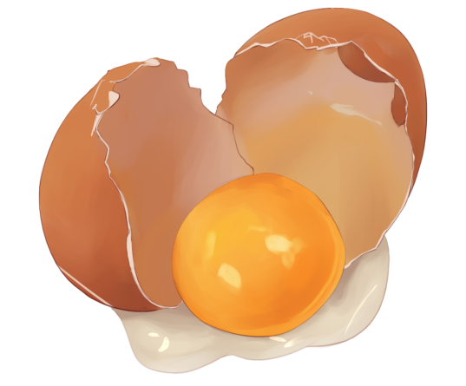

ink
banana
duck
bear
ball
egg

Slide 12
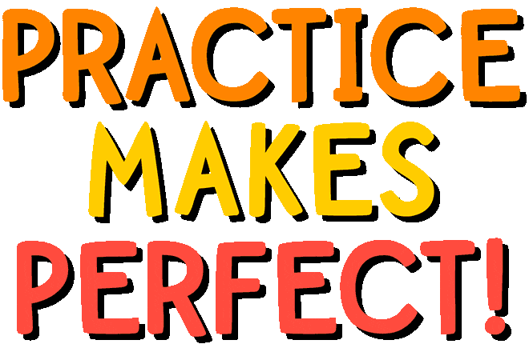

Slide 13
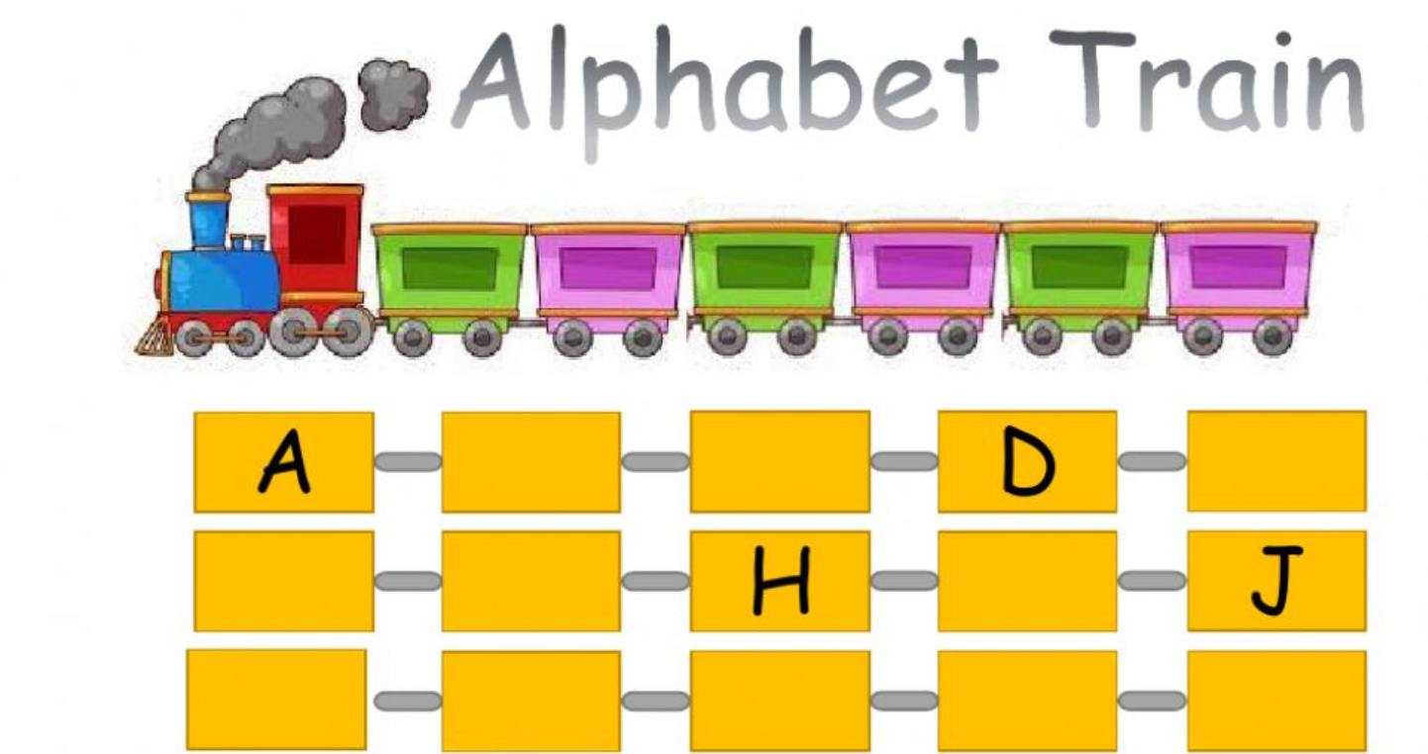
https://www.liveworksheets.com/dr40589qf

Slide 14
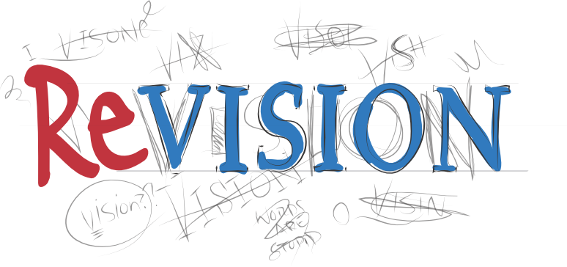
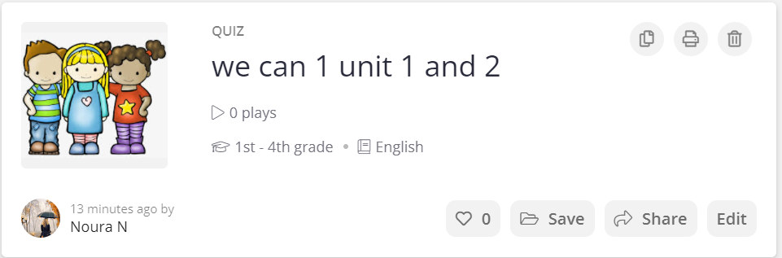
https://quizizz.com/admin/quiz/614edd2b2bd121001db3f3dc

Slide 15


Slide 16
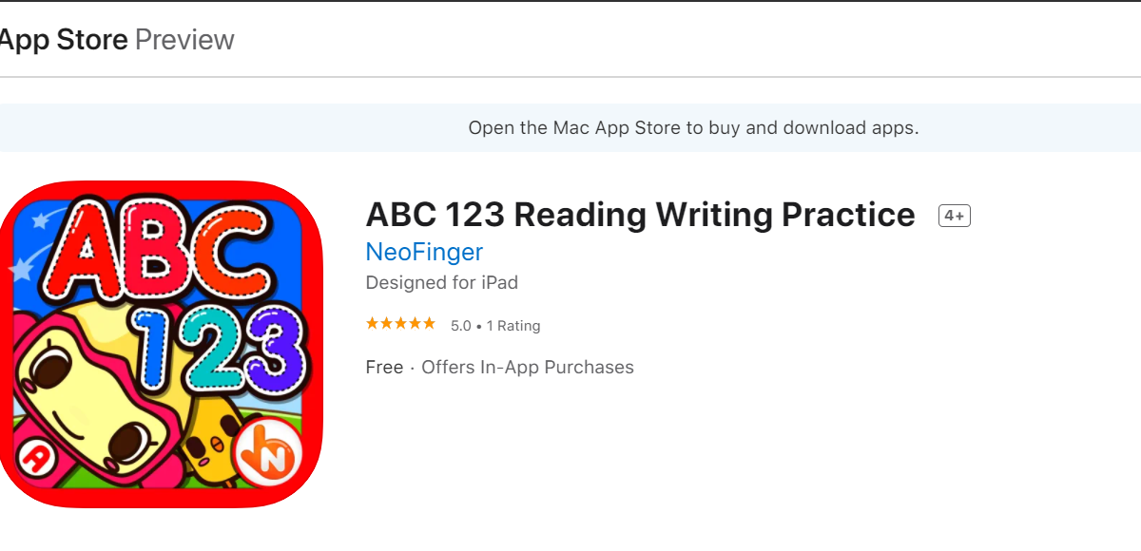
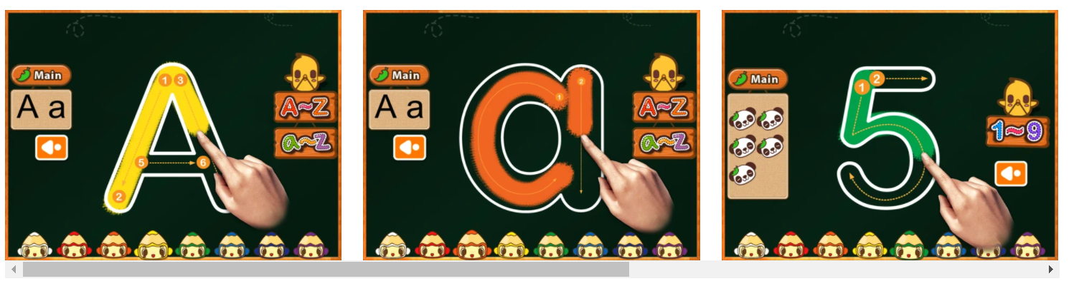


https://apps.apple.com/us/app/abc-123-reading-writing-practice/id459472194

Slide 17

T.Noura A Al-Nejaim

