Slide 1
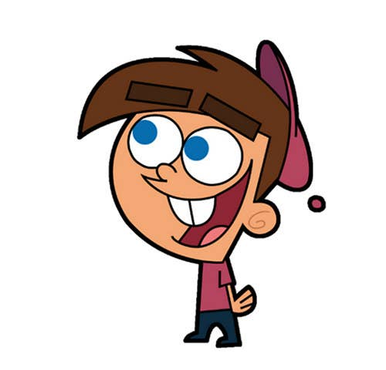


Welcome to class
T.
Mohamad
Zaid

Slide 2
Day
Tuesday
Date
4th OCT 2022
Subject
We can 3
Unit
3 Thing we Wear
Lesson
2 Words in Action

Slide 3

Revision for the previous unit :
Who is wearing green ?
Who is wearing black ?

Slide 4


Revision for the previous unit :
What is this color?
What is this color?
red
blue

Slide 5




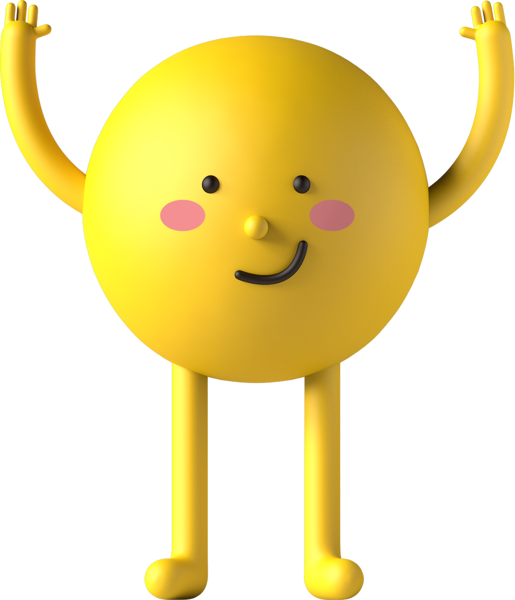
PAGEs 16 , 17

Slide 6

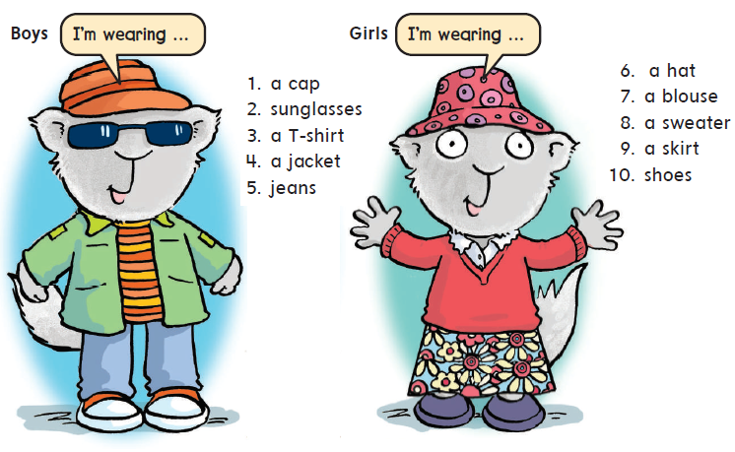

Words in Action
Listen , point and chant

Slide 7

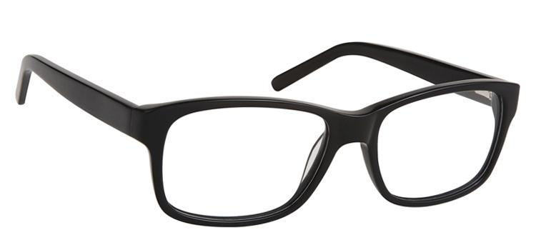
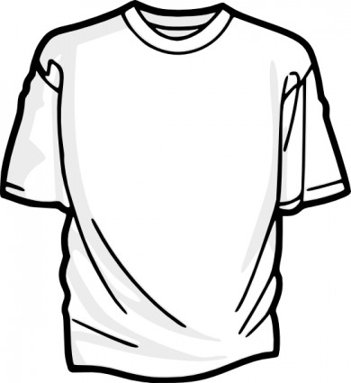
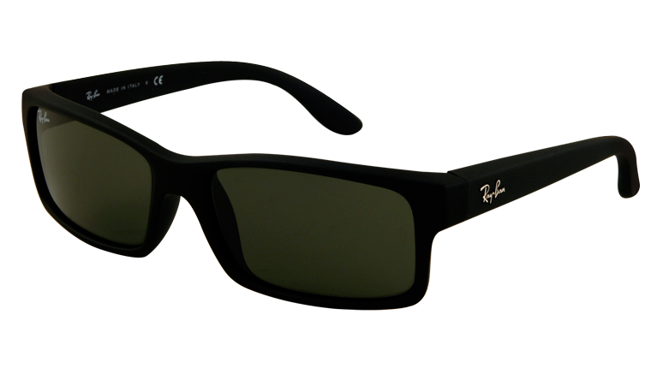
Glasses
Sunglasses
T-shirt

Slide 8
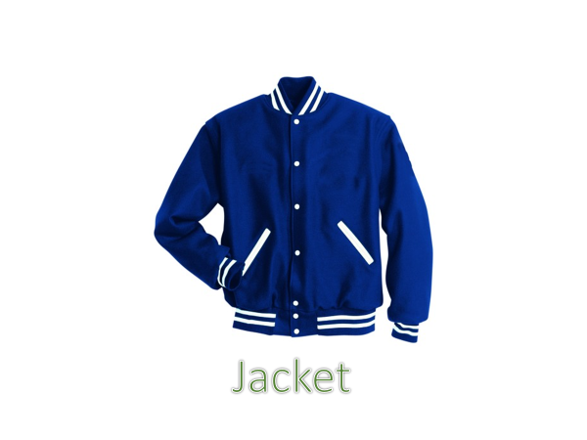
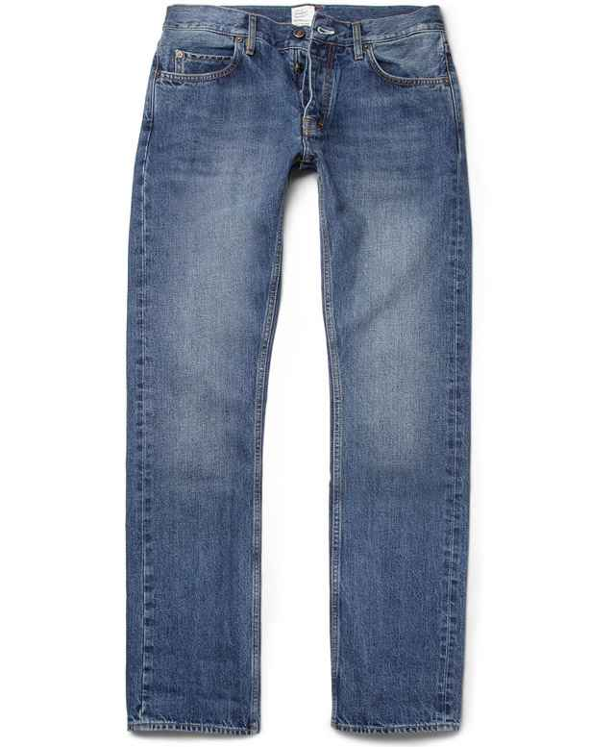

Jacket
Jeans
Cap

Slide 9
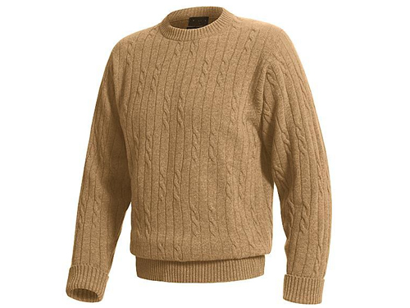
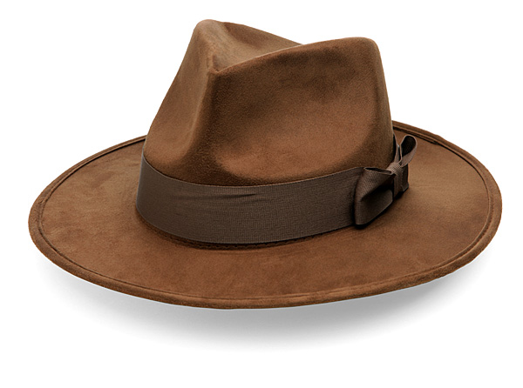
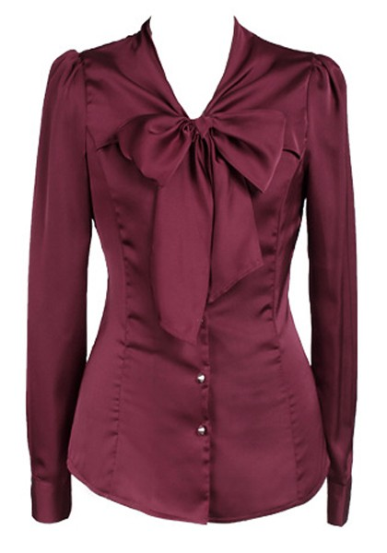
Hat
Blouse
Sweater

Slide 10
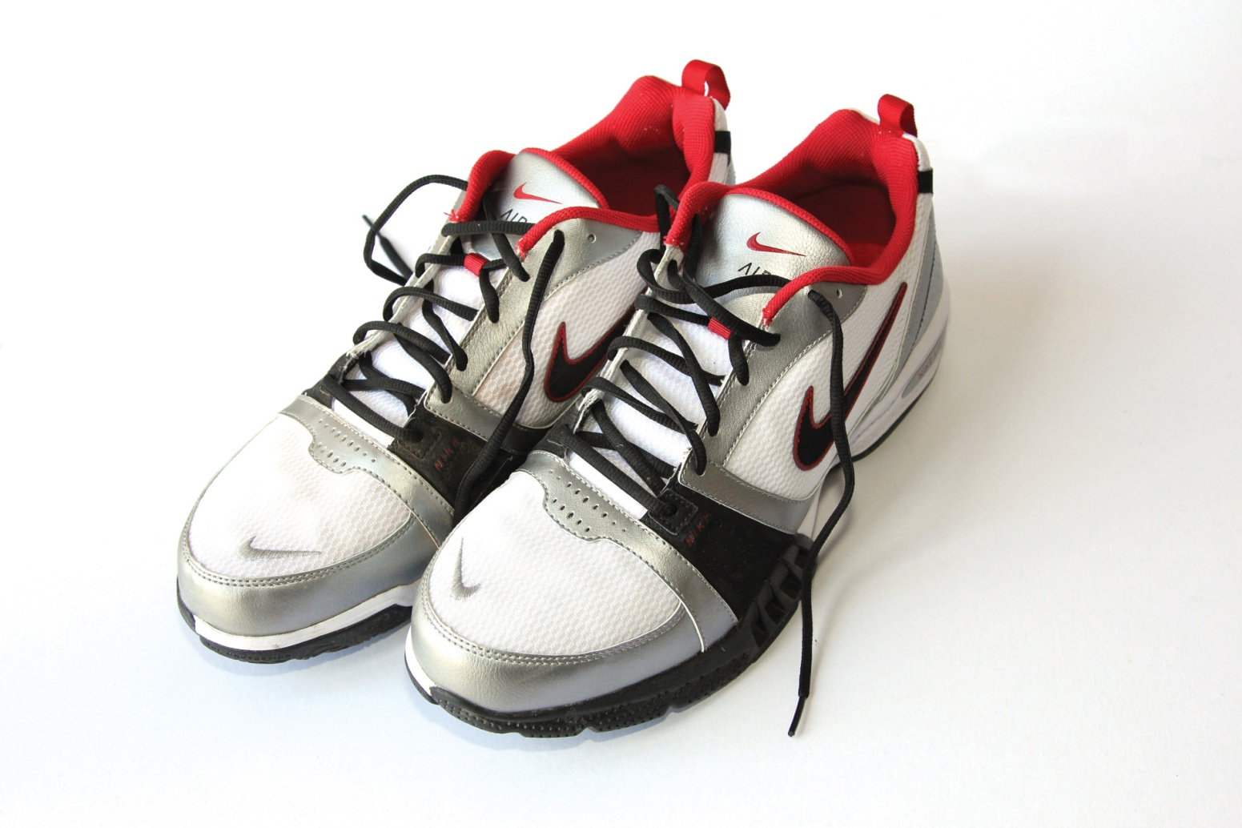
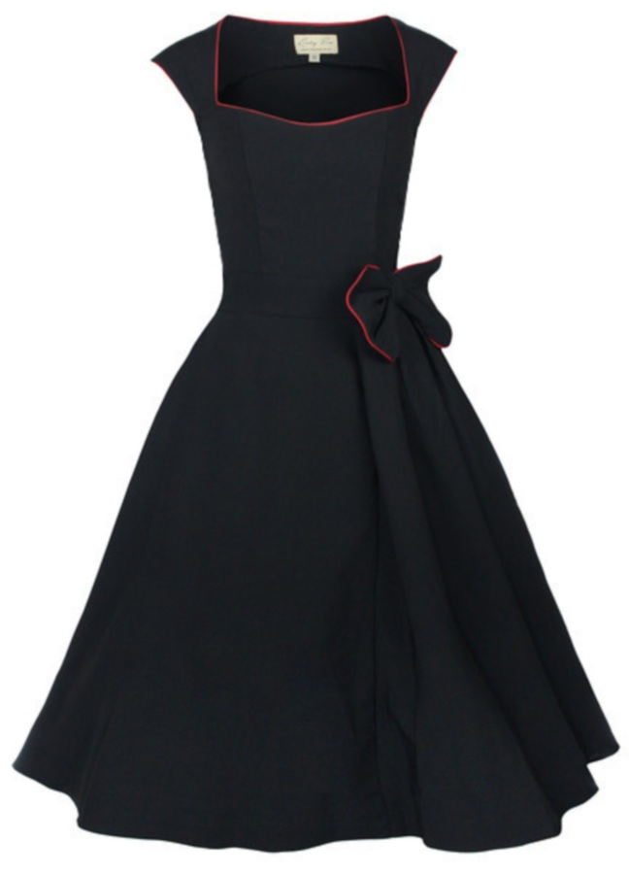
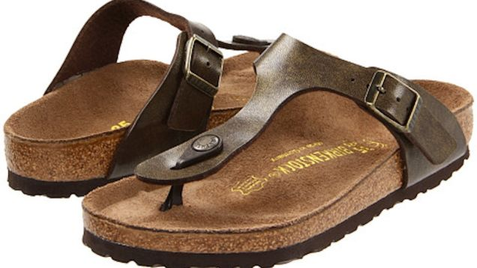
Shoes
Dress
Sandals

Slide 11

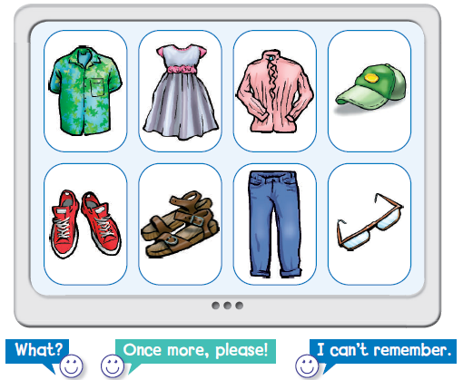

Touch the screen
Listen and touch the right picture! Use two hands

Slide 12
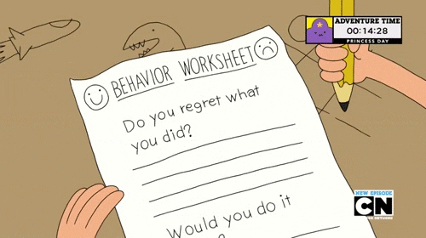
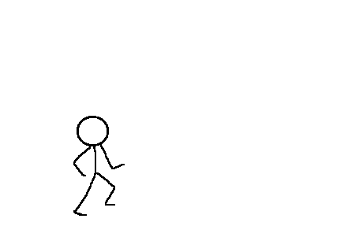

https://www.liveworksheets.com/lj2392167qz

Slide 13


Open your workbook
Pages
Open your workbook
Pages

Slide 14
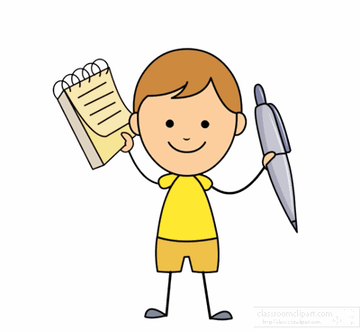

Home work at

Slide 15


