Slide 1



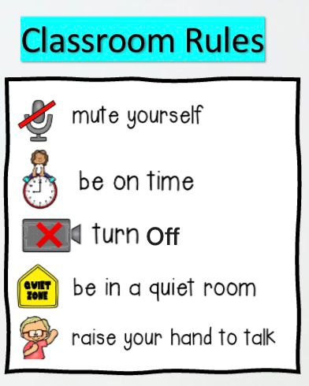



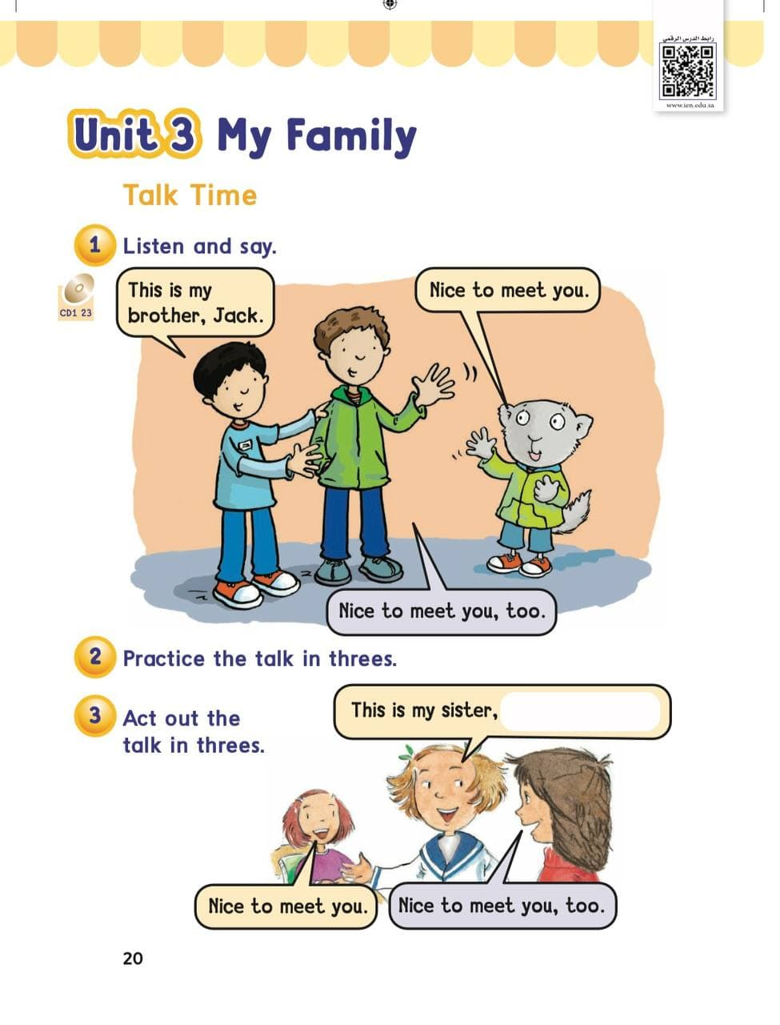
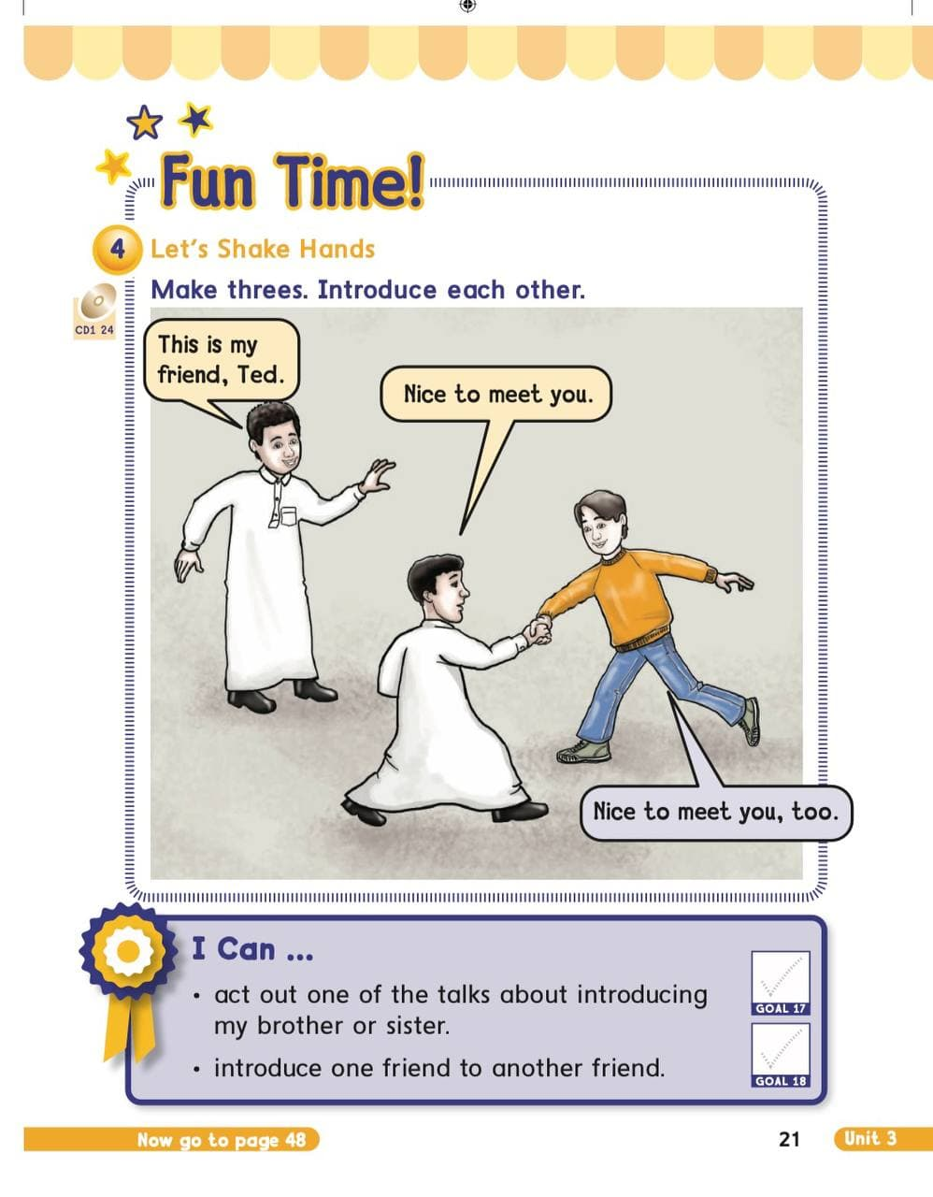





















KSA National Anthem
Unit 3 : My Family
Warm up
Sunday
Lesson 1: Talk Time
Main lesson
Fun Time
P: 20
P: 21
work book
Moral Goal

Slide 2







KSA National Anthem
Classroom Rules
Warm Up
Main lesson
Fun Time
work book
Moral Goal

Slide 3
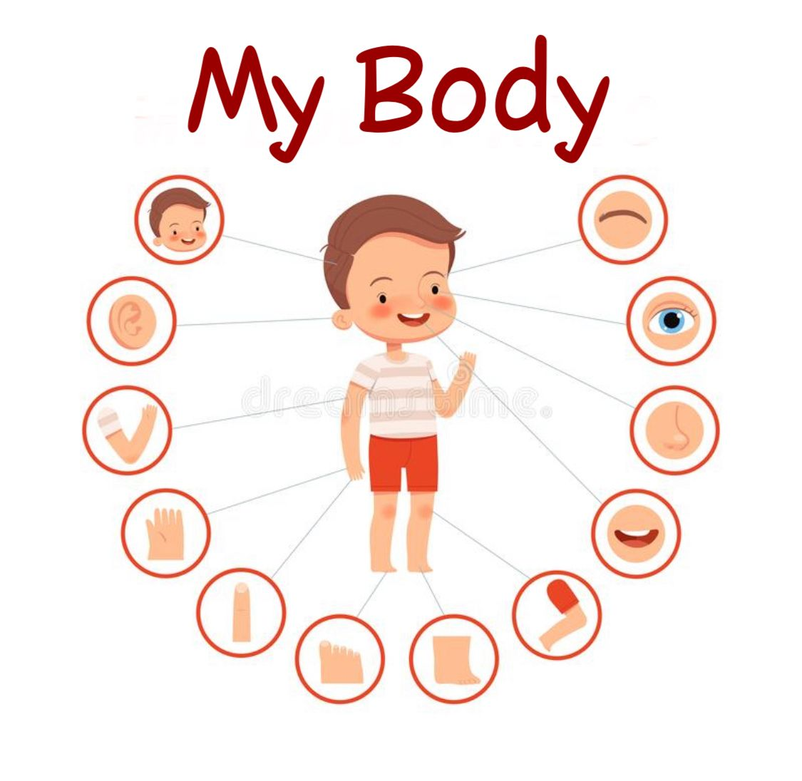



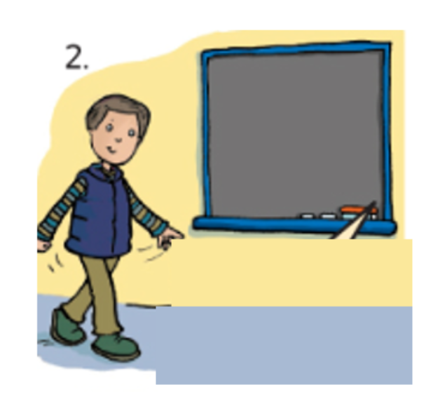


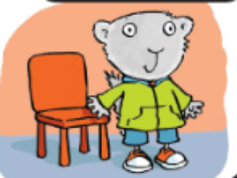
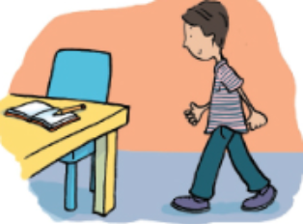
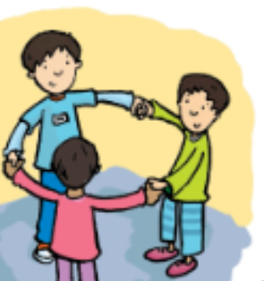
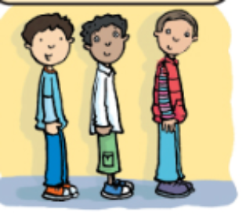
KSA National Anthem
Classroom Rules
Warm up
Main lesson
Fun Time
work book
Moral Goal

Slide 4
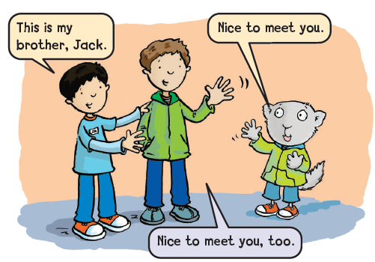
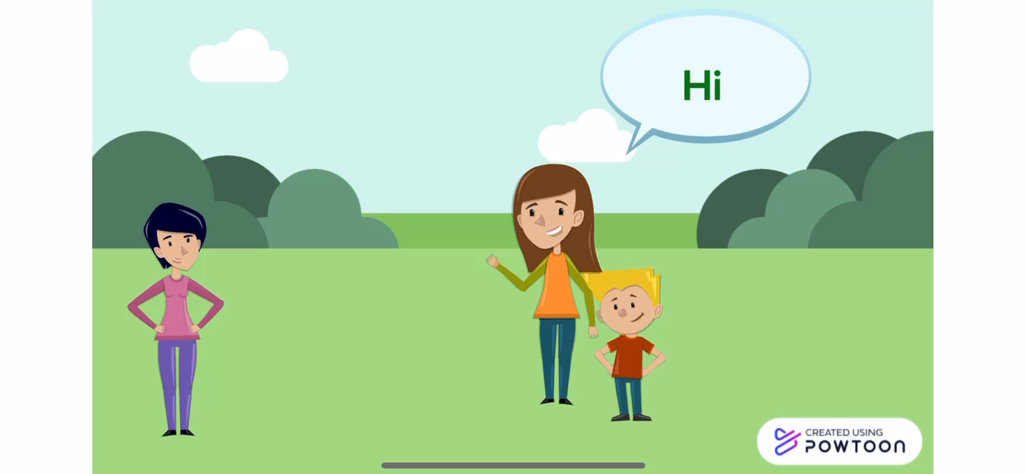

KSA National Anthem
Classroom Rules
Listen and say
1
Warm up
Main lesson
Fun Time
work book
Moral Goal

Slide 5

KSA National Anthem
قال تعالى:
Classroom Rules
Warm up
Main lesson
Fun Time
Work book
ما أجمل دين الإسلام حيث علمنا أدب اللقاء والمعاملة الحسنة
Moral Goal

Slide 6


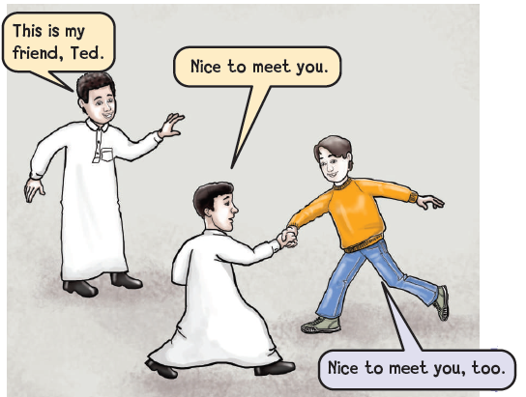
KSA National Anthem
Classroom Rules
Warm up
4
Let’s shake hands
Make threes . Introduce each other
Main lesson
Fun Time
work book
Moral Goal

Slide 7
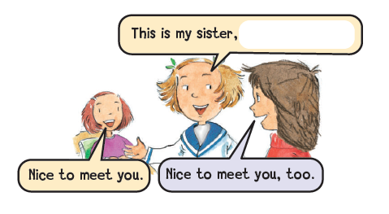
KSA National Anthem
Classroom Rules
Warm up
Main lesson
Fun Time
work book
Moral Goal
2
Practice the talks in threes
تدرب على المحادثة من خلال مجموعة من 3
3
Act out the talks in threes
مثل المحادثة مع مجموعة من 3

Slide 8
KSA National Anthem
Classroom Rules
Warm up
Main lesson
This is ………...
Fun Time
work book
Moral Goal

Slide 9
KSA National Anthem
Classroom Rules
This is my brother
Warm up
Main lesson
This is my sister
Fun Time
work book
Moral Goal
This is my friend

Slide 10
KSA National Anthem
Classroom Rules
Warm up
Main lesson
Nice to meet you
Fun Time
work book
Moral Goal

Slide 11
KSA National Anthem
Classroom Rules
Warm up
Nice to meet
you
Main lesson
Fun Time
too
work book
Moral Goal

Slide 12

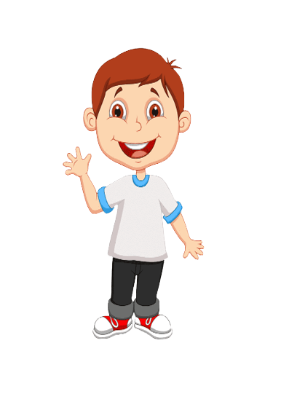

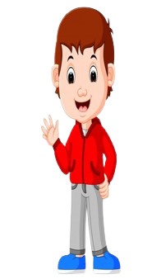
KSA National Anthem
Hi…….
My brother Ahmad
Classroom Rules
Nice……
Warm up
Main lesson
Fun Time
work book
Moral Goal
Complete

Slide 13
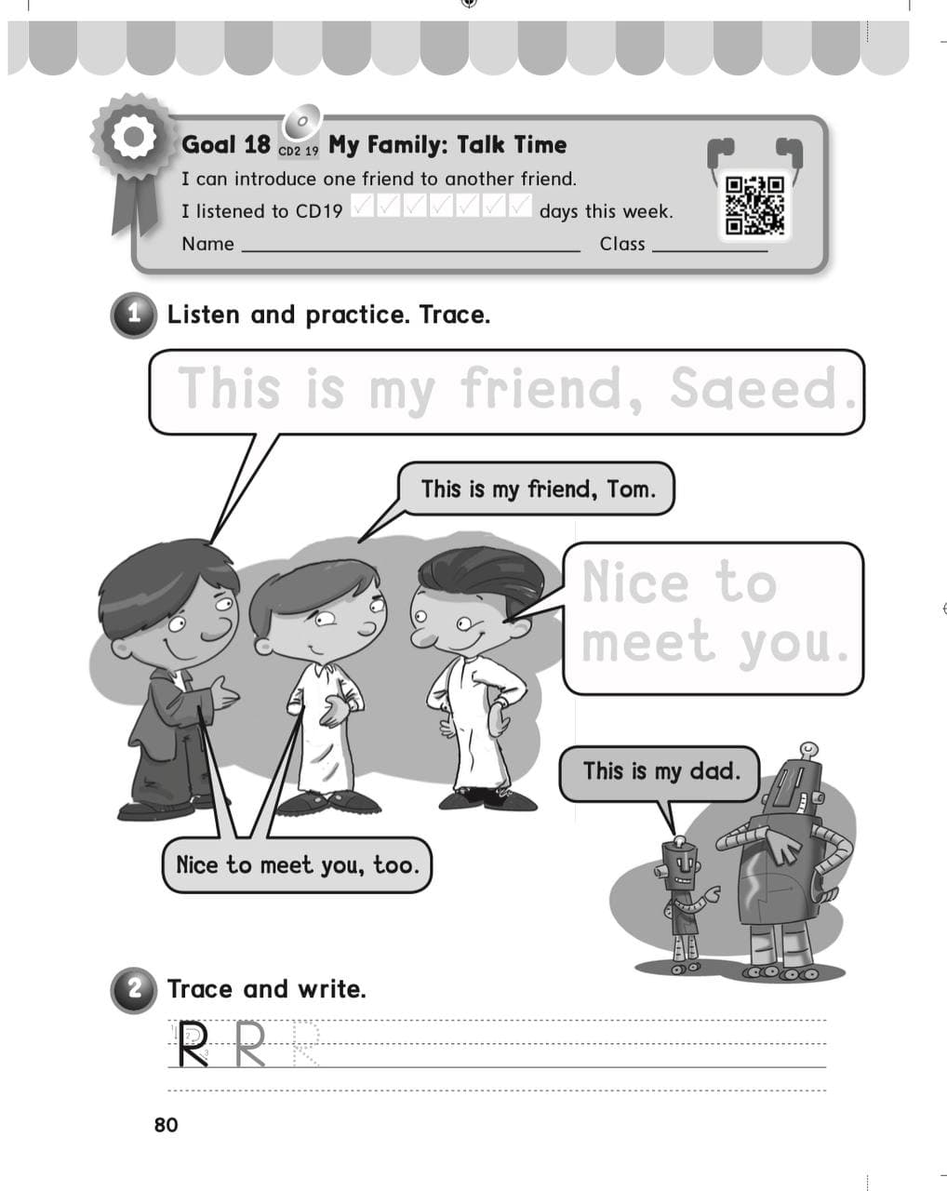
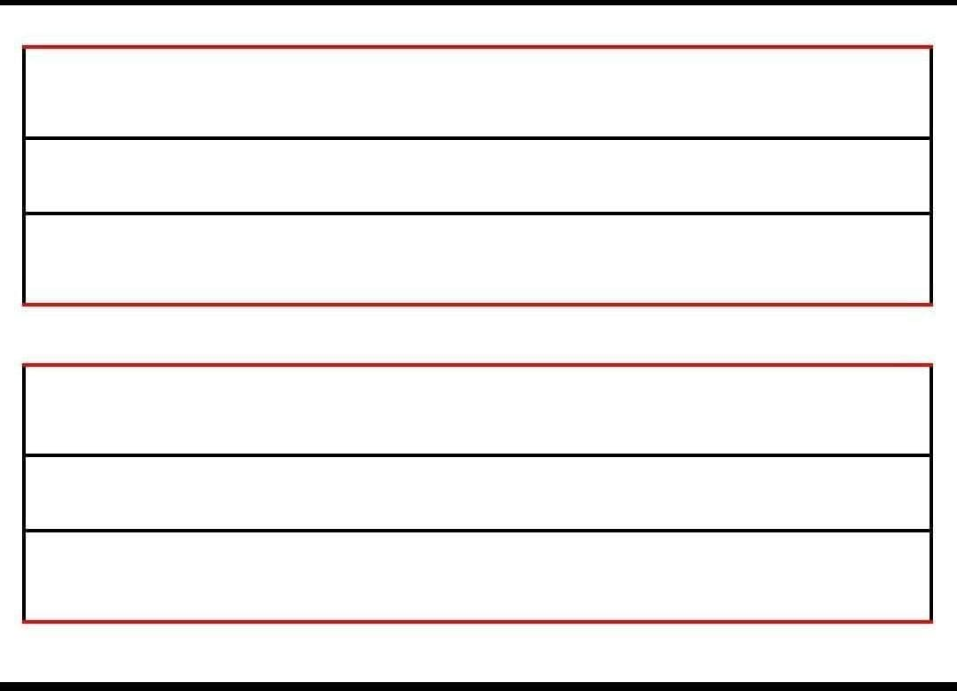
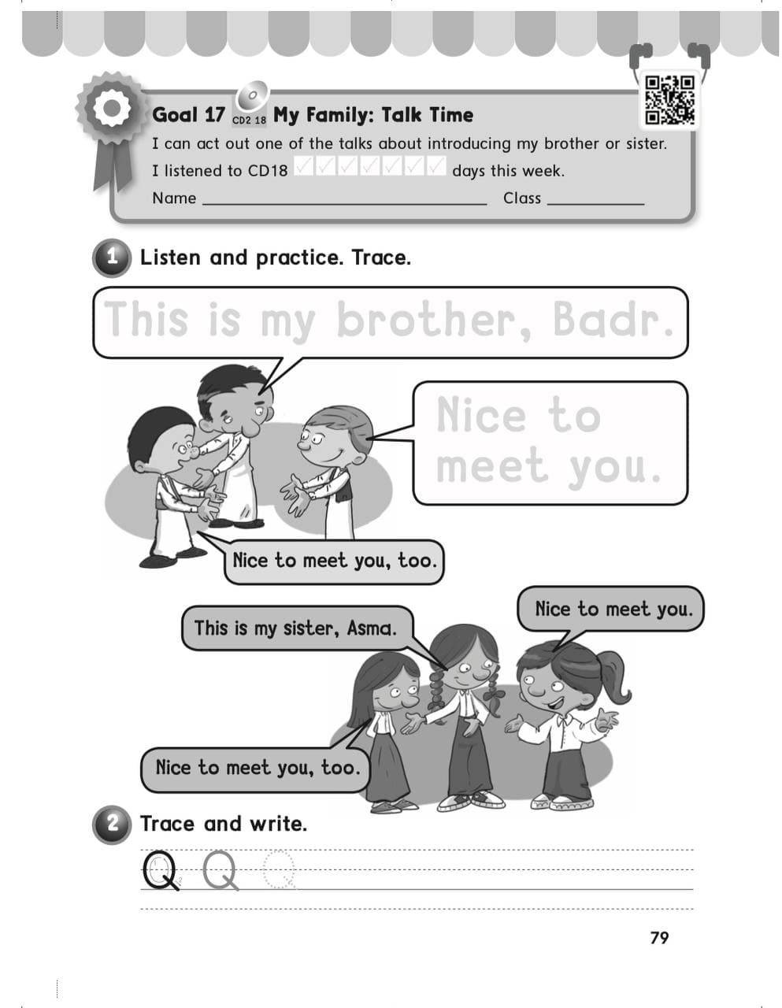
KSA National Anthem
Classroom Rules
Warm up
Main lesson
Fun Time
work book
Moral Goal
P: 79 / 80

Slide 14





