Slide 1
We can 3

Slide 2


Slide 3

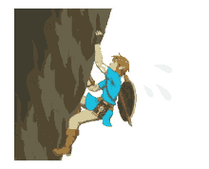
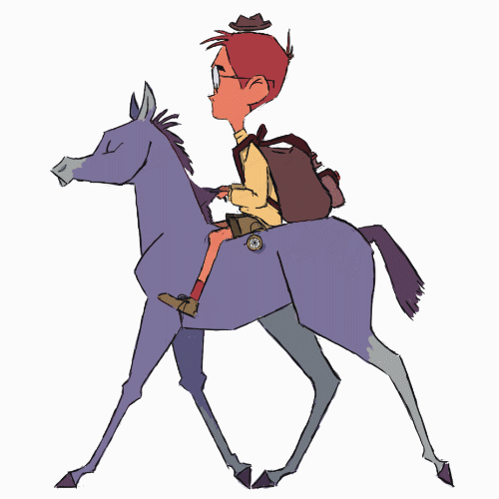
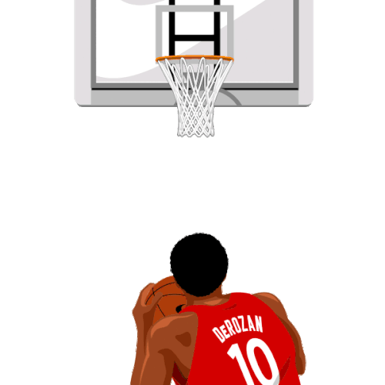


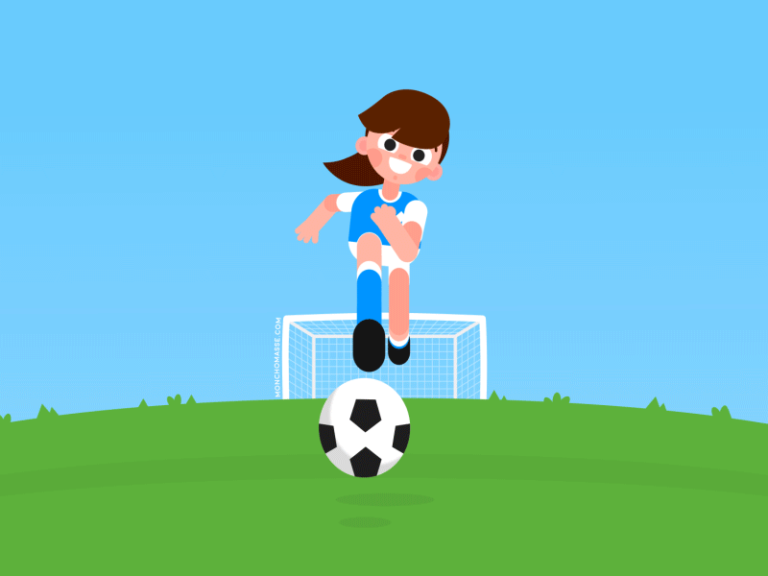
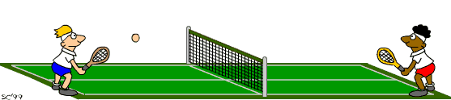
1-What sport do you like?
2-Do you play tennis?
3- does he rock climbing?

Slide 4



Slide 5
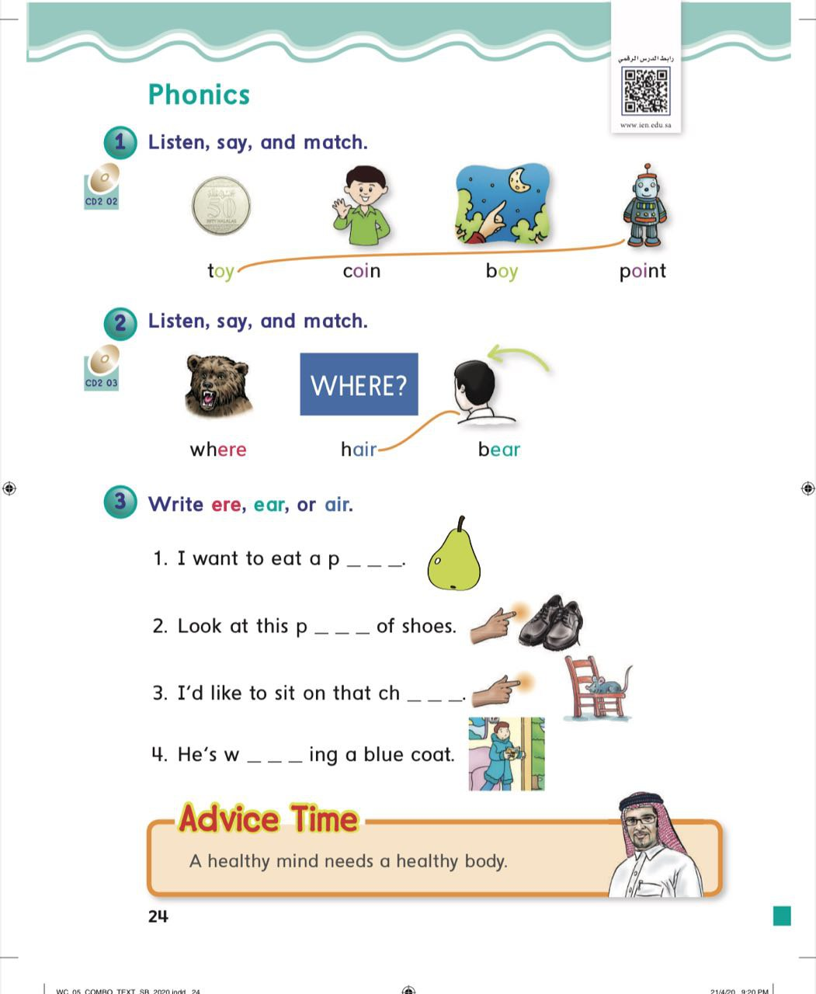
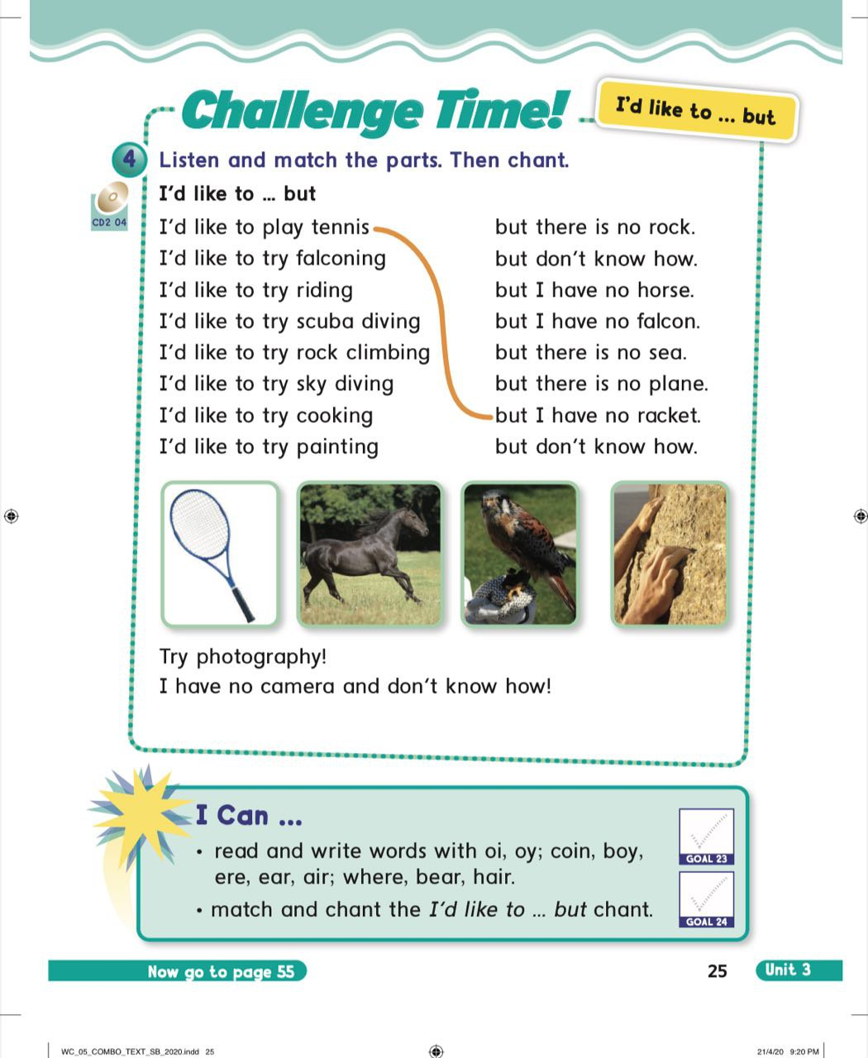

Slide 6
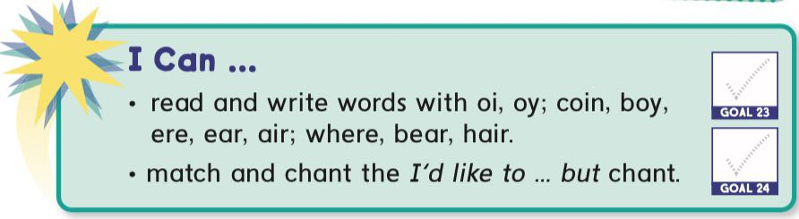


Slide 7
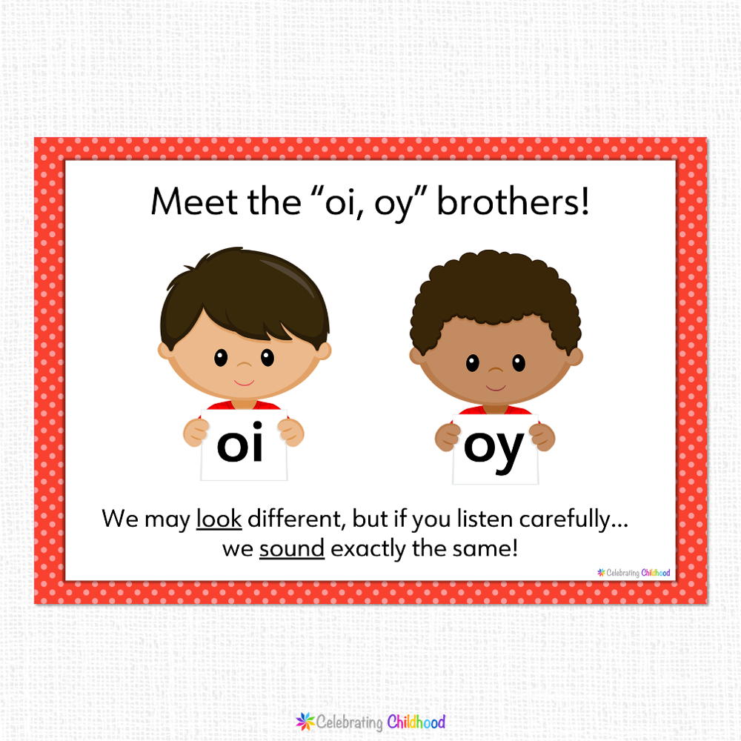

Slide 8



Slide 9
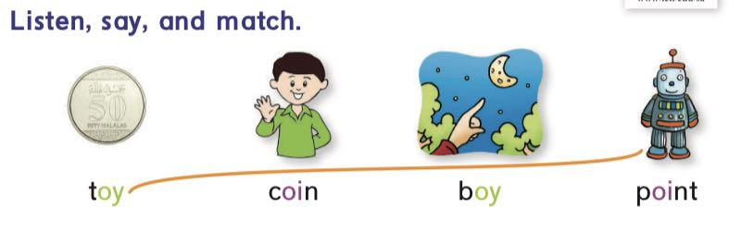

Slide 10


Slide 11
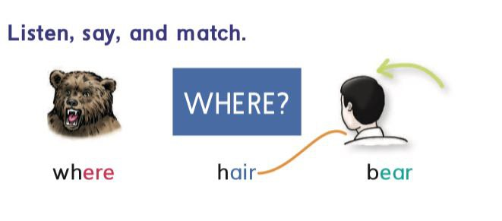

Slide 12
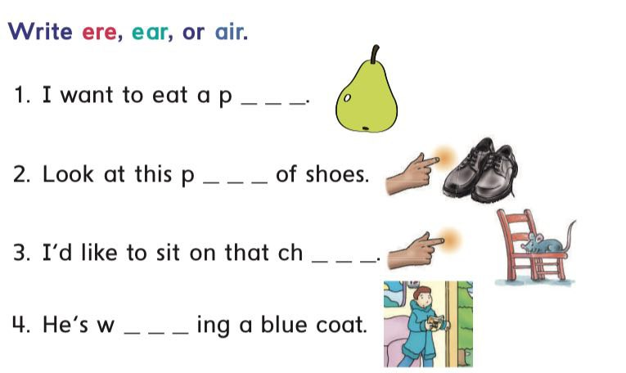

Slide 13
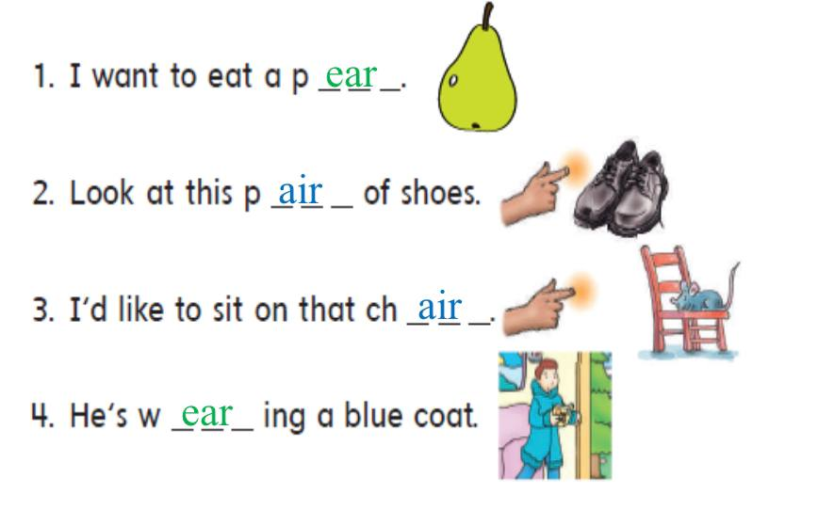

Slide 14


Slide 15



Slide 16



Slide 17
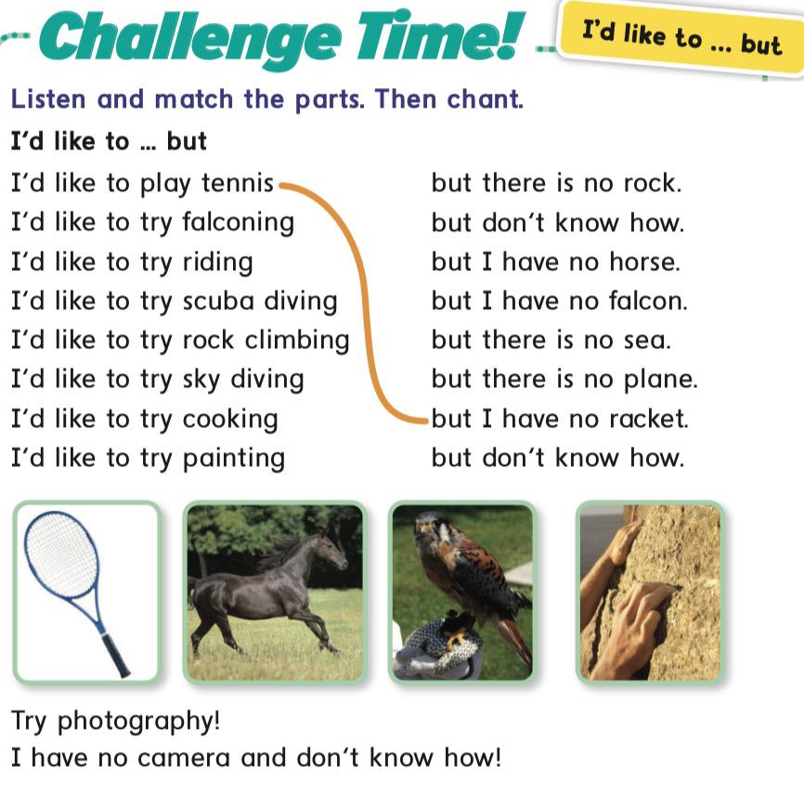


Slide 18
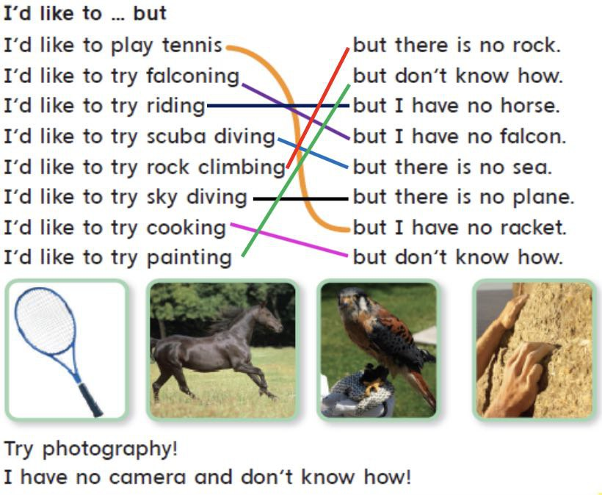

Slide 19


Slide 20

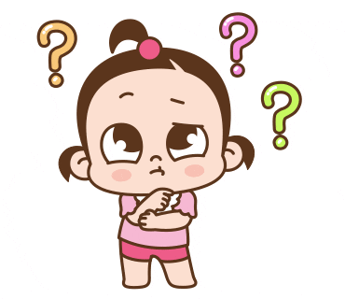
oi
oy
B _ _

Slide 21

oi
oy
C _ _ n

Slide 22
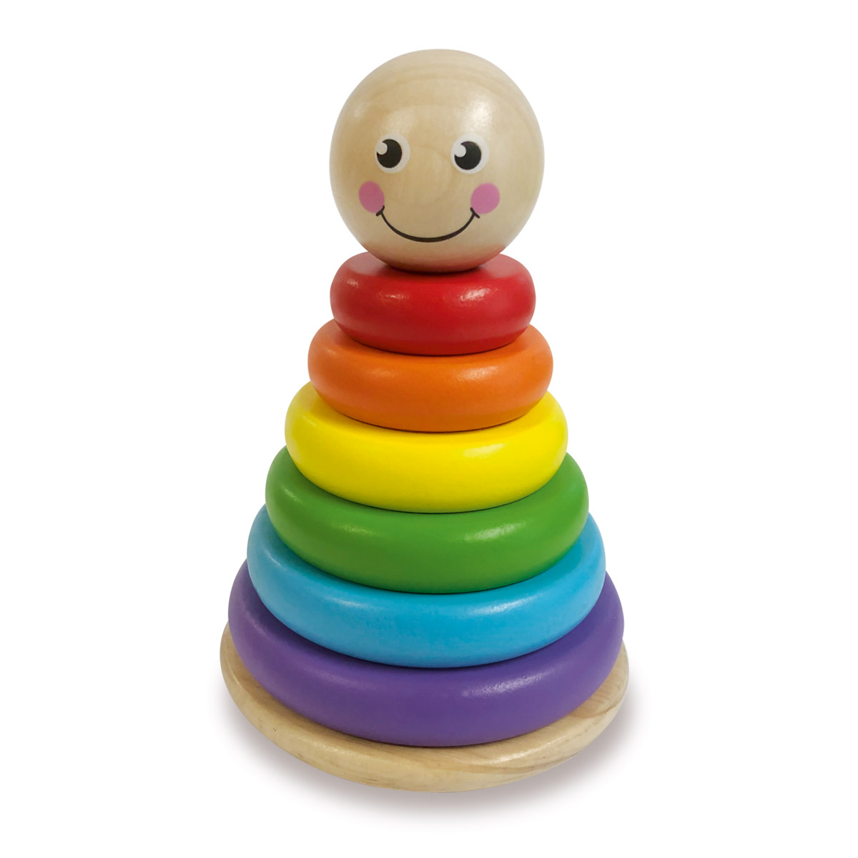
oi
oy
T _ _

Slide 23

er
ir
ar
Pe _ _

Slide 24

er
ir
ar
Be _ _

Slide 25

er
ir
ar
Ha _ _

Slide 26



Slide 27

HOMEWORK

Slide 28


Goodbye

